Slide 1
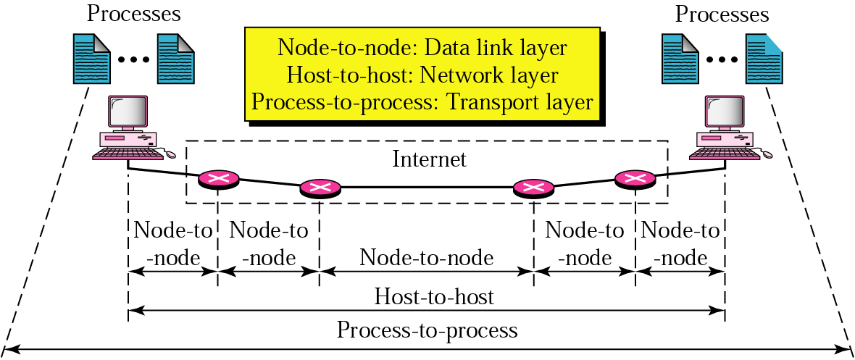
Topic 5: End-to-End Protocol
Notes:
Image Credit: Behroze Forouzan; Notes Credit: Peterson and Davie
The previous three topics covered in the lectures have described various technologies that can be used to connect together a collection of computers: direct links (including LAN technologies like Ethernet and token ring), packet-switched networks (including cell-based networks like ATM), and internetworks. The next problem is to turn this host-to-host packet delivery service into a process-to-process communication channel.
This is the role played by the transport level of the network architecture, which, because it supports
communication between the end application programs, is sometimes called the end-to-end protocol.
The end-to-end protocols will be next topic we’d cover in our Computer Networks Class.

Slide 2
Topic’s objectives
To find out the answers to:
1 – What is the responsibility of transport layer?
2 – What are common TCP/ IP transport protocols?
Notes:
Today we’d be seeing what are the primary objectives/ functions of an end-to-end transport layer protocol.
We’d also be seeing two common TCP/ IP end-to-end transport protocols that provide contrasting services: the first (UDP) provides a simple demultiplexing service and the other (TCP) provides a reliable byte stream service.

Slide 3
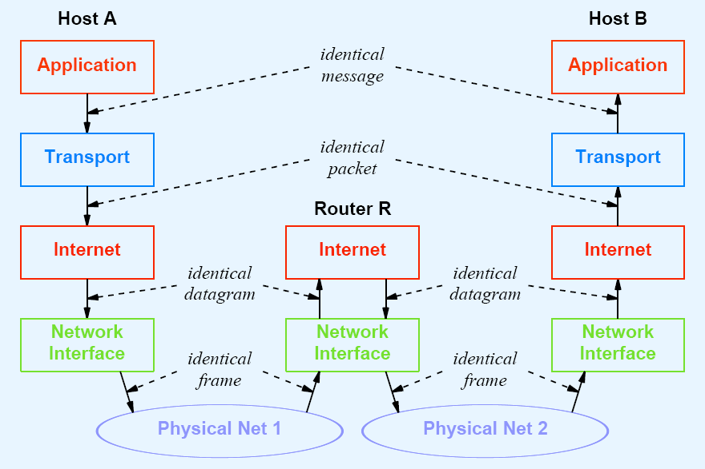
Recap: How Layering Works?
segment
Notes:
Before we move on with today’s topic, we will have a little recap of layering and encapsulation to connect transport layer protocols with what we have studied up till now.
In the figure above, an application is exchanging messages with another peer application by sending the message to a transport layer service which is responsible for somehow delivering this message.
The transport layer sends the message (now called a segment when port information is added to the message) to the Internet or networking layer which is responsible for the host-to-host delivery (i.e., route the message to the end host by appropriate routing techniques).
The datagram or packet (i.e., transport segment + network addressing information) is then passed to the NIC (the data link layer) which is responsible for exchanging the datagram with the NIC on the next-hop node.
If you note above, frames and datagrams are being exchanged between neighboring nodes, whereas segments and messages are exchanged between end-to-end devices. Our discussion today will focus on end-to-end communication which exchanges end-to-end segments.

Slide 4
Recap: How Encapsulation Works?
Imagine you’d like to open a website (let’s say www.cricinfo.com)
Application data
GET / HTML/1.1
Source Port | Destination Port
> 1024 | 80
Payload
TCP Segment
Payload
IP Packet
Source IP | Destination IP
202.125.157.150 | 79.140.80.57
Payload
Payload
MAC Frame
Source MAC address | Destination MAC address 23:34:aa:bb:cc:dd | 12:34:aa:bb:cc:dd
Payload
FCS
Notes:
We now revisit one of the examples we’ve seen in our class previously.

Slide 5




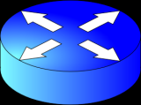
Recap: How Encapsulation Works?
HTTP Request
Browser
Communicating
App Processes
Cricinfo Webserver
202.125.157.150:2123
79.140.80.57:80
HTTP Reply

Slide 6
Transport Layer Protocols
Transport protocol is expected to provide:
Support for multiple application processes on hosts
Guaranteed message delivery
Sequenced and ordered message delivery
Non duplicate message delivery
Support for arbitrarily large messages
Support for sender/ receiver synchronization
Support for receiver applying flow-control to sender
Notes:
Two forces shape the end-to-end protocol. From above, the application-level processes that use its services have certain requirements. The following list itemizes some of the common properties that a transport protocol can be expected to provide:
■ guarantees message delivery
■ delivers messages in the same order they are sent
■ delivers at most one copy of each message
■ supports arbitrarily large messages
■ supports synchronization between the sender and the receiver
■ allows the receiver to apply flow control to the sender
■ supports multiple application processes on each host
Note that this list does not include all the functionality that application processes might want from the network. For example, it does not include security, which is typically provided by protocols that sit above the transport level.
The underlying best-effort network has on the other hand certain limitations in the level of service it can provide. Some of the more typical limitations of the network are that it may
■ drop messages
■ reorder messages
■ deliver duplicate copies of a given message
■ limit messages to some finite size
■ deliver messages after an arbitrarily long delay
Therefore, the job of the transport layer protocol is to mask these imperfections of the underlying network.

Slide 7
Transport Layer Protocols
Two dominant TCP/IP transport layer protocols:
User Datagram Protocol (UDP)
Transmission Control Protocol (TCP)
Notes:
There are two dominant transport layer protocols in the TCP/ IP suite.
The first, and the simpler, protocol is the User Datagram Protocol which is a very simple transport layer protocol. It merely performs the first task outlined in the goals previously (i.e., it supports multiple application processes at end hosts by multiplexing/ demultiplexing processes traffic through the usage of identifiers known as ports)
The second, and the much more complex, protocol is the Transmission Control Protocol (TCP) which also performs the other goals listed previously.
It can be said, therefore, that TCP provides a reliable byte stream service whereas UDP provides a simple demultiplexing service.

Slide 8
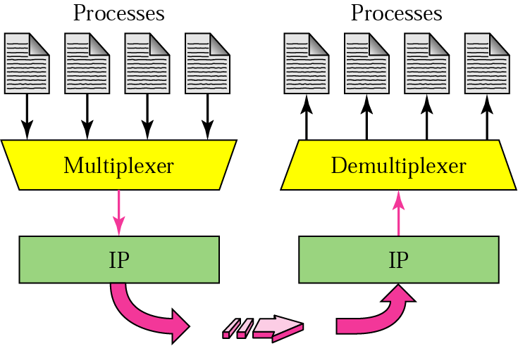
UDP (User Datagram Protocol)
UDP -> Simple Demultiplexer
Notes:
The simplest possible transport protocol is one that extends the host-to-host delivery service of the underlying network into a process-to-process communication service. The Internet’s User Datagram Protocol (UDP) is an example of such a transport protocol.
There are likely to be many processes running on any given host, so the protocol needs to add a level of demultiplexing, thereby allowing multiple application processes on each host to share the network. Aside from this requirement, the transport protocol adds no other functionality to the best-effort service provided by the underlying network.

Slide 9
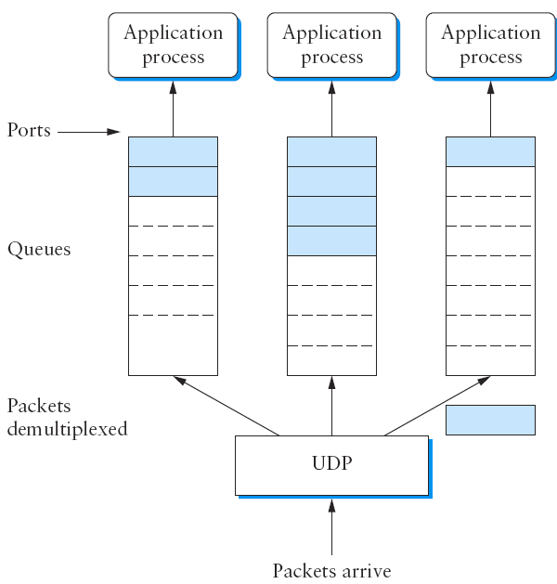
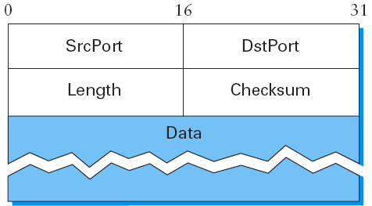
User Datagram Protocol
Notes:
The only interesting issue in such a protocol is the form of the address used to identify the target process. Although it is possible for processes to directly identify each other with an OS-assigned process id (pid), such an approach is only practical in a closed distributed system in which a single OS runs on all hosts and assigns each process a unique id. A more common approach, and the one used by UDP, is for processes to indirectly identify each other using an abstract locator, often called a port
or mailbox.
The basic idea is for a source process to send a message to a port and for the destination process to receive the message from a port. The header for an end-to-end protocol that implements this demultiplexing function typically contains an identifier (port) for both the sender (source) and the receiver (destination) of the message. For example, the UDP header is given in the figure above on the RHS. Notice that the UDP port field is only 16 bits long. This means that there are up to 64K possible ports, clearly not enough to identify all the processes on all the hosts in the Internet. Fortunately, ports are not interpreted across the entire Internet, but only on a single host. That is, a process is really identified by a port on some particular host—a port, host pair. In fact, this pair constitutes the demultiplexing key for the UDP protocol.
The next issue is how a process learns the port for the process to which it wants to send a message. Typically, a client process initiates a message exchange with a server process. Once a client has contacted a server, the server knows the client’s port (it was contained in the message header) and can reply to it. The real problem, therefore, is how the client learns the server’s port in the first place. A common approach is for the server to accept messages at a well-known port. That is, each server receives its messages at some fixed port that is widely published, much like the emergency telephone service available at the well-known phone number 911. In the Internet, for example, the
Domain Name Server (DNS) receives messages at well-known port 53 on each host, the mail service listens for messages at port 25, and the Unix talk program accepts messages at well-known port 517, and so on. This mapping is published periodically in an RFC and is available on most Unix systems in file /etc/services. Sometimes a well-known port is just the starting point for communication: The client and server use the well-known port to agree on some other port that they will use for subsequent communication, leaving the well-known port free for other clients.
Finally, although UDP does not implement flow control or reliable/ordered delivery, it does a little more work than to simply demultiplex messages to some application process—it also ensures the correctness of the message by the use of a checksum. (The UDP checksum is optional in the current Internet, but it will become mandatory with IPv6.) UDP computes its checksum over the UDP header, the contents of the message body, and something called the pseudoheader. The pseudoheader consists of three fields from the IP header—protocol number, source IP address, and destination IP address—plus the UDP length field. (Yes, the UDP length field is included twice in the checksum
calculation.) UDP uses the same checksum algorithm as IP

Slide 10
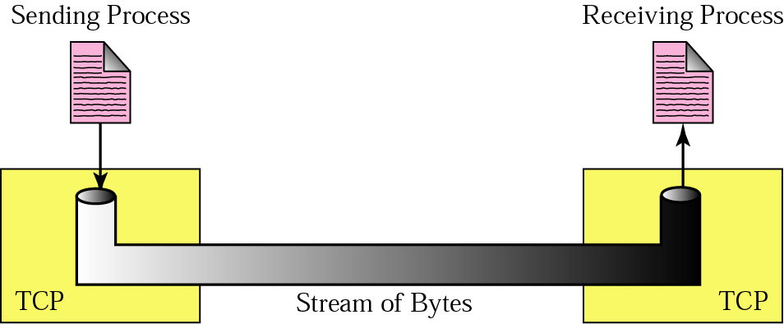
TCP (Transmission Control Protocol)
TCP -> Reliable byte stream
Notes:
In contrast to a simple demultiplexing protocol like UDP, a more sophisticated transport protocol is one that offers a reliable, connection-oriented, byte-stream service. Such a service has proven useful to a wide assortment of applications because it frees the application from having to worry about missing or reordered data.
The Internet’s Transmission Control Protocol (TCP) is probably the most widely used protocol of this type; it is also the most carefully tuned. It is for this reason that we will study TCP in much more detail.
In terms of the properties of transport protocols outlined in the beginning of this presentation, TCP guarantees the reliable, in-order delivery of a stream of bytes. It is a full-duplex protocol, meaning that each TCP connection supports a pair of byte streams, one flowing in each direction. It also includes a flow-control mechanism for each of these byte streams that allows the receiver to limit how much data the sender can transmit at a given time. Finally, like UDP, TCP supports a demultiplexing mechanism that allows multiple application programs on any given host to simultaneously carry on a conversation with their peers. In addition to the above features, TCP also implements a highly tuned congestion-control mechanism.

Slide 11
TCP is end-to-end
At the heart of TCP is the end-to-end sliding windows (SW) algorithm which differs from point-to-point SW in:
TCP requires explicit connection establishment/ breakdown
TCP requires adaptive timeout mechanism
TCP must be able to handle packets way out of order
TCP must support parameter negotiation and flow-control
TCP must be able to deal with network congestion
Notes:
At the heart of TCP is the sliding window algorithm. Even though this is the same basic algorithm we saw in Topic 2---Direct link networks, because TCP runs over the Internet rather than a point-to-point link, there are many important differences. We will now identify these differences and explains how they complicate TCP.
First, whereas the sliding window algorithm presented in Topic 2 runs over a single physical link that always connects the same two computers, TCP supports logical connections between processes that are running on any two computers in the Internet. This means that TCP needs an explicit connection establishment phase during which the two sides of the connection agree to exchange data with each other. This difference is analogous to having to dial up the other party, rather than having a dedicated phone line. TCP also has an explicit connection teardown phase. One of the things that happens during connection establishment is that the two parties establish some shared state to enable the sliding window algorithm to begin. Connection teardown is needed so each host knows it is OK to free this state.
(In summary, TCP will require connection establishment and connection termination)
Second, whereas a single physical link that always connects the same two computers has a fixed RTT, TCP connections are likely to have widely different round-trip times. These end-to-end RTTs vary widely on the basis of time of day and load on network. Variations in the RTT are even possible during a single TCP connection that lasts only a few minutes. What this means to the sliding window algorithm is that the timeout mechanism that triggers retransmissions must be
adaptive. (Certainly, the timeout for a point-to-point link must be a settable parameter, but it is not necessary to adapt this timer for a particular pair of nodes.)
(In summary, TCP will require adaptive timeout mechanism)
Third, packets may be reordered as they cross the Internet, but this is not possible on a point-to-point link where the first packet put into one end of the link must be the first to appear at the other end. Packets that are slightly out of order do not cause a problem since the sliding window algorithm can reorder packets correctly using the sequence number. The real issue is how far out-of-order packets can get, or said another way, how late a packet can arrive at the destination. In the worst case, a packet can be delayed in the Internet until IP’s time to live (TTL) field expires, at which time the packet is discarded (and hence there is no danger of it arriving late). Knowing that IP throws packets away after their TTL expires, TCP assumes that each packet has a maximum lifetime. The exact lifetime, known as the maximum segment lifetime (MSL), is an engineering choice. The current recommended setting is 120 seconds. Keep in mind that IP does not directly enforce this 120-second value; it is simply a conservative estimate that TCP makes of how long a packet might live in the Internet. The implication is significant—TCP has to be prepared for very old packets to suddenly show up at the receiver, potentially confusing the sliding window algorithm.
(In summary, TCP must be able to handle packets that are way out of order)
Fourth, the computers connected to a point-to-point link are generally engineered to support the link. For example, if a link’s delay × bandwidth product is computed to be 8 KB—meaning that a window size is selected to allow up to 8 KB of data to be unacknowledged at a given time—then it is likely that the computers at either end of the link have the ability to buffer up to 8 KB of data. Designing the system otherwise would be silly. On the other hand, almost any kind of computer can be connected to the Internet, making the amount of resources dedicated to any one TCP connection highly variable, especially considering that any one host can potentially support hundreds of TCP connections at the same time. This means that TCP must include a mechanism that each side uses to “learn” what resources (e.g., how much buffer space) the other side is able to apply to the connection. This is the flow-control issue.
(In summary, the communicating entities must have ability to negotiate parameters and be able to perform flow-control)
Fifth, because the transmitting side of a directly connected link cannot send any faster than the bandwidth of the link allows, and only one host is pumping data into the link, it is not possible to unknowingly congest the link. Said another way, the load on the link is visible in the form of a queue of packets at the sender. In contrast, the sending side of a TCP connection has no idea what links will be traversed to reach the destination. For example, the sending machine might be directly connected to a relatively fast Ethernet—and so, capable of sending data at a rate of 100 Mbps—but somewhere out in the middle of the network, a 1.5-Mbps T1 link must be traversed. And to make matters worse, data being generated by many different sources might be trying to traverse this same slow link. This leads to the problem of network congestion.
(In summary, TCP must be able to deal with network congestion)

Slide 12
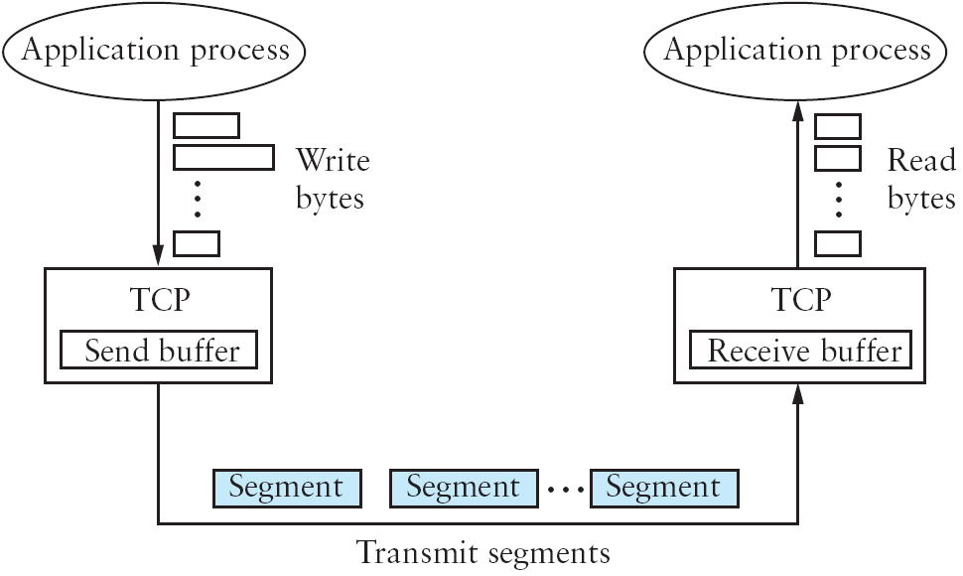
TCP = reliable byte stream
Notes:
TCP is a byte-oriented protocol, which means that the sender writes bytes into a TCP connection and the receiver reads bytes out of the TCP connection. Although “byte stream” describes the service TCP offers to application processes, TCP does not, itself, transmit individual bytes over the Internet. Instead, TCP on the source host buffers enough bytes from the sending process to fill a reasonably sized packet and then sends this packet to its peer on the destination host. TCP on the destination host then empties the contents of the packet into a receive buffer, and the receiving process reads from this buffer at its leisure. This situation is illustrated in Figure 5.3, which, for simplicity, shows data flowing in only one direction. Remember that, in general, a single TCP connection supports byte streams flowing in both directions.
The packets exchanged between TCP peers in the figure above are called segments, since each one carries a segment of the byte stream. Each TCP segment contains the header schematically depicted in the next slide. The relevance of most of these fields will become apparent throughout this section. For now, we simply introduce them. The SrcPort and DstPort fields identify the source and destination ports, respectively, just as in UDP. These two fields, plus the source and destination IP addresses, combine to uniquely identify each TCP connection. That is, TCP’s demux key is given by the 4-tuple ( SrcPort, SrcIPAddr, DstPort, DstIPAddr )

Slide 13
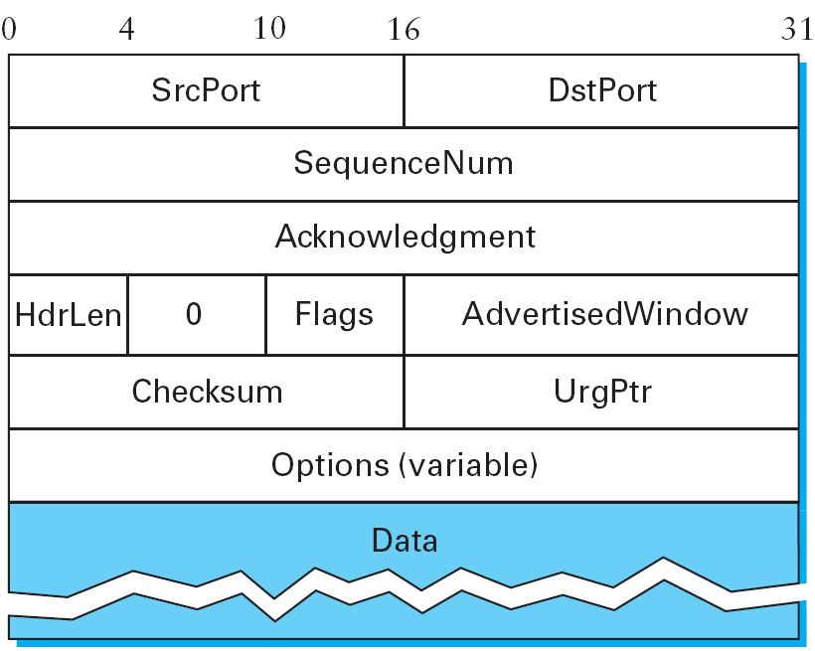
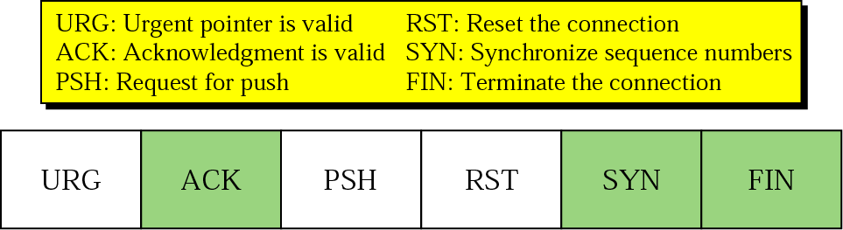
TCP Segment Format
Used with TCP’s sliding windows
Notes:
The Acknowledgment, SequenceNum, and AdvertisedWindow fields are all involved in TCP’s sliding window algorithm. Because TCP is a byte-oriented protocol, each byte of data has a sequence number; the SequenceNum field contains the sequence number for the first byte of data carried in that segment. The Acknowledgment and AdvertisedWindow fields carry information about the flow of data going in the other direction.
The 6-bit Flags field is used to relay control information between TCP peers. The possible flags include SYN, FIN, RESET, PUSH, URG, and ACK. The SYN and FIN flags are used when establishing and terminating a TCP connection, respectively. The ACK flag is set any time the Acknowledgment field is valid, implying that the receiver should pay attention to it. The URG flag signifies that this segment contains urgent data. When this flag is set, the UrgPtr field indicates where the nonurgent data contained in this segment begins. The urgent data is contained at the front of the segment body, up to and including a value of UrgPtr bytes into the segment.

Slide 14
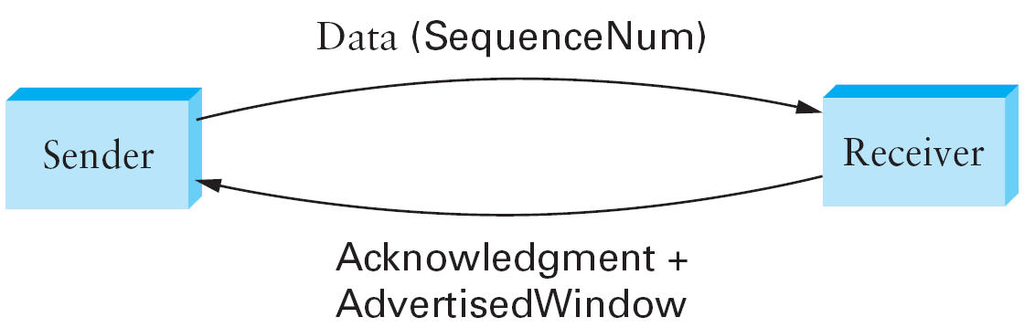
TCP process (unidirectional data flow)

Slide 15
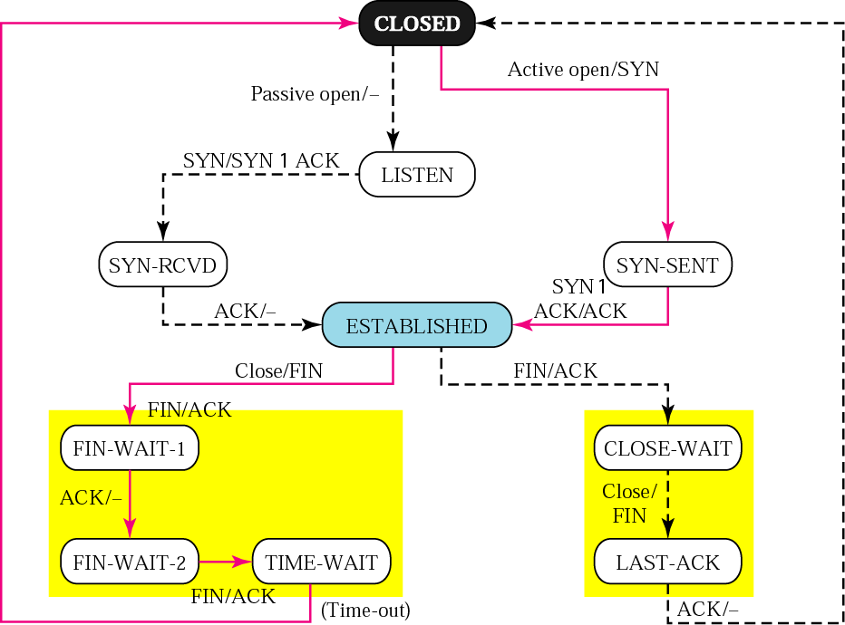
TCP State Transition Diagram
Server just received SYN from client
Active Opening of TCP connection
Active TCP close
Passive TCP close
Own FIN sent
First handshake’s ACK received
Notes:
State Explanation:
SYN_SEND Indicates active open. SYN_RECEIVED Server just received SYN from the client. ESTABLISHED Client received server's SYN and session is established. LISTEN Server is ready to accept connection. FIN_WAIT_1 Indicates active close. TIMED_WAIT Client enters this state after active close. CLOSE_WAIT Indicates passive close. Server just received first FIN from a client. FIN_WAIT_2 Client just received acknowledgment of its first FIN from the server. LAST_ACK Server is in this state when it sends its own FIN.
Opening a Connection: (CLOSED to ESTABLISHED)
TCP is complex enough that its specification includes a state transition diagram. A copy of this diagram is given in the figure above. This diagram shows only the states involved in opening a connection (everything above ESTABLISHED) and in closing a connection (everything below ESTABLISHED). Everything that goes on while a connection is open—that is, the operation of the sliding window algorithm—is hidden in the ESTABLISHED state.
TCP’s state transition diagram is fairly easy to understand. Each circle denotes a state that one end of a TCP connection can find itself in. All connections start in the CLOSED state. As the connection progresses, the connection moves from state to state according to the arcs. Each arc is labeled with a tag of the form event/action. Thus, if a connection is in the LISTEN state and a SYN segment arrives (i.e., a segment with the SYN flag set), the connection makes a transition to the SYN RCVD state and takes the action of replying with an ACK + SYN segment.
Notice that two kinds of events trigger a state transition: (1) a segment arrives from the peer (e.g., the event on the arc from LISTEN to SYN RCVD), or (2) the local application process invokes an operation on TCP (e.g., the active open event on the arc from CLOSE to SYN SENT). In other words, TCP’s state transition diagram effectively defines the semantics of both its peer-to-peer interface and its service interface.
When opening a connection, the server first invokes a passive open operation on TCP, which causes TCP to move to the LISTEN state. At some later time, the client does an active open, which causes its end of the connection to send a SYN segment to the server and to move to the SYN SENT state. When the SYN segment arrives at the server, it moves to the SYN RCVD state and responds with a SYN+ACK segment. The arrival of this segment causes the client to move to the ESTABLISHED state and to send an ACK back to the server. When this ACK arrives, the server finally
moves to the ESTABLISHED state. In other words, we have just traced the three-way handshake.
There are two things to notice about the connection establishment half of the state transition diagram:
First, if the client’s ACK to the server is lost, corresponding to the third leg of the three-way handshake, then the connection still functions correctly. This is because the client side is already in the ESTABLISHED state, so the local application process can start sending data to the other end. Each of these data segments will have the ACK flag set, and the correct value in the Acknowledgment field, so the server will move to the ESTABLISHED state when the first data segment arrives. This is actually an important point about TCP—every segment reports what sequence
number the sender is expecting to see next, even if this repeats the same sequence number contained in one or more previous segments.
Second, we must note the arcs that are not shown. Specifically, most of the states that involve sending a segment to the other side also schedule
a timeout that eventually causes the segment to be resent if the expected response does not happen. These retransmissions are not depicted in the state transition diagram. If after several tries the expected response does not arrive, TCP gives up and returns to the CLOSED state.
Closing a Connection: (ESTABLISHED to CLOSED)
Turning our attention now to the process of terminating a connection, the important thing to keep in mind is that the application process on both sides of the connection must independently close its half of the connection. If only one side closes the connection, then this means it has no more data to send, but it is still available to receive data from the other side. This complicates the state transition diagram because it must account for the possibility that the two sides invoke the close operator at the same time, as well as the possibility that first one side invokes close and then, at some later time, the other side invokes close. Thus, on any one side there are three combinations of transitions that get a connection from the ESTABLISHED state to the CLOSED state:
1) This side closes first: ESTABLISHED → FIN WAIT 1 → FIN WAIT 2 → TIME WAIT → CLOSED.
2) The other side closes first: ESTABLISHED → CLOSE WAIT → LAST ACK → CLOSED.
3) Both sides close at the same time: ESTABLISHED → FIN WAIT 1 → CLOSING → TIME WAIT → CLOSED.
The main thing to recognize about connection teardown is that a connection in the TIME WAIT state cannot move to the CLOSED state until it has waited for two times the maximum amount of time an IP datagram might live in the Internet (i.e., 120 seconds). The reason for this is that while the local side of the connection has sent an ACK in response to the other side’s FIN segment, it does not know that the ACK was successfully delivered. As a consequence, the other side might retransmit its As a consequence, the other side might retransmit its (TCP) FIN segment, and this second FIN segment might be delayed in the network. If the connection were allowed to move directly to the CLOSED state, then another pair of application processes might come along and open the same connection (i.e., use the same pair of port numbers), and the delayed FIN segment from the earlier incarnation of the connection would immediately initiate the termination of the later incarnation of that connection.

Slide 16
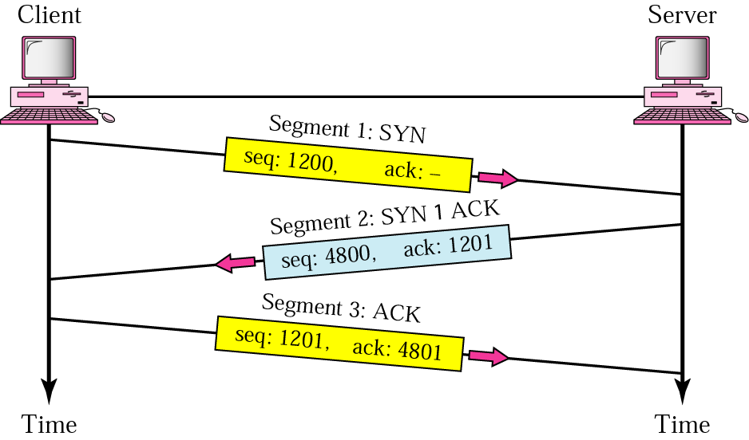
TCP connection establishment
Three-way handshake
Notes:
The algorithm used by TCP to establish and terminate a connection is called a three-way handshake.We first describe the basic algorithm and then show how it is used by TCP. The three-way handshake involves the exchange of three messages between the client and the server, as illustrated in the figure above.
The idea is that two parties want to agree on a set of parameters, which, in the case of opening a TCP connection, are the starting sequence numbers the two sides plan to use for their respective byte streams. In general, the parameters might be any facts that each side wants the other to know about. First, the client (the active participant) sends a segment to the server (the passive participant) stating the initial sequence number it plans to use (Flags = SYN, SequenceNum = x). The server then responds with a single segment that both acknowledges the client’s sequence number (Flags = ACK, Ack = x + 1) and states its own beginning sequence number (Flags = SYN, SequenceNum = y). That is, both the SYN and ACK bits are set in the Flags field of this second message. Finally, the client responds with a third segment that acknowledges the server’s sequence number (Flags = ACK, Ack = y + 1). The reason that each side acknowledges a sequence number that is one larger than the one sent is that the Acknowledgment field actually identifies the “next sequence number expected,” thereby implicitly acknowledging all earlier sequence numbers. Although not shown in this timeline, a timer is scheduled for each of the first two segments, and if the expected response is not received, the segment is retransmitted.

Slide 17
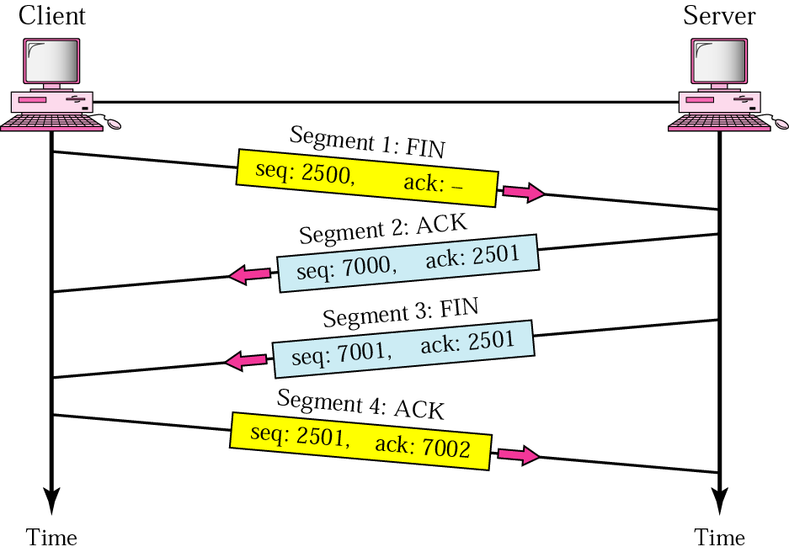
TCP connection termination
Pair of two-way handshakes
Notes:
A TCP connection is normally terminating using a special procedure where each side independently closes its end of the link. It normally begins with one of the application processes signalling to its TCP layer that the session is no longer needed. That device sends a FIN message to tell the other device that it wants to end the connection, which is acknowledged. When the responding device is ready, it too sends a FIN that is acknowledged; after waiting a period of time for the ACK to be received, the session is closed.
Why have a four way exchange rather than a three-way exchange?
The reason is that TCP supports half-closed connections. If A decides it has finished it will send a FIN to B. But B might still have data to send. If it has it will ACK the FIN but won't send a FIN until it has actually finished. Finally, A will send an ACK to B.

Slide 18
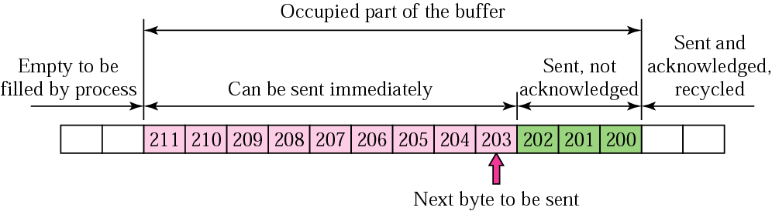
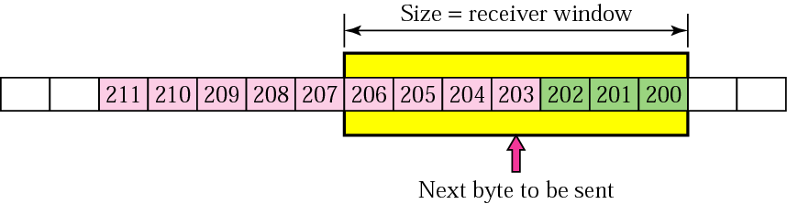
Sliding Window – Sender’s end
Notes:
We are now ready to discuss TCP’s variant of the sliding window algorithm, which serves several purposes: (1) it guarantees the reliable delivery of data, (2) it ensures that data is delivered in order, and (3) it enforces flow control between the sender and the receiver.
TCP’s use of the sliding window algorithm is the same as we saw for point-to-point links (Chapter 2) in the case of the first two of these three functions. Where TCP differs from the earlier algorithm is that it folds the flow-control function in as well.
In particular, rather than having a fixed-size sliding window, the receiver advertises a window size to the sender. This is done using the AdvertisedWindow field in the TCP header. The sender is then limited to having no more than a value of AdvertisedWindow bytes of unacknowledged data at any given time. The receiver selects a suitable value for AdvertisedWindow based on the amount of memory allocated to the connection for the purpose of buffering data. The idea is to keep the sender from overrunning the receiver’s buffer.

Slide 19
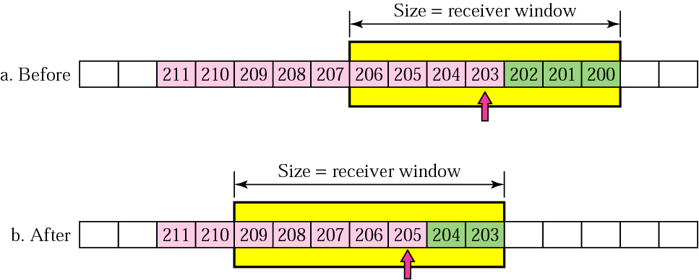
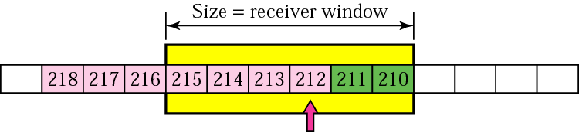
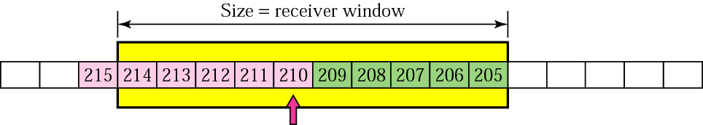
Windows Sliding/ Expanding/ Shrinking
Sliding Windows
Expanding/ Shrinking Windows (based on receiver advertised window)

Slide 20
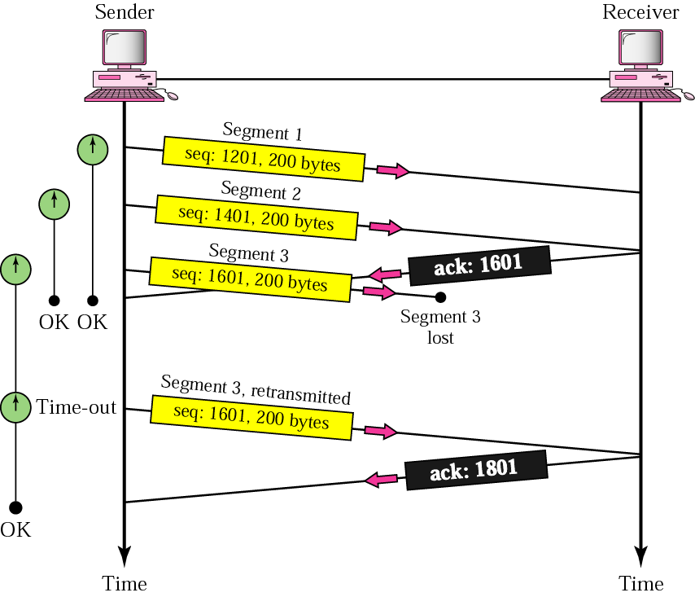
TCP: Lost Segment

Slide 21
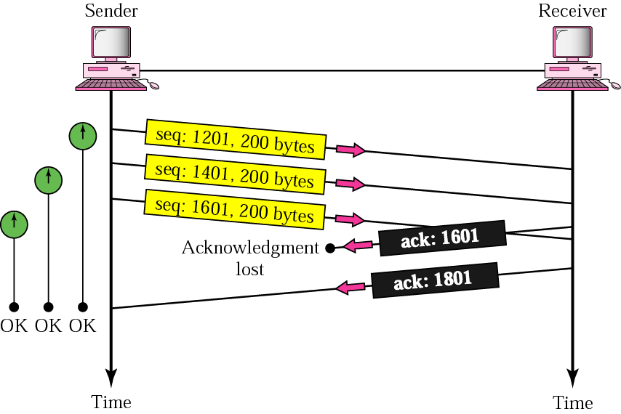
TCP: Lost Acknowledgement

Slide 22
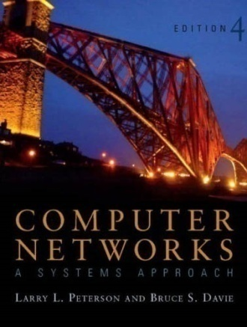
References
Section 5.1:
End-to-End Protocols
[P&D]

Slide 23
?
?
Questions/ Confusions?
?
Use the discussion forum at:
http://compnets.ning.com/
Credits/ Acknowledgement at:
http://sites.google.com/site/cse320site/

