Slide 1
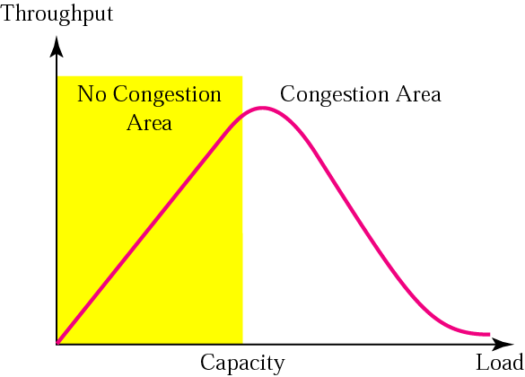
Topic 6: Congestion Control
Notes:
Credit: Forouzan

Slide 2
Topic’s objectives
To learn about:
Flow Control vs. Congestion Control
TCP’s Congestion Control
Slow Start
AIMD Congestion Avoidance
Fast Recovery and Fast Retransmit

Slide 3
Flow Control vs.
Congestion Control
1

Slide 4
Networks in late 1986
5,089 hosts on Internet (Nov 1986)
Backbone speed: 50 – 56 kbps
Control mechanism focused on receiver congestion and not on network congestion
TCP flow control only prevents overwhelming receivers; did not focus on network congestion

Slide 5
Congestion Collapse
Oct 1986, Internet had its first congestion collapse
Link LBL to UC Berkeley
400 yards, 3 hops, 32 Kbps
throughput dropped to 40 bps
factor of ~1000 drop!
Van Jacobson proposed TCP congestion control (1988)
Throughput
Load

Slide 6
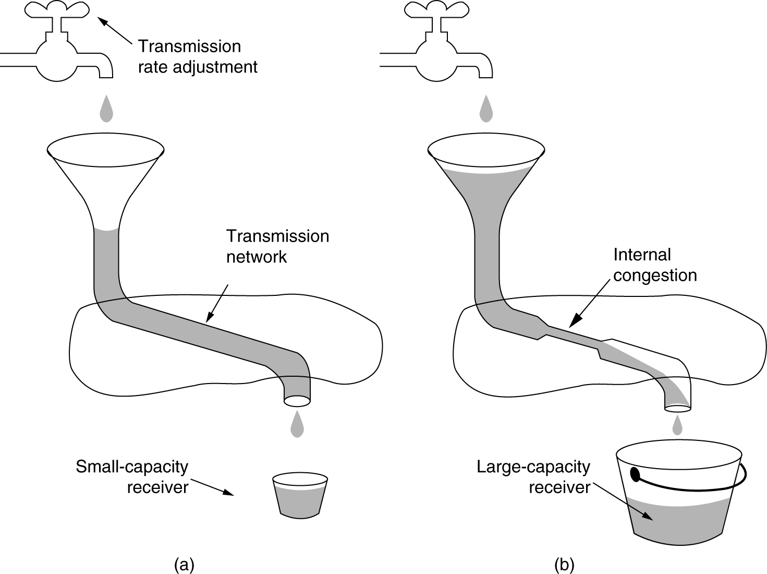
Flow vs Congestion Control
Flow Control
Congestion Control
Notes:
Credit: Forouzan

Slide 7
TCP’s Congestion Avoidance
2
AIMD Congestion Avoidance
Slow Start
Fast Recovery and Fast Retransmit
Notes:
This section describes the predominant example of end-to-end congestion control in use today, that implemented by TCP. The essential strategy of TCP is to send packets into the network without a reservation and then to react to observable events that occur. TCP assumes only FIFO queuing in the network’s routers, but also works with fair queuing.
TCP congestion control was introduced into the Internet in the late 1980s by Van Jacobson, roughly eight years after the TCP/IP protocol stack had become operational. Immediately preceding this time, the Internet was suffering from congestion collapse— hosts would send their packets into the Internet as fast as the advertised window would allow, congestion would occur at some router (causing packets to be dropped), and the hosts would time out and retransmit their packets, resulting in even more congestion. Broadly speaking, the idea of TCP congestion control is for each source to determine how much capacity is available in the network, so that it knows how many packets it can safely have in transit. Once a given source has this many packets in transit, it uses the arrival of an ACK as a signal that one of its packets has left the network, and that it is therefore safe to insert a new packet into the network without adding to the level of congestion. By using ACKs to pace the transmission of packets, TCP is said to be self-clocking. Of course, determining the available capacity in the first place is no easy task. To make matters worse, because other connections come and go, the available bandwidth changes over time, meaning that any given source must be able to adjust the number of packets it has in transit.
We will now describe algorithms used by TCP to address these and other problems. Note that although we describe these mechanisms one at a time, thereby giving the impression that we are talking about three independent mechanisms, it is only when they are taken as a whole that we have TCP congestion control.

Slide 8
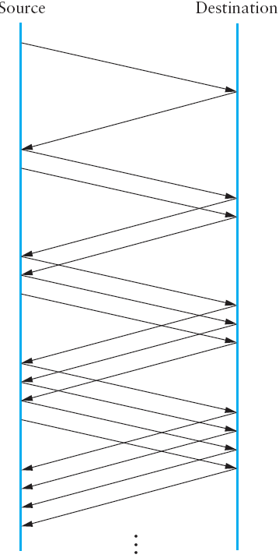
a) AIMD Congestion Avoidance
Additive Increase: Congestion Window increments every RTT
Source
Destination
Additive Increase
Notes:
A congestion-control strategy that only decreases the window size is obviously too conservative. We also need to be able to increase the congestion window to take advantage of newly available capacity in the network. This is the “additive increase”. part of AIMD, and it works as follows. Every time the source successfully sends a CongestionWindow’s worth of packets—that is, each packet sent out during the last RTT has been ACKed—it adds the equivalent of one packet to CongestionWindow. This linear increase is illustrated in the figure above.

Slide 9
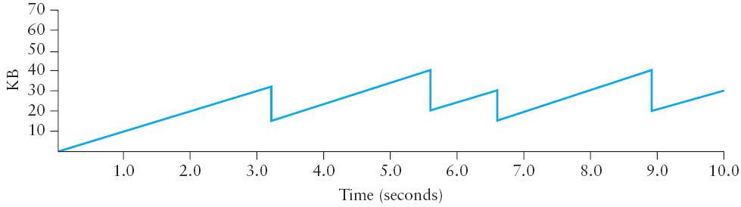
AIMD Congestion Avoidance
Multiplicative Decrease: Congestion Window halves on Packet loss
Multiplicative Decrease
Notes:
TCP maintains a new state variable for each connection, called CongestionWindow, which is used by the source to limit how much data it is allowed to have in transit at a given time. The congestion window is congestion control’s counterpart to flow control’s advertised window. TCP is modified such that the maximum number of bytes of unacknowledged data allowed is now the minimum of the congestion window and the advertised window.
Thus, a TCP source is allowed to send no faster than the slowest component—the network or the destination host—can accommodate. The network limit is estimated using the CongestionWindow parameter whereas the receiver limit is advertised using the AdvertisedWindow paramater.
Problem: The problem, of course, is how TCP comes to learn an appropriate value for CongestionWindow. Unlike the AdvertisedWindow, which is sent by the receiving side of the connection, there is no one to send a suitable CongestionWindow to the sending side of TCP. The answer is that the TCP source sets the CongestionWindow based on the level of congestion it perceives to exist in the network. This involves decreasing the congestion window when the level of congestion goes up and increasing the congestion window when the level of congestion goes down. Taken together, the mechanism is commonly called additive increase/multiplicative decrease (AIMD).
The key question, then, is how does the source determine that the network is congested and that it should decrease the congestion window? The answer is based on the observation that the main reason packets are not delivered, and a timeout results, is that a packet was dropped due to congestion. It is rare that a packet is dropped because of an error during transmission. Therefore, TCP interprets timeouts as a sign of congestion and reduces the rate at which it is transmitting. Specifically, each time a timeout occurs, the source sets CongestionWindow to half of its previous value. This halving of the CongestionWindow for each timeout corresponds to the “multiplicative decrease” part of AIMD.
(Although CongestionWindow is defined in terms of bytes, it is easiest to understand multiplicative decrease if we think in terms of whole packets. For example, suppose the CongestionWindow is currently set to 16 packets. If a loss is detected, CongestionWindow is set to 8. Normally, a loss is detected when a timeout occurs, but as we see below, TCP has another mechanism to detect dropped packets. Additional losses cause CongestionWindow to be reduced to 4, then 2, and finally to 1 packet. CongestionWindow is not allowed to fall below the size of a single packet, or in TCP terminology, the maximum segment size (MSS).)

Slide 10
Fairness of TCP’s AIMD algorithm
R
equal bandwidth share
loss: decrease window by factor of 2
Connection 2 throughput
congestion avoidance: additive increase
loss: decrease window by factor of 2
congestion avoidance: additive increase
Connection 1 throughput
R

Slide 11
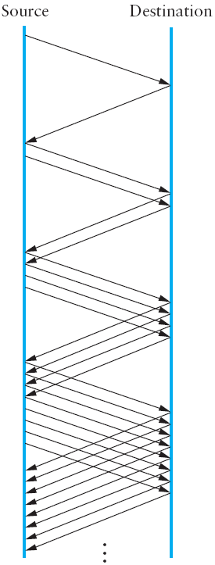
b) Slow Start
Source
Destination
Notes:
The additive increase mechanism just described is the right approach to use when the source is operating close to the available capacity of the network, but it takes too long to ramp up a connection when it is starting from scratch. TCP therefore provides a second mechanism, ironically called slow start, that is used to increase the congestion window rapidly from a cold start. Slow start effectively increases the congestion window exponentially, rather than linearly.
Why any exponential mechanism would be called “slow” is puzzling at first, but it can be explained if put in the proper historical context. We need to compare slow start not against the linear mechanism of the previous subsection, but against the original behavior of TCP. Consider what happens when a connection is established and the source first starts to send packets, that is, when it currently has no packets in transit. If the source sends as many packets as the advertised window allows—which is exactly what TCP did before slow start was developed—then even if there is a fairly large amount of bandwidth available in the network, the routers may not be able to consume this burst of packets. It all depends on how much buffer space is available at the routers. Slow start was therefore designed to space packets out so that this burst does not occur. In other words, even though its exponential growth is faster than linear growth, slow start is much “slower” than sending an entire advertised window’s worth of data all at once.
Specifically, the source starts out by setting CongestionWindow to one packet. When the ACK for this packet arrives, TCP adds 1 to CongestionWindow and then sends two packets. Upon receiving the corresponding two ACKs, TCP increments CongestionWindow by 2—one for each ACK—and next sends four packets. The end result is that TCP effectively doubles the number of packets it has in transit every RTT. The figure above shows the growth in the number of packets in transit during slow start. Compare this to the linear growth of additive increase shown in the previous slide.

Slide 12
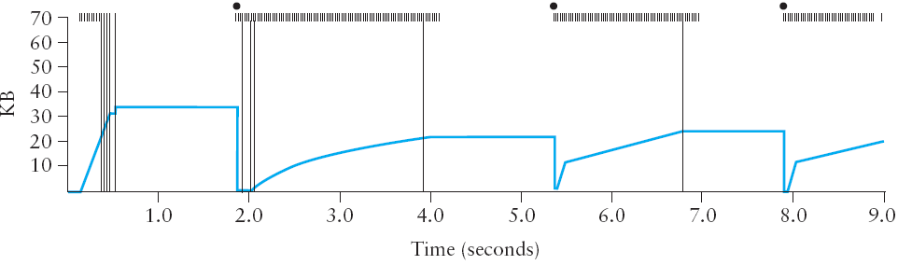
Slow Start and Congestion-Avoidance
time out
time when packet is transmitted
Congestion Window Size (in KB)
time of 1st transmission of packet that was retransmitted eventually
Notes:
The figure above traces how TCP’s CongestionWindow increases and decreases over time and serves to illustrate the interplay of slow start and additive increase/ multiplicative decrease. This trace was taken from an actual TCP connection and shows the current value of CongestionWindow—the colored line—over time.
There are several things to notice about this trace. The first is the rapid increase in the congestion window at the beginning of the connection. This corresponds to the initial slow start phase. The slow start phase continues until several packets are lost at about 0.4 seconds into the connection, at which time CongestionWindow flattens out at about 34 KB.
The reason the congestion window flattens is that there are no ACKs arriving, due to the fact that several packets were lost. In fact, no new packets are sent during this time, as denoted by the lack of hash marks at the top of the graph. A timeout eventually happens at approximately 2 seconds, at which time the congestion window is divided by 2 (i.e., cut from approximately 34 KB to around 17 KB) and CongestionThreshold is set to this value. Slow start then causes CongestionWindow to be reset to one packet and to start ramping up from there.
There is not enough detail in the trace to see exactly what happens when a couple of packets are lost just after 2 seconds, so we jump ahead to the linear increase in the congestion window that occurs between 2 and 4 seconds. This corresponds to additive increase. At about 4 seconds, CongestionWindow flattens out, again due to a lost packet.
Now, at about 5.5 seconds:
A timeout happens, causing the congestion window to be divided by 2, dropping it from approximately 22 KB to 11 KB, and CongestionThreshold is set to this amount.
CongestionWindow is reset to one packet, as the sender enters slow start.
Slow start causes CongestionWindow to grow exponentially until it reaches CongestionThreshold.
4) CongestionWindow then grows linearly.
The same pattern is repeated at around 8 seconds when another timeout occurs.
We now return to the question of why so many packets are lost during the initial slow start period. At this point, TCP is attempting to learn how much bandwidth is available on the network. This is a very difficult task. If the source is not aggressive at this stage—for example, if it only increases the congestion window linearly—then it takes a long time for it to discover how much bandwidth is available. This can have a dramatic impact on the throughput achieved for this connection. On the other hand, if the source is aggressive at this stage, as TCP is during exponential growth, then the source runs the risk of having half a window’s worth of packets dropped by the network.
To see what can happen during exponential growth, consider the situation in which the source was just able to successfully send 16 packets through the network, causing it to double its congestion window to 32. Suppose, however, that the network happens to have just enough capacity to support 16 packets from this source. The likely result is that 16 of the 32 packets sent under the new congestion window will be dropped by the network; actually, this is the worst-case outcome, since some of the packets will be buffered in some router.

Slide 13
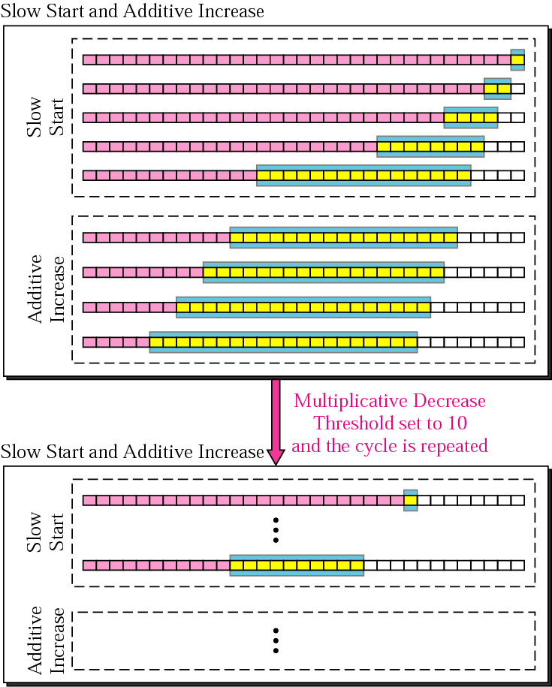
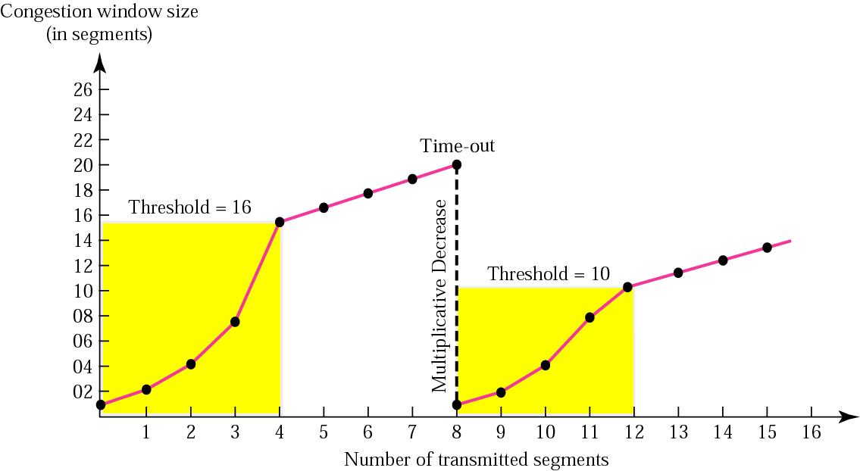
Slow Start and Congestion-Avoidance
Notes:
The figure above traces how TCP’s CongestionWindow increases and decreases over time and serves to illustrate the interplay of slow start and additive increase/ multiplicative decrease. This trace was taken from an actual TCP connection and shows the current value of CongestionWindow—the colored line—over time.
There are several things to notice about this trace. The first is the rapid increase in the congestion window at the beginning of the connection. This corresponds to the initial slow start phase. The slow start phase continues until several packets are lost at about 0.4 seconds into the connection, at which time CongestionWindow flattens out at about 34 KB.
The reason the congestion window flattens is that there are no ACKs arriving, due to the fact that several packets were lost. In fact, no new packets are sent during this time, as denoted by the lack of hash marks at the top of the graph. A timeout eventually happens at approximately 2 seconds, at which time the congestion window is divided by 2 (i.e., cut from approximately 34 KB to around 17 KB) and CongestionThreshold is set to this value. Slow start then causes CongestionWindow to be reset to one packet and to start ramping up from there.
There is not enough detail in the trace to see exactly what happens when a couple of packets are lost just after 2 seconds, so we jump ahead to the linear increase in the congestion window that occurs between 2 and 4 seconds. This corresponds to additive increase. At about 4 seconds, CongestionWindow flattens out, again due to a lost packet.
Now, at about 5.5 seconds:
A timeout happens, causing the congestion window to be divided by 2, dropping it from approximately 22 KB to 11 KB, and CongestionThreshold is set to this amount.
CongestionWindow is reset to one packet, as the sender enters slow start.
Slow start causes CongestionWindow to grow exponentially until it reaches CongestionThreshold.
4) CongestionWindow then grows linearly.
The same pattern is repeated at around 8 seconds when another timeout occurs.
We now return to the question of why so many packets are lost during the initial slow start period. At this point, TCP is attempting to learn how much bandwidth is available on the network. This is a very difficult task. If the source is not aggressive at this stage—for example, if it only increases the congestion window linearly—then it takes a long time for it to discover how much bandwidth is available. This can have a dramatic impact on the throughput achieved for this connection. On the other hand, if the source is aggressive at this stage, as TCP is during exponential growth, then the source runs the risk of having half a window’s worth of packets dropped by the network.
To see what can happen during exponential growth, consider the situation in which the source was just able to successfully send 16 packets through the network, causing it to double its congestion window to 32. Suppose, however, that the network happens to have just enough capacity to support 16 packets from this source. The likely result is that 16 of the 32 packets sent under the new congestion window will be dropped by the network; actually, this is the worst-case outcome, since some of the packets will be buffered in some router.

Slide 14
Slow Start and Congestion-Avoidance
TCP Tahoe
window
time
SS
CA
SS: Slow Start
CA: Congestion Avoidance

Slide 15
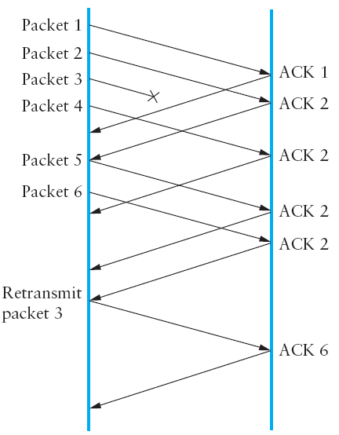
c) Fast Retransmit
Source
Destination
Notes:
The mechanisms described so far were part of the original proposal to add congestion control to TCP. It was soon discovered, however, that the coarse-grained implementation of TCP timeouts led to long periods of time during which the connection went dead
while waiting for a timer to expire. Because of this, a new mechanism called fast re-transmit was added to TCP. Fast retransmit is a heuristic that sometimes triggers the retransmission of a dropped packet sooner than the regular timeout mechanism. The fast retransmit mechanism does not replace regular timeouts; it just enhances that facility.
The idea of fast retransmit is straightforward. Every time a data packet arrives at the receiving side, the receiver responds with an acknowledgment, even if this sequence number has already been acknowledged. Thus, when a packet arrives out of order— that is, TCP cannot yet acknowledge the data the packet contains because earlier data has not yet arrived—TCP resends the same acknowledgment it sent the last time. This second transmission of the same acknowledgment is called a duplicate ACK. When
the sending side sees a duplicate ACK, it knows that the other side must have received a packet out of order, which suggests that an earlier packet might have been lost. Since it is also possible that the earlier packet has only been delayed rather than lost, the sender waits until it sees some number of duplicate ACKs and then retransmits the missing packet. In practice, TCP waits until it has seen three duplicate ACKs before retransmitting the packet.
The figure above illustrates how duplicate ACKs lead to a fast retransmit. In this example, the destination receives packets 1 and 2, but packet 3 is lost in the network. Thus, the destination will send a duplicate ACK for packet 2 when packet 4 arrives, again when packet 5 arrives, and so on. (To simplify this example, we think in terms of packets 1, 2, 3, and so on, rather than worrying about the sequence numbers for each byte.) When the sender sees the third duplicate ACK for packet 2—the one sent because the receiver had gotten packet 6—it retransmits packet 3. Note that when the retransmitted copy of packet 3 arrives at the destination, the receiver then sends a cumulative ACK for everything up to and including packet 6 back to the source.

Slide 16
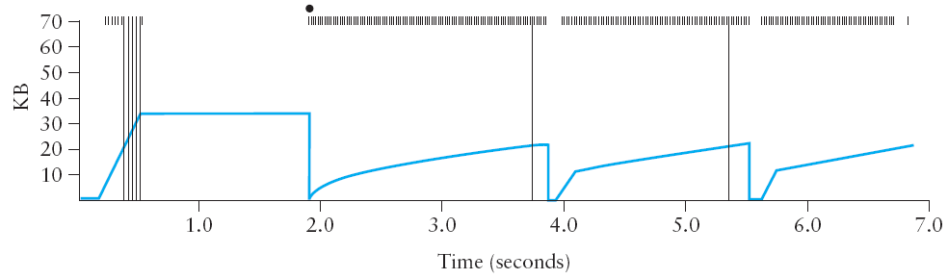
Fast Retransmit
Notes:
The figure above illustrates the behavior of a version of TCP with the fast retransmit mechanism. It is interesting to compare this trace with that given in the previous figure, where fast retransmit was not implemented—the long periods during which the congestion window stays flat and no packets are sent have been eliminated. In general, this technique is able to eliminate about half of the coarse-grained timeouts on a typical TCP connection, resulting in roughly a 20% improvement in the throughput over what could otherwise have been achieved. Notice, however, that the fast retransmit strategy does not eliminate all coarse-grained timeouts. This is because for a small window size, there will not be enough packets in transit to cause enough duplicate ACKs to be delivered.
Given enough lost packets—for example, as happens during the initial slow start phase—the sliding window algorithm eventually blocks the sender until a timeout occurs. Given the current 64-KB maximum advertised window size, TCP’s fast retransmit
mechanism is able to detect up to three dropped packets per window in practice.
Finally, there is one last improvement we can make. When the fast retransmit mechanism signals congestion, rather than drop the congestion window all the way back to one packet and run slow start, it is possible to use the ACKs that are still in the pipe to clock the sending of packets. This mechanism, which is called fast recovery, effectively removes the slow start phase that happens between when fast retransmit detects a lost packet and additive increase begins. For example, fast recovery avoids the slow start period between 3.8 and 4 seconds in the figure above and instead simply cuts the congestion window in half (from 22 KB to 11 KB) and resumes additive increase. In other words, slow start is only used at the beginning of a connection and whenever a coarse-grained timeout occurs. At all other times, the congestion window is following a pure additive increase/multiplicative decrease pattern.

Slide 17
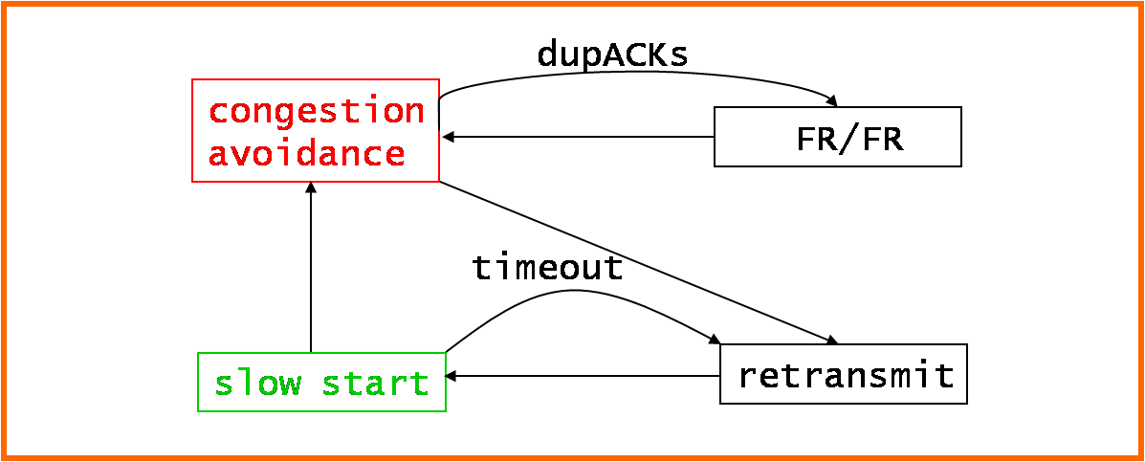
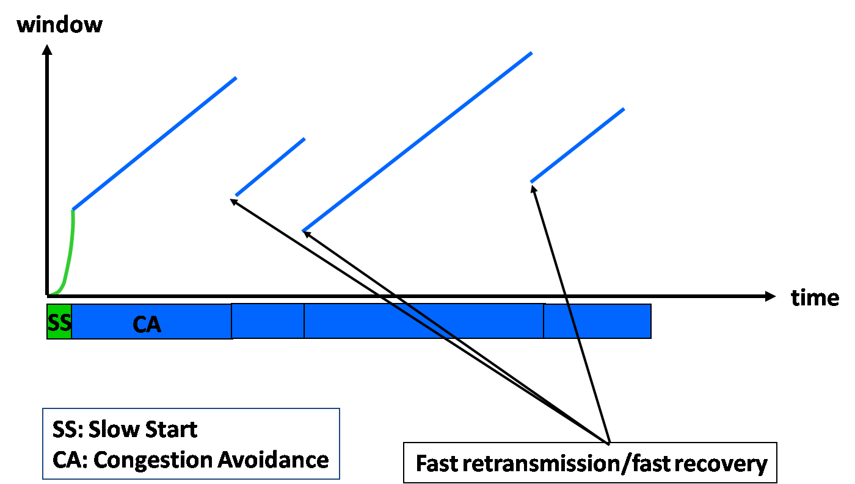
Fast Recovery
TCP Reno

Slide 18

References
Section 6.3:
TCP Congestion Control [P&D]

Slide 19
?
?
Questions/ Confusions?
?
Use the discussion forum at:
http://compnets.ning.com/
Credits/ Acknowledgement at:
http://sites.google.com/site/cse320site/

