Slide 1
Next-Generation Networks
IPTV
Single converged IP backbone
Voice over IP
Data
Access technology independent service

Slide 2
Driving force towards NGNs
High Speed (Broadband) Internet Access
Flexible IP core technology (MPLS)
Session Initial Protocol (SIP)
IP Multimedia Subsystem (IMS)
Already covered in the course
To be covered today
Notes:
The definition of NGN depends on who you ask. To someone who’s working in the data communication field, it means access-agnostic services that are driven by protocols such as MPLS (for flexible routing) and SIP (for flexible signaling). To some one in the telecom world (the mobile telephone industry), it means the employment of IMS and a packet switching core through which voice, video and data traffic is exchanged.
There are other definitions as well, for example, certain people define xG (next-gen networks) as those wireless networks in which node interfaces are not fixed to any one interface; instead, the interfaces have cognition or intelligence through which they can choose a channel on which there is reduced interference. The reason motivating the development of cognitive radio networks is that often licensed frequency (which is assigned to particular users) is underutilized whereas unlicensed users have much data to send; this reason has been impeding the development of new wireless application. This technology in short is called cognitive radio network, or dynamic spectrum access networks. [for more details, check out: http://tinyurl.com/nbl74b]

Slide 3
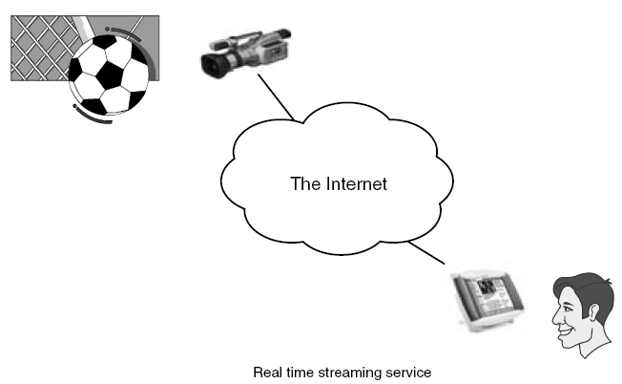
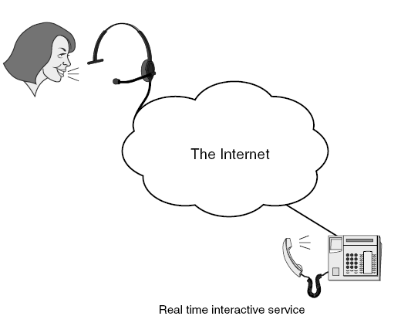
Real time services
Real-time streaming service
Real-time interactive service
Notes:
The Internet has been proved to be a powerful tool in developing asynchronous services (such as email), but it can also provide synchronous (real-time) services. Examples include videoconferencing over the Net and live broadcast n a workstation attached to an IP network. Real-time services are delay sensitive. The information they carry needs to be delivered to its destination within a prescribed time limit. If the delay introduced by the network is any longer, either the information becomes no longer useful to the receiver or the service quality drops dramatically.
It is possible to further classify real-time services into streaming and interactive categories. Streaming services typically have lower requirements than interactive ones. Consider the transmission of a soccer match as an example of a streaming service. Relatively large delays, in the order of even some seconds, are acceptable for the user as long as the image and sound quality hold up, but probably not vice versa. The industry currently deems it acceptable for users to see a goal on the screen a couple of seconds after it really happened on the soccer field where the match takes place.
Services with an interactive flavor have tougher requirements. In a voice conversation over the Internet, the delay must be kept very low. Otherwise it is impossible to undertake a normal conversation. The maximum acceptable delay for this kind of real-time interactive service depends on many factors, but in general, it is lower than the delay for streaming services.
According to the International Telecommunication Union Telecommunication Standardization Sector (ITU-T), the maximum acceptable delay for voice conversations is a round-trip delay of 300 ms.

Slide 4
Requirements for real-time-traffic
Session creation/ modification/ termination (SIP)
Session description protocol (SDP)
Packetization and clocking (RTP)
SIP is independent of:
the type of multimedia session handled
the session description mechanism
Notes:
SIP establishes, modifies, and terminates multimedia sessions. It can be used to invite new members to an existing session or to create brand new sessions. A new session is created if two conditions are met: (1) both parties are willing to talk to each other (2) they agree on the media parameters that will be used.
SIP is independent of the type of multimedia session handled and of the mechanism used to describe the session. It is equally useful for videoconferences, audio calls, shared whiteboards, and gaming sessions. Sessions consisting of RTP streams carrying audio and video are usually described using SDP, but some types of session can be described with other description protocols. Assuming Bob wants to play chess with Laura, he has the option of using a chess-specific session, which will be described by a chess specific description protocol instead of SDP. If Bob and Laura were to play a video game over the Internet, they also would probably use a protocol other than SDP to describe their gaming session.
In short, SIP is used to distribute session descriptions among potential participants. Once the session description is distributed, SIP can be used to negotiate and modify the parameters of the session and terminate the session.

Slide 5
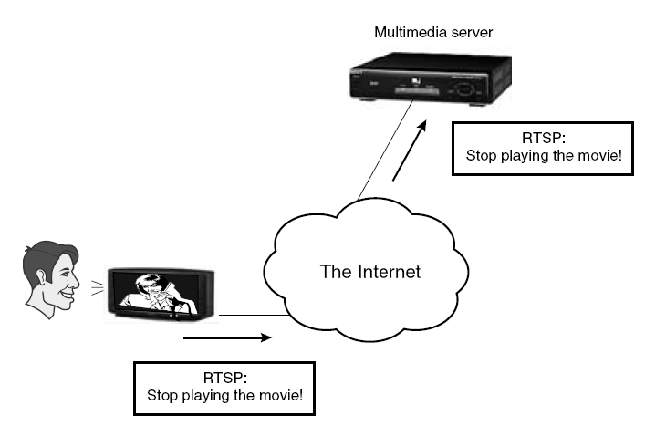
Real Time Streaming Protocol
RTSP does not itself handle the transmission of streaming data
Notes:
The Real Time Streaming Protocol (RTSP) is a network control protocol for use in entertainment and communications systems to control streaming media servers. The protocol is used to establish and control media sessions between end points. Clients of media servers issue VCR-like commands, such as play and pause, to facilitate real-time control of playback of media files from the server.
The transmission of streaming data itself is not a task of the RTSP protocol. Most RTSP servers use the Real-time Transport Protocol (RTP) for media stream delivery, however some vendors implement proprietary transport protocols. The RTSP server from RealNetworks, for example, also features RealNetworks' proprietary RDT stream transport.

Slide 6
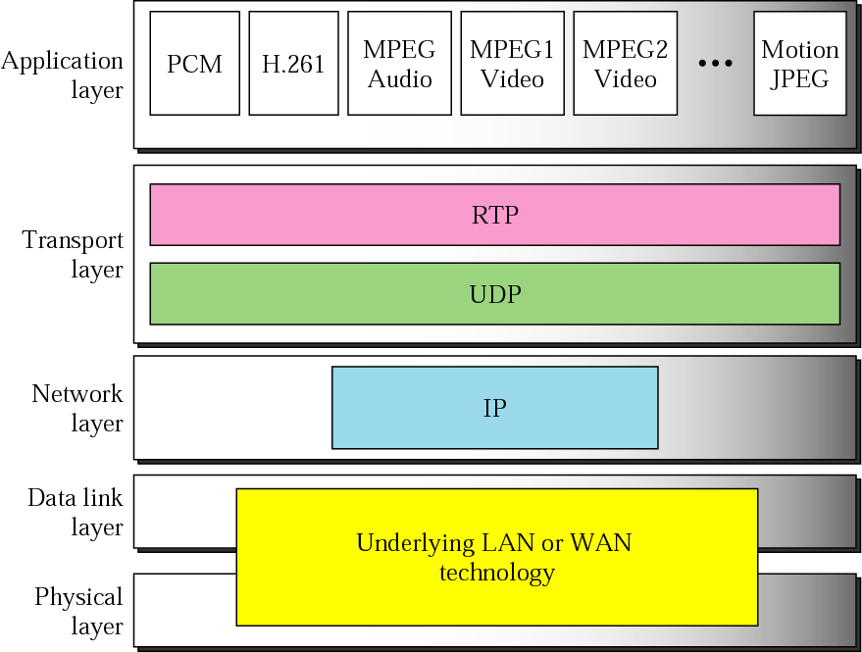
Real Time Protocol
Notes:
You might wonder why a protocol whose name identifies it as a “transport protocol” appears in a discussion on application-layer issues. The reason for this is that RTP contains a considerable amount of functionality that is specific to multimedia applications. Furthermore, it typically runs on top of one of the transport-layer protocols described in UDP which provides some of the application-independent functions you usually associate with a transport protocol.
RTP is nevertheless called a transport protocol because it provides common end-to-end functions to a number of applications. (Most application-layer protocols, like HTTP and SMTP, for example, are specific to a single application.) A point to note here is the difficulty of fitting real-world protocols into a strict layerist model.
Before we look at RTP in detail, it will help to consider some of the applications that might use it. Multimedia applications, as we’ve mentioned, are divided into two classes—conferencing applications and streaming applications.
A popular example of the former class (conferencing or interactive application) is vat, the audioconferencing tool that is often used over networks supporting IP multicast. Streaming applications typically deliver audio or video streams from a server to a client, and are typified by such commercial products as Real Audio. Because of the lack of human interaction, such applications place somewhat different requirements on the underlying protocols. It should by now be apparent that designers of a transport protocol for multimedia applications face a real challenge in defining the requirements broadly enough to meet the needs of very different applications. They must also pay attention to the interactions among different applications, for example, the synchronization of audio and video streams. We will see how these concerns affected the design of RTP in the next slide.

Slide 7
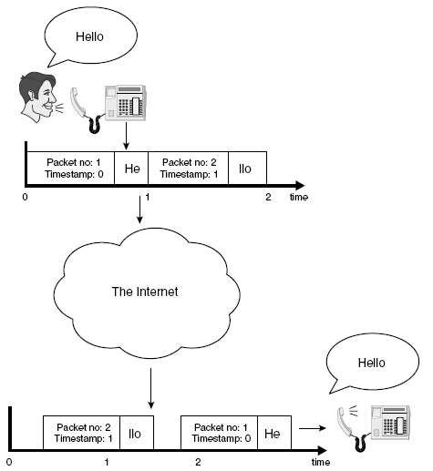
Real Time Protocol (RTP)
Notes:
In the NGN, voice and video is transported within IP packets, which, given the connectionless nature of IP networking, requires additional information to be passed end to end to assist in clock recovery and depacketisation. This is achieved with the IETF Real-time Transport Protocol (RTP)
An interesting question that may arise here is: Why is there a need of RTP timestamp when we have packet numbers?
The timestamp is used to place the incoming audio and video packets in the correct timing order (playout delay compensation). The sequence number is mainly used to detect losses. Sequence numbers increase by one for each RTP packet transmitted, timestamps increase by the time "covered" by a packet. For video formats where a video frame is split across several RTP packets, several packets may have the same timestamp. In some cases such as carrying DTMF (touch tone) data (RFC 2833), RTP timestamps may not be monotonic.

Slide 8
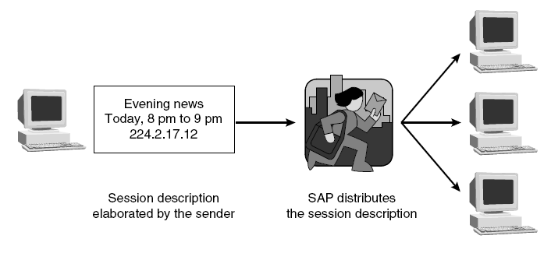
Session Announcement Protocol
Notes:
[From Wikipedia]
Session Announcement Protocol (SAP) is a protocol for broadcasting multicast session information. A SAP listening application can listen to the well-known SAP multicast address and construct a guide of all advertised multicast sessions. SAP was published by the IETF as RFC 2974. SAP typically uses Session Description Protocol (SDP) as the format of the session descriptions, and the multicast sessions typically use Real-time Transport Protocol (RTP).

Slide 9
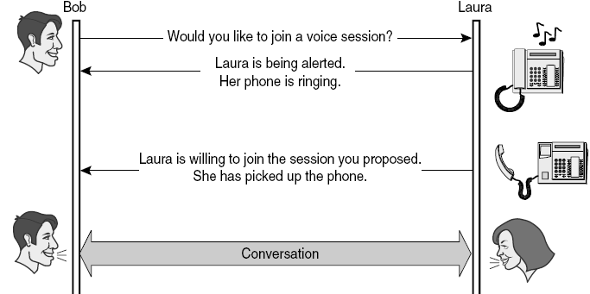
Session Initiation Protocol
Notes:
Just like the traditional applications (HTTP and SMTP), multimedia applications such as audio- and videoconferencing applications need application-layer protocols. Much of the initial experience in designing protocols for multimedia applications came from the “MBone tools”—applications such as vat and vic that were developed for use on the MBone, using IP multicast to enable multiparty conferencing.
Initially, each application implemented its own protocol (or protocols), but it became apparent that many multimedia applications have common requirements. This ultimately led to the development of a number of general-purpose protocols for use by multimedia applications.
Another class of protocol that many multimedia applications need is a session control protocol. For example, suppose that we wanted to be able to make IP-based telephone calls across the Internet. We would need some mechanism to notify the intended recipient of such a call that we wanted to talk to her, for example, by sending a message to some multimedia device that would cause it to make a ringing sound. We would also like to be able to support features like call forwarding, three-way calling, and so on. SIP (Session Initiation Protocol) and H.323 are examples of protocols that address the issues of session control

Slide 10
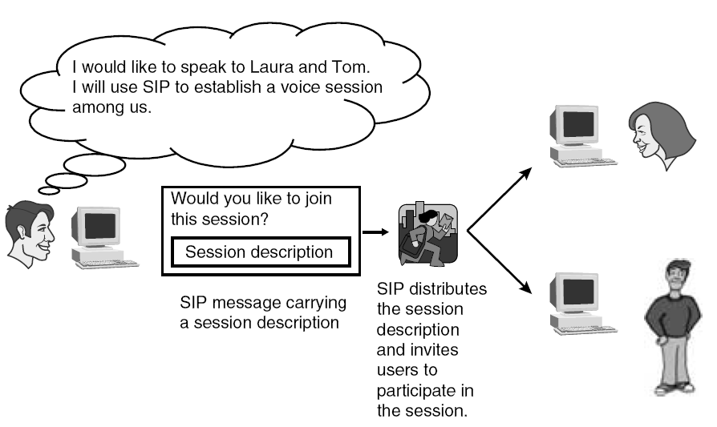
Session Description in SIP msg
Notes:
As mentioned previously, SIP is independent of the type of multimedia session handled and of the mechanism used to describe the session. It is equally useful for video-conferences, audio calls, shared whiteboards, and gaming sessions. Sessions consisting of RTP streams carrying audio and video are usually described using SDP, but some types of session can be described with other description protocols. Assuming Bob wants to play chess with Laura, he has the option of using a chess-specific session, which will be described by a chess specific description protocol instead of SDP. If Bob and Laura were to play a video game over the Internet, they also would probably use a protocol other than SDP to describe their gaming session.
In short, SIP is used to distribute session descriptions among potential participants. Once the session description is distributed, SIP can be used to negotiate and modify the parameters of the session and terminate the session.
The following example illustrates all of these functions. Bob wants to have an audio-video session with Laura and plans to use a Pulse Code Modulation (PCM) codec to encode voice. In this example, the session distribution part consists of Bob sending Laura a session description with a PCM codec for the voice component of the session. Laura prefers to use a Global System for Mobile Communications (GSM) codec because it consumes less bandwidth, so she persuades Bob to do it her way. Both finally settle on a GSM audio codec, but the session cannot be established until this negotiation is concluded.
Suddenly, in the middle of the audio-video session, Laura decides she is having a bad-hair day and wants to kill the video component. She modifies the session for audio only. When Bob then decides the conversation is over (I can’t imagine why), the session is terminated. Just as telephone systems inform a caller about the status of his or her call setup by playing different tones (busy tone or ringing tone), SIP provides the session initiator with information about the progress of his or her session setup.

Slide 11
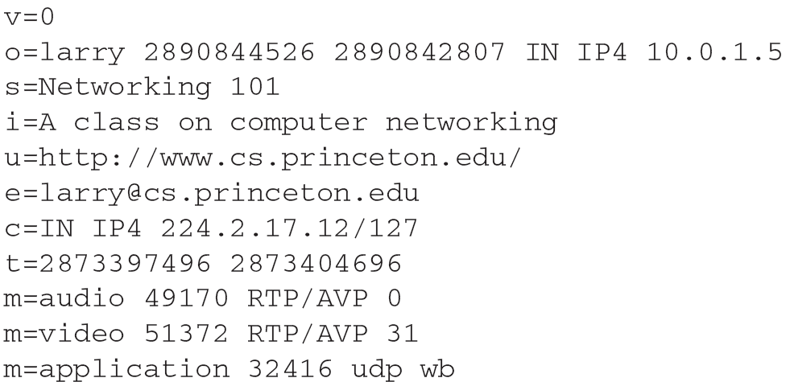
Session Description Protocol
Notes:
From Wikipedia:
The Session Description Protocol (SDP) is a format for describing streaming media initialization parameters in an ASCII string. The IETF published the original specification as an IETF Proposed Standard in April 1998^{[1]}, and subsequently published a revised specification as an IETF Proposed Standard as RFC 4566 in July 2006.^{[2]}
SDP is intended for describing multimedia communication sessions for the purposes of session announcement, session invitation, and parameter negotiation. SDP does not deliver media itself but is used for negotiation between end points of media type, format, and all associated properties. The set of properties and parameters are often called a session profile. SDP is designed to be extensible to support new media types and formats.
SDP started off as a component of the Session Announcement Protocol (SAP), but found other uses in conjunction with Real-time Transport Protocol (RTP), Real-time Streaming Protocol (RTSP), Session Initiation Protocol (SIP) and even as a standalone format for describing multicast sessions.

Slide 12
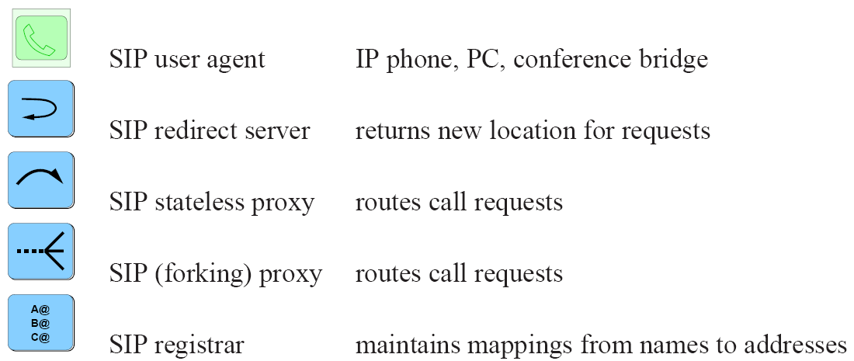
SIP Building Blocks
SIP user agent IP phone, PC, conference bridge
SIP registrar maps from names to addresses
SIP stateless proxy routes call requests
SIP redirect server returns new locations for requests
SIP (forking) proxy routes call requests
Notes:
To understand how SIP may be used for creating/ terminating/ modifying SIP sessions, it’s vital to understand their role inside any architecture that uses SIP.
SIP building blocks are five main entities shown above.

Slide 13
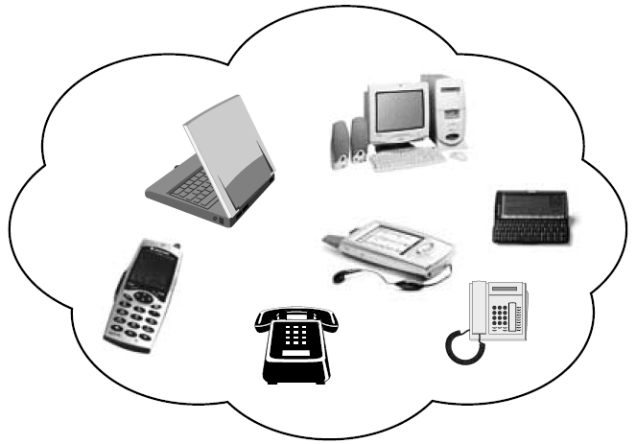

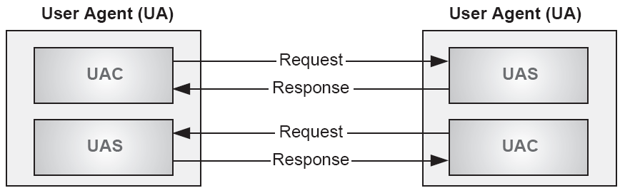
SIP User Agents
Notes:
User Agent (UA) is the SIP entity that interacts with the user. It usually has an interface towards the user. Say Bob wants to make a call over the Internet with his computer. He launches the proper program that contains a SIP
User Agent. The user interacts with the UA through the aforementioned interface—often a window with a selection of buttons. When Bob clicks the Call Laura button, the UA triggers the appropriate SIP messages to establish the call. Laura also has a SIP UA in her computer. When its UA receives the invitation from Bob’s, it alerts Laura by showing a pop-up window with two buttons: Accept call from Bob and Reject call from Bob. Depending on which button Laura clicks, her UA sends SIP messages back to Bob’s UA. All interactions between users and the SIP protocol are mediated by UAs. However, keep in mind that some systems using SIP are not directly connected to users. For example, Bob can redirect all session invitations received from midnight to 7 A.M. to his SIP answering machine. The machine will automatically establish sessions in order to record messages. It also contains a UA—one that does not necessarily maintain interaction with the user, but can still respond to invitations or forward invitations on Bob’s behalf. The lowly wake-up call is a good example of a session created automatically. The UA at the hotel reception is programmed to call the guest’s UA at time t.
Media Tools All in all, SIP delivers a session description to a SIP UA. If the session described is a voice session, the UA will have to deliver it to the
voice tool that will handle the audio. For other types of sessions, the UA will deliver the session to the proper media tool. SIP UAs are sometimes incorporated into the same user interface with media tools for the session. An audio/video session can’t be established without a SIP UA, an audio tool, and a video tool. If these three are combined under the same user interface, they appear as a single application to the user: a videoconference application. The separation between the SIP UA handling the delivery of a session description and the media tools actually handling the contents of the session description is powerful. This separation enables SIP to establish any type of session.
What Does a SIP User Agent Look Like? SIP UAs are implemented on top of many different systems. They can run, for instance, in a computer as one among many applications, or they can be implemented in a dedicated device, such as a SIP phone. The device type will not affect SIP. Media tools might vary from device to device depending on the type of sessions invoked, but the SIP behavior is always the same.
Nonetheless, from the user point of view, SIP devices can look very different from each other. This is because the user interface varies with the kind of device. The user interface of a videoconference program running on a computer will most likely be a window with a selection of buttons to click, but a SIP phone will probably resemble a traditional telephone with the buttons 0 through 9, *, and . SIP devices range from powerful computers accessing the Internet with a high-bandwidth connection to small devices with low-bit rate wireless connections. The figure above shows some examples. I should mention that work to adapt SIP for household appliances is ongoing. Therefore, future examples of devices with SIP User Agents could include refrigerators, toasters, and lamps. We are focusing on telephony examples because they are easier to understand and more immediately relevant for most readers; however, remember that SIP is powerful precisely because it can be used to establish any kind of session. Voice sessions are just one example.

Slide 14
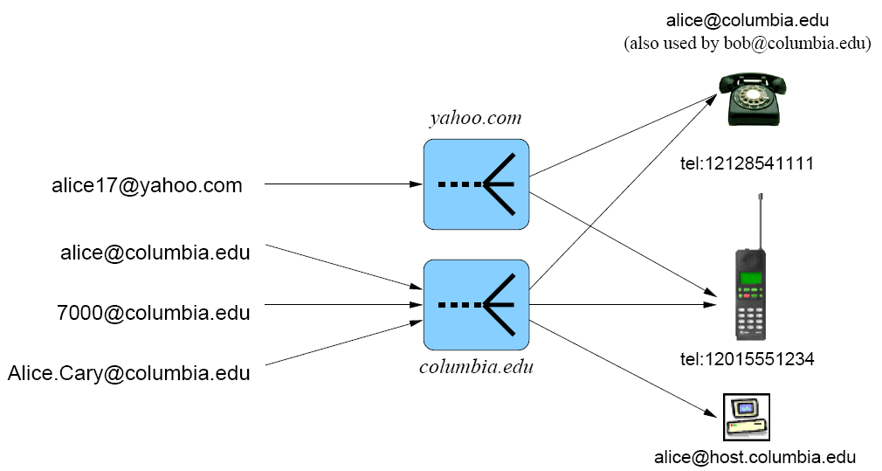
SIP Addresses
Notes:
SIP can’t deliver a session description to a potential participant until he or she has been located. Frequently, a single user might be reached at several locations. For instance, a student using a computer room in the university typically works on a different workstation every day. Thus, he or she is reachable at different Internet Protocol (IP) addresses depending on which computer is available and wants to receive incoming session invitations only at his or her current location. Another person might want, for instance, to receive session invitations on his or her workstation in the morning when the user arrives at the office, on his or her desktop at home in the evening, and on his or her mobile terminal when the user is traveling.
SIP URLs: We’ve already mentioned that SIP provides some user mobility. Users in a SIP environment are identified by SIP Uniform Resource Locators (URLs). The format of a SIP URL is similar to an e-mail address, generally consisting of a username and a domain name, which looks something like this: SIP:Bob.Johnson@company.com.
Registrations: We’ve noted that users register their current location to a server if they wish to be found. In this example, Bob is working on his laptop, whose IP address is 131.160.1.112. His login name is Bob. He registers his current position with the company server. Now Laura wants to call Bob. She has his public SIP address (SIP:Bob.Johnson@company.com) because it’s printed on his business card.
In this situation, SIP provides two modes of operation: redirect and proxy. In the proxy mode of operation, the server contacts Bob at 131.160.1.112 and delivers Laura’s session description to him. In the redirect mode, the server tells Laura to try SIP:Bob@131.160. 1.112 instead.
A user may very well register several locations at one server. Or the user might register his or her locations with several servers. It’s not unusual for various servers and locations to be contacted before a user is finally reached.

Slide 15
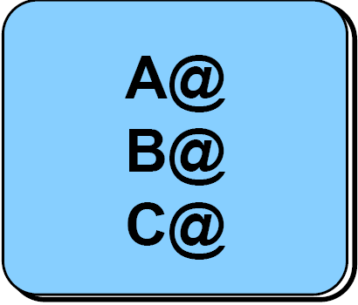

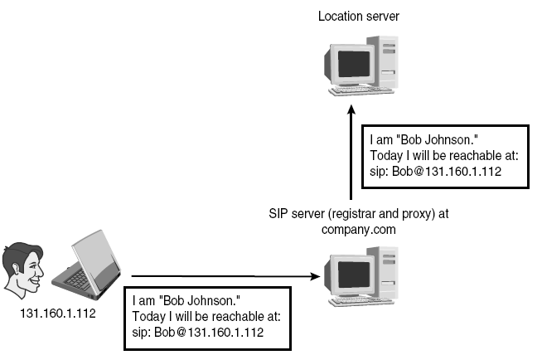
SIP Registrar/ Location Server
?
Notes:
Registrar refers to a SIP server accepting registrations. A registrar is usually co-located with a redirect server or a proxy server (Figure 4-13).
Location servers are not SIP entities, but they are an important part of any architecture that uses SIP. A location server stores and returns possible locations for users. It can make use of information from registrars or from other databases. Most registrars upload location updates to a location server upon receipt. The figure above shows how this is done. The proxy server at company.com consults a location server for a SIP URL where Bob might be reachable. The location server can provide the server with this information because the registrar previously uploaded it. However, SIP is not used between location servers and SIP servers. Some location servers use Lightweight Directory Access Protocol (LDAP) [RFC 1777] to communicate with SIP servers.

Slide 16
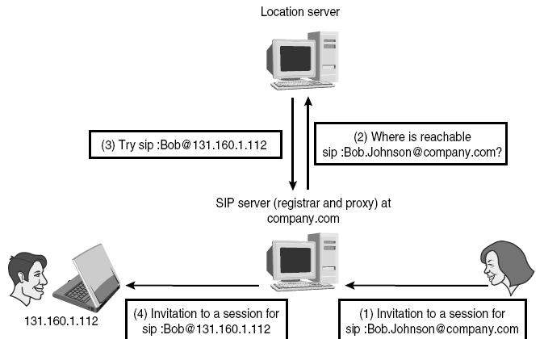
SIP Registrar/ Location Server
?
SIP is not used to query location server; LDAP is used instead

Slide 17

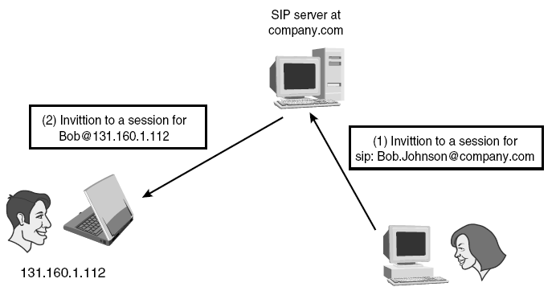
SIP Proxy Server
Notes:
Let us assume now that the domain company.com has a proxy server handling incoming invitations. When Laura’s UA tries SIP:Bob.Johnson@ company.com, it will reach the proxy server at company.com, which will promptly try SIP:Bob@university.com on behalf of Laura’s UA. If domain university.com also has a proxy server, it will try SIP:Bob@workstation1234. university.com, where Bob is finally reached. In this scenario, Laura’s UA tries only one location, but several proxies are in the path between UAs.
Forking Proxies When a proxy server tries more than one location for the user, it is said to fork the invitation. Forking proxies can perform parallel
or sequential searches depending on their configuration. A parallel search consists of trying all of the possible locations at the same time, whereas a sequential search consists of trying each location individually.
Group Addresses Proxy servers also create group addresses. In a future slide, we will show a forking proxy receiving an invitation for SIP:sales@company.com and trying all persons in the sales department until it finds one who is available.

Slide 18
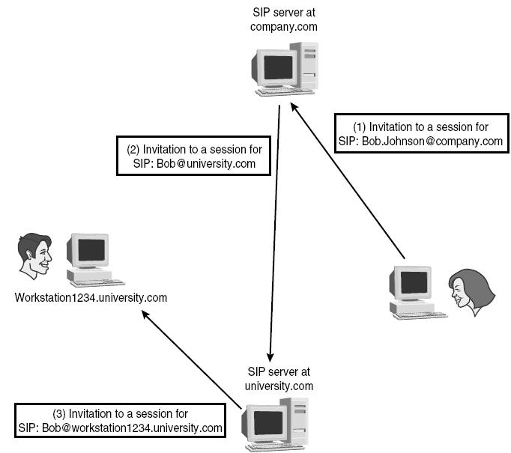
SIP Proxy/ Redirect Server

Slide 19
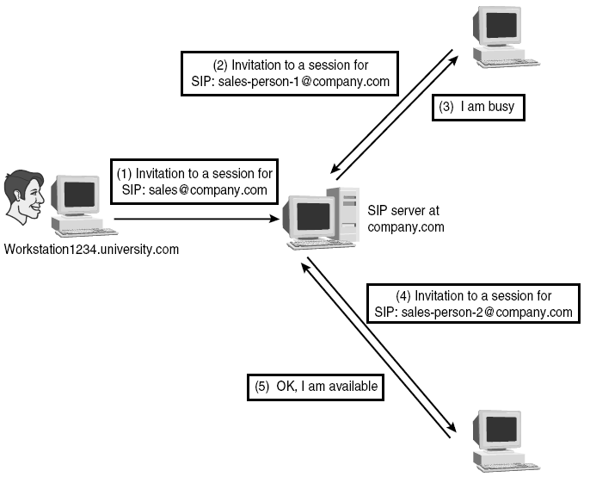
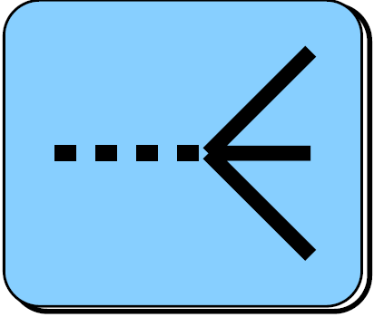
SIP Forking Proxy Scenario

Slide 20
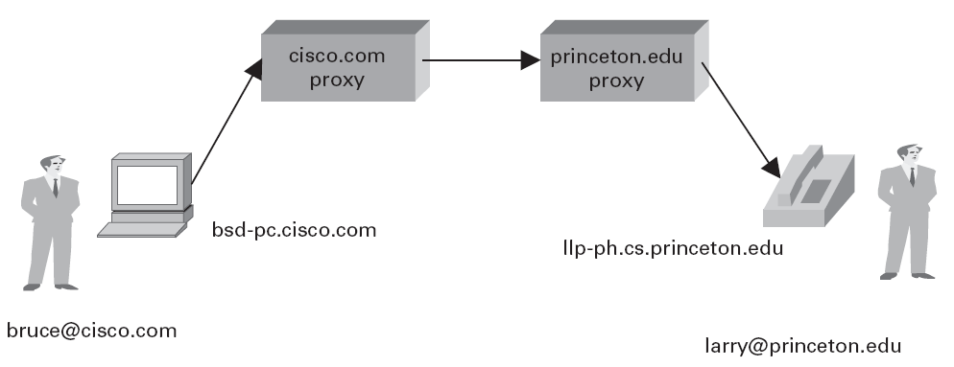
SIP Operation

Slide 21
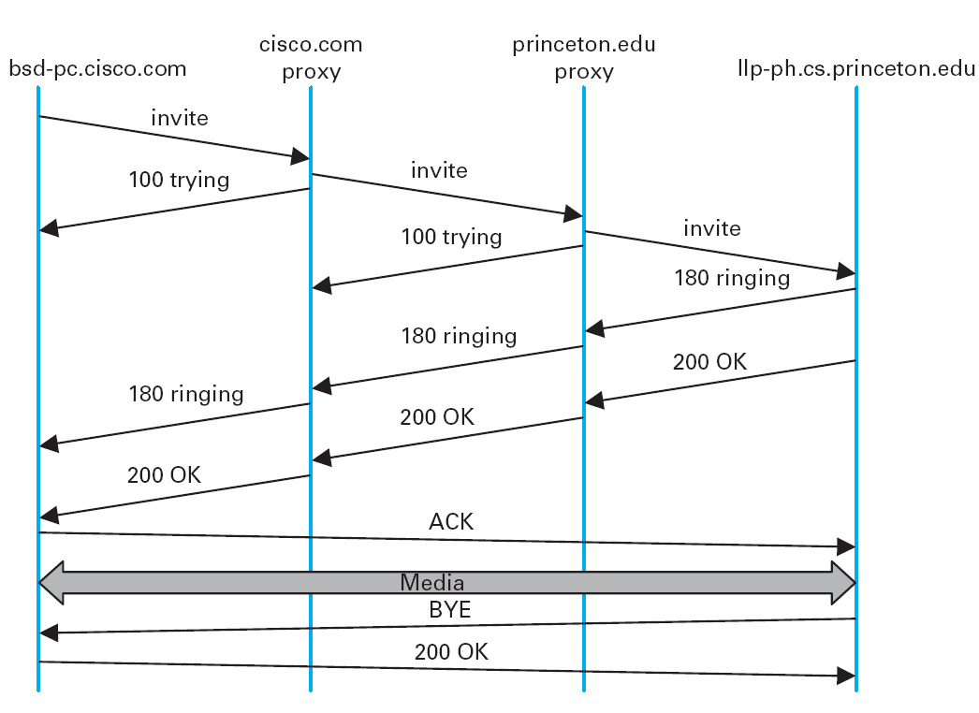
SIP Operation

Slide 22
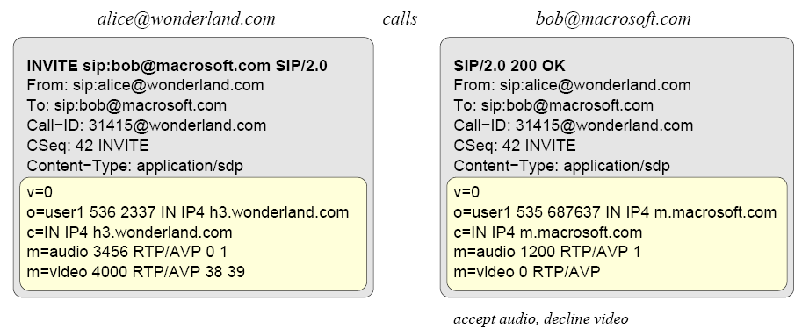
SIP Invitation/ and
Media Negotiation
Notes:
Session Description Protocol:
v = version
o = originator and session identifier (user1, e.g., is the originator, 536 and 2337 for Alice is a number unique to Alice’s machine and the sequence number of this SDP update, respectively)
c = IP multicast address to which stream will be sent
m = media
Audio and Video media is supported at Alice’s machine at port 3456 and 4000 respectively (using RTP’s AVP profile)
Call-ID The Call-ID represents a SIP signaling relationship shared among two or more users. It identifies a particular invitation and all of the subsequent transactions related to that invitation in a format that looks like the following:
Call-ID: ges456fcdw21lkfgte12ax@workstation1234.university.com
A server that is juggling SIP signalling for many sessions employs Call-ID to associate incoming messages to the proper session. For instance, Bob invites Laura to a chess session with a particular Call-ID. Laura’s UA accepts and soon the game commences. After a while, Bob calls Laura to speak with her while they are still playing chess. This INVITE from Bob’s UA has a different Call-ID from the previous one. When Bob and Laura finish speaking, Bob’s UA sends a BYE to Laura’s UA to end the phone call. Laura’s UA uses the Call-ID of the BYE message to decide whether to terminate the chess game or the conversation
Contact A Contact header provides a URL where the user can be reached directly. This feature is important because it offloads SIP servers that do not need to be in the signalling path after routing the first INVITE. For instance, Laura calls Bob at SIP:Bob.Johnson@company.com. Company. com’s proxy forwards the INVITE to SIP:Bob@131.160.1.112, where Bob turns out to be. He accepts the call. Bob’s UA returns a 200 OK response with a Contact header:
Contact: Bob Johnson <sip:Bob@131.160.1.112>
When Laura’s UA receives this 200 OK response, it sends the ACK to Bob’s UA. Because Bob’s location can be found in the contact header, the ACK is sent directly to SIP:Bob@131.160.1.112 and the ACK does not traverse the proxy at company.com.

Slide 23
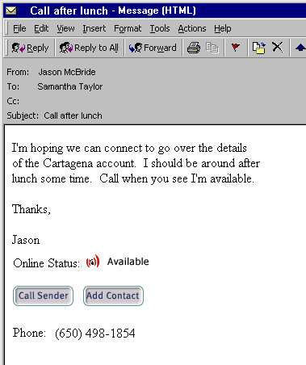
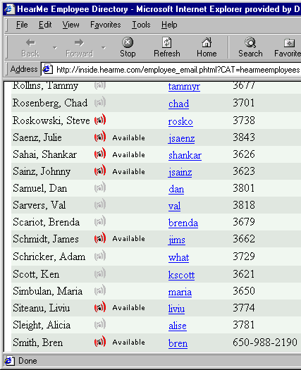

SIP Applications

Slide 24
IP Multimedia Subsystem (IMS)
Notes:
Just like the traditional applications of the previous section, multimedia applications such as audio- and videoconferencing applications need application-layer protocols. Much of the initial experience in designing protocols for multimedia applications came from the “MBone tools”—applications such as vat and vic that were developed for use on the MBone, using IP multicast to enable multiparty conferencing. Initially, each application implemented its own protocol (or protocols), but it became apparent that many multimedia applications have common requirements. This ultimately led to the development of a number of general-purpose protocols for use by multimedia applications.
We have already seen one protocol that is of general use to multimedia applications in the form of RSVP (see Section 6.5.2.) That protocol can be used to request the allocation of resources in the network so that the desired quality of service (QoS) can be provided to an application. In addition to a QoS signalling protocol, many multimedia applications also need some sort of transport protocol, with rather different characteristics than TCP and with more functionality than UDP. The protocol that has been developed to meet those needs is called the Real-time Transport Protocol (RTP), described below.
A third class of protocol that many multimedia applications need is a session control protocol. For example, suppose that we wanted to be able to make IP-based
telephone calls across the Internet. We would need some mechanism to notify the intended recipient of such a call that we wanted to talk to her, for example, by sending a message to some multimedia device that would cause it to make a ringing sound.We would also like to be able to support features like call forwarding, three-way calling, and so on. SIP (Session Initiation Protocol) and H.323 are examples of protocols that address the issues of session control

Slide 25
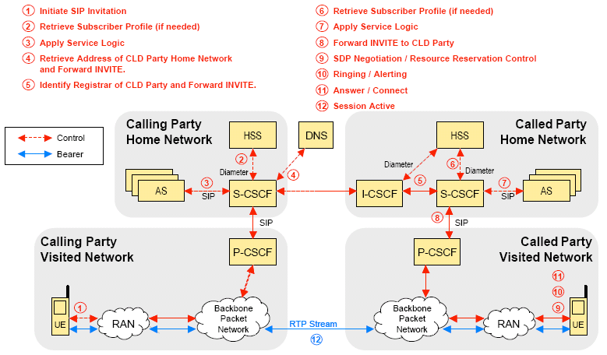
IP Multimedia Subsystem (IMS)

Slide 26

References
Chapter 9.3:
Applications[P&D]

Slide 27
?
?
Questions/ Confusions?
?
Use the discussion forum at:
http://compnets.ning.com/
Credits/ Acknowledgement at:
http://sites.google.com/site/cse320site/

