Slide 1
Topic 2: Direct Link Network
Lecture
1
Link-layer Basics
Ethernet LAN technology
datagram
Link layer protocol
Adapter
Adapter
frame
frame
Sender
Receiver
Notes:
Credit: Jennifer Ruxford

Slide 2
Network’s definition
Recap
A network can be defined recursively as two or more nodes connected by a physical link, or by two or more networks connected by one or more nodes.
Notes:
Networks of any size can be built using the two building blocks: links and nodes

Slide 3
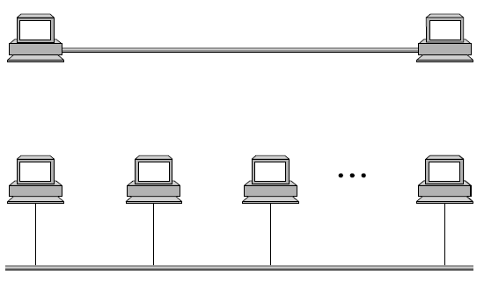
Nodes /Links
Recap
Nodes that utilize the network
Hosts, PCs, etc.
Notes:
Nodes are often general-purpose computers, like a desktop workstation, a multiprocessor, or a PC. For our purposes, let’s assume it’s a workstation-class machine. This workstation can serve as a host that users run application programs on.

Slide 4
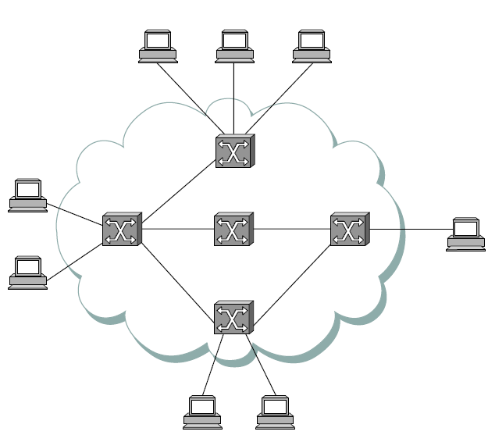
Nodes /Links
Recap
Nodes implementing the network
Switches/ Routers, etc.
Notes:
Nodes might also be used inside the network as a switch that forwards messages from one link to another, or it might be configured as a router that forwards internet packets from one network to another. In some cases, a network node—most commonly a switch or router inside the network, rather than a host—is implemented by special-purpose hardware.

Slide 5
Nodes/ Links
Recap
Point to Point Link
Multiple-access Link
Notes:
Link: Physical medium; Physical medium can be electromagnetic waves (i.e., wireless).
These are example of direct link networks, where nodes are directly connected through physical medium. No packet switches are used, and we postpone the discussion of switched networks to Topic 3.

Slide 6
Topic’s objectives
To find out the answers to:
1 - How to use nodes and links as building blocks of creating scalable direct-link networks ?
2 - How the Ethernet LAN technology works ?

Slide 7
Fundamental issues in
Data-link networks

Slide 8
Fundamental data-link problems
Encoding
Framing
Error detection
Reliable delivery
Access Mediation
Notes:
Courtesy: Textbook – Peterson and Davie
The first step in turning nodes and links into usable building blocks is to understand how to connect them in such a way that bits can be transmitted from one node to the other. Since it is actually signals that propagate over physical links, the task is to encode the binary data that the source node wants to send
into the signals that the links are able to carry, and then to decode the signal back into the corresponding binary data at the receiving node. We ignore the details of modulation and assume we are working with two discrete signals: high and low. In practice, these signals might correspond to two different voltages on a copper-based link, or two different power levels on an optical link.

Slide 9
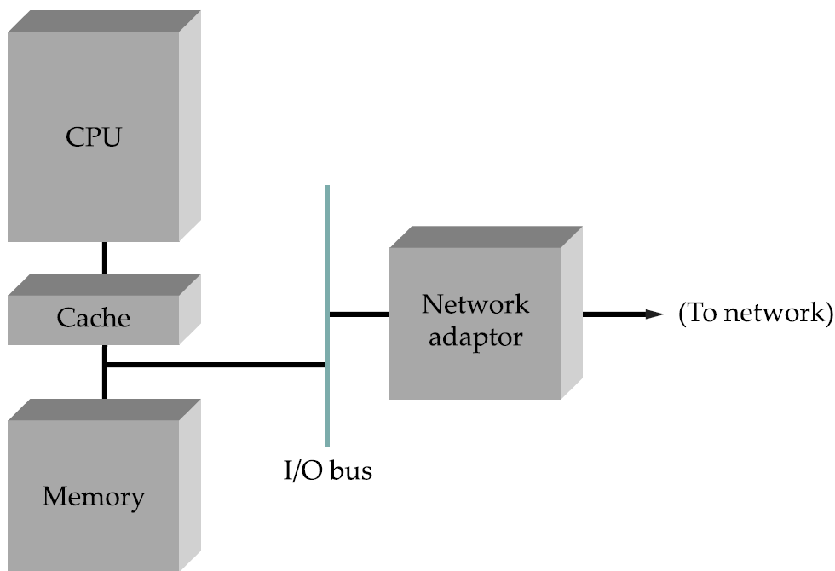
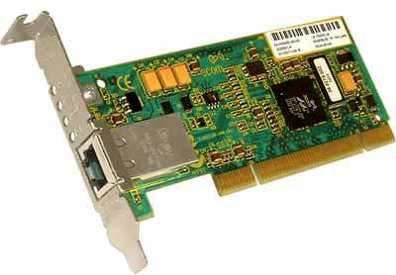
Network Adapter
Responsible for the mentioned link-layer tasks
Also, called Network Interface Card (NIC)
Notes:
Each node connects to the network via a network adaptor. This adaptor generally sits on the system’s I/O bus and delivers data between the workstation’s memory and the network link. A software module running on the workstation—the device driver—manages this adaptor. It issues commands to the adaptor, telling it, for example, from what memory location outgoing data should be transmitted and into what memory location incoming data should be stored.

Slide 10
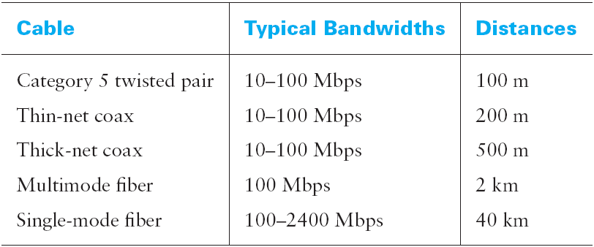
Which transmission link to use?
Wired LAN
Notes:
If the nodes you want to connect are in the same room, in the same building, or even on the same site (e.g., a campus), then you can buy a piece of cable and physically string it between the nodes. Exactly what type of cable you choose to install depends on the technology you plan to use to transmit data over the link.
Of these, Category 5 (Cat-5) twisted pair—it uses a thicker gauge than the twisted pair you find in your home—is quickly becoming the within-building norm. Because of the difficulty and cost in pulling new cable through a building, every effort is made to make new technologies use existing cable; Gigabit Ethernet, for example, has been designed to run over Cat-5 wiring. Fiber is typically used to connect buildings at a site.

Slide 11
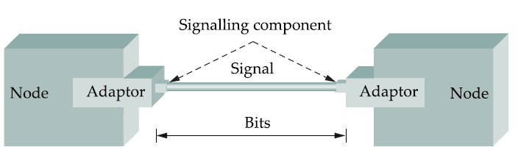
Encoding
How to encode bits into signals that the link can carry
Notes:
It is the signals that actually propagate over physical links. The task, therefore, is to encode the binary data that the source node wants to send into the signals that the links are able to carry, and then to decode the signal back into the corresponding binary data at the receiving node. We ignore the details of modulation and assume we are working with two discrete signals: high and low. In practice, these signals might correspond to two different voltages on a copper-based
link, or two different power levels on an optical link.
As we have said, most of the functions discussed in this chapter are performed by a network adaptor—a piece of hardware that connects a node to a link. The network adaptor contains a signalling component that actually encodes bits into signals at the sending node and decodes signals into bits at the receiving node. Thus, as illustrated in the figure above, signals travel over a link between two signalling components, and bits flow between network adaptors.
We will come back to Encoding again in future lectures.

Slide 12
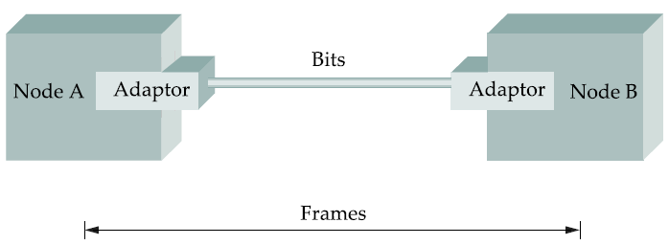
Framing
Notes:
Now that we have seen (when we studied encoding) how to transmit a sequence of bits over a point-to-point link—from adaptor to adaptor—let’s consider the scenario illustrated in the figure above.
Since we are focusing on packet-switched networks in this course [which means that blocks of data (called frames at this level), not bit streams, are exchanged between nodes]. It is the network adaptor that enables the nodes to exchange frames. When node A wishes to transmit a frame to node B, it tells its adaptor to transmit a frame from the node’s memory. This results in a sequence of bits being sent over the link. The adaptor on node B then collects together the sequence of bits arriving on the link and deposits the corresponding frame in B’s memory. Recognizing exactly what set of bits constitutes a frame—that is, determining where the frame begins and ends—is the central challenge faced by the adaptor.

Slide 13
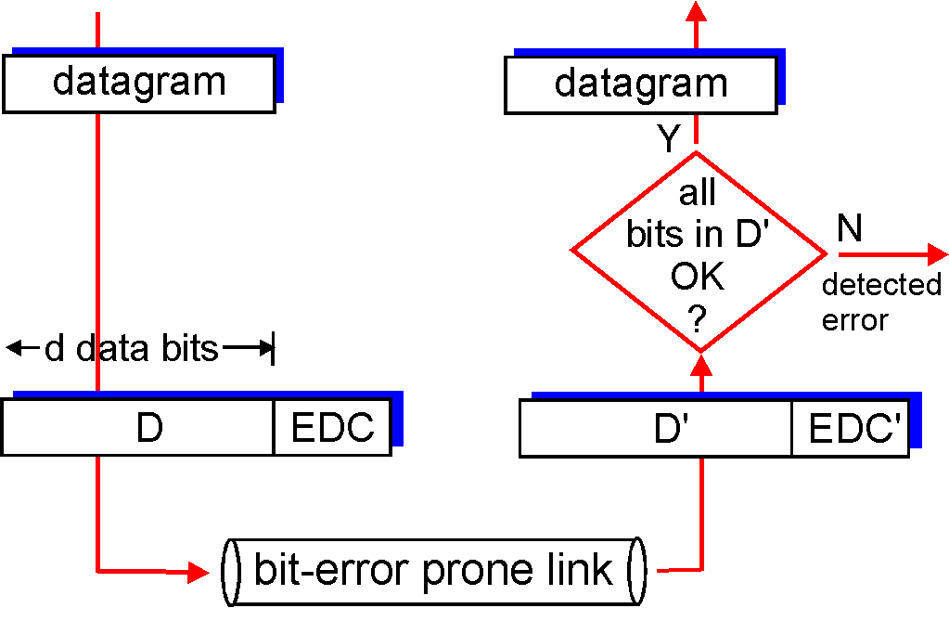
Error Detection
Basic mechanism is to add redundancy to determine errors.
Notes:
As discussed in a previous lecture, bit errors (and burst errors) are sometimes introduced into frames. This happens, for example, because of electrical interference or thermal noise. Although errors are rare, especially on optical links, some mechanism is needed to detect these errors so that corrective action can be taken.
There is a long history of techniques for dealing with bit errors in computer systems, dating back to Hamming and Reed/Solomon codes that were developed
for use when storing data on magnetic disks and in early core memories. We will study error detection techniques most commonly used in networking.
Detecting errors is only one part of the problem. The other part is correcting errors once detected. There are two basic approaches that can be taken when the
recipient of a message detects an error. One is to notify the sender that the message was corrupted so that the sender can retransmit a copy of the message. If bit errors are rare, then in all probability the retransmitted copy will be error-free. Alternatively, there are some types of error detection algorithms that allow the recipient to reconstruct the correct message even after it has been corrupted; such algorithms rely on error-correcting codes.
One of the most common techniques for detecting transmission errors is a technique known as the cyclic redundancy check (CRC). It is used in nearly all the link-level protocols we will discuss including Ethernet LANs and Token Ring LANs.
The basic idea behind any error detection scheme is to add redundant information to a frame that can be used to determine if errors have been introduced. In the extreme, we could imagine transmitting two complete copies of the data. If the two copies are identical at the receiver, then it is probably the case that both are correct. If they differ, then an error was introduced into one (or both) of them, and they must be discarded. This is a rather poor error detection scheme for two reasons. First, it sends n redundant bits for an n-bit message. Second, many errors will go undetected—any error that happens to corrupt the same bit positions in the first and second copies of the message.
Fortunately, we can do a lot better than this simple scheme. In general, we can provide quite strong error detection capability while sending only k redundant bits for an n-bit message, where k ≪ n. On an Ethernet, for example, a frame carrying up to 12,000 bits (1500 bytes) of data requires only a 32-bit CRC code, or as it is commonly expressed, uses CRC-32.
We say that the extra bits we send are redundant because they add no new information to the message. Instead, they are derived directly from the original message using some well-defined algorithm. Both the sender and the receiver know exactly what that algorithm is. The sender applies the algorithm to the message to generate the redundant bits. It then transmits both the message and those few extra bits. When the receiver applies the same algorithm to the received message, it should (in the absence of errors) come up with the same result as the sender. It compares the result with the one sent to it by the sender. If they match, it can conclude (with high likelihood) that no errors were introduced in the message during transmission. If they do not match, it can be sure that either the message or the redundant bits were corrupted, and it must take appropriate action, that is, discarding the message, or correcting it if that is possible.

Slide 14
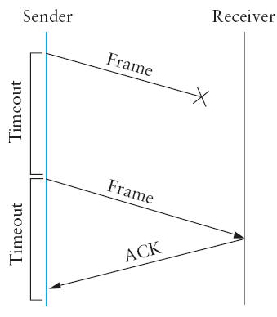
Reliable Transmission
Fundamental mechanisms:
Acknowledgements
Timeouts
Automatic Repeat Request (ARQ)
Notes:
As we saw in the previous section, frames are sometimes corrupted while in transit, with an error code like CRC used to detect such errors. While some error codes are strong enough also to correct errors, in practice the overhead is typically too large to handle the range of bit and burst errors that can be introduced on a network link. Even when error-correcting codes are used (e.g., on wireless links), some errors will be too severe to be corrected. As a result, some corrupt frames must be discarded. A link-level protocol that wants to deliver frames reliably must somehow recover from these discarded (lost) frames.
This is usually accomplished using a combination of two fundamental mechanisms—acknowledgments and timeouts. An acknowledgment (ACK for short)
is a small control frame that a protocol sends back to its peer saying that it has received an earlier frame. By control frame we mean a header without any data, although a protocol can piggyback an ACK on a data frame it just happens to be sending in the opposite direction. The receipt of an acknowledgment indicates to the sender of the original frame that its frame was successfully delivered. If the sender does not receive an acknowledgment after a reasonable amount of time, then it retransmits the original frame. This action of waiting a reasonable amount of time is called a timeout. The general strategy of using acknowledgments and timeouts to implement reliable delivery is sometimes called automatic repeat request (normally abbreviated ARQ).

Slide 15
Shared access networks:
Ethernet
Notes:
Ethernet is the most famous example of LAN technology. Developed in mid-70s at the Xerox Palo Alto Research Center (PARC), the Ethernet is a working example of a more general class of shared access LANs that operate on the Carrier Sense on Multiple Access – Collision Detection technology.
Ethernet is like a bus with multiple stations plugged into it. The ‘carrier sense’ means that all the nodes can distinguish between idle and a busy link, and ‘collision detect’ means that a node listen as it transmits and can therefore detect when a frame it is transmitting has interfered (collided) with a frame transmission by another node.
Ethernet has its root in an early packet radio network called Aloha developed at the University of Hawaii. Like the Aloha network, the fundamental problem in Ethernet is how to mediate access to the shared medium. In Aloha, the medium is atmosphere, and in Ethernet the medium is a coax cable.
Thus the core idea in both Ethernet and Aloha is an algorithm that controls when each node can transmit.
Digital Equipment Corporation, Intel and Xerox defined a 10 Mbps standard in 1978. This standard formed the basis of the Ethernet standard.

Slide 16

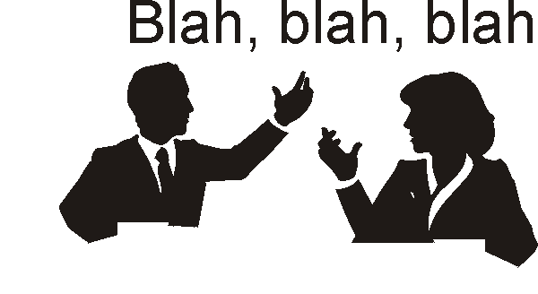
Example Multiple Access Links
Shared RF
(e.g., 802.11 WiFi)
Shared wire
(e.g., cabled Ethernet)
Shared acoustical waves
(Humans at a party)
Shared RF (satellite)

Slide 17
Different approaches to MAC
Three broad classes:
Channel Partitioning
Divide channel into smaller “pieces” (time slots, frequency, code) and allocate for exclusive use
Random Access
Channel not divided, allow (and recover from) collisions
“Taking turns”
Nodes use tokens to share the media
Notes:
Example of sharing the media through channel partitioning is FDM/ TDM and CDMA. They allocated fixed slots/ frequencies/ codes to users and therefore are fair. By ‘fair’ it means that a single user cannot take control of the media depriving others of the right to access it.
Examples of ‘Random Access’ MAC is Aloha, CSMA, CSMA/ CD and CSMA/ CA.
Example of ‘Taking turns’ is Token Ring. Such algorithms are fair in that all users get to access the media after some time (a single node cannot hog all the channel for extended times). It is also deterministic as the time it will take a node to get the token back can be determined a priori.

Slide 18
Random Access Protocol
When node has packet to send
transmit at full channel data rate R.
no a priori coordination among nodes
Random access MAC protocol specifies:
how to detect collisions
how to recover from collisions (e.g., via delayed retransmissions)
Examples of random access MAC protocols:
ALOHA; CSMA/CD, CSMA/CA

Slide 19




Ethernet Standardization
802.3 Standard
10 Mbps – Ethernet
100 Mbps – Fast Ethernet
1 Gbps – Gigabit Ethernet
Notes:
Digital Equipment Corporation (DEC) and Intel Corporation joined Xerox to define the initial 10 Mbps Ethernet standard in 1978. This standard then formed the basis for IEEE 802.3 standard.
With one exception (type and length field), the 1978 Ethernet standard can be thought of as a proper subset of the 802.3 standard. 802.3, in addition, defines a much wider collection of physical media over which Ethernet can operate and more recently, it has been extended to include a 100 Mbps standard known as Fast Ethernet, and a 1000 Mbps version known as Gigabit Ethernet.
With the introduction of Gigabit Ethernet, what started as a LAN technology has now had its reach extended to distances that make Ethernet a metropolitan-area and even a wide-area networking standard (since Gigabit Ethernet uses OFC that has a higher range).
In the book, we cover 10 Mbps Ethernet since it is typically used in multi-access mode and we are interested in knowing how multiple hosts share a single link. Both 100 Mbps and 1 Gbps Ethernets are to be used in full duplex, point to point configuration which mean they typically use switched networks.

Slide 20
CSMA/CD (Collision Detection)
CSMA/CD: carrier sensing, collision detection
“Collisions” detected within short time
Colliding transmissions aborted
Human analogy: the polite conversationalist
Collision detection:
Easy in wired LANs (used in Ethernet)
Difficult (and therefore not used) in wireless LANs
Notes:
CSMA/CA is derived from CSMA/CD (Collision Detection), which is the base of Ethernet.
The main difference is the collision avoidance : on a wire, the transceiver has the ability to listen while transmitting and so to detect collisions (with a wire all transmissions have approximately the same strength). But, even if a radio node could listen on the channel while transmitting, the strength of its own transmissions would mask all other signals on the air. So, the protocol can't directly detect collisions like with Ethernet and only tries to avoid them.

Slide 21
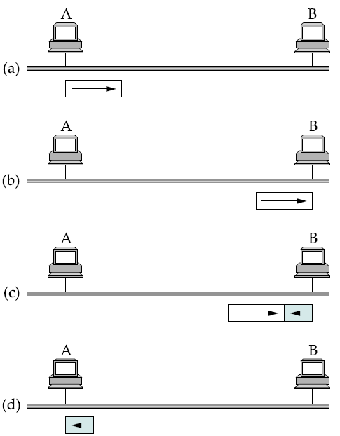
How do collisions occur?
Propagation delay: d

Slide 22
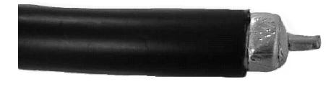
Thicknet – 10Base5
Controller
Vampire Tap
Ethernet Bus
Transceiver
Segment length < 500m
Notes:
An Ethernet segment is implemented on a coaxial cable of up to 500 m. This cable is similar to the type used for cable TV, except that it typically has an impedance of 50 ohms instead of cable TV’s 75 ohms. Hosts connect to an Ethernet segment by tapping into it; taps must be at least 2.5 m apart. A transceiver—a small device directly attached to the tap—detects when the line is idle and drives the signal when the host is transmitting. It also receives incoming signals. The transceiver is, in turn, connected to an Ethernet adaptor, which is plugged into the host. All the logic that makes up the Ethernet protocol, as described in this section, is implemented in the adaptor (not the transceiver).
Vampire Tap is also called a Media Access Unit (MAU) and it’s called a Vampire Tap since it connects to the cable by simply puncturing the cable with a sharp prong that extends into the cable until it makes contact with the central conductor (From: Tomasi’s book)

Slide 23
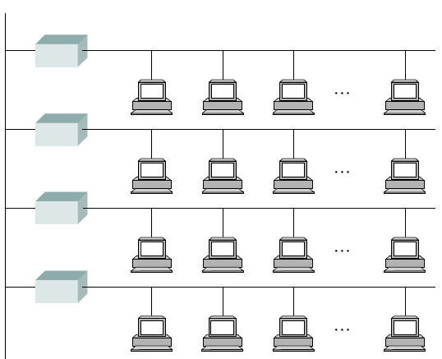
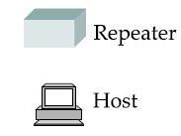
Ethernet Repeater
Max Segment length: 500 m
Notes:
Multiple Ethernet segments can be joined together by repeaters. A repeater is a device that forwards digital signals, much like an amplifier forwards analog signals. However, no more than four repeaters may be positioned between any pair of hosts, meaning that an Ethernet has a total reach of only 2500 m.
An Ethernet is limited to supporting a maximum of 1024 hosts
Any signal placed on the Ethernet by a host is broadcast over the entire network; that is, the signal is propagated in both directions, and repeaters forward the signal on all outgoing segments. Terminators attached to the end of each segment absorb the signal and keep it from bouncing back and interfering with trailing signals.

Slide 24
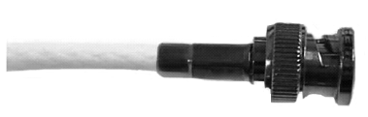

Thinnet – 10Base2
Transceiver
Controller
BNC T-Junction
Ethernet Bus
Segment length < 200m
Notes:
In addition to the system of segments and repeaters just described, alternative technologies have been introduced over the years. For example, rather than using a 50-ohm coax cable, an Ethernet can be constructed from a thinner cable known as 10Base2; the original cable is called 10Base5 (the two cables are commonly called thin-net and thick-net, respectively). The “10” in 10Base2 means that the network operates at 10 Mbps, “Base” refers to the fact that the cable is used in a baseband system, and the “2” means that a given segment can be no longer than 200 m (a segment of the original 10Base5 cable can be up to 500 m long).
Because the cable is so thin, you do not tap into a 10Base2 or 10BaseT cable in the same way as you would with 10Base5 cable. With 10Base2, a T-joint is spliced into the cable. In effect, 10Base2 is used to daisy-chain a set of hosts together.

Slide 25
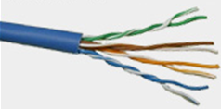
Twisted Pair – 10BaseT
Controller
Segment length < 100m
Hub: multi-port repeater
Notes:
Today, a third cable technology is predominantly used, called 10BaseT, where the “T” stands for twisted pair. Typically, Category 5 twisted pair wiring is used. A 10BaseT segment is usually limited to under 100 m in length. (Both 100-Mbps and 1000-Mbps Ethernets also run over Category 5 twisted pair, up to distances of 100 m.)
With 10BaseT, the common configuration is to have several point-to-point segments coming out of a multi-way repeater, sometimes called a hub, as illustrated in Figure 2.26. Multiple 100-Mbps Ethernet segments can also be connected by a hub, but the same is not true of 1000-Mbps segments.

Slide 26
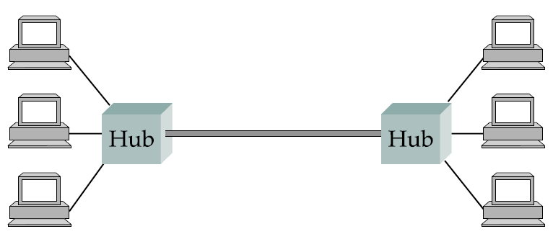
Ethernet Hub
Single collision domain
Notes:
It is important to understand that whether a given Ethernet spans a single segment, a linear sequence of segments connected by repeaters, or multiple segments connected in a star configuration by a hub, data transmitted by any one host on that Ethernet reaches all the other hosts. This is the good news. The bad news is that all these hosts are competing for access to the same link, and as a consequence, they are said to be in the same collision domain.

Slide 27
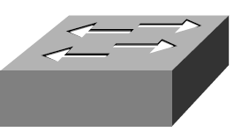
Ethernet Switch
Collision domain
Collision domain
Bridge/ Switch
To be studied when we get to Packet Switching (Topic 3)

Slide 28
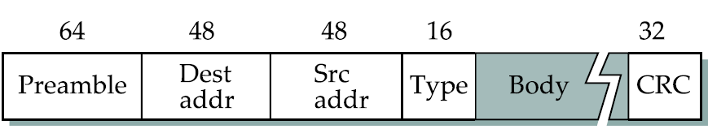
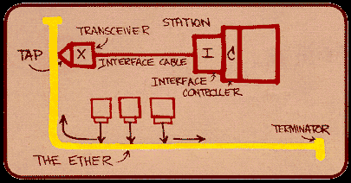
MAC protocol
Metcalfe’s Original Ethernet Sketch
Notes:
We now turn our attention to the algorithm that controls access to the shared Ethernet link. This algorithm is commonly called the Ethernet’s media access control (MAC). It is typically implemented in hardware on the network adaptor. We will not describe the hardware per se, but instead focus on the algorithm it implements. First, however,
we describe the Ethernet’s frame format and addresses.
Frame Format
Each Ethernet frame is defined by the format given in Figure 2.27. The 64-bit preamble allows the receiver to synchronize with the signal; it is a sequence of alternating 0s and 1s. Both the source and destination hosts are identified with a 48-bit address. The packet type field serves as the demultiplexing key; that is, it identifies to which
of possibly many higher-level protocols this frame should be delivered. Each frame contains up to 1500 bytes of data. Minimally, a frame must contain at least 46 bytes of data, even if this means the host has to pad the frame before transmitting it. The reason for this minimum frame size is that the frame must be long enough to detect a collision; we discuss this more below. Finally, each frame includes a 32-bit CRC. Like the HDLC protocol described in Section 2.3.2, the Ethernet is a bit-oriented framing protocol. Note that from the host’s perspective, an Ethernet frame has a 14-byte header: two 6-byte addresses and a 2-byte type field.
The frame format shown above is taken from the Digital-Intel-Xerox Ethernet standard. The 802.3 frame format is exactly the same, except it substitutes a 16-bit length field for the 16-bit type field. 802.3 is usually paired with an encapsulation standard that defines a type field used to demultiplex incoming frames. This type field is the first thing in the data portion of the 802.3 frames; that is, it immediately follows the 802.3 header.

Slide 29
MAC Address
MAC Address: 48 bits (Ethernet)
Organizationally Unique Identifier (initial 24 bits) ensures that MAC addresses are unique
Every Ethernet host has a unique address
Flat addressing -> does not facilitate routing
ff-ff-ff-ff-ff-ff -> link-layer broadcast address
Notes:
Each host on an Ethernet—in fact, every Ethernet host in the world—has a unique
Ethernet address. Technically, the address belongs to the adaptor, not the host; it is
usually burned into ROM. Ethernet addresses are typically printed in a form humans
can read as a sequence of six numbers separated by colons. Each number corresponds
to 1 byte of the 6-byte address and is given by a pair of hexadecimal digits, one for each
of the 4-bit nibbles in the byte; leading 0s are dropped. For example, 8:0:2b:e4:b1:2 is
the human-readable representation of Ethernet address
00001000 00000000 00101011 11100100 10110001 00000010

Slide 30
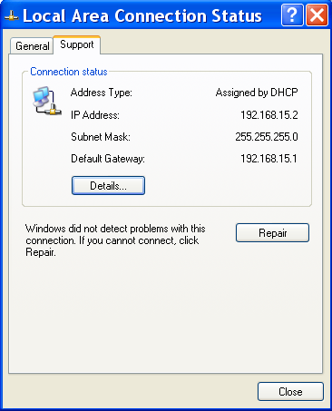
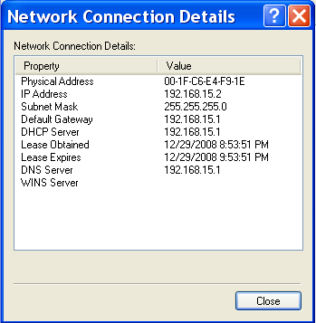
Receiver Algorithm at NIC
An Ethernet NIC receives all frames but accepts:
Frames addressed to its own address
Frames addressed to the broadcast address
Frames addressed to a multicast address, if instructed to listen to that address
All frames, if placed in promiscuous mode

Slide 31
Transmit Algorithm: CSMA/ CD
If NIC senses channel idle, starts transmission
If NIC senses channel busy, waits until channel idle, then transmits
If NIC transmits entire frame detecting no another transmission, NIC is done with frame.

Slide 32
Transmit Algorithm: CSMA/ CD
If NIC detects another transmission while transmitting, aborts and sends jam signal
After aborting, NIC enters exponential backoff: after mth collision, K is chosen randomly from {0,1,2,…,2^{m}-1}. NIC waits K·512 bit times, returns to Step 1.

Slide 33
Recovery from Collisions
Exponential Backoff:
Goal: adapt retransmission attempts to estimated current load
heavy load: random wait will be longer
first collision: choose K from {0,1}; delay is K x 512 bit transmission times
after second collision: choose K from {0,1,2,3}
after ten collisions: choose K from {0,1,2,3,4,…,1023}

Slide 34
Collisions – worst case scenario
Propagation delay: d
A sends a frame at t
A’s frame arrives at B
at t + d
B sends a frame at t +d causing a collision
B’s runt (32 bit) arrives at A at t+2d
Notes:
The figure above illustrates the worst-case scenario, where hosts A and B are at opposite ends of the network. Suppose host A begins transmitting a frame at time t, as shown in (a). It takes it one link latency (let’s denote the latency as d) for the frame to reach host B. Thus, the first bit of A’s frame arrives at B at time t +d, as shown in (b). Suppose an instant before host A’s frame arrives (i.e., B still sees an idle line), host B begins to transmit its own frame. B’s frame will immediately collide with A’s frame, and this collision will be detected by host B (c). Host B will send the 32-bit jamming sequence, as described above. (B’s frame will be a runt.) Unfortunately, host A will not know that the collision occurred until B’s frame reaches it, which will happen one link latency later, at time t+2×d, as shown in (d). Host A must continue to transmit until this time in order to detect the collision. In other words, host A must transmit for 2×d to be sure that it detects all possible collisions.
Considering that a maximally configured Ethernet is 2500 m long, and that there may be up to four repeaters between any two hosts, the round-trip delay has been determined to be 51.2 μs, which on a 10-Mbps Ethernet corresponds to 512 bits.

Slide 35
Minimum sized Ethernet frame
Propagation delay: d
An Ethernet station must transmit for at least 2d time to be able to detect a collision
The maximum RTT for 10Base5 is 51.2 us;
therefore min frame size = 512 bits (64 bytes)
Notes:
The figure above illustrates the worst-case scenario, where hosts A and B are at opposite ends of the network. Suppose host A begins transmitting a frame at time t, as shown in (a). It takes it one link latency (let’s denote the latency as d) for the frame to reach host B. Thus, the first bit of A’s frame arrives at B at time t +d, as shown in (b). Suppose an instant before host A’s frame arrives (i.e., B still sees an idle line), host B begins to transmit its own frame. B’s frame will immediately collide with A’s frame, and this collision will be detected by host B (c). Host B will send the 32-bit jamming sequence, as described above. (B’s frame will be a runt.) Unfortunately, host A will not know that the collision occurred until B’s frame reaches it, which will happen one link latency later, at time t+2×d, as shown in (d). Host A must continue to transmit until this time in order to detect the collision. In other words, host A must transmit for 2×d to be sure that it detects all possible collisions.
Considering that a maximally configured Ethernet is 2500 m long, and that there may be up to four repeaters between any two hosts, the round-trip delay has been determined to be 51.2 μs, which on a 10-Mbps Ethernet corresponds to 512 bits.

Slide 36
Experience with Ethernet
Simple decentralized and cheap methodology
In practice: nodes < 200; distance << 2500 m; dprop is as low as 5 us
In such condition, Ethernet performs very well.
Very versatile; started with 3 Mbps and has now reached 10 Gbps

Slide 37
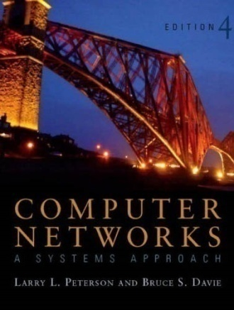

References
Section 2.6:
Direct Link Networks [P&D]
Chapter 5:
Link Layer and LANs [K&R]

Slide 38
?
?
Questions/ Confusions?
?
Use the discussion forum at:
http://compnets.ning.com/
Credits/ Acknowledgement at:
http://sites.google.com/site/cse320site/

