Slide 1
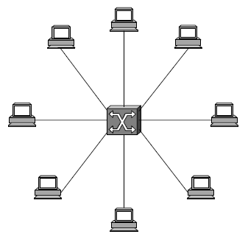
Topic 3: Packet Switching
Problem Statement:
Connecting nodes that aren’t directly connected
Notes:
The directly connected networks described in the previous chapter suffer from two limitations. First, there is a limit to how many hosts can be attached. For example, only two hosts can be attached to a point-to-point link, and an Ethernet can connect up to only 1024 hosts. Second, there is a limit to how large of a geographic area a single network can serve. For example, an Ethernet can span only 2500 m, and even though point-to-point links can be quite long, they do not really serve the area between the two ends. Since our goal is to build networks that can be global in scale, the next problem is therefore to enable communication between hosts that are not directly connected.
This problem is not unlike the one addressed in the telephone network: Your phone is not directly connected to every person you might want to call, but instead is connected to an exchange that contains a switch. It is the switches that create the impression that you have a connection to the person at the other end of the call. Similarly, computer networks use packet switches (as distinct from the circuit switches used for telephony) to enable packets to travel from one host to another, even when no direct connection exists between those hosts.
A packet switch is a device with several inputs and outputs leading to and from the hosts that the switch interconnects. The core job of a switch is to take packets that arrive on an input and forward (or switch) them to the right output so that they will reach their appropriate destination. There are a variety of ways that the switch can determine the “right” output for a packet, which can be broadly categorized as connectionless and connection-oriented approaches.
A key problem that a switch must deal with is the finite bandwidth of its outputs. If packets destined for a certain output arrive at a switch and their arrival rate exceeds the capacity of that output, then we have a problem of contention. The switch queues (buffers) packets until the contention subsides, but if it lasts too long, the switch will run out of buffer space and be forced to discard packets. When packets are discarded too frequently, the switch is said to be congested. The ability of a switch to handle contention is a key aspect of its performance, and many high-performance switches use exotic hardware to reduce the effects of contention.

Slide 2
Topic’s objectives
To find out the answers to:
1 – How to connect nodes not directly connected?
2 – What different packet switching techniques exist?

Slide 3
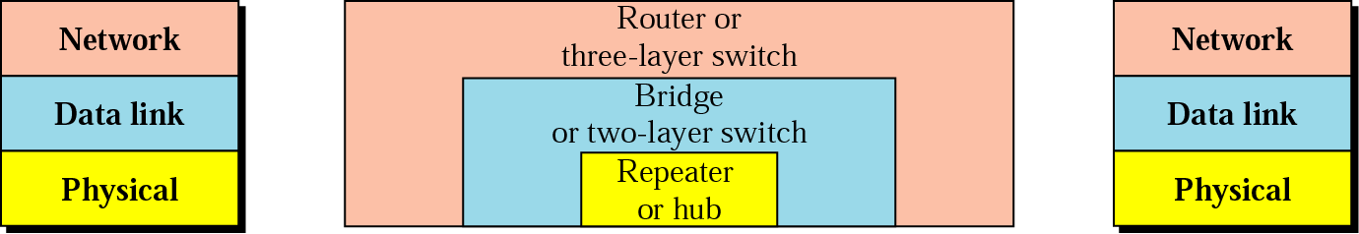
Connecting Devices
Notes:
We now focus more closely on some specific switching technologies. We begin by considering a class of switches that is used to forward packets between shared-media LANs such as Ethernets. Such switches are sometimes known by the obvious name of LAN switches; historically they have also been referred to as bridges.
Suppose you have a pair of Ethernets that you want to interconnect. One approach you might try is to put a repeater between them, as described in Chapter 2. This would not be a workable solution, however, if doing so exceeded the physical limitations of the Ethernet. (Recall that no more than two repeaters between any pair of hosts and no more than a total of 2500 m in length is allowed.)
An alternative would be to put a node between the two Ethernets and have the node forward frames from one Ethernet to the other. This node would be in promiscuous mode, accepting all frames transmitted on either of the Ethernets, so it could forward them to the other. The node we have just described is typically called a bridge, and a collection of LANs connected by one or more bridges is usually said to form an extended LAN.
Note that a bridge meets our definition of a switch from the previous section: a multi-input, multi-output device, which transfers packets from an input to one or of device is needed to make these networks useful.

Slide 4
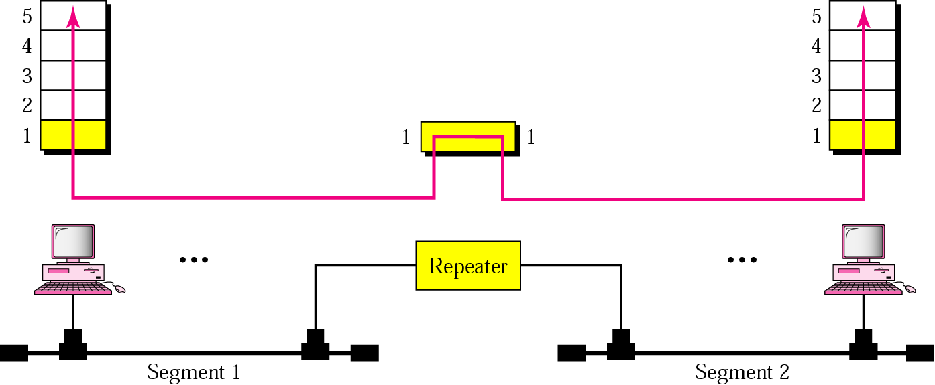
Connecting Devices - Repeaters
Single collision domain

Slide 5
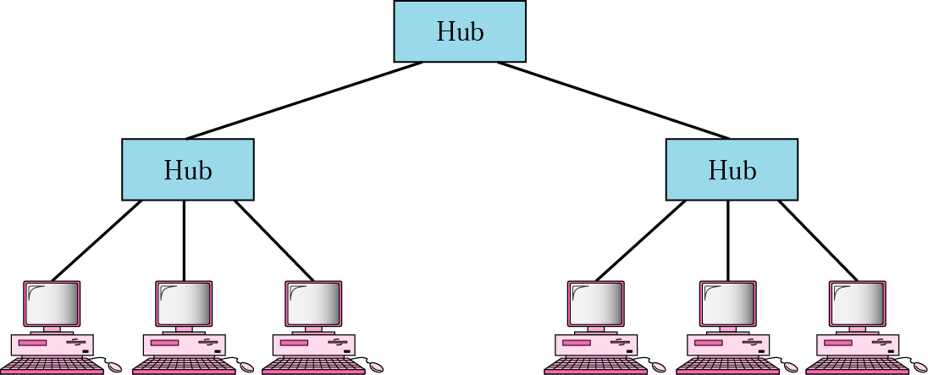
Connecting Devices - Hubs
Single collision domain

Slide 6
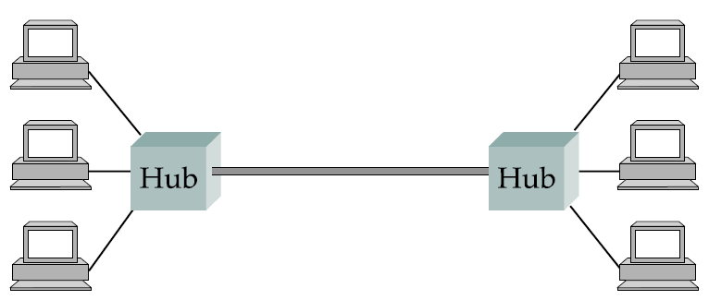
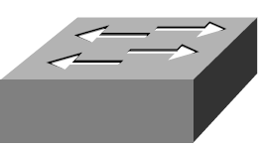
Connecting Devices - Bridge
Collision domain
Collision domain
Bridge

Slide 7
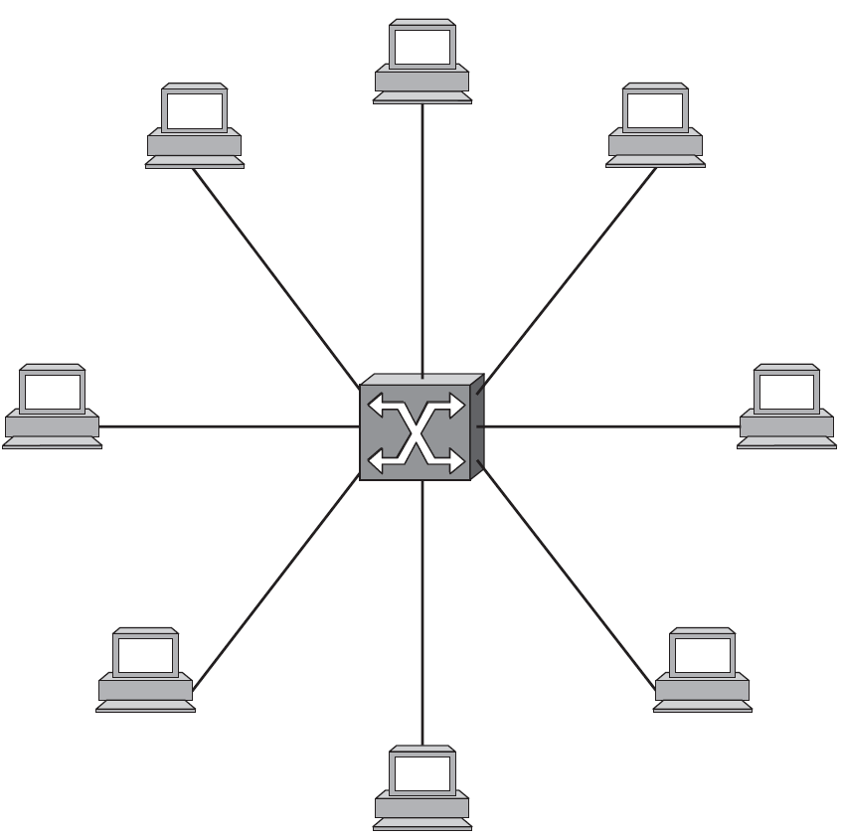
Switches (L2 and L3)
Notes:
We now focus more closely on some specific switching technologies. We begin by considering a class of switches that is used to forward packets between shared-media LANs such as Ethernets. Such switches are sometimes known by the obvious name of LAN switches; historically they have also been referred to as bridges.
Suppose you have a pair of Ethernets that you want to interconnect. One approach you might try is to put a repeater between them, as described in Chapter 2. This would not be a workable solution, however, if doing so exceeded the physical limitations of the Ethernet. (Recall that no more than two repeaters between any pair of hosts and no more than a total of 2500 m in length is allowed.)
An alternative would be to put a node between the two Ethernets and have the node forward frames from one Ethernet to the other. This node would be in promiscuous mode, accepting all frames transmitted on either of the Ethernets, so it could forward them to the other. The node we have just described is typically called a bridge, and a collection of LANs connected by one or more bridges is usually said to form an extended LAN.
Note that a bridge meets our definition of a switch from the previous section: a multi-input, multi-output device, which transfers packets from an input to one or of device is needed to make these networks useful.

Slide 8
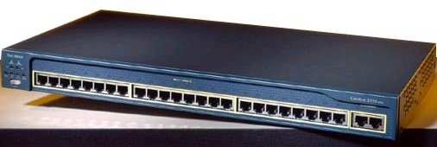
Switch = multi-port bridge
Cisco Systems Catalyst Switch; Image Credit: Cisco Systems
Notes:
A switch can be thought of as a multi-port bridge conceptually arranged in the scheme shown above.
Each host connected to a port can be conceptualized to have a dedicated LAN segment for itself with a bridge each connecting this segment with other dedicated segments connecting to other ports.
There are no collisions between different ports.
We’ve covered before that hub is logically equivalent to shared bus; switch simulates a bridged LAN with one computer/ segment.

Slide 9
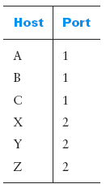
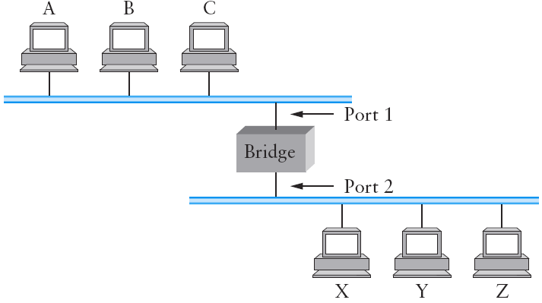
How bridges/ L2 switches self-learn?
From: Peterson/ Davie: “Computer Networks – A Systems Approach”
Notes:
The first optimization we can make to a bridge is to observe that it need not forward all frames that it receives. Consider the bridge in Figure 3.11. Whenever a frame from host A that is addressed to host B arrives on port 1, there is no need for the bridge to forward the frame out over port 2. The question, then, is, How does a bridge come to learn on which port the various hosts reside?
One option would be to have a human download a table into the bridge similar to the one given in Table 3.3. Then, whenever the bridge receives a frame on port 1 that is addressed to host A, it would not forward the frame out on port 2; there would be no need because host A would have already directly received the frame on the LAN connected to port 1. Anytime a frame addressed to host A was received on port 2, the bridge would forward the frame out on port 1.
Note that a bridge using such a table would be using the datagram (or connectionless) model of forwarding described in Section 3.1.1. Each packet carries a global address, and the bridge decides which output to send a packet on by looking up that address in a table.
Having a human maintain this table is quite a burden, especially considering that there is a simple trick by which a bridge can learn this information for itself. The idea is for each bridge to inspect the source address in all the frames it receives. Thus, when host A sends a frame to a host on either side of the bridge, the bridge receives this frame and records the fact that a frame from host A was just received on port 1. In this way, the bridge can build a table just like the one shown above.
When a bridge first boots, this table is empty; entries are added over time. Also, a timeout is associated with each entry, and the bridge discards the entry after a specified period of time. This is to protect against the situation in which a host—and as a consequence, its LAN address—is moved from one network to another. Thus, this table is not necessarily complete. Should the bridge receive a frame that is addressed to a host not currently in the table, it goes ahead and forwards the frame out on all the other ports. In other words, this table is simply an optimization that filters out some frames; it is not required for correctness.

Slide 10
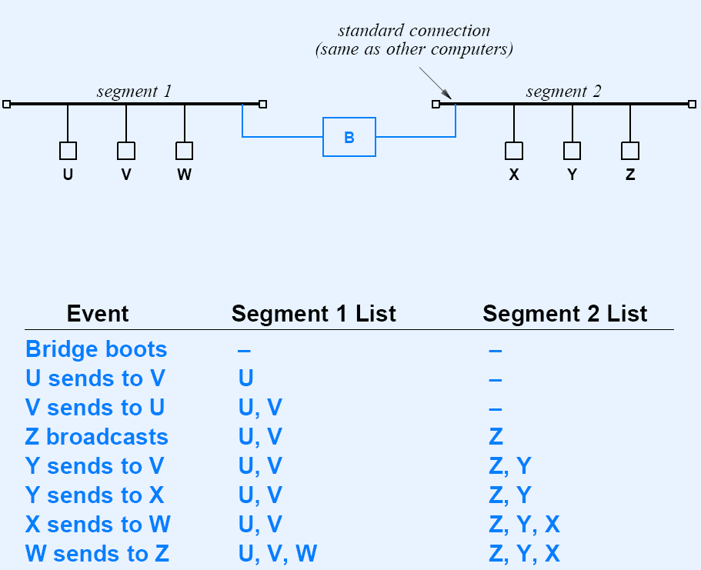
How bridges/ L2 switches self-learn?
Exercise

Slide 11
Advantages of Switching
Three desirable features:
Although a switch has limited I/O ports, large networks can be built by interconnecting switches
Switches can be connected using Point-to-Point links -> we can build geographically dispersed networks
Adding a new host does not necessarily degrade the network performance of existing nodes
Notes:
In the simplest terms, a switch is a mechanism that allows us to interconnect links to form a larger network. A switch is a multi-input, multi-output device, which transfers packets from an input to one or more outputs.
The last claim above cannot be made for the shared-media networks discussed in the last chapter. For example, it is impossible for two hosts on the same Ethernet to transmit continuously at 10 Mbps because they share the same transmission medium. Every host on a switched network has its own link to the switch, so it may be entirely possible for many hosts to transmit at the full link speed (bandwidth), provided that the switch is designed with enough aggregate capacity.
In general, switched networks are considered more scalable (i.e., more capable of growing to large numbers of nodes) than shared-media networks because of this ability to support many hosts at full speed.
A switch is connected to a set of links and, for each of these links, runs the appropriate data link protocol to communicate with the node at the other end of the link. A switch’s primary job is to receive incoming packets on one of its links and to transmit them on some other link. This function is sometimes referred to as either switching or forwarding, and in terms of the OSI architecture, it is the main function of the network layer.
Note: Normally the function of switching between different data-links is called routing (distinct from switching which is at L2 and is used for the same link-layer technology).

Slide 12
L3 Switching Approaches
L3 switching = routing across different potentially heterogeneous networks;
Major packet-switching approaches are:
Datagram – connectionless (CL) approach
Virtual Circuit – connection-oriented (CO) approach
Source Routing
Notes:
The question then is, How does the switch decide which output port to place each packet on? The general answer is that it looks at the header of the packet for an identifier that it uses to make the decision. The details of how it uses this identifier vary, but there are two common approaches. The first is the datagram or connectionless approach. The second is the virtual circuit or connection-oriented approach. A third approach, source routing, is less common than these other two, but it is simple to explain and does have some useful applications.

Slide 13
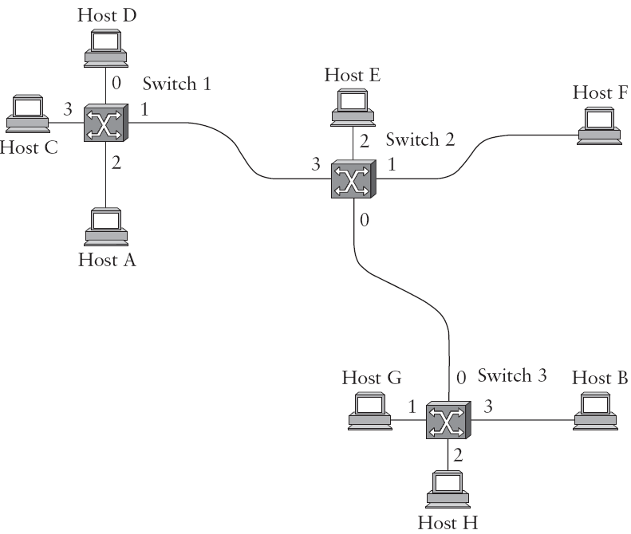
Datagram (CL) Approach
Why is this approach called connection-less?
What will be the forwarding table at Switch 2?
Notes:
The idea behind datagrams is incredibly simple: You just make sure that every packet contains enough information to enable any switch to decide how to get it to its destination. That is, every packet contains the complete destination address. Consider the example network illustrated in Figure 3.4, in which the hosts have addresses A, B, C, and so on. To decide how to forward a packet, a switch consults a forwarding table (sometimes called a routing table), an example of which is depicted in Table 3.1.
This particular table shows the forwarding information that switch 2 needs to forward datagrams in the example network. It is pretty easy to figure out such a table when you have a complete map of a simple network like that depicted here; we could imagine a network operator configuring the tables statically. This is called Static Routing.
It is a lot harder to create the forwarding tables in large, complex networks with dynamically changing topologies and multiple paths between destinations. That harder problem is known as routing and is the topic of Section 4.2. We can think of routing as a process that takes place in the background so that, when a data packet turns up, we will have the right information in the forwarding table to be able to forward, or switch, the packet.
Connectionless (datagram) networks have the following characteristics:
■ A host can send a packet anywhere at any time, since any packet that turns up at a switch can be immediately forwarded (assuming a correctly populated forwarding table). As we will see, this contrasts with most connection-oriented networks, in which some “connection state” needs to be established before the first data packet is sent.
■ When a host sends a packet, it has no way of knowing if the network is capable of delivering it or if the destination host is even up and running.
■ Each packet is forwarded independently of previous packets that might have been sent to the same destination. Thus, two successive packets from host A to host B may follow completely different paths (perhaps because of a change in the forwarding table at some switch in the network).
■ A switch or link failure might not have any serious effect on communication if it is possible to find an alternate route around the failure and to update the forwarding table accordingly.

Slide 14
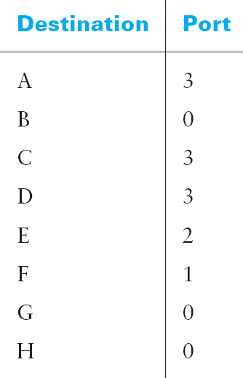
Datagram Approach
Forwarding table at Switch 2
Notes:
The idea behind datagrams is incredibly simple: You just make sure that every packet contains enough information to enable any switch to decide how to get it to its destination. That is, every packet contains the complete destination address. Consider the example network illustrated in Figure 3.4, in which the hosts have addresses A, B, C, and so on. To decide how to forward a packet, a switch consults a forwarding table (sometimes called a routing table), an example of which is depicted in Table 3.1.
This particular table shows the forwarding information that switch 2 needs to forward datagrams in the example network. It is pretty easy to figure out such a table when you have a complete map of a simple network like that depicted here; we could imagine a network operator configuring the tables statically. This is called Static Routing.
It is a lot harder to create the forwarding tables in large, complex networks with dynamically changing topologies and multiple paths between destinations. That harder problem is known as routing and is the topic of Section 4.2. We can think of routing as a process that takes place in the background so that, when a data packet turns up, we will have the right information in the forwarding table to be able to forward, or switch, the packet.
Connectionless (datagram) networks have the following characteristics:
■ A host can send a packet anywhere at any time, since any packet that turns up at a switch can be immediately forwarded (assuming a correctly populated forwarding table). As we will see, this contrasts with most connection-oriented networks, in which some “connection state” needs to be established before the first data packet is sent.
■ When a host sends a packet, it has no way of knowing if the network is capable of delivering it or if the destination host is even up and running.
■ Each packet is forwarded independently of previous packets that might have been sent to the same destination. Thus, two successive packets from host A to host B may follow completely different paths (perhaps because of a change in the forwarding table at some switch in the network).
■ A switch or link failure might not have any serious effect on communication if it is possible to find an alternate route around the failure and to update the forwarding table accordingly.

Slide 15
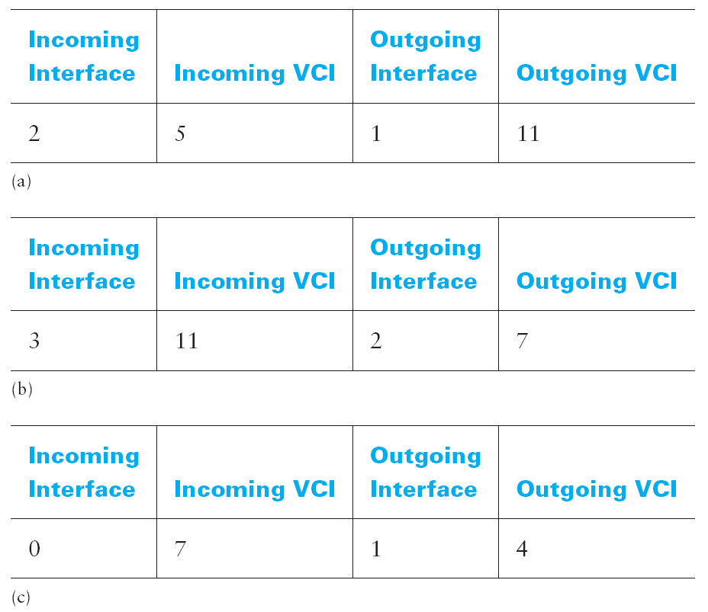
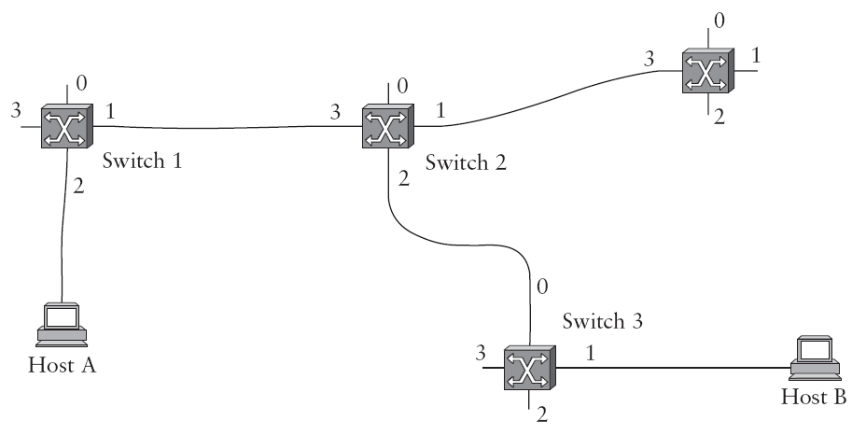
Virtual Circuit (VC) Approach
Virtual Circuits are:
like circuit switching since end-to-end path is established/ torn down
like packet switching since data divided into packets with identifiers
VC state information is kept at each switch
Different VCI identify the same circuit; VCI is significant only locally
Multiple VCs can be defined for an interface
Notes:
A widely used technique for packet switching, which differs significantly from the datagram model, uses the concept of a virtual circuit (VC). This approach, which is also called a connection-oriented model, requires that we first set up a virtual connection from the source host to the destination host before any data is sent. To understand how this works, consider Figure 3.5, where host A again wants to send packets to host B. We can think of this as a two-stage process. The first stage is “connection setup.” The second is data transfer. We consider each in turn.
Connection Setup Phase: In the connection setup phase, it is necessary to establish “connection state” in
each of the switches between the source and destination hosts. The connection state for a single connection consists of an entry in a “VC table” in each switch through which the connection passes. One entry in the VC table on a single switch contains:
■ a virtual circuit identifier (VCI) that uniquely identifies the connection at this switch and that will be carried inside the header of the packets that belong to this connection
■ an incoming interface on which packets for this VC arrive at the switch
■ an outgoing interface in which packets for this VC leave the switch
■ a potentially different VCI that will be used for outgoing packets
The semantics of one such entry is as follows: If a packet arrives on the designated incoming interface and that packet contains the designated VCI value in its header, then that packet should be sent out the specified outgoing interface with the specified outgoing VCI value first having been placed in its header.
There may of course be many virtual connections established in the switch at one time. Also, we observe that the incoming and outgoing VCI values are generally not the same. Thus, the VCI is not a globally significant identifier for the connection; rather, it has significance only on a given link—that is, it has link local scope.
Whenever a new connection is created, we need to assign a new VCI for that connection on each link that the connection will traverse. We also need to ensure that the chosen VCI on a given link is not currently in use on that link by some existing connection.
There are two broad classes of approach to establishing connection state. One is to have a network administrator configure the state, in which case the virtual circuit is “permanent.” Of course, it can also be deleted by the administrator, so a permanent virtual circuit (PVC) might best be thought of as a long-lived or administratively configured VC.
Alternatively, a host can send messages into the network to cause the state to be established. This is referred to as signalling, and the resulting virtual circuits are said to be switched. The salient characteristic of a switched virtual circuit (SVC) is that a host may set up and delete such a VC dynamically without the involvement of a network administrator. Note that an SVC should more accurately be called a “signalled” VC, since it is the use of signalling (not switching) that distinguishes an SVC from a PVC.
In real networks of reasonable size, the burden of configuring VC tables correctly in a large number of switches would quickly become excessive using the above procedures. Thus, some sort of signalling is almost always used, even when setting up “permanent” VCs. In the case of PVCs, signalling is initiated by the network administrator, while SVCs are usually set up using signalling by one of the hosts. We consider now how the same VC just described could be set up by signalling from the host.
To start the signalling process, host A sends a setup message into the network, that is, to switch 1. The setup message contains, among other things, the complete destination address of host B. The setup message needs to get all the way to B to create the necessary connection state in every switch along the way. We can see that getting the setup message to B is a lot like getting a datagram to B, in that the switches have to know which output to send the setup message to so that it eventually reaches B. For now, let’s just assume that the switches know enough about the network topology to figure out how to do that, so that the setup message flows on to switches 2 and 3 before finally reaching host B.
There are several things to note about virtual circuit switching:
■ Since host A has to wait for the connection request to reach the far side of the network and return before it can send its first data packet, there is at least one RTT of delay before data is sent.
■ While the connection request contains the full address for host B (which might be quite large, being a global identifier on the network), each data packet contains only a small identifier, which is only unique on one link. Thus, the per-packet overhead caused by the header is reduced relative to the datagram model.
■ If a switch or a link in a connection fails, the connection is broken and a new one will need to be established. Also, the old one needs to be torn down to free up table storage space in the switches.
■ The issue of how a switch decides which link to forward the connection request on has been glossed over. In essence, this is the same problem as building up the forwarding table for datagram forwarding, which requires some sort of routing algorithm.

Slide 16
Virtual Circuit Approaches
1) Permanent Virtual Circuit (PVC)
Connection state entered manually
Administrator maintained
Survives reboot
Usually persists for months

Slide 17
Virtual Circuit Approach
2) Switched Virtual Circuit (SVC)
Requested dynamically
Application initiated
Terminated when application exits

Slide 18
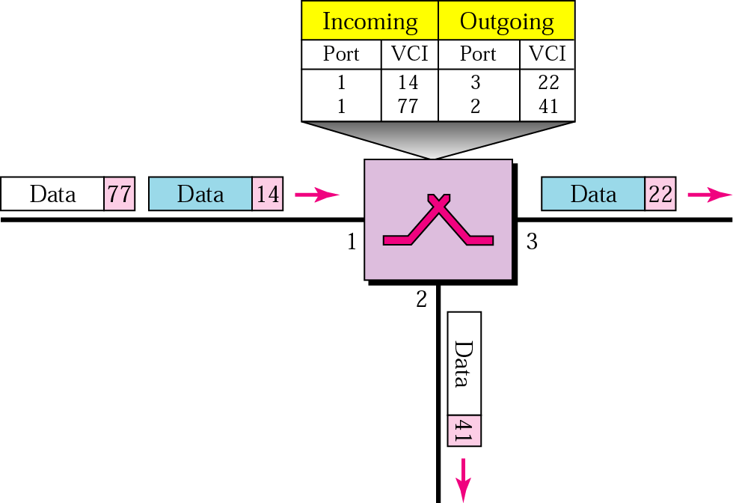
Multiple VCs share physical circuit
Notes:
A widely used technique for packet switching, which differs significantly from the datagram model, uses the concept of a virtual circuit (VC). This approach, which is also called a connection-oriented model, requires that we first set up a virtual connection from the source host to the destination host before any data is sent. To understand how this works, consider Figure 3.5, where host A again wants to send packets to host B. We can think of this as a two-stage process. The first stage is “connection setup.” The second is data transfer. We consider each in turn.
Connection Setup Phase: In the connection setup phase, it is necessary to establish “connection state” in
each of the switches between the source and destination hosts. The connection state for a single connection consists of an entry in a “VC table” in each switch through which the connection passes. One entry in the VC table on a single switch contains:
■ a virtual circuit identifier (VCI) that uniquely identifies the connection at this switch and that will be carried inside the header of the packets that belong to this connection
■ an incoming interface on which packets for this VC arrive at the switch
■ an outgoing interface in which packets for this VC leave the switch
■ a potentially different VCI that will be used for outgoing packets
The semantics of one such entry is as follows: If a packet arrives on the designated incoming interface and that packet contains the designated VCI value in its header, then that packet should be sent out the specified outgoing interface with the specified outgoing VCI value first having been placed in its header.
There may of course be many virtual connections established in the switch at one time. Also, we observe that the incoming and outgoing VCI values are generally not the same. Thus, the VCI is not a globally significant identifier for the connection; rather, it has significance only on a given link—that is, it has link local scope.
Whenever a new connection is created, we need to assign a new VCI for that connection on each link that the connection will traverse. We also need to ensure that the chosen VCI on a given link is not currently in use on that link by some existing connection.
There are two broad classes of approach to establishing connection state. One is to have a network administrator configure the state, in which case the virtual circuit is “permanent.” Of course, it can also be deleted by the administrator, so a permanent virtual circuit (PVC) might best be thought of as a long-lived or administratively configured VC.
Alternatively, a host can send messages into the network to cause the state to be established. This is referred to as signalling, and the resulting virtual circuits are said to be switched. The salient characteristic of a switched virtual circuit (SVC) is that a host may set up and delete such a VC dynamically without the involvement of a network administrator. Note that an SVC should more accurately be called a “signalled” VC, since it is the use of signalling (not switching) that distinguishes an SVC from a PVC.
In real networks of reasonable size, the burden of configuring VC tables correctly in a large number of switches would quickly become excessive using the above procedures. Thus, some sort of signalling is almost always used, even when setting up “permanent” VCs. In the case of PVCs, signalling is initiated by the network administrator, while SVCs are usually set up using signalling by one of the hosts. We consider now how the same VC just described could be set up by signalling from the host.
To start the signalling process, host A sends a setup message into the network, that is, to switch 1. The setup message contains, among other things, the complete destination address of host B. The setup message needs to get all the way to B to create the necessary connection state in every switch along the way. We can see that getting the setup message to B is a lot like getting a datagram to B, in that the switches have to know which output to send the setup message to so that it eventually reaches B. For now, let’s just assume that the switches know enough about the network topology to figure out how to do that, so that the setup message flows on to switches 2 and 3 before finally reaching host B.
There are several things to note about virtual circuit switching:
■ Since host A has to wait for the connection request to reach the far side of the network and return before it can send its first data packet, there is at least one RTT of delay before data is sent.
■ While the connection request contains the full address for host B (which might be quite large, being a global identifier on the network), each data packet contains only a small identifier, which is only unique on one link. Thus, the per-packet overhead caused by the header is reduced relative to the datagram model.
■ If a switch or a link in a connection fails, the connection is broken and a new one will need to be established. Also, the old one needs to be torn down to free up table storage space in the switches.
■ The issue of how a switch decides which link to forward the connection request on has been glossed over. In essence, this is the same problem as building up the forwarding table for datagram forwarding, which requires some sort of routing algorithm.

Slide 19
Virtual Circuit vs. Leased Lines
Leased line, even when idle, remains dedicated unlike VCs in which statistical multiplexing is used
Bit delay is constant on a leased line but variable on virtual circuits (due to queuing delays)
Leased lines are circuit switched whereas virtual circuits are packet switched
Leased lines are usually more expensive than VCs
Notes:
A widely used technique for packet switching, which differs significantly from the datagram model, uses the concept of a virtual circuit (VC). This approach, which is also called a connection-oriented model, requires that we first set up a virtual connection from the source host to the destination host before any data is sent. To understand how this works, consider Figure 3.5, where host A again wants to send packets to host B. We can think of this as a two-stage process. The first stage is “connection setup.” The second is data transfer. We consider each in turn.
Connection Setup Phase: In the connection setup phase, it is necessary to establish “connection state” in
each of the switches between the source and destination hosts. The connection state for a single connection consists of an entry in a “VC table” in each switch through which the connection passes. One entry in the VC table on a single switch contains:
■ a virtual circuit identifier (VCI) that uniquely identifies the connection at this switch and that will be carried inside the header of the packets that belong to this connection
■ an incoming interface on which packets for this VC arrive at the switch
■ an outgoing interface in which packets for this VC leave the switch
■ a potentially different VCI that will be used for outgoing packets
The semantics of one such entry is as follows: If a packet arrives on the designated incoming interface and that packet contains the designated VCI value in its header, then that packet should be sent out the specified outgoing interface with the specified outgoing VCI value first having been placed in its header.
There may of course be many virtual connections established in the switch at one time. Also, we observe that the incoming and outgoing VCI values are generally not the same. Thus, the VCI is not a globally significant identifier for the connection; rather, it has significance only on a given link—that is, it has link local scope.
Whenever a new connection is created, we need to assign a new VCI for that connection on each link that the connection will traverse. We also need to ensure that the chosen VCI on a given link is not currently in use on that link by some existing connection.
There are two broad classes of approach to establishing connection state. One is to have a network administrator configure the state, in which case the virtual circuit is “permanent.” Of course, it can also be deleted by the administrator, so a permanent virtual circuit (PVC) might best be thought of as a long-lived or administratively configured VC.
Alternatively, a host can send messages into the network to cause the state to be established. This is referred to as signalling, and the resulting virtual circuits are said to be switched. The salient characteristic of a switched virtual circuit (SVC) is that a host may set up and delete such a VC dynamically without the involvement of a network administrator. Note that an SVC should more accurately be called a “signalled” VC, since it is the use of signalling (not switching) that distinguishes an SVC from a PVC.
In real networks of reasonable size, the burden of configuring VC tables correctly in a large number of switches would quickly become excessive using the above procedures. Thus, some sort of signalling is almost always used, even when setting up “permanent” VCs. In the case of PVCs, signalling is initiated by the network administrator, while SVCs are usually set up using signalling by one of the hosts. We consider now how the same VC just described could be set up by signalling from the host.
To start the signalling process, host A sends a setup message into the network, that is, to switch 1. The setup message contains, among other things, the complete destination address of host B. The setup message needs to get all the way to B to create the necessary connection state in every switch along the way. We can see that getting the setup message to B is a lot like getting a datagram to B, in that the switches have to know which output to send the setup message to so that it eventually reaches B. For now, let’s just assume that the switches know enough about the network topology to figure out how to do that, so that the setup message flows on to switches 2 and 3 before finally reaching host B.
There are several things to note about virtual circuit switching:
■ Since host A has to wait for the connection request to reach the far side of the network and return before it can send its first data packet, there is at least one RTT of delay before data is sent.
■ While the connection request contains the full address for host B (which might be quite large, being a global identifier on the network), each data packet contains only a small identifier, which is only unique on one link. Thus, the per-packet overhead caused by the header is reduced relative to the datagram model.
■ If a switch or a link in a connection fails, the connection is broken and a new one will need to be established. Also, the old one needs to be torn down to free up table storage space in the switches.
■ The issue of how a switch decides which link to forward the connection request on has been glossed over. In essence, this is the same problem as building up the forwarding table for datagram forwarding, which requires some sort of routing algorithm.

Slide 20
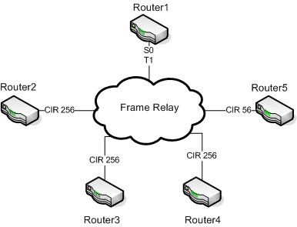
Frame relay – Example VC technology
Other approaches include X.25 and ATM
Notes:
A widely used technique for packet switching, which differs significantly from the datagram model, uses the concept of a virtual circuit (VC). This approach, which is also called a connection-oriented model, requires that we first set up a virtual connection from the source host to the destination host before any data is sent. To understand how this works, consider Figure 3.5, where host A again wants to send packets to host B. We can think of this as a two-stage process. The first stage is “connection setup.” The second is data transfer. We consider each in turn.
Connection Setup Phase: In the connection setup phase, it is necessary to establish “connection state” in
each of the switches between the source and destination hosts. The connection state for a single connection consists of an entry in a “VC table” in each switch through which the connection passes. One entry in the VC table on a single switch contains:
■ a virtual circuit identifier (VCI) that uniquely identifies the connection at this switch and that will be carried inside the header of the packets that belong to this connection
■ an incoming interface on which packets for this VC arrive at the switch
■ an outgoing interface in which packets for this VC leave the switch
■ a potentially different VCI that will be used for outgoing packets
The semantics of one such entry is as follows: If a packet arrives on the designated incoming interface and that packet contains the designated VCI value in its header, then that packet should be sent out the specified outgoing interface with the specified outgoing VCI value first having been placed in its header.
There may of course be many virtual connections established in the switch at one time. Also, we observe that the incoming and outgoing VCI values are generally not the same. Thus, the VCI is not a globally significant identifier for the connection; rather, it has significance only on a given link—that is, it has link local scope.
Whenever a new connection is created, we need to assign a new VCI for that connection on each link that the connection will traverse. We also need to ensure that the chosen VCI on a given link is not currently in use on that link by some existing connection.
There are two broad classes of approach to establishing connection state. One is to have a network administrator configure the state, in which case the virtual circuit is “permanent.” Of course, it can also be deleted by the administrator, so a permanent virtual circuit (PVC) might best be thought of as a long-lived or administratively configured VC.
Alternatively, a host can send messages into the network to cause the state to be established. This is referred to as signalling, and the resulting virtual circuits are said to be switched. The salient characteristic of a switched virtual circuit (SVC) is that a host may set up and delete such a VC dynamically without the involvement of a network administrator. Note that an SVC should more accurately be called a “signalled” VC, since it is the use of signalling (not switching) that distinguishes an SVC from a PVC.
In real networks of reasonable size, the burden of configuring VC tables correctly in a large number of switches would quickly become excessive using the above procedures. Thus, some sort of signalling is almost always used, even when setting up “permanent” VCs. In the case of PVCs, signalling is initiated by the network administrator, while SVCs are usually set up using signalling by one of the hosts. We consider now how the same VC just described could be set up by signalling from the host.
To start the signalling process, host A sends a setup message into the network, that is, to switch 1. The setup message contains, among other things, the complete destination address of host B. The setup message needs to get all the way to B to create the necessary connection state in every switch along the way. We can see that getting the setup message to B is a lot like getting a datagram to B, in that the switches have to know which output to send the setup message to so that it eventually reaches B. For now, let’s just assume that the switches know enough about the network topology to figure out how to do that, so that the setup message flows on to switches 2 and 3 before finally reaching host B.
There are several things to note about virtual circuit switching:
■ Since host A has to wait for the connection request to reach the far side of the network and return before it can send its first data packet, there is at least one RTT of delay before data is sent.
■ While the connection request contains the full address for host B (which might be quite large, being a global identifier on the network), each data packet contains only a small identifier, which is only unique on one link. Thus, the per-packet overhead caused by the header is reduced relative to the datagram model.
■ If a switch or a link in a connection fails, the connection is broken and a new one will need to be established. Also, the old one needs to be torn down to free up table storage space in the switches.
■ The issue of how a switch decides which link to forward the connection request on has been glossed over. In essence, this is the same problem as building up the forwarding table for datagram forwarding, which requires some sort of routing algorithm.

Slide 21
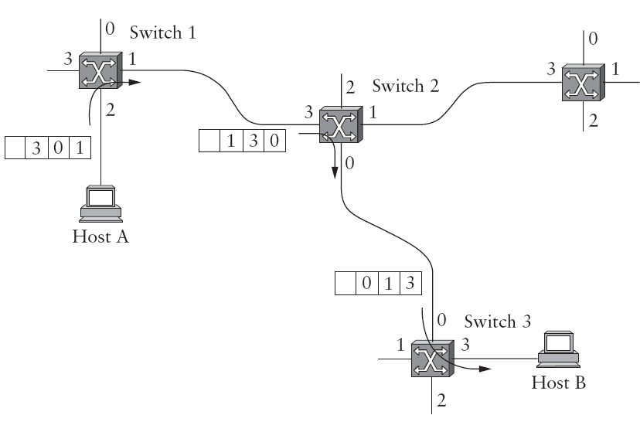
Source Routing Approach
Notes:
A third approach to switching that uses neither virtual circuits nor conventional datagrams is known as source routing. The name derives from the fact that all the information about network topology that is required to
switch a packet across the network is provided by the source host.
There are various ways to implement source routing. One would be to assign a number to each output of each switch and to place that number in the header of the packet. The switching function is then very simple: For each packet that arrives on an input, the switch would read the port number in the header and transmit the packet on that output. However, since there will in general be more than one switch in the path between the sending and the receiving host, the header for the packet needs to contain enough information to allow every switch in the path to determine which output the packet needs to be placed on. One way to do this would be to put an ordered list of switch ports in the header and to rotate the list so that the next switch in the path is always at the front of the list.
In this example, the packet needs to traverse three switches to get from host A to host B. At switch 1, it needs to exit on port 1, at the next switch it needs to exit at port 0, and at the third switch it needs to exit at port 3. Thus, the original header when the packet leaves host A contains the list of ports (3, 0, 1), where we assume that each switch reads the rightmost element of the list. To make sure that the next switch gets the appropriate information, each switch rotates the list after it has read its own entry. Thus, the packet header as it leaves switch 1 en route to switch 2 is now (1, 3, 0); switch 2 performs another rotation and sends out a packet with (0, 1, 3) in the header. Although not shown, switch 3 performs yet another rotation, restoring the
header to what it was when host A sent it.
There are some variations on this approach. For example, rather than rotate the header, each switch could just strip the first element as it uses it. Rotation has an advantage over stripping, however: Host B gets a copy of the complete header, which may help it figure out how to get back to host A.

Slide 22
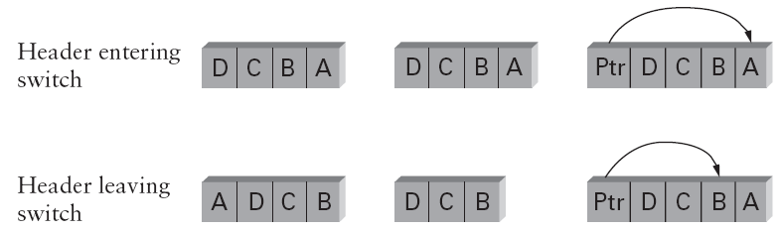
Source Routing Approach
Rotation
Stripping
Pointer
Notes:
A third approach to switching that uses neither virtual circuits nor conventional datagrams is known as source routing. The name derives from the fact that all the information about network topology that is required to
switch a packet across the network is provided by the source host.
There are various ways to implement source routing. One would be to assign a number to each output of each switch and to place that number in the header of the packet. The switching function is then very simple: For each packet that arrives on an input, the switch would read the port number in the header and transmit the packet on that output. However, since there will in general be more than one switch in the path between the sending and the receiving host, the header for the packet needs to contain enough information to allow every switch in the path to determine which output the packet needs to be placed on. One way to do this would be to put an ordered list of switch ports in the header and to rotate the list so that the next switch in the path is always at the front of the list.
In this example, the packet needs to traverse three switches to get from host A to host B. At switch 1, it needs to exit on port 1, at the next switch it needs to exit at port 0, and at the third switch it needs to exit at port 3. Thus, the original header when the packet leaves host A contains the list of ports (3, 0, 1), where we assume that each switch reads the rightmost element of the list. To make sure that the next switch gets the appropriate information, each switch rotates the list after it has read its own entry. Thus, the packet header as it leaves switch 1 en route to switch 2 is now (1, 3, 0); switch 2 performs another rotation and sends out a packet with (0, 1, 3) in the header. Although not shown, switch 3 performs yet another rotation, restoring the
header to what it was when host A sent it.
There are some variations on this approach. For example, rather than rotate the header, each switch could just strip the first element as it uses it. Rotation has an advantage over stripping, however: Host B gets a copy of the complete header, which may help it figure out how to get back to host A.

Slide 23
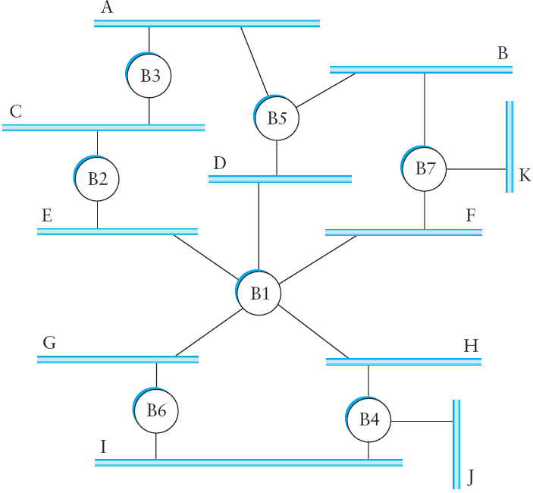
Loop free bridging
Notes:
We now focus more closely on some specific switching technologies. We begin by considering a class of switches that is used to forward packets between shared-media LANs such as Ethernets. Such switches are sometimes known by the obvious name of LAN switches; historically they have also been referred to as bridges.
Suppose you have a pair of Ethernets that you want to interconnect. One approach you might try is to put a repeater between them, as described in Chapter 2. This would not be a workable solution, however, if doing so exceeded the physical limitations of the Ethernet. (Recall that no more than two repeaters between any pair of hosts and no more than a total of 2500 m in length is allowed.)
An alternative would be to put a node between the two Ethernets and have the node forward frames from one Ethernet to the other. This node would be in promiscuous mode, accepting all frames transmitted on either of the Ethernets, so it could forward them to the other. The node we have just described is typically called a bridge, and a collection of LANs connected by one or more bridges is usually said to form an extended LAN.
Note that a bridge meets our definition of a switch from the previous section: a multi-input, multi-output device, which transfers packets from an input to one or of device is needed to make these networks useful.

Slide 24
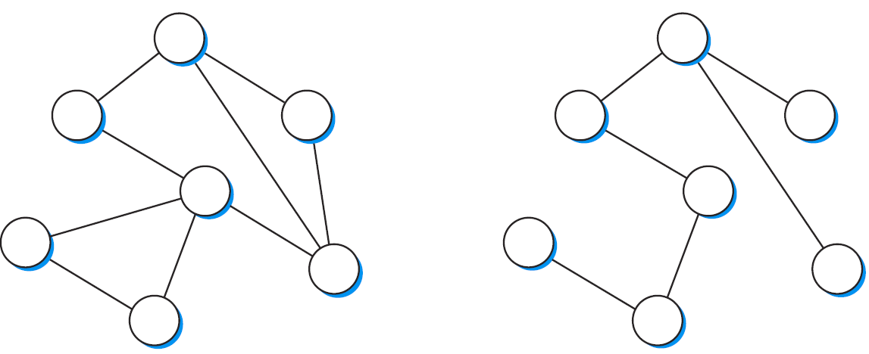
Cyclic graph/ spanning tree
How will bridges in such networks correctly learn?
How will such networks handle broadcast?

Slide 25
Algorhyme – Radia Perlman
I think that I shall never see A graph more lovely than a tree.
A tree whose crucial property Is loop-free connectivity
A tree which must be sure to span, So packets can reach every LAN.
First the Root must be selected. By ID it is elected.
Least-cost paths from Root are traced. In the tree these paths are placed.
A mesh is made by folks like me. Then bridges find a spanning tree.

Slide 26
Spanning Tree Protocol
Root Bridge
Figure from: Peterson/ Davie: “Computer Networks – A Systems Approach”
Notes:
The preceding strategy works just fine until the extended LAN has a loop in it, in which case it fails in a horrible way—frames potentially loop through the extended LAN forever. This is easy to see in the example depicted in Figure 3.12, where, for example, bridges B1, B4, and B6 form a loop. How does an extended LAN come to have a loop in it? One possibility is that the network is managed by more than one administrator, for example, because it spans multiple departments in an organization. In such a setting, it is possible that no single person knows the entire configuration of the network, meaning that a bridge that closes a loop might be added without anyone knowing. A second, more likely scenario is that loops are built into the network on purpose—to provide redundancy in case of failure.
The main idea of the spanning tree is for the bridges to select the ports over which they will forward frames. The algorithm selects ports as follows. Each bridge has a unique identifier; for our purposes, we use the labels B1, B2, B3, and so on. The algorithm first elects the bridge with the smallest id as the root of the spanning tree; exactly how this election takes place is described below. The root bridge always forwards frames out over all of its ports. Next, each bridge computes the shortest path to the root and notes which of its ports is on this path. This port is also selected as the bridge’s preferred path to the root. Finally, all the bridges connected to a given LAN elect a single designated bridge that will be responsible for forwarding frames toward the root bridge. Each LAN’s designated bridge is the one that is closest to the root, and if two or more bridges are equally close to the root, then the bridges’ identifiers are used to break ties; the smallest id wins. Of course, each bridge is connected to more than one LAN, so it participates in the election of a designated bridge for each LAN it is connected to. In effect, this means that each bridge decides if it is the designated bridge relative to each of its ports. The bridge forwards frames over those ports for which it is the designated bridge.
Figure 3.14 shows the spanning tree that corresponds to the extended LAN shown in Figure 3.12. In this example, B1 is the root bridge, since it has the smallest id. Notice that both B3 and B5 are connected to LAN A, but B5 is the designated bridge since it is closer to the root. Similarly, both B5 and B7 are connected to LAN B, but in this case, B5 is the designated bridge since it has the smaller id; both are an equal distance from B1.
While it is possible for a human to look at the extended LAN given in Figure 3.12 and to compute the spanning tree given in Figure 3.14 according to the rules given above, the bridges in an extended LAN do not have the luxury of being able to see the topology of the entire network, let alone peek inside other bridges to see their ids. Instead, the bridges have to exchange configuration messages with each other and then decide whether or not they are the root or a designated bridge based on these messages.
Specifically, the configuration messages contain three pieces of information:
1) the id for the bridge that is sending the message
2) the id for what the sending bridge believes to be the root bridge
3) the distance, measured in hops, from the sending bridge to the root bridge

Slide 27
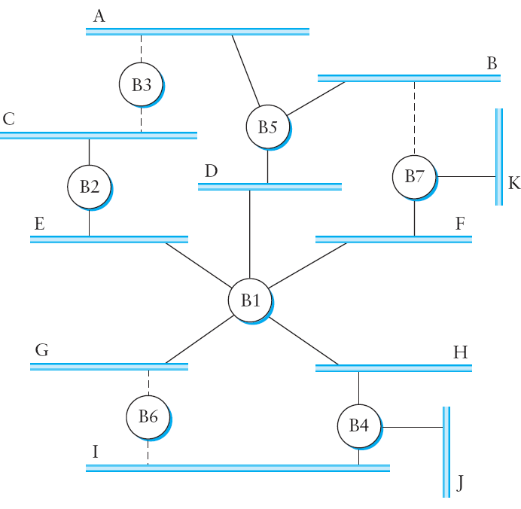
Broadcast/ Multicast
From: Peterson/ Davie: “Computer Networks – A Systems Approach”
Notes:
The preceding discussion has focused on how bridges forward unicast frames from one LAN to another. Since the goal of a bridge is to transparently extend a LAN across multiple networks, and since most LANs support both broadcast and multicast, then bridges must also support these two features. Broadcast is simple—each bridge forwards a frame with a destination broadcast address out on each active (selected) port other than the one on which the frame was received.
Multicast can be implemented in exactly the same way, with each host deciding for itself whether or not to accept the message. This is exactly what is done in practice. Notice, however, that since not all the LANs in an extended LAN necessarily have a host that is a member of a particular multicast group, it is possible to do better. Specifically, the spanning tree algorithm can be extended to prune networks over which multicast frames need not be forwarded.
Consider a frame sent to group M by a host on LAN A in Figure 3.14. If there is no host on LAN J that belongs to group M, then there is no need for bridge B4 to forward the frames over that network. On the other hand, not having a host on LAN H that belongs to group M does not necessarily mean that bridge B1 can avoid forwarding multicast frames onto LAN H. It all depends on whether or not there are members of group M on LANs I and J.

Slide 28
Problems with L2 Switching
Scaling and heterogeneity issues
Broadcast storms (single broadcast domain)

Slide 29
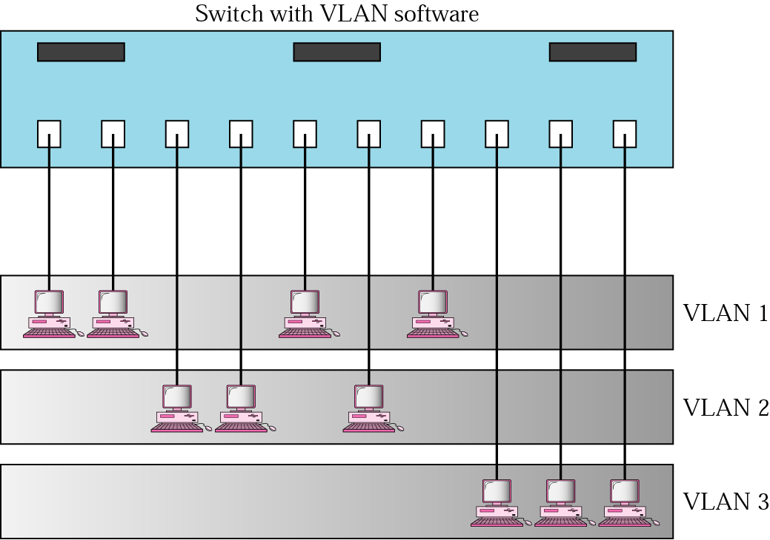
Virtual LAN
Notes:
The bridge-based solution just described is meant to be used in only a fairly limited setting—to connect a handful of similar LANs. The main limitations of bridges become apparent when we consider the issues of scale and heterogeneity.
On the issue of scale, it is not realistic to connect more than a few LANs by means of bridges, where in practice “few” typically means “tens of.” One reason for this is that the spanning tree algorithm scales linearly; that is, there is no provision for imposing a hierarchy on the extended LAN. A second reason is that bridges forward all broadcast frames. While it is reasonable for all hosts within a limited setting (say, a department) to see each other’s broadcast messages, it is unlikely that all the hosts in a larger environment (say, a large company or university) would want to have to be bothered by each other’s broadcast messages. Said another way, broadcast does not scale, and as a consequence, extended LANs do not scale.
VLAN Example:
One approach to increasing the scalability of extended LANs is the virtual LAN (VLAN). VLANs allow a single extended LAN to be partitioned into several seemingly separate LANs. Each virtual LAN is assigned an identifier (sometimes called a color), and packets can only travel from one segment to another if both segments have the same identifier. This has the effect of limiting the number of segments in an extended LAN that will receive any given broadcast packet.
We can see how VLANs work with an example. Figure 3.15 shows four hosts on four different LAN segments. In the absence of VLANs, any broadcast packet from any host will reach all the other hosts. Now let’s suppose that we define the segments connected to hosts W and X as being in one VLAN, which we’ll call VLAN 100. We also define the segments that connect to hosts Y and Z as being in VLAN 200. To do this, we need to configure a VLAN ID on each port of bridges B1 and B2. The link between B1 and B2 is considered to be in both VLANs. When a packet sent by host X arrives at bridge B2, the bridge observes that it came in a port that was configured as being in VLAN 100. It inserts a VLAN header between the Ethernet header and its payload. The interesting part of the VLAN header is the VLAN ID; in this case, that ID is set to 100. The bridge now applies its normal rules for forwarding to the packet, with the extra restriction that the packet may not be sent out an interface that is not part of VLAN 100. Thus, under no circumstances will the packet—even a broadcast packet—be sent out the interface to host Z, which is in VLAN 200. The packet is, however, forwarded to bridge B1, which follows the same rules, and thus may forward the packet to host W but not to host Y.
An attractive feature of VLANs is that it is possible to change the logical topology without moving any wires or changing any addresses. For example, if we wanted to make the segment that connects to host Z be part of VLAN 100, and thus enable X, W, and Z to be on the same virtual LAN, we would just need to change one piece of configuration on bridge B2.

Slide 30
Assignment (Non-Programming) 2
Reading/ summarizing Cell Switching (ATM)
Some textbook questions on STP, bridging
Assignment document to be uploaded
Deadline is 15December 2021
Notes:
We now focus more closely on some specific switching technologies. We begin by considering a class of switches that is used to forward packets between shared-media LANs such as Ethernets. Such switches are sometimes known by the obvious name of LAN switches; historically they have also been referred to as bridges.
Suppose you have a pair of Ethernets that you want to interconnect. One approach you might try is to put a repeater between them, as described in Chapter 2. This would not be a workable solution, however, if doing so exceeded the physical limitations of the Ethernet. (Recall that no more than two repeaters between any pair of hosts and no more than a total of 2500 m in length is allowed.)
An alternative would be to put a node between the two Ethernets and have the node forward frames from one Ethernet to the other. This node would be in promiscuous mode, accepting all frames transmitted on either of the Ethernets, so it could forward them to the other. The node we have just described is typically called a bridge, and a collection of LANs connected by one or more bridges is usually said to form an extended LAN.
Note that a bridge meets our definition of a switch from the previous section: a multi-input, multi-output device, which transfers packets from an input to one or of device is needed to make these networks useful.

Slide 31
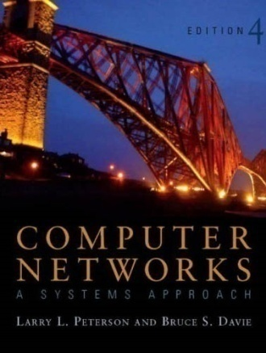
References
Chapter 3:
Packet Switching [P&D]

Slide 32

?
?
Questions/ Confusions?
?
Use the discussion forum at:
http://compnets.ning.com/
Credits/ Acknowledgement at:
http://sites.google.com/site/cse320site/

