Slide 1
Chapter 6
CS435: Introduction to Software Engineering
Dr. M. Zhu
Requirements Modeling: Scenarios, Information, and Analysis Classes
Slide Set to accompany
Software Engineering: A Practitioner’s Approach, 7/e
by Roger S. Pressman
Slides copyright © 1996, 2001, 2005, 2009 by Roger S. Pressman
For non-profit educational use only
These slides are designed to accompany Software Engineering: A Practitioner’s Approach, 7/e (McGraw-Hill, 2009). Slides copyright 2009 by Roger Pressman.

Slide 2
Requirements Modeling
A combination of text and diagrammatic forms to depict requirements in a way that is relatively easy to understand, and more important, straightforward to review for correctness, completeness and consistency.
Once preliminary models are created, they are refined and analyzed to assess their clarity, completeness and consistency.
Some different perspectives:
  Scenario-based model represents the system from the user’s point of view.
  Data modeling represents the information space and depicts the data objects that the software will manipulate and the relationship among them.
  Class-base modeling defines objects, attributes and relationships.
  Flow-oriented models that represents the functional elements of the system and how they transform data as it moves through the system.
  Behavioral models that depict how the software behaves as a consequence of external “events”.
These slides are designed to accompany Software Engineering: A Practitioner’s Approach, 7/e (McGraw-Hill, 2009). Slides copyright 2009 by Roger Pressman.

Slide 3
Requirements Analysis
Requirements analysis
  specifies software’s operational characteristics
  indicates software's interface with other system elements
  establishes constraints that software must meet
Requirements analysis allows the software engineer (called an analyst or modeler in this role) to:
  elaborate on basic requirements established during earlier requirement engineering tasks
  build models that depict user scenarios, functional activities, problem classes and their relationships, system and class behavior, and the flow of data as it is transformed.
These slides are designed to accompany Software Engineering: A Practitioner’s Approach, 7/e (McGraw-Hill, 2009). Slides copyright 2009 by Roger Pressman.

Slide 4
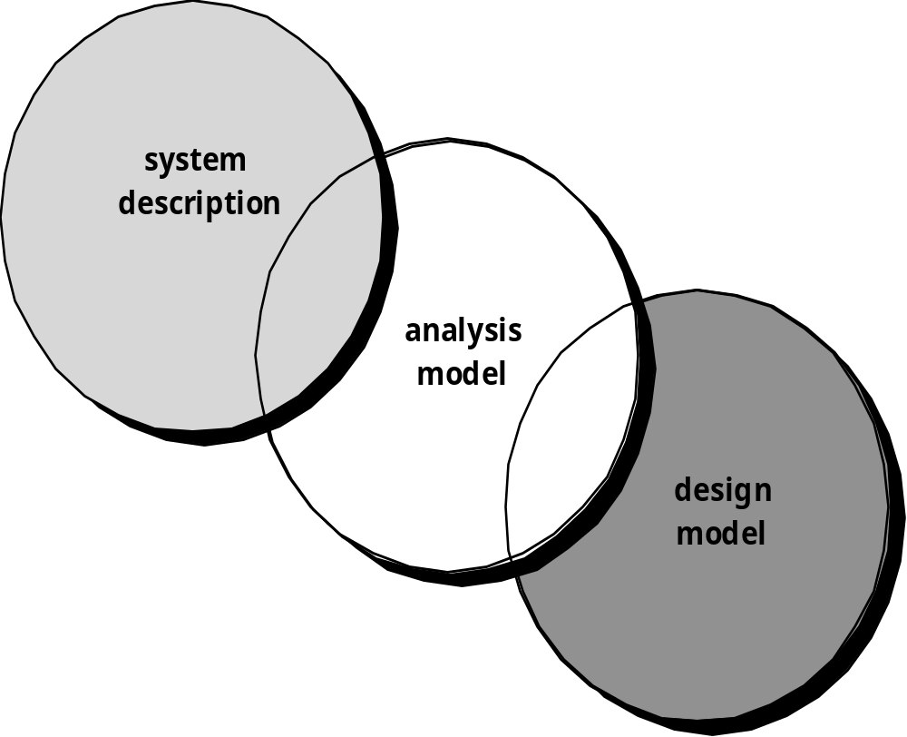
A Bridge
These slides are designed to accompany Software Engineering: A Practitioner’s Approach, 7/e (McGraw-Hill, 2009). Slides copyright 2009 by Roger Pressman.

Slide 5
Overall Objectives
The primary focus Is on what, not how.
  What user interaction occurs in a particular circumstance, what objects do the system manipulate, what functions must the system perform, what behaviors do the system exhibit, what interfaces are defined, and what constraints apply?
Three primary objectives: 1) to describe what the customer requires, 2) to establish a basis for the creation of a software design, and 3) to define a set of requirements that can be validated once the software is built.
All elements of the requirements model will be directly traceable to parts of the design model. A clear division of analysis and design tasks between these two important modeling activities is not always possible. Some design invariably occurs as part of analysis and some analysis will be conducted during design.
These slides are designed to accompany Software Engineering: A Practitioner’s Approach, 7/e (McGraw-Hill, 2009). Slides copyright 2009 by Roger Pressman.

Slide 6
Rules of Thumb
The model should focus on requirements that are visible within the problem or business domain. The level of abstraction should be relatively high.
  Do not get bogged own in details and try to explain how the system will work.
Each element of the analysis model should add to an overall understanding of software requirements and provide insight into the information domain, function and behavior of the system.
Delay consideration of infrastructure and other non-functional models until design.
  A database may be required, but the classes necessary to implement it the function to access it and the behavior that will be exhibited should be considered only after problem domain analysis has been completed.
Minimize coupling throughout the system.
  It is important to represent relationships between classes and functions. However, if the level of interconnectedness is extremely high, efforts should be made to reduce it.
Be certain that the analysis model provides value to all stakeholders.
  Business stakeholder uses the model to validate requirements; designers should use them as a basis for design; QA use them to plan acceptance tests.
Keep the model as simple as it can be.
  Do not create additional diagrams or complex notational form if they add no new information or a simple list will do.
These slides are designed to accompany Software Engineering: A Practitioner’s Approach, 7/e (McGraw-Hill, 2009). Slides copyright 2009 by Roger Pressman.

Slide 7
Analysis Patterns
Analysis patterns often reoccur across many applications within a specific business domain. If these patterns are defined and categorized in a manner that allows you to recognize and apply them to solve common problem, the creation of the analysis model is expedited. It will reduce time-to-market and reduces development costs.
But how are analysis patterns and classes recognized in the first place? Who defines them, categorizes them, and readies them for use on subsequent projects? The answers to these questions lie in domain analysis.
These slides are designed to accompany Software Engineering: A Practitioner’s Approach, 7/e (McGraw-Hill, 2009). Slides copyright 2009 by Roger Pressman.

Slide 8
Domain Analysis
Software domain analysis is the identification, analysis, and specification of common requirements from a specific application domain, typically for reuse on multiple projects within that application domain . . . [Object-oriented domain analysis is] the identification, analysis, and specification of common, reusable capabilities within a specific application domain, in terms of common objects, classes, subassemblies, and frameworks . . .
Donald Firesmith
These slides are designed to accompany Software Engineering: A Practitioner’s Approach, 7/e (McGraw-Hill, 2009). Slides copyright 2009 by Roger Pressman.

Slide 9
Domain Analysis
Define the domain to be investigated.
Collect a representative sample of applications in the domain.
Analyze each application in the sample.
Develop an analysis model for the objects.
May be viewed as an umbrella activate for the software process. It is an ongoing software engineering activity that is not connected to any one software project.
The job of domain analyst is to discover and define analysis patterns, analysis classes and related information that may be used by many people working on similar but not necessarily the same applications.
These slides are designed to accompany Software Engineering: A Practitioner’s Approach, 7/e (McGraw-Hill, 2009). Slides copyright 2009 by Roger Pressman.

Slide 10
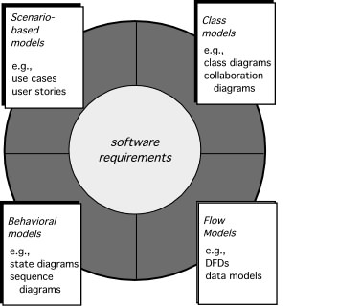
Elements of Requirements Analysis
These slides are designed to accompany Software Engineering: A Practitioner’s Approach, 7/e (McGraw-Hill, 2009). Slides copyright 2009 by Roger Pressman.

Slide 11
Requirements Modeling Approaches
Scenario-based elements: depicts how the user interacts with the system and the specific sequence of activities that occur as the software is used.
Class-based elements: model the objects that the system will manipulate, the operations that will be applied to the object to effect the manipulation, relationships between the objects, and the collaborations that occur between the classes that are defined.
Behavior-based elements: depict how external events change the state of the system or the classes that reside within it.
Flow-oriented elements: represent the system as an information transform, depicting how data objects are transformed as they flow through various system functions.
These slides are designed to accompany Software Engineering: A Practitioner’s Approach, 7/e (McGraw-Hill, 2009). Slides copyright 2009 by Roger Pressman.

Slide 12
Scenario-Based Modeling
The success of a software is measured in many ways, however, user satisfaction resides at the TOP of the list.
Makes use of use cases to capture the ways in which end-users will interact with the system
UML requirements modeling begins with the creation of scenarios in the from of use cases, activity diagrams, and swim lane diagrams
“[Use-cases] are simply an aid to defining what exists outside the system (actors) and what should be performed by the system (use-cases).” Ivar Jacobson
  (1) What should we write about?
  (2) How much should we write about it?
  (3) How detailed should we make our description?
  (4) How should we organize the description?
These slides are designed to accompany Software Engineering: A Practitioner’s Approach, 7/e (McGraw-Hill, 2009). Slides copyright 2009 by Roger Pressman.

Slide 13
What to Write About?
Inception and elicitation—provide you with the information you’ll need to begin writing use cases.
Requirements gathering meetings, QFD, and other requirements engineering mechanisms are used to
  identify stakeholders
  define the scope of the problem
  specify overall operational goals
  establish priorities
  outline all known functional requirements, and
  describe the things (objects) that will be manipulated by the system.
To begin developing a set of use cases, list the functions or activities performed by a specific actor.
These slides are designed to accompany Software Engineering: A Practitioner’s Approach, 7/e (McGraw-Hill, 2009). Slides copyright 2009 by Roger Pressman.

Slide 14
SafeHome Surveillance (subsystem) Functions:
Select camera to view
Request thumbnails from all cameras
Display camera views in a PC window
Control pa and zoom for a specific camera
Selectively record camera output
Replay camera output
Access camera surveillance via the Internet
For each of the function, develop use cases by starting with some narrative.
These slides are designed to accompany Software Engineering: A Practitioner’s Approach, 7/e (McGraw-Hill, 2009). Slides copyright 2009 by Roger Pressman.

Slide 15
How Much to Write About?
As further conversations with the stakeholders progress, the requirements gathering team develops use cases for each of the functions noted.
In general, use cases are written first in an informal narrative fashion.
If more formality is required, the same use case is rewritten using a structured format similar to the one proposed.
These slides are designed to accompany Software Engineering: A Practitioner’s Approach, 7/e (McGraw-Hill, 2009). Slides copyright 2009 by Roger Pressman.

Slide 16
Developing a Use-Case
Begin by listing the activities performed by a single actor to accomplish a single function
What system information will the actor acquire, produce or change?
What information does the actor desire from the system?
Will the actor have to inform the system about changes in the external environment?
Continue this process for each actor and each system function
Use-cases are written first in narrative form and then mapped to a template if more formality is required
These slides are designed to accompany Software Engineering: A Practitioner’s Approach, 7/e (McGraw-Hill, 2009). Slides copyright 2009 by Roger Pressman.

Slide 17
Primary Use case Example: Access camera surveillance via the Internet-display camera views (ACS-DCV)
The homeowner logs onto the website.
The homeowner enters his or her user ID.
The homeowner enters two passwords each at least eight characters in length.
The system displays all major function buttons.
The homeowner selects the “surveillance” from the major function buttons.
The homeowner selects “pick a camera”.
The system displays the floor plan of the house.
The homeowner selects a camera icon from the floor plan
The homeowner selects the “view” button.
The system displays a viewing window that is identified by the camera ID
The system displays video output within the viewing window at one frame per second.
These slides are designed to accompany Software Engineering: A Practitioner’s Approach, 7/e (McGraw-Hill, 2009). Slides copyright 2009 by Roger Pressman.

Slide 18
Developing a Use-Case
Each primary scenarios should be reviewed and refined to see if alternative interactions are possible
  Can the actor take some other action at this point?
  Is it possible that the actor will encounter an error condition at some point? If so, what?
  Is it possible that the actor will encounter some other behavior at some point? If so, what?
  Answers to these questions result in the creation of a set of secondary scenarios that are part of the original use case but represent alternative behavior.
These slides are designed to accompany Software Engineering: A Practitioner’s Approach, 7/e (McGraw-Hill, 2009). Slides copyright 2009 by Roger Pressman.

Slide 19
Secondary scenarios for Safehome surveillance
6. The homeowner selects “pick a camera”.
7. The system displays the floor plan of the house
For these steps in the ACS-DCV:
Yes to the first question: The actor may choose to view thumbnail snapshots of all cameras simultaneously. Hence a secondary scenario might be “view thumbnail snapshots for all cameras”.
Yes to the second question: A floor plan with camera icons may have never been configured.
Yes to the third question: The system may encounter an alarm condition and provide the actor with a number of options relevant to the nature of the alarm. Because this secondary scenario can occur at any time for virtually all interactions, it will not become part of the ACS-DCV use case. Rather, a separate use case- Alarm condition encountered would be developed and referenced from other use cases as required.
These slides are designed to accompany Software Engineering: A Practitioner’s Approach, 7/e (McGraw-Hill, 2009). Slides copyright 2009 by Roger Pressman.

Slide 20
Exceptions
Describe situations (failures or user choices) that cause the system to exhibit unusual behavior
Brainstorming should be used to derive a reasonably complete set of exceptions for each use case
  Are there cases where a validation function occurs for the use case?
  Are there cases where a supporting function (actor) fails to respond appropriately?
  Can poor system performance result in unexpected or improper use actions?
Handling exceptions may require the creation of additional use cases
These slides are designed to accompany Software Engineering: A Practitioner’s Approach, 7/e (McGraw-Hill, 2009). Slides copyright 2009 by Roger Pressman.

Slide 21
Use case Template for Surveillance
ACS-DCV -1
Iteration: 2, last modification: January 14 by V. Raman.
Primary actor: Homeowner.
Goal in context: To view output of camera placed throughout the house from any remote location via the internet
Preconditions: system must be fully configured; appropriate user ID and passwords must be obtained.
Trigger: The homeowner decides to take a look inside the house while away.
Scenario: ( the 11 steps in previous slide)
These slides are designed to accompany Software Engineering: A Practitioner’s Approach, 7/e (McGraw-Hill, 2009). Slides copyright 2009 by Roger Pressman.

Slide 22
Use case Template for Surveillance
ACS-DCV -2
Exceptions:
  ID or passwords are incorrect or not recognized see use case Validate ID and passwords.
  Surveillance function not configured for this system.—display error message. See use case configure surveillance function.
  Homeowner selects “view thumbnail snapshots for all camera” see use case View thumbnail snapshots for all camera.
  A floor plan is not available or has not been configured ---display error message and see use case Configure floor plan.
  An alarm condition is encountered. – see use case Alarm condition encountered.
These slides are designed to accompany Software Engineering: A Practitioner’s Approach, 7/e (McGraw-Hill, 2009). Slides copyright 2009 by Roger Pressman.

Slide 23
Use case Template for Surveillance
ACS-DCV -3
Priority: Moderate priority, to be implemented after basic functions
When available: Third increment.
Frequency of use: Moderate frequency.
Channel to actor: Via PC-based browser and Internet Connection
Secondary actors: System administrator, camera
Channels to secondary actors:
  System administrator: PC-based system
  Camera: wireless connectivity
These slides are designed to accompany Software Engineering: A Practitioner’s Approach, 7/e (McGraw-Hill, 2009). Slides copyright 2009 by Roger Pressman.

Slide 24
Use case Template for Surveillance
ACS-DCV -4
Open Issues:
  What mechanisms protect unauthorized use of this capability by employees of SafeHome Products?
  Is security sufficient? Hacking into this feature would represent a major invasion of privacy.
  Will system response via the Internet be acceptable given the bandwidth required for camera views?
  Will we develop a capability to provide video at a higher frames-per-second rate when high bandwidth connections are available?
These slides are designed to accompany Software Engineering: A Practitioner’s Approach, 7/e (McGraw-Hill, 2009). Slides copyright 2009 by Roger Pressman.

Slide 25
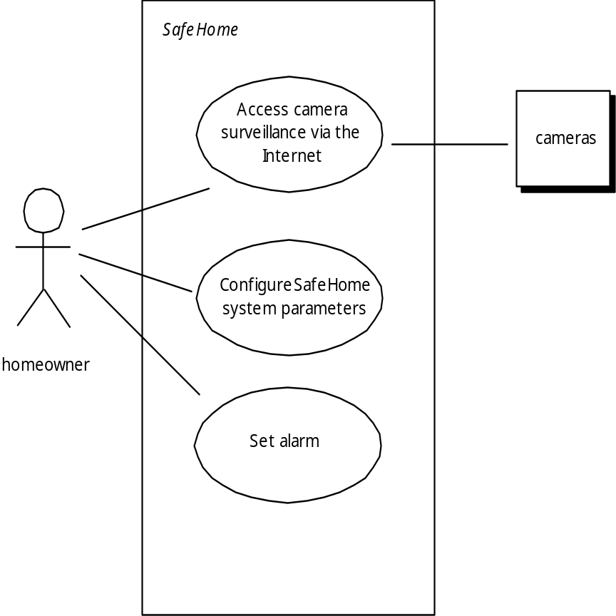
Use-Case Diagram
These slides are designed to accompany Software Engineering: A Practitioner’s Approach, 7/e (McGraw-Hill, 2009). Slides copyright 2009 by Roger Pressman.

Slide 26
Use Case Discussion
In many cases, there is no need to create a graphical representation of a usage scenario. However, diagrammatic representation can facilitate understanding, particularly when the scenario is complex.
Every modeling notation has limitations, and the use case is no exception. If the description is unclear, the use case can be misleading or ambiguous. A use case focus on functional and behavioral requirements and is generally inappropriate for nonfunctional requirements. For situations in which the requirements models must have significant detail and prevision, a user case may not be sufficient.
However, scenario-based modeling is appropriate for a significant majority of all situations that you will encounter as a software engineer.
These slides are designed to accompany Software Engineering: A Practitioner’s Approach, 7/e (McGraw-Hill, 2009). Slides copyright 2009 by Roger Pressman.

Slide 27
UML Activity Diagrams
When a text-based model may not impart information in a clear and concise manner. In such case, you can choose from a broad array of UML graphical models.
Supplements use-case by providing graphical representation of the interaction flow within a specific scenario
Similar to flow chart
  Rounded rectangles used to represent functions
  Diamonds used to represent decision points
  Labeled arrows represent system flow
  Solid horizontal lines indicate parallel activities
These slides are designed to accompany Software Engineering: A Practitioner’s Approach, 7/e (McGraw-Hill, 2009). Slides copyright 2009 by Roger Pressman.

Slide 28
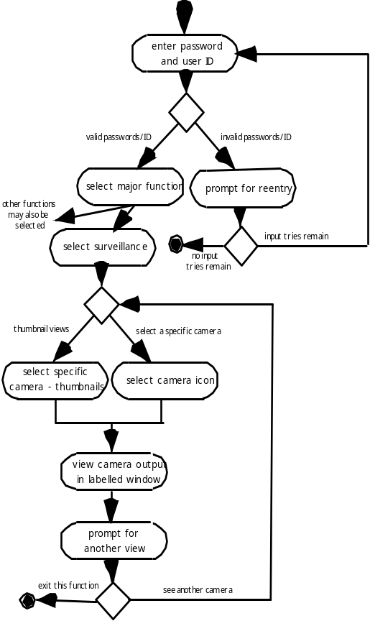
UML Activity Diagram for ACS-DCV
It adds additional details not directly mentioned by the use case. For example, a user may only attempt to enter userID and password a limited number of times. This is represented by a decision diamond below “prompt for reentry”.
These slides are designed to accompany Software Engineering: A Practitioner’s Approach, 7/e (McGraw-Hill, 2009). Slides copyright 2009 by Roger Pressman.

Slide 29
UML Swimlane Diagrams
Variation of activity diagrams used show flow of activities in use case as well as indicating which actor has responsibility for activity rectangle actions
Responsibilities are represented by parallel line segments that divide the diagram vertically headed by the responsible actor
These slides are designed to accompany Software Engineering: A Practitioner’s Approach, 7/e (McGraw-Hill, 2009). Slides copyright 2009 by Roger Pressman.

Slide 30
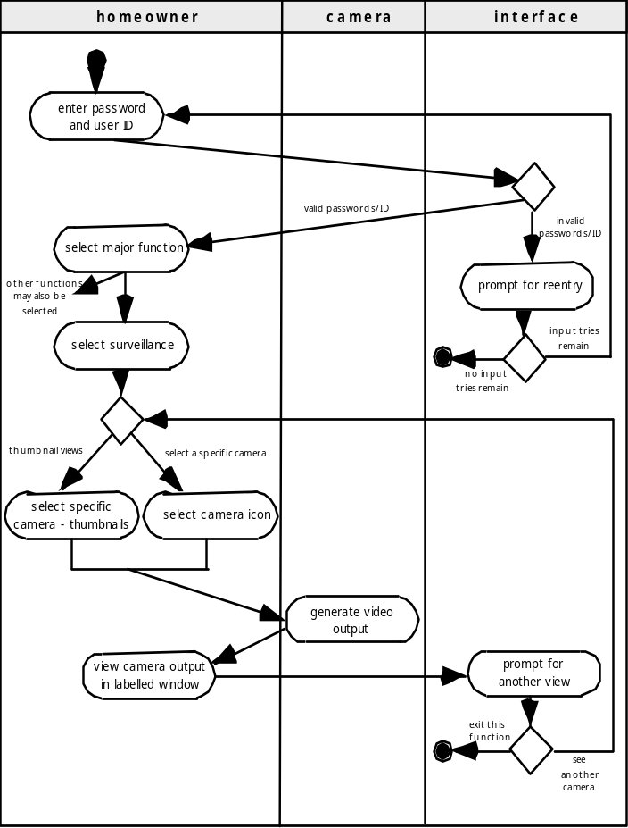
Swimlane Diagrams
Allows the modeler to represent the flow of activities described by the use-case and at the same time indicate which actor (if there are multiple actors involved in a specific use-case) or analysis class has responsibility for the action described by an activity rectangle
These slides are designed to accompany Software Engineering: A Practitioner’s Approach, 7/e (McGraw-Hill, 2009). Slides copyright 2009 by Roger Pressman.

Slide 31
Data Modeling
If software requirements include the need to create, extend, or interface with a database or if complex data structures must be constructed an manipulated, the team may choose to create a data model as part of overall requirements modeling.
examines data objects independently of processing
focuses attention on the data domain
creates a model at the customer’s level of abstraction
indicates what the data objects are and how data objects relate to one another (ER model)
These slides are designed to accompany Software Engineering: A Practitioner’s Approach, 7/e (McGraw-Hill, 2009). Slides copyright 2009 by Roger Pressman.

Slide 32
What is a Data Object?
a representation of almost any composite information that must be understood by software.
  composite information—something that has a number of different properties or attributes ( e.g. width a single value is not, dimension with height, width and depth is a data object)
can be an external entity (e.g., anything that produces or consumes information), a thing (e.g., a report or a display), an occurrence (e.g., a telephone call) or event (e.g., an alarm), a role (e.g., salesperson), an organizational unit (e.g., accounting department), a place (e.g., a warehouse), or a structure (e.g., a file).
The description of the data object incorporates the data object and all of its attributes.
A data object encapsulates data only—there is no reference within a data object to operations that act on the data.
These slides are designed to accompany Software Engineering: A Practitioner’s Approach, 7/e (McGraw-Hill, 2009). Slides copyright 2009 by Roger Pressman.

Slide 33
Data Objects and Attributes
A data object contains a set of attributes that act as an aspect, quality, characteristic, or descriptor of the object. A specific Chevey Corvette is an instance of the data object car
object: automobile
attributes:
make
model
body type
price
options code
These slides are designed to accompany Software Engineering: A Practitioner’s Approach, 7/e (McGraw-Hill, 2009). Slides copyright 2009 by Roger Pressman.

Slide 34
What is a Data Object Relationship?
Data objects are connected to one another in different ways.
  A connection is established between person and car because the two objects are related.
    A person owns a car
    A person is insured to drive a car
The relationships owns and insured to drive define the relevant connections between person and car.
Several instances of a relationship can exist
Objects can be related in many different ways
These slides are designed to accompany Software Engineering: A Practitioner’s Approach, 7/e (McGraw-Hill, 2009). Slides copyright 2009 by Roger Pressman.

Slide 35
ERD Notation
One common form:
(0, m)
object
relationship
object
1
(1, 1)
2
attribute
Another common form:
object
relationship
object
1
2
(0, m)
(1, 1)
These slides are designed to accompany Software Engineering: A Practitioner’s Approach, 7/e (McGraw-Hill, 2009). Slides copyright 2009 by Roger Pressman.

Slide 36
Building an ERD
Level 1—model all data objects (entities) and their “connections” to one another
Level 2—model all entities and relationships
Level 3—model all entities, relationships, and the attributes that provide further depth
These slides are designed to accompany Software Engineering: A Practitioner’s Approach, 7/e (McGraw-Hill, 2009). Slides copyright 2009 by Roger Pressman.

Slide 37
The ERD: An Example
request
for service
Customer
places
(1,1)
(1,m)
(1,1)
standard
task table
(1,n)
work
order
generates
(1,1)
(1,1)
(1,1)
selected
from
work
tasks
(1,w)
(1,w)
consists
of
(1,i)
materials
lists
These slides are designed to accompany Software Engineering: A Practitioner’s Approach, 7/e (McGraw-Hill, 2009). Slides copyright 2009 by Roger Pressman.

Slide 38
Class-Based Modeling
Class-based modeling represents:
  objects that the system will manipulate
  operations (also called methods or services) that will be applied to the objects to effect the manipulation
  relationships (some hierarchical) between the objects
  collaborations that occur between the classes that are defined.
The elements of a class-based model include classes and objects, attributes, operations, CRC models, collaboration diagrams and packages.
These slides are designed to accompany Software Engineering: A Practitioner’s Approach, 7/e (McGraw-Hill, 2009). Slides copyright 2009 by Roger Pressman.

Slide 39
Identifying Analysis Classes
Examining the usage scenarios developed as part of the requirements model and perform a "grammatical parse" [Abb83]
  Classes are determined by underlining each noun or noun phrase and entering it into a simple table.
  Synonyms should be noted.
  If the class (noun) is required to implement a solution, then it is part of the solution space; otherwise, if a class is necessary only to describe a solution, it is part of the problem space.
But what should we look for once all of the nouns have been isolated?
These slides are designed to accompany Software Engineering: A Practitioner’s Approach, 7/e (McGraw-Hill, 2009). Slides copyright 2009 by Roger Pressman.

Slide 40
Manifestations of Analysis Classes
Analysis classes manifest themselves in one of the following ways:
    External entities (e.g., other systems, devices, people) that produce or consume information
    Things (e.g, reports, displays, letters, signals) that are part of the information domain for the problem
    Occurrences or events (e.g., a property transfer or the completion of a series of robot movements) that occur within the context of system operation
    Roles (e.g., manager, engineer, salesperson) played by people who interact with the system
    Organizational units (e.g., division, group, team) that are relevant to an application
    Places (e.g., manufacturing floor or loading dock) that establish the context of the problem and the overall function
    Structures (e.g., sensors, four-wheeled vehicles, or computers) that define a class of objects or related classes of objects
These slides are designed to accompany Software Engineering: A Practitioner’s Approach, 7/e (McGraw-Hill, 2009). Slides copyright 2009 by Roger Pressman.

Slide 41
Potential Classes
Retained information. The potential class will be useful during analysis only if information about it must be remembered so that the system can function.
Needed services. The potential class must have a set of identifiable operations that can change the value of its attributes in some way.
Multiple attributes. During requirement analysis, the focus should be on "major" information; a class with a single attribute may, in fact, be useful during design, but is probably better represented as an attribute of another class during the analysis activity.
Common attributes. A set of attributes can be defined for the potential class and these attributes apply to all instances of the class.
Common operations. A set of operations can be defined for the potential class and these operations apply to all instances of the class.
Essential requirements. External entities that appear in the problem space and produce or consume information essential to the operation of any solution for the system will almost always be defined as classes in the requirements model.
These slides are designed to accompany Software Engineering: A Practitioner’s Approach, 7/e (McGraw-Hill, 2009). Slides copyright 2009 by Roger Pressman.

Slide 42
Defining Class Attributes
Attributes describe a class that has been selected for inclusion in the analysis model.
  build two different classes for professional baseball players
    For Playing Statistics software: name, position, batting average, fielding percentage, years played, and games played might be relevant
    For Pension Fund software: average salary, credit toward full vesting, pension plan options chosen, mailing address, and the like.
These slides are designed to accompany Software Engineering: A Practitioner’s Approach, 7/e (McGraw-Hill, 2009). Slides copyright 2009 by Roger Pressman.

Slide 43
Class Attributes for System Class in SafeHome
A homeowner can configure the security function to reflect sensor information, alarm response information, activation/deactivation information, identification information and so forth.
Identification information = system ID + verification phone number + system status
Alarm response information = delay time + telephone number
Activation/deactivation information = master password + number of allowable tries + temporary password
These slides are designed to accompany Software Engineering: A Practitioner’s Approach, 7/e (McGraw-Hill, 2009). Slides copyright 2009 by Roger Pressman.

Slide 44
Defining Class Operations
Do a grammatical parse of a processing narrative and look at the verbs
Operations can be divided into four broad categories:
  (1) operations that manipulate data in some way (e.g., adding, deleting, reformatting, selecting)
  (2) operations that perform a computation
  (3) operations that inquire about the state of an object, and
  (4) operations that monitor an object for the occurrence of a controlling event.
These slides are designed to accompany Software Engineering: A Practitioner’s Approach, 7/e (McGraw-Hill, 2009). Slides copyright 2009 by Roger Pressman.

Slide 45
Defining Operation for System class in SafeHome
Program() Display() Reset() Query() Arm() Disarm()
From the processing narrative: “Sensor is assigned a number an type or a master password is programmed for arming and disarming the system”. These phrases indicate a number of things.
That an assign() operation is relevant for the sensor class.
That a program() operation will be applied to the system class. It can have some more variations.
That arm() and disarm() are operations that apply to system class.
These slides are designed to accompany Software Engineering: A Practitioner’s Approach, 7/e (McGraw-Hill, 2009). Slides copyright 2009 by Roger Pressman.

Slide 46
CRC Models
Class-responsibility-collaborator (CRC) modeling [Wir90] provides a simple means for identifying and organizing the classes that are relevant to system or product requirements. Ambler [Amb95] describes CRC modeling in the following way:
  A CRC model is really a collection of standard index cards that represent classes. The cards are divided into three sections. Along the top of the card you write the name of the class. In the body of the card you list the class responsibilities on the left and the collaborators (request for information or request for some action) on the right.
These slides are designed to accompany Software Engineering: A Practitioner’s Approach, 7/e (McGraw-Hill, 2009). Slides copyright 2009 by Roger Pressman.

Slide 47
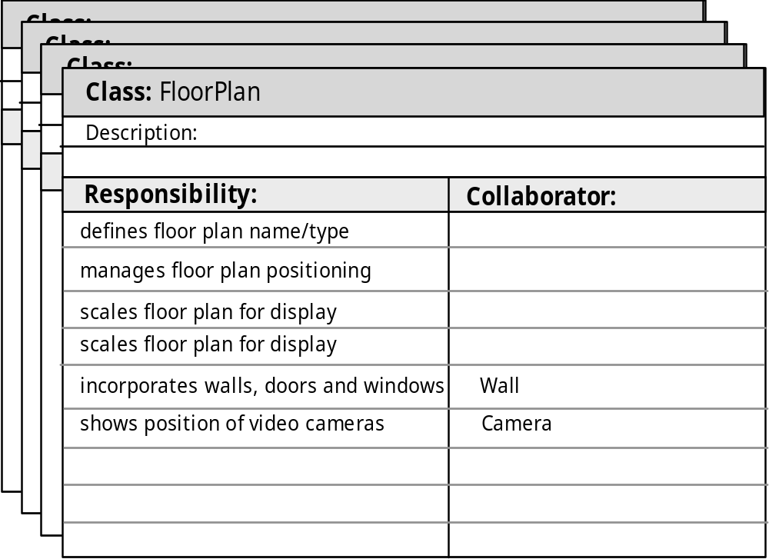
CRC Modeling
These slides are designed to accompany Software Engineering: A Practitioner’s Approach, 7/e (McGraw-Hill, 2009). Slides copyright 2009 by Roger Pressman.

Slide 48
Class Types
Entity classes, also called model or business classes, are extracted directly from the statement of the problem (e.g., FloorPlan and Sensor).
Boundary classes are used to create the interface (e.g., interactive screen or printed reports) that the user sees and interacts with as the software is used. (e.g., CameraWindow displays surveillance camera output.)
Controller classes manage a “unit of work” [UML03] from start to finish. That is, controller classes can be designed to manage
  the creation or update of entity objects;
  the instantiation of boundary objects as they obtain information from entity objects;
  complex communication between sets of objects;
  validation of data communicated between objects or between the user and the application.
These slides are designed to accompany Software Engineering: A Practitioner’s Approach, 7/e (McGraw-Hill, 2009). Slides copyright 2009 by Roger Pressman.

Slide 49
Class Responsibilities
Five guidelines for allocating responsibilities to classes:
System intelligence should be distributed across classes to best address the needs of the problem
Each responsibility should be stated as generally as possible
Information and the behavior related to it should reside within the same class
Information about one thing should be localized with a single class, not distributed across multiple classes.
Responsibilities should be shared among related classes, when appropriate.
These slides are designed to accompany Software Engineering: A Practitioner’s Approach, 7/e (McGraw-Hill, 2009). Slides copyright 2009 by Roger Pressman.

Slide 50
Class Collaborations
Classes fulfill their responsibilities in one of two ways:
  A class can use its own operations to manipulate its own attributes, thereby fulfilling a particular responsibility, or
  a class can collaborate with other classes.
Collaborations identify relationships between classes
Collaborations are identified by determining whether a class can fulfill each responsibility itself
three different generic relationships between classes [WIR90]:
  the is-part-of relationship
  the has-knowledge-of relationship
  the depends-upon relationship
  For example, ControlPanel object must determine whether any sensors are open. A responsibility named determine-sensor-status() is defined. If sensors are open, controlPanel must set a status attribute to “not ready”. Sensor information can be acquired from each Sensor object. Therefor,, the responsibility can be fulfilled only if ControlPanel works in collaboration with sensor.
These slides are designed to accompany Software Engineering: A Practitioner’s Approach, 7/e (McGraw-Hill, 2009). Slides copyright 2009 by Roger Pressman.

Slide 51

Composite Aggregate Class
Video Game Classes
  PlayerHead, PlayerBody, PlayerArms and PlayerLegs is-part-of Player.
  Depends-upon implies that two classes have a dependency that is not achieved by has-knowledge-if or is-part-of. For example, PlayerHead must always be connected to PlayerBody, yet each object could exist without direct knowledge of the other. An attribute of the PlayerHead object called center-position is determined from the center position of PlayerBody. Thus, PlayerHead depends-upon PlayerBody.
These slides are designed to accompany Software Engineering: A Practitioner’s Approach, 7/e (McGraw-Hill, 2009). Slides copyright 2009 by Roger Pressman.

Slide 52
Class Associations and Dependencies
Two analysis classes are often related to one another in some fashion
  In UML these relationships are called associations
  Associations can be refined by indicating multiplicity (the term cardinality is used in data modeling
In many instances, a client-server relationship exists between two analysis classes.
  In such cases, a client-class depends on the server-class in some way and a dependency relationship is established
These slides are designed to accompany Software Engineering: A Practitioner’s Approach, 7/e (McGraw-Hill, 2009). Slides copyright 2009 by Roger Pressman.

Slide 53
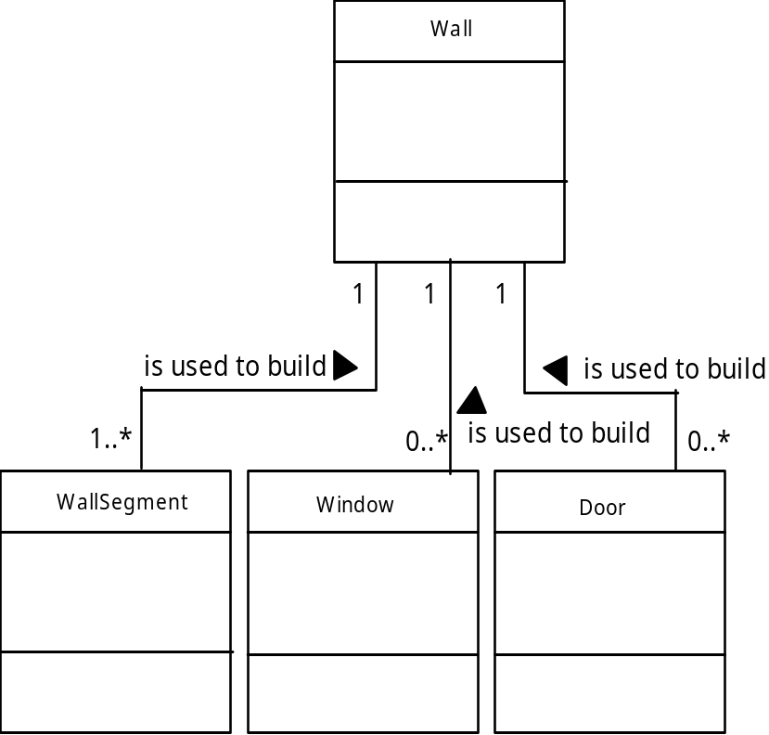
Class Multiplicity
These slides are designed to accompany Software Engineering: A Practitioner’s Approach, 7/e (McGraw-Hill, 2009). Slides copyright 2009 by Roger Pressman.

Slide 54
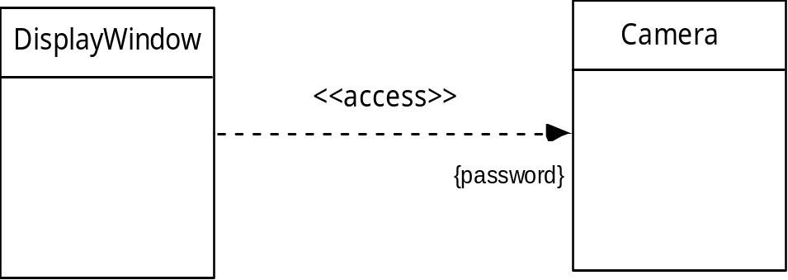
Class Dependencies
These slides are designed to accompany Software Engineering: A Practitioner’s Approach, 7/e (McGraw-Hill, 2009). Slides copyright 2009 by Roger Pressman.

Slide 55
Analysis Packages
Various elements of the analysis model (e.g., use-cases, analysis classes) are categorized in a manner that packages them as a grouping
The plus sign preceding the analysis class name in each package indicates that the classes have public visibility and are therefore accessible from other packages.
Other symbols can precede an element within a package. A minus sign indicates that an element is hidden from all other packages and a # symbol indicates that an element is accessible only to packages contained within a given package.
These slides are designed to accompany Software Engineering: A Practitioner’s Approach, 7/e (McGraw-Hill, 2009). Slides copyright 2009 by Roger Pressman.

Slide 56
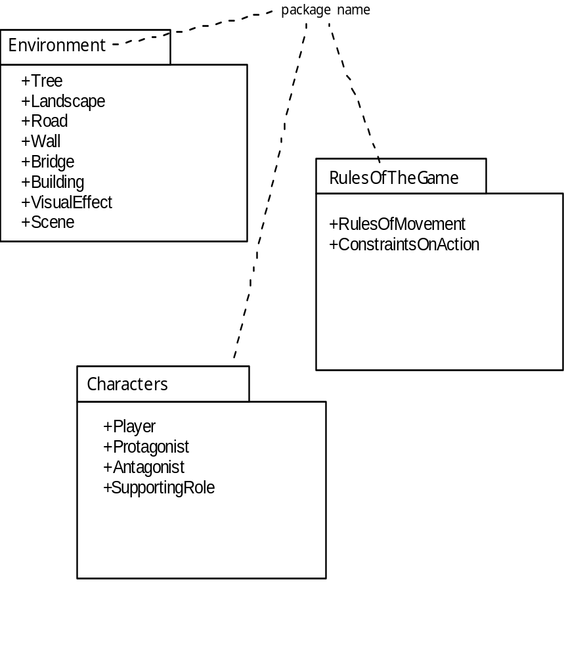
Analysis Packages
These slides are designed to accompany Software Engineering: A Practitioner’s Approach, 7/e (McGraw-Hill, 2009). Slides copyright 2009 by Roger Pressman.

Slide 57
Reviewing the CRC Model
All participants in the review (of the CRC model) are given a subset of the CRC model index cards.
  Cards that collaborate should be separated (i.e., no reviewer should have two cards that collaborate).
All use-case scenarios (and corresponding use-case diagrams) should be organized into categories.
The review leader reads the use-case deliberately.
  As the review leader comes to a named object, she passes a token to the person holding the corresponding class index card.
When the token is passed, the holder of the class card is asked to describe the responsibilities noted on the card.
  The group determines whether one (or more) of the responsibilities satisfies the use-case requirement.
If the responsibilities and collaborations noted on the index cards cannot accommodate the use-case, modifications are made to the cards.
  This may include the definition of new classes (and corresponding CRC index cards) or the specification of new or revised responsibilities or collaborations on existing cards.
These slides are designed to accompany Software Engineering: A Practitioner’s Approach, 7/e (McGraw-Hill, 2009). Slides copyright 2009 by Roger Pressman.

