Slide 1
Chapter 8
CS435: Introduction to Software Engineering
Dr. M. Zhu
Design Concepts
Slide Set to accompany
Software Engineering: A Practitioner’s Approach, 7/e
by Roger S. Pressman
Slides copyright © 1996, 2001, 2005, 2009 by Roger S. Pressman
For non-profit educational use only
May be reproduced ONLY for student use at the university level when used in conjunction with Software Engineering: A Practitioner's Approach, 7/e. Any other reproduction or use is prohibited without the express written permission of the author.
All copyright information MUST appear if these slides are posted on a website for student use.
These slides are designed to accompany Software Engineering: A Practitioner’s Approach, 7/e (McGraw-Hill, 2009) Slides copyright 2009 by Roger Pressman.

Slide 2
Design
Software design encompasses the set of principles, concepts, and practices that lead to the development of a high-quality system or product. Concept->Practice->software representations.
Design is where you stand with a foot in two worlds – the world of technology and the world of people and human purpose – and you try to bring the two together.
Design model provides detail about software architecture, data structures, interfaces, and components that are necessary to implement the system. It can be assessed for quality and improved before code is generated.
These slides are designed to accompany Software Engineering: A Practitioner’s Approach, 7/e (McGraw-Hill, 2009) Slides copyright 2009 by Roger Pressman.

Slide 3
Design
Mitch Kapor, the creator of Lotus 1-2-3, presented a “software design manifesto” in Dr. Dobbs Journal. He said:
  Good software design should exhibit:
  Firmness: A program should not have any bugs that inhibit its function.
  Commodity: A program should be suitable for the purposes for which it was intended.
  Delight: The experience of using the program should be pleasurable one.
These slides are designed to accompany Software Engineering: A Practitioner’s Approach, 7/e (McGraw-Hill, 2009) Slides copyright 2009 by Roger Pressman.

Slide 4
Design
Software design sits at the technical kernel of software engineering and is applied regardless of the software process model that is used.
After requirement modeling, it is the last action within the modeling activity and sets the stage for construction (code generation and testing).
Elements of the requirements model provides information that is necessary to create the four design models required for a complete specification of design.
These slides are designed to accompany Software Engineering: A Practitioner’s Approach, 7/e (McGraw-Hill, 2009) Slides copyright 2009 by Roger Pressman.

Slide 5

Requirements Model -> Design Model
These slides are designed to accompany Software Engineering: A Practitioner’s Approach, 7/e (McGraw-Hill, 2009) Slides copyright 2009 by Roger Pressman.

Slide 6
Design
The data/class design transforms class models into design class realizations and the requisite data structures required to implement the software. The objects and relationships defined in the CRC diagram and the detailed data content depicted by class attributes and other notation provide the basis for the data design action. Part of class design may occur in conjunction with the design of software architecture.
The architectural design (framework of a computer-based system) defines the relationship between major structural elements of the software, the architectural styles and design patterns that can be used to achieve the requirements defined for the system, and the constraints that affect the way in which architecture can be implemented.
These slides are designed to accompany Software Engineering: A Practitioner’s Approach, 7/e (McGraw-Hill, 2009) Slides copyright 2009 by Roger Pressman.

Slide 7
Design
The interface design describes how the software communicates with systems that interoperate with it, and with humans who use it. An interface implies a flow of information (data/control) and a specific type of behavior. Therefore, usage scenarios and behavioral models provide much of the information needed.
The component-level design transforms structural elements of the software architecture into a procedural description of software components. Information obtained from the class-based models, flow models, and behavioral models serve as the basis for component design.
These slides are designed to accompany Software Engineering: A Practitioner’s Approach, 7/e (McGraw-Hill, 2009) Slides copyright 2009 by Roger Pressman.

Slide 8
Design and Quality
The importance of design can be stated with a single word – quality. It is the place where quality is fostered in software engineering. Deign provides you with representations of software that can be assessed for quality. Design is the only way that you can accurately translate stakeholder’s requirements into a finished software products or system.
Software design serves as the foundation for all the software engineering and support activities that follow.
Without design, you risk building an unstable system – one that will fail when small changes are made; one that may be difficult to test; one whose quality cannot be assessed until late in the software process, when time is short and many dollars have already been spent.
These slides are designed to accompany Software Engineering: A Practitioner’s Approach, 7/e (McGraw-Hill, 2009) Slides copyright 2009 by Roger Pressman.

Slide 9
Design Process
It is an iterative process through which requirements are translated into a “blueprint” for constructing the software.
Initially, the blueprint depicts a holistic view of software. That is the design is represented at a high level of abstraction- a level that can be directly traced into the specific system objective and more detailed data, functional, and behavioral requirements.
As design iteration occur, subsequent refinement leads to design representations at much lower level of abstraction with subtle connection to requirements.
These slides are designed to accompany Software Engineering: A Practitioner’s Approach, 7/e (McGraw-Hill, 2009) Slides copyright 2009 by Roger Pressman.

Slide 10
Design Process: Software Design Characteristics
Three characteristics that serve as a guide for the evaluation of a good design.
the design must implement all of the explicit requirements contained in the analysis model, and it must accommodate all of the implicit requirements desired by the customer.
the design must be a readable, understandable guide for those who generate code and for those who test and subsequently support the software.
the design should provide a complete picture of the software, addressing the data, functional, and behavioral domains from an implementation perspective.
These slides are designed to accompany Software Engineering: A Practitioner’s Approach, 7/e (McGraw-Hill, 2009) Slides copyright 2009 by Roger Pressman.

Slide 11
Technical Criteria for Good Design
A design should exhibit an architecture that (1) has been created using recognizable architectural styles or patterns, (2) is composed of components that exhibit good design characteristics and (3) can be implemented in an evolutionary fashion
  For smaller systems, design can sometimes be developed linearly.
A design should be modular; that is, the software should be logically partitioned into elements or subsystems
A design should contain distinct representations of data, architecture, interfaces, and components.
A design should lead to data structures that are appropriate for the classes to be implemented and are drawn from recognizable data patterns.
A design should lead to components that exhibit independent functional characteristics.
A design should lead to interfaces that reduce the complexity of connections between components and with the external environment.
A design should be derived using a repeatable method that is driven by information obtained during software requirements analysis.
A design should be represented using a notation that effectively communicates its meaning.
These slides are designed to accompany Software Engineering: A Practitioner’s Approach, 7/e (McGraw-Hill, 2009) Slides copyright 2009 by Roger Pressman.

Slide 12
Design Principles
The design process should not suffer from ‘tunnel vision.’
The design should be traceable to the analysis model.
The design should not reinvent the wheel.
The design should “minimize the intellectual distance” [DAV95] between the software and the problem as it exists in the real world.
The design should exhibit uniformity and integration.
The design should be structured to accommodate change.
The design should be structured to degrade gently, even when aberrant data, events, or operating conditions are encountered.
Design is not coding, coding is not design.
The design should be assessed for quality as it is being created, not after the fact.
The design should be reviewed to minimize conceptual (semantic) errors.
From Davis [DAV95]
These slides are designed to accompany Software Engineering: A Practitioner’s Approach, 7/e (McGraw-Hill, 2009) Slides copyright 2009 by Roger Pressman.

Slide 13
Design Quality Attributes (FURPS)
Functionality: evaluate the feature set and capabilities of the program, the generality of the functions that are delivered , and the security of the overall system.
Usability is assessed by considering human factors, overall aesthetics, consistency, and documentation.
Reliability is evaluated by measuring the frequency and severity of failure, the accuracy of output results, the mean-time-to-failure, the ability to recover form failure, and the predictability of the program.
Performance is measured by considering processing speed, response time, resource consumption, throughput, and efficiency.
Supportability combines the ability to extend the program, adaptability, serviceability, maintainability, testability, compatibility, configurability.
From Hewlett-Packard [Gra87]]
These slides are designed to accompany Software Engineering: A Practitioner’s Approach, 7/e (McGraw-Hill, 2009) Slides copyright 2009 by Roger Pressman.

Slide 14
Fundamental Concepts
A set of fundamental software design concepts has evolved over the history of software engineering. They span both traditional and object-oriented software development.
M.A. Jackson [Jac75] once said: “ the beginning of wisdom for a software engineer is to recognize the difference between getting a program to work, and getting it right.”
Fundamental software design concepts provide the necessary framework for “getting it right”.
These slides are designed to accompany Software Engineering: A Practitioner’s Approach, 7/e (McGraw-Hill, 2009) Slides copyright 2009 by Roger Pressman.

Slide 15
Fundamental Concepts
Abstraction—data, procedure, control
Architecture—the overall structure of the software
Patterns—”conveys the essence” of a proven design solution
Separation of concerns—any complex problem can be more easily handled if it is subdivided into pieces
Modularity—compartmentalization of data and function
Hiding—controlled interfaces
Functional independence—single-minded function and low coupling
Refinement—elaboration of detail for all abstractions
Aspects—a mechanism for understanding how global requirements affect design
Refactoring—a reorganization technique that simplifies the design
OO design concepts—Appendix II
Design Classes—provide design detail that will enable analysis classes to be implemented
These slides are designed to accompany Software Engineering: A Practitioner’s Approach, 7/e (McGraw-Hill, 2009) Slides copyright 2009 by Roger Pressman.

Slide 16
Data Abstraction
door
manufacturer
model number
type
swing direction
inserts
lights
type
number
weight
opening mechanism
implemented as a data structure
These slides are designed to accompany Software Engineering: A Practitioner’s Approach, 7/e (McGraw-Hill, 2009) Slides copyright 2009 by Roger Pressman.

Slide 17
Procedural Abstraction
open
details of enter
algorithm
implemented with a "knowledge" of the
object that is associated with enter
These slides are designed to accompany Software Engineering: A Practitioner’s Approach, 7/e (McGraw-Hill, 2009) Slides copyright 2009 by Roger Pressman.

Slide 18
Architecture
“The overall structure of the software and the ways in which that structure provides conceptual integrity for a system.” [SHA95a]
What properties should be specified?
Structural properties. This aspect of the architectural design representation defines the components of a system (e.g., modules, objects, filters) and the manner in which those components are packaged and interact with one another. For example, objects are packaged to encapsulate both data and the processing that manipulates the data and interact via the invocation of methods
Extra-functional properties. The architectural design description should address how the design architecture achieves requirements for performance, capacity, reliability, security, adaptability, and other system characteristics.
Families of related systems. The architectural design should draw upon repeatable patterns that are commonly encountered in the design of families of similar systems. In essence, the design should have the ability to reuse architectural building blocks.
These slides are designed to accompany Software Engineering: A Practitioner’s Approach, 7/e (McGraw-Hill, 2009) Slides copyright 2009 by Roger Pressman.

Slide 19
Pattern
Brad Appleton defines design pattern in the following manner: A pattern is a named nugget of insight which conveys the essence of a proven solution to a recurring problem within a certain context amidst competing concern.
The intent of each design pattern is to provide a description that enables a designer to determine
(1) whether the pattern is applicable to the current work,
(2) whether the pattern can be reused (hence, saving design time),
(3) whether the pattern can serve as a guide for developing a similar, but functionally or structurally different pattern.
These slides are designed to accompany Software Engineering: A Practitioner’s Approach, 7/e (McGraw-Hill, 2009) Slides copyright 2009 by Roger Pressman.

Slide 20
Design Pattern Template
Design Pattern Template
Pattern name—describes the essence of the pattern in a short but expressive name
Intent—describes the pattern and what it does
Also-known-as—lists any synonyms for the pattern
Motivation—provides an example of the problem
Applicability—notes specific design situations in which the pattern is applicable
Structure—describes the classes that are required to implement the pattern
Participants—describes the responsibilities of the classes that are required to implement the pattern
Collaborations—describes how the participants collaborate to carry out their responsibilities
Consequences—describes the “design forces” that affect the pattern and the potential trade-offs that must be considered when the pattern is implemented
Related patterns—cross-references related design patterns
These slides are designed to accompany Software Engineering: A Practitioner’s Approach, 7/e (McGraw-Hill, 2009) Slides copyright 2009 by Roger Pressman.

Slide 21
Separation of Concerns
Any complex problem can be more easily handled if it is subdivided into pieces that can each be solved and/or optimized independently
A concern is a feature or behavior that is specified as part of the requirements model for the software
By separating concerns into smaller, and therefore more manageable pieces, a problem takes less effort and time to solve.
These slides are designed to accompany Software Engineering: A Practitioner’s Approach, 7/e (McGraw-Hill, 2009) Slides copyright 2009 by Roger Pressman.

Slide 22
Modularity
"modularity is the single attribute of software that allows a program to be intellectually manageable" [Mye78].
Monolithic software (i.e., a large program composed of a single module) cannot be easily grasped by a software engineer.
  The number of control paths, span of reference, number of variables, and overall complexity would make understanding close to impossible.
In almost all instances, you should break the design into many modules, hoping to make understanding easier and as a consequence, reduce the cost required to build the software.
These slides are designed to accompany Software Engineering: A Practitioner’s Approach, 7/e (McGraw-Hill, 2009) Slides copyright 2009 by Roger Pressman.

Slide 23
Modularity: Trade-offs
What is the "right" number of modules
for a specific software design?
module development cost
cost of
software
module
integration
cost
optimal number
number of modules
of modules
These slides are designed to accompany Software Engineering: A Practitioner’s Approach, 7/e (McGraw-Hill, 2009) Slides copyright 2009 by Roger Pressman.

Slide 24
Information Hiding
module
• algorithm
controlled
interface
• data structure
• details of external interface
• resource allocation policy
clients
"secret"
a specific design decision
These slides are designed to accompany Software Engineering: A Practitioner’s Approach, 7/e (McGraw-Hill, 2009) Slides copyright 2009 by Roger Pressman.

Slide 25
Why Information Hiding?
reduces the likelihood of “side effects”
limits the global impact of local design decisions
emphasizes communication through controlled interfaces
discourages the use of global data
leads to encapsulation—an attribute of high quality design
results in higher quality software
These slides are designed to accompany Software Engineering: A Practitioner’s Approach, 7/e (McGraw-Hill, 2009) Slides copyright 2009 by Roger Pressman.

Slide 26
Stepwise Refinement
open
walk to door;
reach for knob;
open door;
repeat until door opens
turn knob clockwise;
walk through;
if knob doesn't turn, then
close door.
take key out;
find correct key;
insert in lock;
endif
pull/push door
move out of way;
end repeat
These slides are designed to accompany Software Engineering: A Practitioner’s Approach, 7/e (McGraw-Hill, 2009) Slides copyright 2009 by Roger Pressman.

Slide 27

Sizing Modules: Two Views
These slides are designed to accompany Software Engineering: A Practitioner’s Approach, 7/e (McGraw-Hill, 2009) Slides copyright 2009 by Roger Pressman.

Slide 28
Functional Independence
Functional independence is achieved by developing modules with "single-minded" function and an "aversion" to excessive interaction with other modules.
Cohesion is an indication of the relative functional strength of a module.
  A cohesive module performs a single task, requiring little interaction with other components in other parts of a program. Stated simply, a cohesive module should (ideally) do just one thing.
Coupling is an indication of the relative interdependence among modules.
  Coupling depends on the interface complexity between modules, the point at which entry or reference is made to a module, and what data pass across the interface.
These slides are designed to accompany Software Engineering: A Practitioner’s Approach, 7/e (McGraw-Hill, 2009) Slides copyright 2009 by Roger Pressman.

Slide 29
Aspects
Ideally, a requirements model can be organized in a way that allows you to isolate each concern so that it can be considered independently. In practice, however, some of these concerns span the entire system and cannot be easily compartmentalized.
Consider two requirements, A and B. Requirement A crosscuts requirement B “if a software decomposition [refinement] has been chosen in which B cannot be satisfied without taking A into account. [Ros04]
An aspect is a representation of a cross-cutting concern.
These slides are designed to accompany Software Engineering: A Practitioner’s Approach, 7/e (McGraw-Hill, 2009) Slides copyright 2009 by Roger Pressman.

Slide 30
Aspects—An Example
Consider two requirements for the SafeHomeAssured.com WebApp. Requirement A is described via the use-case Access camera surveillance via the Internet. A design refinement would focus on those modules that would enable a registered user to access video from cameras placed throughout a space. Requirement B is a generic security requirement that states that a registered user must be validated prior to using SafeHomeAssured.com. This requirement is applicable for all functions that are available to registered SafeHome users. As design refinement occurs, A* is a design representation for requirement A and B* is a design representation for requirement B. Therefore, A* and B* are representations of concerns, and B* cross-cuts A*.
An aspect is a representation of a cross-cutting concern. Therefore, the design representation, B*, of the requirement, a registered user must be validated prior to using SafeHomeAssured.com, is an aspect of the SafeHome WebApp.
These slides are designed to accompany Software Engineering: A Practitioner’s Approach, 7/e (McGraw-Hill, 2009) Slides copyright 2009 by Roger Pressman.

Slide 31
Refactoring
An important design activity suggested for many agile methods, it is reorganization technique that simplifies the design of a component.
Fowler [FOW99] defines refactoring in the following manner:
  "Refactoring is the process of changing a software system in such a way that it does not alter the external behavior of the code [design] yet improves its internal structure.”
When software is refactored, the existing design is examined for
  redundancy
  unused design elements
  inefficient or unnecessary algorithms
  poorly constructed or inappropriate data structures
  or any other design failure that can be corrected to yield a better design.
These slides are designed to accompany Software Engineering: A Practitioner’s Approach, 7/e (McGraw-Hill, 2009) Slides copyright 2009 by Roger Pressman.

Slide 32
OO Design Concepts
Requirements model defines a set of analysis classes. Each describes some element of the problem domain, focusing on aspects of the problem that are user visible. The level of abstraction is high.
As the design model evolves, you will define a set of design classes that refine the analysis classes by providing design detail that will enable the classes to be implemented, and implement a software infrastructure that supports the business solution.
Five different types of design classes, each representing a different layer of the design architecture:
  User interface classes
  Business domain classes
  Process classes
  Persistent classes
  System classes
These slides are designed to accompany Software Engineering: A Practitioner’s Approach, 7/e (McGraw-Hill, 2009) Slides copyright 2009 by Roger Pressman.

Slide 33
Design Classes
Design classes in three big categories
  Entity classes
  Boundary classes
  Controller classes
Inheritance—all responsibilities of a superclass is immediately inherited by all subclasses
Messages—stimulate some behavior to occur in the receiving object
Polymorphism—a characteristic that greatly reduces the effort required to extend the design
These slides are designed to accompany Software Engineering: A Practitioner’s Approach, 7/e (McGraw-Hill, 2009) Slides copyright 2009 by Roger Pressman.

Slide 34
Design Classes
Analysis classes are refined during design to become entity classes
Boundary classes are developed during design to create the interface (e.g., interactive screen or printed reports) that the user sees and interacts with as the software is used.
  Boundary classes are designed with the responsibility of managing the way entity objects are represented to users.
Controller classes are designed to manage
  the creation or update of entity objects;
  the instantiation of boundary objects as they obtain information from entity objects;
  complex communication between sets of objects;
  validation of data communicated between objects or between the user and the application.
These slides are designed to accompany Software Engineering: A Practitioner’s Approach, 7/e (McGraw-Hill, 2009) Slides copyright 2009 by Roger Pressman.

Slide 35

The Design Model
These slides are designed to accompany Software Engineering: A Practitioner’s Approach, 7/e (McGraw-Hill, 2009) Slides copyright 2009 by Roger Pressman.

Slide 36
Design Model Elements
Data elements
  Data model --> data structures
  Data model --> database architecture
Architectural elements
  Application domain
  Analysis classes, their relationships, collaborations and behaviors are transformed into design realizations
  Patterns and “styles” (Chapters 9 and 12)
Interface elements
  the user interface (UI)
  external interfaces to other systems, devices, networks or other producers or consumers of information
  internal interfaces between various design components.
Component elements
Deployment elements
These slides are designed to accompany Software Engineering: A Practitioner’s Approach, 7/e (McGraw-Hill, 2009) Slides copyright 2009 by Roger Pressman.

Slide 37
Architectural Elements
The architectural model [Sha96] is derived from three sources:
  information about the application domain for the software to be built;
  specific requirements model elements such as data flow diagrams or analysis classes, their relationships and collaborations for the problem at hand, and
  the availability of architectural patterns (Chapter 12) and styles (Chapter 9).
These slides are designed to accompany Software Engineering: A Practitioner’s Approach, 7/e (McGraw-Hill, 2009) Slides copyright 2009 by Roger Pressman.

Slide 38
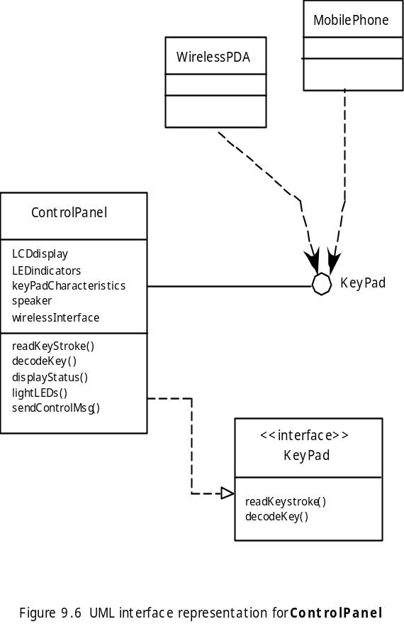
Interface Elements
How information flows in and out of the system and how components communicate and collaborate.
Three major elements:
  User interface
  External interface to other system, device, networks or producers or consumers of information
  Internal interfaces between components.
These slides are designed to accompany Software Engineering: A Practitioner’s Approach, 7/e (McGraw-Hill, 2009) Slides copyright 2009 by Roger Pressman.

Slide 39
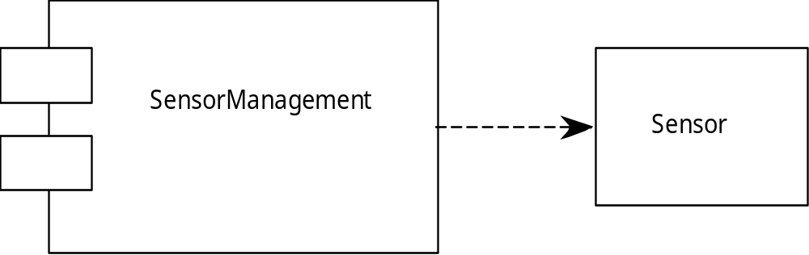
Component Elements
Describe the internal details of each software components. It defines data structure for all local data objects and algorithmic details for all processing that occurs within a component and an interface that allows access to all component operations.
Within the context of object-oriented SE, a component is represented in UML diagram as shown above. SensorManagement performs all functions associated with sensors including monitoring and configuring them.
These slides are designed to accompany Software Engineering: A Practitioner’s Approach, 7/e (McGraw-Hill, 2009) Slides copyright 2009 by Roger Pressman.

Slide 40
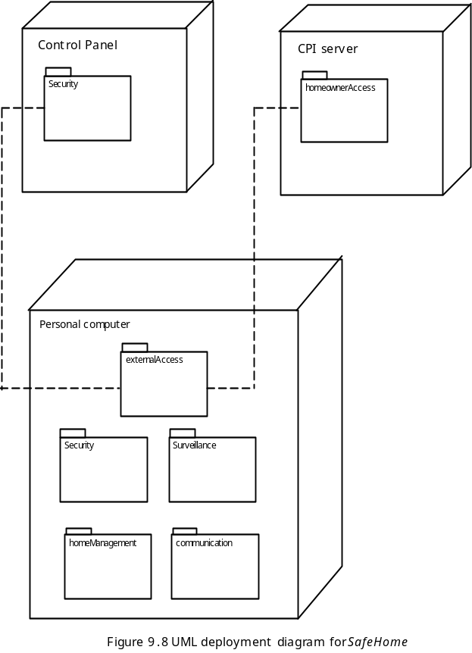
Deployment Elements
How software functionality and subsystems will be allocated within the physical computing environment that will support the software.
  E.g. Safehome product are configured to operate within three primary computing environments- a home-based PC, the safehome control panel, and a server housed at CPI corp.
These slides are designed to accompany Software Engineering: A Practitioner’s Approach, 7/e (McGraw-Hill, 2009) Slides copyright 2009 by Roger Pressman.

