Slide 1
Applied Physics(C. Sc.) BS CS Semester-I Course Code: L-14(Prisms) IUB & All Affiliated Colleges. Reality Awards Boost Up (YT-Channel)

Slide 2
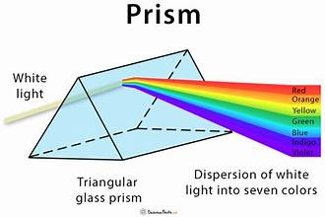
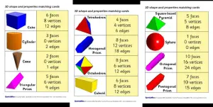
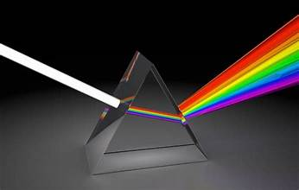
Prism:
It is a three-dimensional solid object in which the two ends are identical. It is the combination of the flat faces, identical bases and equal cross-sections. The faces of the prism are parallelograms or rectangles without the bases. And the bases of the prism could be triangle, square, rectangle or any n-sided polygon. For example, a pentagonal prism has two pentagonal bases and 5 rectangular faces.
Prisms are optical devices that manipulate light by bending or refracting it. They are widely used in various fields, including physics, optics, and vision correction. Prisms play a crucial role in altering the path of light and have diverse applications. This article aims to provide a comprehensive understanding of prisms, including their types, uses, and applications.
Prism Shape
A prism has a solid shape consisting of two identical ends (such as triangle, square, rectangle, etc.), flat faces or surfaces and uniform cross-section across its length. The cross-section looks like a triangle hence called triangular prism. The shape of the prism does not have any curve. Therefore, a prism can have square, rectangular, pentagonal and other polygon shapes but not the circular shape.
Cross Section of Prism
The cross-section is the shape obtained by the intersection of an object by a plane along its axis. It is also said as cutting a three-dimensional object with a plane to obtain another shape.
If a prism is intersected by a plane, parallel to the base, then the shape of cross-section will be same as the base. For instance, a square pyramid is cut by a plane, parallel to the base, then the shape of cross-section of pyramid will also be a square.

Slide 3
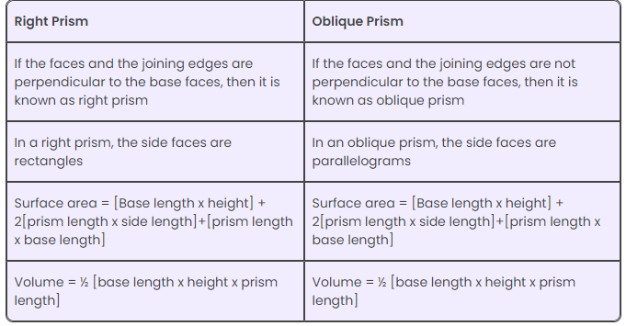
Types of Prism:
Depending upon the cross-sections, the prisms are named. It is of two types, namely;
Regular Prism
Irregular Prism
Regular Prism
If the bases of the prism are in the shape of a regular polygon, it is called regular prism.
Irregular Prism
If the bases are in the shape of an irregular polygon, then the prism is called an irregular prism.
Prism Based on Shape of Bases
Based on the shape of the bases, it is further categorized into different types, namely;
Triangular prism (has triangular bases)
Square prism (has square bases)
Rectangular prism (has rectangular bases)
Pentagonal prism (has pentagonal bases)
Hexagonal prism (has hexagonal bases)
Right Prism And Oblique Prism
Apart from regular and irregular, the prism can be classified into two more types;
Right Prism
Oblique Prism
The difference between both the prism for triangular bases are;

Slide 4
Types of Prisms:
There are several types of prisms, each with its unique shape and properties. Some common types of prisms include:
Rectangular Prism: This prism has rectangular bases and rectangular faces. It is commonly used in optics experiments and educational demonstrations.
Triangular Prism: The triangular prism has triangular bases and rectangular or triangular faces. It is widely used in spectroscopy, as it can separate white light into its component colors.
Porro Prism: This type of prism is commonly found in binoculars and other optical devices. It allows light to be reflected multiple times within the prism, resulting in a compact design and image inversion.
Pellin-Broca Prism: This prism is used in spectrometers and spectroscopes for precise wavelength measurements.
Dove Prism: The Dove prism has a unique shape, resembling a pentagonal prism with a roof-like top. It is often used in imaging systems to rotate and invert images without changing their orientation.
Amici Roof Prism: This prism is widely used in binoculars and spotting scopes to correct the orientation of the image.

Slide 5
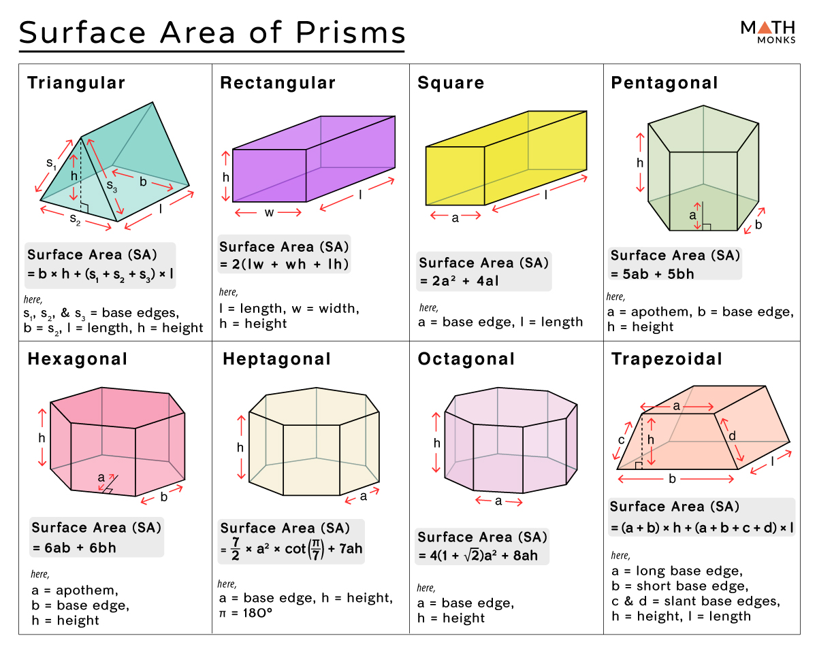
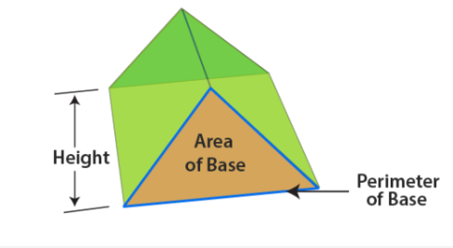
Surface Area of a Prism:
The surface area, also known as the total surface area (TSA) of a prism, is the total space occupied by its flat faces. The surface area is measured in square units such as m2, cm2, mm2, or in2.
Formulas
The general formula to find the total surface area of a prism is:
Total Surface Area (TSA) = 2 × Base Area + Base Perimeter × Height, here, the height of a prism is the distance between the two bases.
The total surface area of a prism is the combined area of the 2 bases and the areas of the lateral faces.
Since Lateral Surface Area (LSA) of a prism = Base perimeter x height
The lateral surface area is the area of all the faces except the bases.
We can also write:
Total Surface Area (TSA) = 2 × Base Area + LSA
However, there are specific formulas to calculate the surface area of different prisms. They are given below:
Some formulas have additional labeling for particular prisms.
In triangular, rectangular, and trapezoidal prisms, ‘l’ (or length) stands for the distance between the bases, and ‘h’ stands for the height of the polygonal base. ‘l’ is the length for a square prism, and ‘a’ represents the four congruent base edges. For pentagonal and hexagonal prisms, ‘a‘ is the apothem, and ‘b’ is the base edge.
Volume of a Prism
The volume of the prism is defined as the product of the base area and the prism height.
For example, if you want to find the volume of a square prism, you must know the area of a square, then its volume can be calculated as follows:
The volume of a square Prism = Area of square × height
V = s2 × h cubic units
Where “s” is the side of a square.

Slide 6
Uses and Applications:
Optics and Photography: Prisms are widely used in optics and photography to manipulate light and achieve specific effects. They can be used to control the path of light, create reflections, and split light into its spectral components.
Vision Correction: Prisms are utilized in eyeglasses and ophthalmic lenses to correct vision problems related to eye misalignment. Prism lenses can help align the images seen by both eyes, reducing double vision and improving binocular vision.
Spectroscopy: Prisms are integral components of spectrometers and spectroscopes. They disperse light into its component wavelengths, allowing scientists to analyze the composition of substances based on their spectral signatures.
Astronomy: Prisms are used in telescopes and astronomical instruments to analyze and study the light emitted by celestial objects. They can separate light into different wavelengths, aiding in the identification of specific elements and compounds.
Laser Technology: Prisms are utilized in laser applications to manipulate laser beams. They can be used to steer and control the direction of laser light, adjust beam shape, and create beam splitters.
: Considerations and Limitations: There are certain considerations and limitations to keep in mind. These include:
Light Dispersion: Prisms disperse light into its component colors, which can result in chromatic aberration. This effect should be taken into account in applications where accurate color representation is essential.
Angle of Deviation: The angle at which light is bent or deviated by a prism depends on its shape and refractive index. Understanding the properties of the specific prism is crucial for achieving the desired effect.
Material Selection: The choice of prism material is important, as different materials have varying refractive indices and transmission properties. Factors such as transparency, durability, and resistance to environmental conditions should be considered.

