Slide 1
Applied Physics(Com. Sc) BS CS Semester-I Course Code: L-5(Work) IUB & All Affiliated Colleges. Reality Awards Boost Up (YT-Channel)
Rushmat Ali
Assistant Professor of Physics
Govt. Kh. F. Graduate College R. Y. Khan

Slide 2
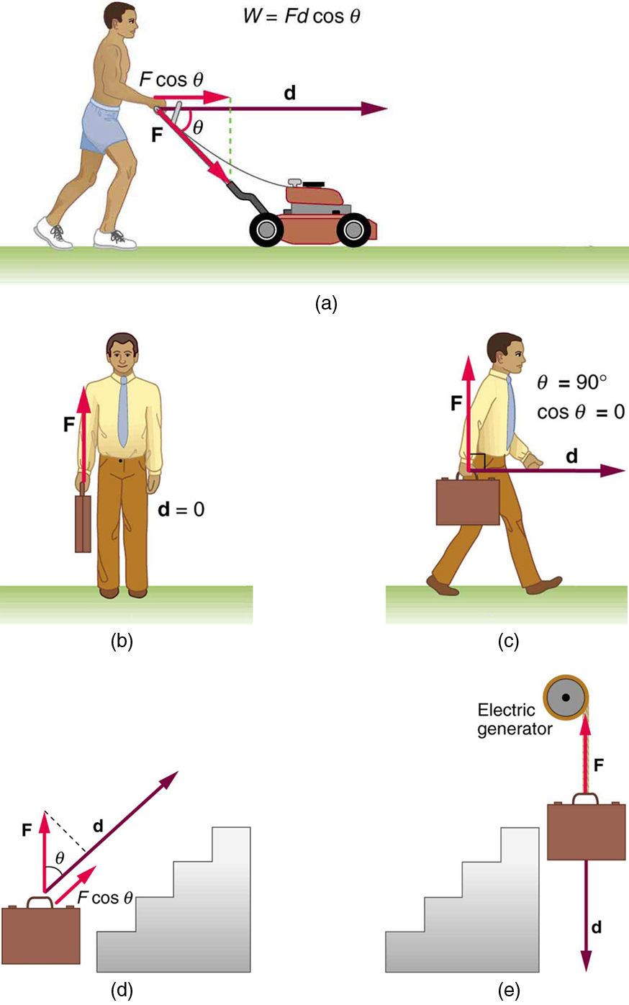
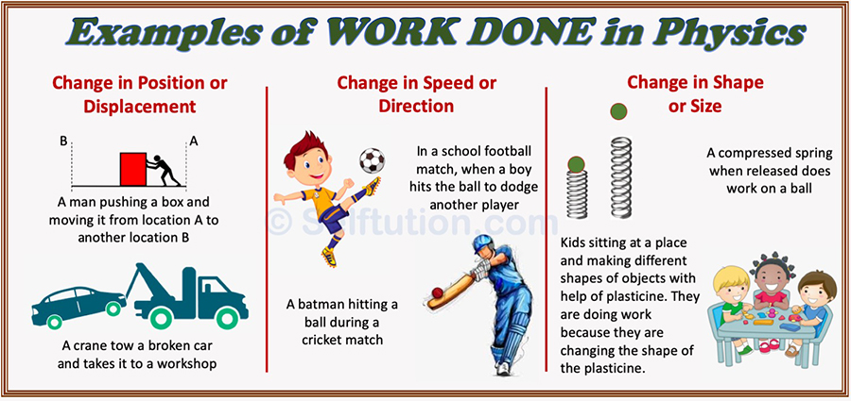
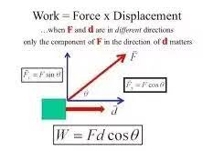
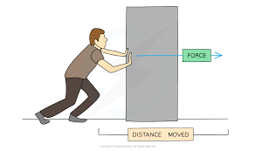

Work
ORIGIN OF WORK:
First recorded before 900 BC; (noun) Middle English worke, Old English worc, replacing Middle English werk(e), Old English weorc, cognate with Old Frisian, Old Saxon werk, Old High German werah, werc (German Werk ), Old Norse verk, Greek érgon; (verb) Middle English worken, derivative of the noun, replacing Middle English wyrchen, Old English wyrcean; cognate with German wirken, Old Norse verkja, Gothic waurkjan
An activity a person engages in regularly to earn a livelihood. people looking for work: a specific task, duty, function, or assignment often being a part or phase of some larger activity.
Work: The definition of work in Physics reveals its relationship to energy – whenever work is done, energy is transferred. For a work to be done, in a scientific sense, a force must be exerted, and there must be displacement in the direction of the force. Work can be categorized in two depending upon force.
1. Work done by a constant Force. 2. Work done by a variable force.
Work done by a constant force: When a constant acts on a body and it covers a displacement in the direction of force, work is said to be done.
The scalar/dot product of force and displacement is equal to work. It is denoted by “W” Mathematically: W= $\vec{F }$ $∙ \vec{d }=F d cos θ$. Here, $θ$is angle between force and displacement.

Slide 3
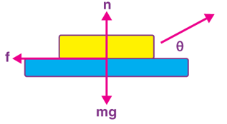
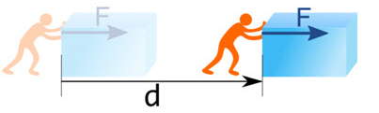
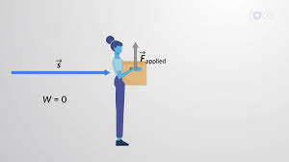
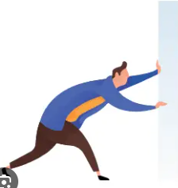
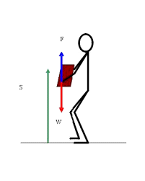
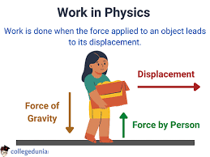
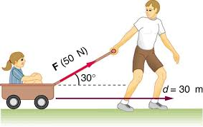

Factors Affecting Work:
Since, W =𝑭 𝒅 𝒄𝒐𝒔 𝜽. There are 3 factors affecting work.
Force: Force is a push or a pull that can cause any object with a mass to change its velocity and acceleration. If the force acting on an object is zero irrespective of the state of the object (dynamic or static), that work done by force is zero. There are 4 forces acting on the body. Friction, Normal, weight, applied force. If $\vec{F}=0, W=0$
Displacement:It is a vector quantity that gives the shortest distance between the initial and final positions of any object. If $\vec{F }≠0, \vec{d}=0, W=0$
The Angle 𝜽: The angle between the Force Vector $\vec{F }$ and the Displacement Vector $\vec{d }$. Depending upon angle, there are three types of work.
Positive Work: If the angle between force and displacement is zero or $\vec{F }⇈\vec{d }$ then work done will be positive maximum. i.e. W= Fd cos 0$°$ =F d(1)= + Fd= work done by the body.
Zero Work: If the angle between Force an displacement is 90$°$ or $\vec{F }⊥\vec{d }$, then work done is zero. i.e. W= Fd cos 90$°$ =Fd (0) =0=No work is done.
Negative Work: If the angle between Force and displacement is 180$°$ or $\vec{F }∥\vec{d }$then negative work is done, i.e. W=F d cos 180$°$=Fd (-) = - Fd= Work is done on the body.

Slide 4
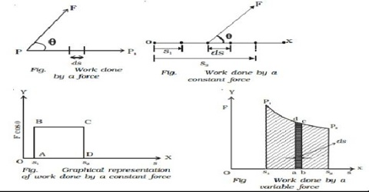
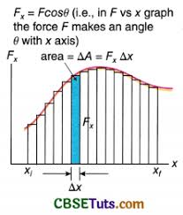
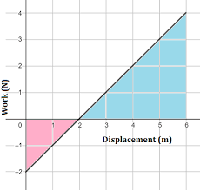
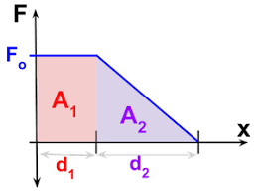

Graphical representation of work
A graph is drawn by taking component of applied force along y-axis and displacement along x-axis.
Graphically, Area under graph and distance axis is equal to work done.
If the applied force is constant then the graph will be a straight line parallel to X-axis. Suppose, due to the action of this force the body moves from position x1 to position x2. Then the area of work done from the graph is obtained from the area of the rectangle subtended by the force in the Y-axis and difference x2 – x1 in the x-axis.
If the applied force is variable, then graph is not rectangle.
Units of work:
S.I. Unit of work is Joule.
1 J= (1N) (1m)
Work is said to be one joule when a force of 1 newton acts on a body and displaces it through 1meter in the direction of force.
C.G.S. Unit of work is erg.
1 erg = (1 dyne) (1cm)
1 J= ${10}^{7} ergs$
The End

