Slide 1
Applied Physics(Com. Sc.) BS CS Semester-I Course Code: L-7(Power) IUB & All Affiliated Colleges. Reality Awards Boost Up (YT-Channel)
Rushmat Ali
Assistant Professor of Physics
Govt. Kh. F. Graduate College R. Y. Khan

Slide 2
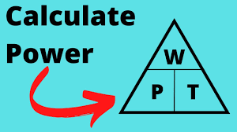
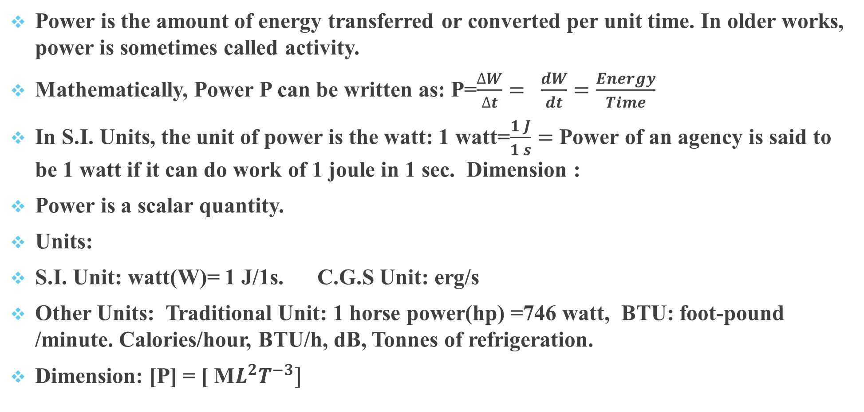
Power
Power is the amount of energy transferred or converted per unit time. In older works, power is sometimes called activity.
Mathematically, Power P can be written as: P=$\frac{∆W}{∆t}= \frac{dW}{dt}=\frac{Energy}{Time}$
In S.I. Units, the unit of power is the watt: 1 watt=$\frac{1 J}{1 s}=$ Power of an agency is said to be 1 watt if it can do work of 1 joule in 1 sec. Dimension :
Power is a scalar quantity.
Units:
S.I. Unit: watt(W)= 1 J/1s. C.G.S Unit: erg/s
Other Units: Traditional Unit: 1 horse power(hp) =746 watt, BTU: foot-pound /minute. Calories/hour, BTU/h, dB, Tonnes of refrigeration.
Dimension: [P] = [ M$L^{2}T^{−3}]$

Slide 3
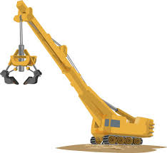

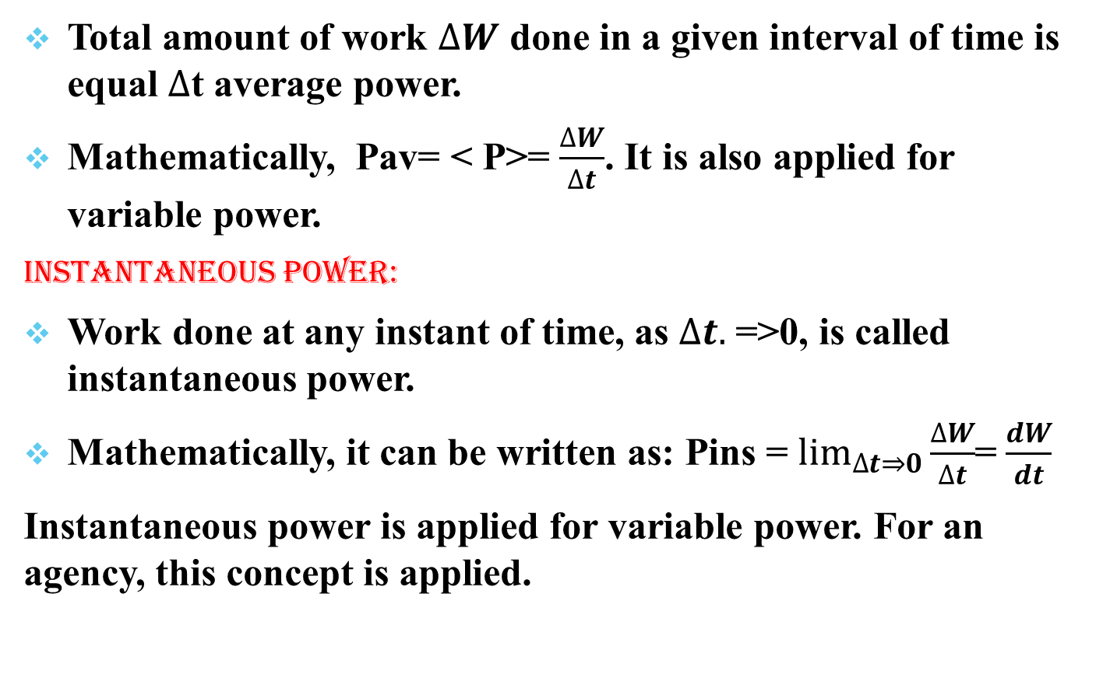
Average Power:
Total amount of work $∆W$ done in a given interval of time is equal $∆$t average power.
Mathematically, Pav= < P>= $\frac{∆W}{∆t}$. It is also applied for variable power.
Instantaneous Power:
Work done at any instant of time, as $∆t.$ =>0, is called instantaneous power.
Mathematically, it can be written as: Pins = $\lim_{∆t⇒0}{\frac{∆W}{∆t}}$= $\frac{dW}{dt}$
Instantaneous power is applied for variable power. For an agency, this concept is applied.

Slide 4
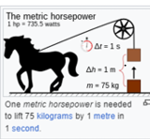
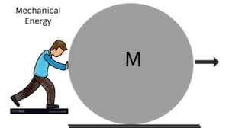

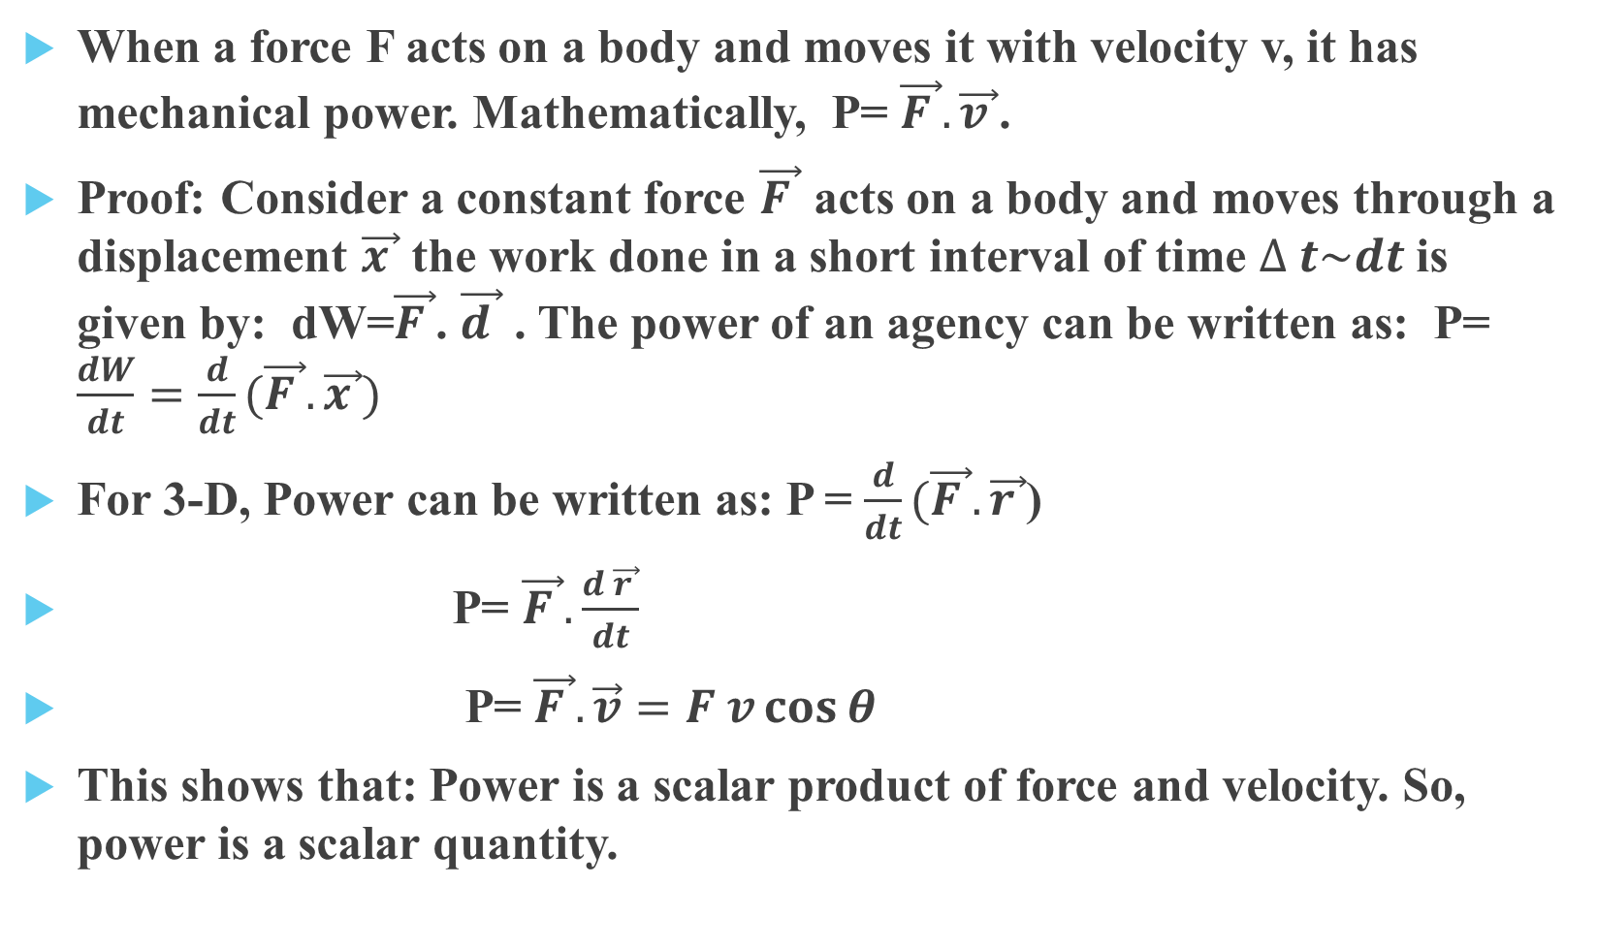
Mechanical Power:
When a force F acts on a body and moves it with velocity v, it has mechanical power. Mathematically, P= $\vec{F }. \vec{v }$.
Proof: Consider a constant force $\vec{F }$ acts on a body and moves through a displacement $\vec{x }$ the work done in a short interval of time $∆ t\sim dt$is given by: dW=$\vec{F }$. $\vec{d }$ . The power of an agency can be written as: P= $\frac{dW}{dt}=\frac{d}{dt}(\vec{F }.\vec{x })$
For 3-D, Power can be written as: P = $\frac{d}{dt}(\vec{F }.\vec{r }$)
P= $\vec{F }. \frac{d \vec{r }}{dt}$
P= $\vec{F }. \vec{v}=F v\cos{θ}$
This shows that: Power is a scalar product of force and velocity. So, power is a scalar quantity.
$$∆$$

Slide 5
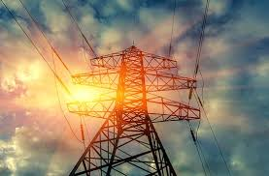
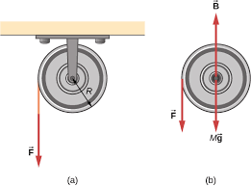
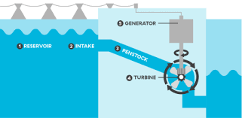
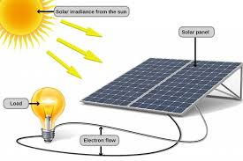
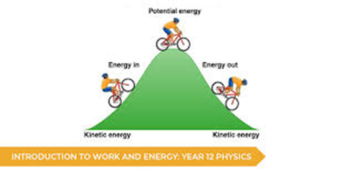


Other types of Power:
Rotational Power: In rotational Systems, the torque acting on the body $\vec{τ }$ rRotating with angular velocity $\vec{ω }$ , the power is given by: P = $\vec{τ }.\vec{ω},$ $τ=$ Torque(N m), $ω=$angular (radiant/s)
Hydraulic Power: In fluids, power is given by: P =P Q; P=Pressure(N/m2), Q=Volumetric Flow rate(m3/s)
Radiant Power: This power is related to Intensity I at distance/radius r. The power emitted is given by: P = $\vec{I }. \vec{A }=I (4πr^{2})$.
Electrical Power: In an electrical Circuit, P=$\vec{V }.\vec{I }=I^{2}R=\frac{V^{2}}{R}$
Here, V=Voltage/Potential Difference(V), I=Current(A), R=V/I=Resistance(V/A=ohm)

Slide 6
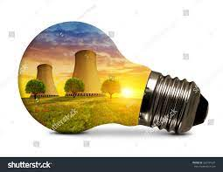
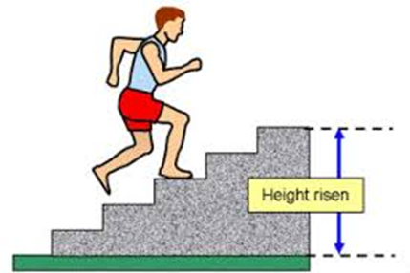
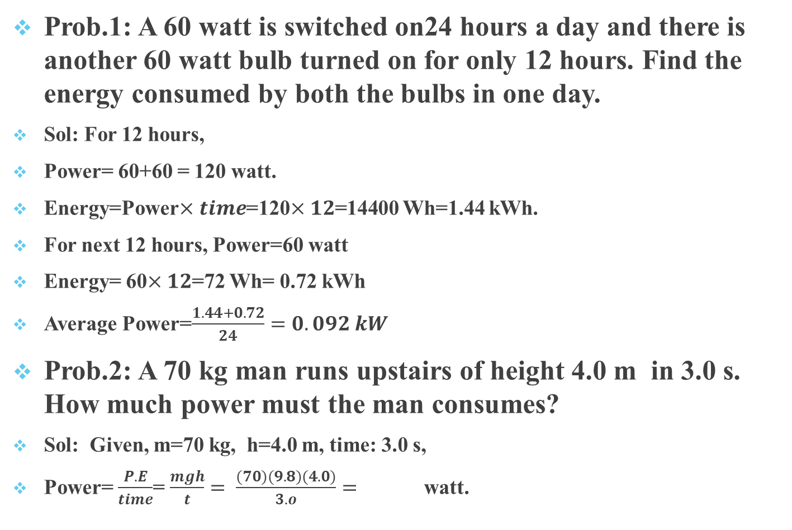
Related Problems:
Prob.1: A 60 watt is switched on24 hours a day and there is another 60 watt bulb turned on for only 12 hours. Find the energy consumed by both the bulbs in one day.
Sol: For 12 hours,
Power= 60+60 = 120 watt.
Energy=Power$×time$=120$×12$=14400 Wh=1.44 kWh.
For next 12 hours, Power=60 watt
Energy= 60$×12$=72 Wh= 0.72 kWh
Average Power=$\frac{1.44+0.72}{24}=0.092 kW$
Prob.2: A 70 kg man runs upstairs of height 4.0 m in 3.0 s. How much power must the man consumes?
Sol: Given, m=70 kg, h=4.0 m, time: 3.0 s,
Power= $\frac{P.E}{time}$= $\frac{mgh}{t}= \frac{(70)(9.8)(4.0)}{3.o}=$ watt.

