Slide 1
Problem & Data
The AI Backbone
From Vague Goal to Trained Model in 10 Steps
AI Foundations • Section 2

Slide 2
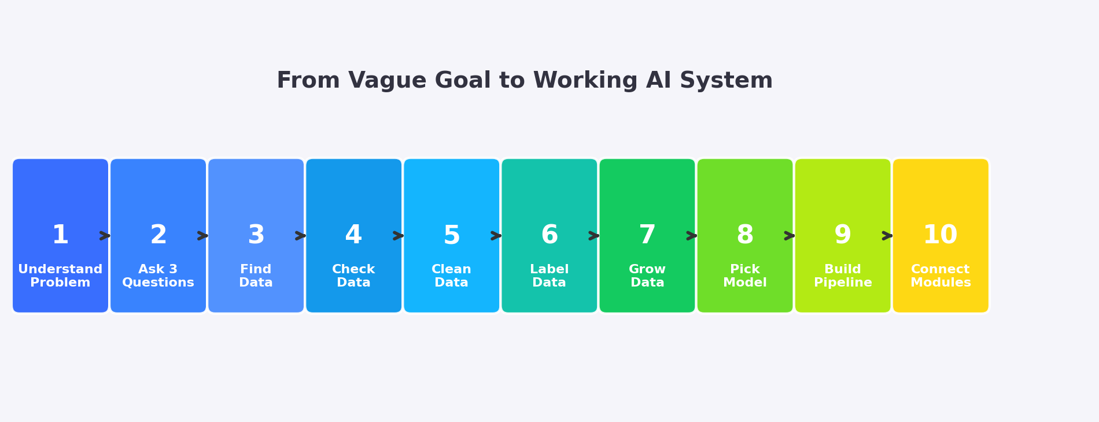
The 10-Step Roadmap
Each step builds on the previous one. You cannot skip steps — but you WILL loop back as you learn more about your data.

Slide 3
Step 1: Understand the Problem
Don't start with 'which model?' — Start with 'what would a HUMAN do?'
• Someone gives you a vague goal ("Build AI for hospital")
• You ask: "What SPECIFICALLY do you want to know?"
• You watch what a HUMAN expert actually does in that role
• You list each specific task the human performs
• Each task = one potential ML problem to solve
• Some tasks need ML, others are simple rules — identify which is which
Vague Goal | Specific Question | Tasks Found
Build AI for hospital | Predict which patients will need ICU? | Vital sign monitoring, Risk scoring, Triage
Make exam fair | Catch cheaters automatically? | Phone detection, Gaze tracking, Identity
Help cricket team | Predict match outcome? | Player stats, Weather, Pitch analysis
KEY INSIGHT: The #1 mistake beginners make is jumping straight to models. Spend 80% of your thinking time understanding the problem BEFORE touching code.

Slide 4
ExamGuard — Watching the Invigilator
What Invigilator Does | Data Used | How They Think | ML Type
Spots phone on desk | Images (camera) | "I recognize that shape" = trained on examples | YOLO (Supervised)
Notices student looking sideways repeatedly | Video (face direction) | "Head turned toward neighbor" = recognizing behavior | CNN + Pose Estimation
Senses something "off" about a student | Video (body language) | "Can't explain but not normal" = gut feeling | Autoencoder (Anomaly Detection)
Decides to confront or wait | Judgment (context) | "Is it worth disrupting? Balancing risk vs. harm" | Reinforcement Learning
Counts absent students | Counting | "30 desks, 28 present" = simple arithmetic | NOT ML — Simple Rule!
KEY INSIGHT: 1 project = 5 ML models + 1 simple rule. Not everything needs ML! A real AI system is a COLLECTION of models, each handling one specific task.

Slide 5
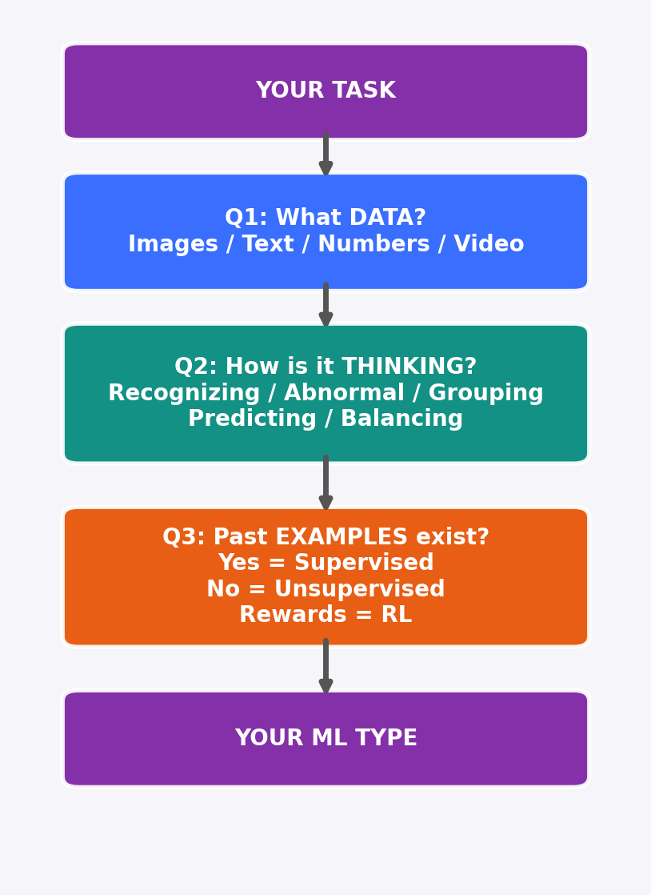
Step 2: The 3 Questions That Decide Your ML Type
How to use the 3 Questions:
1. Start with your specific task (e.g., "detect phones")
2. Q1 — What data will you feed the model?
Images from CCTV? Text from reviews?
Spreadsheet numbers? Audio clips?
3. Q2 — How does a human THINK about this?
"I RECOGNIZE that" → Classification
"That seems ABNORMAL" → Anomaly Detection
"These GROUP together" → Clustering
"I PREDICT this will happen" → Regression
"I'm BALANCING tradeoffs" → RL
4. Q3 — Do you have labeled examples?
Yes (labeled data) → Supervised Learning
No (just raw data) → Unsupervised Learning
Rewards/penalties → Reinforcement Learning

Slide 6
Q1 + Q2 + Q3 → Your ML Type
Use this table as a quick-reference to map ANY problem to the right approach.
Data (Q1) | Thinking (Q2) | Labels? (Q3) | ML Type | Model Examples
Images | Recognizing | Yes | Supervised | CNN / YOLO
Images | Something off | No | Anomaly Detection | Autoencoder
Text | Categorizing | Yes | Supervised | Naive Bayes / BERT
Numbers | Predicting category | Yes | Classification | LogReg / DT / RF
Numbers | Predicting amount | Yes | Regression | Linear / Poly / RF
Numbers | Something off | No | Anomaly Detection | Isolation Forest
Numbers | Grouping | No | Clustering | K-Means / DBSCAN
Any | Balancing tradeoffs | Rewards | Reinforcement Learning | Q-Learning / PPO
TIP: Most real projects need MULTIPLE rows from this table. ExamGuard uses rows 1, 2, and 8!

Slide 7
Practice: Apply 3 Questions to Real Problems
Restaurant Manager — "Reduce food waste"
Clothing Store — "Reduce returns"
Task | Data (Q1) | Thinking (Q2) | ML Type
Predict daily demand | Sales numbers | Predicting amount | Regression
Spot spoiled ingredients | Images | Something off | Anomaly
Group similar dishes | Menu + sales | Grouping | Clustering
Categorize complaints | Text reviews | Categorizing | Classification
Optimize pricing | Sales + prices | Balancing tradeoffs | RL
Task | Data (Q1) | Thinking (Q2) | ML Type
Predict if item returned | Purchase data | Predicting category | Classification
Recommend right size | Body + item data | Predicting amount | Regression
Detect listing errors | Product images | Something off | Anomaly
Group return reasons | Text feedback | Grouping | Clustering
Optimize return policy | Cost + satisfaction | Balancing tradeoffs | RL
NOTICE THE PATTERN:
Every real-world project decomposes into 4-6 sub-tasks. Each sub-task maps to a different ML type. This is why Step 1 (decomposition) is so critical — without it, you'd try to build ONE model to do everything, and it would fail.

Slide 8
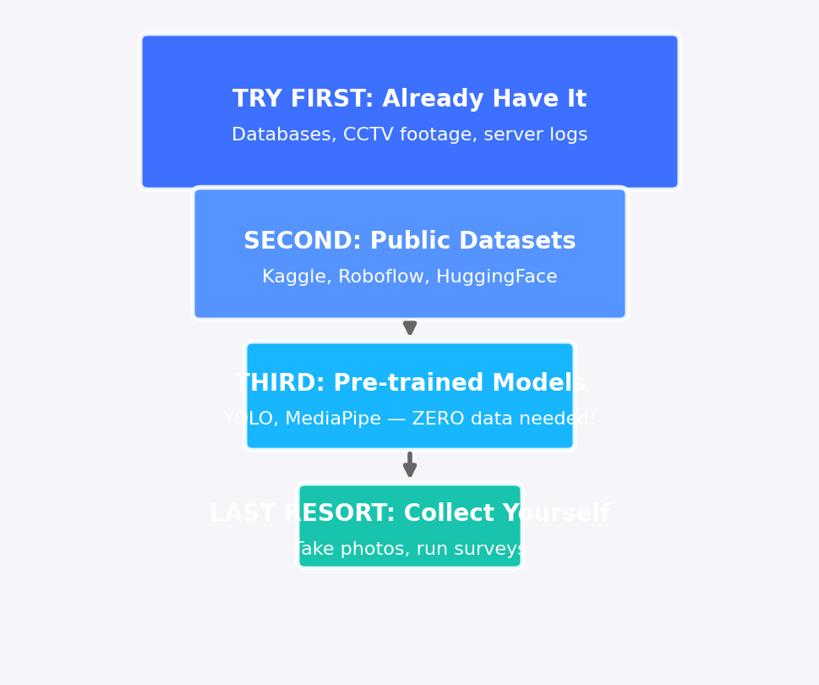
Step 3: Where to Get Data
Data Source Priority (try top-to-bottom):
1. YOUR OWN DATA is always best because it matches
your exact situation. CCTV from YOUR exam hall,
patient records from YOUR hospital.
2. PUBLIC DATASETS are great for starting out.
Kaggle.com has 200K+ datasets. Roboflow has
labeled image datasets. HuggingFace for text.
3. PRE-TRAINED MODELS already know how to do
common tasks. YOLO detects 80 objects out of
the box. MediaPipe tracks faces and poses.
You may need ZERO data!
4. COLLECTING YOUR OWN is expensive and slow.
Only do this when nothing else works.
But the result is the most valuable data.

Slide 9
Pre-trained Models — Start with ZERO Data
Model | What It Does | Data Needed | Install Command
YOLOv8 | Detect 80 objects (phone, person, bag...) | Zero! | pip install ultralytics
MediaPipe Face | Face landmarks + gaze direction | Zero! | pip install mediapipe
MediaPipe Pose | Body skeleton tracking (33 points) | Zero! | (same package)
BERT / DistilBERT | Text understanding, sentiment, classification | Zero for basic use | pip install transformers
Whisper | Speech-to-text (98 languages) | Zero! | pip install openai-whisper
THE 10-PHOTO TEST — Before committing to any model:
1. Take 10 photos/samples from YOUR actual setup (your classroom, your camera angle)
2. Run the pre-trained model on those 10 samples
3. Check accuracy: >85% = Use AS-IS | 60-85% = FINE-TUNE with your data | <60% = Wrong model, try another
4. This takes 30 minutes and saves you WEEKS of wrong-path work

Slide 10
Step 4: Validate Your Data — 5 Checks
1. SIZE — Count your rows/images
Less than 500 samples is risky and may not generalize. 500-5,000 is workable for most tasks. 10,000+ is great. For images, even 200 can work with augmentation + transfer learning.
2. LOOK — Open 30 random samples
Are images clear enough? Are labels actually correct? Do the numbers make sense? You'd be surprised how many datasets have wrong labels or corrupted files.
3. RELEVANCE — Does it match YOUR situation?
A dataset of phones on streets is NOT the same as phones on exam desks. Different angles, lighting, and context. Your model will fail if training data doesn't match deployment.
4. BALANCE — Check class distribution
500 phone images + 500 no-phone images = GOOD. 4,500 no-phone + 50 phone = BAD. The model will just say 'no phone' every time and be 98% accurate but useless.
5. TRUST — Who made this dataset?
Check: download count, community ratings, recent updates, clear documentation. A dataset with 50K downloads and 4.8 stars is safer than one uploaded yesterday with no description.
RED FLAGS: No documentation | Last updated 5+ years ago | Less than 100 downloads | Mismatch with your use case | Only 1 class

Slide 11
Step 5: Clean Your Data — 80% of ML Work
Problem | Example | Fix
Missing values | 50% of rows have blank fields | Fill with average/median, or delete row if too many missing
Duplicates | Same row appears 100 times | Find duplicates and remove (keep one copy)
Wrong labels | "Phone" label on a no-phone image | Manually check 50 random samples, fix incorrect ones
Outliers | Age = 500, Salary = -10 | Cap at reasonable max/min, or remove if clearly error
Wrong format | "Rs 50,000" instead of 50000 | Convert strings to numbers, standardize currency
Inconsistent | "Male", "M", "m", "male" | Map all variants to one standard format
Blurry images | Can't see what's in the photo | Remove or recapture. Blurry = noise for the model.
GARBAGE IN = GARBAGE OUT
The single most important rule in ML. A simple model on clean data will ALWAYS beat a fancy model on dirty data. Data scientists spend 60-80% of their time on cleaning alone.

Slide 12
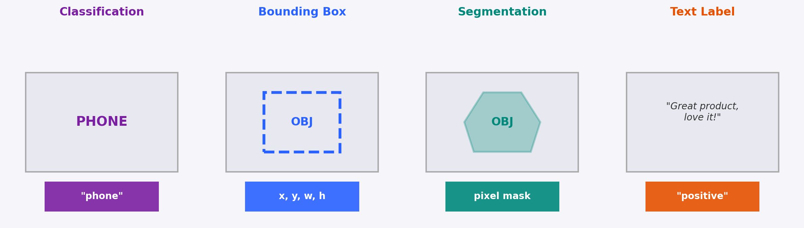
Step 6: Label Your Data
Best Practices for Labeling:
• Be CONSISTENT — same rules for every image. Write a labeling guide.
• Label TIGHTLY — bounding box should hug the object, not include extra space.
• When in doubt, SKIP the image rather than guess wrong.
• Have 2 people label independently, then compare. Agreement < 90%? Rules are unclear.
Tools: Roboflow (web, free tier) | LabelImg (desktop, free) | CVAT (open source) | Label Studio

Slide 13
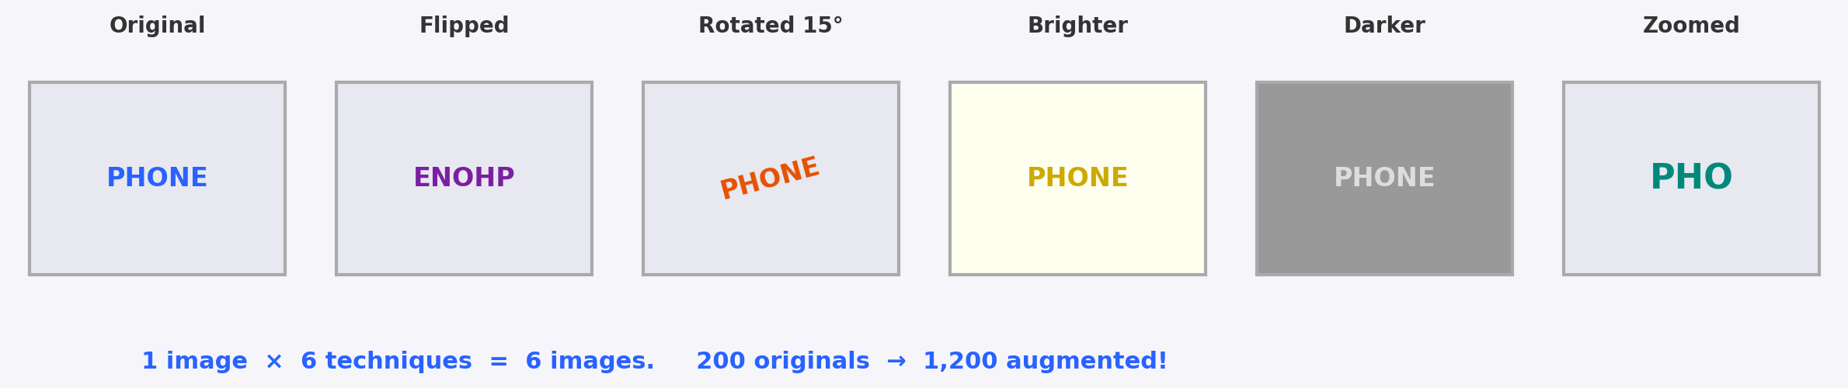
Step 7: Data Augmentation — Make Small Data Bigger
When TO augment:
• You have fewer than 1,000 images per class
• Your model is overfitting (training accuracy high, test accuracy low)
• You want your model to handle different lighting/angles
When NOT to augment:
• Text data (flipping text makes no sense)
• Numbers/tabular data (use SMOTE instead)
• If augmented images become unrealistic
Tools for Augmentation:
• Roboflow — web-based, automatic augmentation pipeline
• Albumentations — Python library, 60+ transforms
• torchvision.transforms — built into PyTorch
• Keras ImageDataGenerator — built into TensorFlow
Common transforms: flip, rotate, brightness, contrast,
crop, blur, noise, scale, shear, cutout

Slide 14
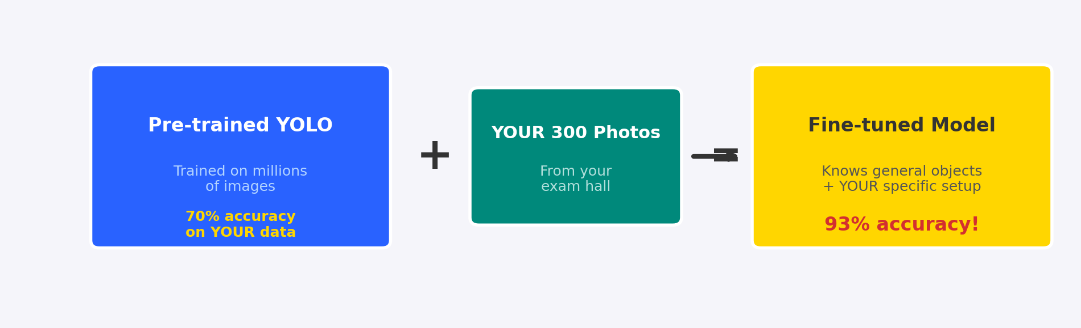
Step 8: Transfer Learning — Build on What Exists
Extending Your Model in Phases:
Phase 1: Phones only → Train on 300 phone photos → Deploy & test
Phase 2: + Cheat sheets → Add 200 chit photos, retrain → Now detects 2 things
Phase 3: + Earpieces → Add 150 earpiece photos → Now detects 3 things
Phase 4: + Smartwatches → Add 100 watch photos → Full detection system
KEY RULE: You NEVER train from scratch. Always build on what exists.
Transfer learning = standing on the shoulders of giants.

Slide 15
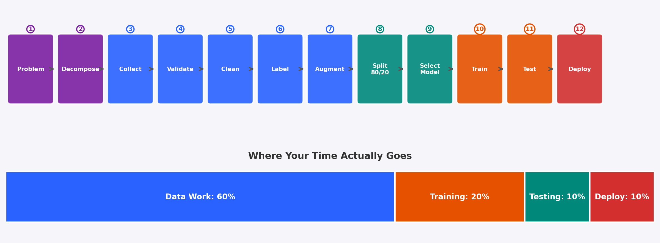
Step 9: The Complete Pipeline
Notice: 60% of the work is data preparation (Steps 3-8). Only 20% is actual model training. This is why 'data engineering' is a separate career. Most beginners spend 90% on models and 10% on data — and then wonder why their models don't work.

Slide 16
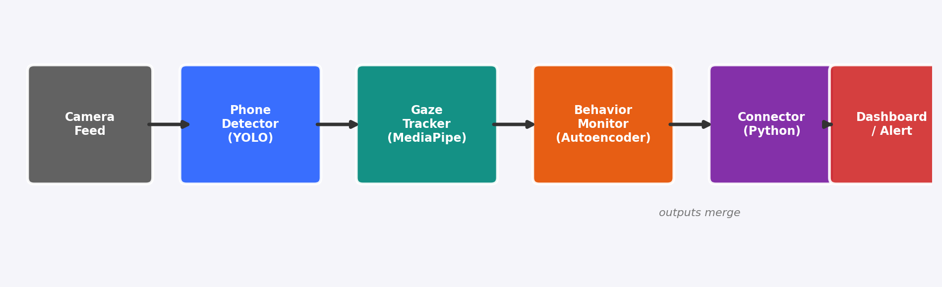
Step 10: How Real AI Systems Work
Key Rules for Multi-Model Systems:
• Each model runs INDEPENDENTLY — if one fails, others keep working
• The Connector is SIMPLE Python code (if/else logic), not another ML model
• Models communicate through standard formats: JSON, CSV, or simple variables
• Build and test EACH model separately before connecting them
• Use confidence scores: "YOLO says phone detected with 87% confidence"
• Set thresholds per model: only alert if confidence > 70% (configurable)
• Log everything — when models disagree, logs help you debug

Slide 17
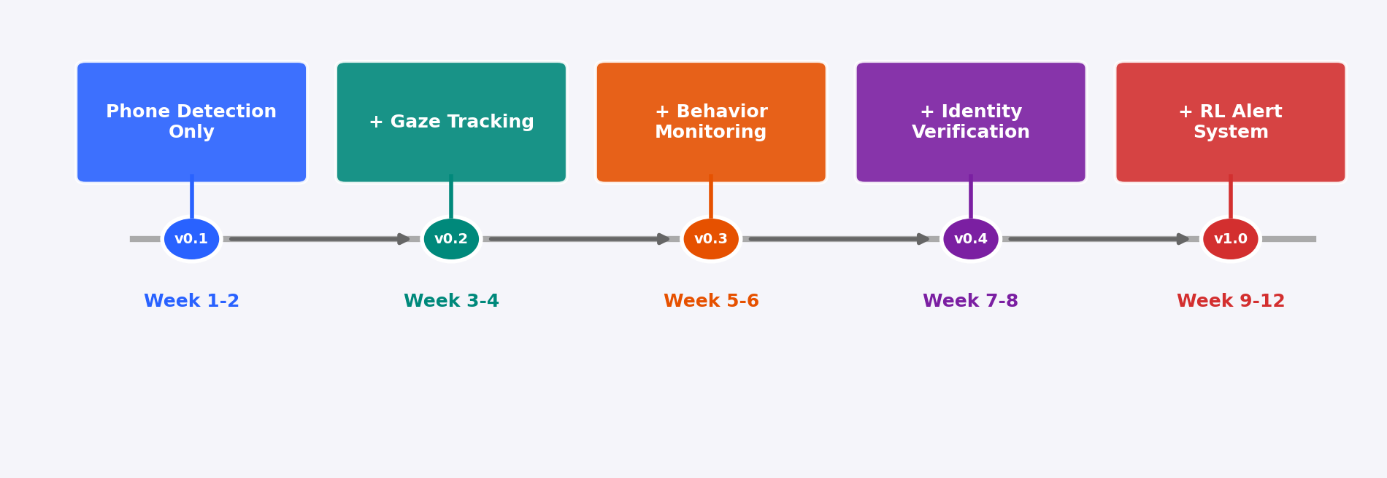
Build ONE Module at a Time
Why Build Incrementally?
• Each version is DEPLOYABLE and TESTABLE on its own
• You get feedback from real users after Week 2, not Week 12
• If v0.1 doesn't work, you haven't wasted 12 weeks
• Each new module builds on proven working infrastructure
• Your stakeholders see progress every 2 weeks (keeps funding alive!)
NEVER try to build everything at once. Ship v0.1 fast, iterate.

Slide 18
Quick Reference — 10 Steps to AI
1
UNDERSTAND the problem — watch what a human does, list every specific task.
2
ASK 3 QUESTIONS — What data? How thinking? Past examples? → ML type.
3
FIND DATA — check what you have, then public datasets, then pre-trained models.
4
VALIDATE DATA — check size, look at samples, relevance, balance, trust.
5
CLEAN DATA — fix missing values, duplicates, wrong labels, outliers, formats.
6
LABEL DATA — classification, bounding box, or segmentation. Be consistent.
7
AUGMENT DATA — flip, rotate, brightness. 200 images → 1,200 images.
8
TRANSFER LEARN — start from pre-trained model, fine-tune with YOUR data.
9
BUILD PIPELINE — Problem → Data → Clean → Train → Test → Deploy. 60% = data work.
10
CONNECT MODULES — each model is independent, simple Python connector merges outputs.
Remember: 80% thinking, 20% coding. The best AI engineers are problem-solvers first, coders second.

