Slide 1

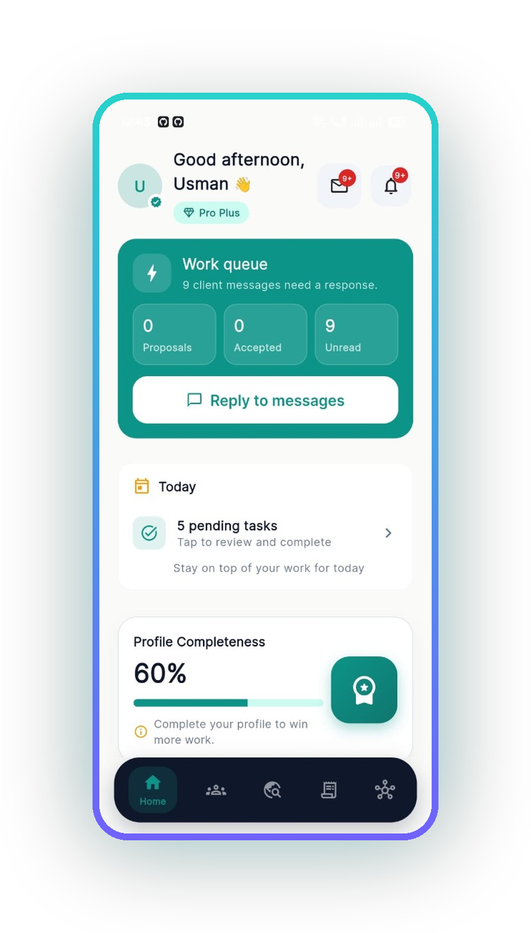
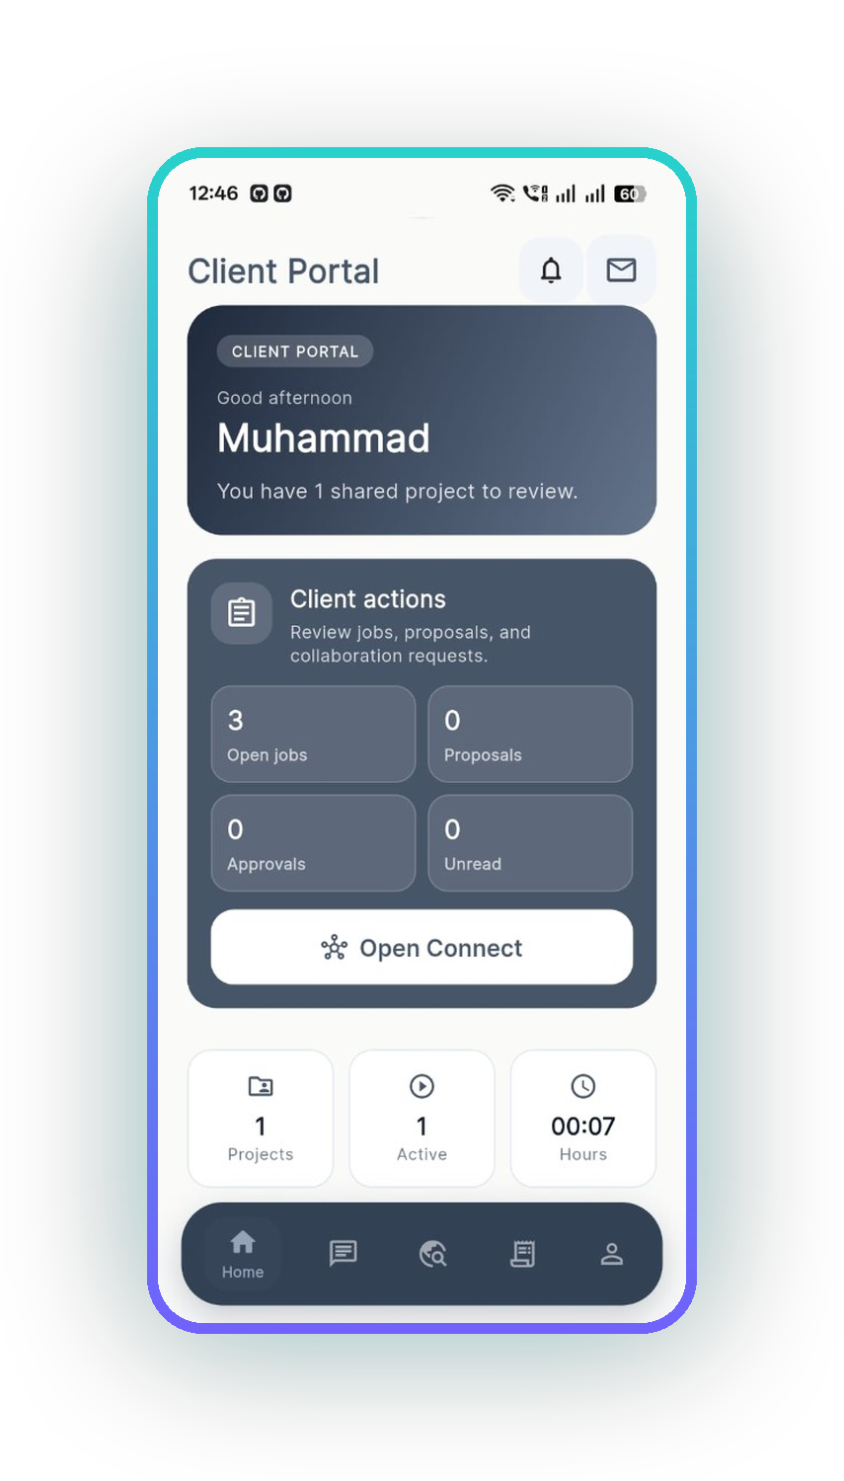
QUANTIC MSSE · CAPSTONE PRESENTATION
Freelance work.
One connected
system.
The AI-assisted operating system where independent professionals
find work, run the delivery and get paid — in one place.
Solo Capstone · three sprints · web and Android, one shared record.
WEB · LIVE AT CLIVORA.IO
ANDROID · GOOGLE PLAY
Usman Ghias — Product Owner, Scrum Master and sole engineer · CODCrafters
github.com/UsmanGhias/clivora
Notes:
[0:00–1:00] Photo ID to camera now, then say your full name and programme.
"My name is Usman Ghias. This is my Quantic MSSE Capstone presentation for CLIVORA,
the freelance operating system. The web app is live at clivora.io and the Android app
is on Google Play. I am the sole engineer, and I acted as Product Owner and Scrum
Master across three sprints."
Hold the ID up for a full five seconds. Do not skip this — it is a grading requirement.

Slide 2
02 / 40
HOW THIS SESSION RUNS
Agenda
Product first, then the engineering behind it, then the agile record, then a live demo.
01
02
03
The problem
The product
Engineering
Why independent work fragments across tools
Web and Android walkthrough with real screens
Architecture, patterns, security, AI, tests, CI/CD
04
05
06
Agile process
Live demo
Close
Baseline vs Capstone, three sprints, the board
Job → accept → project → invoice → paid
Results, submission links, next roadmap
CLIVORA · Quantic MSSE Capstone · clivora.io
github.com/UsmanGhias/clivora
Notes:
[1:00–1:40] "Here is the shape of the next eighteen minutes."
Read the six headings only. Do not read the sub-lines. Move on quickly — the value
is in sections 2, 3 and 5.

Slide 3
03 / 40
TEAM, ROLES AND HONEST SCOPE
One person, three roles, and a clear line around the grading
ROLE
ROLE
ROLE
Product Owner
Scrum Master
Engineer
Wrote and ranked the user stories, accepted or rejected each sprint increment, owned the release call.
Ran sprint planning, kept the GitHub board honest, enforced the definition of done and the timebox.
All Flutter, Next.js, SQL, CI and release work. Every commit in the repo is attributable to me.
Scope statement
CLIVORA already existed before this Capstone. The baseline product — CRM, invoicing, Connect, offline sync, billing — shipped earlier and I do not present it as sprint work.
The three sprints being graded are a new increment: test and CI hardening, turning Ask AI into a real retrieval-augmented system, and one reliable hire-to-invoice demo loop.
CLIVORA · Quantic MSSE Capstone · clivora.io
github.com/UsmanGhias/clivora
Notes:
[1:40–2:40] This slide protects your grade. Say it plainly:
"I want to be precise about scope. CLIVORA was already live before this Capstone. I am
not claiming the whole product as three sprints of work. What Quantic is grading is a
new increment on top of a real production system: testing and CI, an AI retrieval layer,
and one end-to-end demo loop. Everything else I show is labelled baseline."
Graders reward this honesty. Do not rush it.

Slide 4
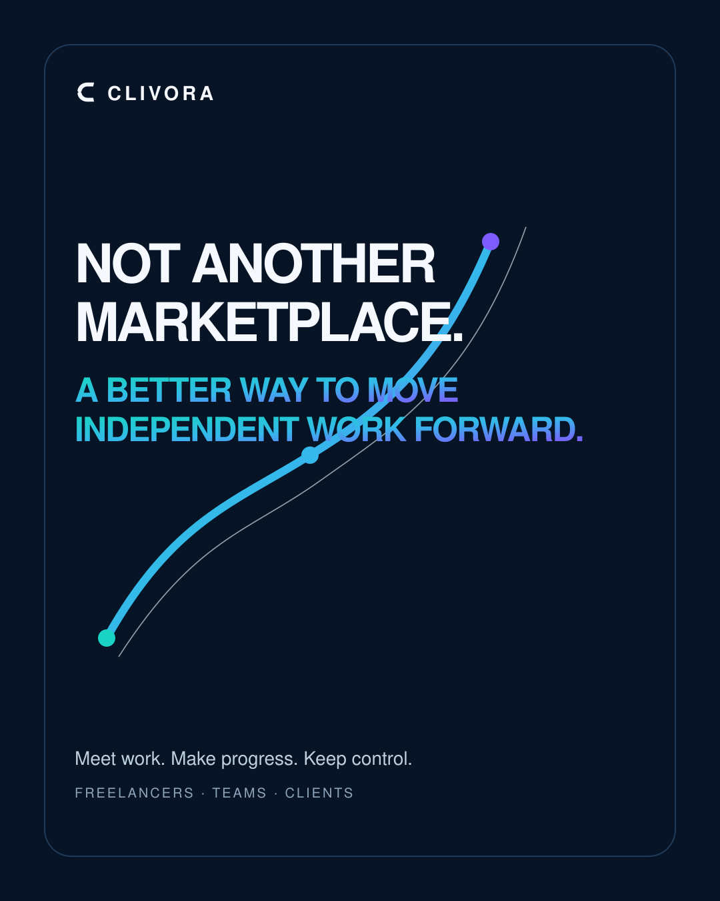
04 / 40
01
SECTION ONE
The problem
Not another marketplace. A connected way to move independent work forward.
CLIVORA PREMIUM CAMPAIGN V2
CLIVORA · Quantic MSSE Capstone · clivora.io
github.com/UsmanGhias/clivora

Slide 5
05 / 40
SECTION 01 · THE PROBLEM
Independent work is not hard because of the work. It is hard because of the seams.
01
02
03
04
Discovery is walled off
Delivery is scattered
Money leaks
Clients are left guessing
Marketplaces own the client relationship and take a cut of every deal.
Chat in one app, tasks in another, files in a third, hours in a spreadsheet.
Invoices are rebuilt by hand, follow-ups are forgotten, revenue is invisible.
No shared place to see progress, approve work or pay against a record.
2 sides
$0
Offline
1 record
One product has to serve the freelancer and the client, or the seam stays
Platform fee CLIVORA takes on a negotiated Connect deal
Mobile work happens on bad networks — the app cannot assume a connection
Brief, delivery and invoice must resolve to one auditable trail
CLIVORA · Quantic MSSE Capstone · clivora.io
github.com/UsmanGhias/clivora
Notes:
[2:40–4:00] Four seams, then four constraints. Keep it concrete:
"Every freelancer I talked to had the same four problems. Discovery is walled off inside
marketplaces that own the client. Delivery is scattered across four or five apps. Money
leaks because invoicing is manual. And the client has nowhere to look."
Then point at the bottom row: "Those problems set four hard constraints on the design —
two-sided, zero platform fee, offline-capable, and one auditable record."

Slide 6
06 / 40
USERS AND THE ALTERNATIVES
Who it is for, and why the existing options do not fit
USER 01
USER 02
USER 03
Solo freelancer
Independent team / agency
The client
Needs one place for clients, projects, hours and invoices — on a phone, often offline.
Needs shared projects, task assignment, roles and a single revenue picture.
Needs to see progress, approve work, message once and pay against a real invoice.
WHY NOT JUST USE WHAT EXISTS
Freelance marketplaces
Own the client relationship and charge a percentage of each deal
Generic project tools
No invoicing, no client portal, no concept of a freelance plan
Accounting apps
Invoice-only; nothing about delivery, tasks or the client conversation
Spreadsheets + chat
Zero automation, no offline guarantees, no shared client view
CLIVORA · Quantic MSSE Capstone · clivora.io
github.com/UsmanGhias/clivora
Notes:
[4:00–5:00] Three users, then the gap.
"Three users, one product. The freelancer, the independent team, and — this is the part
most tools miss — the client, who gets a real account, not a shared link."
Then the table: "None of the four existing categories covers this. Marketplaces own the
client. Project tools do not invoice. Accounting apps do not do delivery. Spreadsheets do
not do anything automatically."

Slide 7
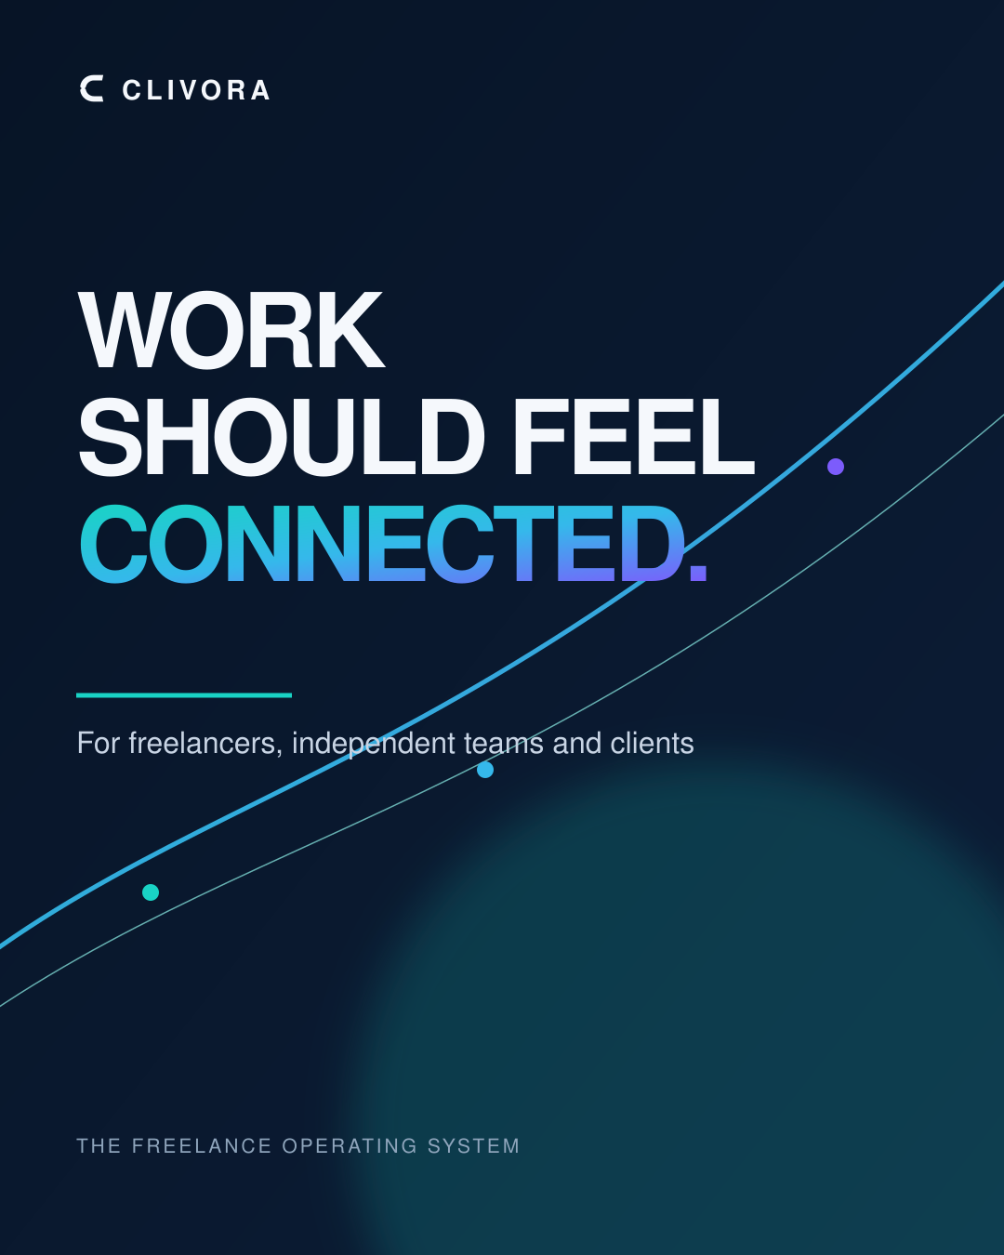
07 / 40
02
SECTION TWO
The product
Work should feel connected — for freelancers, independent teams and clients.
CLIVORA PREMIUM CAMPAIGN V2
CLIVORA · Quantic MSSE Capstone · clivora.io
github.com/UsmanGhias/clivora

Slide 8
08 / 40
SECTION 02 · THE PRODUCT
One workspace, five connected surfaces
Everything below writes to the same Postgres record, so nothing has to be re-entered.
Connect
CRM
Money
Client hub
Jobs, talent, proposals,
mutual accept before contact
Clients, projects, tasks,
files, meetings
Quotes, invoices, expenses,
timesheets, recurring
Shared projects, approvals,
messages, payments
One record in Supabase Postgres
Row-level security scopes every row to its owner
Ask AI
Reads that record, cites what it used, and never acts without a human
CLIVORA · Quantic MSSE Capstone · clivora.io
github.com/UsmanGhias/clivora
Notes:
[5:00–5:45] Trace the flow with your cursor: Connect → CRM → Money → Client hub.
"Five surfaces, one record. A job accepted in Connect becomes a client and a project in
CRM. That project's hours become a timesheet and an invoice in Money. The client sees the
same objects in their own hub. Nothing is re-entered, because there is only one row."
Ask AI sits underneath and reads that record — I come back to it in section three.

Slide 9
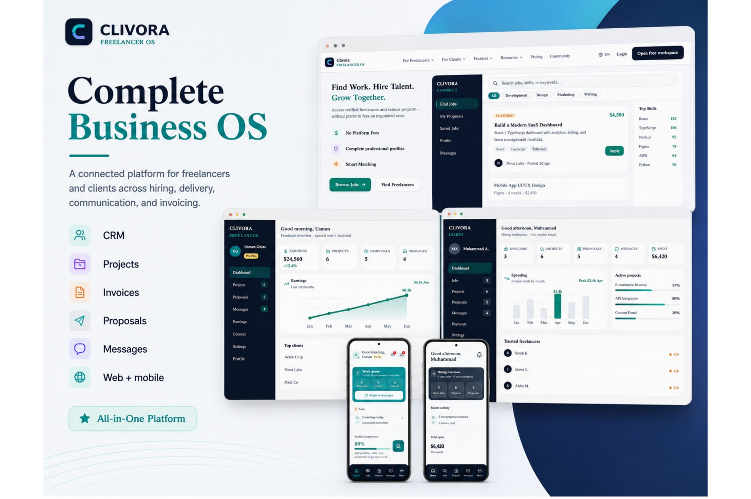
09 / 40
WEB · LIVE AT CLIVORA.IO
The freelancer workspace
The web app is a Next.js 15 App Router product deployed as a Node process on Hostinger. Server Components load the profile and gate every route before the browser renders anything.
This is the surface a freelancer opens in the morning: what needs attention, what is in flight, and what has not been paid.
Server-gated routes, no client-side auth
Same Postgres rows as the Android app
Public invoice share links at /i/[token]
CLIVORA · Quantic MSSE Capstone · clivora.io
CLIVORA · Quantic MSSE Capstone · clivora.io
github.com/UsmanGhias/clivora
github.com/UsmanGhias/clivora
Notes:
[5:45–6:15] "This is the live web workspace at clivora.io. Next.js 15, App Router,
deployed as a Node process — not a static export, because routes are gated on the server
before anything renders."
Fast pass. The real depth comes in the demo.

Slide 10
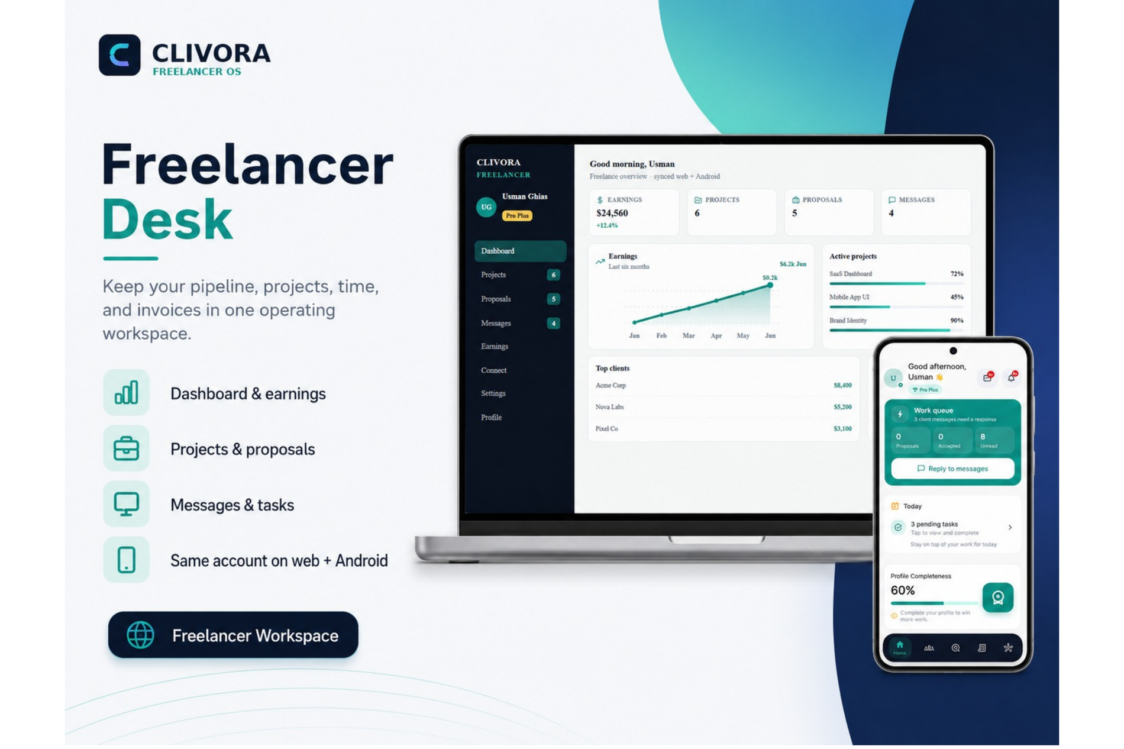
10 / 40
THE DAILY LOOP
From daily priority
to final invoice
Six steps cover almost everything a freelancer does in a day. CLIVORA is designed so each step hands off to the next without an export, a copy-paste or a second tool.
1
Start the day
2
Organise the work
3
Keep clients close
4
Discover opportunities
5
Track the time
6
Send the invoice
CLIVORA · Quantic MSSE Capstone · clivora.io
CLIVORA · Quantic MSSE Capstone · clivora.io
github.com/UsmanGhias/clivora
github.com/UsmanGhias/clivora
Notes:
[6:15–6:45] "Six steps, and the point is the hand-offs. Step five, tracked time, becomes
step six, the invoice line — automatically. That is the whole thesis of the product."

Slide 11
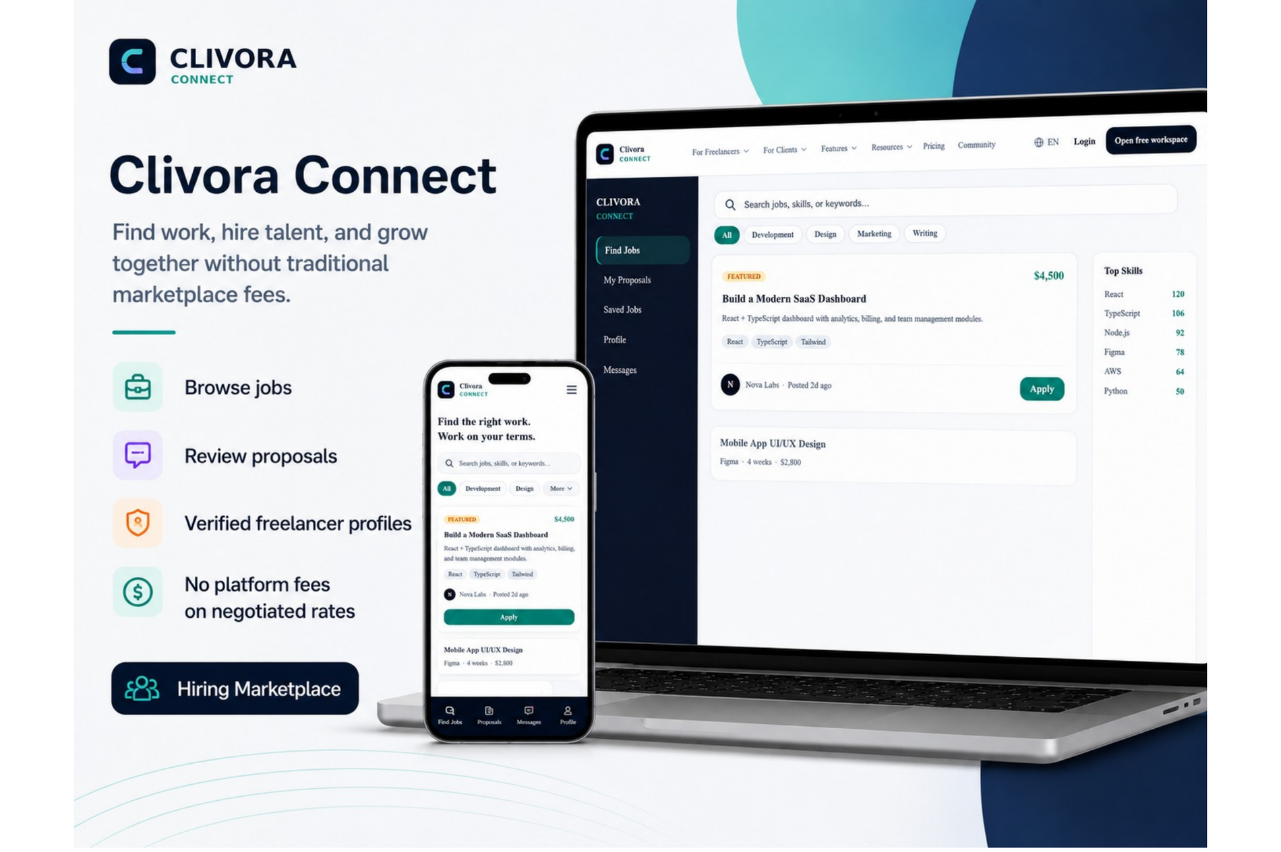
11 / 40
CLIVORA CONNECT · NOT ANOTHER MARKETPLACE
Find the work.
Keep the relationship.
Connect is a private marketplace. Contact details stay hidden until both sides accept, and CLIVORA takes no percentage of the negotiated deal.
Mutual accept
Emails are revealed only after both parties agree
$0 platform fee
Revenue comes from subscriptions, not from your deal
Pro Plus to act
Browsing is free; posting and contacting is an entitlement
CLIVORA · Quantic MSSE Capstone · clivora.io
CLIVORA · Quantic MSSE Capstone · clivora.io
github.com/UsmanGhias/clivora
github.com/UsmanGhias/clivora
Notes:
[6:45–7:20] This is the differentiator — say it clearly.
"Connect is where the work is discovered, but it is deliberately not a marketplace that
owns you. Contact details unlock only on mutual accept, and CLIVORA charges zero platform
fee on the deal. We monetise the subscription, not your invoice."

Slide 12
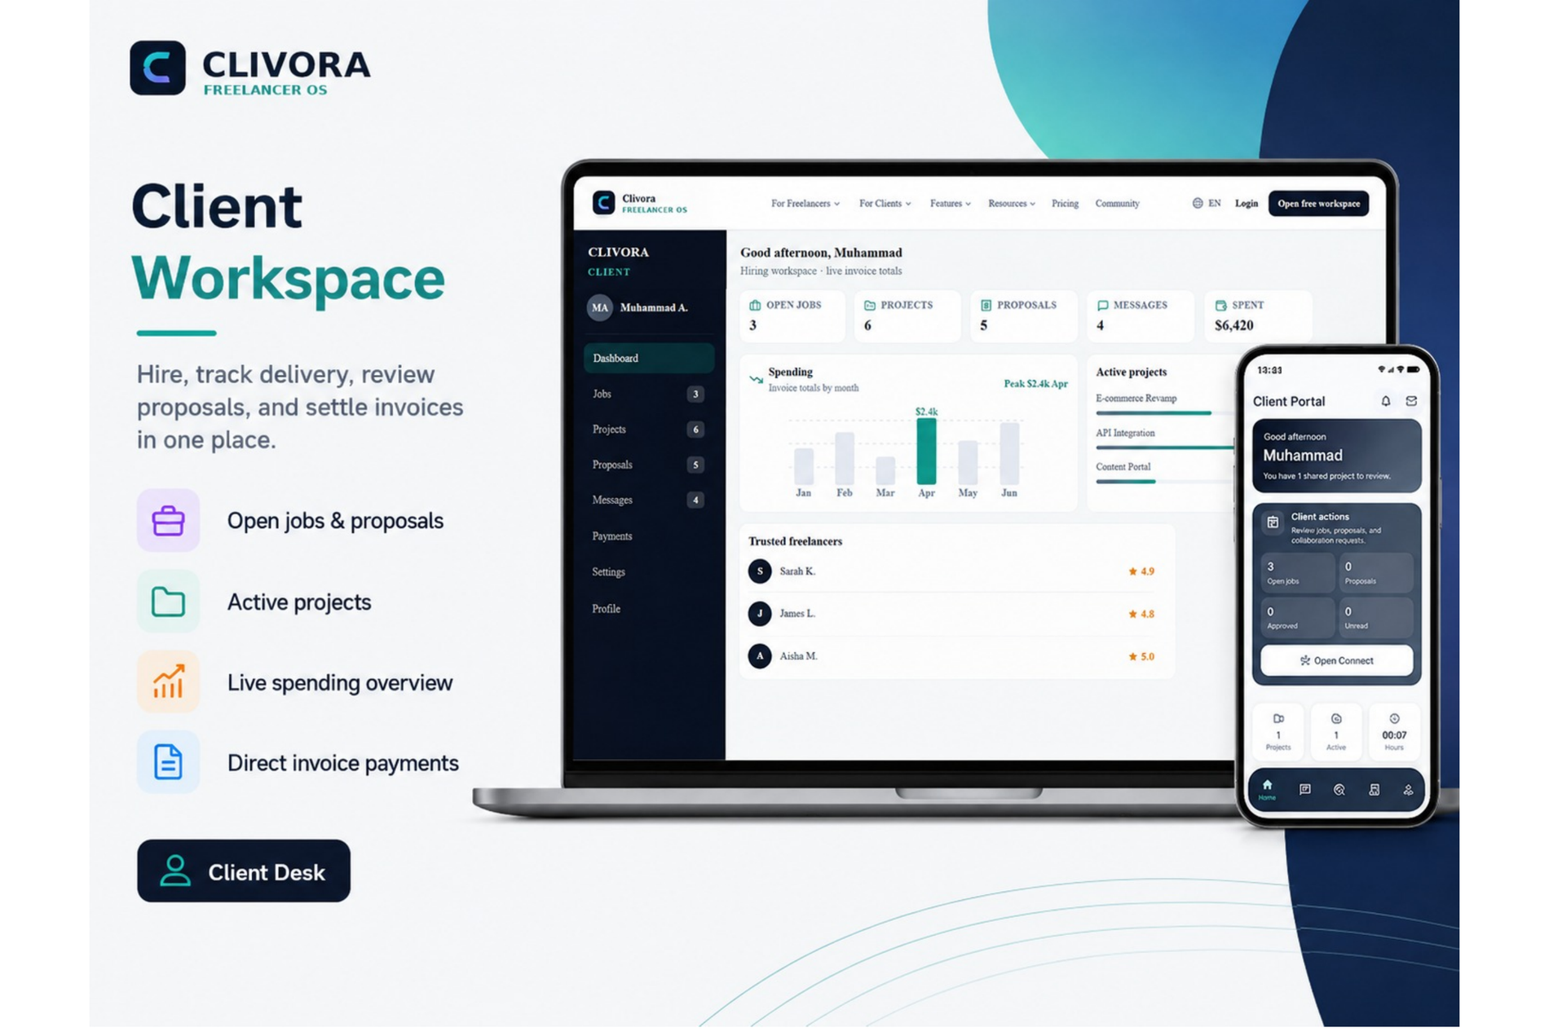
12 / 40
BUILT FOR CLIENTS
The client is a
first-class user
Clients get a real account, not a share link. They see the projects that were explicitly shared with them, approve work, message once, and pay against an invoice that already exists in the system.
Shared projects with live progress
Client actions queue: jobs, proposals, approvals
Invoices and contracts in one hub
One thread per relationship
CLIVORA · Quantic MSSE Capstone · clivora.io
CLIVORA · Quantic MSSE Capstone · clivora.io
github.com/UsmanGhias/clivora
github.com/UsmanGhias/clivora
Notes:
[7:20–7:50] "Most freelance tools treat the client as a read-only link. In CLIVORA the
client signs in, sees only what was shared with them — enforced in Postgres, not in the UI —
and acts from their own queue."

Slide 13
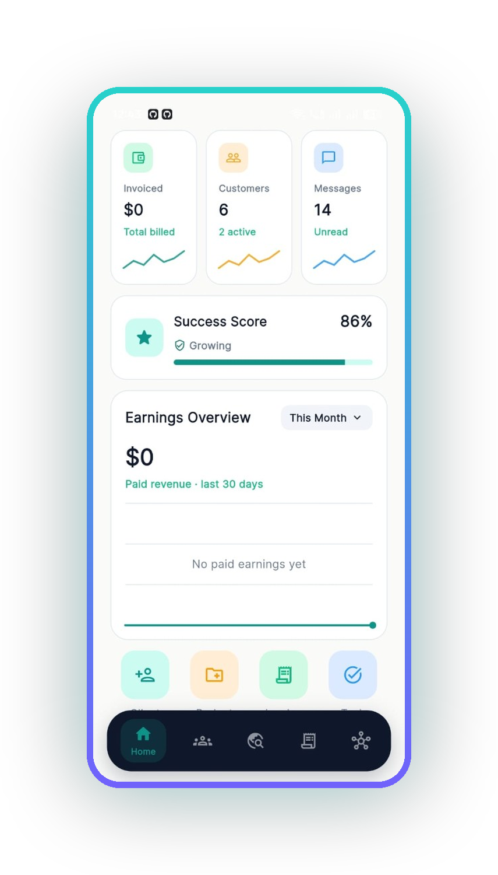
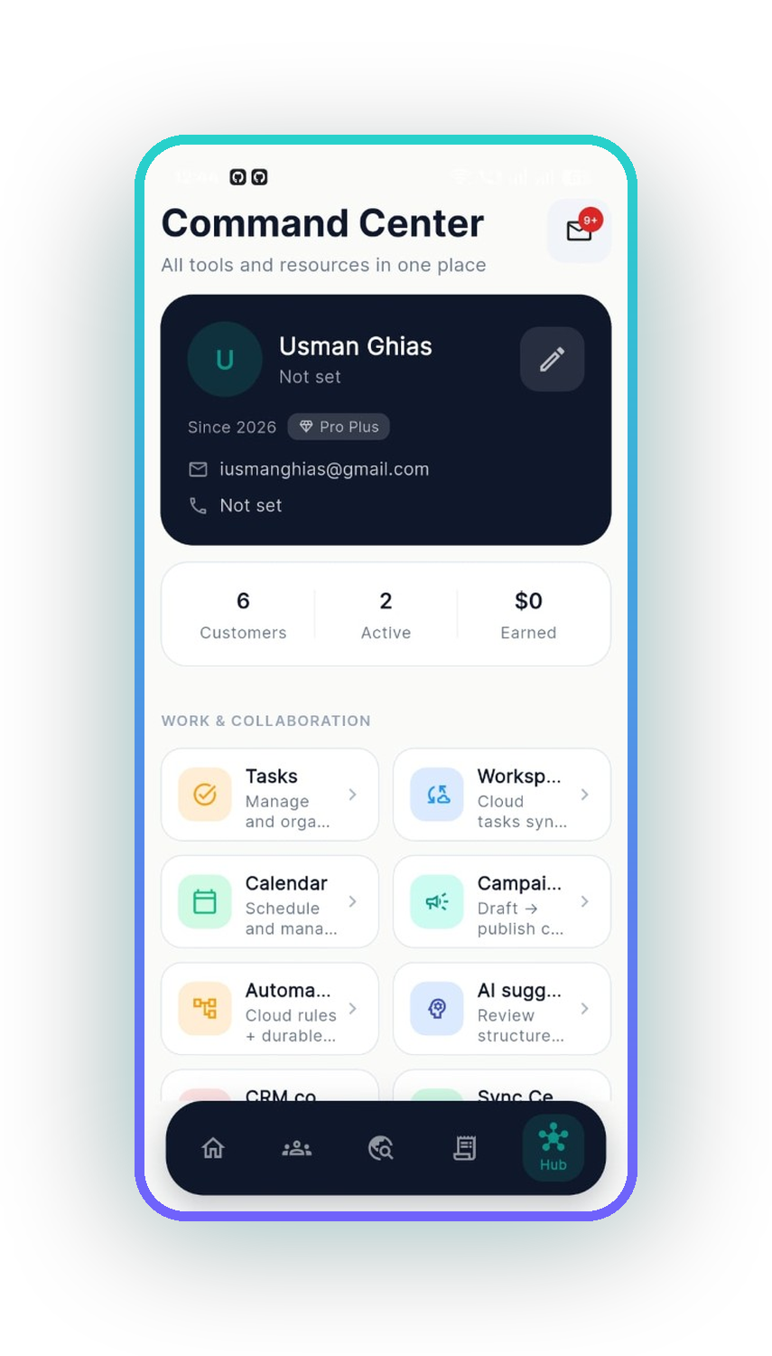
13 / 40
ANDROID · FLUTTER · GOOGLE PLAY
The freelancer's phone, unretouched
01
Work queue first
Unanswered client messages, accepted work and today's tasks before anything else.
02
The business at a glance
Invoiced total, active customers, unread messages, success score and 30-day revenue.
03
Command Center
Every module reachable in two taps — tasks, calendar, campaigns, automations, AI.
UNRETOUCHED SCREENSHOTS FROM THE RELEASED ANDROID BUILD
CLIVORA · Quantic MSSE Capstone · clivora.io
github.com/UsmanGhias/clivora
Notes:
[7:50–8:30] Emphasise that these are real screenshots, not mockups.
"These are unretouched screenshots from the build that is on Google Play. Note the phone
status bar. Screen one is the work queue — the app opens on what needs a response, not on
a marketing dashboard. Screen two is the business summary. Screen three is Command Center,
which is how you reach the other thirty modules."

Slide 14
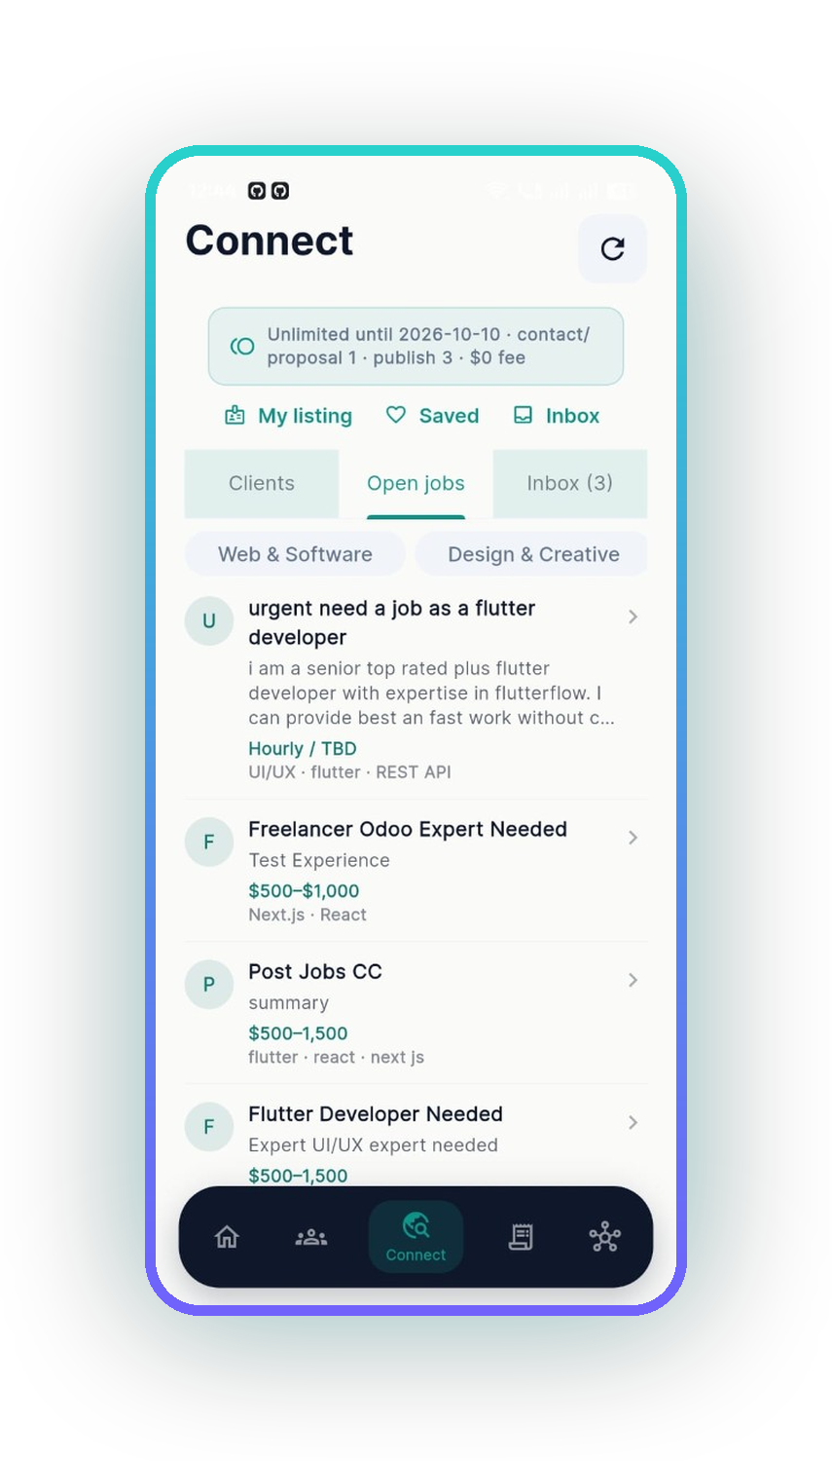
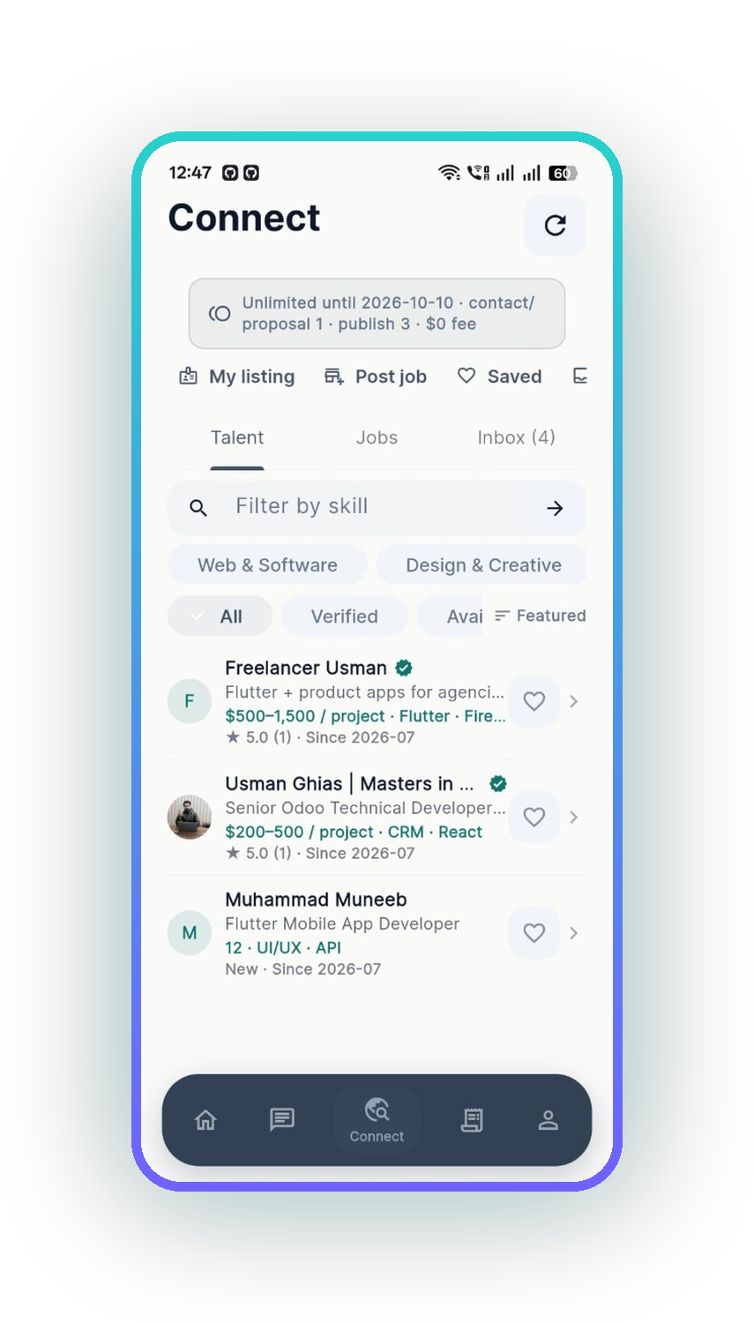
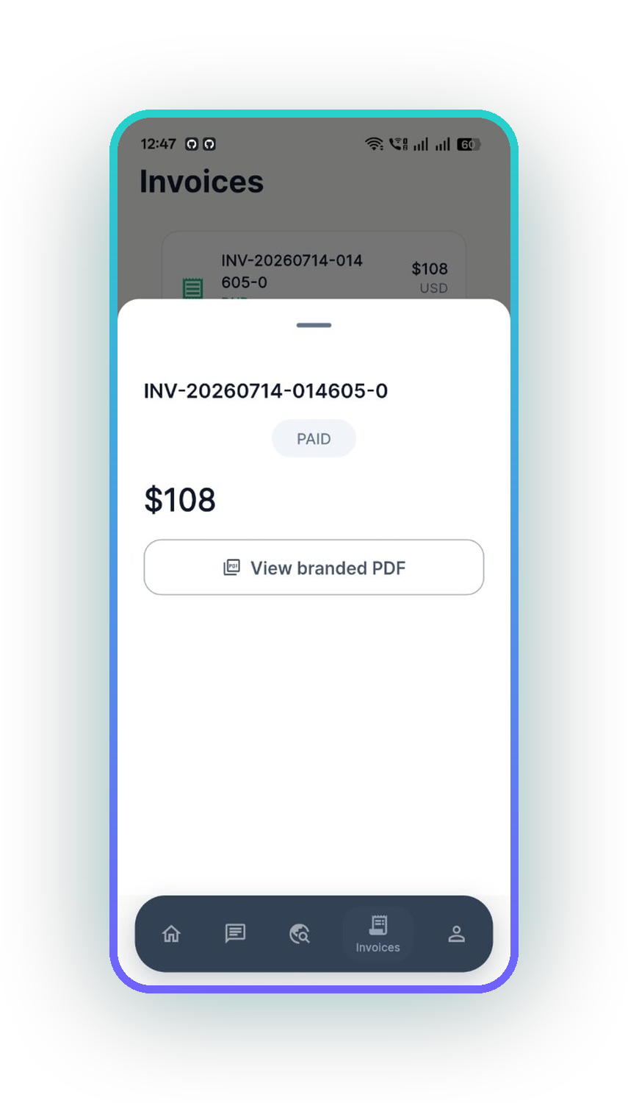
14 / 40
ANDROID · CONNECT AND MONEY
Discovery and getting paid
01
Open jobs
Live Connect listings with budget bands and skills. Browsing is free on every plan.
02
Verified talent
The other side of the same marketplace — verified profiles, rates and history.
03
Paid, with a branded PDF
A real invoice moved to PAID, with a generated branded PDF the client can keep.
UNRETOUCHED SCREENSHOTS FROM THE RELEASED ANDROID BUILD
CLIVORA · Quantic MSSE Capstone · clivora.io
github.com/UsmanGhias/clivora
Notes:
[8:30–9:10] "Connect on mobile — jobs on one side, talent on the other, same private
marketplace. And the end of the loop: a real invoice marked paid, with a branded PDF
generated from the record. That invoice number is from my own account."

Slide 15
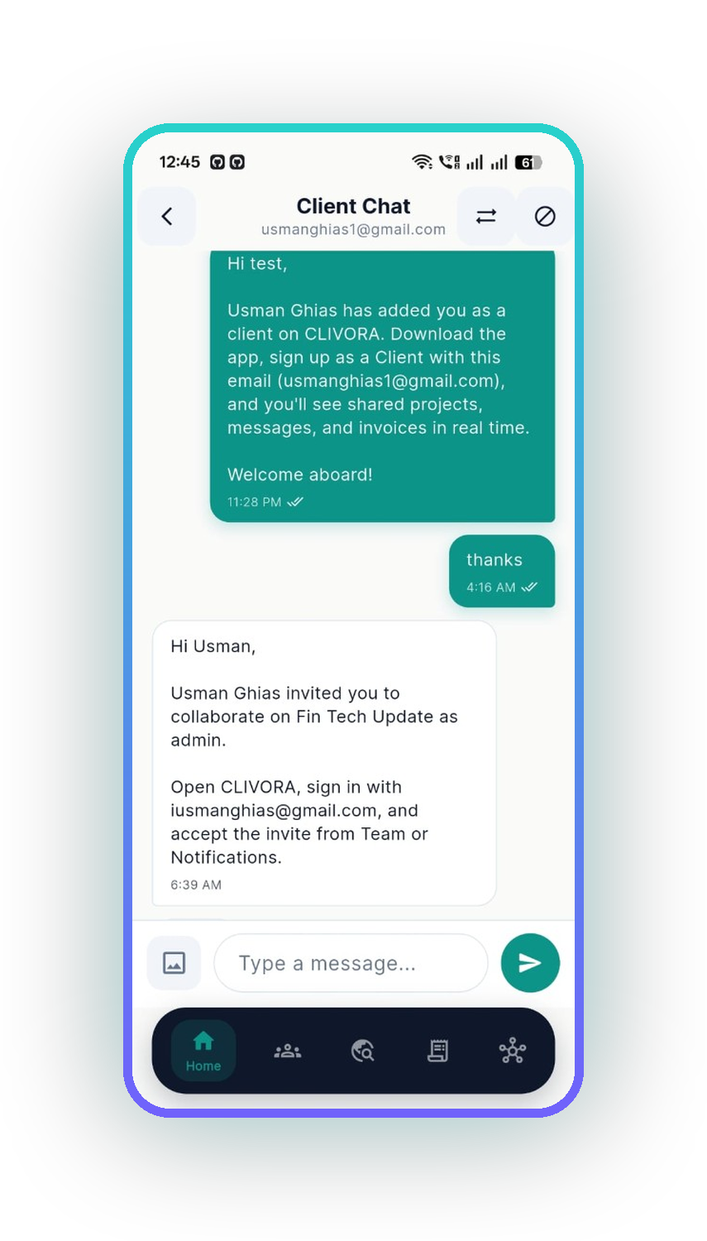
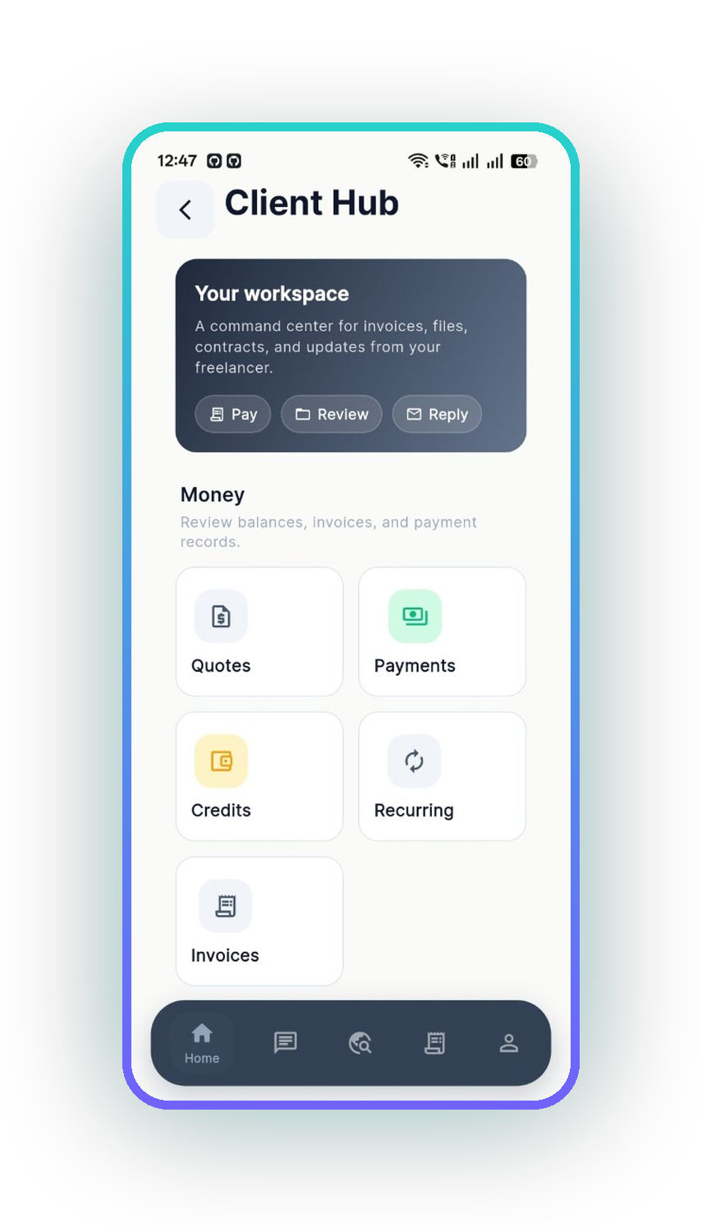
15 / 40
ANDROID · THE CLIENT SIDE
The client's phone is a different app
01
Client portal
A client signs in and sees their action queue and only the projects shared with them.
02
One thread per relationship
Invitations, updates and replies in a single conversation, synced to the web app.
03
Client hub
Quotes, payments, credits, recurring and invoices — the money view for the buyer.
UNRETOUCHED SCREENSHOTS FROM THE RELEASED ANDROID BUILD
CLIVORA · Quantic MSSE Capstone · clivora.io
github.com/UsmanGhias/clivora
Notes:
[9:10–9:45] "Same binary, different experience. When the account type is client, the app
renders the portal instead of the workspace. The client sees one shared project here —
enforced by row-level security in Postgres, which I will come back to."

Slide 16
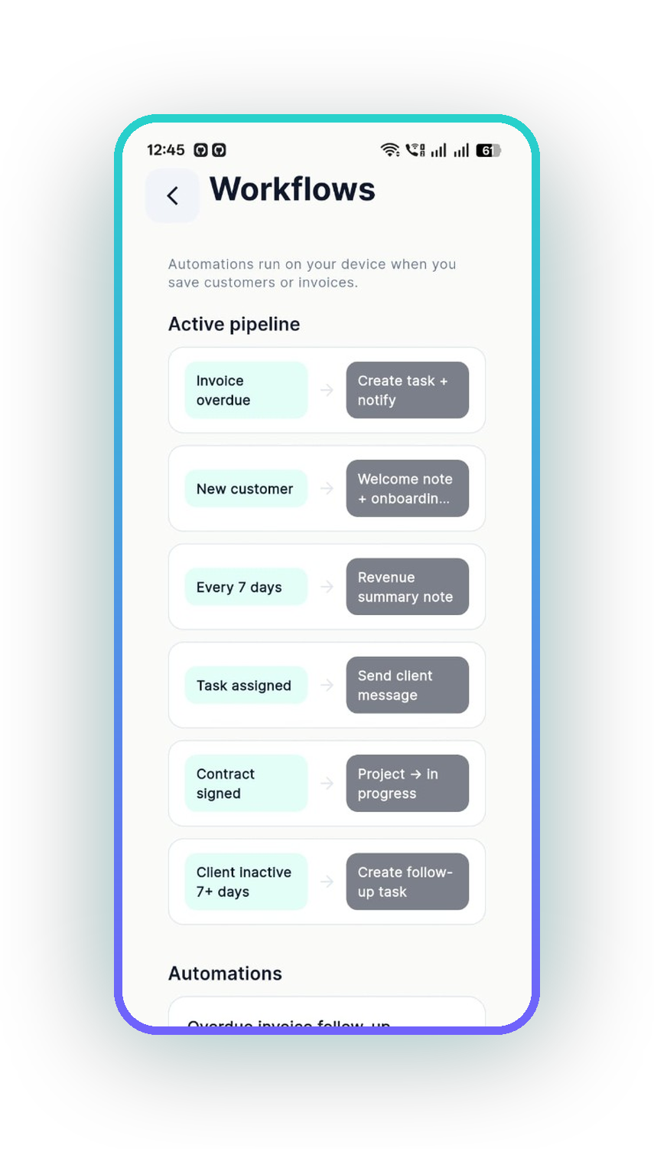
16 / 40
AUTOMATION ENGINE
Rules that run on the device
Automations fire locally when a customer or invoice is saved, so follow-ups happen even when the network does not.
Invoice overdue
Create task + notify
New customer
Welcome note + onboarding
Every 7 days
Revenue summary note
Task assigned
Send client message
Contract signed
Project → in progress
Client inactive 7+ days
Create follow-up task
CLIVORA · Quantic MSSE Capstone · clivora.io
CLIVORA · Quantic MSSE Capstone · clivora.io
github.com/UsmanGhias/clivora
github.com/UsmanGhias/clivora
Notes:
[9:45–10:15] "Six trigger-action rules ship with the app, and they execute on the device
when you save a customer or an invoice. That matters offline: an overdue invoice still
creates a follow-up task on a train with no signal, and the resulting rows sync later
through the outbox."

Slide 17
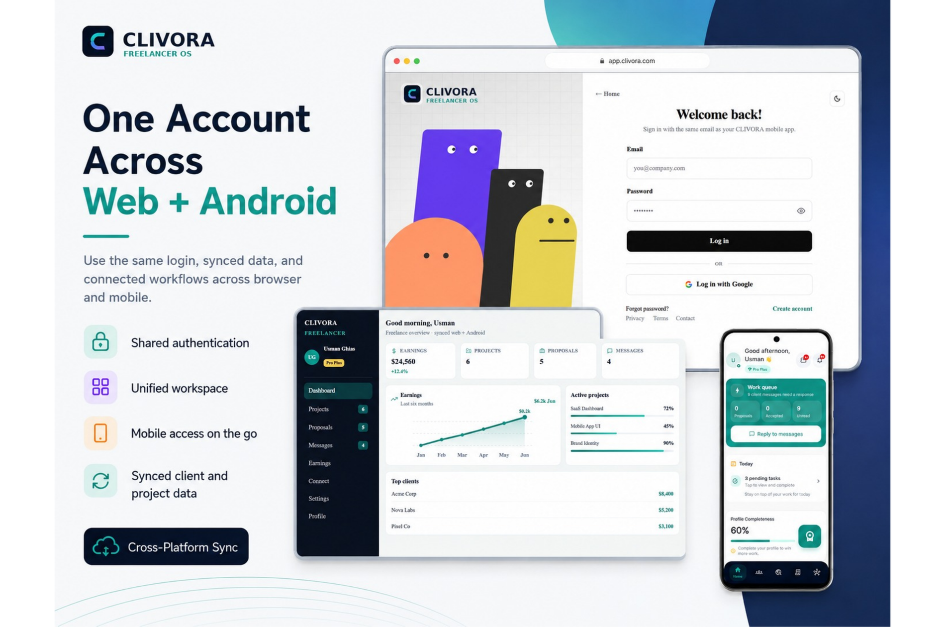
17 / 40
ONE ACCOUNT, TWO CLIENTS
The same product,
not a port
Shared source of truth
Both clients read and write the same Postgres rows. There is no sync layer between two databases, because there is only one.
Shared business rules
plan-gates.ts on the web and PlanLimits in Flutter are mirrored, and both are unit-tested.
Different strengths
Web gets server-rendered route gating. Android gets offline-first storage and on-device automation.
CLIVORA · Quantic MSSE Capstone · clivora.io
CLIVORA · Quantic MSSE Capstone · clivora.io
github.com/UsmanGhias/clivora
github.com/UsmanGhias/clivora
Notes:
[10:15–10:40] "One account works on both. This is the Google Play feature graphic, and the
important claim is underneath it: this is not a web app wrapped in a shell. Two native
clients, one contract, one database, mirrored business rules that are unit-tested on both
sides."
That is the bridge into the engineering section.

Slide 18
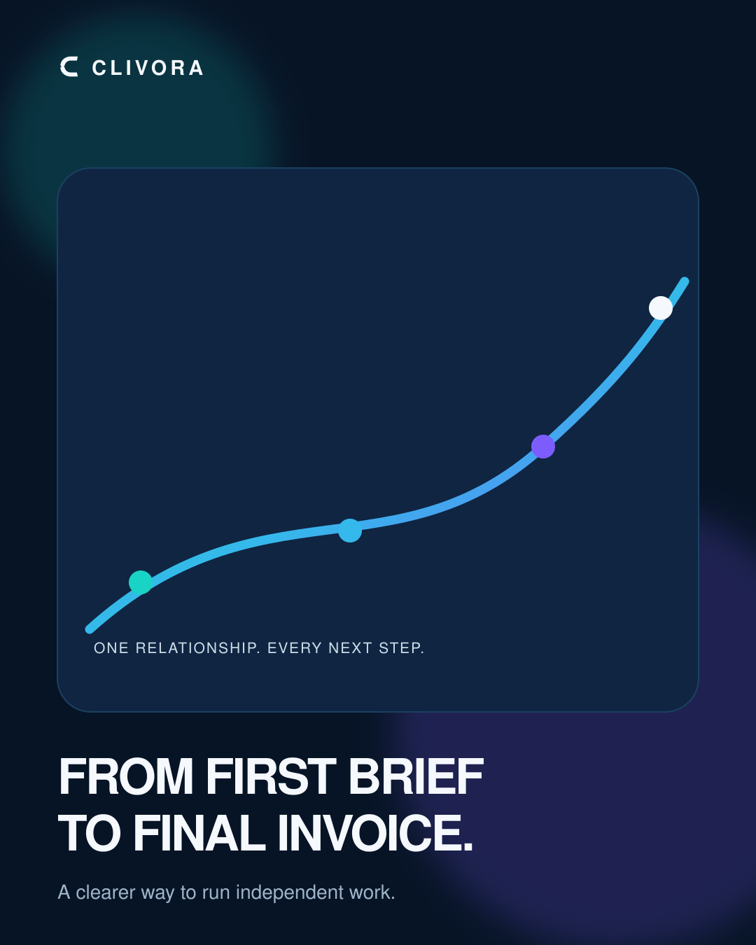
18 / 40
03
SECTION THREE
Engineering
From first brief to final invoice — one auditable record behind every screen.
CLIVORA PREMIUM CAMPAIGN V2
CLIVORA · Quantic MSSE Capstone · clivora.io
github.com/UsmanGhias/clivora

Slide 19
19 / 40
SECTION 03 · ENGINEERING
System architecture
Two untrusted clients, one trusted database. Authorisation lives in Postgres, not in the UI.
CLIENTS
Next.js 15 · App Router
Flutter · Android
React Server Components · clivora.io on Hostinger Node
Google Play · org.codcrafters.clivora
APP LAYER
Backend-for-Frontend
Repositories + Drift SQLite
Server Components + Route Handlers · secrets never reach the browser
Offline-first cache and a transactional sync outbox
CLOUD
Postgres + RLS
Auth
Storage
Edge Functions
system of record
Google + email
vault + share links
server-only jobs
CLIVORA · Quantic MSSE Capstone · clivora.io
github.com/UsmanGhias/clivora
Notes:
[10:40–11:40] Walk it top to bottom, once.
"Three tiers. At the top, two clients — Next.js 15 on the web, Flutter on Android. In the
middle, each client has its own app layer: the web uses a backend-for-frontend so LLM keys
and service-role secrets never enter the browser bundle or the APK; Android has repositories
over a local Drift SQLite database with a sync outbox. At the bottom, Supabase.
The load-bearing decision is that both clients are untrusted. Authorisation is row-level
security in Postgres, so hiding a button is never the security control."

Slide 20
20 / 40
PATTERN · TRANSACTIONAL OUTBOX ON A MOBILE CLIENT
Offline-first sync, and what happens when sync fails
Freelancers work on bad networks. The Android app never blocks a write on connectivity.
Edit offline
Drift write
Outbox row
Flush
Postgres
user saves a client
or an invoice
local SQLite commits
immediately
sync_outbox_entries
marked pending
connectivity returns,
queue drains in order
RLS-checked write,
cloud is authoritative
Failure path is explicit
Why this pattern
Unknown operation kinds are marked permanently_failed and kept for diagnosis rather than silently dropped. Last-write-wins collisions write a conflict record.
It is the transactional outbox from distributed systems, adapted to a phone. Tested with in-memory Drift in test/sync_outbox_service_test.dart.
CLIVORA · Quantic MSSE Capstone · clivora.io
github.com/UsmanGhias/clivora
Notes:
[11:40–12:30] This is your strongest engineering story. Slow down.
"The riskiest subsystem in the product is offline sync, so it uses a named pattern: the
transactional outbox, adapted to a mobile client. A save commits to local SQLite
immediately and writes a pending row to sync_outbox_entries. When connectivity returns the
queue drains in order into Postgres, where row-level security checks it again.
The failure path is deliberate: an operation kind the app does not understand is marked
permanently_failed and kept, because a silently dropped invoice is worse than a visible
error. That behaviour is covered by unit tests against an in-memory database."

Slide 21
21 / 40
PATTERN · AUTHORISATION IN THE DATA LAYER
Security model: the database is the last word
Both a browser bundle and an APK can be read by an attacker, so neither can be the gate.
Client
Assumed hostile. Hiding UI is a UX choice, never a control.
Concrete controls
FLUTTER APK / BROWSER BUNDLE
Connect emails hidden until mutual accept
Vault share links resolve owner-scoped files, never a raw caller path
Server
Cookie sessions via @supabase/ssr. LLM keys and service role stay here.
ROUTE HANDLERS + SERVER COMPONENTS
Privileged profile columns guarded by DB triggers
No service-role key in any shipped client
Database
Every table policy-scoped to the owner. Triggers protect role, account type and plan flags from self-elevation.
Secrets, keystores and .env gitignored
POSTGRES ROW-LEVEL SECURITY
CLIVORA · Quantic MSSE Capstone · clivora.io
github.com/UsmanGhias/clivora
Notes:
[12:30–13:20] "Security is a three-layer story and the summary is that the database has
the last word. The client is assumed hostile — anyone can decompile the APK. The server
holds the session and the secrets. And Postgres row-level security scopes every table to
its owner, with triggers so a client cannot promote itself to Pro Plus or to admin by
writing its own profile row.
The concrete consequences are on the right. The one I care most about is that Connect
emails are unreachable until both sides accept — that is a policy in the database, not a
hidden field in the UI."

Slide 22
22 / 40
DESIGN DECISIONS
Patterns used, and why each one was chosen
Feature-first modules
Repository pattern
Transactional outbox
lib/features/* and App Router areas.
Sprint slices map to folders, so invoices never bleed into Connect.
CloudCrmRepository, CloudInvoiceRepository, web/src/lib/crm.
One place for queries, mapping and entitlement checks.
Offline writes queue and drain in order.
Chosen because mobile connectivity cannot be a precondition.
Backend-for-Frontend
Policy objects
Expand / contract
Server Components and route handlers hold the session.
Keeps secrets out of the browser bundle and the APK.
plan-gates.ts and Flutter PlanLimits.
Product rules become testable functions, not UI copy.
Money stored as major units and integer minor units.
Migration without a flag-day cutover.
CLIVORA · Quantic MSSE Capstone · clivora.io
github.com/UsmanGhias/clivora
Notes:
[13:20–14:00] Do not read all six. Pick three and say why.
"Six named patterns. I will call out three. Repository, so the same business rule holds on
web and Android. Policy objects, so a free-plan cap of three clients is a pure function I
can unit-test rather than a disabled button. And expand-contract for money, because invoice
amounts are stored both as major units and as integer minor units, which let me migrate
away from floating-point currency without a flag day."

Slide 23
23 / 40
CORRECTNESS WHERE IT HURTS MOST
Money is never a floating-point number
An invoice that is a cent wrong destroys trust faster than any missing feature.
Legacy shape
Expand
Backfill
Read minor
Contract
amount stored as a
decimal number
add total_minor and
siblings, dual-write
compute minor units
for historical rows
all arithmetic moves to
integer minor units
retire the float path
once reads are clean
Proven by tests, not by inspection
Entitlements get the same treatment
web/src/lib/money.test.ts — conversion + dual-write fields
Free caps: 3 clients · 5 projects · 10 invoices per UTC month
Helpers are pure functions in web/src/lib/money.ts
plan.test.ts and plan-gates.test.ts pin the boundaries
CLIVORA · Quantic MSSE Capstone · clivora.io
github.com/UsmanGhias/clivora
Notes:
[14:00–14:35] "Two places where a bug is unforgivable: money and plan limits.
Invoice amounts are stored as major units and as integer minor units at the same time, and
the migration follows expand-contract — dual-write, backfill, switch reads, then retire the
old path. No flag day. And the free-plan caps — three clients, five projects, ten invoices
per UTC month — are pure functions with tests pinning the boundary, including the month
rollover, because 'ten invoices this month' is ambiguous until you fix the timezone."

Slide 24
24 / 40
AI ENGINEERING
Ask AI: retrieval-augmented, grounded, and never autonomous
Sprint 2 turned a generic assistant into a system that answers from the user's own records.
Question
CRM context
Retrieve
Assemble
Generate
Grounded answer
asked inside the
workspace
aggregates for the
signed-in owner
crm_embeddings:
keyword + recent
prompt built from
retrieved chunks
OpenAI or Anthropic,
key server-side only
cites the invoice or
client it came from
Human-in-the-loop gate
Structured suggestions are feature-flagged and require review. auto_pay and auto_publish are forbidden — the model proposes, a person commits.
Fail open, honestly
Indexing is opt-in
Evaluated, not vibes
No key or no index? Ask AI falls back to CRM aggregates and honest offline tips rather than inventing an answer.
POST /api/ai/index-crm. Live invoice and client saves were left unchanged, so the AI work could not regress the money path.
A written eval set of questions and expected citations lives in docs/capstone/ASK_AI_EVAL.md.
CLIVORA · Quantic MSSE Capstone · clivora.io
github.com/UsmanGhias/clivora
Notes:
[14:35–15:40] This is the AI-engineering requirement. Be precise about what shipped.
"Before this Capstone, Ask AI was a thin wrapper: it loaded CRM aggregates and asked a
model. Aggregates are shallow — they cannot answer 'which client is slowest to pay'.
Sprint 2 made it a retrieval system. The question triggers retrieval over crm_embeddings
scoped to the signed-in owner, the prompt is assembled from those chunks, and the answer
cites the invoice or client it came from.
Three engineering decisions matter more than the model choice. It fails open — no key or
no index means honest aggregates instead of a hallucination. Indexing is opt-in through its
own endpoint, so the AI work could not regress the invoice save path. And there is a
written eval set, so 'it feels better' is not the evidence.
The red band is the governance answer: the model proposes, a human commits. Auto-pay and
auto-publish are explicitly forbidden."

Slide 25
25 / 40
VERIFICATION
Test strategy: cheap tests where the blast radius is largest
Eight automated suites run in CI on every push and pull request to main and develop.
WHAT EACH SUITE PROVES
Manual release smoke
Play install, Connect accept, public invoice link
money.test.ts
Minor-unit conversion and invoice dual-write fields
plan-gates.test.ts
Free-plan caps and UTC-month invoice counting
Widget + routing
crm-rag.test.ts
Chunking, ilike sanitisation, no invented amounts
App boots to splash · notification deep links
plan.test.ts
Pro / Pro Plus / client detection
sync_outbox_service_test
Pending vs permanently_failed, payload migration
Unit — 8 suites
database_test.dart
Drift insert/read and per-user invoice counts
Vitest (web) + flutter test · money, plans, RAG, outbox, Drift
notification_deep_link
Notifications route to the right screen
widget_test.dart
App boots to the CLIVORA splash
Fast, deterministic, no device or cloud credentials needed
CLIVORA · Quantic MSSE Capstone · clivora.io
github.com/UsmanGhias/clivora
Notes:
[15:40–16:30] "Testing follows one rule: put the cheap deterministic tests where the blast
radius is largest. That is money, plan gates, the RAG helpers and the sync outbox — all
pure functions or in-memory database tests, no device and no cloud credentials, so they
run in seconds in CI.
Above that, widget tests for boot and notification routing. Manual testing sits at the top
and is only a release smoke check — I do not count it as engineering evidence.
I will also be honest about the gap: web end-to-end coverage with Playwright is still an
open risk, tracked as QA-001. Sprint 1 closed the unit-test and CI gap; the journey tests
are still outstanding."

Slide 26
26 / 40
DELIVERY
CI/CD: the same gates for the Capstone and for production
GitHub Actions on main and develop. A test that does not run in CI is not evidence.
CONTINUOUS INTEGRATION
Push / PR
flutter analyze
flutter test
typecheck + lint
npm test
next build
main or develop
static analysis on lib/
unit + widget suites
tsc --noEmit · eslint
--max-warnings=0
Vitest suites
production build must
compile
CONTINUOUS DELIVERY
Merge to main
Hostinger Node
Tag vX.Y.Z-playstore
Signed APK / AAB
green build required
clivora.io serves the
Next.js process
re-runs analyze + test
Google Play release
CLIVORA · Quantic MSSE Capstone · clivora.io
github.com/UsmanGhias/clivora
Notes:
[16:30–17:00] "Three workflows. Continuous integration runs on every push and pull request
to main or develop: Flutter analyze and test, then the web typecheck, lint with zero
warnings allowed, the Vitest suites, and a production build.
Delivery splits by client. Web is a Node process on Hostinger, so a green merge to main is
what reaches clivora.io. Android is tag-driven — a release tag re-runs the analysis and
tests before it signs an APK and an app bundle for Play.
Adding npm test into that pipeline was a Sprint 1 story. Before it, the web tests existed
but nothing enforced them."

Slide 27
27 / 40
DEPLOYMENT RECOMMENDATION
Where this should run, and what it costs relatively
The handbook asks for a recommendation with relative cost. Mine is to stay on managed cloud — and the reason is architectural, not only financial.
OPTION
WHAT IT MEANS
RELATIVE COST
RECOMMENDATION
Managed cloud
Hostinger Node for Next.js · Supabase cloud · Google Play for Android distribution
Low to moderate. No Kubernetes bill, no ops headcount. Already live.
Recommended for the Capstone and early production.
CHOSEN
Heavier public cloud
Same app on AWS or GCP — Cloud Run or ECS, RDS, S3, load balancers
Higher monthly cost and materially higher ops time at this traffic level.
Only once Hostinger or Supabase limits are actually reached.
DEFERRED
On-premises
Customer-hosted Postgres and Node, sideloaded or MDM-managed Android
High: hardware, TLS, backups, 24/7 ops, Play enterprise distribution.
Wrong fit — Connect is a two-sided network and needs a shared service.
NOT RECOMMENDED
CLIVORA · Quantic MSSE Capstone · clivora.io
github.com/UsmanGhias/clivora
Notes:
[17:00–17:40] "The handbook asks for a deployment recommendation with relative cost, so
here are three options judged honestly.
Managed cloud is what CLIVORA runs on today and what I recommend keeping. A Node process
on Hostinger, Supabase for the database and auth, Google Play for distribution. Low to
moderate cost, and critically no ops headcount.
Moving to AWS or GCP would cost more in money and much more in operator time, and buys
nothing at this traffic level — so it is deferred, not rejected.
On-premises I actively recommend against, and the reason is architectural, not financial:
Connect is a two-sided network. A customer-hosted instance cannot match a freelancer in one
company with a client in another."

Slide 28
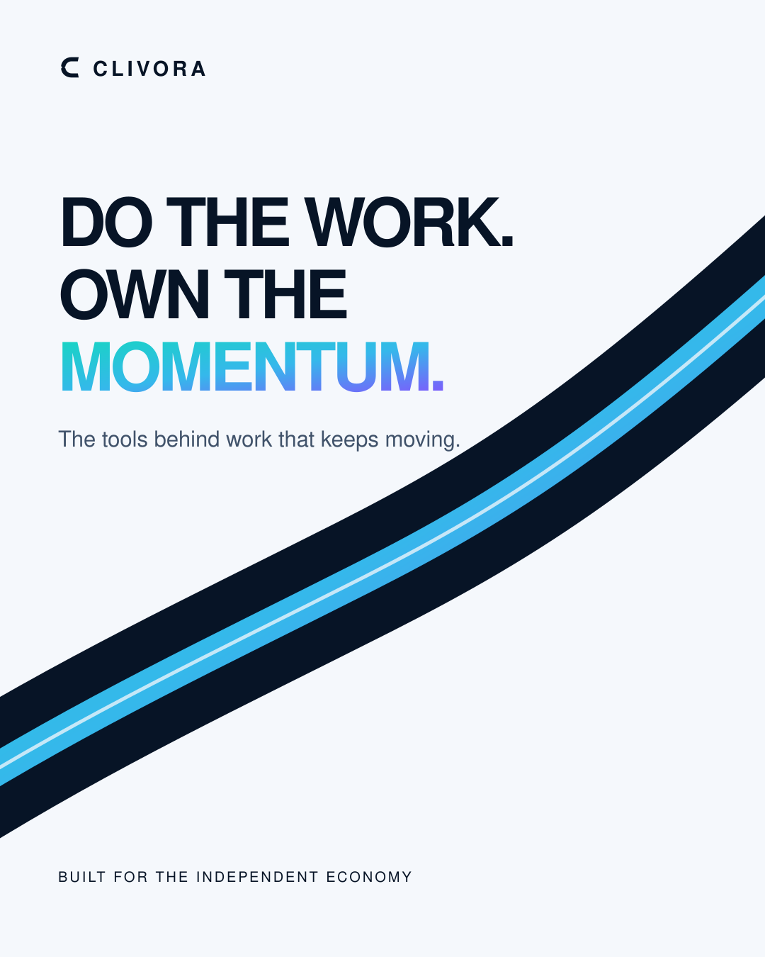
28 / 40
04
SECTION FOUR
Agile process
Do the work. Own the momentum. Three sprints, planned and demonstrated.
CLIVORA PREMIUM CAMPAIGN V2
CLIVORA · Quantic MSSE Capstone · clivora.io
github.com/UsmanGhias/clivora

Slide 29
29 / 40
SECTION 04 · AGILE PROCESS
Baseline versus the Capstone increment
This is the same boundary from slide three, now with the evidence attached.
BASELINE — SHIPPED BEFORE THE CAPSTONE
CAPSTONE INCREMENT — WHAT QUANTIC GRADES
Freelancer and client accounts, Google sign-in
SPRINT 1
Grader-ready repo: docs, board, secrets hygiene, unit tests, npm test in CI
CRM: clients, projects, invoices, expenses, quotes, timesheets
Android offline CRM with the sync outbox
SPRINT 2
Connect: jobs, talent, proposals, mutual accept
Ask AI becomes retrieval-augmented, with an eval set and a human-review gate
Messaging, meetings, public invoice share pages
Free / Pro / Pro Plus gates, Play Billing
SPRINT 3
Admin console, feature flags, vault share links
One reliable hire-to-invoice demo loop and this presentation
CLIVORA · Quantic MSSE Capstone · clivora.io
github.com/UsmanGhias/clivora
Notes:
[17:40–18:10] "Left column: baseline, already in production, not claimed as sprint work.
Right column: the three sprints Quantic is grading. Sprint 1 made the repository
gradeable and closed the test and CI gap. Sprint 2 treated CLIVORA as an AI system. Sprint 3
is the demo loop and this presentation."

Slide 30
30 / 40
CADENCE
Three sprints, 20 August to 14 November 2026
Four weeks each, solo team, weekly timeboxed check-ins. Every sprint closes with a demo recorded for the Product Owner — accept or reject, then re-plan.
20 Aug
17 Sep
16 Oct
14 Nov
SPRINT 1
Grader-ready repo
Exit demo — README links resolve, tests pass in CI
SPRINT 2
Ask AI as an AI system
Exit demo — Ask AI answering from a real invoice
SPRINT 3
The demo loop
Exit demo — the Capstone video, ID on camera
CLIVORA · Quantic MSSE Capstone · clivora.io
github.com/UsmanGhias/clivora
Notes:
[18:10–18:45] "Three sprints across twelve weeks, four weeks each, starting 20 August and
finishing 14 November. Each bar ends in a diamond, which is the sprint review — a screen
recording demonstrating the increment to the Product Owner.
I know I am both the developer and the Product Owner. I still ran the ceremony properly:
each increment was explicitly accepted or rejected before the next sprint was planned, and
the board reflects that."

Slide 31
31 / 40
SPRINT DETAIL
What was planned, delivered and demonstrated
SPRINT 1
20 Aug – 17 Sep
SPRINT 2
18 Sep – 16 Oct
SPRINT 3
17 Oct – 14 Nov
Grader-ready engineering
CLIVORA as an AI system
One loop, end to end
docs/capstone/ written: design and testing, stories, sprint plan
Retrieval over crm_embeddings in the Ask AI route
Scripted hire → project → timesheet → invoice → paid
GitHub Project and capstone-labelled issues
Opt-in indexing endpoint so saves stay untouched
Client-side verification on a second real account
Secrets, keystores and .env moved into .gitignore
crm-rag unit tests: chunking, sanitisation, no invented amounts
Demo script committed so the run is repeatable
New unit suites: plan gates, money, outbox
Written eval set in ASK_AI_EVAL.md
This deck, speaker notes and the recorded walkthrough
npm test wired into the CI workflow
Human-review gate: auto_pay and auto_publish forbidden
Final submission package for Quantic
CLIVORA · Quantic MSSE Capstone · clivora.io
github.com/UsmanGhias/clivora
Notes:
[18:45–19:20] Pick one item per sprint, not all fifteen.
"Sprint 1's most useful story was wiring npm test into CI — the web tests existed, but
nothing forced them to run, so they were decoration. Sprint 2's was the opt-in indexing
endpoint, because it let me add retrieval without touching the invoice save path. Sprint 3's
was committing the demo script, so the loop I am about to show is repeatable rather than
lucky."

Slide 32
32 / 40
WORKING AGREEMENT
The board and the definition of done
DEFINITION OF DONE — EVERY STORY
COLLABORATIVE TOOLING
GitHub Issues + Project
Code on main, or in a pull request into main
Labels capstone, sprint-1/2/3. Public board for graders.
Tests added or updated whenever the behaviour is testable
GitHub Actions
CI on every push; tag-driven Android release jobs.
Board card moved to Done — not left in progress
Hostinger
Continuous delivery target for the web app.
No secrets committed, verified before push
Google Play Console
Baseline features never relabelled as new Capstone work
Android distribution and release tracks.
Google Drive
Final demo recording, shared with link access.
CLIVORA · Quantic MSSE Capstone · clivora.io
github.com/UsmanGhias/clivora
Notes:
[19:20–19:45] "The definition of done was written before Sprint 1 and did not move.
Two clauses are unusual and both are deliberate. 'No secrets committed' is a done criterion,
not a code review nicety, because this repository is public for grading. And the last one —
baseline features are never relabelled as Capstone work — is what stops a solo project from
quietly inflating its own scope."

Slide 33
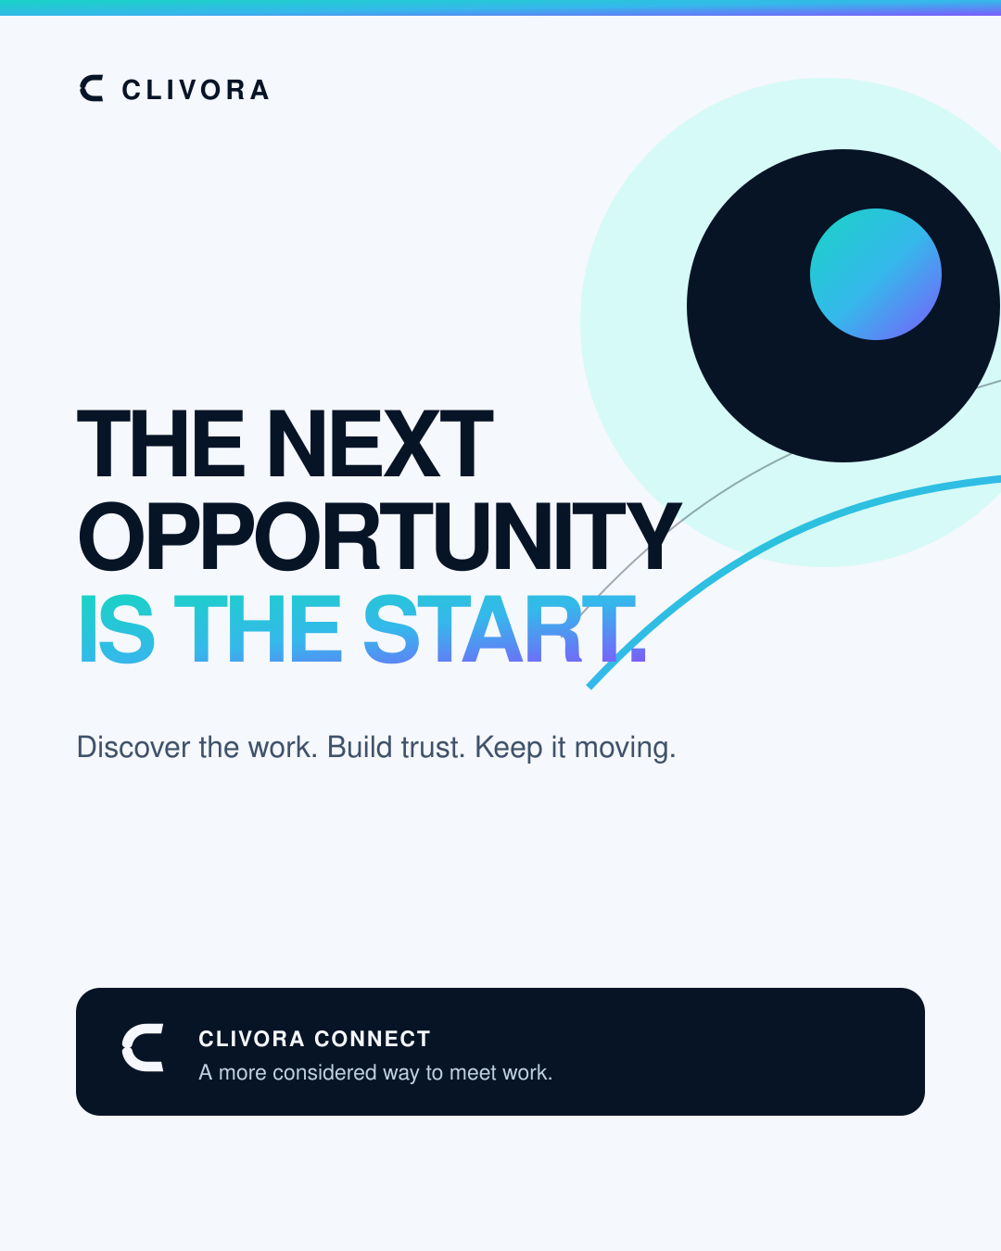
33 / 40
05
SECTION FIVE
Live demo
The next opportunity is the start — and the invoice is the proof.
CLIVORA PREMIUM CAMPAIGN V2
CLIVORA · Quantic MSSE Capstone · clivora.io
github.com/UsmanGhias/clivora

Slide 34
34 / 40
SECTION 05 · LIVE DEMO
The loop I am about to run
One continuous path from a posted job to a paid invoice, across two real accounts.
1
2
3
4
5
6
Client posts
Freelancer proposes
Mutual accept
Project created
Invoice issued
Marked paid
a job on Connect
browse, then send
contact unlocked
tasks + timesheet
from tracked time
branded PDF, $0 fee
Two real accounts
Both clients
What I will not claim
A freelancer account and a separate client account, both signed in. Nothing is faked with a demo flag.
Part of the loop runs in the browser on clivora.io and part on the Android build, against the same rows.
Payment is recorded, not processed. There is no live Stripe or escrow, and I will say so on screen.
CLIVORA · Quantic MSSE Capstone · clivora.io
github.com/UsmanGhias/clivora
Notes:
[19:45–20:15] Set expectations before you share the screen.
"Six steps, two accounts, both clients. I will post a job as the client, propose as the
freelancer, accept from both sides so the contact unlocks, turn it into a project with
tracked time, raise the invoice from that time, and mark it paid.
One honest caveat, and I will repeat it on screen: payment here is recorded, not processed.
There is no live Stripe and no escrow in CLIVORA. Saying otherwise would be the easiest way
to lose credibility."
NOW SWITCH TO THE LIVE PRODUCT. Follow docs/capstone/DEMO_SCRIPT.md. Budget 5–6 minutes.

Slide 35
35 / 40
WHERE THIS LANDED
Results and the evidence behind each claim
8
2
3
$0
Automated suites running in CI
Native clients on one shared record
Sprints, planned and demonstrated
Platform fee on a Connect deal
DELIVERED IN THE INCREMENT
OPEN, AND TRACKED HONESTLY
Repository a grader can navigate: design and testing doc, stories, sprint plan
QA-001: web end-to-end journeys still need Playwright coverage
CI enforcing web tests, not just building the app
Outbox behaviour under process death and account switch is untested
Ask AI grounded in the user's own CRM, with a written eval set
match_crm_embeddings SQL is in the repo, not yet applied in production
A hire-to-invoice loop that runs from a committed script
Payments are recorded, not processed — no live gateway
CLIVORA · Quantic MSSE Capstone · clivora.io
github.com/UsmanGhias/clivora
Notes:
[20:15–20:45] Claim the wins, then own the gaps. Graders trust the second list.
"Four numbers on top. Eight automated suites in CI, two native clients on one record, three
sprints demonstrated, and zero platform fee on a Connect deal.
On the left, what actually shipped. On the right, what is still open — and I want to be
explicit about these because they are in the repository, not hidden. Web end-to-end coverage
is my largest remaining risk. The outbox is untested under process death. The vector-match
SQL exists but has not been applied to production. And payments are recorded, not processed."

Slide 36
36 / 40
SUBMISSION
What goes into Quantic, and in which of the two buttons
The most common way to lose marks here is uploading the deck into the presentation slot.
BUTTON 1 · PROJECT
BUTTON 2 · PRESENTATION
Submit the working software
Submit the video, not the slides
Live product: https://clivora.io
15–20 minute recording, photo ID shown on camera
Repository: https://github.com/UsmanGhias/clivora
Uploaded to Google Drive with link access for anyone
Agile board: Issues filtered by the capstone label
Group Project Agreement attached
Design and testing: docs/capstone/DESIGN_AND_TESTING.md
Share the repository with the grader account
Do not upload this PPTX, its PDF or a ZIP as the presentation. The presentation submission is the video link. This deck is a speaking aid only.
CLIVORA · Quantic MSSE Capstone · clivora.io
github.com/UsmanGhias/clivora
Notes:
[20:45–21:10] Read the red band out loud — it is a reminder to yourself as much as to the
grader. "Two buttons. The project button takes the live product, the repository, the board
and the design and testing document. The presentation button takes the video link, not
these slides."
Before you submit: confirm the Drive link opens in a private browser window, and confirm
the grader account has read access to the repository.

Slide 37
37 / 40
THANK YOU
Discover the work.
Do the work.
Own the momentum.
Usman Ghias · Product Owner, Scrum Master and engineer · CODCrafters
Happy to take questions on the architecture, the sprint record or the open risks.
LIVE
https://clivora.io
REPOSITORY
https://github.com/UsmanGhias/clivora
DESIGN + TESTING
docs/capstone/DESIGN_AND_TESTING.md
Notes:
[21:10–21:30] Close on the campaign line, then stop talking.
"Discover the work. Do the work. Own the momentum. That is the product thesis and it is also
what these three sprints were for. Thank you — I am happy to take questions on the
architecture, the sprint record, or the open risks."
Do not add new content after this. End the recording.

Slide 38
38 / 40
APPENDIX · NOT PRESENTED
Roadmap after the Capstone
Ranked by the risk it removes, not by how impressive it demos.
NEXT
NEXT
THEN
Playwright end-to-end suite
Outbox resilience tests
Apply match_crm_embeddings
Closes QA-001: login, Connect accept, invoice share.
Process death and account switch under Flutter integration tests.
Vector search in a maintenance window, behind a flag.
THEN
LATER
LATER
Ask AI citations in the UI
Payments
iOS
Show the invoice or client each sentence came from.
A real gateway, only when it can be operated and supported properly.
Same Flutter codebase, once Android retention justifies the review overhead.
CLIVORA · Quantic MSSE Capstone · clivora.io
github.com/UsmanGhias/clivora
Notes:
Appendix. Only open this if a grader asks what comes next.

Slide 39
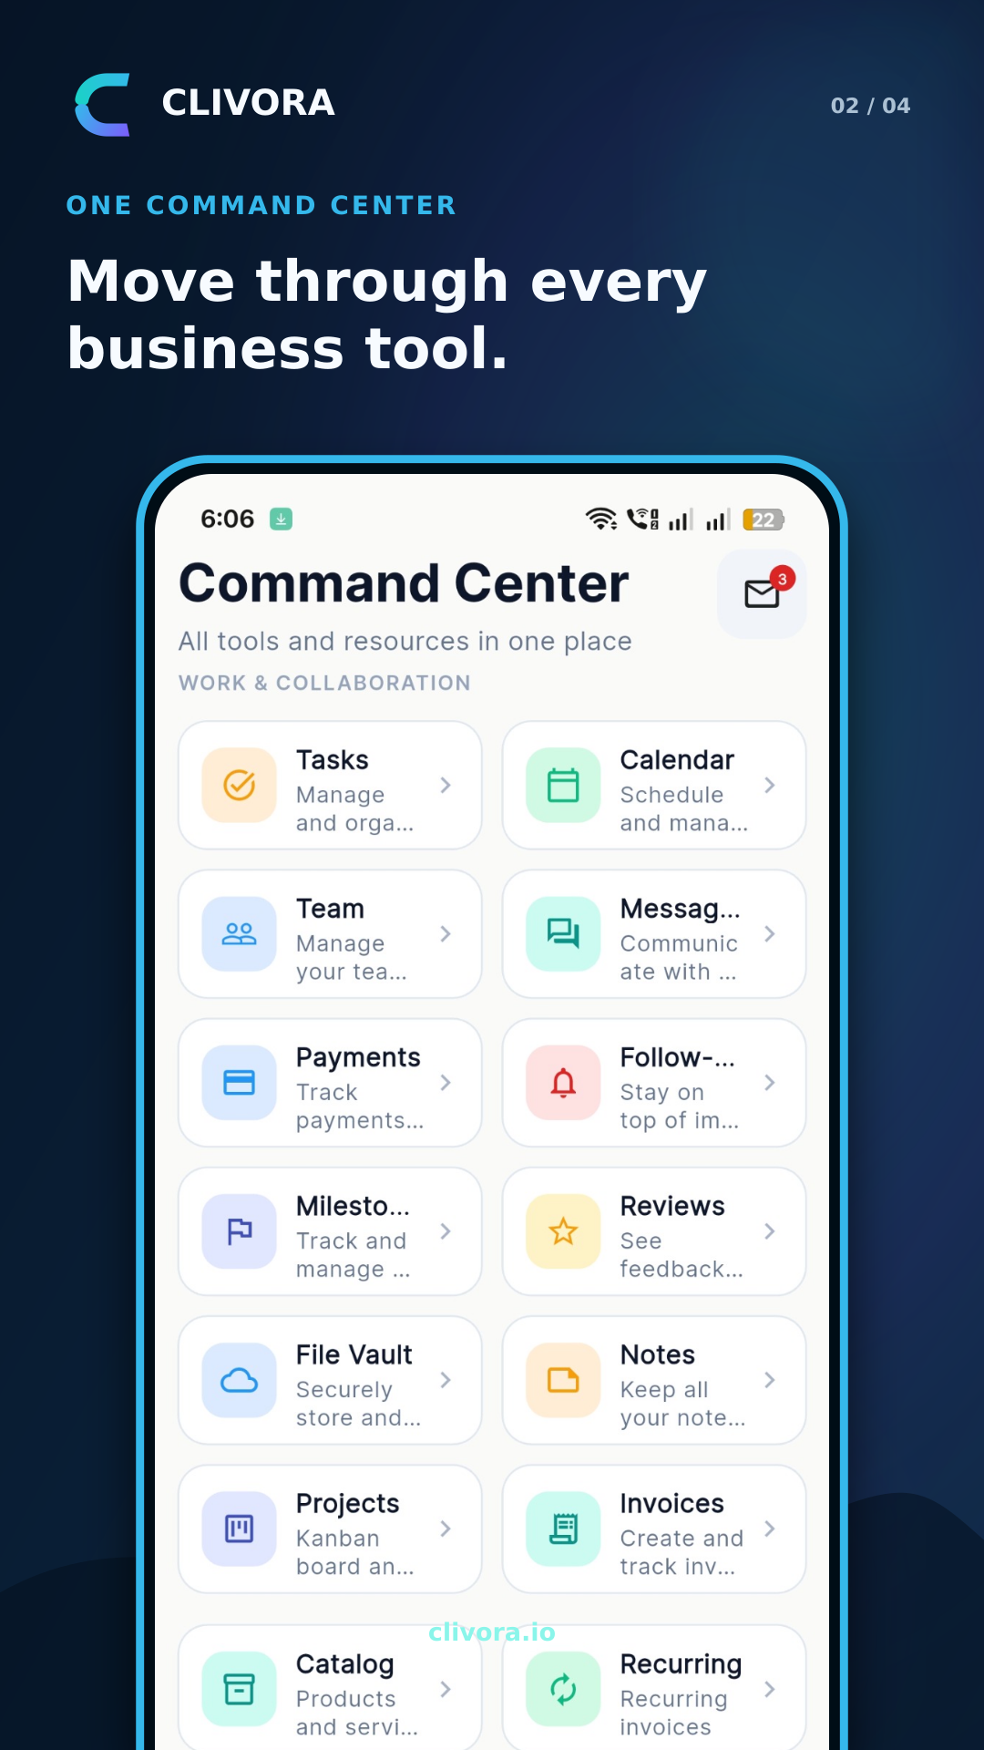
39 / 40
APPENDIX · NOT PRESENTED
Go-to-market artefacts already produced
Included because the handbook rewards a product, not only a repository.
Premium Campaign V2
Five editorial creatives, a 20-second vertical film and an original 102 BPM soundtrack.
Marketing launch kit
65 assets: square, portrait, story and landscape adaptations, paid-ad variants, WhatsApp statuses.
Google Play listing
Feature graphic and four store screenshots, all generated from real product screens.
Keyword research
126 ranked search terms across freelancer, CRM, invoicing and project-management intent.
Publishing calendar
A seven-day launch sequence with per-platform captions and a fixed posting order.
CLIVORA · Quantic MSSE Capstone · clivora.io
github.com/UsmanGhias/clivora
Notes:
Appendix. Evidence that CLIVORA is a product with a launch, not a class exercise.

Slide 40
40 / 40
APPENDIX · PRE-RECORDING CHECKLIST
Run this list before you hit record
Before recording
During recording
After recording
Photo ID physically in hand
Show ID and say your full name in the first minute
Upload to Google Drive, anyone-with-link access
1920x1080 screen, notifications silenced
Say the word baseline when showing pre-Capstone features
Test the link in a private browser window
Freelancer and client accounts both signed in
Never claim Stripe or escrow is live
Attach the Group Project Agreement
Demo data reset per DEMO_SCRIPT.md
Run the whole loop without cutting the recording
Give the grader account read access to the repo
This deck open in presenter view with notes
Stay inside 20 minutes
Submit both buttons — project and presentation
CLIVORA · Quantic MSSE Capstone · clivora.io
github.com/UsmanGhias/clivora
Notes:
Appendix. Read this immediately before recording. Do not present it.

