Slide 1

A Parallel Algorithm for Updating a Multi-objective Shortest Path in Large Dynamic Networks (MOSP)
Ibrahim Azhar, 22i-0928
Usman Haroon, 22i-1177
Fahad Saleem, 22i-0764
Notes:
Welcome everyone. Today, we present our research titled 'A Parallel Algorithm for Updating a Multi-objective Shortest Path in Large Dynamic Networks.' This work is a culmination of efforts by our dedicated team. We'll be walking through the motivation, core contributions, the algorithmic strategy we developed, and our implementation roadmap.
We represent [Your University] and this project was completed under the guidance of [Your Course Info]. Our diverse team brings together strengths in distributed systems, algorithm optimization, and practical implementation across platforms such as MPI, OpenMP, and METIS.
Let’s begin by understanding why this topic is significant and how it impacts various real-world applications.

Slide 2
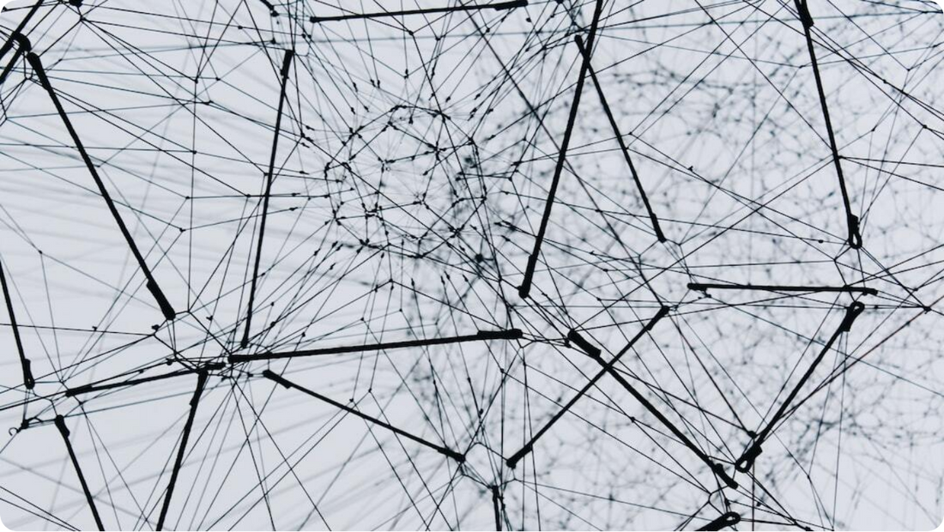
Problem Definition
What is Multi-objective Shortest Path (MOSP)?
Multi-objective Optimization: Simultaneously optimizes multiple criteria like time, distance, and energy consumption.
Pareto Optimality: Improving one objective degrades at least one other; solutions form a Pareto front.
Dynamic Graphs: Networks evolve via edge insertions/deletions, requiring real-time updates.
Notes:
At the core of this study is the Multi-objective Shortest Path (MOSP) problem, a complex challenge that seeks to optimize several objectives simultaneously. Unlike traditional shortest path problems, MOSP must consider trade-offs—like minimizing time and conserving fuel—which makes solutions non-trivial and more nuanced.
The concept of Pareto optimality is central here. Instead of a single best path, MOSP yields a set of paths where improving one criterion inevitably worsens another. This Pareto front represents a spectrum of equally valid solutions from which decision-makers can choose based on context-specific priorities.
Moreover, the challenge is heightened by the nature of dynamic graphs. These are networks that continuously change due to edge insertions or deletions. This volatility necessitates algorithms capable of fast and efficient updates, avoiding full recalculation for every minor change.

Slide 3



Motivation
Why is the MOSP Problem Important?
Real-world Applications
Used in route optimization (road networks), data routing (WSNs), and energy-time trade-offs (drone delivery systems).
Dynamic Networks
Frequent topological changes like edge insertions pose computational challenges.
Conflicting Objectives
Need to balance multiple goals such as minimizing travel time and energy consumption.
Notes:
Understanding why the Multi-objective Shortest Path (MOSP) problem is critical requires a look at its wide applicability and inherent complexity. Consider modern road networks used in GPS systems, wireless sensor networks deployed for data communication, or drone-based delivery systems navigating urban spaces. Each of these domains demands routing solutions that are both optimal and adaptable.
However, real-world networks are rarely static. Roads get congested, sensor nodes fail, or drones face dynamic weather patterns—all resulting in frequent changes to the graph structure. In such dynamic environments, recalculating the optimal paths quickly and accurately becomes a pressing need.
The MOSP problem is further complicated by the presence of conflicting objectives. For example, a drone may need to minimize delivery time while also conserving battery power. These competing goals require sophisticated algorithms that can update solutions in real-time without compromising on performance.

Slide 4
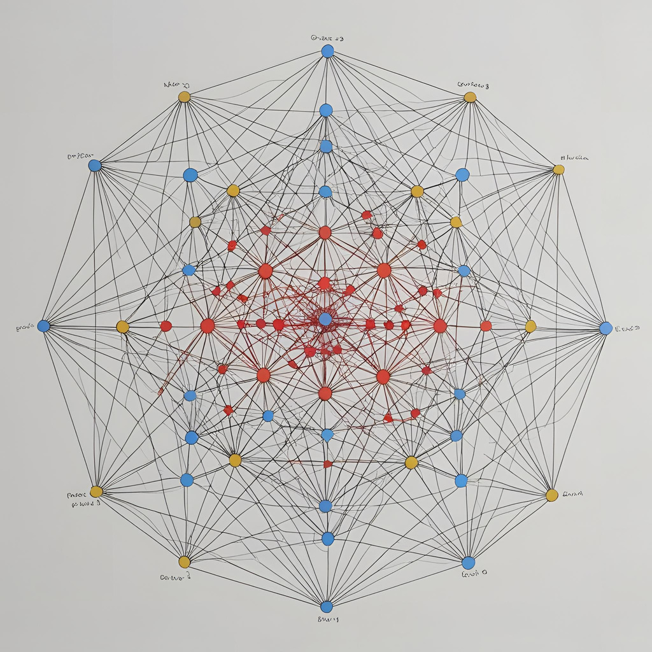
Key Contributions of the Paper
Advancing Dynamic MOSP with Parallelism
SOSP Update: Introduces a parallel algorithm to efficiently update shortest paths in dynamic graphs.
MOSP Heuristic: Leverages SOSP updates to construct a composite graph for efficient MOSP estimation.
Shared-memory Parallelism: Implements OpenMP-based parallelism for high efficiency in shared-memory systems.
Scalability: Demonstrates performance on large-scale, real-world networks.
Notes:
At the core of this study is the Multi-objective Shortest Path (MOSP) problem, a complex challenge that seeks to optimize several objectives simultaneously. Unlike traditional shortest path problems, MOSP must consider trade-offs—like minimizing time and conserving fuel—which makes solutions non-trivial and more nuanced.
The concept of Pareto optimality is central here. Instead of a single best path, MOSP yields a set of paths where improving one criterion inevitably worsens another. This Pareto front represents a spectrum of equally valid solutions from which decision-makers can choose based on context-specific priorities.
Moreover, the challenge is heightened by the nature of dynamic graphs. These are networks that continuously change due to edge insertions or deletions. This volatility necessitates algorithms capable of fast and efficient updates, avoiding full recalculation for every minor change.

Slide 5
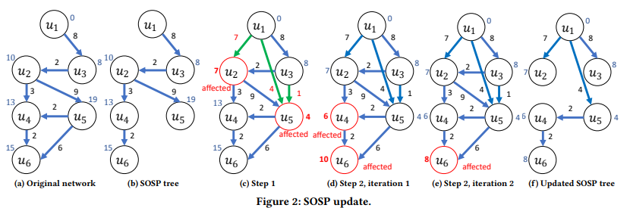
Algorithm 1 – SOSP_Update
Group inserted edges by destination vertex to avoid race conditions in parallel updates.
In parallel, each thread processes one group: it checks if any new edge gives a shorter path to the destination and updates it if needed.
Mark affected vertices, i.e., those whose distances changed due to inserted edges.
Iteratively propagate changes: affected vertices may influence neighbours — these are relaxed in parallel until no more changes occur.
The result is an updated SOSP tree reflecting the new shortest paths after edge insertions.
Notes:
Let’s now dive into the core algorithms proposed in the paper. These two interlinked methods form the foundation of the entire approach to handling dynamic MOSP.
The first, Parallel SOSP Update, is designed for single-objective shortest path recalculations. When new edges are introduced in the graph, it leverages parallel processing and grouping techniques to efficiently update the shortest path tree, minimizing computational waste.
The second algorithm adapts these SOSP updates to tackle the multi-objective case. It constructs a combined graph incorporating updated paths from different objectives, then applies a heuristic to determine the best MOSP solutions. Together, these algorithms offer a powerful and scalable method to maintain optimal paths in evolving networks.

Slide 6
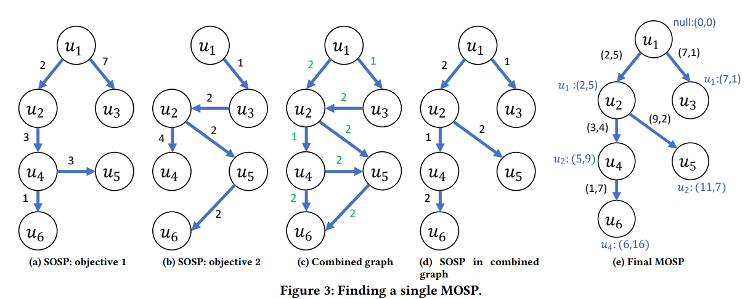
Algorithm 2 – MOSP_Update (Heuristic)
Run Algorithm 1 for each objective to update the individual SOSP trees (e.g., time, fuel).
Build a combined ensemble graph by taking all edges from SOSP trees; edges common to multiple trees are prioritized via lower weights.
Assign weights inversely to frequency: edge in more SOSP trees → lower weight → higher chance of being selected.
Run a single SOSP algorithm (e.g., Bellman-Ford) on this combined graph to find one balanced path.
Reassign original weights to the resulting path to retrieve a valid MOSP solution balancing the objectives.
Notes:
Let’s now dive into the core algorithms proposed in the paper. These two interlinked methods form the foundation of the entire approach to handling dynamic MOSP.
The first, Parallel SOSP Update, is designed for single-objective shortest path recalculations. When new edges are introduced in the graph, it leverages parallel processing and grouping techniques to efficiently update the shortest path tree, minimizing computational waste.
The second algorithm adapts these SOSP updates to tackle the multi-objective case. It constructs a combined graph incorporating updated paths from different objectives, then applies a heuristic to determine the best MOSP solutions. Together, these algorithms offer a powerful and scalable method to maintain optimal paths in evolving networks.

Slide 7




Parallelization Strategy
Using MPI, OpenMP/OpenCL, and METIS
MPI for Inter-node Communication
Distributes graph partitions across multiple machines; minimizes communication overhead.
OpenMP for Intra-node Parallelism
Parallelizes edge relaxation and label propagation on each node for efficient computation.
Graph Partitioning with METIS
Partitions graph into p parts balancing computational load and minimizing cross-partition links.
Execution Flow
Partition graph → run parallel SOSP updates → merge results for MOSP.
Notes:
The performance and scalability of the MOSP solution hinge significantly on the parallelization strategy. This slide outlines the three-pronged approach used: MPI, OpenMP, and METIS.
MPI handles communication across nodes in a distributed system. It allows graph partitions to be spread across multiple machines while minimizing communication overhead. Within each node, OpenMP ensures that computations such as edge relaxation and label propagation happen in parallel across available cores.
To ensure effective parallelism, the METIS tool is employed for graph partitioning. It divides the graph into nearly equal subgraphs while minimizing the number of edges between partitions, thereby optimizing inter-process communication.
The entire flow begins with METIS-based partitioning, followed by parallel SOSP updates using MPI and OpenMP, and ends with a merging phase to compute the final MOSP solutions.

Slide 8
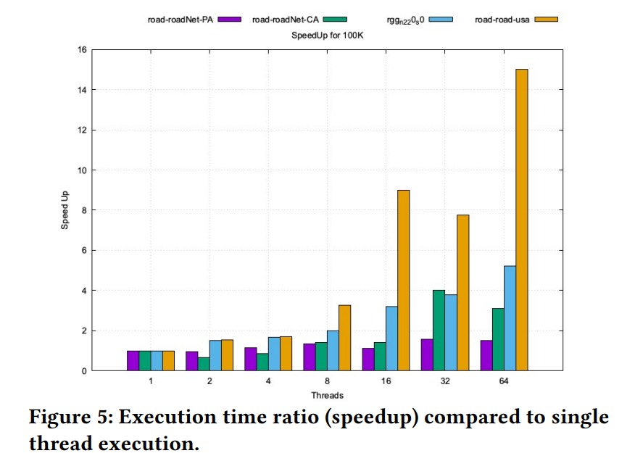
Multi-Threaded Graph Analysis
Understanding the Core Methods
Experimental Setup: All experiments were conducted on dual 32- core AMD EPYC Rome 7452 CPUs with 64 GB DDR4 RAM allocated
Variable Threading: For strong scaling analysis, the number of OpenMP threads was increased from 1 to 64 while keeping the batch size constant for each experiment.
Speed Up: The largest network in the test suite, i.e., Road-USA shows the maximum speedup (up to 15𝑋)
Trend: The general trend shows that the execution time decreases gradually when the number of threads increases.
Notes:
Let’s now dive into the core algorithms proposed in the paper. These two interlinked methods form the foundation of the entire approach to handling dynamic MOSP.
The first, Parallel SOSP Update, is designed for single-objective shortest path recalculations. When new edges are introduced in the graph, it leverages parallel processing and grouping techniques to efficiently update the shortest path tree, minimizing computational waste.
The second algorithm adapts these SOSP updates to tackle the multi-objective case. It constructs a combined graph incorporating updated paths from different objectives, then applies a heuristic to determine the best MOSP solutions. Together, these algorithms offer a powerful and scalable method to maintain optimal paths in evolving networks.

Slide 9

Implementation
Implementation Plan for Parallel MOSP
MPI: Handles graph partitioning and update distribution across machines.
OpenMP/OpenCL: Performs vertex and edge computations in parallel within each partition.
METIS: Efficiently partitions graphs into balanced, low-intercommunication subgraphs.
Dataset and Testing: Utilize public graph datasets to benchmark performance and scalability.
Notes:
For this project, you'll implement a highly parallelized framework to solve the MOSP problem using real-world datasets. The workflow incorporates industry-standard tools and libraries tailored for high-performance computing and large-scale graph analysis.
MPI will be responsible for distributing graph segments and coordinating updates across different nodes. Within each node, OpenMP or OpenCL will manage concurrent processing of edges and vertices, ensuring optimal resource utilization. METIS will provide efficient partitioning to balance the computational load while reducing the communication overhead between partitions.
Public datasets from repositories such as the Network Repository will be used for empirical validation. These datasets simulate real-world conditions, enabling us to measure scalability and effectiveness of our implementation under dynamic conditions.

Slide 10

Challenges & Next Steps
Planning for Implementation
MPI Communication: Ensuring low-latency and high-throughput communication among processes.
Dynamic Updates: Efficiently manage frequent graph changes without full recomputation.
Scalable Parallelism: Designing robust thread-level and process-level parallelism
.
Next Steps: Set up METIS, implement SOSP updates, test on small graphs, then scale.
Notes:
Implementing a parallel MOSP solution in dynamic environments introduces several non-trivial challenges. One major hurdle is managing efficient inter-process communication via MPI. With increasing partitions, the need for low-latency, synchronized data sharing grows significantly.
Another difficulty is maintaining responsiveness in the face of frequent graph updates. Rather than recalculating everything from scratch, we must develop methods that intelligently update only the affected paths. Furthermore, achieving truly scalable performance requires careful design of both thread-level and inter-node parallelism.
As for the path forward, we'll start with METIS-based graph partitioning, then proceed to implement the SOSP update mechanism. Testing will begin with small datasets to ensure correctness and performance, followed by scalability evaluation on larger graphs.

Slide 11



Q&A
Open Floor for Questions and Discussion
Clarifications
Ask about the algorithm design, implementation challenges, or use cases.
Feedback
We welcome constructive feedback and discussion to enhance our approach.
Next Steps
Suggestions or collaboration ideas for future work are appreciated.
Notes:
We now open the floor for questions. Feel free to ask for clarification on any aspect of our presentation—whether it's about the algorithms, implementation details, or potential applications of this work.
We’re also keen on receiving feedback. If there are areas you think could be improved or enhanced, we’d love to hear your thoughts. Constructive criticism is vital for refining our work and pushing the boundaries of what this project can achieve.
Lastly, if this work sparks any ideas for further research or collaboration, please share them. Our goal is to not only present a solution but also to contribute to the growing body of knowledge on dynamic and parallel pathfinding algorithms.

