Slide 1
Chapter 4
Employee Rights and Discipline

Slide 2
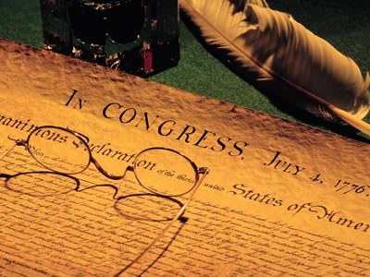
Introduction
Employee rights have become one of the more important human resource issues
The U.S. Constitution, laws, and Supreme Court rulings have increasingly constrained employer actions

Slide 3
Legal questions we’ll answer
Suppose you were in charge of hiring 50 new cashiers for a large new discount retail store that was opening. You're checking references, and making criminal background checks, but just to be on the safe side, you would like to check their credit reports to make sure applicants aren't in any financial trouble that may tempt them to be less than honest when handing cash. Can you do it? Do you need to tell anyone?

Slide 4
Employee Rights Legislation and the HRM Implications
Privacy Act of 1974
Requires government agencies to make information contained in their personnel files available to employees
Employees can review letters of recommendation made on their behalf
Similar state laws apply to state and private-sector employees
Restrictions: employee waivers of right-to-review procedures that stipulate when and how a file can be accessed

Slide 5
Employee Rights Legislation and the HRM Implications
The Fair Credit Reporting Act of 1971
Requires employers to notify employees that their credit is being checked
Provides additional information to applicants who are negatively affected by a credit check
Information used must be job-relevant

Slide 6
Employee Rights Legislation and the HRM Implications
The Drug-Free Workplace Act of 1988
Requires government agencies, federal contractors, and those receiving federal funds of $100,000 or more to:
Establish and disseminate drug-free policies
Provide substance-abuse awareness programs
Drug-free policies must include:
What is expected of employees
Penalties for infractions of policies
Substance abuse awareness programs

Slide 7
Employee Rights Legislation and the HRM Implications
Polygraph Protection Act of 1988
Prohibits employers in the private sector from using lie-detector tests in all employment decisions
May still be used during investigations of suspected criminal activity
Employees can challenge the results of a polygraph

Slide 8
Employee Rights Legislation and the HRM Implications
Worker Adjustment and Retraining Notification Act of 1988
Protects employees from unexpected plant closings.
Organizations of 100+ employees must give 60 days notice if closing facility or laying off 50 or more workers
State officials must be notified
Penalty for not notifying is one day’s pay and benefits for each day’s notice
The law does recognize circumstances in which advance notice is impossible.

Slide 9
Current Issues in Employee Rights
Social Media
Employee and employer rights are evolving through court cases
Discussion of working conditions on social media sites with co-workers is generally protected
Angry rants and name calling on social media are not usually protected
Organizations need to establish a social media policy and inform employees of the policy.

Slide 10
Current Issues in Employee Rights
Drug Testing
For current employees:
Offers rehabilitation to those who fail
Communicates that drugs will not be tolerated
For applicants:
Should be done after a job offer is made
Those who fail are usually no longer considered
Companies are:
Moving to more precise tests (that do not use body fluids)
Communicating clear policies and procedures
Relating the testing program to safety and job performance
Even organizations not covered by the Drug-Free Workplace Act conduct drug testing.

Slide 11
Current Issues in Employee Rights
Drug Testing
Under the Drug Free Workplace Act, all individuals with federal contracts or grants and the organizations with federal grants or contracts over $100,000 are required to actively pursue a drug-free workplace.
This act also requires employees who hold certain jobs in companies regulated by the Department of Transportation and the Nuclear Regulatory Commission to be subject to drug tests.

Slide 12
Current Issues Regarding Employee Rights
Honesty Tests
Written tests to get applicants to reveal information about their integrity
Legal alternative to polygraph
Used to predict theft and drug use
Multiple questions on the same topic to assess consistency of responses
Shouldn’t be sole criterion for a hiring decision

Slide 13
Current Issues in Employee Rights
Whistle-blowing
Employee notifies authorities of wrongdoing in an organization.
Sarbanes-Oxley Act protects some employees from employer retaliation
Some state laws protect the jobs of whistleblowers

Slide 14
Current Issues in Employee Rights
Employee Monitoring and Workplace Security
Company interests are protected against
Theft
Revealing of trade secrets to competitors
Using the customer database for personal gain
Lost productivity
HRM policies must be clear on monitoring
E-mail
Internet use
Phone
How to balance security with employees’ rights? Tough question!

Slide 15
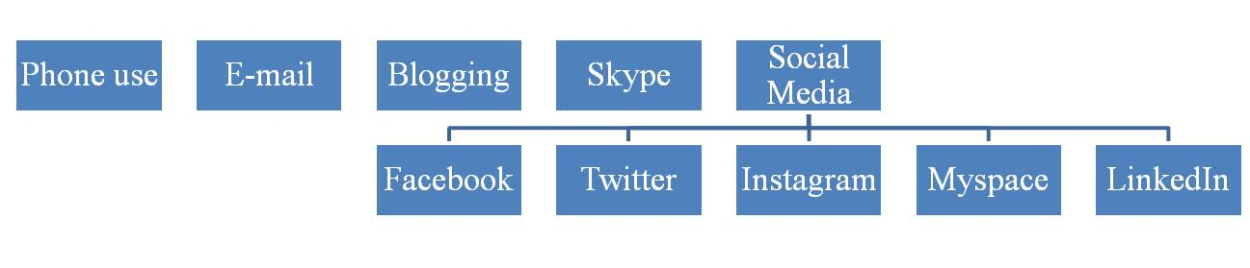
Current Issues in Employee Rights
Employee Monitoring and Workplace Security
Monitoring may include many types of employee communication
Technology has blurred the line between public and private
See “Social Media in the Workplace” from SHRM

Slide 16
Current Issues in Employee Rights
Workplace Romance
Concerns include
Favoritism
Ethical issues
Low productivity
Morale problems
Workplace violence
Options include
Forbid co-worker relationships (fraternization policies)
Require “consensual relationship” contracts

Slide 17
Employment-at-Will Doctrine
Allows dismissal of employees at any time for any reason except race, religion, sex, national origin, age, or disability.
Exceptions to the doctrine:
Contractual relationship:
Legal agreement exists defining how employee issues are handled
Statutory considerations:
Federal and/or state laws can create exceptions
Public policy violation:
Employees cannot be fired for disobeying an illegal order from the employer
Implied employment contract:
Promise or guarantee about job security, verbal or written
Breach of good faith:
Employer breaches a promise or abuses its managerial powers.

Slide 18
Discipline and Employee Rights
Discipline
Employees conduct themselves according to organizational rules and standards
They know what is expected
They know meeting those expectations is in the best interest of themselves and the organization

Slide 19
Discipline and Employee Rights
HR managers should consider:
seriousness of the problem
duration of the problem
frequency and nature of the problem
extenuating factors
degree of socialization
history of organization’s discipline practices
management backing

Slide 20
Discipline and Employee Rights
The most frequent violations requiring
disciplinary action
attendance
dishonesty
job behaviors
outside
activities

Slide 21
Discipline and Employee Rights
Real people’s “real” (outrageous) reasons for being late to work:
“My heat was shut off so I had to stay home to keep my snake warm.”
“My husband thinks it’s funny to hide my car keys before he goes to work.“
“My father didn’t wake me up.”
“My bike tire went flat after a groundhog bit it.”
“A gurney fell out of an ambulance and delayed traffic.”
“I feel as if I’m in everyone’s way if I show up on time.”

Slide 22

Discipline and Employee Rights
Follow the Hot-Stove rule:
Immediate response
Advance warning
Consistent action
Impersonal application

Slide 23
Discipline and Employee Rights
Make disciplinary action corrective rather than punitive. Use a progressive approach
Verbal warning
Written warning
Suspension
Dismissal

Slide 24
Discipline and Employee Rights
When firing an employee:
Review all facts
Set the stage
Be very clear
Allow a little dignity
Let the employee talk
Give severance pay
Sign waiver of right to sue for wrongful termination
Pay for earned time
Have person leave that day
Inform person of benefits
Take protective steps (change passwords, etc.)
Inform staff of firing

Slide 25
Let’s Play Jeopardy-style!
1. An act that requires government agencies to make available to employees information contained in their personnel files.
What is the Privacy Act of 1974?
2. An act that requires employers to notify employees that their credit is being checked.
What is the Fair Credit Reporting Act of 1971?
3. An act that protects employees from unexpected plant closings.
What is the Worker Adjustment and Retraining Notification Act of 1988?
4. A doctrine that allows dismissal of employees at any time for any reason except race, religion, sex, national origin, age, or disability.
What is the Employment-at-Will-Doctrine?
5. attendance, job behaviors, outside activities, dishonesty
What are the four most common violations requiring disciplinary action?
6. give an immediate response, give ample warning, be consistent, be impersonal
What is the Hot-Stove Rule?

