Slide 1
Chapter 9
Managing Careers

Slide 2
Introduction
Traditionally, career development programs helped employees advance within the organization
Today, each individual must take responsibility for managing their career
Some helpful career development sites:
http://managementhelp.org/career/career.htm
http://associationdatabase.com/aws/NCDA/pt/sp/home_page

Slide 3
Introduction
Organizations now focus on matching the career needs of employees with the requirements of the organization
While many organizations still invest in their employees, they don’t offer career security and they can’t meet the needs of everyone in a diverse workforce

Slide 4
What is a Career?
A career
Is a pattern of work-related experiences that span the course of a person’s life
Reflects any work, paid or unpaid
Is a broad definition helpful in today’s work environment where employees and organizations have diverse needs

Slide 5
What is a Career?
Organizational career planning
Develops career ladders, tracks careers, and provides opportunities for development
Individual career development
Helps employees identify their goals and the steps to achieve them

Slide 6
What is a Career?
Career development looks at the long-term career effectiveness and success of employees
Employee training and development focuses on performance in the immediate or intermediate time frames

Slide 7
What is a Career?
Career development adds value to the company by
Ensuring needed talent will be available
Improving the organization's ability to attract and retain talented employees
Ensuring that minorities and women get opportunities for growth and development.
Reduces employee frustration
Enhances cultural diversity
Promotes organizational goodwill

Slide 8
What is a Career?
Individuals’ external career success is measured by criteria such as:
Progression up the hierarchy
Type of occupation
Long-term commitment
Income
Internal career success is measured by the meaningfulness of one’s work and achievement of personal life goals
the external/internal distinction important to the manager who wants to motivate employees

Slide 9

What is a Career?
Effective coaches give guidance through direction, advice, criticism, and suggestion in an attempt to aid the employee’s growth

Slide 10
What is a Career?
Mentors are typically senior-level employees who provide a support system for junior employees by offering insight into:
How the organization operates, helping expand the junior employee’s professional network,
Assisting in setting career development goals, and
Providing feedback when necessary

Slide 11
What is a Career?
Disadvantages of coaching/mentoring include:
A tendency to perpetuate current styles and practices
Reliance on the coach’s ability to be a good teacher
Considerations for organizations:
Coaching between employees who do not have a reporting relationship
Ways to effectively implement cross-gender mentoring

Slide 12
Traditional Career Stages
Exploration
Establishment
Mid career
Late Career
Decline
High
Will performance increase or decline?
Job Performance
Low
Transition from school to work
Getting first job and being accepted
The elder statesperson
Preparing for retirement
5
10
15
20
25
30
35
40
45
50
55
60
65
70
75
Age

Slide 13
Traditional Career Stages
exploration
Includes school and early work experiences, such as internships. Involves:
Trying out different fields
Discovering likes and dislikes
Forming attitudes toward work and social relationship patterns
this stage is least relevant to HRM because it occurs prior to employment

Slide 14
Traditional Career Stages
establishment
Includes:
Searching for work
Getting first job
Getting evidence of “success” or “failure”
Takes time and energy to find a “niche” and to “make your mark”

Slide 15
Traditional Career Stages
mid-career
Employee may:
Continue to grow
Seeking increased responsibility
Plateau
Satisfied with their role in the organization
Deteriorate
Loss of interest and reduced productivity

Slide 16
Traditional Career Stages
late career
Successful workers with seniority can enjoy being respected for their judgment. Good resource for teaching others
Those who have declined may experience job insecurity
Plateauing is expected; life off the job increases in importance

Slide 17
Traditional Career Stages
decline
May be most difficult for those who were most successful at earlier stages
Today’s longer life spans and legal protections for older workers open the possibility for continued work contributions, either paid or volunteer

Slide 18
Career Choices and Preferences
Good career choice outcomes provide a positive
self-concept and the opportunity to do work that
we value.
Models to help you match your skills to careers:
Holland
Vocational
Preferences
Schein
Anchors
Myers Briggs
Typologies
Also try the classic work “What Color is Your Parachute?” for career advice and a wealth of information: http://www.jobhuntersbible.com/

Slide 19
Career Choices and Preferences
Holland
Vocational
Preferences
Three major components
People have varying occupational preferences
If you think your work is important, you will be a more productive employee
You will have more in common with people who have similar interests

Slide 20
Career Choices and Preferences
Holland
Vocational
Preferences
R
I
Model identifies six vocational themes
1. Realistic
2. Investigative
3. Artistic
4. Social
5. Enterprising
6. Conventional
C
A
E
S
Letters connected by the line indicate reinforcing themes; letters not connected represent opposing themes.

Slide 21
Career Choices and Preferences
Holland
Vocational
Preferences
Preferences can be matched to work environments
Example: social-enterprising-conventional preference structure matches career ladder in large bureaucracy

Slide 22
Career Choices and Preferences
Schein
Anchors
Personal value clusters determine what is important to individuals
Technical-functional competence
Managerial competence
Security-stability
Creativity
Autonomy-independence
Success of person-job match determines individual’s fit with the job

Slide 23
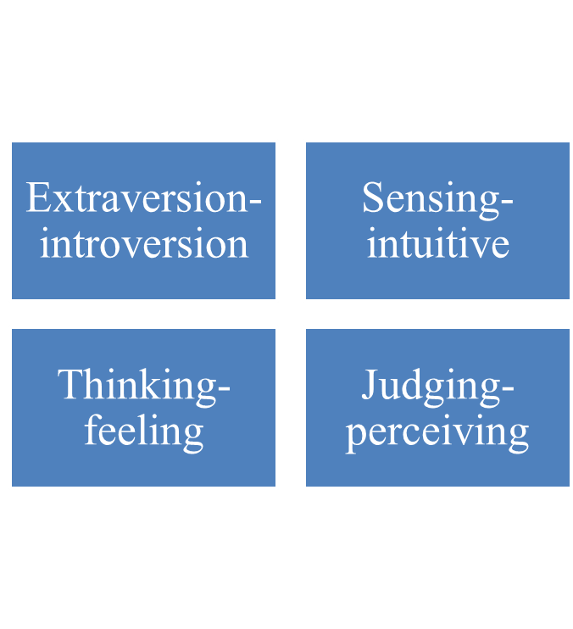
Career Choices and Preferences
Myers Briggs
Typologies
These four personality dimensions identify 16 personality types.
Managers find knowing personality types useful in understanding how workers interact
Job characteristics can be matched to individual preferences

Slide 24
Enhancing Your Career
You are ultimately responsible for your own career.
manage your
reputation
know yourself
network contacts
Successful
Career
Tips
build and maintain
keep current
balance your
specialist & generalist
competencies
keep your
options open
document your
achievements

Slide 25
True or False?
1. Your employer is ultimately responsible for your career path.
False!
2. A career is a pattern of work-related experiences that span the course of a person’s life.
True!
3. Career development looks at the short career effectiveness and success of employees.
False!
4. Establishment is the first traditional career stage.
False!
5. The Holland Vocational Model identifies six vocational themes.
True!
6. The Myers-Briggs Typologies (four dimensions that identify 16 personality types) help match job characteristics to individual preferences.
True!

