Slide 1
Chapter 10
Establishing the Performance Management System

Slide 2
Introduction
Employees see performance evaluations as having a direct effect on their work lives
Questions regarding the performance management process:
What is the purpose of the evaluation?
Who should be evaluated?
What format should be used?
Who will do the evaluation?

Slide 3
Performance Management Systems
Performance management systems have three main purposes:
Two-way feedback – performance measures mutually set between employee and employer
Development – identify areas in which employees have deficiencies or weaknesses
Documentation - to meet legal requirements

Slide 4
Performance Management Systems
Improving performance management systems
Focus on the individual
Discussions of performance may be emotional and may generate conflicts when subordinates and supervisors do not agree
Focus on the process
Company policies and procedures may present barriers to a properly functioning appraisal process
Train appraisers
Training reduces appraiser uncertainty and errors in the process

Slide 5
Performance Management and EEO
EEO laws require performance management systems to be objective and job-related
ADA: performance management systems must measure “reasonable” success.
Click here to see EEOC guidelines for appraising employees with disabilities.
Valid performance appraisals are conducted at established intervals
Evaluations done by trained appraisers
Poorly trained supervisors may show bias

Slide 6
Appraisal Process
1
establish performance standards with employees
2
communicate expectations and set goals
3
measure actual performance
4
compare actual performance with standards
5
discuss the appraisal with the employee
6
if necessary, initiate corrective action

Slide 7
Appraisal Process
Establish performance standards
Derived from company’s strategic goals
Based on job analysis and job description
Communicate expectations
Goals must be articulated from supervisor to employee and from employee to supervisor

Slide 8
Appraisal Process
Measure actual performance using
Personal observation
Statistical reports
Oral reports
Written reports
Compare performance with standards
Explain different levels of performance and how acceptable they are compared to the standard

Slide 9
Appraisal Process
Discuss appraisal with the employee
Feedback has strong impact on employee self-esteem and future performance
Feedback can be positive or negative
Initiate corrective action if necessary
Immediate action deals with symptoms of the problem
Basic corrective action deals with the source of the problem

Slide 10
Appraisal Process
Five common mistakes managers can make in giving a performance review:
1
waiting for the performance appraisal to give feedback
2
overemphasizing recent performances
3
being too positive or negative
4
being critical without being constructive
5
talking not listening

Slide 11
Appraisal Methods
The Three Appraisal Approaches
absolute standards
relative standards
achieved outcomes
no single approach is best; each has its strengths and weaknesses

Slide 12
Appraisal Methods
Absolute standards
Employee’s performance is measured against established standards
Evaluation is independent of any other employee

Slide 13
Appraisal Methods
absolute standards
Critical incident appraisal
Based on key behavior anecdotes illustrating effective or ineffective job performance
Checklist appraisal
Appraiser checks off behaviors that apply to the employee
Graphic rating scale appraisal
Appraiser rates employee on a number of job-related factors; avoids abstract categories

Slide 14
Appraisal Methods
absolute standards
Forced-choice appraisal
Appraisers ponder sets of statements that appear to be equally favorable, then choose the statement that best describes the employee
Behaviorally anchored rating scales (bars)
Appraiser rates employee on factors that are defined by behavioral descriptions illustrating various dimensions along each rating scale

Slide 15
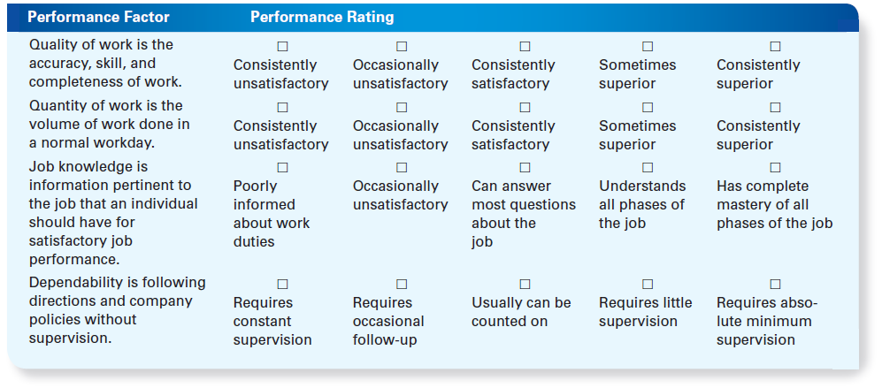
Graphic Rating Scale

Slide 16
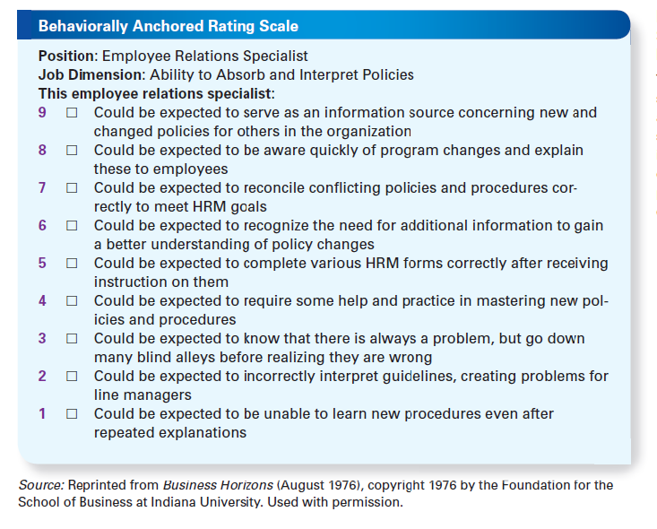
Behaviorally Anchored Rating Scale

Slide 17
Appraisal Methods
relative standards
Group order ranking
Employees are placed in a classification reflecting their relative performance, such as “top one-fifth”
Individual ranking
Employees are ranked from highest to lowest
Paired comparison
Each individual is compared to every other final ranking is based on number of times the individual is preferred member in a pair

Slide 18
Appraisal Methods
achieved outcomes
Management by Objectives (MBO)
Includes mutual objective-setting and evaluation based on the attainment of the specific objectives
The organizational objectives translate into specific objectives for the divisional/departmental/ individual levels

Slide 19
Appraisal Methods
achieved outcomes
Common elements in an MBO program are:
Goal specific
Participative decision making
Specific time period
Performance feedback
Effectively increases employee performance and organizational productivity, especially when goals are difficult enough to require stretching

Slide 20
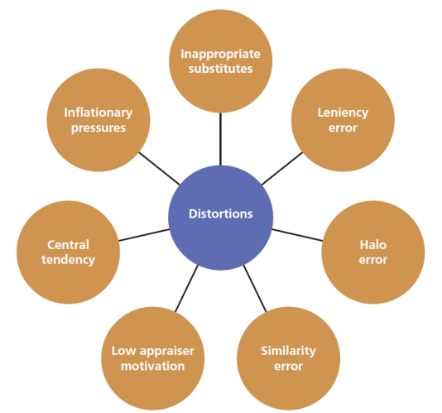
Factors that distort appraisals

Slide 21
Factors That Distort Appraisals
Leniency error
Each evaluator has his/her own value system; Some evaluate high (positive leniency) and others, low (negative leniency)
Halo error
Evaluator lets an assessment of an individual on one trait influence evaluation on all traits

Slide 22
Factors That Distort Appraisals
Similarity error
Evaluator rates others in the same way that the evaluator perceives him or herself
Low appraiser motivation
Evaluator may be reluctant to give an accurate appraisal if it means the employee may not attain expected rewards as a result

Slide 23
Factors That Distort Appraisals
Central tendency
The reluctance to use the extremes of a rating scale resulting in all employees being rated close to average
Inflationary pressures
Rater feels pressures for equality or fear of revenge from unhappy employees
Rater ranks employees better than they deserve to avoid conflict

Slide 24
Factors That Distort Appraisals
Inappropriate substitutes for performance
Effort, enthusiasm, appearance, etc., are less relevant for some jobs than others
Attribution theory
Evaluations are affected based on whether someone’s performance is due to:
Internal factors they can control
External factors they cannot control
If poor performance is attributed to internal control, the judgment is harsher than when it is attributed to external control

Slide 25
Creating effective performance management systems
To create better performance management systems:
Use behavior-based measures
They’re more job-related and elicit more inter-rater agreement than traits such as “loyalty” or “friendliness”
Combine absolute and relative standards
Absolute standards tend to be positively lenient
Relative standards suffer when there is little variability
Provide ongoing feedback
Expectations and disappointments should be shared with employees on a frequent basis

Slide 26
Creating effective performance management systems
To create better performance management systems:
Use multiple raters
The more used, the more reliable and valid the results
Peer evaluations, Upward evaluations and 360-degree appraisals)
Rate selectively
Appraisers should evaluate only in areas about which they have sufficient knowledge, they should be organizationally close the individual being evaluated, and should be an effective rater
Train appraisers
Poor appraisals can demoralize employees and increase legal liabilities

Slide 27
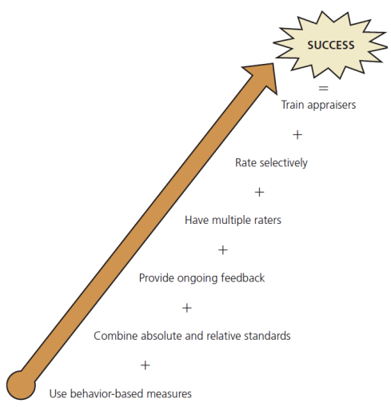
Creating effective performance management systems

Slide 28

Creating effective performance management systems
For an effective performance appraisal meeting
Prepare/schedule meeting in advance
Create supportive aura about meeting
Describe appraisal’s purpose
Involve employee in appraisal discussion
Focus on behaviors, not employee
Cite specific examples
Give positive and negative feedback
Ensure employee understood appraisal
Generate a development plan

Slide 29
International Performance Appraisal
Challenges in evaluating overseas employees:
Different cultural perspectives and expectations between the parent and local country may make evaluation difficult
Evaluation forms may not be translated accurately
Quantitative measures may be misleading

Slide 30
Matching
internal and external control factors weigh heavily in the appraisal
three appraisal approaches
communicate expectations
two-way feedback, development, documentation
three purposes of performance management systems
factors that can
distort appraisals
attribution theory
absolute standards, relative standards, achieved outcomes
absolute standards, relative standards, achieved outcomes
leniency error, halo error, similarity error, central tendency, inflationary pressures, inappropriate substitutes
step in the appraisal process

