Slide 1
Chapter 14
Understanding Labor Relations and Collective Bargaining

Slide 2
Introduction
A union is an organization of workers, acting collectively, seeking to promote and protect its mutual interests through collective bargaining
Only 12% of the private sector workforce is unionized
Labor contracts typically stipulate:
  Wages
  Hours
  Terms and conditions of employment

Slide 3
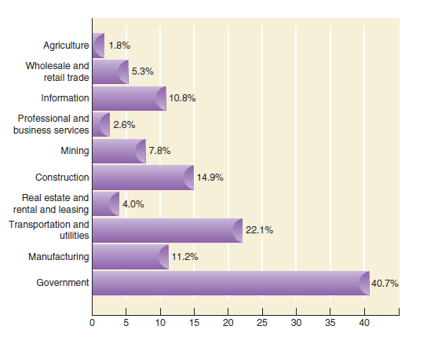
Union membership by industry

Slide 4
Why Employees Join Unions
Higher wages and benefits:
  The strength of large numbers and negotiating skills of professional bargainers give unions an advantage over individuals
Greater job security:
  Collective bargaining contracts limit management’s ability to arbitrarily hire, promote, or fire
Influence over work rules:
  Unions represent workers and define channels for complaints and concerns
Watch Solidarity Forever sung by Pete Seeger
http://www.youtube.com/watch?v=9g1IArAW5Dk
for a feel of what unions meant to people at the turn of the 20th century, when labor laws were almost nonexistent.

Slide 5
Why Employees Join Unions
Compulsory Membership
Union shops
  Require that all employees hired into positions covered under the collective-bargaining agreement must join the union agency shops require nonunion employees to pay an amount equal to union fees and dues
Right to work laws
  Prohibit union membership as a condition of employment
Open shops
  Allow union membership to be totally voluntary
Maintenance of membership clauses
  Require union members to remain for the duration of the contract dues check-off provisions require employers to withhold union dues from members’ paychecks

Slide 6
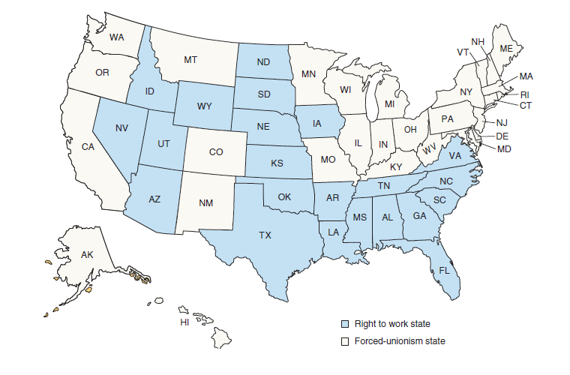
Right to work laws

Slide 7
Labor Legislation
The Wagner Act
  Also known as the national labor relations act
  “Bill of rights” for unions, guaranteeing right to organize and bargain collectively
national labor relations board (NLRB):
  Determines bargaining units
  Conducts elections
  Prevents or corrects unfair labor practices
  www.nlrb.gov

Slide 8
Labor Legislation
The Wagner Act
Unfair labor practices include:
  Interfering with an employee’s right to bargain collectively
  Interfering with or discriminating against anyone because of union activity
  Discriminating against employee who gave testimony under the act
  Refusing to bargain collectively with employee representatives

Slide 9
Labor Legislation
Taft-Hartley Act
Also known as the Labor-Management Relations Act
Amended Wagner to address employer concerns
Specified unfair union labor practices
  Coercion of employees to join the union
  Refusing to bargain collectively
  Engaging in illegal strikes and boycotts
  Obtaining compensation for services not performed
  Discriminating against an employee to whom union membership has been denied

Slide 10
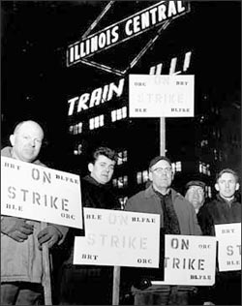
Labor Legislation
The Railway Labor Act
Gave workers in the transportation industry the right to bargain collectively
Allowed congressional and
presidential intercession in the event
of an impasse
Established the
National Mediation Board
http://www.nmb.gov

Slide 11
Labor Legislation
Landrum-Griffin Act
  Also known as the Labor and Management Reporting and Disclosure Act
  Made union officials accountable for funds, elections, and other business and representational matters
  Required annual filing of information by unions and by individuals employed by unions
  Required that all members be allowed to vote by secret ballot

Slide 12
Labor Legislation
Executive Orders 10988 and 11491
  Permitted federal employees to join unions and established the Federal Labor Relations Council (FLRC)
Racketeering Influenced and Corrupt Organizations Act (RICO) of 1970
  Prohibits payment and loans in the form of bribery, kickbacks, or extortion
  Used to oust labor officials with organized crime ties
The Department of Labor’s inspector general investigates union and organized crime activity
http://www.oig.dol.gov/laborracprogram.htm

Slide 13
Labor Legislation
Civil Service Reform Act of 1978
  Replaced executive orders as basic law governing labor relations for federal employees.
  Established the Federal Labor Relations Authority www.flra.gov
  Broad-scope grievance procedure

Slide 14
Labor Legislation
Union Organizing Process
Unorganized
Authorization card campaign: Did union get 30% or more?
No
Yes
No union vote for one year
Petition NLRB for election: Are authorization cards in order?
No
Yes
Vote taken: Did union receive a majority vote?
No
Yes
Certification of bargaining unit

Slide 15
Unionizing Employees
Employees want to form a union. Now what?
  Thirty percent of employees must sign authorization cards indicating their interest in having an election
  Representation certification (RC)is held by secret ballot
  If the union is accepted by a majority of eligible voting workers, the union becomes the workers’ legal representative

Slide 16
Unionizing Employees
Once the National Labor Relations Board certifies a union, each worker must abide by the negotiated contract
Representation decertification (RD) elections can be held to vote unions out
RMs are decertification elections initiated by management
Most agreements bar the use of decertification elections during the term of a contract

Slide 17
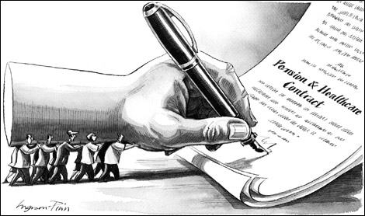
Collective Bargaining
What is collective bargaining?
The negotiation, administration, and interpretation of a written agreement between two parties, at least one of which represents a group that is acting collectively, that covers a specific period of time

Slide 18
Collective Bargaining
Objective and Scope of Collective Bargaining
  Contracts must be acceptable to management, union representatives, and union membership
  Four issues appear in all labor contracts; the first three are mandated by the Wagner Act
wages
terms and conditions
of employment
grievance
procedures
hours

Slide 19
Collective Bargaining
Collective Bargaining Participants
  Large corporations have HRM departments with industrial relations experts; corporate executives, and company lawyers
  In small companies, the president typically represents the company
  Union bargaining teams include an officer of the local union, local shop stewards, and reps from the international/ national union
  Government watches to ensure rules are followed

Slide 20
Collective Bargaining
The Collective Bargaining Process
Preparing to negotiate
  Fact-gathering: includes
    internal information - employee performance records, overtime
    external information - data on what similar organizations are doing and the economy)
  Goal-setting: management decides what it can expect from the negotiation
  Strategy development: this includes assessing the other side’s power and tactics

Slide 21
Collective Bargaining
The Collective Bargaining Process
Preparation for
negotiations
Contract
negotiation
Agreement
no
Prepare for next negotiation
yes
Union
ratification
no
yes
Contract
administration

Slide 22
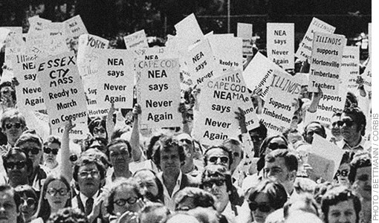
Collective Bargaining
Negotiating at the bargaining table
Each side usually begins by publicly demanding more than they are willing to accept
More realistic assessments and compromises take place behind closed doors
After oral agreement, a written
contract is submitted to the
union for ratification

Slide 23
Collective Bargaining
Contract administration is the implementation, interpretation, and monitoring of the negotiated contract between labor and management.
  Explaining the contract
  Implementing the contract
  Interpreting the contract and grievance process
  Monitoring activities during contract period

Slide 24
Collective Bargaining
Failure to reach agreement
Strikes versus Lockouts
Strikes
Lockouts
Employers deny unionized workers access to their jobs during an impasse
Wildcat strikes - unauthorized and illegal strikes that occur because of worker dissatisfaction during an existing contract
Economic strikes - labor and management cannot reach agreement before the current contract expires
NFL referee strike of 2012
National Hockey League Lockout of 2012

Slide 25
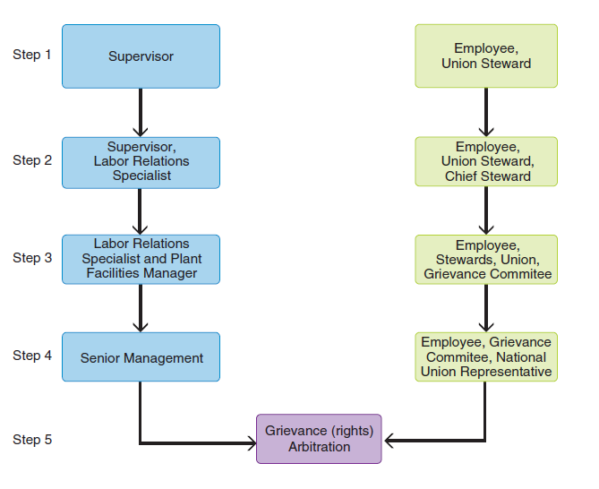
Typical Grievance Procedure

Slide 26
Collective Bargaining
Impasse-Resolution Techniques - used when labor and management cannot agree
Conciliation and mediation
  Involve a third party to either keep negotiations going or make nonbinding settlement recommendations
Fact-finding
  Involves a neutral third party who conducts a hearing and recommends a nonbinding settlement
Interest arbitration
  Involves a panel of one neutral, one management, and one union representative who hear testimony and render a decision to settle a contract negotiation dispute
  Primarily in public-sector bargaining
  Binding only if there is unanimous agreement

Slide 27
Critical Issues for Unions Today
Reasons for decline in membership include:
  New concerns of a growing middle class
  Greater diversity of the workforce
  Growth of the service sector
  Diminished financial resources of unions
  Anti-union pressures resulting from increased competitiveness
  Layoffs of large numbers of union workers
  Hiring of replacement workers for strikers

Slide 28
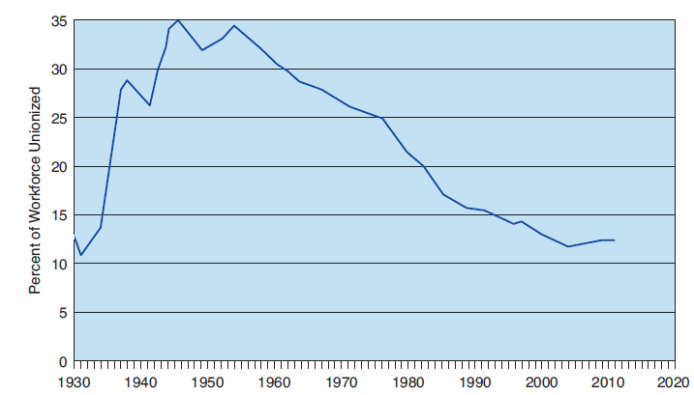
Union membership in the U.S.

Slide 29
Critical Issues for Unions Today
Unions are changing some of their organizing tactics and may currently be gaining public support
They also are placing more emphasis on the service sector
Some unions recognize that they can gain more by cooperating with management rather than fighting
The Electromation case illustrates the potential legal difficulties of cooperative efforts: The NLRB ruled that employee committees were an unfair labor practice

Slide 30
Critical Issues for Unions Today
Public-Sector Unionization
Membership of government workers in unions has increased from 11% in 1970 to nearly 37% in 2011
Public-sector labor relations differs from private-sector labor relations
Sunshine laws in some states mandate that labor-management negotiations be open to the public

Slide 31
International Labor Relations
Differing Perspectives Toward Labor Relations
Countries differ in their labor relations histories, government involvement, and public acceptance of labor unions
The labor relations function for international companies is more likely to be centralized with the parent company when domestic sales are larger than those overseas
The European Union
Brings together a dozen or more labor relations systems
Countries wishing to do business in Europe must keep up with changing labor legislation
See FedEE for general information on labor laws by country. http://www.fedee.com/natlaw.html

Slide 32
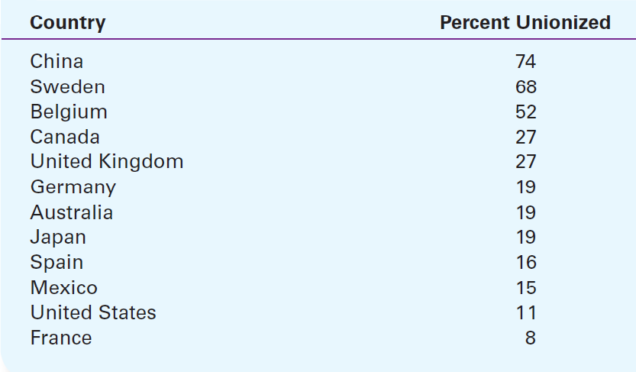
Union membership around the world

Slide 33
Matching
Wagner Act
union
Taft-Hartley Act
unionized workers denied access to their jobs during an impasse
National Labor Relations Board
Labor-Management Relations Act
certifies unions
National Labor Relations Act
organization of workers, acting collectively
lockout

