Slide 1
STRINGS REPRESENTATION
Computer Organization and Assembly Language
Computer Science Department
National University of Modern Languages
Islamabad

Slide 2
STRING REPRESENTATION
Two ways of representation
  Explicitly storing string length (used in PASCAL)
    string BYTE ‘Error message’
    str_len WORD $-string
      $ represents the current value of the location counter
        $ points to the byte after the last character of string
  Using a sentinel character (used in C)
    Uses NULL character
      Such NULL-terminated strings are called ASCIIZ strings

Slide 3
STRING PRIMITIVE INSTRUCTIONS
Move string data: MOVSB, MOVSW, MOVSD
Compare strings: CMPSB, CMPSW, CMPSD
Scan string: SCASB, SCASW, SCASD
Store string data: STOSB, STOSW, STOSD
Load ACC from string: LODSB, LODSW, LODSD
Only use memory operands
Use ESI, EDI or both to address memory

Slide 4
MOVSB, MOVSW, AND MOVSD (1 OF 2)
The MOVSB, MOVSW, and MOVSD instructions copy data from the memory location pointed to by ESI to the memory location pointed to by EDI.
MOVSB moves from DS:SI to ES:DI. You have to load DS and ES both with AX
.data
source DWORD 0FFFFFFFFh
target DWORD ?
.code
mov esi,OFFSET source
mov edi,OFFSET target
movsd

Slide 5
MOVSB, MOVSW, AND MOVSD (2 OF 2)
ESI and EDI are automatically incremented or decremented:
  MOVSB increments/decrements by 1
  MOVSW increments/decrements by 2
  MOVSD increments/decrements by 4

Slide 6
DIRECTION FLAG
The Direction flag controls the incrementing or decrementing of ESI and EDI.
  DF = clear (0): increment ESI and EDI
  DF = set (1): decrement ESI and EDI
The Direction flag can be explicitly changed using the CLD and STD instructions:
CLD ; clear Direction flag
STD ; set Direction flag

Slide 7
USING A REPEAT PREFIX
REP (a repeat prefix) can be inserted just before MOVSB, MOVSW, or MOVSD.
ECX controls the number of repetitions
Example:
Copy 20 doublewords from source to target
.data
source DWORD 20 DUP(?)
target DWORD 20 DUP(?)
.code
cld ; direction = forward
mov ecx,LENGTHOF source ; set REP counter
mov esi,OFFSET source
mov edi,OFFSET target
rep movsd

Slide 8
USING A REPEAT PREFIX
REP | Repeat while ECX>0
REPZ,REPE | Repeat while Zero Flag=1 and ECX>0
REPNZ,REPNE | Repeat while Zero Flag=0 and ECX>0
Conditions are checked before repeating

Slide 9
REPETITION PREFIXES (1/3)
rep
    while (ECX ≠ 0)
      execute the string instruction
      ECX := ECX−1
    end while
ECX register is first checked
  If zero, string instruction is not executed at all

Slide 10
REPETITION PREFIXES (2/3)
repe/repz
    while (ECX ≠ 0)
      execute the string instruction
      ECX := ECX−1
      if (ZF = 0)
      then
      exit loop
      end if
    end while
Useful with cmps and scas string instructions

Slide 11
REPETITION PREFIXES (3/3)
repne/repnz
    while (ECX ≠ 0)
      execute the string instruction
      ECX := ECX−1
      if (ZF = 1)
      then
      exit loop
      end if
    end while

Slide 12
YOUR TURN . . .
Use MOVSD to delete the first element of the following doubleword array. All subsequent array values must be moved one position forward toward the beginning of the array:
  array DWORD 1,1,2,3,4,5,6,7,8,9,10
.data
array DWORD 1,1,2,3,4,5,6,7,8,9,10
.code
cld
mov ecx,(LENGTHOF array) - 1
mov esi,OFFSET array+4
mov edi,OFFSET array
rep movsd

Slide 13
CMPSB, CMPSW, AND CMPSD
The CMPSB, CMPSW, and CMPSD instructions each compare a memory operand pointed to by ESI to a memory operand pointed to by EDI.
  CMPSB compares bytes
  CMPSW compares words
  CMPSD compares doublewords
Repeat prefix often used
  REPE (REPZ)
  REPNE (REPNZ)

Slide 14
COMPARING A PAIR OF DOUBLEWORDS
If source > target, the code jumps to label L1; otherwise, it jumps to label L2
.data
source DWORD 1234h
target DWORD 5678h
.code
mov esi,OFFSET source
mov edi,OFFSET target
cmpsd ; compare doublewords
ja L1 ; jump if source > target
jmp L2 ; jump if source <= target

Slide 15
STRING COMPARE INSTRUCTION
cmpsb --- compare two byte strings
Compare two bytes at ESI and EDI and set flags
if (DF=0) ; forward direction
then
ESI := ESI+1
EDI := EDI+1
else ; backward direction
ESI := ESI−1
EDI := EDI−1
end if
Flags affected: As per cmp instruction (ESI)−(EDI)

Slide 16
COMPARING ARRAYS
Use a REPE (repeat while equal) prefix to compare corresponding elements of two arrays.
.data
source DWORD COUNT DUP(?)
target DWORD COUNT DUP(?)
.code
mov ecx,COUNT ; repetition count
mov esi,OFFSET source
mov edi,OFFSET target
cld ; direction = forward
repe cmpsd ; repeat while equal

Slide 17
EXAMPLE: COMPARING TWO STRINGS (1 OF 3)
This program compares two strings (source and destination). It displays a message indicating whether the lexical value of the source string is less than the destination string.
.data
source BYTE "MARTIN "
dest BYTE "MARTINEZ"
str1 BYTE "Source is smaller",0dh,0ah,0
str2 BYTE "Source is not smaller",0dh,0ah,0
Source is smaller
Screen output:

Slide 18
EXAMPLE: COMPARING TWO STRINGS (2 OF 3)
.code
main PROC
  cld ; direction = forward
  mov esi,OFFSET source
  mov edi,OFFSET dest
  mov ecx,LENGTHOF source
  repe cmpsb
  jb source_smaller
  mov edx,OFFSET str2 ; "source is not smaller"
  jmp done
source_smaller:
  mov edx,OFFSET str1 ; "source is smaller"
done:
  call WriteString
  exit
main ENDP
END main

Slide 19
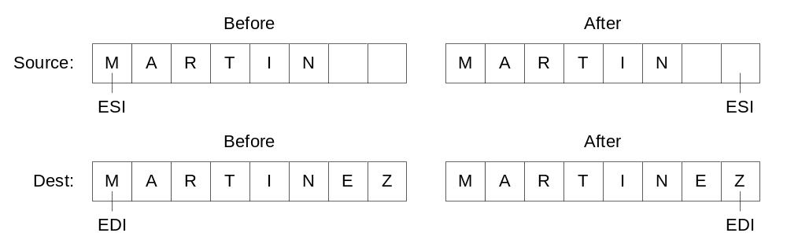
EXAMPLE: COMPARING TWO STRINGS (3 OF 3)
The following diagram shows the final values of ESI and EDI after comparing the strings:

Slide 20
SCASB, SCASW, AND SCASD
The SCASB, SCASW, and SCASD instructions compare a value in AL/AX/EAX to a byte, word, or doubleword, respectively, addressed by EDI.
Useful types of searches:
  Search for a specific element in a long string or array.
  Search for the first element that does not match a given value.

Slide 21
SCASB EXAMPLE
Search for the letter 'F' in a string named alpha:
.data
alpha BYTE "ABCDEFGH",0
.code
mov edi,OFFSET alpha
mov al,'F' ; search for 'F'
mov ecx,LENGTHOF alpha
cld
repne scasb ; repeat while not equal
dec edi ; EDI points to 'F'

Slide 22
STOSB, STOSW, AND STOSD
The STOSB, STOSW, and STOSD instructions store the contents of AL/AX/EAX, respectively, in memory at the offset pointed to by EDI.
Example: fill an array with 0FFh
.data
Count = 100
string1 BYTE Count DUP(?)
.code
mov al,0FFh ; value to be stored
mov edi,OFFSET string1 ; ES:DI points to target
mov ecx,Count ; character count
cld ; direction = forward
rep stosb ; fill with contents of AL

Slide 23
LODSB, LODSW, AND LODSD
LODSB, LODSW, and LODSD load a byte or word from memory at ESI into AL/AX/EAX, respectively.
Rarely used with REP
LODSB can be used to replace code
mov al,[esi]
inc esi
Example:
.data
array BYTE 1,2,3,4,5,6,7,8,9
.code
mov esi,OFFSET array
mov ecx,LENGTHOF array
cld
L1: lodsb ; load byte into AL
or al,30h ; convert to ASCII
call WriteChar ; display it
loop L1

Slide 24
ARRAY MULTIPLICATION EXAMPLE
Multiply each element of a doubleword array by a constant value.
.data
array DWORD 1,2,3,4,5,6,7,8,9,10
multiplier DWORD 10
.code
cld ; direction = up
mov esi,OFFSET array ; source index
mov edi,esi ; destination index
mov ecx,LENGTHOF array ; loop counter
L1: lodsd ; copy [ESI] into EAX
mul multiplier ; multiply by a value
stosd ; store EAX at [EDI]
loop L1

Slide 25
YOUR TURN . . .
Write a program that converts each unpacked binary-coded decimal byte belonging to an array into an ASCII decimal byte and copies it to a new array.
.data
array BYTE 1,2,3,4,5,6,7,8,9
dest BYTE (LENGTHOF array) DUP(?)
mov esi,OFFSET array
mov edi,OFFSET dest
mov ecx,LENGTHOF array
cld
L1: lodsb ; load into AL
or al,30h ; convert to ASCII
stosb ; store into memory
loop L1

Slide 26
REFERENCE
Assembly Language for Intel-Based Computer
Kip R. Irvine
4th edition
Chapter 9

Slide 27
Take Home Activity---

Slide 28
Quiz

