Slide 1


Slide 2


Slide 3
Python: Data Cleaning
By Usman Khan

Slide 4
Why, When & How.

Slide 5
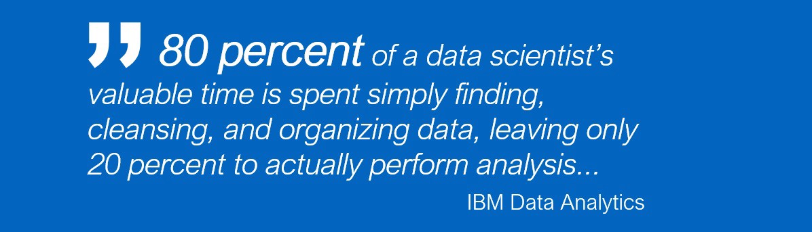

Slide 6
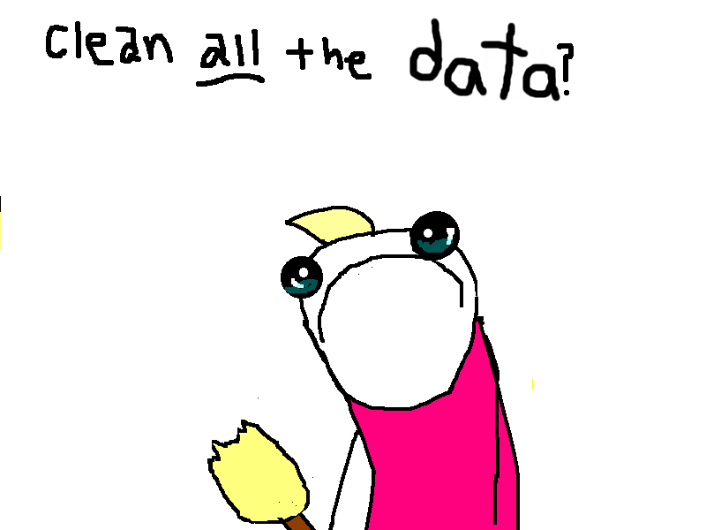

Slide 7
Sources of Missing Values
User forgot to fill in a field.
Data was lost while transferring manually from a legacy database.
There was a programming error.
Users chose not to fill out a field tied to their beliefs about how the results would be used or interpreted

Slide 8
Conclusion
Dealing with messy data is inevitable. Data cleaning is just part of the process on a data science project.
Armed with these techniques, you’ll spend less time data cleaning, and more time exploring and modeling.

