Slide 1
Hello World!

Slide 3
Fundamentals of Machine Learning
Usman Khan

Slide 4
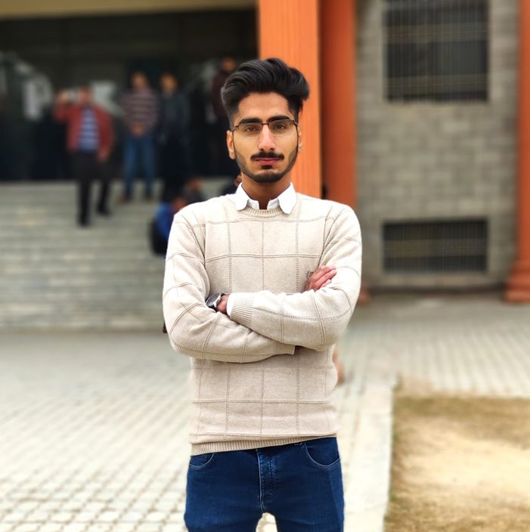
About the Speaker
Usman Khan
MLSA Alpha
ML Engineer at Winx Technologies
System Executive at Young’s Pvt LTD
Technical Lead DSC NUML Islamabad

Slide 5
K- Means Clustering
Unsupervised Learning

Slide 6
Implementation
Choose the Number of Clusters
Specify the Cluster Seeds
Assign Each point to a centroid
Adjust the Centroids

Slide 7
Demo
You can also Code along. Link for the data set will be provided in the chat

Slide 8
Questions / Answers

Slide 9
Thank You
www.github.com/UsmanNiazi
www.linkedin.com/in/UsmanNiazi99
www.twitter.com/UsmanNiazi99

