Slide 1
Computer Languages

Slide 2
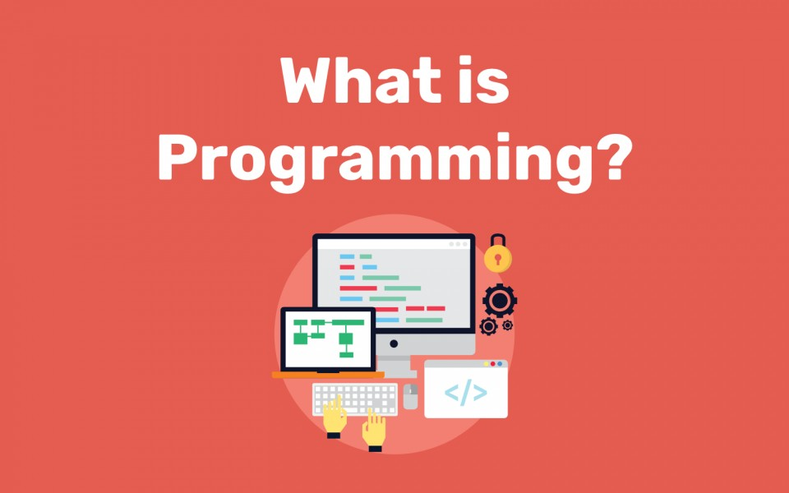
What is programming?

Slide 3
What is programming?
As a computer user you know that computers don't have feelings. They don't work any faster or slower depending on if we're angry at them or if we're happy. Computers can perform millions of calculations per second, but they require us to tell them exactly what to do. If they do something else than we want them to do the problem is usually that they don't understand our instructions the way we understand them.
The only big difference between programming and what you're familiar with already is that instead of clicking buttons to do things we write the instructions using a programming language. Most programming languages consist of English words, digits and some characters that have special meanings.
Unlike people often think, programming is usually not complicated. Large programs are always made of small, simple pieces, and those pieces are written one by one. Programming languages are made to be used by humans, so if there's an easy way to do something and a difficult way to do something, you should use the easier way.

Slide 4
Computer Languages
Machine Language
Uses binary code
Machine-dependent
Assembly Language
Uses mnemonics
Machine-dependent
High-Level Language (HLL)
Uses English-like language
Machine independent
Examples: Pascal, C, C++, Java, Python, . . .

Slide 5
Machine Language
The representation of a computer program which is actually read and understood by the computer.
A program in machine code consists of a sequence of machine instructions.
Instructions:
Machine instructions are in binary code
Instructions specify operations and memory cells involved in the operation
Example:
Operation | Address
0010 | 0000 0000 0100
0100 | 0000 0000 0101
0011 | 0000 0000 0110

Slide 6
Assembly Language
A symbolic representation of the machine language of a specific processor.
Is converted to machine code by an assembler.
Usually, each line of assembly code produces one machine instruction (One-to-one correspondence).
Programming in assembly language is slow and error-prone but is more efficient in terms of hardware performance.
Example:
Load Price
Add Tax
Store Cost

Slide 7
High-level language
A programming language which use statements consisting of English-like keywords such as "FOR", "PRINT" or “IF“, ... etc.
Each statement corresponds to several machine language instructions (one-to-many correspondence).
Much easier to program than in assembly language.
Data are referenced using descriptive names
Operations can be described using familiar symbols
Example:
Cost = Price + Tax

Slide 8
Syntax & Semantics
Syntax:
The structure of strings in some language. A language's syntax is described by a grammar.
Semantics:
The meaning of the language

Slide 9
Compilers & Programs
Compiler
A program that converts another program from some source language (or high-level programming language ) to machine language (object code).
Some compilers output assembly language which is then converted to machine language by a separate assembler.

Slide 10
Compilation into Assembly L
Assembly Language
Source
Program
Compiler
Assembly Language
Machine Language
Assembler

Slide 11
Compilers & Programs
Source program
The form in which a computer program, written in some formal programming language, is written by the programmer.
Can be compiled automatically into object code or machine code or executed by an interpreter.
Python source programs have extension ‘.py’

Slide 12
What are libraries?
Most programs are very large and consist of several modules.
Even small programs use existing code provided by the programming environment called libraries.

Slide 13
Program Execution
Steps taken by the CPU to run a program (instructions are in machine language):
Fetch an instruction
Decode (interpret) the instruction
Retrieve data, if needed
Execute (perform) actual processing
Store the results, if needed

Slide 14
Program Errors
Syntax Errors:
Errors in grammar of the language
Runtime error:
When there are no syntax errors, but the program can’t complete execution
Divide by zero
Invalid input data
Logical errors:
The program completes execution, but delivers incorrect results
Incorrect usage of parentheses

Slide 15
Compilation
Source
Program
Compiler
Target
Program
Input
Target Program
Output
Compiler translates source into target (a machine language program)
Compiler goes away at execution time

Slide 16
Interpretation
Source
Program
Interpreter
Output
Input
The interpreter stays around during execution
It reads and executes statements one at a time

Slide 17
Python
Python is an interpreted, high-level general purpose,Object-oriented ,structured programming language.

Slide 18
Python features
Lutz, Programming Python
no compiling or linking | rapid development cycle
no type declarations | simpler, shorter, more flexible
automatic memory management | garbage collection
high-level data types and operations | fast development
object-oriented programming | code structuring and reuse, C++
access to interpreter information | mixed language systems
classes, modules, exceptions | "programming-in-the-large" support
wide portability | simplified extensions, smaller binaries
system tools, GUIs, persistence, databases, etc. | programs can be modified without stopping

