Slide 1
Starting your day right with a Photon
SEIS 744 – Internet of Things
Usman Waheed

Slide 2
The problem at hand
Shower takes too long to warm up
Too cold to just jump in
Too much of a waste of time to just wait around

Slide 3
Solution
Particle Photon and peripherals to
Switch on the shower according to a web-based command
Monitor temperature
Send an alert when it is at required temperature
Monitor for someone actually walking into the shower
Switch shower off if no one walks in by a certain time limit

Slide 4
Design
Particle Photon
Servo to actuate shower
Temperature sensor
LED and photoresistor to detect motion

Slide 5
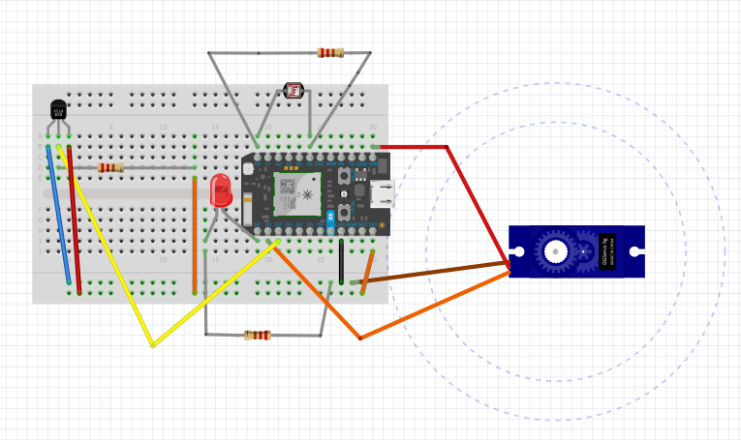
Design

Slide 6
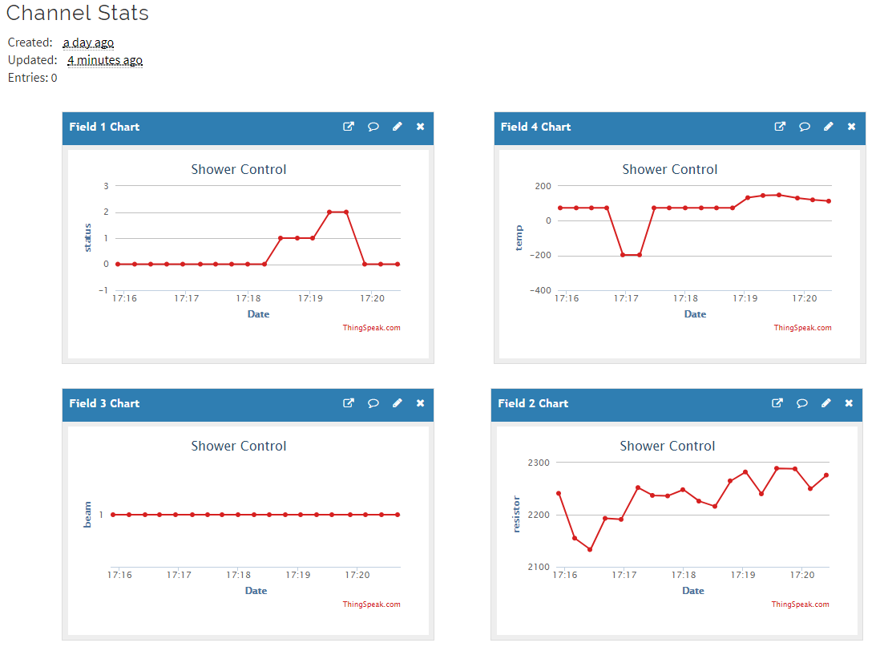
Photon in action!

Slide 7
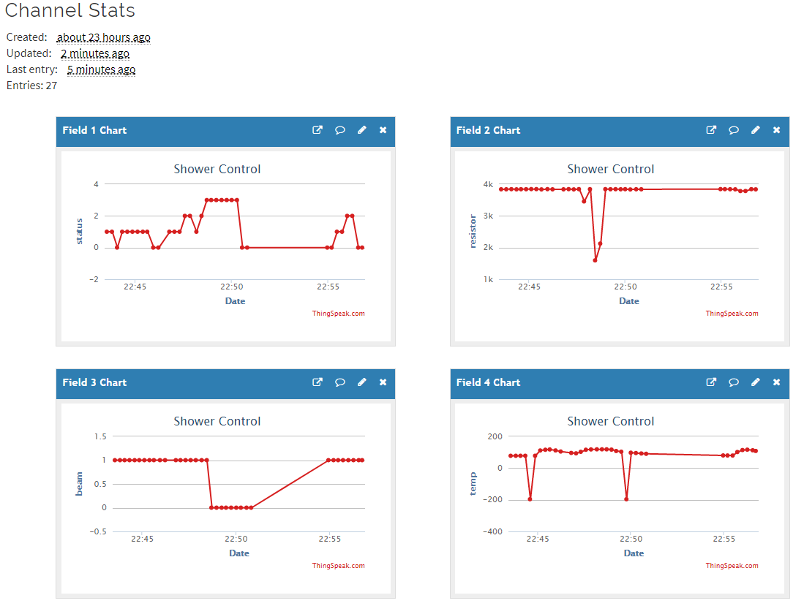
Photon in action! Demonstrating status 3 at top right

Slide 8
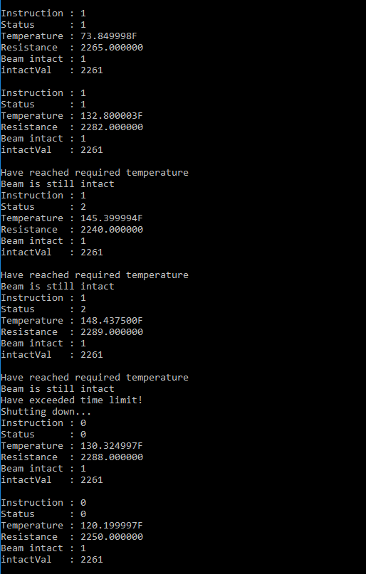
Photon in action!

Slide 9
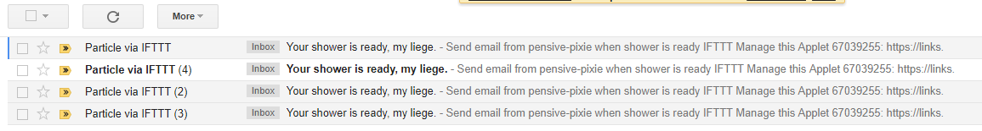
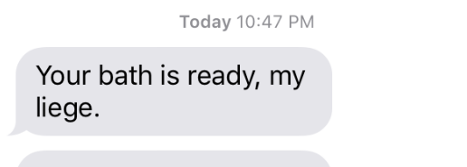
Photon in action!

Slide 10
Code Review
Import and minor edits to supporting libraries
Using function exposed to the web to send instructions
Curl
IFTTT schedule or on demand
Using Booleans to drop in and out of various branches of the code
Setting state variables to monitor execution
Publishing data to ThingsSpeak channel
Robust to random fluctuations in sensor data by allowing Booleans to be set once for an instruction loop.

Slide 11
Looking to the future
Mine the data; conserve time, water, heating or other resources
More powerful and robust components
Beam calibration; more precise beam; ambient light fluctuations
Motor with requisite torque; micro-servo may not cut it
Various other applications
Coffee makers etc.
Warm up your car in the winter
253 million cars and trucks; average age of 11+ years
Electric cars – resistance heating range impact

