Slide 1

COURSE MARKETPLACE
PadiLearn
A learning marketplace built around how Nigeria actually buys,
pays and learns — not a global platform with naira bolted on.
Product and differentiation overview

Slide 2
Why another learning platform
Three frictions that global platforms do not feel, and local sellers work around badly.
1
Price points don't fit
2
Payment rails don't reach
3
Data is expensive
Global catalogues price in dollars. A ₦2,500 course is below the floor most platforms are built to handle — and that is the price the market actually bears.
Card-first checkout and foreign payout rails exclude most Nigerian teachers. Getting paid is harder than getting students.
Streaming a course twice costs more than the course. Anything that assumes cheap, constant bandwidth quietly excludes the buyer.
So teachers sell courses over WhatsApp instead.
It works — no fees, instant payment, a channel buyers already trust. What it cannot do is discovery, structured progress, refunds, or proof that a teacher is any good. That is the gap.

Slide 3
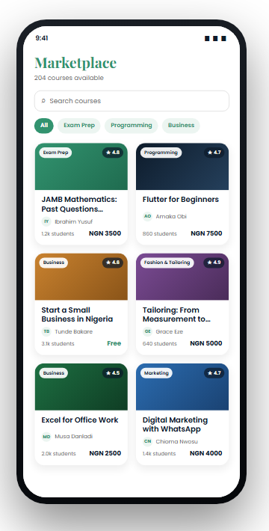
What PadiLearn is
A two-sided marketplace. Anyone can learn; anyone can teach and be paid.
1
Learners
Browse a categorised catalogue, pay in naira, and keep their place across sessions and devices.
2
Teachers
Publish a course, upload lessons, set a price, and receive money into a Nigerian bank account.
3
The platform
Takes a commission only when a sale settles. No listing fee, no subscription, no upfront cost to teach.

Slide 4
We take our cut of what arrives, not what was charged
Almost every marketplace takes its percentage on the gross price. On low-value courses, where a flat processing fee dominates, that quietly overcharges the seller.
Commission on gross
Commission on net (ours)
Course price ₦2,500
Processing fee −₦138
Platform 15% of ₦2,500 −₦375
Teacher receives ₦1,987
Course price ₦2,500
Processing fee −₦138
Platform 15% of ₦2,362 −₦354
Teacher receives ₦2,008
The gap widens as prices fall. On a ₦1,000 course, gross-basis commission costs the teacher roughly a fifth of their margin — which is exactly the price band this market lives in.

Slide 5
Teachers can't price themselves into a loss
Nigerian card processing waives its flat fee below ₦2,500. Cross that line and earnings fall off a cliff.
Price it at ₦2,499 and the teacher earns ₦2,093.
Price it at ₦2,600 — ₦101 more — and they earn ₦2,092.
No other course platform does this.
The course form calculates the split live and warns when a price lands in the dead zone, suggesting the better one. It costs us commission to tell them — which is the point.

Slide 6
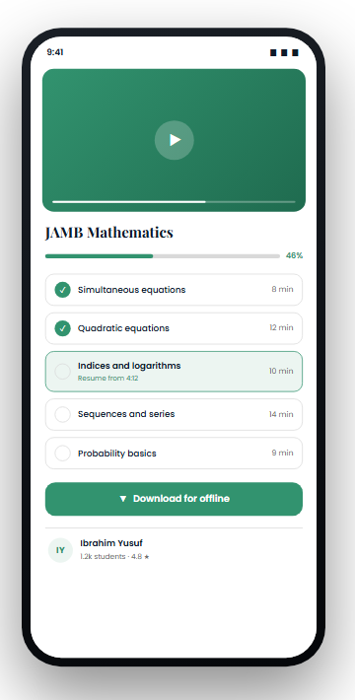
Built for the network people actually have
Assumptions about bandwidth are assumptions about who gets to use the product.
1
Courses cached on device
The learner's course list is stored locally, so a cold start with no signal opens to their courses rather than a spinner or an error.
2
Resume to the second
Playback position is written back while watching and restored on return — across sessions, and across devices.
3
Progress computed server-side
Completion is derived from lesson records by a database trigger, so it cannot drift between what the app shows and what the platform believes.

Slide 7
Money that arrives, and can be trusted
Payments and payouts are the part a marketplace cannot afford to get almost right.
1
Local rails, not cards alone
2
Payout names come from the bank
Paystack checkout — cards, bank transfer, USSD — in naira, through a processor Nigerian buyers already recognise.
A teacher enters their 10-digit NUBAN; the account name is resolved through the bank and never typed. Nigerian transfers are irreversible, so the name has to be verified, not asserted.
3
Enrolment is server-authoritative
4
Every sale reconstructable
Access is granted by an edge function after the payment is verified with the processor — never by the app saying the payment succeeded.
Each transaction stores the processing fee, the platform fee and the teacher's earning separately, and the three always sum to the amount paid.

Slide 8
Two more things teachers and learners notice
A
Course video is not public
B
Signing up asks almost nothing
Lesson files live in a private bucket. The app never holds a permanent link — it asks the server for a short-lived signed URL each time, and only for a lesson the viewer is entitled to.
For a teacher deciding whether to put their livelihood on a platform, this is the question they ask first.
Google and Apple sign-in, then one question: are you here to learn or to teach? Asked after the account exists, not before — so the form is a tap, not five fields and a decision.
The role is claimed once, server-side, and cannot be self-escalated afterwards.

Slide 9
Where this sits
Against the two options a Nigerian teacher chooses between today.
 | Global platforms | Selling over WhatsApp | PadiLearn
Priced for ₦1,000–₦5,000 courses | No | Yes | Yes
Commission taken on net, not gross | No | n/a | Yes
Payout to a Nigerian bank account | Rarely | Direct | Yes, name-verified
Works on a poor connection | Partly | Yes | Cached offline
Discovery beyond your own contacts | Yes | No | Yes
Structured progress and completion | Yes | No | Yes
Content protected from resharing | Yes | No | Signed URLs

Slide 10
What is built
A small stack, deliberately — one mobile codebase and a managed backend.
1
Flutter
One codebase, Android and iOS.
Working today
Catalogue, search and categories
Paid enrolment end to end
Lesson playback with resume
Progress tracked and recomputed server-side
Teacher publishing and lesson upload
Payout account capture, bank-verified
Course comments and teacher notifications
Offline course list
2
Supabase
Auth, Postgres, storage and edge functions. Row-level security enforces who may read and write what.
3
Paystack
Checkout and payouts, driven from server-side functions so the client can never mark itself as paid.

Slide 11
What is not done yet
Current status, and the gaps we are closing.
1
Pre-launch
2
Payments tested, not proven
No live users and no revenue yet. The catalogue in the current build is sample content, in place while the first teacher cohort is recruited.
The full paid flow works against the processor's test mode. It has not run at volume, and refunds and disputes are not built.
3
Nothing has been through a security review
4
No content moderation
Access rules are written and enforced at the database, but no external audit has been done.
There is no review step between a teacher publishing and a course appearing.

Slide 12
The bet
A marketplace wins here by being cheaper to sell on
and easier to get paid from — not by having more courses.
padilearn

