Slide 1

INVESTOR PITCH
PadiLearn
The marketplace for Nigerian teachers who already have students —
and no good way to charge them.
Amber blocks mark the slides where your own figures are required
Notes:
This deck ships with placeholders on every slide that needs real data. Do not present it until those are filled — an investor will ask for exactly those numbers first.

Slide 2
The problem
Nigeria has no shortage of people teaching. It has a shortage of ways to get paid for it.
1
Teaching already happens
2
Charging for it is the hard part
3
Global platforms do not fit
Exam prep, trades, software, tailoring — sold today through WhatsApp groups, in person, and by word of mouth.
Collecting payment means manual transfers and trust. Chasing it does not scale past a teacher's own contacts.
Built for dollar price points and foreign payout rails. A ₦2,500 course is beneath the floor they are designed for.
A teacher's ceiling is their contact list. We raise the ceiling and take a cut of the difference.

Slide 3
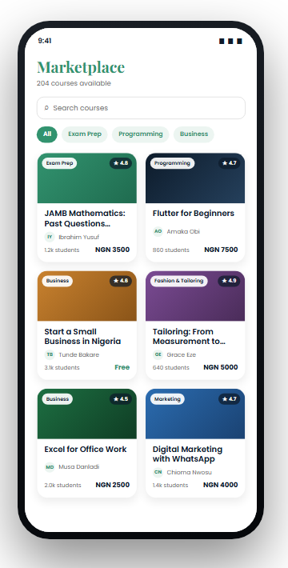
The solution
A marketplace priced and plumbed for this market specifically.
1
Sell without a storefront
Publish a course, set a naira price, reach buyers beyond your own contacts.
2
Get paid into a Nigerian account
Local checkout in, bank transfer out, account name verified with the bank.
3
Keep more of a small sale
Commission is taken on what settles, not on the list price — which matters most at the low prices this market bears.

Slide 4
Market
Sizing must come from sources you can defend in the room.
YOUR NUMBERS GO HERE
What belongs here
TAM — Nigerians paying for any form of paid learning today, with the source cited
SAM — those reachable on a smartphone with a means of digital payment
SOM — a defensible three-year share, built bottom-up from teachers onboarded × courses × average price
Adjacent proof points — what the market already spends on exam prep, and on informal skills training
Build the bottom-up number first and lead with it. A large top-down TAM invites scepticism; a defensible bottom-up model invites the next question.

Slide 5
How we make money
One revenue line today: commission on a completed sale. No listing fee, no subscription.
15%
₦0
100%
of the settled amount,
after processing fees
cost to a teacher to
list or publish
of payouts to
verified bank accounts
On a ₦2,500 sale, ₦138 goes to processing, ₦354 to PadiLearn and ₦2,008 to the teacher. Every transaction stores the three parts separately, so the split is auditable per sale rather than reconstructed from an average.
Later lines — promoted placement, cohort courses, certification — are deliberately not in this model.

Slide 6
Unit economics
The revenue side is known. The cost side is yours to fill.
Known
YOUR NUMBERS GO HERE
Revenue per sale: 15% of settled amount
Processing: 1.5%, plus ₦100 above ₦2,500, capped at ₦2,000
Marginal hosting cost per enrolment is close to zero
No cost of goods — teachers supply the content
CAC — per learner and per teacher, which will differ sharply
Average order value, and repeat purchase rate
Teacher retention — how many publish a second course
Payback period, and LTV/CAC
Teacher acquisition is the number that decides this business. One teacher who brings their own students is worth many paid learner installs — if that holds, say so with evidence.

Slide 7
Why this is defensible
Not the features — those are copyable. The things that compound.
1
Teachers bring their own demand
2
Payment trust is slow to earn
A teacher joining brings an existing audience. Acquisition cost falls as the teacher side grows, which a pure content library never gets.
Verified payouts and a clean settlement record take time to build and are the first thing a teacher asks about.
3
Pricing intelligence
4
Local-first is hard to retrofit
Knowing what converts at each price band, in this market, is proprietary and accrues from day one.
Offline behaviour, low price points and naira rails are architectural. A global platform cannot bolt them on cheaply.

Slide 8
Traction
Currently pre-launch. This slide is the one investors read first.
YOUR NUMBERS GO HERE
Until there are numbers, show evidence instead
Teachers who have committed to publish at launch, by name and subject
Letters of intent, or a waiting list with real sign-ups
A pilot cohort: one teacher, one course, real money collected
Pre-orders — the strongest possible signal before launch
One real teacher with ten paying students beats any projection. Get that before raising if you possibly can.

Slide 9
Competition
Honestly placed. We lose on catalogue and brand, and win on economics and reach.
 | Global platforms | Selling over WhatsApp | PadiLearn
Catalogue depth | Wins | No | Behind
Brand recognition | Wins | n/a | Behind
Economics at ₦1,000–₦5,000 | No | Wins | Competitive
Payout into a Nigerian bank | Rarely | Direct | Yes, verified
Discovery beyond own contacts | Yes | No | Yes
Works on a poor connection | Partly | Yes | Cached offline
Content protection | Yes | None | Signed URLs
Notes:
Saying plainly where you lose makes the columns where you win believable. Investors discount decks where every row is a win.

Slide 10
Roadmap
Sequenced by what removes the most risk, not by what is easiest.
1
2
3
4
Now
Next
Then
Later
Pilot
Teacher supply
Payment breadth
Trust and scale
One teacher, one paid course, real money end to end. Proves the rails and the appetite together.
Recruit the first cohort. Teacher acquisition cost is the number that decides the model.
Refunds and disputes, automated payouts, and the reconciliation a real ledger needs.
Moderation, ratings that mean something, and a security review before volume.

Slide 11
Team and the ask
Both need your real detail before this deck goes anywhere.
Team
The ask
YOUR NUMBERS GO HERE
YOUR NUMBERS GO HERE
Who is building it, and what each person has shipped before
Why this team for this market — distribution or teaching relationships count double
Advisers, and any gaps you are hiring for
Amount, and the runway it buys in months
The split — teacher acquisition, engineering, compliance
The milestone it reaches: the number that makes the next round obvious
Frame the raise as buying a specific proof, not a period of time. "Enough to get 50 teachers earning" lands better than "18 months of runway".

Slide 12
PadiLearn
Your padi for learning.
Contact details here

