Slide 1
NEXA NET
Enterprise Network Design with Inter-VLAN Routing
Usman Haider(0074)
Nabeel Ahmad(0071)
Notes:
Welcome slide. Project name is Nexa Net. Introduce the team.

Slide 2
Project Objectives
🎯 Main Goal
🔒 Traffic Segmentation
Design and implement a fully functional, scalable enterprise network.
Segment network traffic logically by department using VLANs.
🔗 Inter-Department Communication
⚙️ IP Automation
Enable communication between isolated departments using a router.
Automate IP address assignment for all end-user devices via DHCP.
Notes:
Main goal was to simulate a real-world corporate network where departments are kept separate for security but can communicate through a central router.

Slide 3
Physical Network Topology
🌐 INTERNET
Router 2911
Core Switch 3560
HR
VLAN 10
IT
VLAN 20
Finance
VLAN 30
Sales
VLAN 40
Mgmt
VLAN 50
● PCs / Devices
Notes:
Point out the core switch in the middle which connects everything. Access switches on the outside connect actual users.

Slide 4
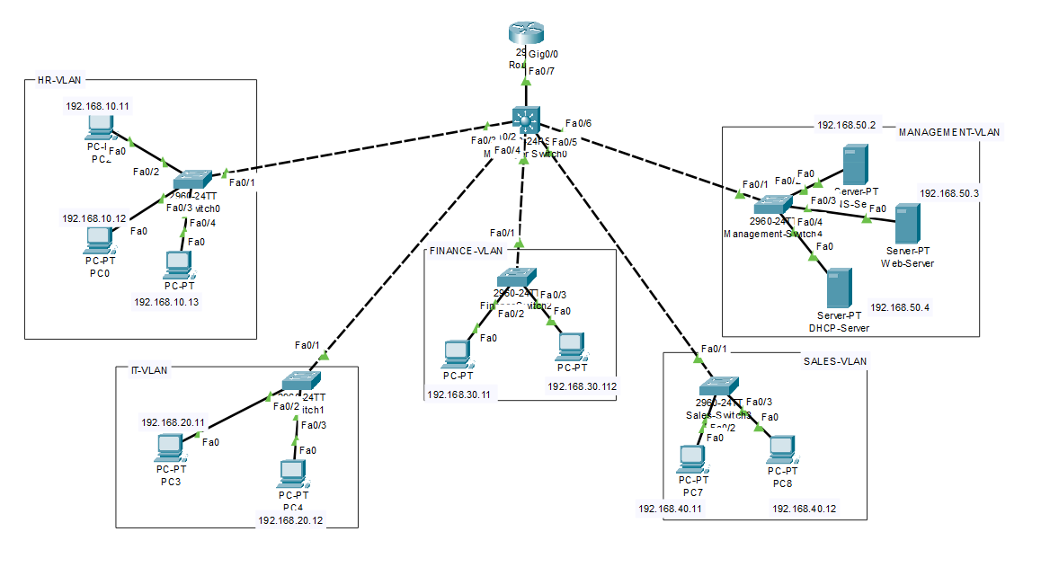
Topology Diagram

Slide 5
Logical Network Segmentation (VLANs)
VLAN ID
Department
Subnet / IP Range
Gateway
VLAN 10
HR (Human Resources)
192.168.10.0 /24
192.168.10.1
VLAN 20
IT (Information Tech)
192.168.20.0 /24
192.168.20.1
VLAN 30
Finance
192.168.30.0 /24
192.168.30.1
VLAN 40
Sales
192.168.40.0 /24
192.168.40.1
VLAN 50
Management & Servers
192.168.50.0 /24
192.168.50.1
💡 /24 subnet = up to 254 usable IPs per department | Highly scalable design
Notes:
Each /24 subnet gives 254 usable IPs per department, making the network scalable.

Slide 6
Core Networking Technologies
01
Router-on-a-Stick (802.1Q)
02
DHCP Pools
Uses virtual sub-interfaces on a single router port to route traffic between all 5 VLANs — no extra hardware needed.
Router automatically leases IP addresses to PCs based on their assigned VLAN. Zero manual configuration.
03
802.1Q Trunking
04
Spanning Tree PortFast
Core & access switches connected via Trunk links — allows multiple VLANs to travel across a single cable.
Enabled on PC ports to bypass listening/learning states for immediate connectivity when a device boots.
Notes:
Router-on-a-stick means we send all 5 VLANs up a single trunk cable to the router, saving hardware cost.

Slide 7
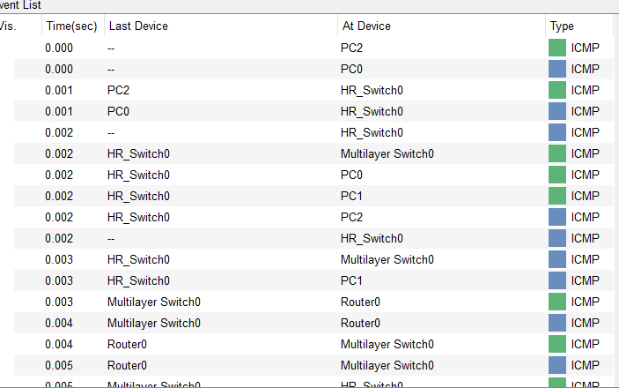
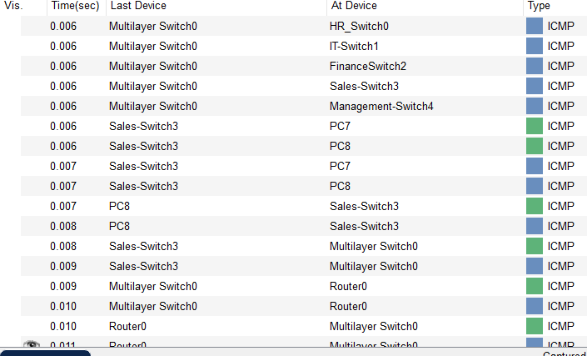
Testing the Network (Simulation)
📸
Insert Packet Tracer
Screenshot Here
(Ping / Simulation Panel)
✅ Same-VLAN Communication
PCs within the same VLAN can ping each other successfully.
✅ DHCP IP Assignment
DHCP correctly assigns IPs to PCs — verified via 'ipconfig' on each PC.
✅ Inter-VLAN Routing
Ping from VLAN 10 (HR) to VLAN 50 (Server) passed — packet routed through sub-interfaces.
✅ DNS Resolution
www.nexanet.com resolved correctly to 192.168.50.20.
✅ Web Server Access
Browser on HR PC accessed 'Welcome to Nexa Net!' page from Web Server.
Notes:
Ping from HR PC to Web Server proved the packet traveled through switches, up to the router, got routed to VLAN 50, and came back.

Slide 8
The Benefits of This Design
📡
🔐
🗂️
Broadcast Control
Enhanced Security
Logical Organization
Performance Boost
Department Isolation
Flexible Grouping
Broadcast packets (like DHCP requests) are contained within their specific VLAN — preventing network slowdowns across all departments.
By separating departments, ACLs can later restrict access — e.g., preventing Sales from reaching Finance servers.
Employees can be grouped by department regardless of their physical location in the building.
This design mirrors best practices used in real corporate enterprise networks.
Notes:
Conclude by emphasizing this setup mirrors best practices used in real corporate enterprise networks.

Slide 9
?
Questions?
Thank you for listening!
Notes:
Open floor for questions. Summarize: Nexa Net covers VLANs, DHCP, DNS, Web Server, Inter-VLAN Routing, and WiFi.

