Slide 1


Souq.com UAE Web Scrapping

Slide 2

Souq an Amazon Company
Established in 2005
Largest e-commerce site in ME.
45 million customers
9.5 million unique products in 35 different categories.

Slide 3

Business Problem & Solution
Retailers don’t like to browse and analyze manually the prices of products.
Building application to retrieve prices through web scrapping and do analytics.

Slide 4
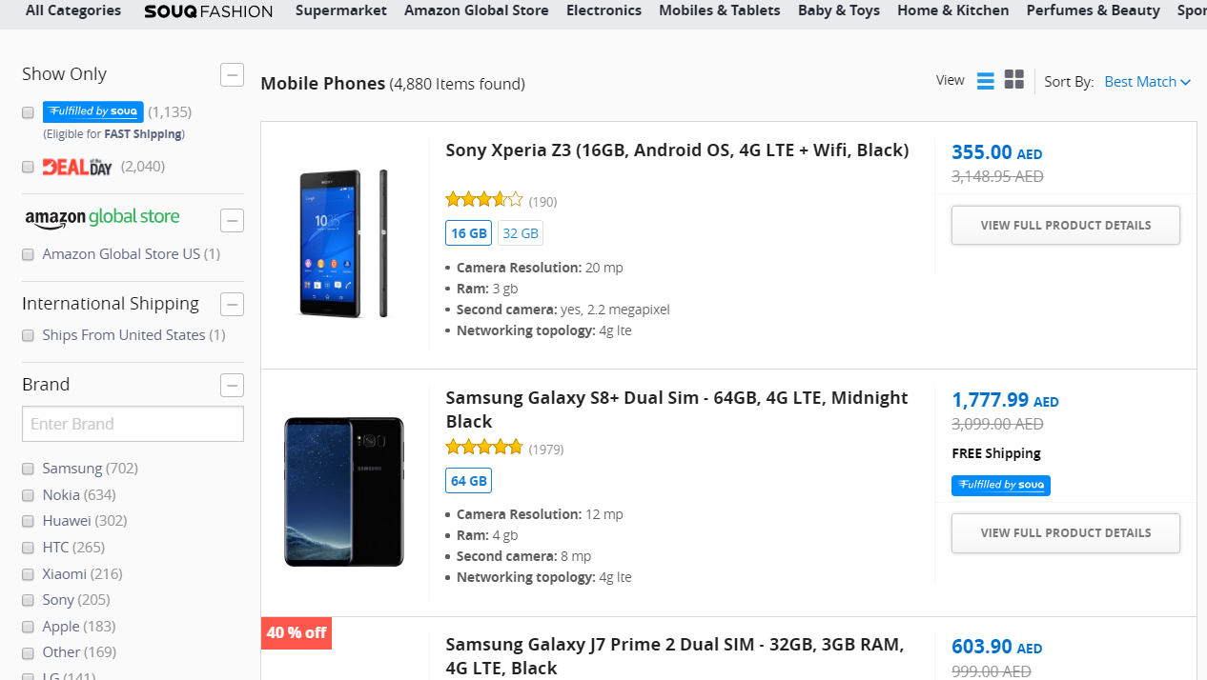

Slide 5
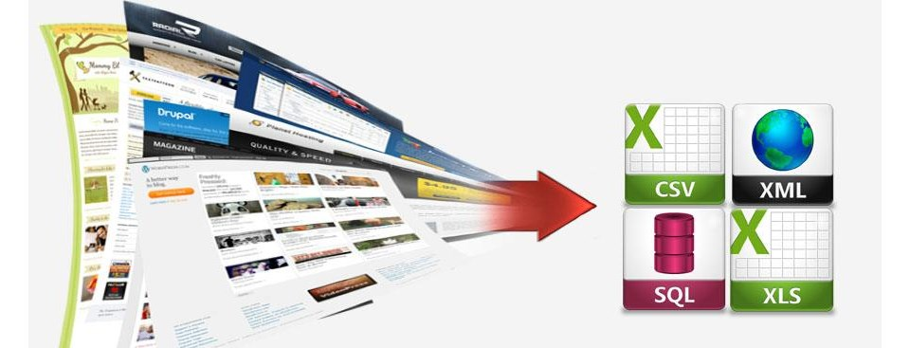
Code

Slide 6
Problems Faced & Future Advancements
Iterating on 10 pages.
AED and Commas in Price values.
Collecting data from other e-commerce websites and comparing prices.
Implementing this on more products.

Slide 7
References
https://www.youtube.com/watch?v=XQgXKtPSzUI
https://www.youtube.com/watch?v=PI1-1TtFz50
https://www.youtube.com/watch?v=mKxFfjNyj3c

Slide 8

Thanks

