Slide 1
ADVENTURE WORKS ANALYSIS

Slide 2
OVERVIEW
This report analyzes the sales datasets of a supermarket between 2015-2017,
having branches in six different countries: USA, Canada, UK, France, Australia
and Germany across three different continents: North America, Europe and Pacific.
The goal of this analysis is to identify trends and highlight key insights from this datasets, whereby recommendations to improve operation and productivity will be giving for quality decision making.

Slide 3
PROBLEM STATEMENT
Assess the overall sales performance, profitability, quantity sold and product costs for a specified period
Forecast annual sales to inform strategic planning.
Compare sales performance across various products to identify top performers.
Investigate how occupation influences customer purchasing behavior.
Determine the impact of gender on sales.

Slide 4
SKILLS DEMONSTRATED
The following skills were demonstrated
Excel
Tableau for visualization
Descriptive skills
Analytical skills

Slide 5
Data source
This datasets is from 3signetld, the major data analytic firm
for major businesses in the region

Slide 6
DATA TRANSFORMATION
This is a clean dataset and already transformed and normalized therefore
no major transformation was undertaken

Slide 7
DATA MODELING
Relationships were established among these seven tables, using their primary keys. Since each table has a
primary key, and each primary key is in the sales data table, therefore relationship was created during data
importation in tableau with the primary keys.

Slide 8

DATA VISUALIZATION
Total sales for the period is 24,914,587

Slide 9

DATA VISUALIZATION
Total profit for the period is 10,580,800

Slide 10
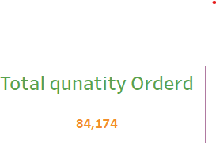
DATA VISUALIZATION
Total Quantity Ordered: 84,174

Slide 11
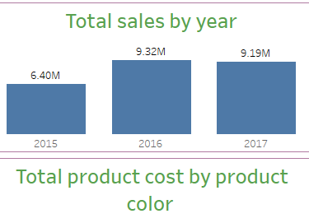
DATA VISUALIZATION
Total sales by year

Slide 12
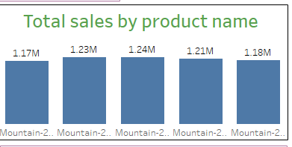
DATA VISUALIZATION
Total sales by product name

Slide 13
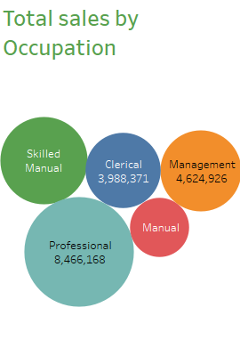
DATA VISUALIZATION
Total sales by Occupation

Slide 14
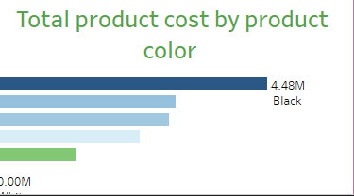
DATA VISUALIZATION
Total product cost by color

Slide 15
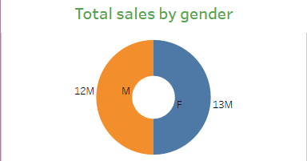
DATA VISUALIZATION
Total sales by gender

Slide 16
RECOMMENDATION
The following are the conclusion and recommendations
1 Increase Focus on High-Selling Years.
2 Expand Product Line of Top Performers.
3. Optimize Product Cost Management.
4 Target Gender-Specific Marketing Campaigns.
5.Occupation-Based Market Segmentation.
6. Monitor Sales of Lower-Performing Products.
7. Consider Product Diversification by Color.
8. Capitalize on Management Sales Opportunities.
9. Analyze Underperformance in Specific Years.

