Slide 1
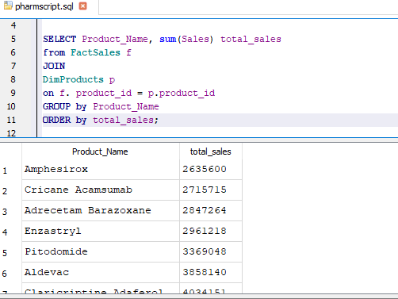
#1 Sales Performance Analysis • What are the total sales for each product? (Identify the top-selling products

Slide 2
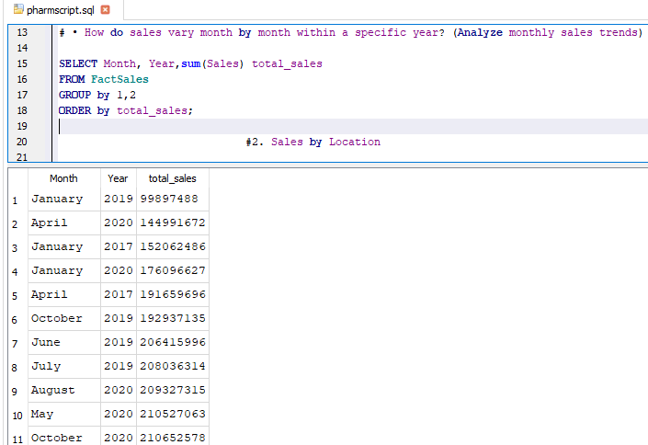
How do sales vary month by month within a specific year? (Analyze monthly sales trends)

Slide 3
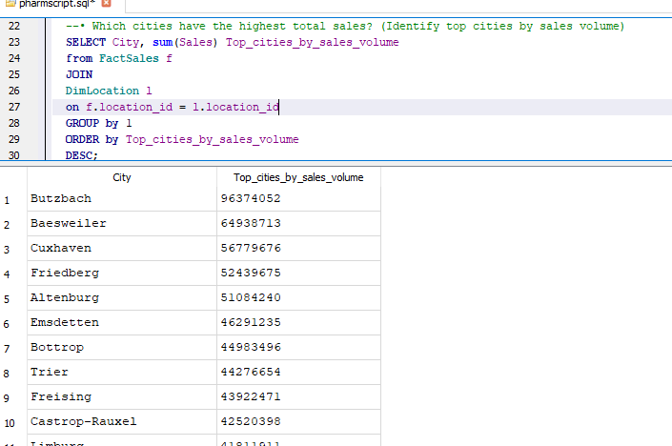
#2. Sales by Location
Which cities have the highest total sales? (Identify top cities by sales volume)

Slide 4
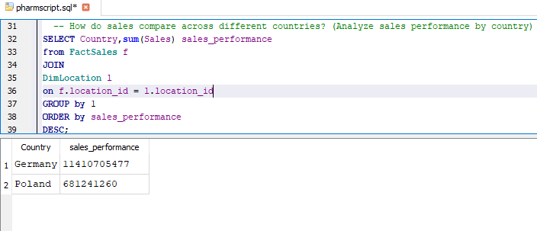
#• How do sales compare across different countries? (Analyze sales performance by country)

Slide 5
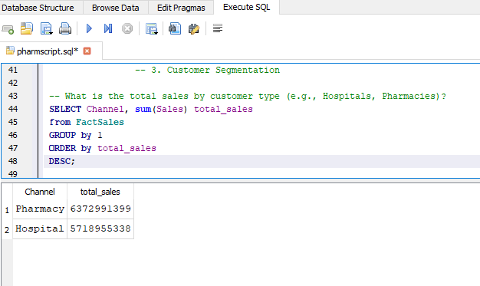
# 3. Customer Segmentation
What is the total sales by customer type (e.g., Hospitals, Pharmacies)?

Slide 6
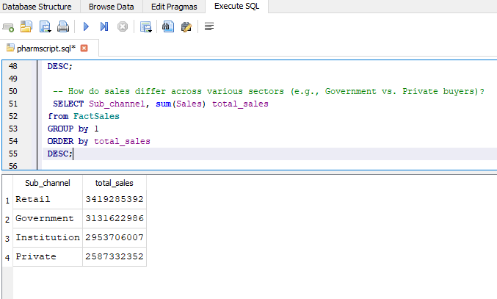
How do sales differ across various sectors (e.g., Government vs. Private buyers)?

Slide 7
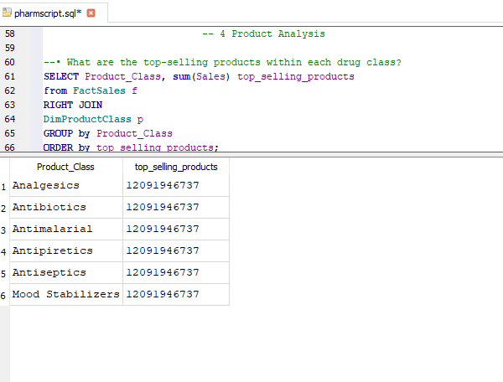
4 Product Analysis
What are the top-selling products within each drug class?

Slide 8
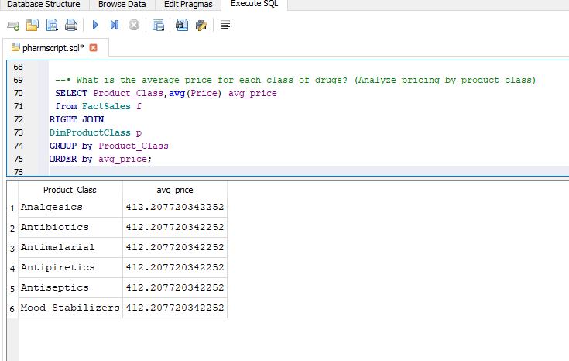
What is the average price for each class of drugs? (Analyze pricing by product class)

Slide 9
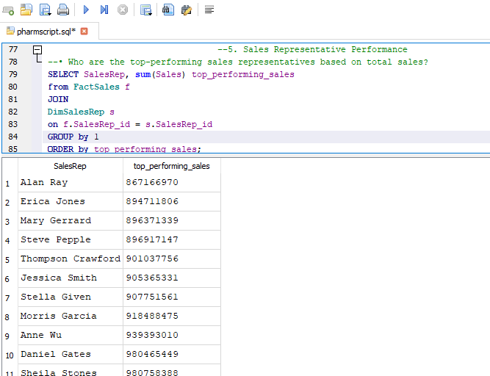
5. Sales Representative Performance

Slide 10
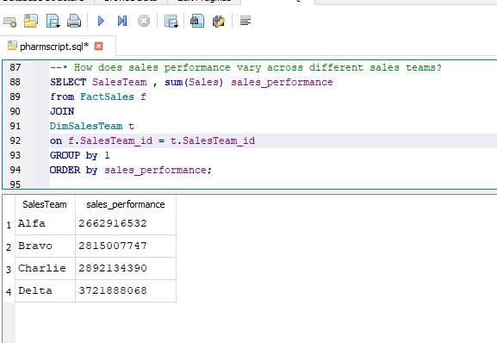
How does sales performance vary across different sales teams?

Slide 11
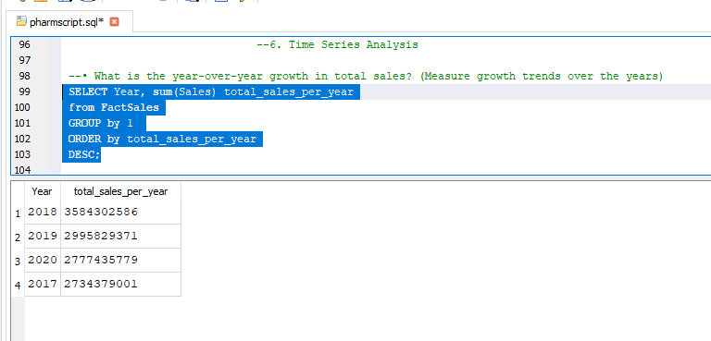
6Time Series Analysis
What is the year-over-year growth in total sales? (Measure growth trends over the years)

Slide 12
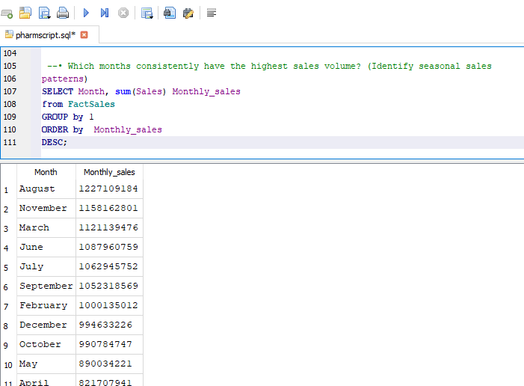
Which months consistently have the highest sales volume? (Identify seasonal sales

