Slide 1
PRESENTATION TITLE
Predicting Loan Defaults
18.01.2023

Slide 2
TEXT LAYOUT 1
Agenda
Data Science Lifecycle​
Project Overview​
Data
Analysis
Modeling
Model Evaluation
Recommendations

Slide 3
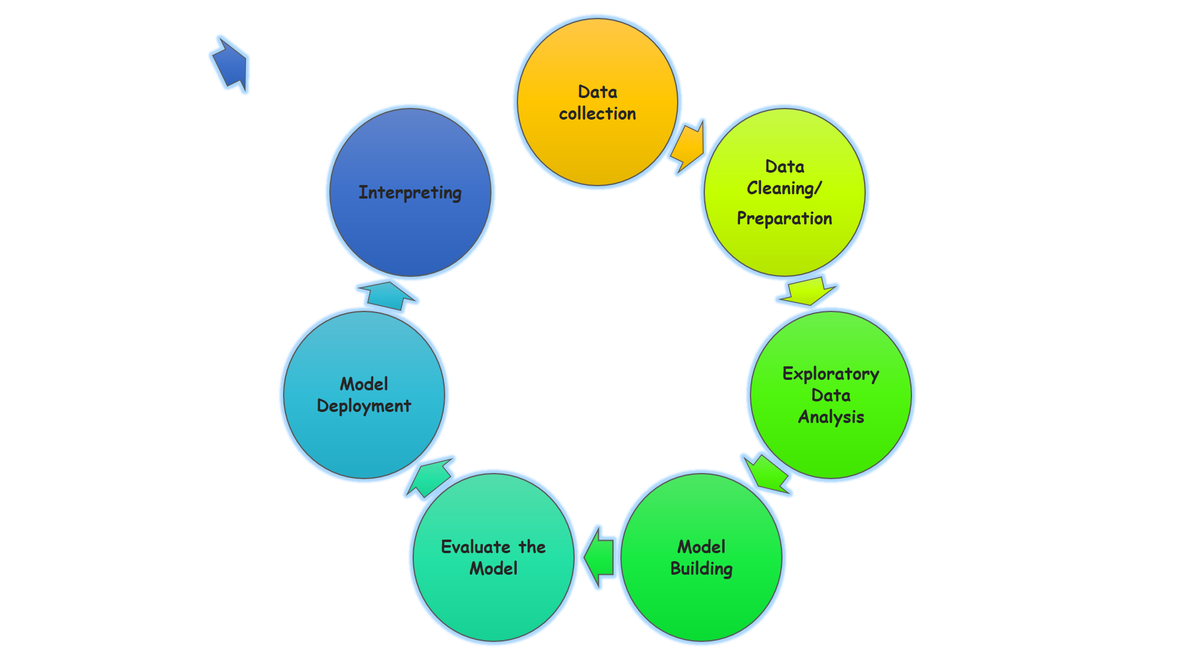
Data Science Lifecycle

Slide 4
TEXT LAYOUT 1
Project Overview
Business Problem: the current process in which potential borrowers apply for a home loan takes 2-3 days for officers to manually check applications.
Business Objective: to make it possible for applicants to receive a response immediately after completing their application.
Hypothesis: implementing a ML model that will predict if the potential borrower will default on loan or not

Slide 5
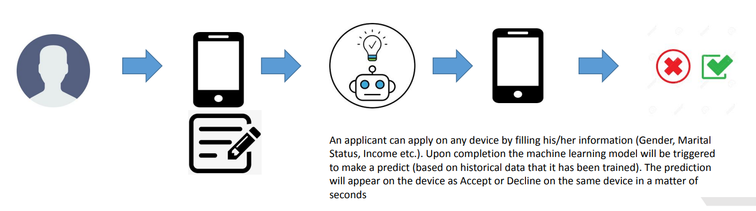
TEXT LAYOUT 1
Process Overview / Solution

Slide 6
TEXT LAYOUT 1
Data
training dataset contains 614 labeled instances and 12 features
data types: numerical (5) and text (7)
8 features have missing values
no duplicates in dataset
more than 65% instances are approved loans

Slide 7
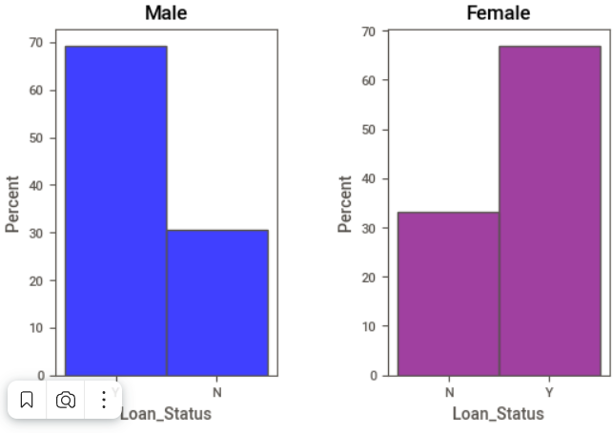
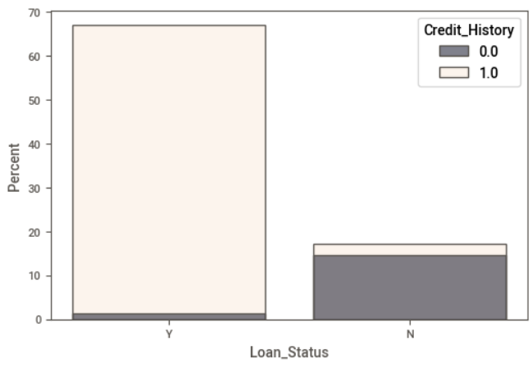
TEXT LAYOUT 1
Analysis
There is a positive correlation between applicant's income and the loan amount.
There is no significant difference between women and men when it comes to defaulting on loans
People who don't have a credit history are more likely to default than those who have.

Slide 8
TEXT LAYOUT 1
Modeling
We tried 4 different base-line models and according to the evaluation metrics chose Random Forest Classifier.
Accuracy and AUC scores:
Random Forest: 79,3 % 0.77
Support Vector Machines: 68,7 % 0.75
AdaBoost: 78,3 % 0.77
Gradient Boosting: 78,2 % 0.77

Slide 9
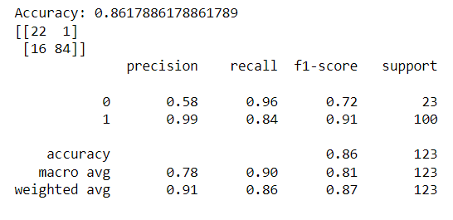
TEXT LAYOUT 1
Model Evaluation
Model Performance after tuning:
Accuracy: 86.2 %

