Slide 1
COVID Mapping
A choropleth representation of COVID cases
Project by: Supervisor
Bigen Aryal (77) Lecturer Manish Joshi
Bikramaditya Prasad Subedi (75)
Milan Dhamala (73)
Rajeshwor Niroula (71)
Usta Adhikari (68)

Slide 2
INTRODUCTION
Our project COVID Mapping displays
COVID-19 cases i.e. (active, recovered and death) on a choropleth map from a database where the
database is fed with datas from official sources via manual entry

Slide 3
OBJECTIVES
-To make effective response using the available data to the harshly hit centers
-To clearly indicate on a choropleth map as patterns, trends would be missed in a textual data
-To provide precise and accurate COVID data in provincial manner
-To decrease reliability over API’s as we gather datas from official sources manually as soon as it is released

Slide 4
FEATURES
-An all in one platform to show death, infected and recovered counts
-User-friendly web app
-Interactive choropleth map and bar plot
-Manual data entry allows authentic data feeding

Slide 5
Tools and Technique
-Xampp and apache server for mysql
-Django framework for backend
-Pycharm IDE by Jetbrains studio
-Folium for choropleth
-Plotly for Bar plots

Slide 6
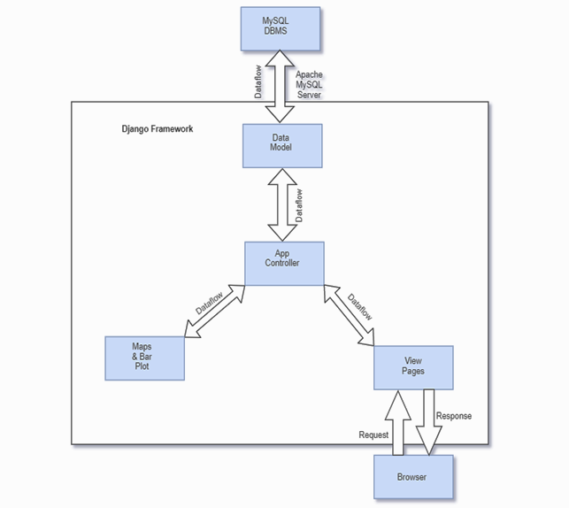
Flowchart
-controller linkages
-Python class based data model
-Pandas dictionaries for data conversion
-NumPy for data formattings
-Objects rendered in view page

Slide 7
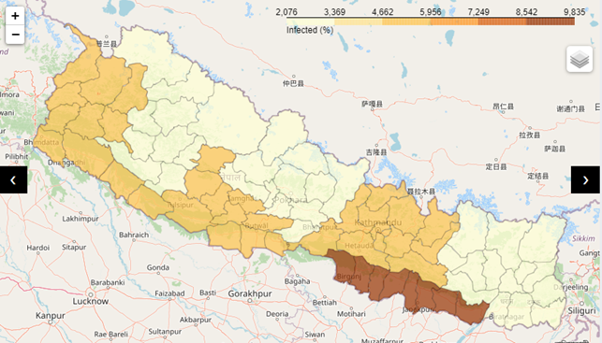
Maps
-interactive folium map
-borders marked using api
-variable colour contrast displaying varying densities
-well labeled and defined legend
-three maps showing death, recovery and infected states
Map showing infection

Slide 8
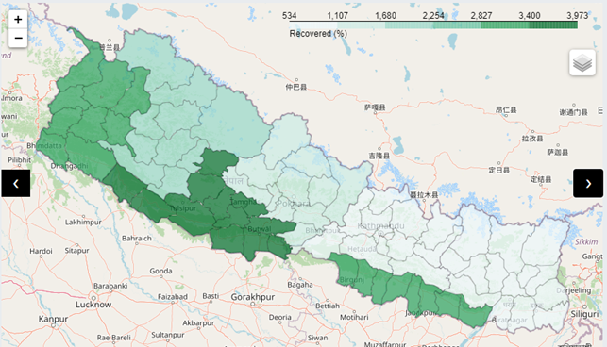
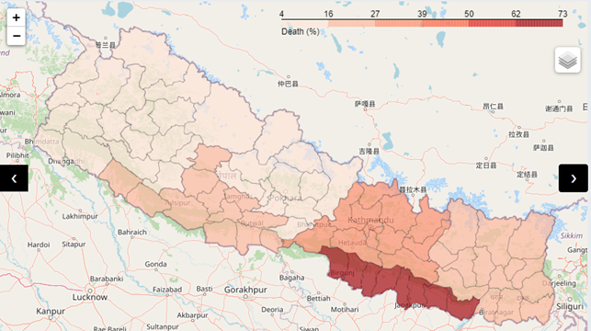
Map showing recovery
Map showing death

Slide 9
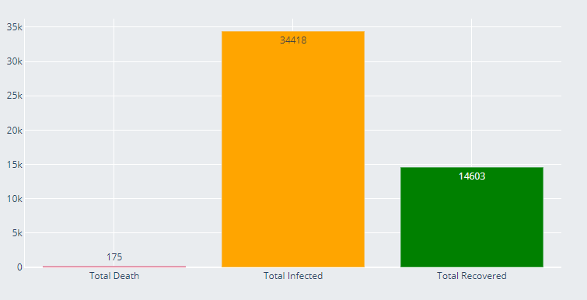
Bar Plot
-Using Plotly
-Displays total recovered, death and infected population
-Different colours for each datas

Slide 10
LIMITATION
-Currently we have not acquired a domain hence our functionality is limited to a localhost
-Manual data entry wouldn’t be as efficient as scraping data
-The UI could be more user-friendly with some added extensions and features

Slide 11
Future Enhancement
-A robust scraper that would fetch datas from authentic sources can be added
-Premium server features by cooperation with hosting companies can commercialize the web app

Slide 12
CONCLUSION
-Robust statistical representation of datas
-Familiarity with python web app tools
-Implementation of in-semester knowledge
-Completion of semester project

