Slide 1
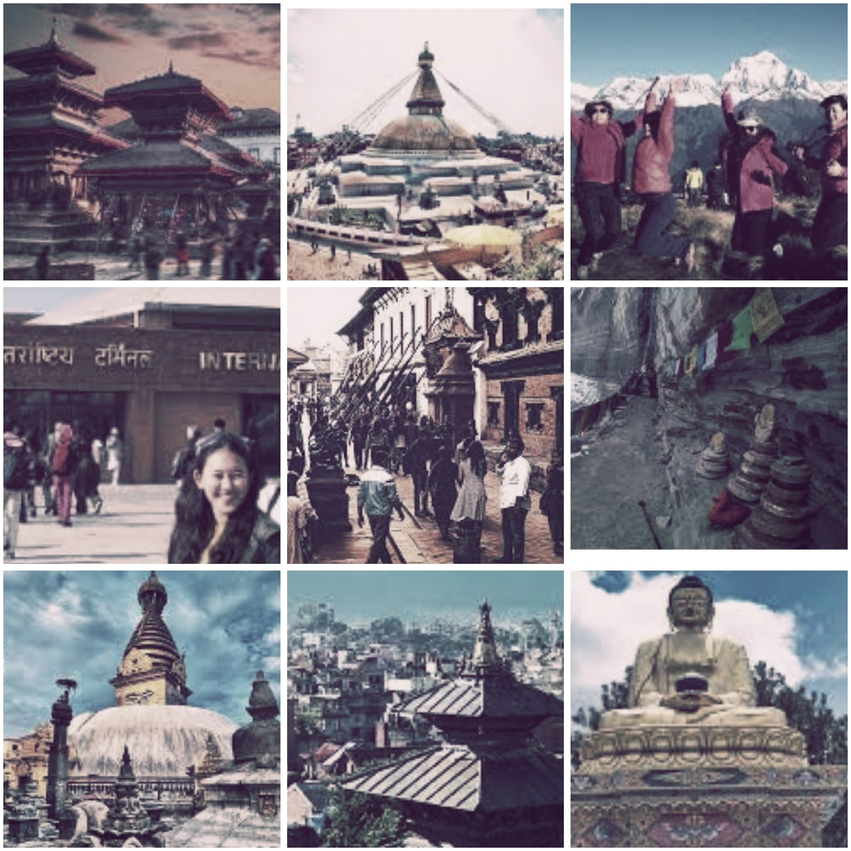
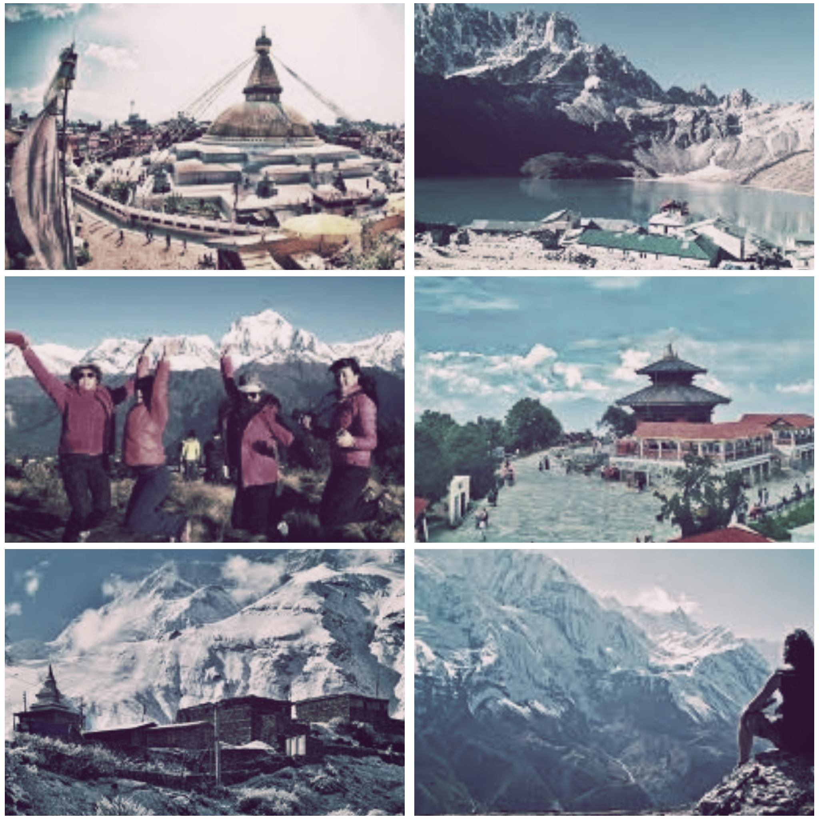


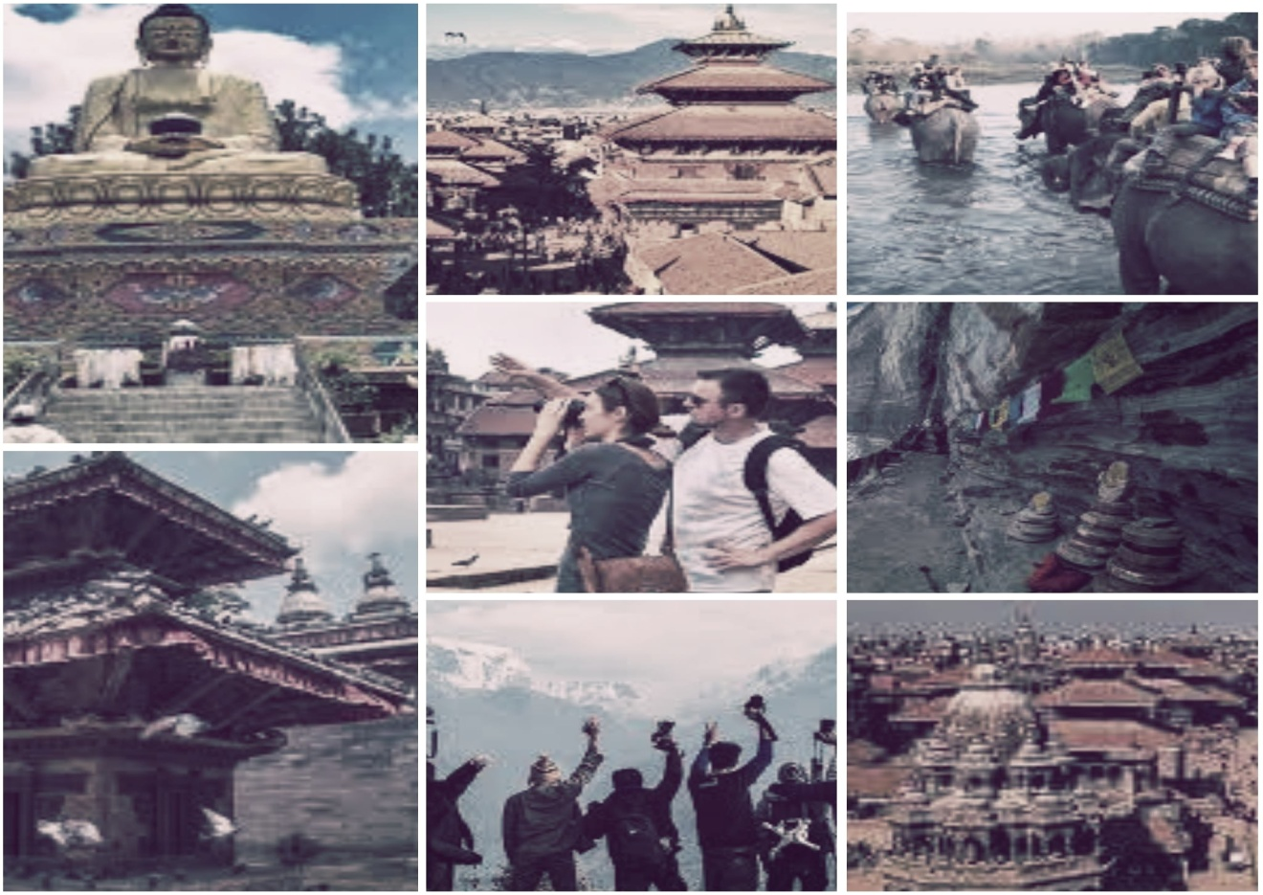
G
H
U
M
G
H
A
M
Under the supervision of Satyendra Lohani
Presented by:
Ashwin Shrestha, Suniti Sainju & Usta Adhikari

Slide 2
What / Why “Ghumgham”?
What :
Ghumgham is a desktop application.
It provides essential details about the tourism places.
Why :
To promote and develop the Nepalese tourism industry.

Slide 3
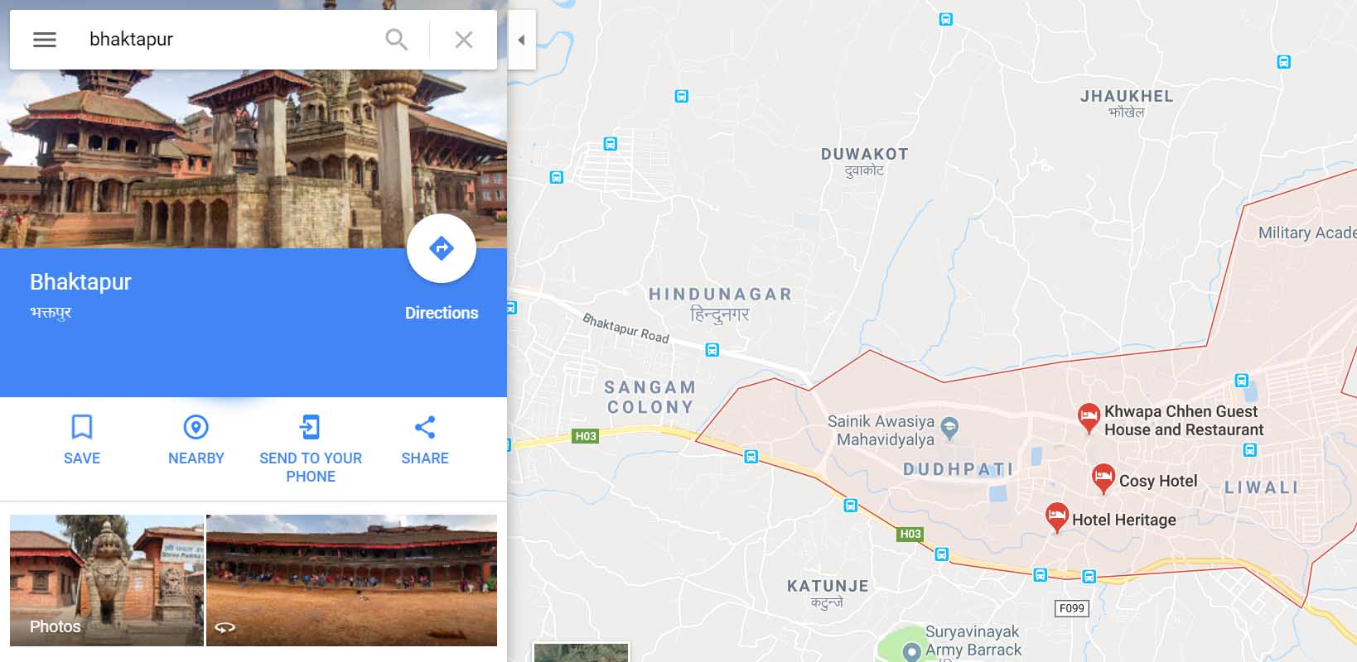
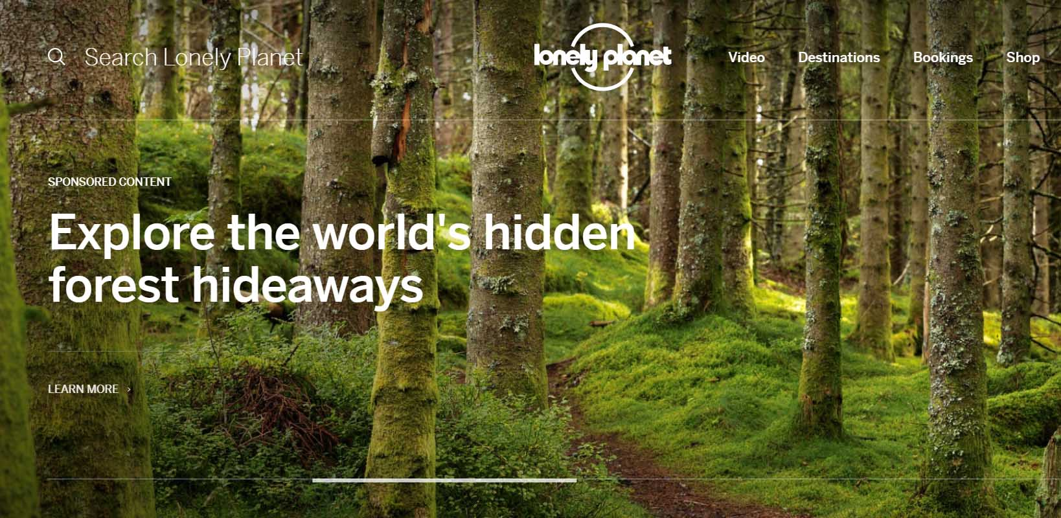
Related Works
2. lonelyplanet.com
Google Maps

Slide 4


Language / Tools Used
Programming Language Used :
C++ (Qt)

Slide 5
Objectives
To enhance our C++ learning skills,
To make the tourism places of Nepal easily accessible to the tourists,
To establish a global communication between the travel agencies and tourists,
To promote tourism industry of Nepal globally.

Slide 6
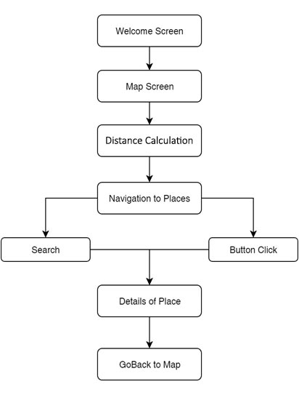
Design and Implementation
Fig: Use Case Diagram

Slide 7
Features
Easy access to the details of the tourism places in Nepal.
Information of various travel agencies and hotels providing services at that place.
Browse and search main tourism places of Nepal.
Shows the distance between the source and destination.

Slide 8
Future Enhancement
Including more tourism places in Nepal and the distance between them.
Use query languages like MySQL to store the datas rather than file handling.
Building the web application of Ghumgham too as it will make this application more accessible.
Building live chat system for the easy interaction of tourism agencies and tourists.
Developing user friendly interface.

Slide 9
Conclusion
In this short span of time we have been successfully able to collect all the required data of the tourism places in Nepal and build an awesome application which enhanced our C++ skills and knowledge of Qt Framework. This project have all the capabilities to be commercialized not only being confined as a semester project.
THANK YOU

