Slide 1
Nigeria COVID19 Data Analysis Using Python
Solomon Paul Olokpo

Slide 2
Table of contents
01
02
03
Project Introduction
Data Overview and Extraction
Data Cleaning
04
05
Visualization and Insights
Conclusion
Includes summary and problem statement.
In-depth description of the data and its extraction.
Includes methods used to process the data.
Includes charts and discussions.
Results and conclusion.

Slide 3
01
Introduction

Slide 4
Coronavirus disease (COVID-19) is an infectious disease caused by the SARS-CoV-2 virus.
With its great tendency to spread, Nigeria became a safe haven for it. Ever since the confirmation of the first case in Nigeria on 27th of February, 2020, the trajectory of cases has only seen a steady rise.
This project investigates COVID-19’s stay in Nigeria; exploring its effects on the economy and health sector among others. The solution will also be stated.

Slide 5
02
Data Overview and Extraction

Slide 6
Data Sources
1.
4.
NCDC Dataset
Nigeria GDP Data
2.
5.
John Hopkins GitHub Data Repo
WHO Vaccination Data
3.
6.
Nigeria Budget Data
Nigeria COVID Vulnerability Index

Slide 7
Data Overview
NCDC Dataset | No. of Confirmed Cases
 | No. of Admitted Cases
 | No. of Discharged Cases
 | No. of Deaths
Nigeria COVID Vulner-ability Index | Overall CCVI Index
 | Epidemiological
 | Fragility
 | Health System
 | Population Density
 | Socio-Economic
 | Transport Availability
 | Acute IHR
 | Region
 | Population
Nigeria Budget Data | 2014 Q1 – Q4
 | 2015 Q1 – Q4
 | 2016 Q1 – Q4
 | 2017 Q1 – Q4
 | 2018 Q1 – Q4
 | 2019 Q1 – Q4
 | 2020 Q1 – Q4
Josh Hopkins Global Data | Global Daily Confirmed Cases
 | Global Daily Recovered Cases
 | Global Daily Death Cases
WHO Vaccination Data | Daily Vaccinations
Nigeria GDP Data | Initial Budget
 | Revised Budget

Slide 8
03
Data Cleaning

Slide 9
Data Cleaning
Cleaning NCDC Data involved:
Renaming columns to a more appropriate description
Removing ‘coma’ from numerical columns like No. of Cases (Lab Confirmed)
Conversion of columns to the appropriate datatype
Cleaning Josh Hopkins Global Data involved:
Selecting only the data point for Nigeria
Dropping ‘Province/State’, ‘Country/Region’, ‘Lat’ and ‘Long’ columns

Slide 10
04
Visualization and Insights

Slide 11
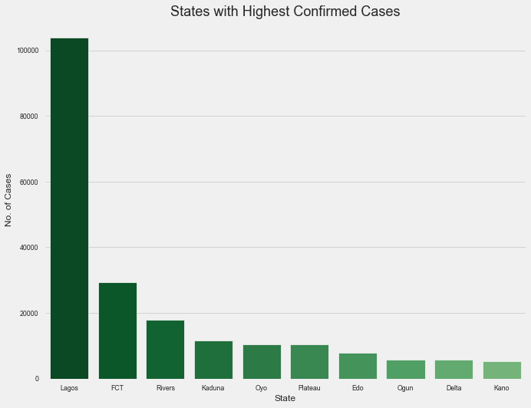
State with Highest Confirmed Cases

Slide 12

Discharged cases by state

Slide 13
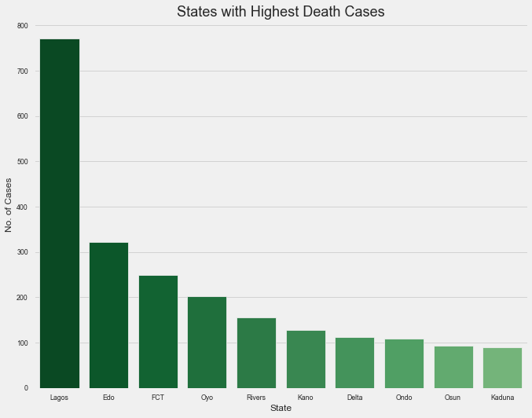
STATES WITH DEATH CASES

Slide 14
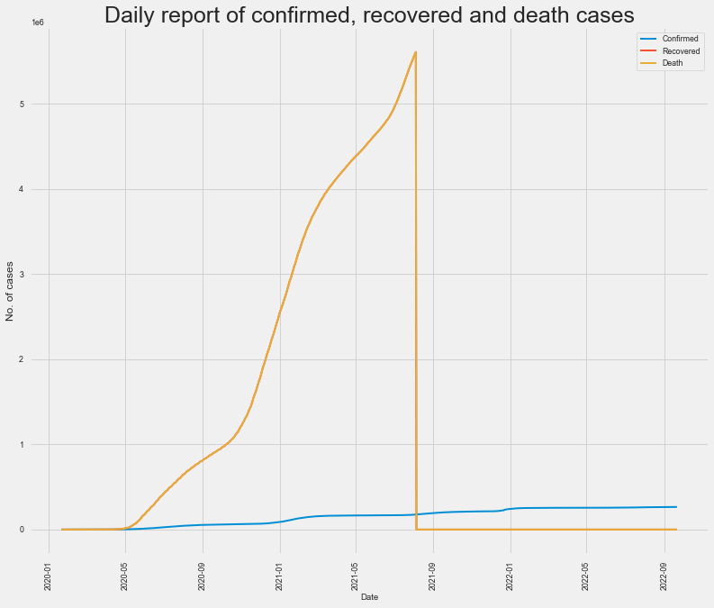
Daily Report of Confirmed, Recovered and Death cases

Slide 15
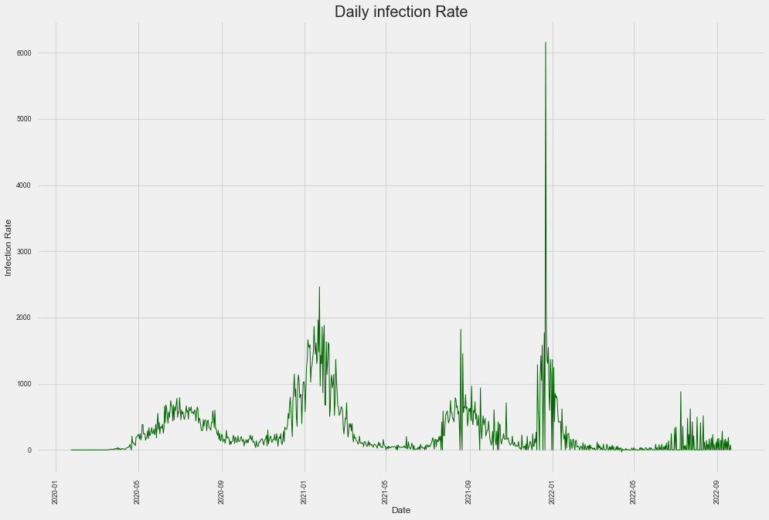
DAILY INFECTION RATE

Slide 16
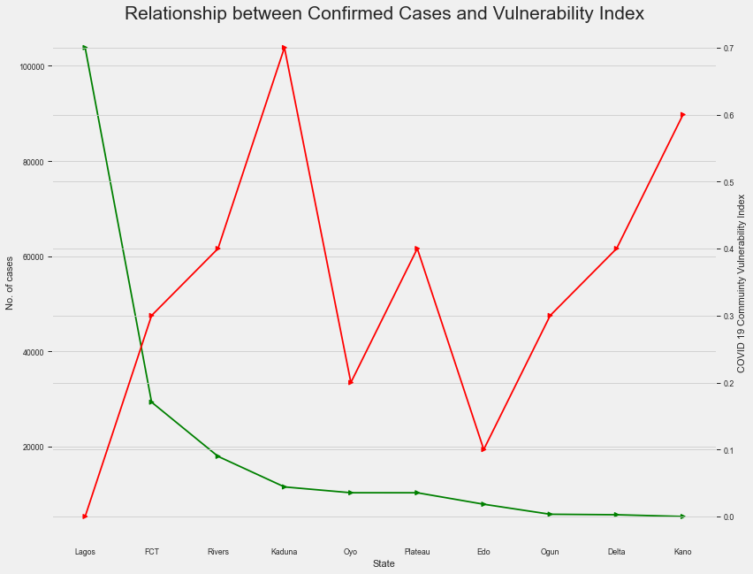
RELATIONSHIP BETWEEN CONFIRMED CASES AND VULNERABILITY INDEX

Slide 17
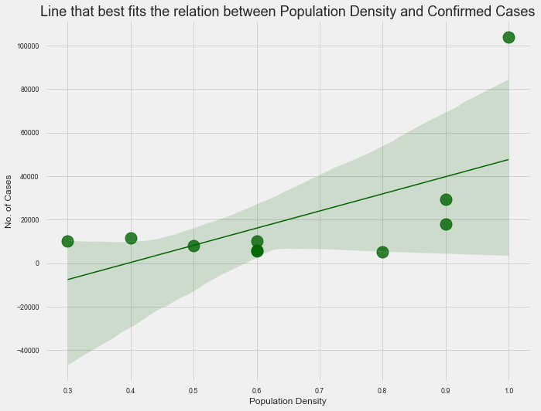
Line of fit between Population Density and Confirmed Cases

Slide 18
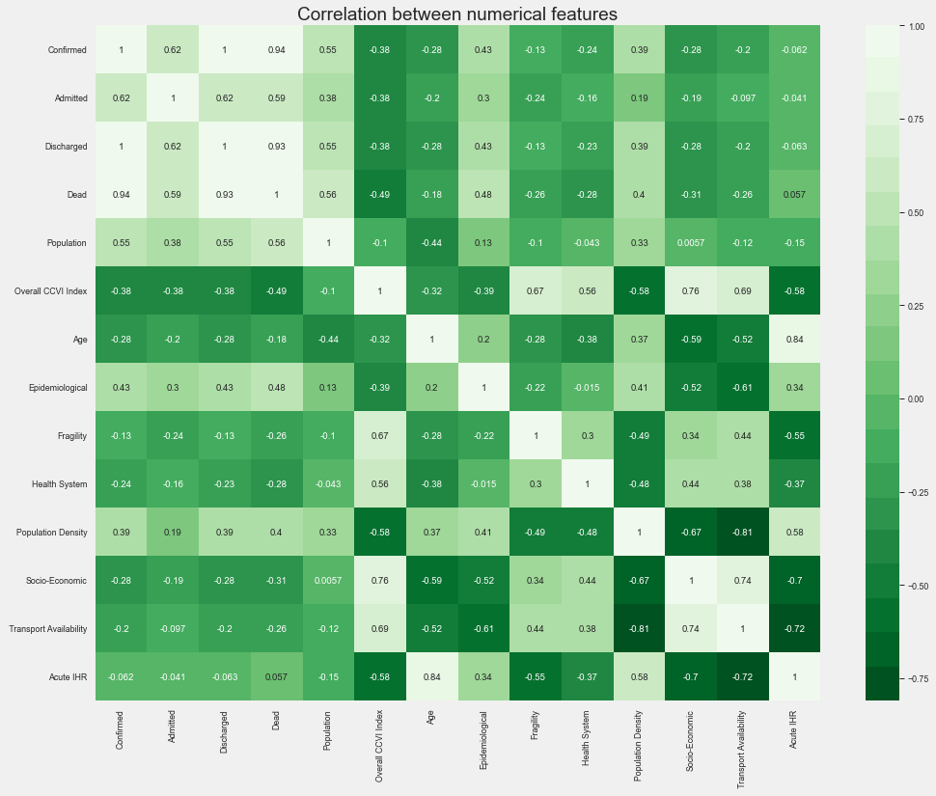
Correlation Between Features

Slide 19
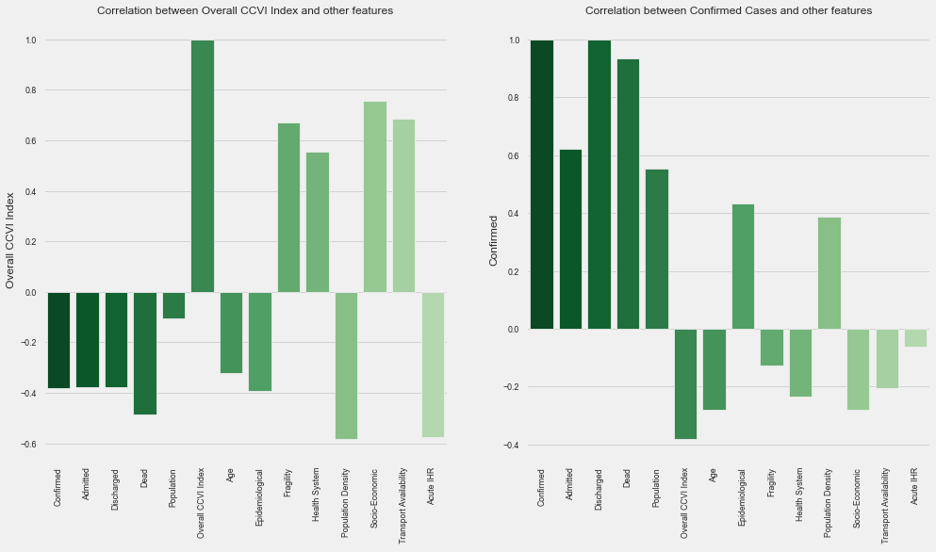
Correlation Between Features

Slide 20
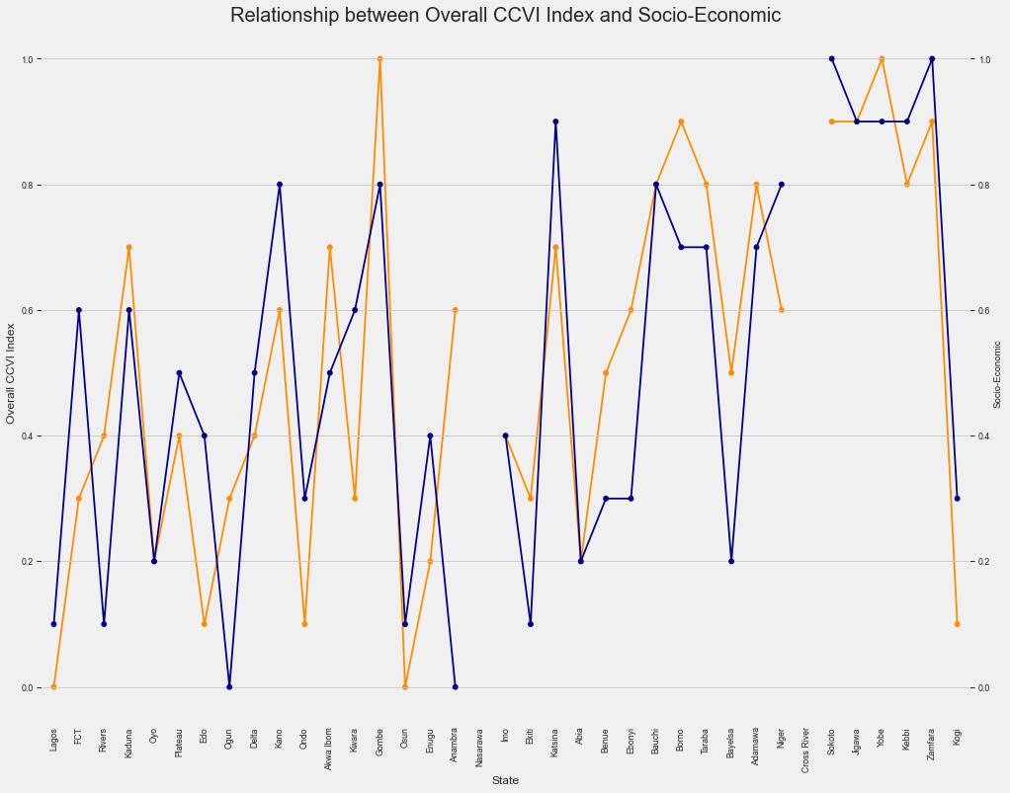
Correlation Between CCVI Index and Social Economic

Slide 21
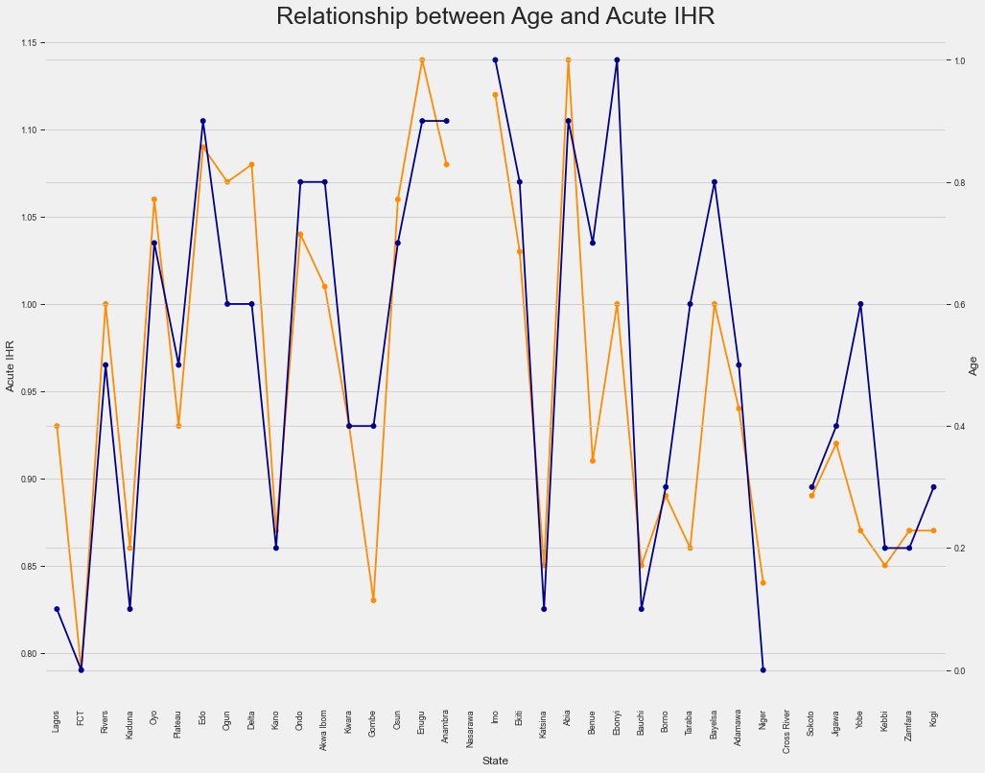
Relationship between Age and Acute IHR

Slide 22
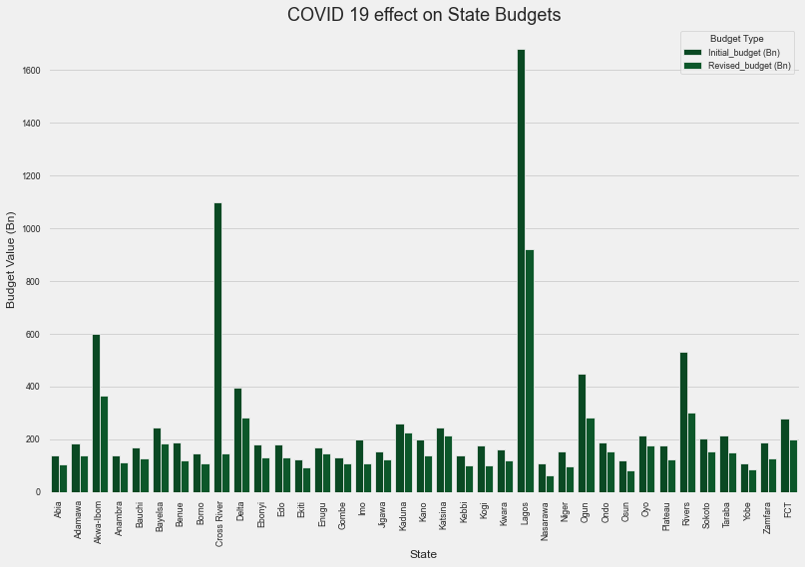
Covid 19 Effect on State Budget

Slide 23
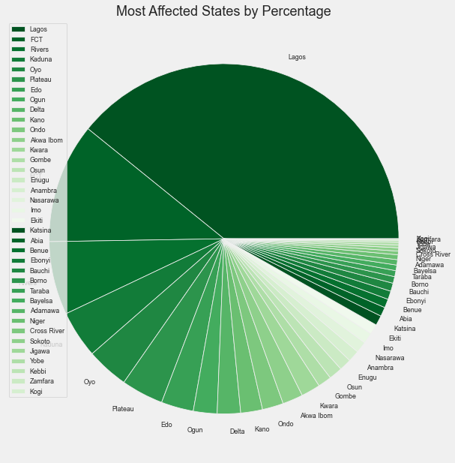

Slide 24
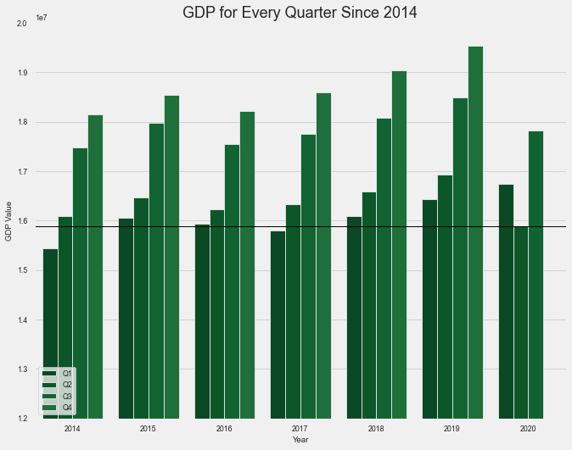

Slide 25
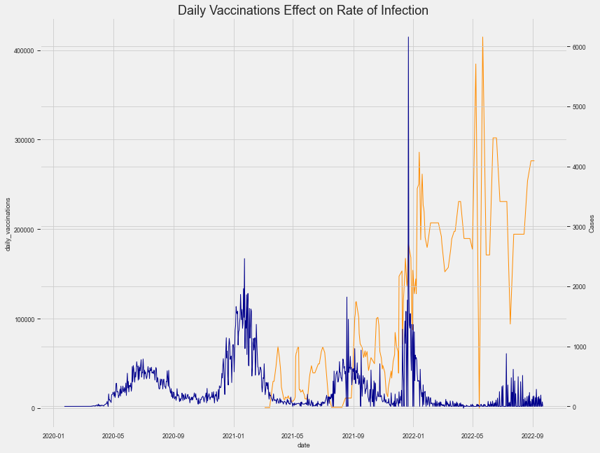

Slide 26
05
Conclusion / Recommendation

Slide 27

Vaccination
The outcome of vaccines from laboratory researches has be instrumental in curbing the death potency of the virus: a relief since it successful synthesis.
While a drastic decline in cases is experienced globally, vaccination, personal hygiene and social distancing remains a practical cure to the COVID19.

Slide 28
Thanks!

Slide 29
References
https://www.aljazeera.com/news/2020/11/21/nigeria-slips-into-recession-blamed-on-covid-19-and-oil-prices
https://www.pwc.com/ng/en/assets/pdf/economic-alert-october-2020.pdf
https://slidesgo.com/theme/covid-19-vaccine-breakthrough-case-investigation-and-reporting#search-Coronavirus&position-7&results-86

