Slide 1
Employee Data Analysis using Excel
STUDENT NAME: MERLIN LEEMA ROSE J.L
REGISTER NO: 6F90A733E89490CB0DB416DC9E8877F8
DEPARTMENT: B.COM (ACCOUNTING & FINANCE)
COLLEGE: SRI KANYAKA PARAMESWARI ARTS & SCIENCE COLLEGE FOR WOMEN

Slide 2
PROJECT TITLE
Employee Performance Analysis using Excel

Slide 3


AGENDA
Problem Statement
Project Overview
End Users
Our Solution and Proposition
Dataset Description
Modelling Approach
Results and Discussion
Conclusion
3/21/2024 Annual Review

Slide 4

PROBLEM STATEMENT
The problem is to identify the Human Resources (HR) department of XYZ Corporation aims to evaluate and improve employee performance across various departments. Currently, performance data is collected, but it is not systematically analysed to provide actionable insights. The HR team needs a comprehensive analysis of employee performance metrics to identify top performers, underperformers, and trends over time.

Slide 5

PROJECT OVERVIEW
Analyze employee performance metrics to identify strengths, areas for improvement, and overall trends. Implement PivotTables to summarize and categorize performance data.
Compare individual employee performance against benchmarks or targets. Analyze seasonal or project-specific performance variations. .
Design dashboards for easy visualization of performance metrics. Share analysis results with management for decision-making.
.

Slide 6

WHO ARE THE END USERS?
Human Resources Team
Managers
Executives
Training and Development Teams
Compensation and Benefits Teams
Performance Review Committees

Slide 7

OUR SOLUTION AND ITS VALUE PROPOSITION
Flexibility to adapt the analysis to different roles, departments, or performance criteria, ensuring relevance and accuracy in evaluations
Solution Data-driven analysis that support performance reviews, promotions, compensation decisions, and targeted training.
Solutions The ability to analyze both current and historical performance data, with periodic updates to keep information.
Value Proposition Saves time and reduces the risk of human error, ensuring consistent and reliable reporting across the organization. .

Slide 8
Dataset Description
EMPLOYEE ID: Unique identifier for each employee in the organization.
FIRST NAME: The first name of the employee. PAY ZONE: The pay zone or salary band to which the employee's compensation falls. DEPARTMENT TYPE: The broader category or type of department the employee's work is associated with. CURRENT EMPLOYEE RATING: The current rating or evaluation of the employee's overall performance.

Slide 9

THE "WOW" IN OUR SOLUTION
Dynamic Dashboards: Create interactive dashboards with Excel’s PivotTables, PivotCharts, and Slicers. These allow users to filter data dynamically and view performance metrics in real-time. Conditional Formatting: Use conditional formatting to visually highlight top performers, underperformers, and trends. Advanced Formulas: Incorporate complex formulas such as INDEX-MATCH or array functions to perform sophisticated calculations and analyses that go beyond basic SUM and AVERAGE functions. Data Visualization: Use charts and graphs like sparklines, heat maps, and bullet charts to present performance data in an engaging and easy-to-understand format.
3/21/2024 Annual Review
9

Slide 10
MODELLING
DATA SET: Kaggle, Employee dataset FEATURE SELECTION: Slicer, Conditional Formatting, Designing DATA CLEANING Missing values, Irrelevant data, Correct Errors, Remove Unnecessary Columns and Rows PIVOT TABLE: Employee ID, First Name, Performance Score. CHART: Report of Employee Performance based on their Current Ratings is resented as Column Chart
10

Slide 11
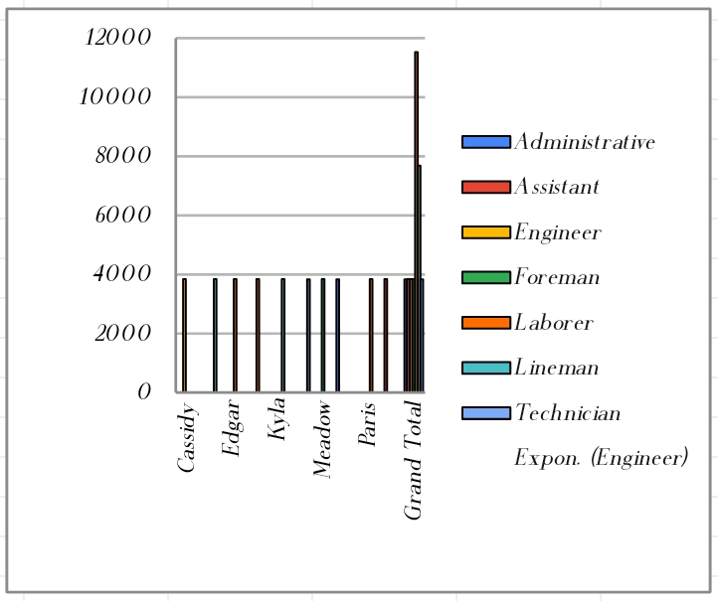
RESULTS
11

Slide 12
CONCLUSION
In conclusion, conducting an employee performance analysis using Excel provides a structured and efficient way to evaluate and track performance metrics. Excel's versatile functions and tools, such as pivot tables, charts, and conditional formatting, allow for clear data visualization and analysis, facilitating informed decision-making. By systematically analyzing performance data, management can identify trends, strengths, and areas for improvement, enabling targeted interventions and fostering a culture of continuous improvement. Regular updates and reviews of this data ensure that performance management remains dynamic and aligned with organizational goals.

