Slide 1
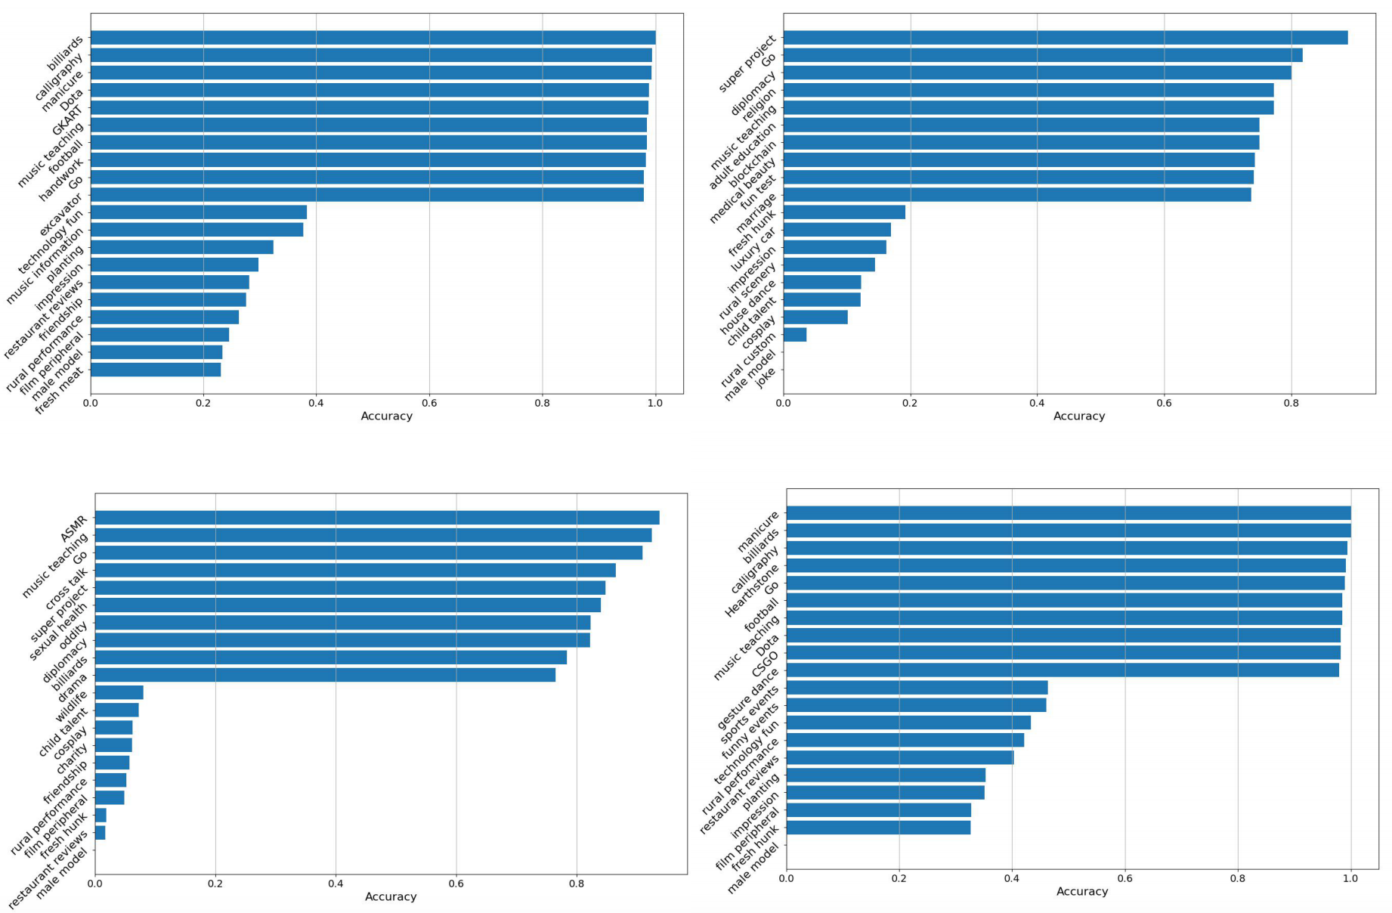
Visual branch
Textual Branch
Audio Branch
Fused

