Slide 1
4-Bit RISC CPU Datapath
with 3-Stage Pipeline (IF – ID – EX)
Digital Design Course Project | Verilog HDL | AMD Xilinx Vivado 2026.1 | Artix-7 (xc7a35tcpg236-1)
Presented by: Tran Quan Bao – SE190570
Notes:
Good morning everyone. My name is Tran Quan Bao, roll number SE190570. Today I will present my course project: a 4-bit RISC CPU datapath with a 3-stage pipeline, designed in Verilog and implemented in Vivado 2026.1 for an Artix-7 FPGA. (~20 sec)

Slide 2
Project Overview
4-bit Datapath
12-bit Fixed ISA
Register File
Signed & unsigned 4-bit integers
Opcode [11:8], Rd, Rs, imm
4 × 4-bit regs (R0–R3), 2 async read ports, 1 sync write port
Harvard Memory
Throughput
Branch Hazards
IMEM: 16 × 12-bit ROM
DMEM: 16 × 4-bit RAM
1 instruction / clock (CPI = 1 once pipeline is primed)
JMP / JZ resolved at EX with automatic 2-bubble flush
Verification: 88 / 88 automated simulation checks PASSED (100%)
Notes:
This project designs, implements and verifies a 4-bit RISC CPU. The datapath is 4 bits wide. Instructions are fixed 12-bit. There are four general-purpose registers. Memory is Harvard style: a 16x12 ROM and a 16x4 RAM. Once the pipeline is full, we get one instruction per clock cycle. Branch hazards are solved by flushing two bubbles. And all 88 automated checks passed. (~50 sec)

Slide 3
Part A – Architecture & Pipeline
Stage 1 – IF
Stage 2 – ID
Stage 3 – EX
program_counter
instruction_memory (ROM)
PC + 1 or branch target
instruction_register (IF/ID)
instruction_decoder
9 control signals
pipeline_register (ID/EX)
register_file · alu
flag_register · data_memory
branch_unit
▶
▶
Top level: cpu_top + 10 sub-modules. mux2 ×3: PC MUX (PC+1 / target), Operand MUX (Rs / imm), Write-back MUX (ALU / RAM).
ALU
Flag Register
Shared adder_subtractor (ARM carry = no-borrow), logic_unit (AND/OR/XOR/NOT/PASS), zero_detector
Zero (Z) and Carry (C) with independent write enables – logic ops update Z only
Notes:
The CPU has three pipeline stages. In Instruction Fetch, the program counter addresses the instruction memory. The IF/ID register holds the instruction and inserts a NOP bubble on flush or reset. In Instruction Decode, the decoder creates nine control signals. The ID/EX register carries those signals together with Rd, Rs, the immediate and the PC. In Execute, we read registers, run the ALU, update flags, access data memory, write back, and resolve branches. A branch taken in EX sends the target to the PC and flushes the two younger instructions. (~60 sec)

Slide 4
Part C – Instruction Set Architecture
[11:8] Opcode (4 bits)
[7:6] Rd (2 bits)
[5:4] Rs (2 bits)
[3:0] imm / addr (4 bits)
Opcode | Mnemonic | Operation | Flags
0000 | ADD | Rd ← Rd + Rs | Z, C
0001 | SUB | Rd ← Rd − Rs (C = no-borrow) | Z, C
0010 | AND | Rd ← Rd & Rs | Z
0011 | OR | Rd ← Rd | Rs | Z
0100 | XOR | Rd ← Rd ^ Rs | Z
0101 | NOT | Rd ← ~Rd | Z
0110 | LDI | Rd ← imm[3:0] | –
0111 | MOV | Rd ← Rs | –
1000 | LOAD | Rd ← DMEM[addr] | –
1001 | STORE | DMEM[addr] ← Rd | –
1010 | JMP | PC ← addr | –
1011 | JZ | If Z = 1: PC ← addr | –
11xx | NOP | No operation (reserved) | –
Registers: R0 = 00 · R1 = 01 · R2 = 10 · R3 = 11
Notes:
Every instruction is 12 bits: a 4-bit opcode, a 2-bit destination register, a 2-bit source register, and a 4-bit immediate or address. There are 12 real instructions: arithmetic ADD and SUB, which update Zero and Carry; logic AND, OR, XOR, NOT, which update Zero only; LDI and MOV for data movement; LOAD and STORE for memory; and JMP and JZ for control flow. Opcodes 1100 to 1111 are reserved NOPs. (~60 sec)

Slide 5
Control Unit Decoder Truth Table
Opcode | Instr | alu_ctrl | alu_src | wb_sel | reg_we | mem_we | z_we | c_we | is_jmp | is_jz
0000 | ADD | 000 | 0 | 0 | 1 | 0 | 1 | 1 | 0 | 0
0001 | SUB | 001 | 0 | 0 | 1 | 0 | 1 | 1 | 0 | 0
0010–0101 | AND/OR/XOR/NOT | 010–101 | 0 | 0 | 1 | 0 | 1 | 0 | 0 | 0
0110 | LDI | 110 | 1 | 0 | 1 | 0 | 0 | 0 | 0 | 0
0111 | MOV | 110 | 0 | 0 | 1 | 0 | 0 | 0 | 0 | 0
1000 | LOAD | 110 | 1 | 1 | 1 | 0 | 0 | 0 | 0 | 0
1001 | STORE | 110 | 1 | 0 | 0 | 1 | 0 | 0 | 0 | 0
1010 | JMP | 000 | 0 | 0 | 0 | 0 | 0 | 0 | 1 | 0
1011 | JZ | 000 | 0 | 0 | 0 | 0 | 0 | 0 | 0 | 1
1100–1111 | NOP | 000 | 0 | 0 | 0 | 0 | 0 | 0 | 0 | 0
Branch unit (EX): pc_sel = is_jmp OR (is_jz AND Zero); flush = pc_sel → 2 bubbles inserted
Notes:
The hardwired decoder maps each opcode to nine control signals with safe defaults. For example, ADD and SUB write the register file and update both Zero and Carry. LDI, LOAD and STORE use the immediate as ALU operand B through alu_src equals 1. LOAD selects RAM data for write-back. STORE enables the memory write. JMP and JZ only raise is_jmp or is_jz and are resolved in the branch unit at EX. (~45 sec)

Slide 6
Step-by-Step Execution Trace
Instruction | Hex | Result | Flags
LDI R1, 5 | 0x645 | R1 = 5 | –
LDI R2, 3 | 0x683 | R2 = 3 | –
ADD R1, R2 | 0x060 | R1 = 8 | Z=0, C=0
STORE R1, 0 | 0x940 | DMEM[0] = 8 | –
SUB R1, R2 | 0x160 | R1 = 2 | Z=0, C=1
LOAD R0, 0 | 0x800 | R0 = 8 | –
SUB R2, R2 | 0x1A0 | R2 = 0 | Z=1, C=1
JZ 9 | 0xB09 | PC ← 9, flush 2 | –
Carry = no-borrow
SUB 5 − 3 → C = 1 (no borrow).
SUB 3 − 5 → C = 0 (borrow).
Branch Flush
Branch resolved in EX → target loaded into PC and the 2 younger instructions become NOP bubbles.
Notes:
Here is a real trace. LDI loads 5 into R1 and 3 into R2. ADD gives 8 with no carry. STORE writes 8 to memory address 0. SUB gives 2, and carry is 1 because there is no borrow. LOAD reads memory back into R0. Then SUB R2, R2 gives zero and sets Z to 1, so the JZ to address 9 is taken and flushes two instructions. (~50 sec)

Slide 7
Part B – Verification Methodology
Tier 1 – Module Level (44 checks)
Tier 2 – System Level: tb_cpu.v (44 checks)
tb_alu.v (11)
Test 1 – program.mem
LDI, ADD, XOR, infinite JMP loop
ADD, SUB with carry/borrow, AND/OR/XOR/NOT, PASS, Zero flag
Test 2 – prog_arith.mem
ADD/SUB, Carry, STORE, LOAD, Zero
tb_register_file.v (11)
Test 3 – prog_logic.mem
MOV, AND/OR/XOR/NOT, clear via XOR Rd,Rd
Reset, R0–R3 read/write, dual-port read, hold when reg_we = 0
Test 4 – prog_jump.mem
JMP, JZ (Z=1 / Z=0), 2-bubble flush
tb_control_unit.v (22)
16 opcodes (incl. 4 reserved) + 6 branch_unit scenarios
Test 5 – Reset
Sync reset + no X/Z on any bus
Notes:
We used a two-tier verification strategy. At module level, there are 44 checks across three testbenches: the ALU with 11 checks, the register file with 11, and the control unit with 22, covering all 16 opcodes and 6 branch scenarios. At system level, tb_cpu has 44 checks across five tests: a demo program, arithmetic with memory, logic operations, jumps with flush verification, and reset with an X/Z check on all buses. (~60 sec)

Slide 8
Simulation Results – 88 / 88 PASSED
tb_alu
tb_register_file
tb_control_unit
tb_cpu
11 / 11
11 / 11
22 / 22
44 / 44
PASSED @ 110 ns
PASSED @ 67 ns
PASSED @ 22 ns
PASSED @ 666 ns
Total: 88 / 88 checks PASSED (100% pass rate)
Evidence: Vivado waveforms and Tcl-console logs for all 4 testbenches; no unknown (X) or high-impedance (Z) values on key outputs or registers after reset.
Notes:
All four testbenches pass in Vivado XSim: ALU 11 of 11 at 110 nanoseconds, register file 11 of 11 at 67 nanoseconds, control unit 22 of 22 at 22 nanoseconds, and the full CPU 44 of 44 at 666 nanoseconds. That is 88 out of 88, a 100 percent pass rate. The waveforms show the PC incrementing, the flush pulse on branches, and register write-backs aligned to the clock. (~50 sec)

Slide 9
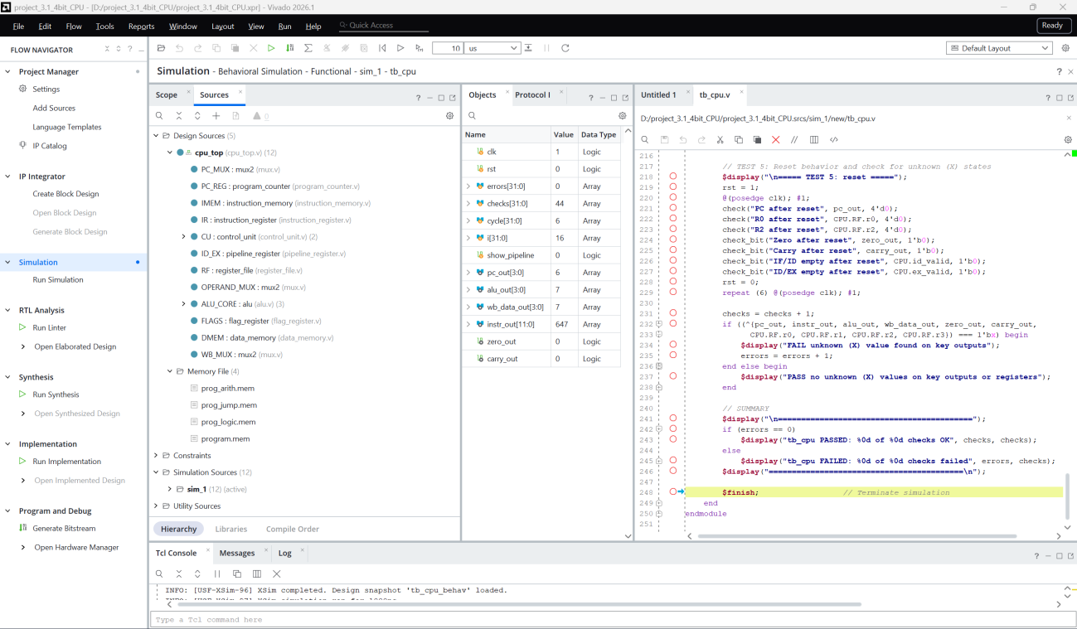
F1 – Sources Window: Design Hierarchy
Hierarchy
Top: cpu_top
PC_REG · IMEM · IR · CU
ID_EX · RF · ALU_CORE
FLAGS · DMEM
3 × mux2: PC_MUX, OPERAND_MUX, WB_MUX
Simulation Sources:
4 testbenches + 4 .mem files
Figure 1: Sources Window – Design Hierarchy vs Simulation Sources
Notes:
F1 shows the Sources window. The top module is cpu_top, which instantiates the program counter, instruction memory, instruction register, control unit, ID/EX pipeline register, register file, ALU, flags, data memory and three mux2 instances. Simulation Sources contain four testbenches and four memory files. (~30 sec)

Slide 10
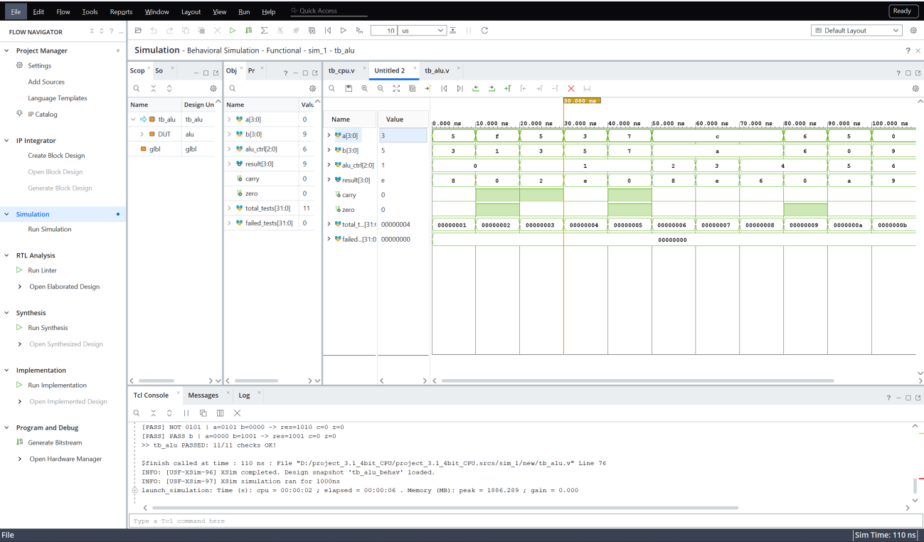
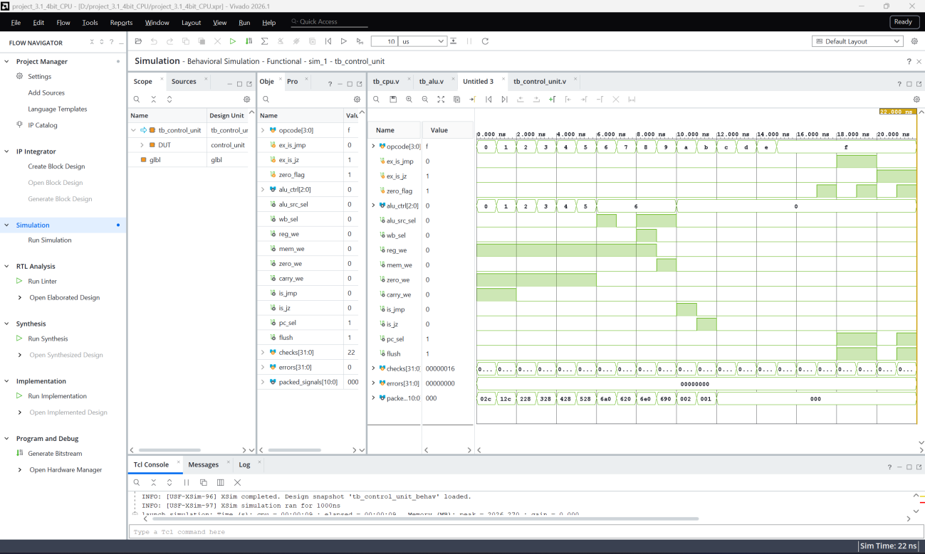
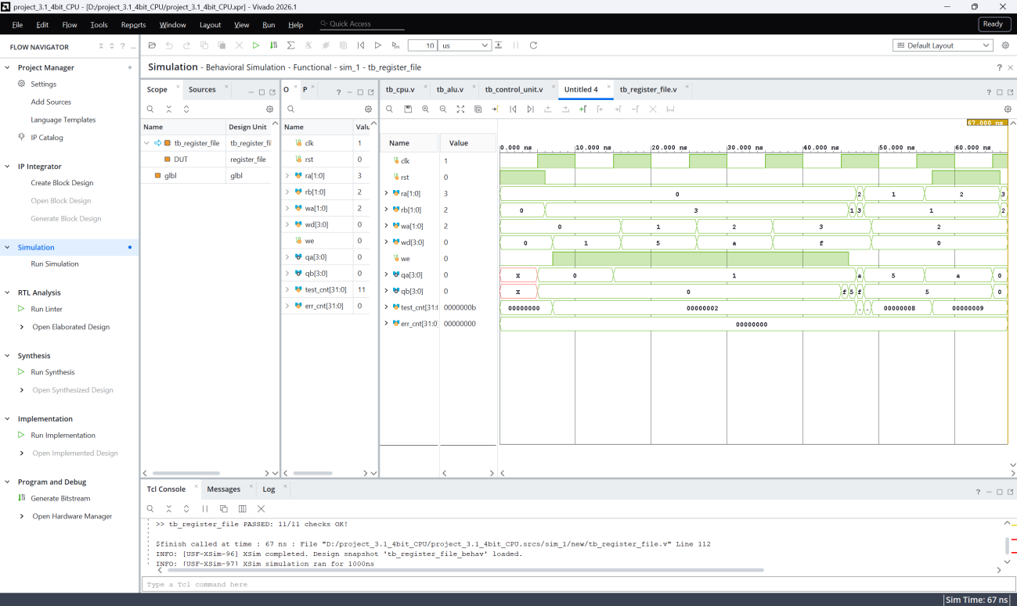
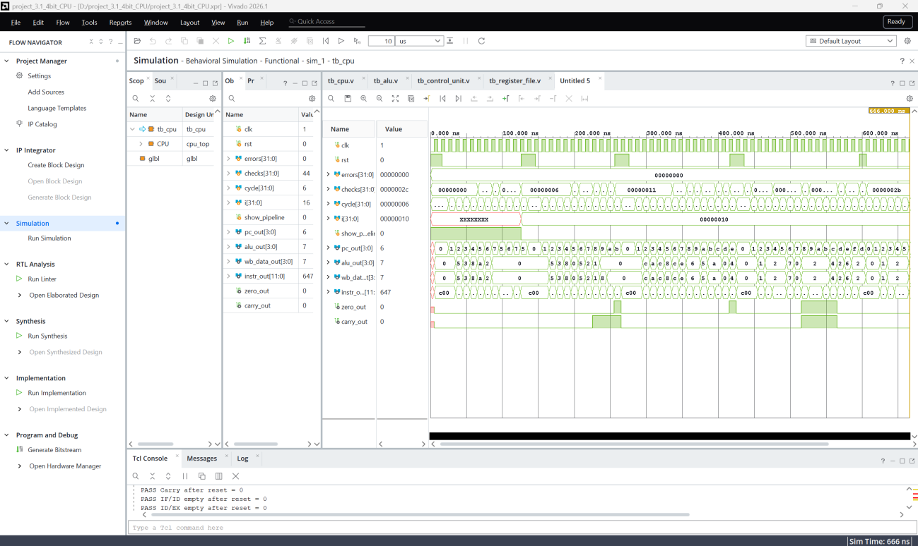
F2 – Behavioral Simulation Waveforms
Fig. 2 – tb_alu
Fig. 3 – tb_control_unit
Fig. 4 – tb_register_file
Fig. 5 – tb_cpu (3-stage pipeline)
Notes:
F2 shows behavioral simulation waveforms for each testbench. The CPU waveform shows the PC incrementing, the flush pulse when a branch is detected, and register write-backs synchronized to the clock edges across the three pipeline stages. (~35 sec)

Slide 11
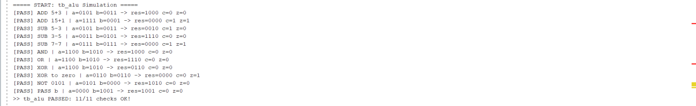
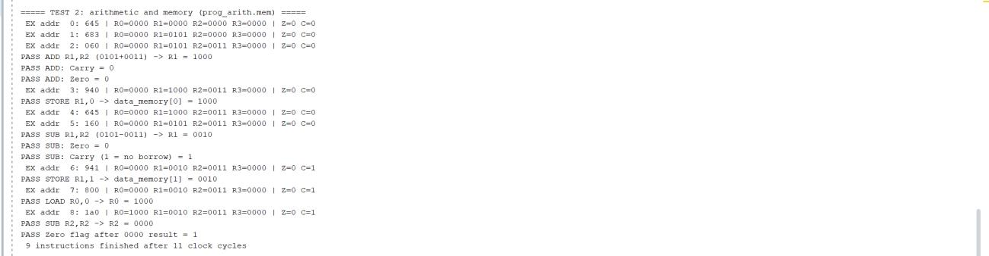
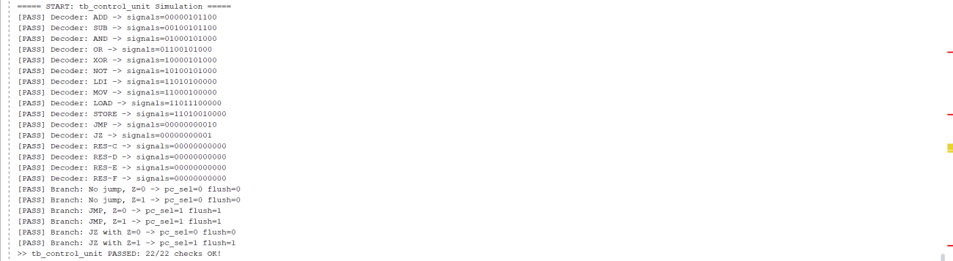
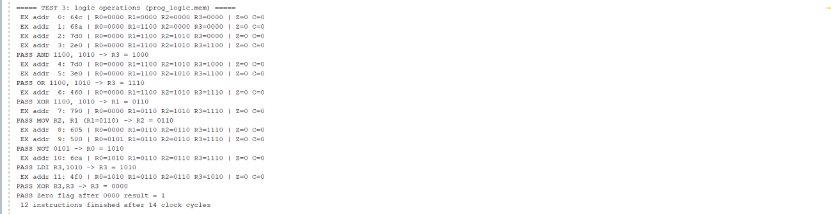
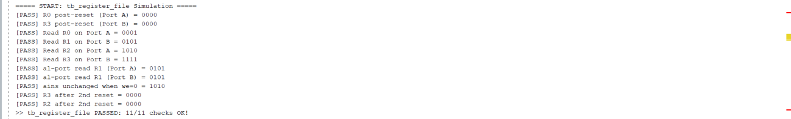
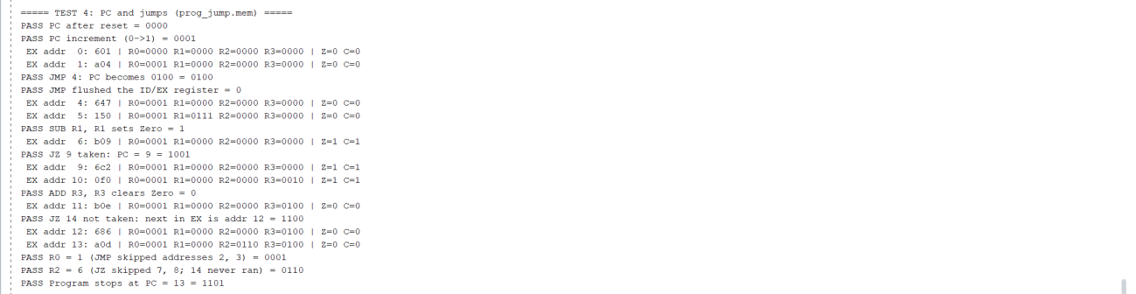
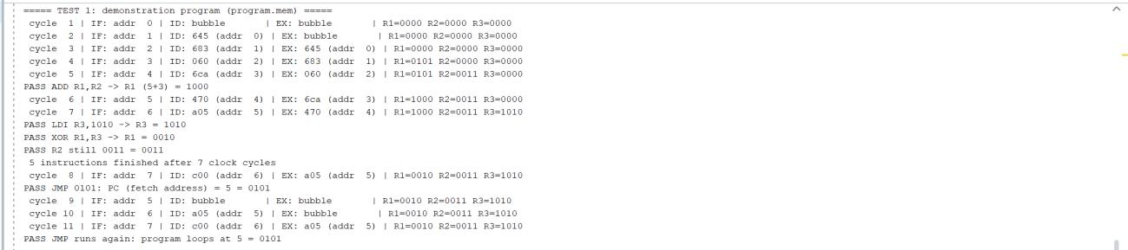
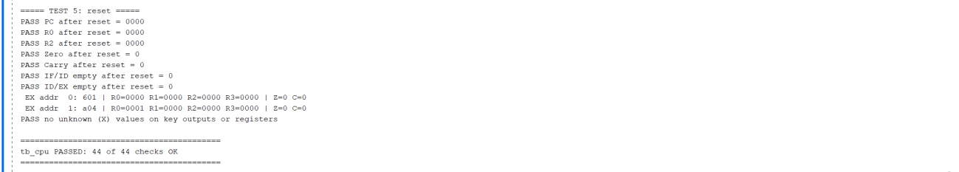
F3 – Tcl Console: Automated PASS Results
Fig. 6 – tb_alu
Fig. 10 – tb_cpu Test 2
Fig. 7 – tb_control_unit
Fig. 11 – tb_cpu Test 3
Fig. 8 – tb_register_file
Fig. 12 – tb_cpu Test 4
Fig. 9 – tb_cpu Test 1
Fig. 13 – tb_cpu Test 5 / result
Notes:
F3 shows the Tcl console logs. Every check prints PASS, and each testbench ends with a PASSED summary: ALU 11 of 11, register file 11 of 11, control unit 22 of 22, and CPU 44 of 44. In total 88 of 88 checks passed. The CPU logs also show cycle-by-cycle pipeline traces for tests 1 to 5. (~40 sec)

Slide 12
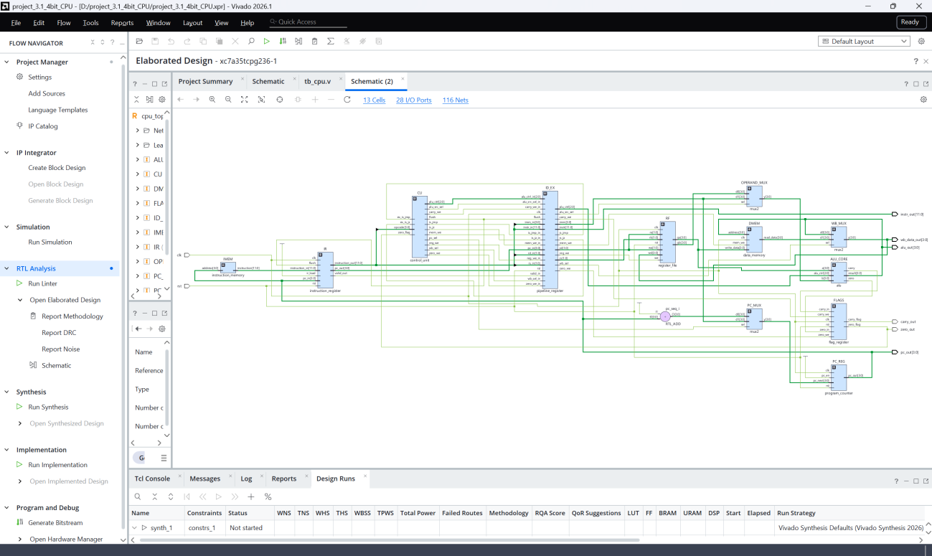
F4 – Elaborated Schematic (RTL Analysis)
RTL Analysis
13 cells
28 I/O ports
116 nets
Clean inter-stage boundary registers isolate IF, ID and EX zones.
Zero unintended latch generation.
Figure 14: Elaborated Schematic
Notes:
F4 is the elaborated schematic: 13 cells, 28 I/O ports and 116 nets. It shows clean inter-stage boundary registers isolating IF, ID and EX, and no unintended latches. (~25 sec)

Slide 13
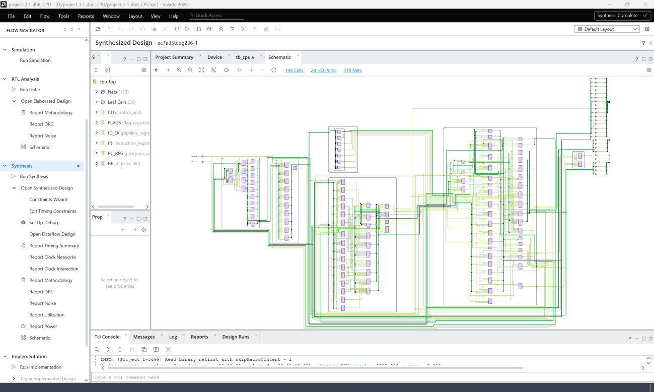
F5 – Synthesized Schematic
Technology Mapping
144 cells
28 I/O ports
319 nets
Mapped to:
LUT6 · MUXF7
FDRE flip-flops
IBUF / OBUF pads
Figure 15: Synthesized Schematic
Notes:
F5 is the post-synthesis schematic. RTL primitives are mapped to FPGA fabric cells: LUT6, MUXF7, FDRE flip-flops and IBUF/OBUF pads, balancing area and logic propagation delay. It has 144 cells and 319 nets. (~25 sec)

Slide 14
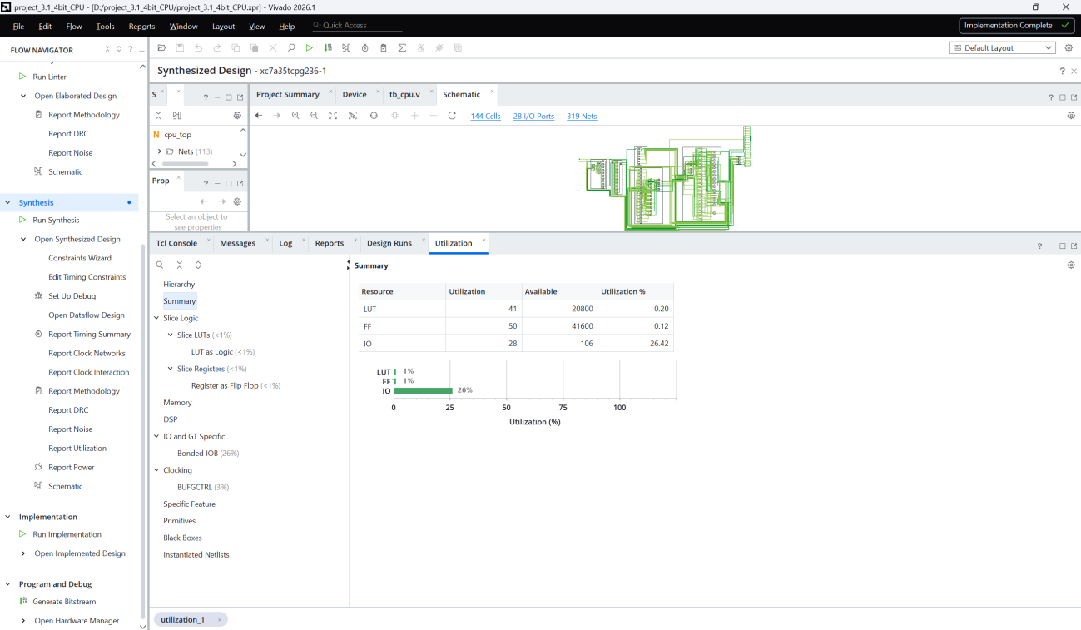
F6 – Utilization Report
Resource | Used | Util.
LUT | 41 / 20,800 | 0.20%
FF | 50 / 41,600 | 0.12%
IO | 28 / 106 | 26.42%
Area is minimized via logic reuse in the shared adder_subtractor core and simple combinational decoders.
Figure 16: Utilization Report
Notes:
F6 is the utilization report on the Artix-7: 41 LUTs, 50 flip-flops and 28 I/O pins. That is 0.20 percent of LUTs, 0.12 percent of flip-flops and 26 percent of I/O. The footprint is small thanks to the shared adder-subtractor and simple combinational decoder. (~30 sec)

Slide 15
Part E – Design Flow in Vivado 2026.1
1
Project Init & Device
2
Source Separation
3
Behavioral Simulation
Create RTL project, Verilog-2005, target Artix-7 xc7a35tcpg236-1
11 design modules vs. 4 testbenches + 4 .mem files
XSim on 4 testbenches → 88 / 88 checks
4
RTL Analysis
5
Logic Synthesis
6
Utilization & Timing
Elaborated schematic: bus connectivity, no inferred latches
RTL → LUTs and D flip-flops
LUT, FF, I/O consumption and timing audit
Notes:
The design followed six steps. One: create the RTL project and select the Artix-7 device. Two: separate design sources, which are 11 synthesizable modules, from simulation sources, which are 4 testbenches and 4 memory files. Three: run behavioral simulation to catch logic, decode and hazard bugs early. Four: inspect the elaborated design to confirm bus connectivity and no latches. Five: run synthesis to map logic to LUTs and flip-flops. Six: review utilization and timing reports. (~60 sec)

Slide 16
Conclusion
Designed a 4-bit RISC CPU with a 3-stage IF–ID–EX pipeline in Verilog HDL
12-bit fixed ISA, Harvard memory, CPI = 1 once the pipeline is primed
2-bubble flush mechanism resolves JMP / JZ control hazards
100% pass rate: 88 / 88 checks (44 module-level + 44 system-level)
Ultra-compact footprint on Artix-7: 41 LUTs, 50 FFs, 28 I/O
Thank you! Questions?
Notes:
In conclusion, the project successfully delivered a verified 4-bit pipelined RISC CPU with hazard handling, achieving 88 out of 88 passing checks and a very small FPGA footprint. Thank you for listening, and I am happy to answer questions. (~25 sec)

