Slide 1
LR-DIMM : Stuff I was able to dig out
-Nil

Slide 2
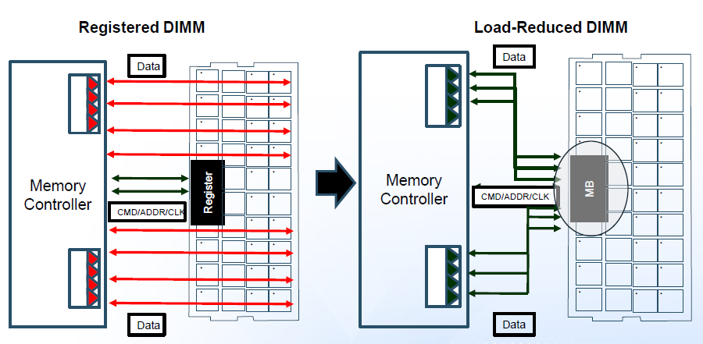
R-DIMM vs LR-DIMM

Slide 3
iMB : intelligent Memory Buffer
The iMB
buffers and re-drives all the C/A signals.
Re-drives the clock through a PLL
Fully-buffered DQ lines as well.

Slide 4
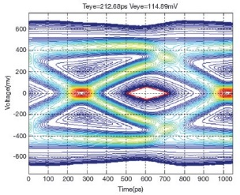
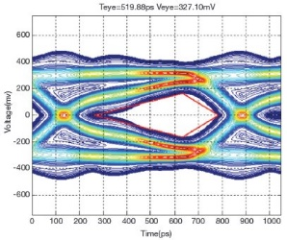
Eye Diagrams
2 quad-ranked DIMMs at 1333MT/s i.e. 667 MHz.
R-DIMM
LR-DIMM
Max data eye width : 212ps
Max data eye height: 115mv
1 quad-ranked DPC at 1066 MT/s
2 quad-ranked DPCs at 800 MT/s
Max data eye width : 520ps
Max data eye height: 327mv
3 quad-ranked DPCs at 1333MT/s

Slide 5
R-DIMM vs LR-DIMM in servers
 | 32 GB Quad-rank R-DIMM HP Proliant G7 | 32 GB Quad-rank LR-DIMM HP Proliant G8
Max DIMMs per channel (DPC) | 2 | 3
Max Capacity per channel | 64 GB | 96 GB
Max BW per channel | 6.4 GB/s (800 MT/s) | 8.5 GB/s (1066 MT/s)
Idle Latency | 80ns | 74ns
Max Power | 6W | 9W

Slide 6
LR-DIMM
Higher Capacity for high-speed channels
Possible due to 2 features of the iMB
Buffering of DQ lines in addition to the C/A lines
Each channel now sees one electrical load per LR-DIMM even though there are 4 ranks on it – so more ranks on the system.
Rank-multiplication
This allows connecting more ranks than what the DDR3 spec allows for a channel – i.e. getting more out of the Chip-Select pins.

Slide 7
Rank-Multiplication
Currently - only enough chip-selects to allow 8 ranks per channel.
But LR-DIMM allows 3 quad-ranked DPC – so 12 ranks
The memory controller sees 2 ranks on the DIMM – but internally the iMB uses the CS and parts of the row-address for an ACT to generate the back-end chip selects.
CS0 CS1

Slide 8
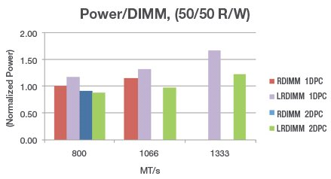
iMB Power
Normalized to 32GB RDIMM power at 800 MT/s
1DPC LRDIMM dissipates 17% and 15% more than RDIMM at 800 and 1066 MT/s
2DPC LRDIMM dissipates 3% lower than R-DIMM at 800 MT/s and 28% lower than 1DPC at 1333 MT/s

Slide 9
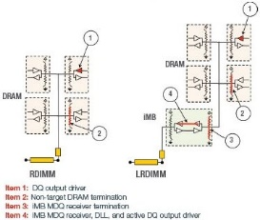
1 DPC power
RDIMM Power = DQ o/p driver power + Termination
LRDIMM Power = DQ o/p driver power + Termination + iMB receiver termination power + iMB receiver, DLL, DQ o/p driver power

Slide 10
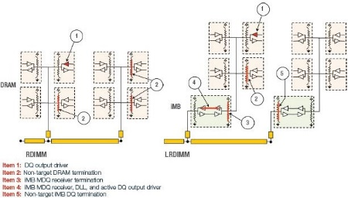
2 DPC Power
RDIMM : Termination power for all additional ranks on the 2nd DIMM
LR-DIMM : Termination power only for the iMB on the 2nd DIMM
Moreover the shorter trace-lengths on the LR-DIMM and the reduced number of electrical loads allows more power-efficient settings for the ODT resistance values which lowers the basic P_{odt} number in LR-DIMM.

Slide 11
Other iMB features
Parity Checking on the C/A bus
Smbus interface : to program the iMB regs
Temperature Sensor (with a programmable temperature at which to generate an interrupt)

