Slide 1
STT-RAM as a sub for SRAM and DRAM
Penn State
DAC’12, ISPASS’13

Slide 2
Cache-Revive: Architecting Volatile STT-RAM Caches for Enhanced Performance in CMPs
Penn State
DAC’12

Slide 3
Key Idea
Main impediment to implementing a STT-RAM based on-chip cache
Bad write characteristics (slow and energy-hungry)
A cache only needs to retain data for as long as the “refresh time” – i.e., till it gets written again.
Few ms for LLC and few µs for L1
Relaxed retention time for STT-RAM implies faster and low-energy writes
Tune the retention time to match the refresh time

Slide 4
SRAM vs STT-RAM
 | Area (mm²) | Read Energy (nJ) | Write Energy (nJ) | Leakage Power at (mW) | Read Latency (ns) | Write latency (ns) | Read @ 2 GHz (cycles) | Write @2 GHz (cycles)
1 MB SRAM | 2.61 | 0.578 | 0.578 | 4542 | 1.012 | 1.012 | 2 | 2
4MB STT-RAM | 3.00 | 1.035 | 1.066 | 2524 | 0.998 | 10.61 | 2 | 22
~3-4x denser (capacity benefit)
1.8x lower leakage energy
Comparable read
latency
~11x higher write latency
(@ 2GHZ)
4

Slide 5
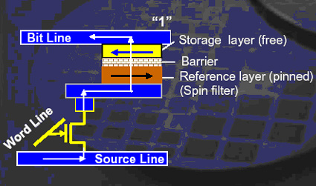
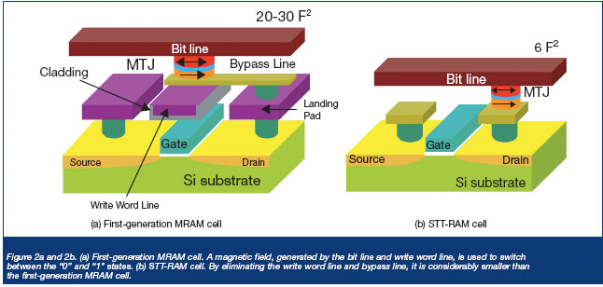
What is STT-RAM ?

Slide 6
How to reduce retention time
The retention time of a MTJ reduces exponentially with reduction in the thermal barrier.
The write current of a MTJ reduces with reduction in the thermal barrier.
Thermal barrier of the MTJ can be lowered by reducing the MTJ planar area and the thickness.
Baseline 2F² planar cell – not much scope to reduce area
Reduce thickness to lower thermal barrier (min. to 2nm)

Slide 7
Write Latency vs Retention time
Retention Time
Operating Point
Write current goes down with reduction in retention time
Retention Time of STT-RAM | Write Latency @ 2 GHz
10 Years | 22 cycles
1 second | 12 cycles
10 millisecond | 6 cycles

Slide 8
Inter-write time in L2
PARSEC
SPEC CPU 2k6
Majority of L2 blocks (> 50%) get refreshed within 10ms

Slide 9
Architecting a volatile STT-RAM
Write-back all unrefreshed dirty data
A n-bit counter associated with each block
2^{n} states , counter incremented after time T (where T = 10ms/ 2^{n} )
If block is written or invalidated before (10 – T)ms, then block goes back to S₀
When block is in state S_{n-1} , block will expire in time T, so WB
With a 2 bit counter leftover time is 2.5ms
Larger counter allows finer granularity for T and allows a block to stay in the L2 longer
Performance overhead
Large WB traffic
Expired block could be critical and show up multiple times on the critical path

Slide 10
Revived STT-RAM
Refresh only blocks that are in the MRU positions
Maintain a temporary buffer for refreshing these blocks
IMP Blocks
NON- IMP Blocks
WAY ID
0 | 1 | 2 | 3 | 4 | 5 | 6 | 7 | 8 | 9 | 10 | 11 | 12 | 13 | 14 | 15
Block
State
Is Buffer Full?
YES
Dirty?
NO
YES
COPY
Write-back to DRAM

Slide 11
Performance
PARSEC Benchmarks
S-4MB – upper bound
M-4MB : 10 yrs retention - benefits from higher capacity, loses when benchmark is write intensive
Volatile M-4MB : 1 sec – no refreshing. Gains from lower write latency
Volatile M-4MB : 10ms – no refreshing. Suffers from excessive WB
Volatile M-4MB : 10ms – with refresh (revive) : bridges the gap with ideal

Slide 12
Energy
Going from S-1MB to M-4MB gives a total of 44% improvement in energy.
Drastic reduction in leakage
Same in 1sec volatile
Volatile 10ms has more WBs compared to volatile 1sec
With refresh, back and forth writes to buffer – but dynamic energy is not dominant
Overall 18% improvement over baseline STT-RAM

Slide 13
Evaluating STT-RAM as an Energy-Efficient Main Memory Alternative
Penn State
ISPASS’13

Slide 14
DRAM vs STT-RAM
Read latency and energy comparable to DRAM
Write latencies are 1.25X-2X higher
Write energy is 5-10X higher
Solve all these and throw away DRAM !
Decoupled sensing and buffering
Key ideas
Partial Writes
Writes bypass the row buffer

Slide 15
STT-RAM cell and peripherals
To sense, apply small voltage difference between bit-line and sense-line and see current.
Different sense-amps and write-amps because of different in read and write currents
Dissociated row-buffer and sense-amps, no restoring

Slide 16
Dumb STT-RAM

Slide 17
Optimized STT-RAM: Selective & Partial Writes
Selective & Partial Writes
Dirty bit with row-buffer says whether or not to write the row back
Partial writes just write the 64B dirty block needs to be written vs the whole row

Slide 18
Optimized STT-RAM: Write Bypass
Write Bypass – write directly to array not the RB
Reduce write interference on read hit-rate
Write driver feeds into write amplifier
Might not work out for benchmarks with high write hit-rate
Each write-hit now converted into a slow array write and might show up on the critical path.

Slide 19
Results : Energy Selective Writes
Unoptimized STT-RAM = 1.96X DRAM
Selective Writes = 1.08X DRAM

Slide 20
Results : Energy Partial Writes
Selective + Partial Writes = 0.59X DRAM
Large reduction in WB energy

Slide 21
Results: Write Bypass + Partial Writes
17% on top of Partial and Selective Writes
Final optimized STT-RAM energy = 0.42X DRAM

Slide 22
Results: Write Bypass Performance
Performance improves by 1%
Surprising unless writes that are happening to the same row can now be done in parallel or with some overlap

Slide 23
Results: Multiprogrammed

Slide 24
Results: Multiprogrammed Energy
Energy = 0.37X of DRAM
Savings not any more significant than the single core cases
Not targeting the ACT+PRE part with their optimizations really (except for the write bypass scheme)

Slide 25
Results: Multiprogrammed Performance
Longer write times finally leads to 6% performance degradation

Slide 26
Good. So how does this stack up against PCM ?
A PCM system with similar optimizations (investigated first by Benjamin Lee, Engin Ipek and Onur Mutlu in ISCA’09)
6-18% energy savings over DRAM because PCM read and write are both higher energy operations
and because there is a performance degradation of 17%
Of course if PCM is denser than DRAM, the page faults saved will help in making these numbers look better
As Manu and David said (as has Al many times)
PCM not gonna float
STT-RAM looks better

