Slide 1


AGILE DEVELOPMENT

Slide 2

Explaining agile Roles
Product Owner
Maximizes value of the product and work of the Development Team.
Scrum Master
Provides guidance in Agile principals
Is the servant-leader to the Product Owner.
Facilitates Scrum events.
Development Team
Consisting of Developers and Testers
Self-organized
Cross-functional

Slide 3
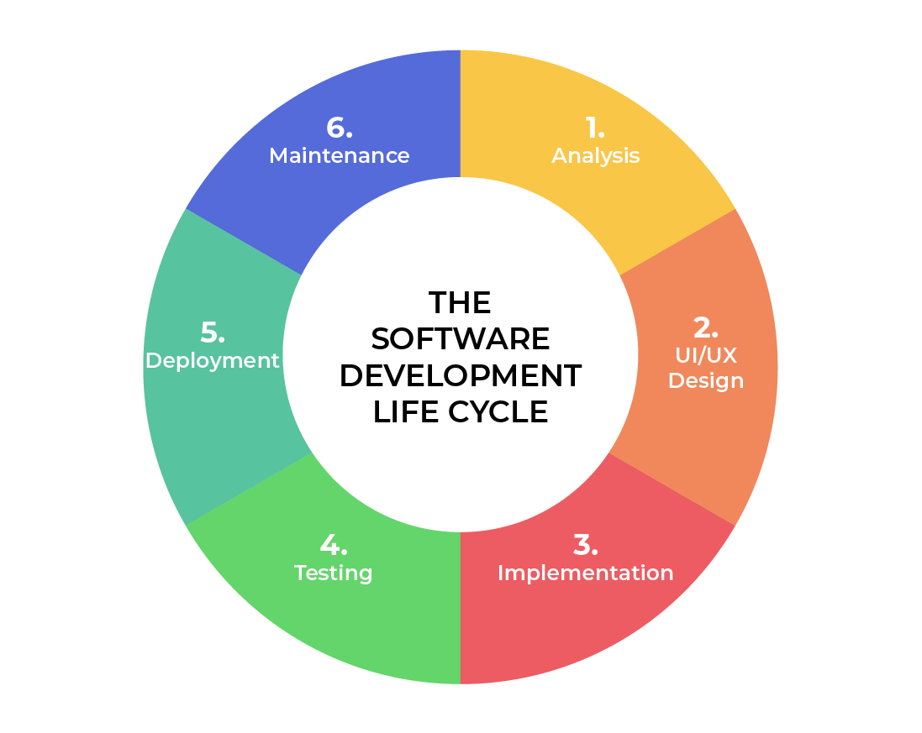
SOFTWARE DEVELOPMENT LIFECYCLE
Analysis
Collaborate with stakeholders.
Gather Requirements.
Design
Define detailed process for functionality.
Define technologies, limitations, time frames and budget.
Implementation
Development begins.
Functionality is broken up into smaller increments.
Testing
Occurs In conjunction with Development.
Process for identifying and mitigating reported defects and issue tracking.
Deployment
Testing complete and product is released to market.
Maintenance
Product in production environment.
Developers must be ready to implement NEW features and bug fixes as they come up.
Notes:
Analysis – The fundamental component of the software development lifecycle is this. In this area, leadership works with a variety of stakeholders to gather the project's requirements. retention.
Design – In this stage, the usefulness is characterized exhaustively. Also discussed are the technologies used, project resources, limitations, deadlines, and budgets.
Development – The development begins during this phase. The project determines the programming language used. Because each functionality is broken down into smaller increments to allow for value-based code development, this phase of the SDLC is the longest.
Testing – Testing is also a common activity alongside development. All phases are involved, but it is only used to track defects and issues using the existing code base..
Deployment – Testing is finished at this point, and the product is ready to go on the market. Before going on sale, UAT (User Acceptance Testing) can be done in a limited setting..
Maintenance – The product has entered the market at this point. Any new features or bug fixes that users request and encounter in production must be addressed by developers.

Slide 4
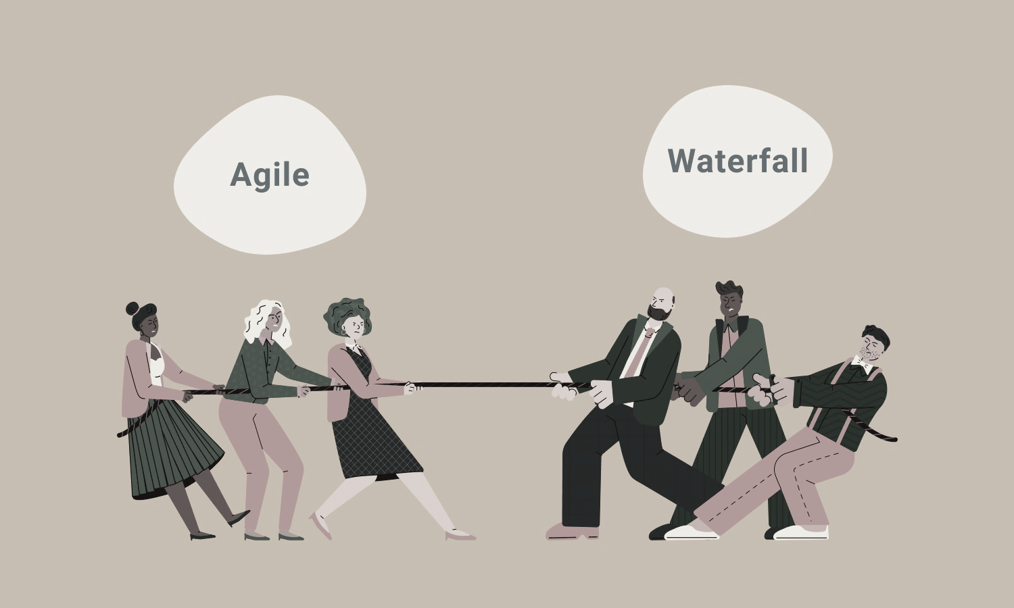
vs
No need to define all requirements.
Major requirements can be defined but functionality can evolve over time.
No time to market constraint
All requirements must be defined.
Contract Negotiation.
Sequential/Linear stages.
Best for simple, unchanging projects
Notes:
A waterfall approach would have made it difficult to complete the SNHU Travel project. Any modifications would have harmed the project given the level of uncertainty. Even though agile involves a high level of uncertainty, any issues discovered would necessitate a costly change order to the agreement.

