Slide 1


SAIR

Slide 2

Abstract
“Sair” tours arranges your vacation out of station.
get your flights tickets, hotels booked, best destinations options at various prices.

Slide 3
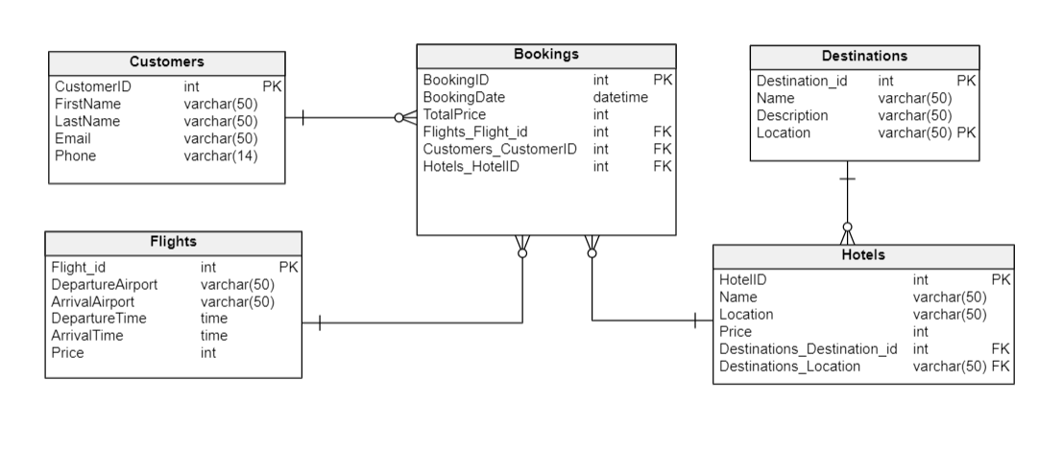
ER Diagram

Slide 4
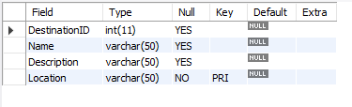
Structure of the Table
Destinations Table
This table shows the name of the destination, its location AND DESCRIPTION.
SYNTAX : desc Destinations;

Slide 5
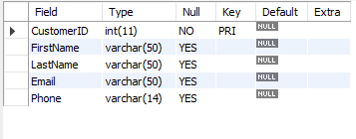
Structure of the Table
CUSTOMERS Table
THIS TABLE CONTAINS INFORMATION ABOUT CUSTOMERS LIKE THEIR NAME,CONTACT ETC.
SYNTAX : DESC CUSTOMERS;

Slide 6
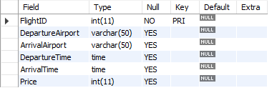
Structure of the Table
Flights Table
This table shows the arrival and deprature time and price of flights.
Syntax : desc flights;

Slide 7
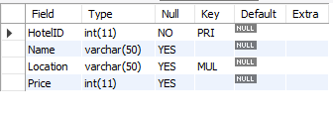
Structure of the Table
Hotels Table
This table gives information about the hotel name and location.
Syntax : desc hotels;

Slide 8
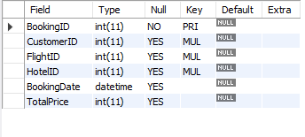
Structure of the Table
Bookings Table
This table shows the flight bookings and prices.
Syntax : desc bookings;

Slide 9
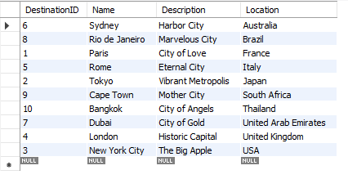
Content of the Table
Destination Table
Syntax : select * from Destinations;

Slide 10
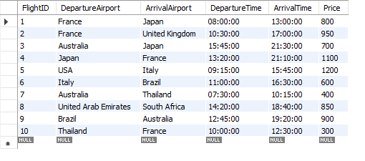
Content of the Table
Flights Table
Syntax : select * from Flights;

Slide 11
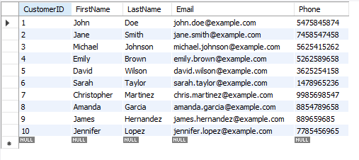
Content of the Table
Customers Table
Syntax : select * from Customers;

Slide 12
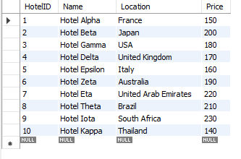
Content of the Table
Hotels Table
Syntax : select * from Hotels;

Slide 13
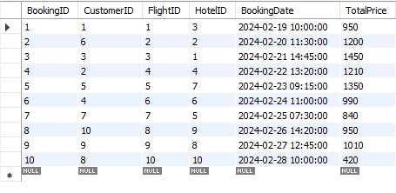
Content of the Table
Bookings Table
Syntax : select * from Bookings;

Slide 14

SUBQUERIES

Slide 15

SUBQUERY
Display the name of Customers who Booked Hotel in Japan:
SELECT *
FROM Customers
WHERE CustomerID IN (
SELECT DISTINCT CustomerID
FROM Bookings
WHERE HotelID IN (
SELECT HotelID
FROM Hotels
WHERE Location = (SELECT Location FROM Destinations WHERE Name = 'Tokyo')
)
);

Slide 16

SUBQUERY
Subquery to Get Customers who Booked the Most Expensive Hotel:
SELECT *
FROM Customers
WHERE CustomerID IN (
SELECT CustomerID
FROM Bookings
WHERE HotelID = (
SELECT HotelID
FROM Hotels
ORDER BY Price DESC
LIMIT 1
)
);

Slide 17

SUBQUERY
Subquery to Get Customers who Booked Flights departing from France:
SELECT *
FROM Customers
WHERE CustomerID IN (
SELECT CustomerID
FROM Bookings
WHERE FlightID IN (
SELECT FlightID
FROM Flights
WHERE DepartureAirport IN (
SELECT Location
FROM Destinations
WHERE Location = 'France'
)
)
);

Slide 18
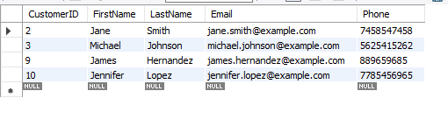
SUBQUERY
Subquery to Get Customers who Booked Flights with Departure Times After 12:00 PM:
SELECT *
FROM Customers
WHERE CustomerID IN (
SELECT CustomerID
FROM Bookings
WHERE FlightID IN (
SELECT FlightID
FROM Flights
WHERE DepartureTime > '12:00:00'
)
);

Slide 19
JOINS

Slide 20
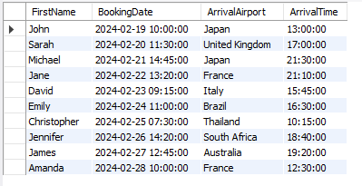
JOINS
Display the bookings made by customers, including when and where they flew.
SELECT Customers.FirstName, Bookings.BookingDate, Flights.ArrivalAirport, Flights.ArrivalTime
FROM Customers
INNER JOIN Bookings ON Customers.CustomerID = Bookings.CustomerID
INNER JOIN Flights ON Bookings.FlightID = Flights.FlightID;

Slide 21
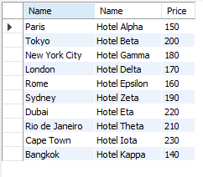
JOINS
Display the prices of the hotels at different locations.
SELECT Destinations.Name,Hotels.Name,Hotels.Price FROM Destinations RIGHT JOIN Hotels ON Destinations.Location = Hotels.Location;

Slide 22
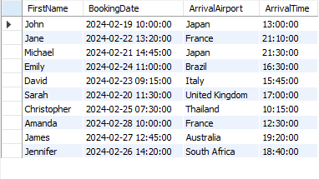
JOINS
Display full trip of customer from booking date to arrival time and location.
SELECT Customers.FirstName, Bookings.BookingDate, Flights.ArrivalAirport, Flights.ArrivalTime
FROM Customers
LEFT JOIN Bookings ON Customers.CustomerID = Bookings.CustomerID
LEFT JOIN Flights ON Bookings.FlightID = Flights.FlightID;

Slide 23
PREPARED BY -
GAURI UTEKAR
IT VEDANT
NOV23-T313/DS/PS/11-1PM

Slide 24
THANK YOU

