Slide 1





From Monolith to Microservices
Manufacturing system · event choreography, security and a shared chassis
Clients
Orders
Payments
Machine
Deliveries
Notes:
In the next ten minutes I'll cover the general architecture and how many elements it has, the endpoints of each service, the exchange, queues and topics, the security measures, what lives in the microservice chassis, our conclusions, and future work. The key idea: the services no longer call each other; they publish facts and react to them.

Slide 2
Architecture: 9 containers, no internal calls
API Gateway · HAProxy :8080 / :8443
5 microservices
9 containers
Clients
client.db
Payments
payment.db
Orders
orders.db
Machine
machine.db
Deliveries
delivery.db
5+1 SQLite + MongoDB
RabbitMQ · topic exchange manufacturing.events
5 predefined durable queues · 13 fact types
13 fact types
37 HTTP endpoints
Shared library: microservice_chassis 0.5.0 in every service and the event logger
Event logger → MongoDB (audit)
Notes:
Nine containers: the HAProxy gateway, RabbitMQ, five FastAPI microservices, an event logger and MongoDB. External requests enter through the gateway, on 8080 or 8443 for HTTPS. Each microservice owns its own SQLite database, now including the machine. Internally, there are no HTTP calls at all: services only publish facts to one topic exchange and react to the facts they subscribe to. The event logger stores every business fact in MongoDB for auditing. All of them share our chassis library.

Slide 3
Endpoints: Clients, Payments and Machine
Clients :13005 · /api/clients, /api/auth
Payments :13006 · /api/payments
Method | Path | Purpose | Auth
POST | /auth/register | Register a user (role user) | —
POST | /auth/token | Log in; access + refresh token | Basic
GET | /auth/token | Same login (compatibility) | Basic
POST | /auth/refresh | Rotate the token pair | —
POST | /auth/logout | Revoke the refresh session | —
POST | /auth/service-token | Token for a service account | Basic
GET | /auth/public-key | Public key (PEM) | —
POST | /clients | Create a client (own email) | JWT
GET | /clients | List clients (own or all) | JWT
GET | /clients/{id} | Get a client | JWT
Method | Path | Purpose | Auth
POST | /payment/{client_id}/deposit | Add balance | JWT
POST | /payment/{client_id}/charge | Charge an order | JWT
GET | /payment/{client_id}/balance | Check balance | JWT
GET | / | Service check | —
GET | /health | Health (chassis) | —
Machine :13002 · /api/machine
Method | Path | Purpose | Auth
GET | /machine/status | Status and queue | JWT
POST | /machine/queue | Enqueue by hand | JWT
DELETE | /machine/queue/{piece_id} | Remove a piece | JWT
Notes:
Clients is the authentication service. Users register, log in with HTTP Basic and get an access token plus a refresh token; refresh rotates the pair and logout revokes it. There's also a service-token endpoint for service accounts, and the public key. The client endpoints themselves now need a JWT, and a normal user can only create and see their own client. Payments has deposit, charge and balance, all with JWT. All machine endpoints are protected too; in the normal flow the machine gets its work from events.

Slide 4
Endpoints: Orders and Deliveries
Orders :13001 · /api/orders, /api/pieces
Deliveries :13004 · prefix /deliveries
Method | Path | Purpose | Auth
POST | /order | Create an order (202) | JWT
GET | /order | List orders | JWT
GET | /order/{id} | Get an order | —
GET | /order/{id}/pieces | Pieces of an order | —
POST | /order/{id}/retry | Re-record pending facts | —
PATCH | /order/{id}/status | Mark Finished or Delivered | —
PATCH | /order/{id}/payment | Payment result (legacy) | —
DELETE | /order/{id} | Delete; 409 for workflow orders | —
GET | /piece | List pieces | —
GET | /piece/{id} | Get a piece | —
GET | /piece/by-status/{status} | Pieces by status (legacy) | —
PATCH | /piece/{id} | Piece status (legacy) | —
GET | /health | Health (chassis) | —
Method | Path | Purpose | Auth
POST | /delivery | Create a delivery | JWT
GET | /delivery | List deliveries | JWT
GET | /delivery/{id} | Get a delivery | JWT
PATCH | /delivery/{id}/status | Sent or Delivered | JWT
DELETE | /delivery/{id} | Delete a delivery | JWT
GET | / | Service check | —
Legacy endpoints
PATCH /piece/{id}, PATCH /order/{id}/payment and /piece/by-status are kept for compatibility; that information now arrives as RabbitMQ facts.
Notes:
Orders is the largest API. Creating and listing orders need a token; the rest let you follow an order and its pieces. Three endpoints are legacy: piece and payment updates and the query by status used to be called by other services, but that information now arrives as facts, so they are only kept for compatibility. All delivery operations now require a token; you use the status update to mark a delivery Sent or Delivered.

Slide 5
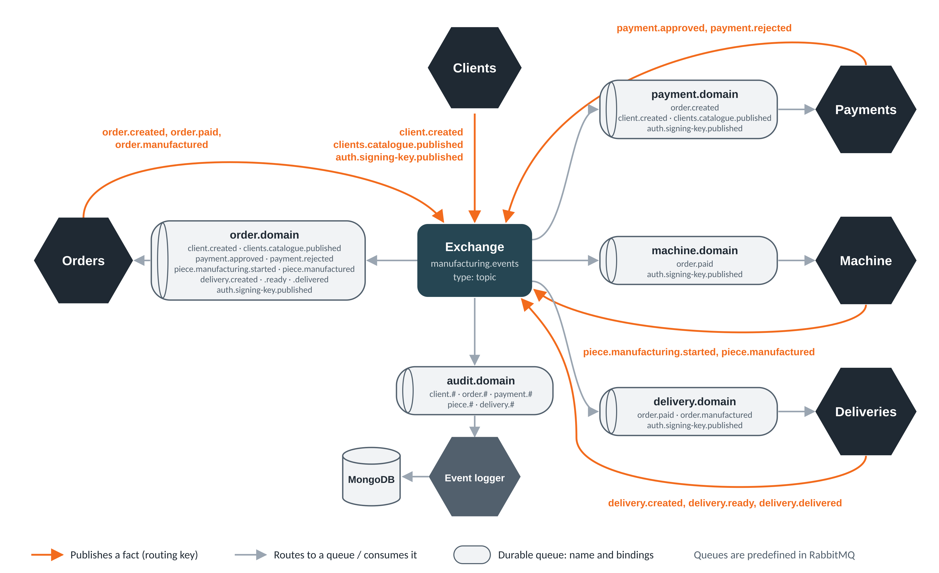
Choreography on one topic exchange
Notes:
This is how the services talk. There is one topic exchange in the middle. Each service publishes facts about its own state, in orange, and each one has a durable queue bound to the facts it cares about, in gray. Orders publishes order created, paid and manufactured; payments answers approved or rejected; the machine reports each piece; deliveries reports created, ready and delivered; and clients publishes new clients, a catalogue snapshot and its public key. A fifth queue, audit, receives every business fact for the event logger, which stores them in MongoDB.

Slide 6
Exchange, queues and topics
Fact (routing key) | Publisher | Subscribed queues
client.created | Clients | order.domain, payment.domain, audit
clients.catalogue.published | Clients | order.domain, payment.domain
auth.signing-key.published | Clients | order, payment, machine, delivery
order.created | Orders | payment.domain, audit
payment.approved / rejected | Payments | order.domain, audit
order.paid | Orders | machine.domain, delivery.domain, audit
piece.manufacturing.started | Machine | order.domain, audit
piece.manufactured | Machine | order.domain, audit
order.manufactured | Orders | delivery.domain, audit
delivery.created / ready / delivered | Deliveries | order.domain, audit
1 exchange
manufacturing.events
topic, durable
5 durable queues
order, payment, machine, delivery and audit .domain; imported into RabbitMQ at boot
Every fact
{event_id, event_type, producer, data}
Persistent, validated with strict Pydantic contracts, deduplicated by event_id
Audit binds client.#, order.#, payment.#, piece.# and delivery.#: 13 fact types in total
Notes:
Here is the complete list. One durable topic exchange, five durable queues that RabbitMQ creates at startup from a definitions file, and thirteen fact types. Publishers only know the exchange; they never create other services' queues, so adding a new subscriber doesn't touch the publishers. Every fact travels in the same envelope with a unique event id, is validated against a strict contract, and is processed only once thanks to the inbox. The audit queue uses wildcards to catch every business fact.

Slide 7






Security measures
JWT on every API
Refresh sessions
Authorization
RS256 checked by the chassis in all five services: issuer, audience, exp, iat and sub; 401 if missing or invalid
Opaque tokens stored as SHA-256 hashes; single use and rotated; reuse revokes the session; 7-day limit; logout
Roles admin and user; a user only creates, reads, orders and pays for their own client (403 otherwise)
Passwords and keys
Edge and transport
Infrastructure and messages
bcrypt hashes; public sign-up only as user; the signing key is published as a fact and stored by each service
HTTPS on :8443 at HAProxy; only whitelisted /api routes, the rest 404; stats behind a password
RabbitMQ only on 127.0.0.1, MongoDB not exposed; strict contracts reject invalid facts
Development level: payments and deliveries run as root, service ports stay open and the TLS key is in the repo
Notes:
Every API now verifies the JWT through the chassis: signature, issuer, audience and the required claims. Sessions use refresh tokens that are stored only as hashes, can be used once, and if someone reuses one, the whole session is revoked; logout revokes it too. Authorization is per client: a normal user can only work with their own client. Passwords use bcrypt, and the public key is distributed as a fact, so services keep working even if the client service is down. At the edge, HTTPS and a route whitelist. RabbitMQ and MongoDB are not exposed. It's still development level, and I'll mention the gaps at the end.

Slide 8

Functionalities moved to the microservice chassis
Functionality | What it does | Used by
JWTVerifier | RS256 verification with cached key refresh | All five APIs
Key handling | Validates and stores the public key received as a fact | JWT consumers
EventBus | Outbox and inbox tables, atomic recording, confirmed publishing, retries | Five services
TopicTransport | Broker connection, exchange and own-queue bindings | Services, event logger
create_database | Engine and session factory per service database | All databases
Logging and /health | Common log format and health endpoint | Orders, payments, logger
6
consumers: the five services and the event logger
microservice_chassis 0.5.0
Shipped as a tested wheel in vendor/ and pinned with ==0.5.0
Imported as my_chassis
Stays in each service: models, event contracts, permissions, payment decisions and workflow rules. Refresh sessions stay in Clients.
Notes:
The chassis grew a lot. Version 0.5.0 is used by all five services and the event logger, installed from a tested wheel in the repository. It now contains the JWT verifier, the handling of the public key that arrives as a fact, and above all the EventBus: the outbox and inbox tables, recording facts in the same transaction as the business change, confirmed publishing, retries and deduplication. Each service's events file just binds the bus to its own database. Business rules, contracts and permissions stay in the services.

Slide 9



Conclusions
Choreography, not RPC
Consistent under failure
Services react to 13 fact types; no service calls another, so each keeps working while others are down.
Transactional outbox and inbox, broker confirms and durable queues: no lost facts, no double charges.
Secured end to end
Shared and auditable
JWT on every API, rotating refresh sessions, per-client authorization and an HTTPS gateway.
The chassis holds the plumbing for all services, and every business fact is archived in MongoDB.
Notes:
To conclude. We moved from an orchestrator to a choreography: services react to facts and never call each other, so one service being down doesn't block the rest. The transactional outbox and inbox, broker confirmations and durable queues keep everything consistent, without lost facts or double charges. Every API is protected with JWT and rotating refresh sessions. And the chassis keeps the plumbing in one place, while the audit gives us a full history of business facts.

Slide 10


Future work and improvements
Security
Chassis
Messaging
Operations
Close direct service ports
Move secrets and certificates out of the repository
Protect the remaining read routes
Publish tagged releases instead of a vendored wheel only
Share the consumer contracts as a package
Dead-letter queue for rejected facts
Publish catalogue and key snapshots only when they change
Clean up old outbox and inbox rows
Remove legacy endpoints and flags
Restore broader test coverage
Monitoring and tests in CI
Notes:
Finally, what we would improve. Security: payments and deliveries currently run as root as a quick fix for volume permissions, so we'd fix the paths and go back to non-root, close the direct ports and move secrets out of the repository. Chassis: the 0.5.0 source should be pushed to its own repository with its tests, and released with tags. Messaging: a dead-letter queue, publishing snapshots only when they change instead of every five seconds, and cleaning old outbox rows. And operationally: remove legacy endpoints, recover test coverage and add CI. Thank you, questions are welcome.

