Slide 1
College Football Bowl Predictor
Picking bowl winners with a confidence, from regular-season data
UE24CS352A ML Mini-Project · Problem 88 · Team G-29
Likith Kumar K M · Uthkarsha

Slide 2
Problem
Predict the winner of every bowl game, plus how confident we are (CS229 2015, project 101)
Bowl pick'em: rank your picks by confidence; a correct pick earns its rank as points
So we need two things: accurate winners and trustworthy confidence
Challenge: only ~35 bowl games a year, and the original data is no longer available

Slide 3
Dataset: rebuilt from play-by-play
Source: sportsdataverse/cfbfastR-data (public GitHub), seasons 2005-2020
~12.6k games, ~25k team-games, aggregated from ~2M plays
566 bowl/postseason games (552 usable) are our samples
36 features per team from the regular season only, so no leakage: scoring, yards/carry and /attempt, sack and INT rates, EPA, success and havoc rate, turnovers, penalties, punting, FG%, Elo
552
bowl games
36
features per team

Slide 4
Approach
Game = features(team 1) − features(team 2); target = score margin
Linear models have no intercept, so swapping teams exactly flips the prediction
8 models: OLS, Ridge, Lasso, logistic, random forest, gradient boosting, ensemble, and baselines (win %, Elo)
Leave-one-season-out CV over 16 seasons; regularisation tuned inside each training fold
Confidence = |predicted margin|, calibrated to a win probability on out-of-fold predictions

Slide 5
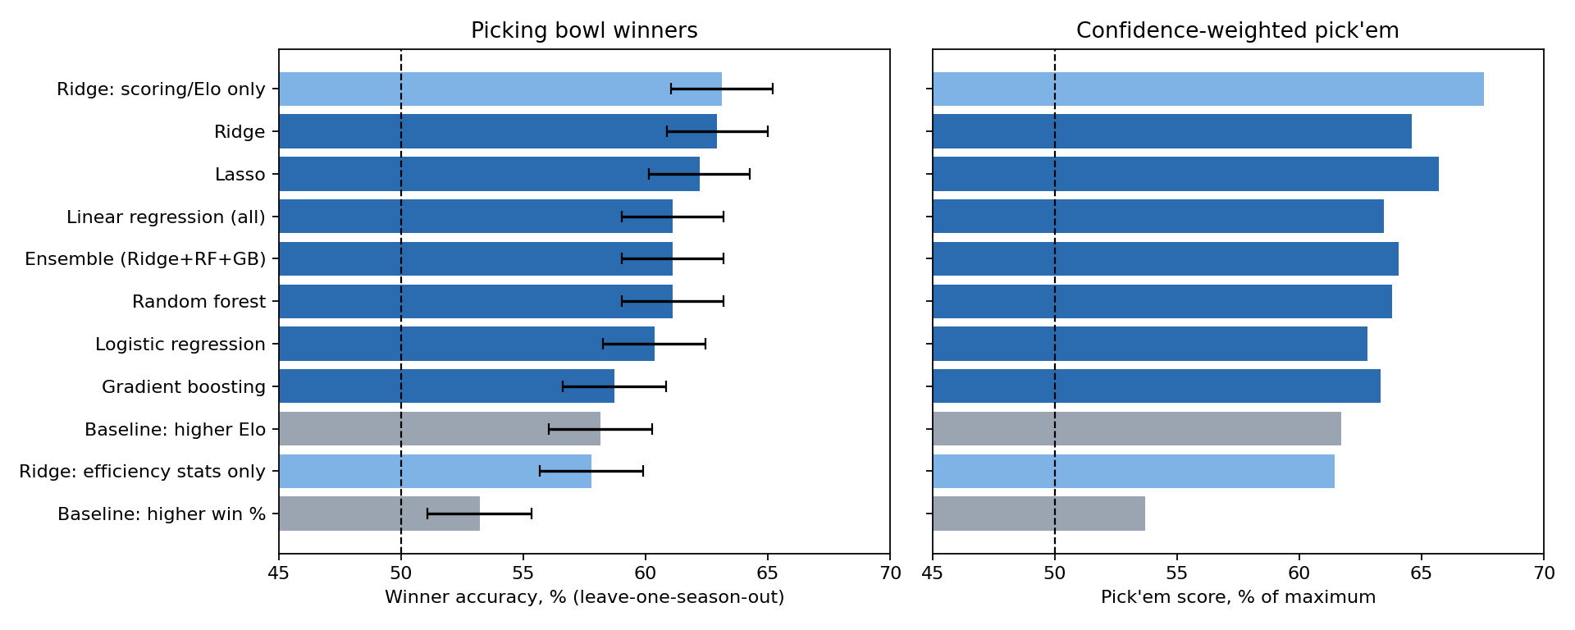
Results: Ridge beats the baselines
Ridge: 62.9% (SE 2.1)
Elo baseline: 58.2%
Win % baseline: 53.2%
Ridge vs Elo: sign test p = 0.029
Flexible models (RF 61.1%, boosting 58.7%) did not beat regularised linear ones with ~550 games.

Slide 6
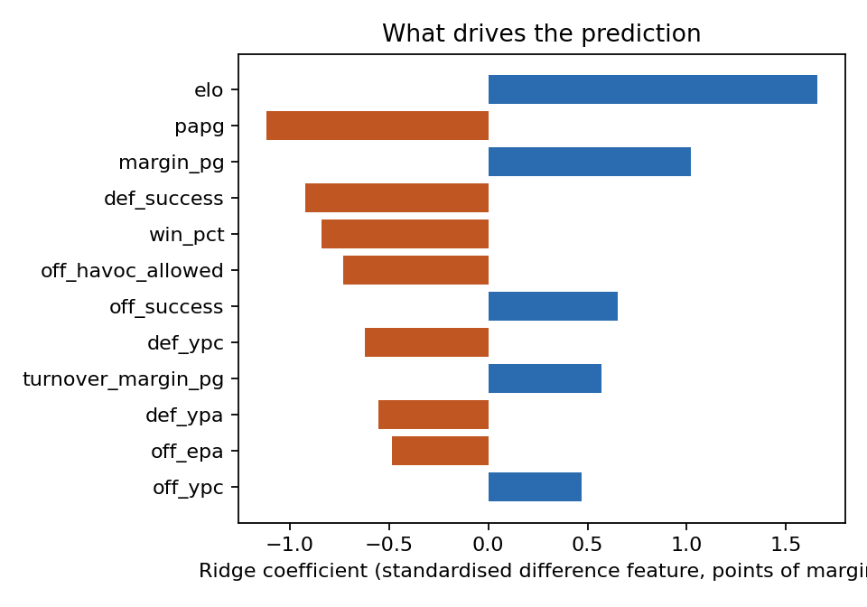
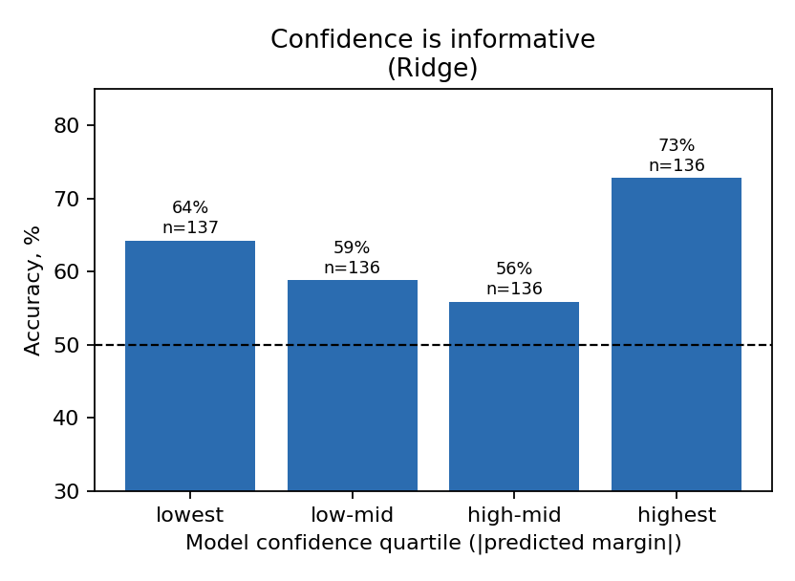
What carries the signal, and the confidence
Scoring + Elo features alone: 63.1%. Efficiency stats alone: 57.8%. Top-confidence quartile: 73%, but quartiles are not monotone (64/59/56/73), so probabilities are rough.

Slide 7
Live demo
streamlit run src/app.py
Matchup tab: any two teams from a season, with predicted winner, margin, probability and the features driving it
Pick'em tab: out-of-fold picks for a season with confidence ranks and score
CLI: python src/predict.py slate 2019

Slide 8
Conclusions and limits
~63% winner accuracy vs 58% Elo and 53% win %: a real but modest gain
Simple, regularised models win on small data
Confidence helps at the top end only
Limits: opt-outs, transfers and motivation are invisible to season stats; Ridge-vs-Elo p-value is one of five tests
Next: betting lines, roster availability, upset detection

