Slide 1

TEAM 23
UTHRA SAHANA KRISHNAN
CHAYA VEMURI
SHRUTI DESHMUKH
SWATI LAKINI
PARAMESHWARI
PYTHON AVENGERS

Slide 2
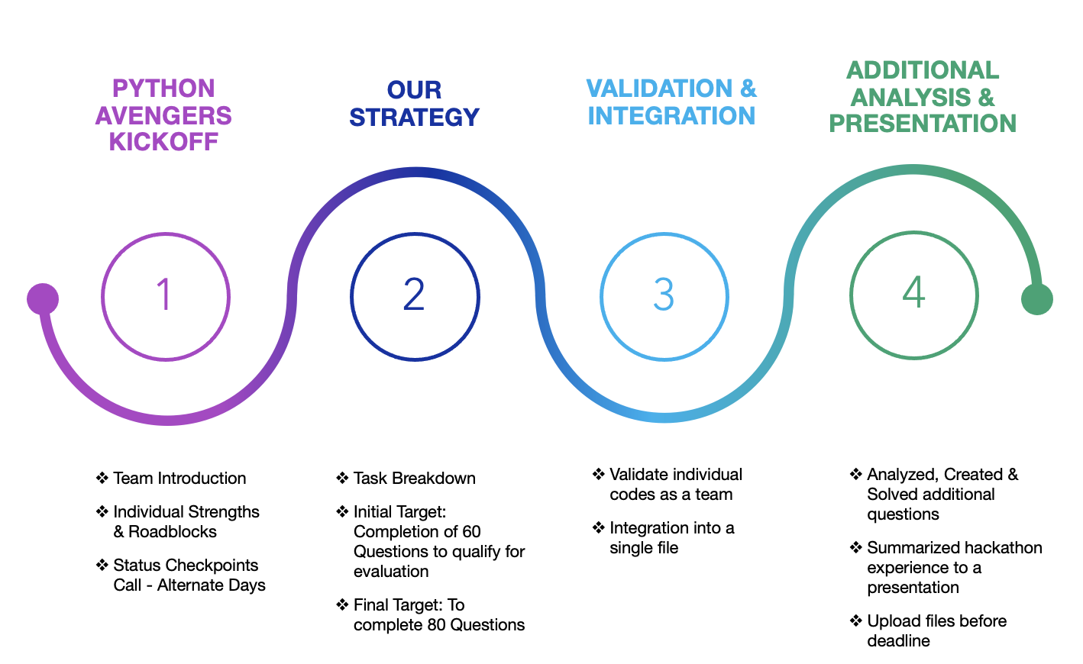
ROADMAP

Slide 3
NEW FUNCTIONS
COMMON FUNCTIONS
missingno
random.seed
setdiff1d()
pymysql
read_sql_query()
melt()
iterrows()
Pywaffle
Qbstyles
sunburst()
loc()
groupby()
assign()
today()
round()
join()
sort_values()
_append()
concat()
merge()
read_excel()
DataFrame()
head()
unique()
dict()
mean()
sum()
value_counts()
max()
range()
FUNCTIONS

Slide 4
Using GitHub & Git
Reading excel files
Merging columns from 2 different sheets
Understanding different chart concepts
SQL → Python connection
Understanding heart related metrics like GCS
Error trace backing
Indentation error
Unicode error
Memory error - n[*]
Module not found
CHALLENGES

Slide 5
Developed skill to coordinate time collectively within the team
Researching and understanding new Python concepts with the help of articles, blogs and videos as and when required
Exploring options to decide on the best approach to connect SQL with Python
Worked as a team and analyzed data set to create and solve additional questions
Effective GitHub utilization
LEARNINGS

Slide 6
HACK IT TOGETHER
THANK YOU

