Slide 1


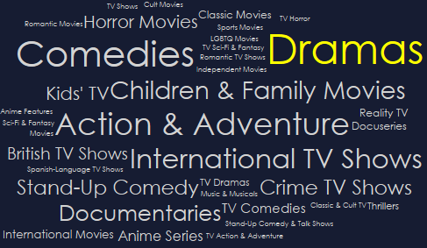
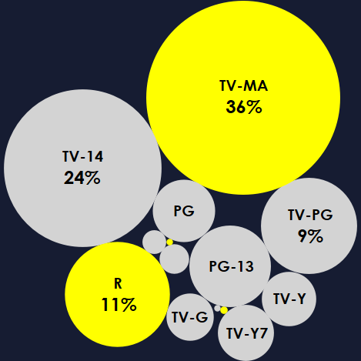
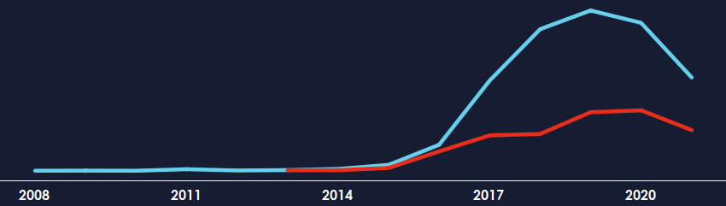
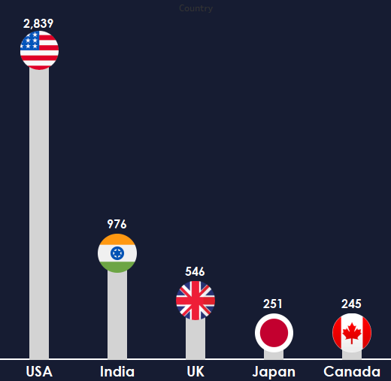
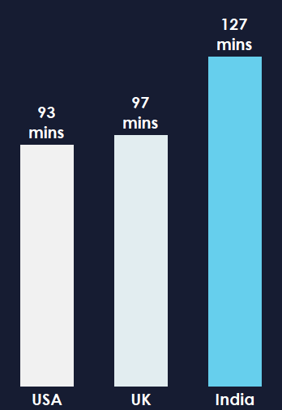
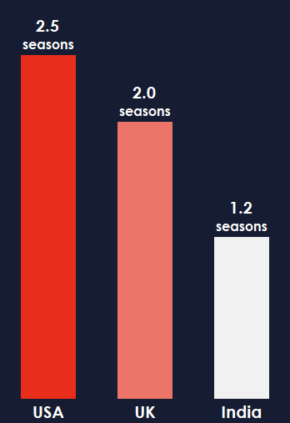
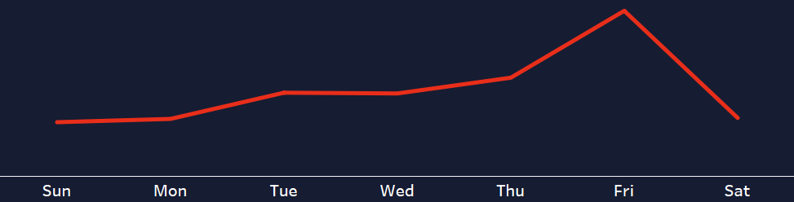

Netflix Onboarding
A perfect strategy for employee productivity
Netflix is an online movie rentals business which started in 1997, covering just the United States at that time (Onyusheva and Baker, 2021). It was co-founded by Reed Hastings and Marc Randolph in August 1997 as a DVD-rental-by-mail firm (Alves, 2018). Netflix expanded into a streaming service in 2007, eventually phasing out the DVD service (Keating, 2013).
Netflix has grown into a global company
In April 2020, Netflix reached 182 million subscribers globally (Alexander, 2020), more than double as compared to the 70.84 million it had in 2015 (Ortega, 2022). According to Netflix’s Investor Page (2022), Netflix currently has 221 million paid subscribers in over 190 countries giving it a place among the world’s leading entertainment services enjoying TV series, documentaries, feature films and mobile games across a wide variety of categories and languages (Netflix Investor, 2022). Members can access as much content as they want, anytime, anywhere, on any internet connected screen and they have the freedom to play, pause and resume watching, all free from ads.
Netflix pays to acquire the license and quality content to stream movies for a particular period (Kumar, Gupta and Dixit, 2020 ). In 2013, Netflix launched its first slate of original programming to save licensing costs making Netflix a strong player in content production becoming the first internet TV network to be nominated for the primetime Emmy (Alves, 2018). Netflix is now available in almost every country around the globe, except China, Crimea, North Korea, and Syria (Netflix Help, 2022).
This poster serves new employees and other employees of the Netflix some insights to get them up to speed and going.
Netflix records phenomenal growth in 2016 due to original content
This growth is also due to the adoption of internet entertainment and Netflix extension more than 130 more countries. (About Netflix, 2016)
72% of all Netflix content are Movies
21% of all Netflix content are listed in Drama
47% of Netflix titles are Adult rated content
7,290
Movies
TV Shows
The USA, India and the UK are the top content producing countries
The English language also favours Netflix's growth in these countries (Lotz, 2021).
The average duration of Indian movies is more than 2 hours
The average duration of US TV shows is generally longer than 2 seasons
The highest number of titles (39%) in United States is because it’s the host country since creation (Lotz, 2021).
Movies
TV Shows
The growth in India is a result of its large population size with youths aspiring for western lifestyle coupled with fast internet (Nafees et al, 2019)
SUMMARY
Netflix reserves its biggest releases on Fridays
Conclusion
Netflix is increasing the amount of dollars dedicated for contents to make available more high-quality outputs that attract new customers (Meng et al, 2022). Most of the content subscribers are interested in are listed under drama, comedies and action & adventure. Netflix is producing more content for adults. Recent trends show an increase in the number of teens content.
With the internet becoming more affordable in other countries, Netflix is leveraging the cheaper internet to invade other nations (About Netflix, 2016). India and the UK join the US as the top producing nations. Since Netflix is a US company, Netflix inherited Hollywood’s culture of releasing the greatest content on Friday.
Netflix inherited this culture from Hollywood where most people turn to the theatre on weekends giving them the entire weekend to enjoy with families and friends (News NCR, 2022)
REFERENCES
About Netflix. (2016) Netflix Is Now Available Around the World - About Netflix. Available at: https://about.netflix.com/en/news/netflix-is-now-available-around-the-world (Accessed: 12 August 2022).
Alexander, J. (2020). Netflix adds 15 million subscribers as people stream more than ever, but warns about tough road ahead. The Verge, 21.
Alves, M. (2018) Netflix: “The Crown” of entertainment (Doctoral dissertation). Available at: https://run.unl.pt/bitstream/10362/49547/1/Alves_2018.pdf (Accessed: 10 August 2022)
Daniele, G. (2015). Netflix: TV series during the Web 2.0 era. Available at: https://www.academia.edu/14144614/Netflix_TV_series_during_the_Web_2_0_era (Accessed: 10 August 2022)
Keating, G. (2013). Netflixed: The Epic Battle for America’s Eyeballs. New York: Penguin
Kumar, J., Gupta, A. and Dixit, S., 2020. Netflix: SVoD entertainment of next gen. Emerald Emerging Markets Case Studies. Available at : https://www.emerald.com/insight/content/doi/10.1108/EEMCS-04-2020-0108/full/html Accessed: 9 August 2022)
Lotz, A. (2021) In between the global and the local: Mapping the geographies of Netflix as a multinational service. International Journal of Cultural Studies, 24(2), pp.195-215. Available at : https://doi.org/10.1177%2F1367877920953166 (Accessed: 11 August 2022)
Meng, H., Zhang, J., Zhang, Y. and Zhou, W. (2022). An Assessment about the Business and Profitability Analysis for Netflix. In 2022 2nd International Conference on Enterprise Management and Economic Development (ICEMED 2022) (pp. 467-477). Atlantis Press. Available at : https://doi.org/10.2991/aebmr.k.220603.076 (Accessed: 14 August 2021)
Nafees, L., Gupta, R., Banerjee, S., Kalia, S. and Mehdi, M. (2019). Netflix in India: Too Good a Market to Give Up!. In SAGE Business Cases. NeilsonJournals Publishing. Available at: https://dx.doi.org/10.4135/9781529753684. (Accessed: 11 August 2022)
Netflix (2022) Netflix - Overview - Profile. Available at: https://ir.netflix.net/ir-overview/profile/default.aspx (Accessed: 11 August 2022).
Netflix Help Center, (2022). Where is Netflix available?. Available at: https://help.netflix.com/en/node/14164 Accessed 12 August 2022.
News NCR. (2022) Friday Release: The reason why movies are released on Friday is not just the weekend. Available at: https://www.newsncr.com/entertainment/friday-release-the-reason-why-movies-are-released-on-friday-is-not-just-the-weekend( Accessed: 11 August 2022).
Onyusheva, I. and Baker, A. (2021). NETFLIX: A CASE STUDY ON INTERNATIONAL BUSINESS STRATEGY DEVELOPMENT. The EUrASEANs: journal on global socio-economic dynamics, 6(31), pp.40-52. Available at: https://euraseans.com/index.php/journal/article/view/288 (Accessed: 9 August 2022).

Slide 2
References
About Netflix. (2016) Netflix Is Now Available Around the World - About Netflix. Available at: https://about.netflix.com/en/news/netflix-is-now-available-around-the-world (Accessed: 12 August 2022).
Alexander, J. (2020). Netflix adds 15 million subscribers as people stream more than ever, but warns about tough road ahead. The Verge, 21.
Alves, M. (2018) Netflix: “The Crown” of entertainment (Doctoral dissertation). Available at: https://run.unl.pt/bitstream/10362/49547/1/Alves_2018.pdf (Accessed: 10 August 2022)
Daniele, G. (2015). Netflix: TV series during the Web 2.0 era. Available at: https://www.academia.edu/14144614/Netflix_TV_series_during_the_Web_2_0_era (Accessed: 10 August 2022)
Keating, G. (2013). Netflixed: The Epic Battle for America’s Eyeballs. New York: Penguin
Kumar, J., Gupta, A. and Dixit, S., 2020. Netflix: SVoD entertainment of next gen. Emerald Emerging Markets Case Studies. Available at : https://www.emerald.com/insight/content/doi/10.1108/EEMCS-04-2020-0108/full/html Accessed: 9 August 2022)
Lotz, A. (2021) In between the global and the local: Mapping the geographies of Netflix as a multinational service. International Journal of Cultural Studies, 24(2), pp.195-215. Available at : https://doi.org/10.1177%2F1367877920953166 (Accessed: 11 August 2022)
Meng, H., Zhang, J., Zhang, Y. and Zhou, W. (2022). An Assessment about the Business and Profitability Analysis for Netflix. In 2022 2nd International Conference on Enterprise Management and Economic Development (ICEMED 2022) (pp. 467-477). Atlantis Press. Available at : https://doi.org/10.2991/aebmr.k.220603.076 (Accessed: 14 August 2021)
Nafees, L., Gupta, R., Banerjee, S., Kalia, S. and Mehdi, M. (2019). Netflix in India: Too Good a Market to Give Up!. In SAGE Business Cases. NeilsonJournals Publishing. Available at: https://dx.doi.org/10.4135/9781529753684. (Accessed: 11 August 2022)
Netflix (2022) Netflix - Overview - Profile. Available at: https://ir.netflix.net/ir-overview/profile/default.aspx (Accessed: 11 August 2022).
Netflix Help Center, (2022). Where is Netflix available?. Available at: https://help.netflix.com/en/node/14164 Accessed 12 August 2022.
News NCR. (2022) Friday Release: The reason why movies are released on Friday is not just the weekend. Available at: https://www.newsncr.com/entertainment/friday-release-the-reason-why-movies-are-released-on-friday-is-not-just-the-weekend( Accessed: 11 August 2022).
Onyusheva, I. and Baker, A. (2021). NETFLIX: A CASE STUDY ON INTERNATIONAL BUSINESS STRATEGY DEVELOPMENT. The EUrASEANs: journal on global socio-economic dynamics, 6(31), pp.40-52. Available at: https://euraseans.com/index.php/journal/article/view/288 (Accessed: 9 August 2022).

