Slide 1
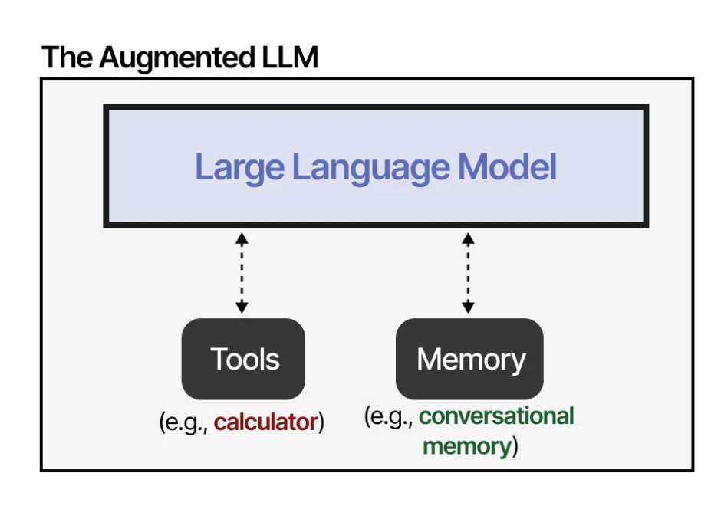
P2. LLM Agent Integration with Tools
LLM is not universally adept...
compensate for LLM disadvantage through external tools, memory, and retrieval systems

Slide 2
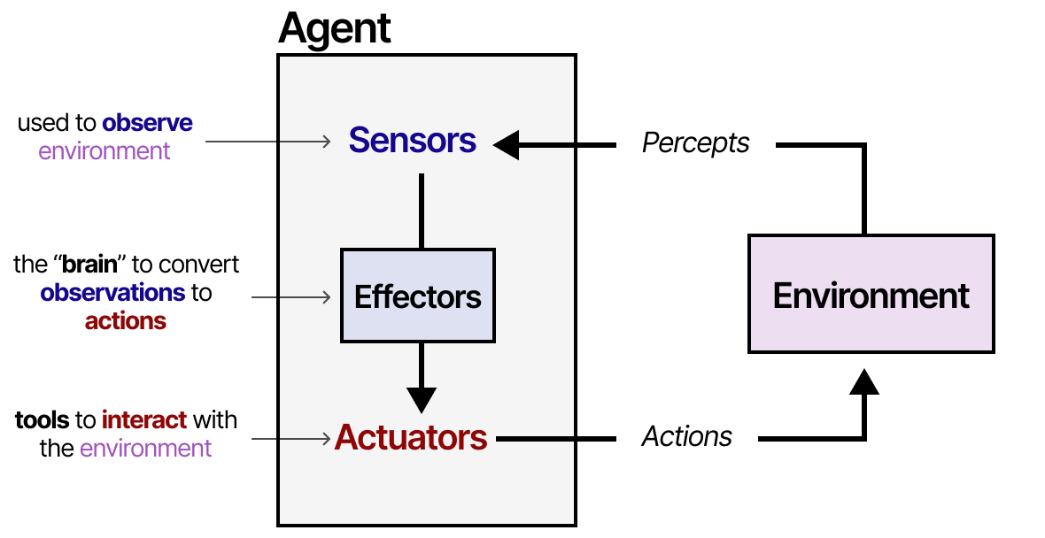
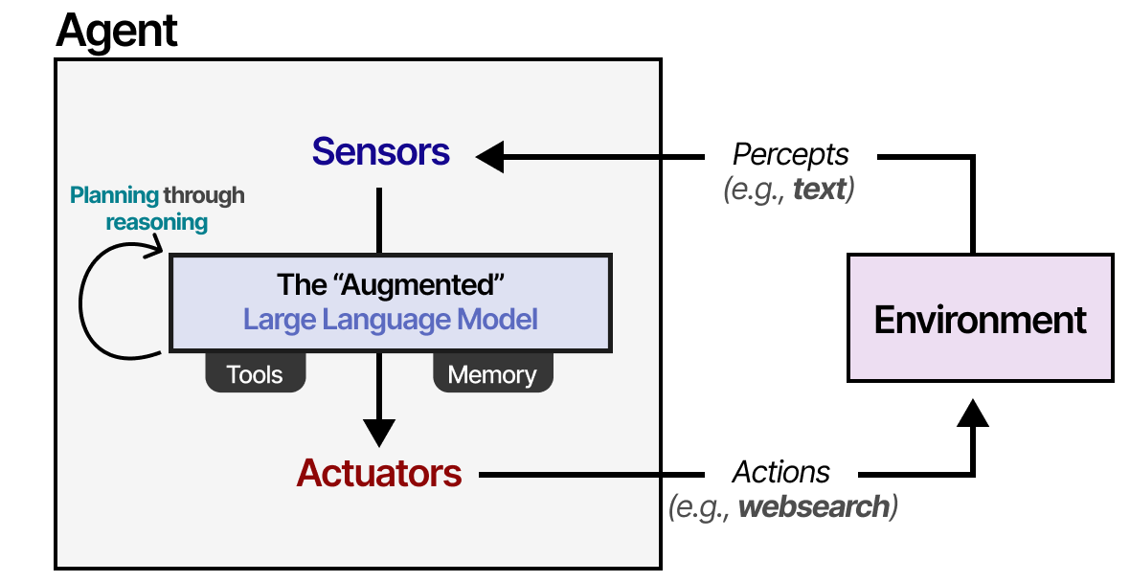
p2. LLM Agent Integration with Symbolic Reasoning and Tools
An agent is anything that can be viewed as perceiving its environment through sensors and acting upon that environment through actuators.

Slide 3
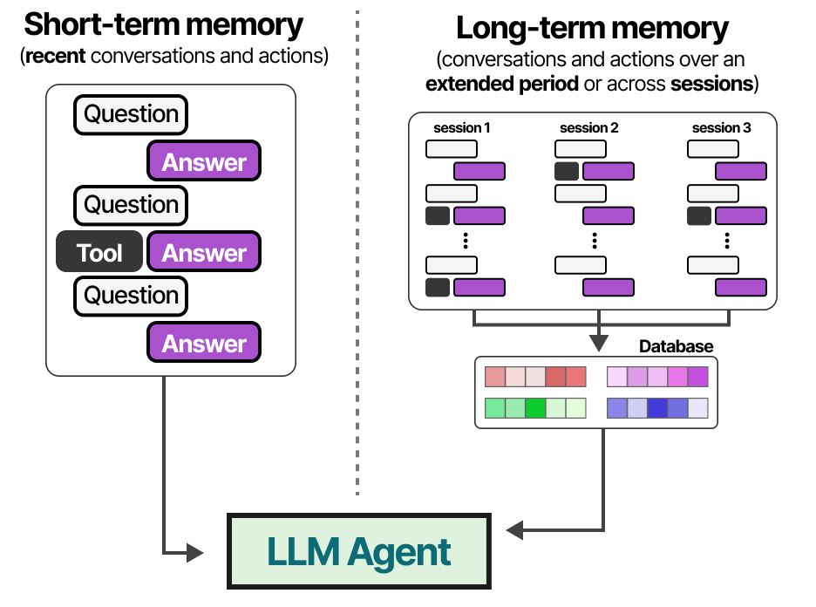
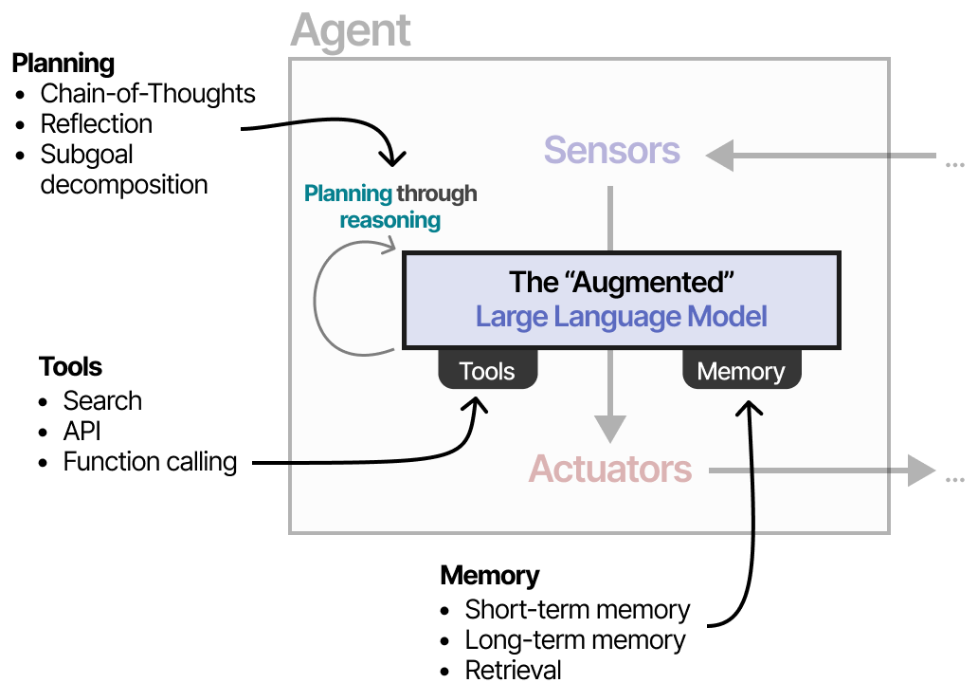
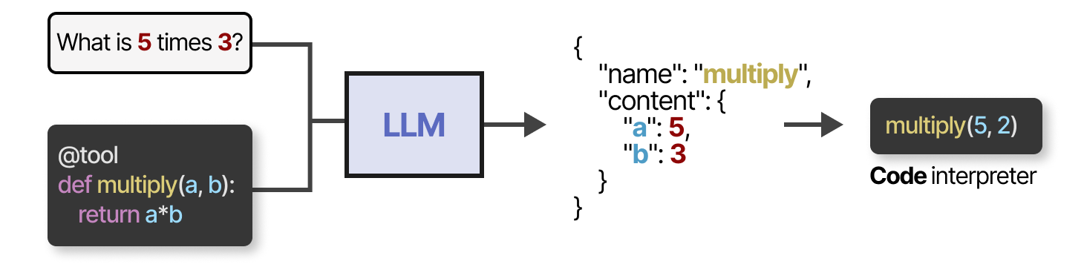
p2. LLM Agent Integration with Symbolic Reasoning and Tools

Slide 4
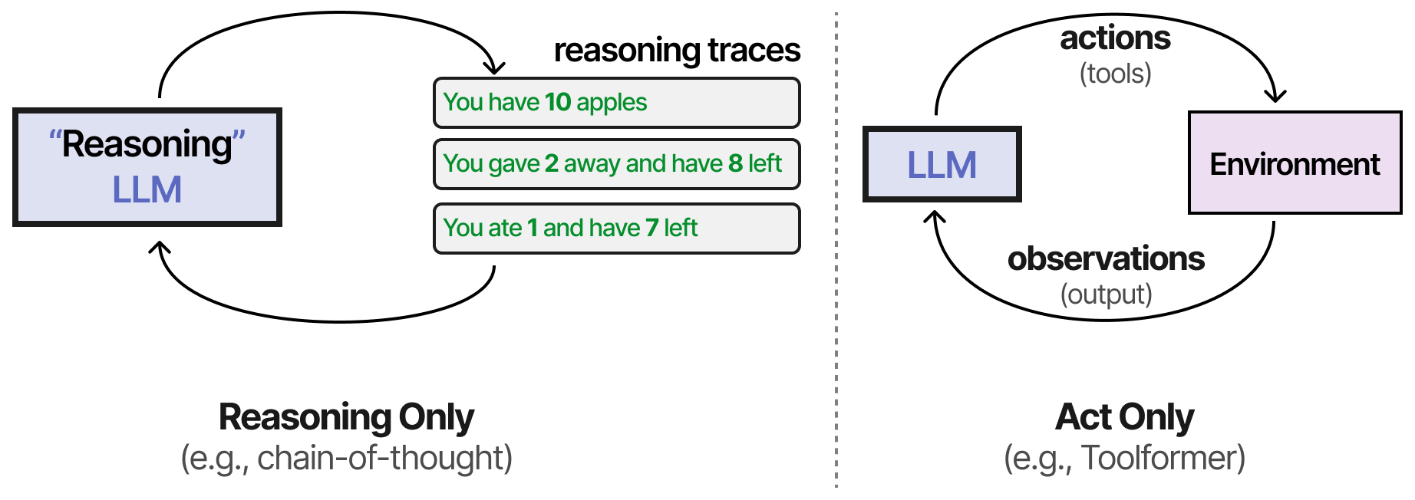
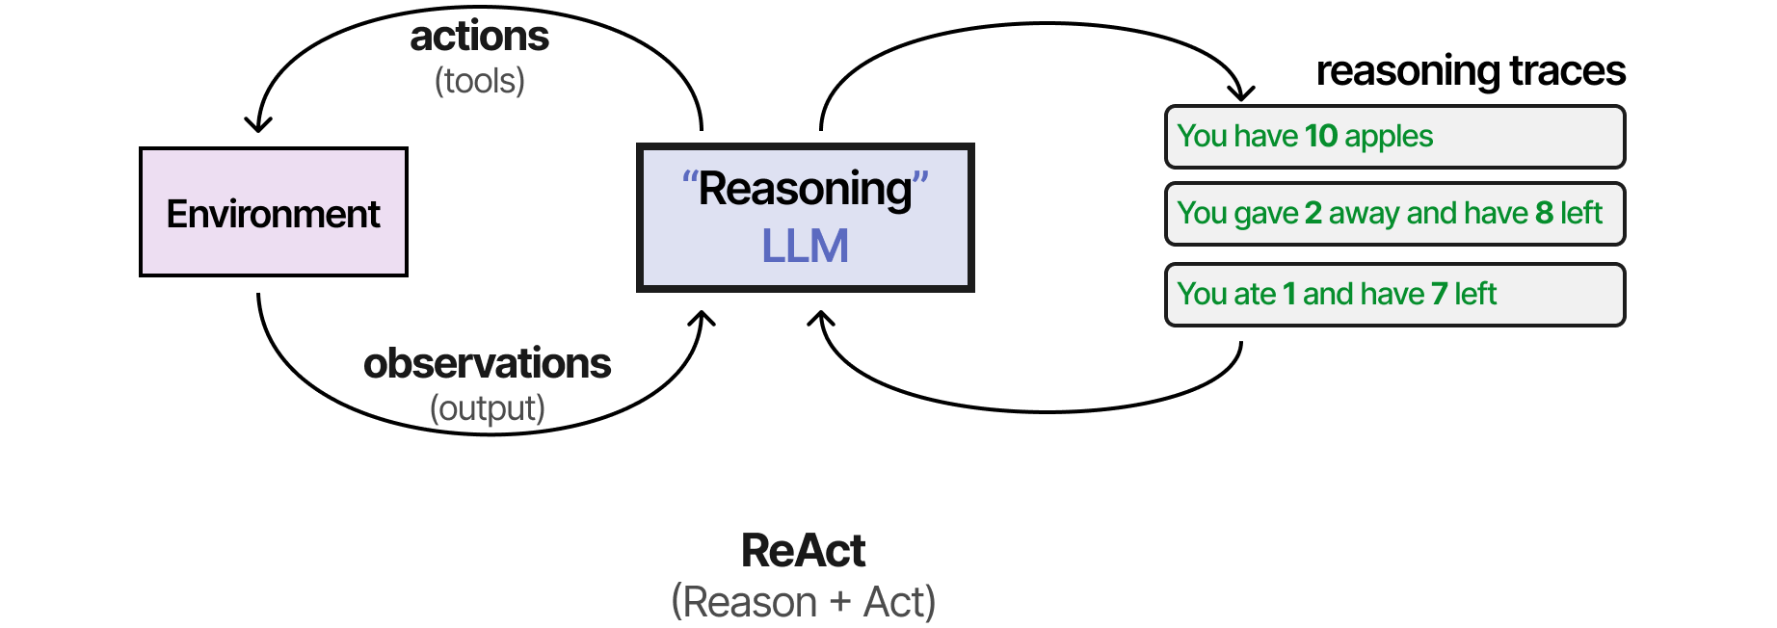
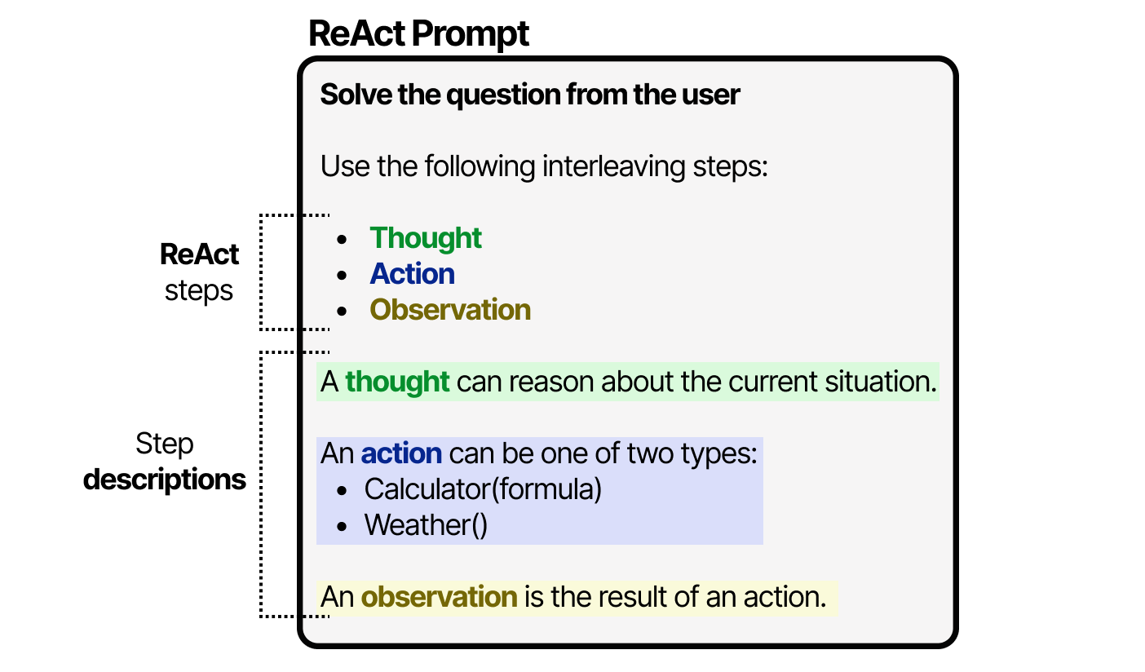
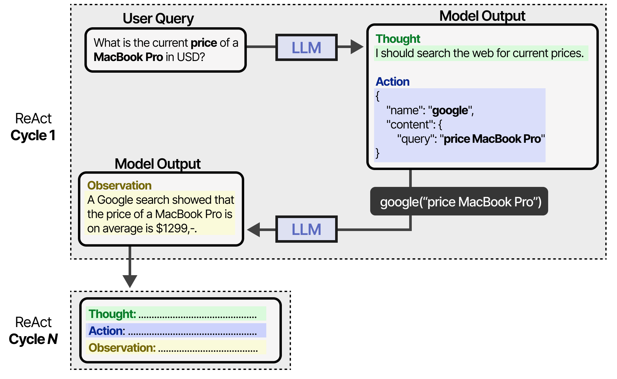
p2. LLM Agent Integration with Tools
Ref: ReAct: Synergizing Reasoning and Acting in Language Models. ICLR 2023 (notable-top-5%)
ReAct (Reasoning and Acting)

Slide 5
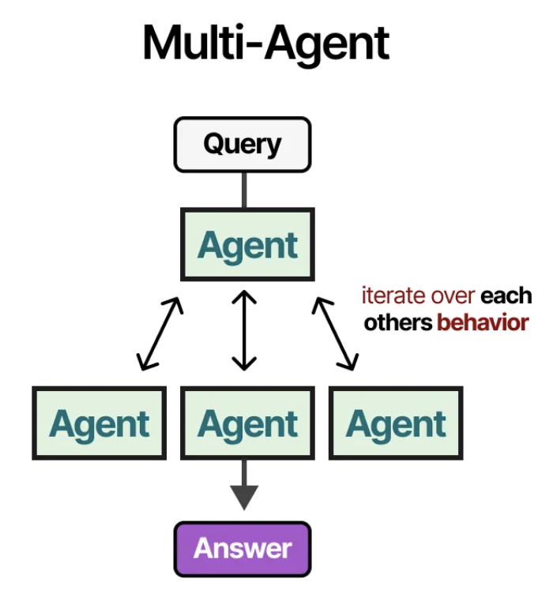
P3. Multi-agent Collaboration
Society of Mind (SOM): higher-level intelligence emerges from the combination of simpler and modular cognitive components.
Multi-Agent systems consist of specialized Agents, each equipped with their own toolset and overseen by a supervisor

Slide 6
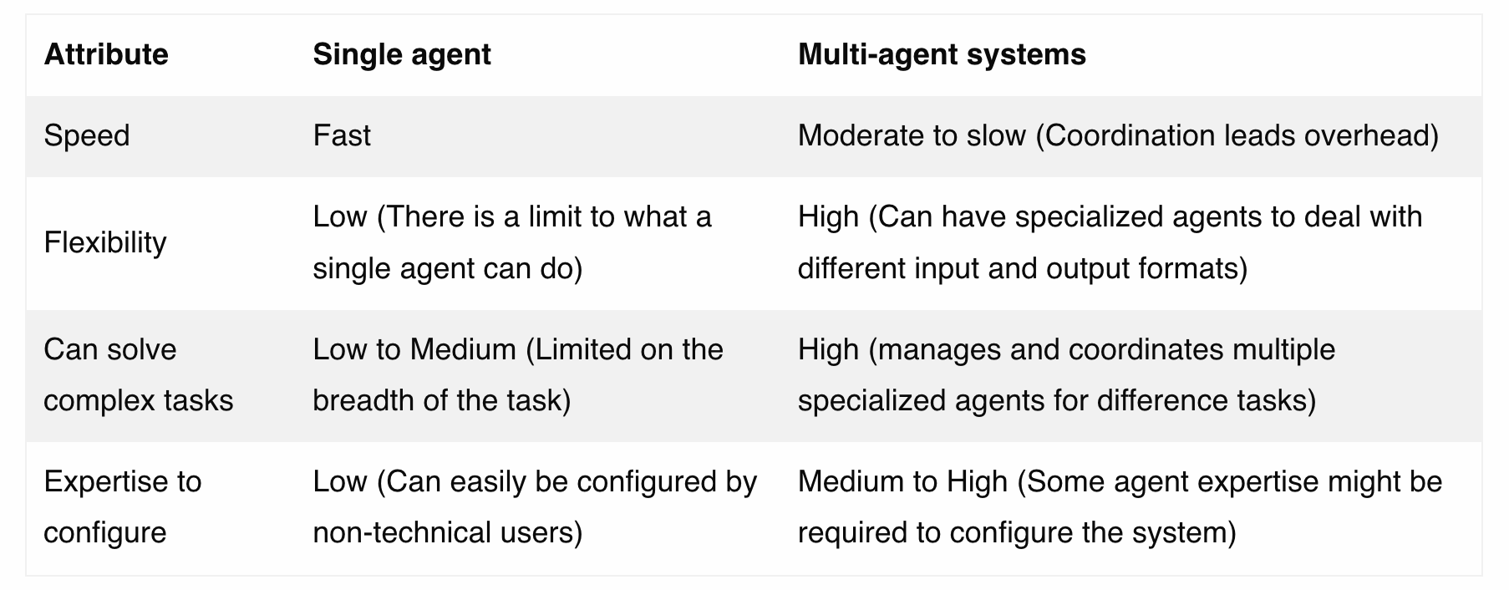
p3. Multi-agent Collaboration
Some Multi-agent Frameworks: 1.OpenAI Swarm
2.Amazon Bedrock Agents
3.Microsoft Magentic-One 4.KAUST GPTSwarm

Slide 7
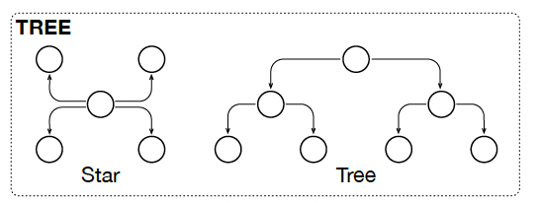
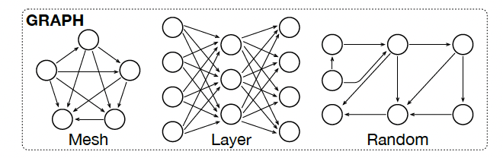
p3. Multi-agent Collaboration
coordinating multiple specialized agents within a unified system to efficiently achieve shared objectives.
direct communication
brain
Centralized
Orchestration
Hierarchical
Orchestration
Decentralized
Orchestration
Agents make independent decisions or reach a consensus as a group

Slide 8
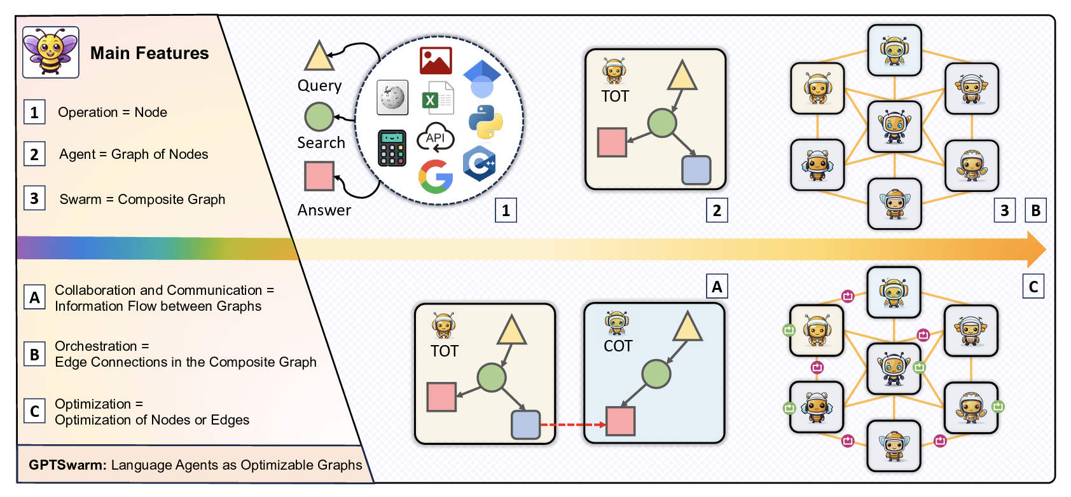
p3. Multi-agent Collaboration
Ref: GPTSwarm: Language Agents as Optimizable Graphs. ICML 2024 Oral

Slide 9
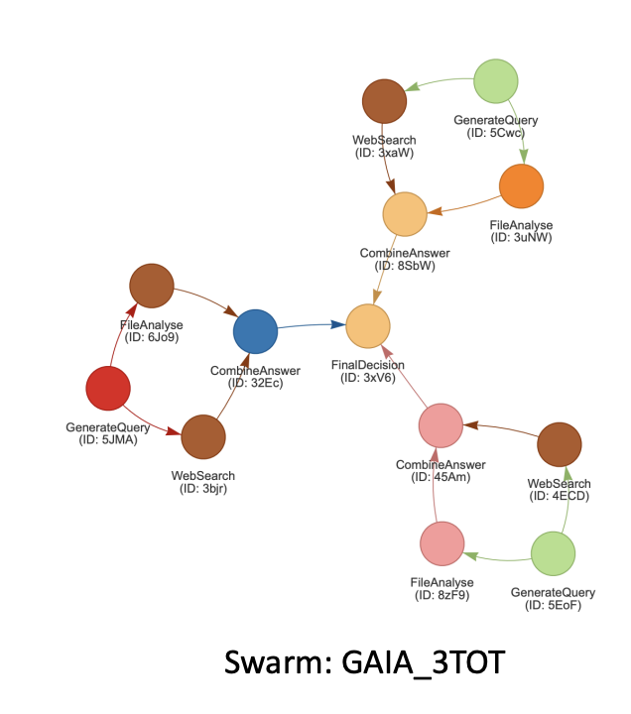
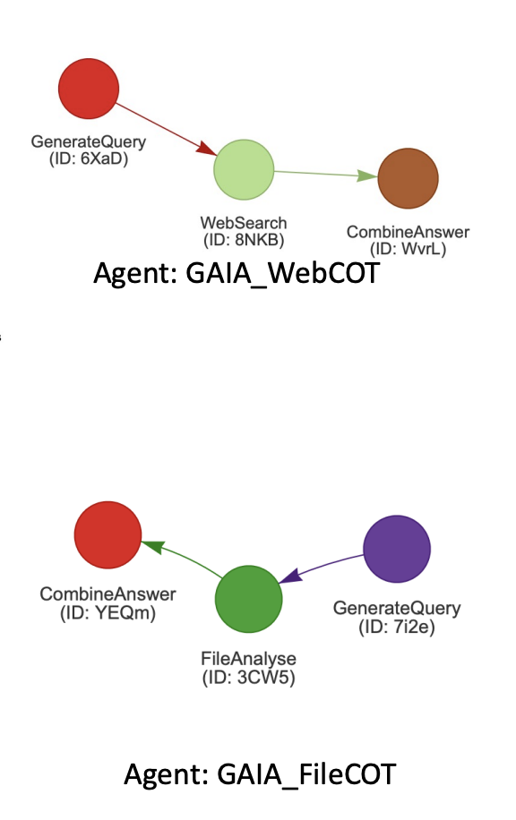
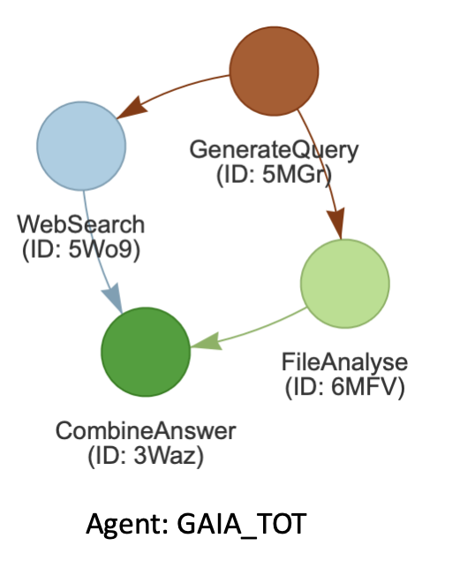
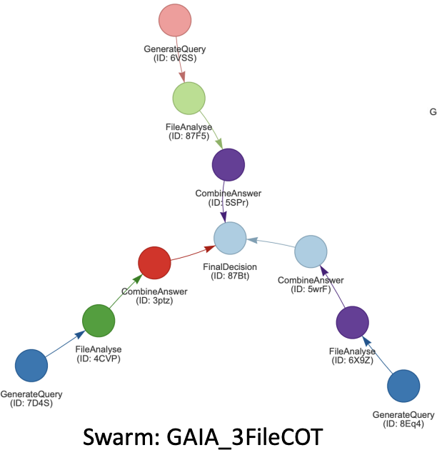
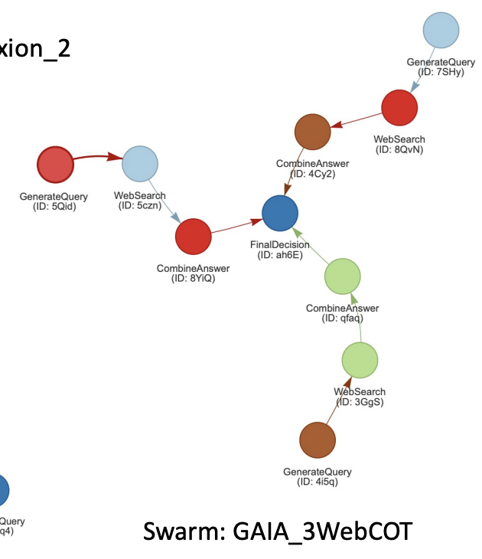
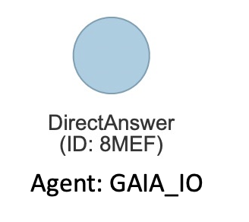
p3. Multi-agent Collaboration
Ref: GPTSwarm: Language Agents as Optimizable Graphs. ICML 2024 Oral

Slide 10
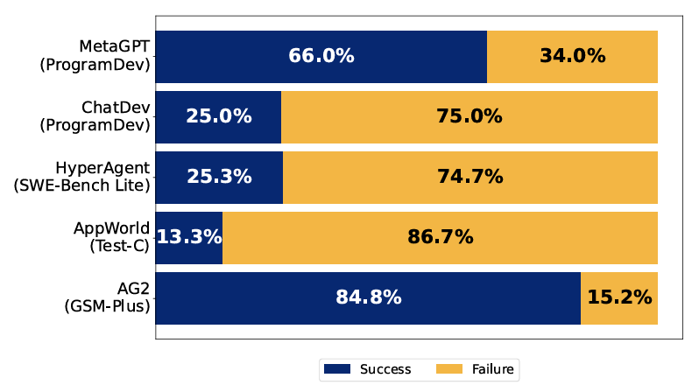
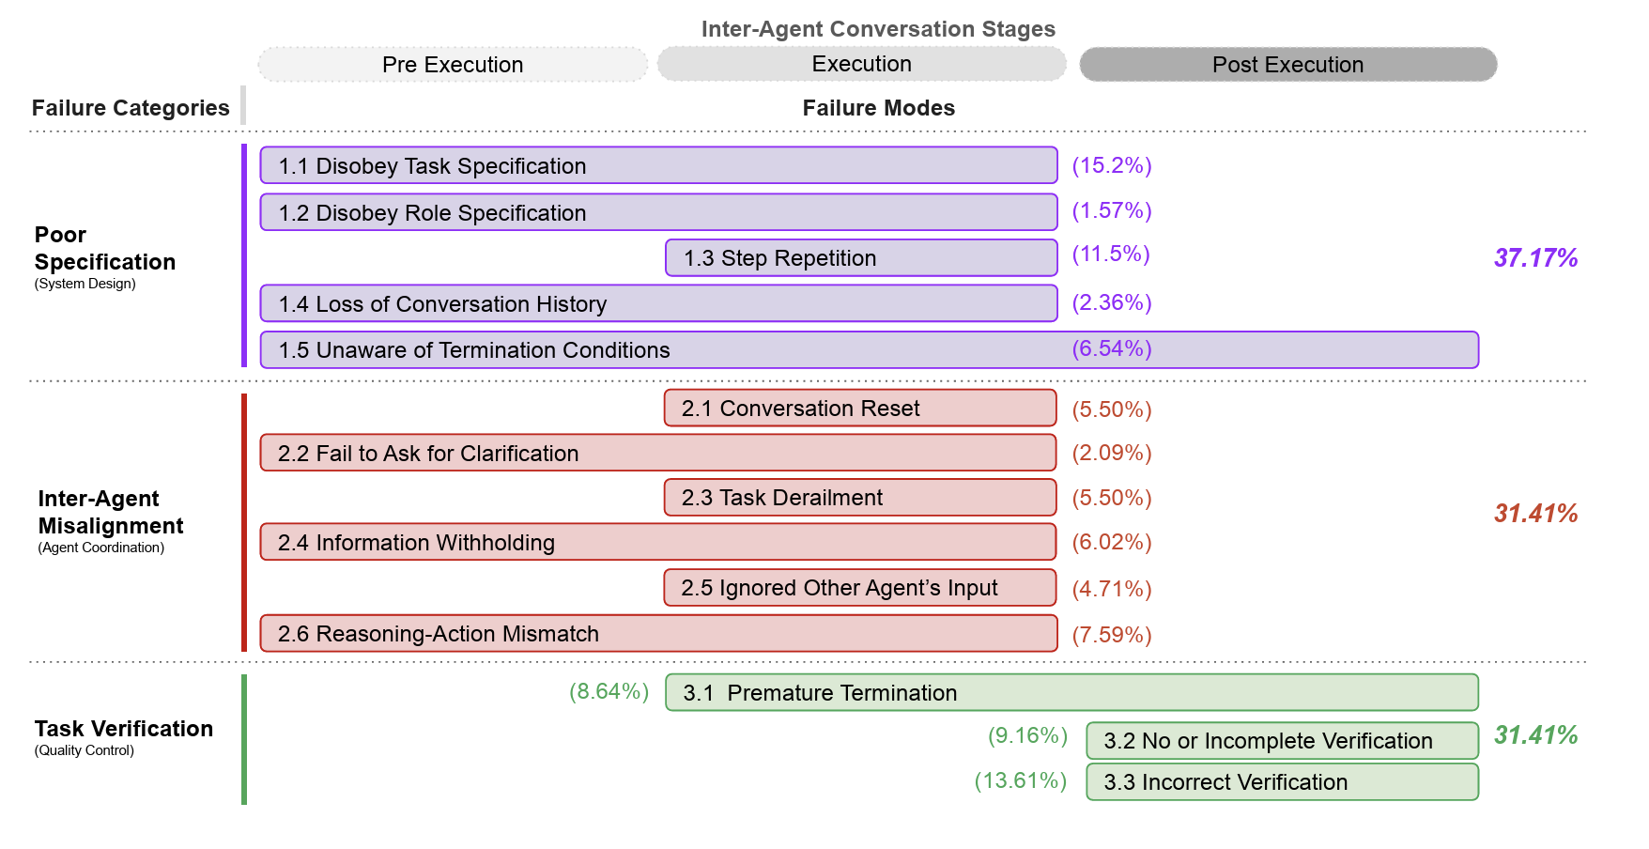
p3. Multi-agent Collaboration

Slide 11
Thanks!

