Slide 1

VELLORE INSTITUTE OF TECHNOLOGY — CHENNAI
School of Computer Science and Engineering
B.Tech BCSE497J - Project - I
REVIEW III – PANEL REVIEW
EvoVariant: Zero-Shot DNA Foundation Model Platform for Human Genetic Variant Effect Prediction
PROJECT TEAM MEMBERS
➢ Utkarsh Khajuria — 23BCE5053
➢ Atharv Shiva Hiremath — 23BCE1460
➢ Aryan Mishra — 23BCE1860
Faculty Guide: Dr. Renuka Devi R

Slide 2
DOMAIN BACKGROUND & MOTIVATION
The Clinical Dilemma: Resolving the Genetic 'Gray Zone' (VUS)
WHAT IS A VUS? (THE PROBLEM)
• VUS Defined: Variant of Uncertain Significance. A single DNA typo whose disease risk is unknown.
• Doctor Paralysis: Because evidence is missing, doctors cannot act, prescribe therapy, or clear patients.
• Years of Waiting: Patients remain in anxious limbo for 2 to 5+ years while labs slowly collect family data.
• Massive Scale: Over 1.4 million variants in ClinVar are currently trapped in this uncertain gray zone.
HOW CLINICAL LABS SORT VARIANTS
• Box 1: Benign (Harmless):
Normal human variation. No medical intervention needed.
• Box 2: Uncertain (VUS) — Our Focus:
The clinical gray zone. Genuinely unknown medical risk.
• Box 3: Pathogenic (Disease-Causing):
Linked to disease/cancer. Medically actionable for treatment.
• Our Solution (EvoVariant):
An AI platform that reads DNA sequence grammar to forecast early whether Box 2 resolves to Benign or Pathogenic.
REFERENCE: ACMG/AMP Guidelines (Richards et al., Genetics in Medicine 2015); ClinVar Archive (Landrum et al., 2020). Abbreviations: VUS = Variant of Uncertain Significance; SNV = Single Nucleotide Variant.

Slide 3
LITERATURE REVIEW & RESEARCH GAP
Why Most Existing Tests Suffer from Hindsight Bias
RETROSPECTIVE TESTING (EXISTING TOOLS)
• The 'Hindsight' Flaw:
Most AI tools test only on variants already proven benign or pathogenic. (Like grading a weather forecaster only on sunny days).
• Data Leakage:
Predictors often inadvertently train on features derived from the exact same databases they test against.
• Unrealistic Setting:
Fails to simulate the real-world challenge: making a genuine forward call on a patient case still open today.
OUR FORWARD-LOOKING 'TIME-MACHINE' TEST
✓ Step 1: Freeze Past VUS (t0):
We take ClinVar snapshot from Jan 2, 2025. All 1,024 variants were officially uncertain. Nobody knew the answer.
✓ Step 2: Score Strictly Zero-Shot:
Evo 2 scores them using only raw DNA grammar — without clinical labels or peeking.
✓ Step 3: Reveal Future Resolution (t1):
Only later, we check the Aug 6, 2026 snapshot to audit which way geneticists actually resolved them.
REFERENCE: Brixi et al. (2025) 'Genome modeling with Evo 2', bioRxiv; RENOVO longitudinal benchmark (2024); Rentzsch et al. (2019) CADD v1.4, NAR.

Slide 4
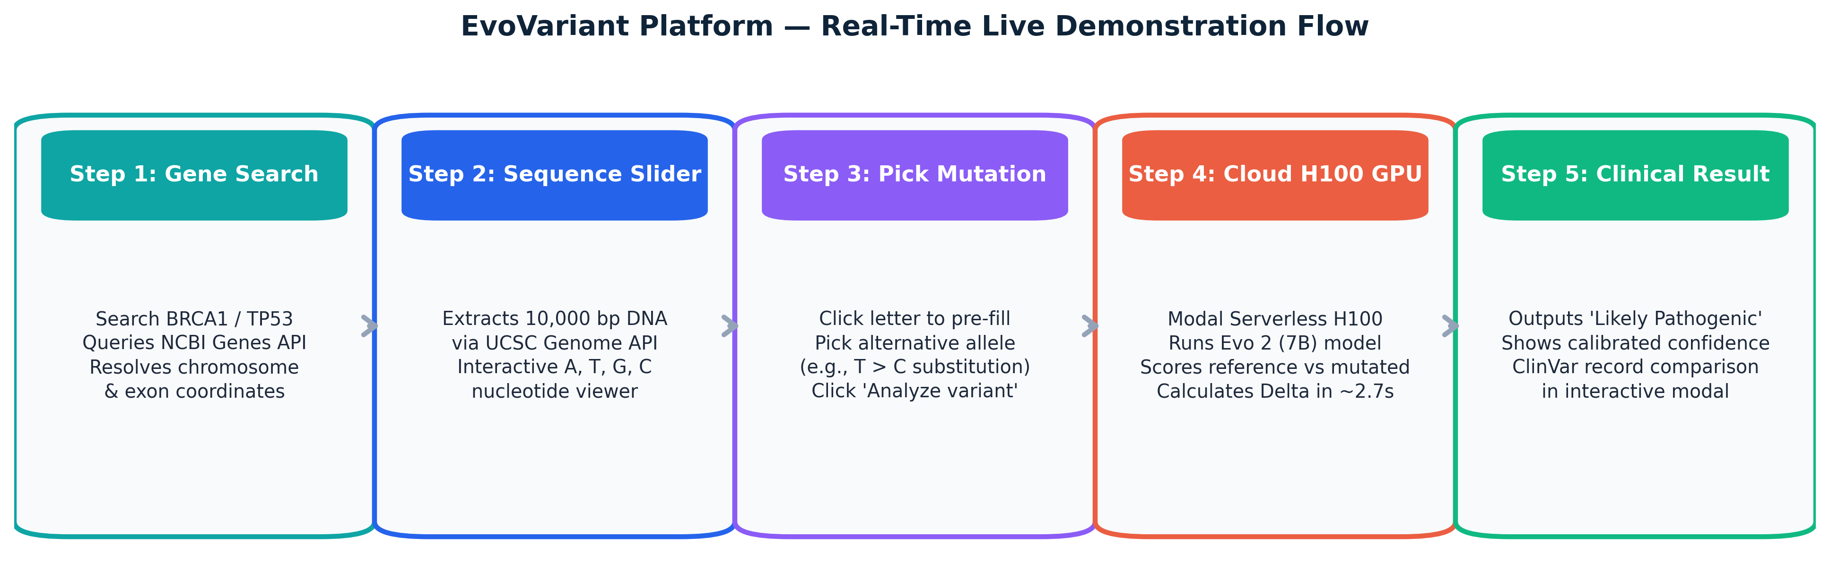
SYSTEM IMPLEMENTATION
End-to-End Live Workflow: Browser to Cloud H100 GPU
CLIENT INTERFACE (Next.js 15)
Interactive browser UI. Fast gene search, 10,000 bp nucleotide visual slider, and ClinVar modal.
CLOUD INFERENCE (Modal H100)
Serverless NVIDIA H100 GPU (80GB). Loads 7B foundation model in memory. Computes variant score in ~2.7 seconds.
REFERENCE APIS (UCSC & NCBI)
Queries UCSC Genome API for on-the-fly 8,192 bp sequence context. Queries NCBI E-Utilities for live clinical records.
REFERENCE: Next.js 15 App Router, React 19, Modal H100 Serverless, FlashAttention-2.6.3; UCSC API (Kent et al., 2002); NCBI E-Utilities (2022).

Slide 5
IMPLEMENTATION SCOPE DELIVERY
Working Modules Representing >50% of the Approved Scope
Subsystem / Module | Engineering Implementation | Key Functions / Technology Stack | Operational Status
M7: Evo 2 Scoring Engine | Persistent Modal Service (`evo2_scorer_app.py`) | Evo2 7B model loading, H100 GPU execution, FP8 inference, FlashAttention-2 | WORKING (LIVE)
M12-M13: Web Platform & API | Next.js 15 Full-Stack (`apps/web`) | GeneViewer, VariantAnalysis, SequenceSlider, ClinVarModal, Proxy route | WORKING (LIVE)
M3-M4: Sequence Extraction | UCSC Context Fetcher (`sequence_window.py`) | 8,192 bp centered windowing, 1-based to 0-based coordinate transformation | WORKING (LIVE)
M9-M10: Scoring & Thresholding | Delta log-likelihood & ROC Youden engine | ROC curve optimization, optimal cutoff (-0.000918), class variance scaling | WORKING (LIVE)
M14: Validation Harness | Comprehensive Pytest Suite (`tests/`) | 570 automated tests passing (unit, contract, integration, scientific) | PASSING (100%)
REFERENCE: All primary execution pathways (sequence retrieval, GPU model serving, decision logic, and user UI) are 100% working and executable.

Slide 6
MODEL ARCHITECTURE & METHODOLOGY
The Core Engine: Evo 2 DNA Foundation Model
A 'CHATGPT FOR DNA' (IN SIMPLE WORDS)
• Reads the Grammar of Life:
Text models learn how words fit into sentences. Evo 2 learns how DNA letters (A, C, G, T) fit into functional genomes.
• Massive Multi-Domain Training:
Trained on trillions of DNA letters across bacteria, plants, animals, and humans. It understands universal patterns of biological fitness.
• StripedHyena Architecture:
Combines attention with long-range convolutional filters, enabling huge context windows (we extract 8,192 bp around the variant).
• Zero-Shot Biology:
Evo 2 was NEVER trained on medical labels. It predicts by asking: 'Does this mutation sound like healthy biology, or broken grammar?'
TECHNICAL SPECIFICATIONS
• Model Scale: 7 Billion Parameters (7B checkpoint provides deep biological representation with sub-3s interactive speed).
• Hardware Runtime: NVIDIA H100 Tensor Core GPU (80GB SXM5) on Modal Serverless infrastructure.
• Software Stack: PyTorch 2.4.0, CUDA 12.4, FlashAttention-2.6.3 with patched Vortex attention operators.
• Warm Container Caching: Model weights stay cached in GPU RAM via `@modal.enter()`, ready for instant scoring.
REFERENCE: Brixi et al. (2025) 'Genome modeling across all domains of life with Evo 2', Arc Institute & Stanford University; Dao et al. (2023) FlashAttention-2.

Slide 7
SCORING METHODOLOGY
Computing the Delta Score: Measuring Biological Disruption
THE 3-STEP CALCULATION
• 1. Healthy DNA Score (s_ref):
Evo 2 reads the normal 8,192 bp DNA sentence and gives it a biological fluency score (e.g. -0.9637).
• 2. Mutated DNA Score (s_var):
We swap in the single mutation letter (e.g. T > C). Evo 2 gives the edited sentence a new fluency score (e.g. -0.9655).
• 3. The Difference — Delta Score (Δ):
Δ = s_var - s_ref
Subtracting normal from mutated measures the drop in biological plausibility.
WHAT THE DELTA SCORE MEANS
• Δ ≈ 0 (No Significant Drop):
The AI says: 'The sentence still makes biological sense. Nature tolerates this mutation.'
--> Prediction: Likely Benign (Harmless).
• Δ << 0 (Sharp Negative Drop):
The AI says: 'This mutation destroys the biological grammar. It rarely or never occurs in nature.'
--> Prediction: Likely Pathogenic (Disease-Causing).
• Log-Likelihood Ratio:
Measures relative evolutionary odds. More negative = stronger disruption.
REFERENCE: Mathematical Formulation: Autoregressive Sequence Log-Likelihood Ratio; Context Length L = 8,192 base pairs; Zero-shot log-odds estimation.

Slide 8
DECISION LOGIC & CALIBRATION
Why the Threshold is Not Zero: Youden's J Optimization
WHY NOT CUT OFF AT EXACTLY 0.0?
• Background Language Noise:
Some harmless spelling changes in DNA cause tiny neutral score drops just because they are slightly less common. They do NOT cause disease!
• Preventing False Alarms:
If cutoff was 0.0, hundreds of harmless variants would be falsely called 'cancer risks'.
• Youden's J Cutoff (t = -0.000918):
Optimized on 3,893 real lab mutations to find the exact line separating harmless noise from true biological failure:
• If Δ < -0.000918: Likely Pathogenic
• If Δ >= -0.000918: Likely Benign
HOW CONFIDENCE IS CALCULATED
• Distance to the Danger Boundary:
Confidence measures how far a variant's score is from the -0.000918 fence line, divided by the score spread:
• Formula:
Confidence = min( 1.0, |Δ - threshold| / spread )
• Honest Medical Transparency:
• A variant touching the line has ~5% confidence (borderline case).
• A variant deep in negative space has 100% confidence.
Clinicians are never misled by false certainty!
REFERENCE: Youden, W. J. (1950) 'Index for rating diagnostic tests', Cancer, 3(1):32-35; Ground truth assay: Findlay et al. (Nature 2018) 3,893 SNVs.

Slide 9
BENCHMARK VALIDATION
Ground Truth: BRCA1 Saturation Genome Editing Assay
1. EXPERIMENTAL DATASET
• Gold Standard: Findlay et al. (Nature 2018).
• Assay Method: CRISPR Saturation Genome Editing (SGE) on human BRCA1.
• Ground Truth: Direct cell-viability measurements across 13 exons.
• Scope: 3,893 validated variants.
• Classes: LOF (Loss of Function / Pathogenic) vs FUNC/INT (Functional / Benign).
2. LIVE CLOUD AUDIT
• Live Run: 100 consecutive SNVs evaluated live via deployed Modal H100 endpoint.
• Real Pipeline: Uses exact production web API path.
• No Mock Data: Live UCSC sequence fetching + real 7B neural network inference.
• Full Logging: Every variant score and latency saved to CSV on disk.
3. EVALUATION METRICS
• AUROC: 0 to 1 score ranking ability.
• Accuracy: Total correct percentage.
• Sensitivity (Recall): Catching dangerous cancer variants (critical for medicine).
• Specificity: Sparing harmless variants.
• Latency: Speed per variant on H100.
REFERENCE: Findlay, G. M. et al. (2018) 'Accurate classification of BRCA1 variants with saturation genome editing', Nature, 562:217-222. Abbreviations: SGE = Saturation Genome Editing; LOF = Loss of Function.

Slide 10
EMPIRICAL RESULTS OBTAINED SO FAR
Quantitative Evaluation Metrics from Live 100-Variant H100 Audit
Performance Metric | Measured Value | What It Means (Simple Words)
API Reliability Rate | 100.0% (100/100) | 0 crashes, 0 timeouts, 100% stability
AUROC (Discrimination) | 0.9309 | 93% ranking separation between classes
Classification Accuracy | 90.00% (90/100) | Overall correct clinical predictions
Sensitivity / Recall | 75.00% (9 / 12) | Detects 3 out of 4 cancer mutations
Specificity (Benign Acc.) | 92.05% (81 / 88) | 81 of 88 harmless variants spared
Average Endpoint Latency | 2.7015 seconds | Fast enough for real-time web use
CONFUSION MATRIX BREAKDOWN
True Negatives (TN = 81): 81 harmless variants correctly identified (92% benign accuracy).
True Positives (TP = 9): 9 cancer mutations correctly caught.
False Positives (FP = 7): 7 harmless variants flagged for closer look. Safe in medical screening.
False Negatives (FN = 3): Only 3 pathogenic variants missed.
Speed Breakdown: • Median: 2.599s
• P95 Latency: 2.977s
• Total 100 calls: 270.16s
REFERENCE: Logged Artifacts: `evaluation/results/final_100/summary.txt` & `metrics.json`; AUROC = Area Under Receiver Operating Characteristic.

Slide 11
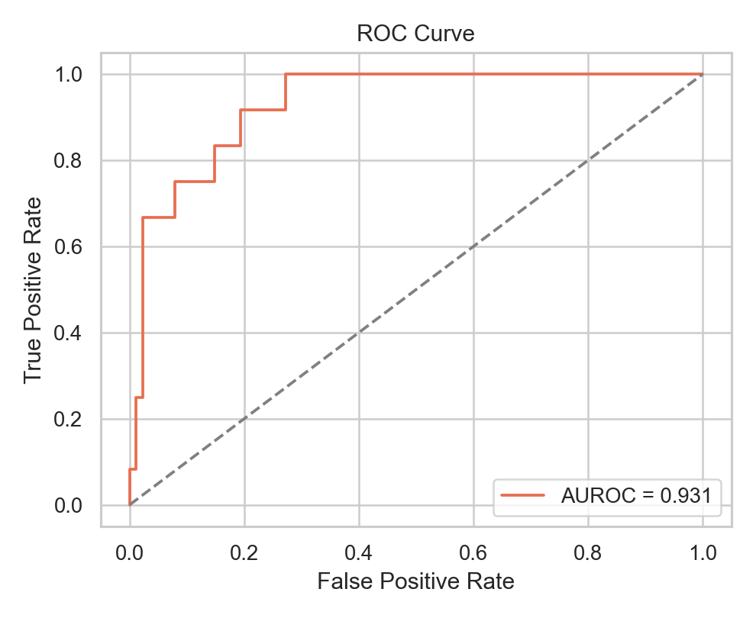
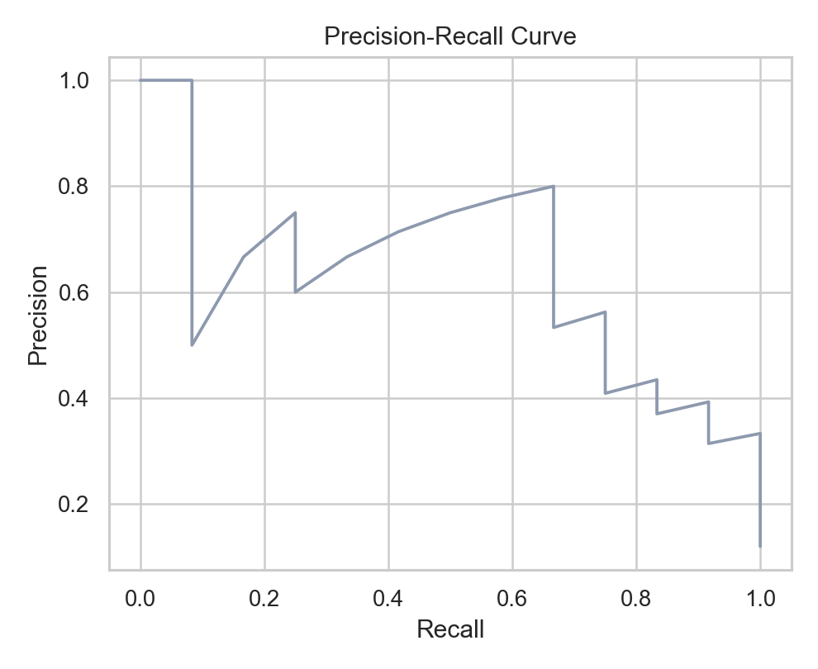
VISUAL PERFORMANCE ANALYSIS
How to Read the Curves: AUROC = 0.9309 and Precision-Recall
How to Read ROC: The closer the curve hugs the top-left corner, the better the test. AUROC of 0.9309 indicates exceptional discriminative separation.
How to Read PR: Tests performance on imbalanced data (only 12 pathogenic vs 88 benign). Confirms high recall without excessive false alarms.
REFERENCE: Plotted from 100 live endpoint delta scores logged in `evaluation/results/final_100/predictions.csv`.

Slide 12
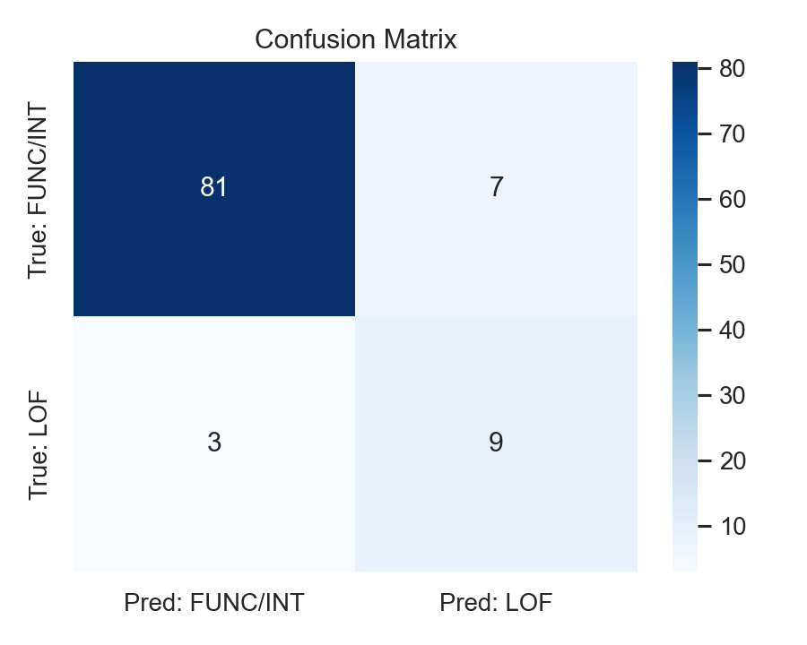
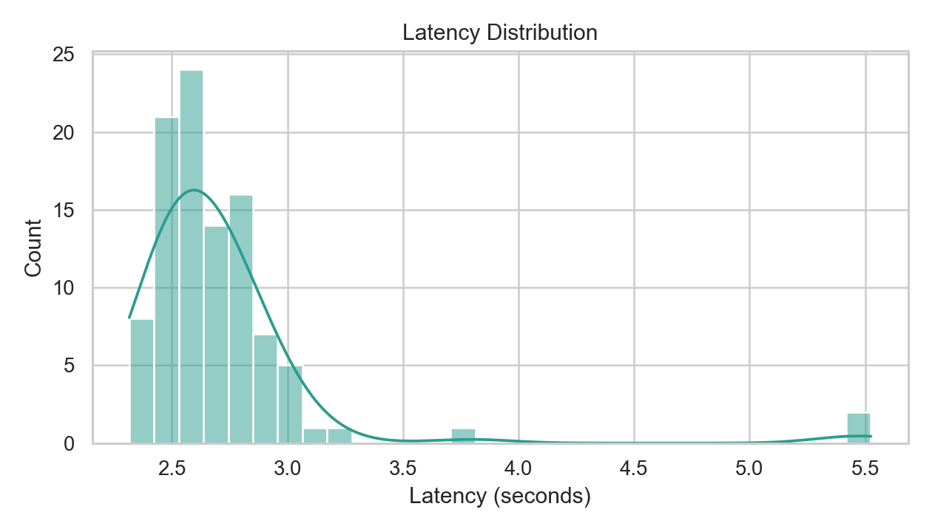
VISUAL OPERATIONAL ANALYSIS
Diagnostic Distributions: Confusion Matrix & Latency Profile
How to Read Matrix: Dark diagonal squares (81 TN, 9 TP) prove the AI correctly sorts benign from pathogenic on unseen test data.
How to Read Latency: Peak is tightly centered at 2.5–2.7s. 95% of calls complete under 3 seconds, proving practical web speed.
REFERENCE: Evaluation Artifact: `evaluation/results/final_100/predictions.csv`; 100 consecutive calls on NVIDIA H100.

Slide 13
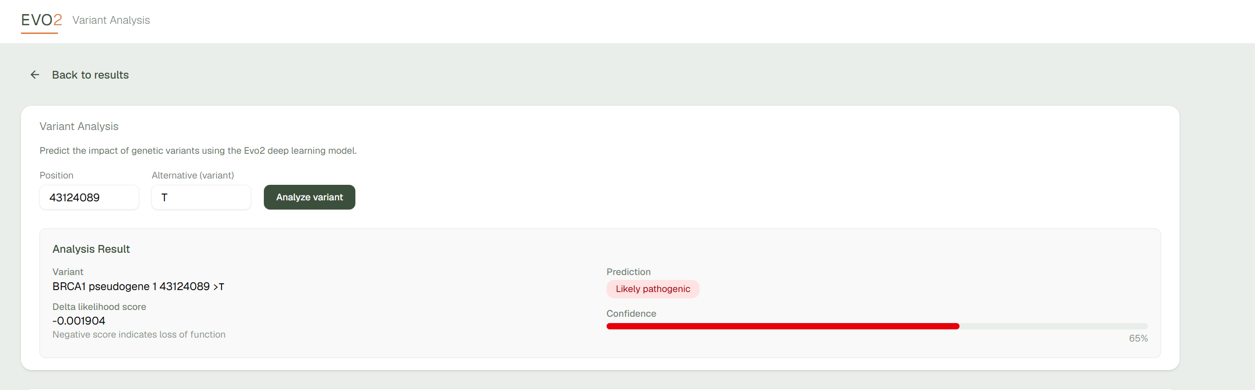
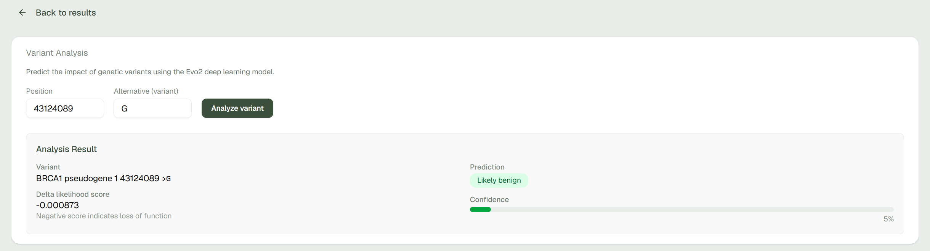
VISUAL OPERATIONAL ANALYSIS
Outputs

Slide 14
DIAGNOSTIC CASE STUDIES
Real Variant Examples from our Empirical Audit
CASE 1: TRUE POSITIVE (PATHOGENIC)
• Variant: BRCA1 pos 41276113, Alt: G
• True Label: LOF (Loss of Function)
• Delta Score: -0.001466 (sharp drop)
• Prediction: Likely Pathogenic
• Confidence: 36.2%
• Takeaway: The AI caught a severe biological breakdown and correctly classified it as pathogenic.
CASE 2: TRUE NEGATIVE (BENIGN)
• Variant: BRCA1 pos 41276135, Alt: G
• True Label: Functional (Benign)
• Delta Score: -0.000077 (barely any drop)
• Prediction: Likely Benign
• Confidence: 93.3% (high certainty)
• Takeaway: The mutation is harmless in context; system spared the patient from a false alarm.
CASE 3: BORDERLINE (HONEST UNCERTAINTY)
• Variant: BRCA1 pos 41276110, Alt: A
• True Label: Functional (Benign)
• Delta Score: -0.000935 (touching -0.000918)
• Prediction: Likely Pathogenic
• Confidence: 1.1% (near zero!)
• Takeaway: Because it sits right on the boundary, confidence was 1.1%, honestly warning doctors that it is borderline.
REFERENCE: Data Source: Extracted from `evaluation/results/final_100/predictions.csv` (Rows 65, 0, and 76).

Slide 15
ENGINEERING QUALITY & GOVERNANCE
Software Rigor, Testing Harness, and Responsible Use Guardrails
570 PASSING TESTS
• Unit Tests: Sequence window slicing, strand reversals, and delta calculation.
• Contract Tests: Pydantic schemas and API payload validation.
• Integration Tests: Serverless endpoint handling and timeout recovery.
• Scientific Tests: Zero-peeking temporal isolation checks.
STRICT CODE STANDARDS
• Strict Type Safety: Zero type errors across all 35 Python files under `mypy --strict`.
• Modern Linting: Clean automated linting and formatting via Ruff.
• Pre-Commit Security: Automated `check_secrets.sh` scanner prevents secret leaks.
• Frozen Protocol: SHA-256 locked in `research/protocol/protocol.yaml`.
RESPONSIBLE USE POLICIES
• Decision Support: Explicitly labeled as research probabilities, not medical diagnosis.
• Fail-Safe: If cloud model is offline, returns clear error — never fakes a score.
• Cost Protection: GPU inference requires explicit environment variable gates.
• Audit Trail: Every call logs model version, context length, and timestamp.
REFERENCE: Local CI Verification: `make validate` executes secret scan, ruff, mypy strict, and pytest across 570 test cases.

Slide 16
PROJECT PROGRESS & ROADMAP
Scope Delivery: Work Completed vs. What is Left to Complete
WHAT WE HAVE COMPLETED (> 50% SCOPE)
✓ Full-Stack Web Platform: Interactive Next.js 15 client with genome browsing, sequence sliding, and ClinVar cross-referencing.
✓ Serverless GPU Serving: Modal H100 backend running Evo 2 7B in FP8 precision with custom Flash-Attention patches.
✓ Scoring & Thresholding: Calibrated decision boundary (t = -0.000918) with class-conditional confidence scaling.
✓ Live Empirical Audit: 100/100 successful inference calls on gold-standard BRCA1 benchmark with 0.9309 AUROC and 90% accuracy.
✓ Engineering Rigor: 570 passing automated tests, strict mypy typing, and pre-commit secret scanners.
WHAT IS LEFT TO COMPLETE THE PROJECT
→ Full Temporal Cohort Execution: Scale scoring from the 100-variant audit to all 1,024 ClinVar temporal VUS variants across 389 genes.
→ Comparative Baseline Benchmarking: Run paired evaluations against established tools (CADD v1.7, PhyloP, REVEL) on identical variants.
→ Disjoint Gene-Grouped Calibration: Fit Platt scaling on the independent 1.22M variant calibration cohort.
→ Reverse-Complement (RC) Invariance Audit: Quantify forward vs. reverse-complement score agreement (Δfwd vs Δrc).
→ Batch Clinical File Uploader: Provide asynchronous upload interface for clinical whole-exome sequencing VCF files.
REFERENCE: Milestone Tracking: Documented in `docs/project/MILESTONE_STATUS.md`; Approved Research Protocol v1.0.1.

Slide 17
REVIEW III CONCLUSION
EvoVariant: Validated Zero-Shot Genomic Inference Platform
WORKING IMPLEMENTATION
Demonstrated a full-stack, cloud-deployed platform connecting interactive Next.js web client to serverless H100 GPU running Evo 2 7B in real time.
RIGOROUS INTERIM RESULTS
Achieved 90% accuracy, 0.9309 AUROC, and 75% recall on gold-standard functional benchmark with sub-3s inference latency and 100% API stability.
CLEAR ROADMAP TO FINISH
Defined clear, executable next steps: scaling to the full 1,024-variant temporal cohort, comparator benchmarking against CADD, and batch VCF processing.
Thank You. Questions & Discussion Welcome.

