Slide 1
VELLORE INSTITUTE OF TECHNOLOGY — CHENNAI
School of Computer Science and Engineering
B.Tech BCSE497J - Project - I
REVIEW III – PANEL REVIEW
EvoVariant: Zero-Shot DNA Foundation Model Platform for Human Genetic Variant Effect Prediction
PROJECT TEAM MEMBERS
➢ Utkarsh Khajuria — 23BCE5053
➢ Atharv Shiva Hiremath — 23BCE1460
➢ Aryan Mishra — 23BCE1860

Slide 2
DOMAIN BACKGROUND & PROBLEM STATEMENT
The Clinical Dilemma: Resolving the Genetic 'Gray Zone' (VUS)
WHAT IS A VARIANT OF UNCERTAIN SIGNIFICANCE?
• The 'Spelling Change' in DNA: Human DNA has 3 billion letters (A, C, G, T). A Single Nucleotide Variant (SNV) changes just one letter. Some are harmless; others cause cancer or hereditary diseases.
• The Clinical Deadlock (VUS): When genetic tests find a mutation without enough clinical proof, it is classified as VUS (Variant of Uncertain Significance). Doctors cannot act, prescribe preventative medicine, or advise families.
• The Multi-Year Waiting Bottleneck: Resolving a VUS typically takes 2 to 5+ years of slow familial tracking and expensive lab cell cultures. Over 1.4 million variants in ClinVar remain stuck in this gray zone.
• Our Core Research Objective: Can a general-purpose AI model that understands DNA predict early whether an uncertain variant will eventually resolve as harmless (benign) or disease-causing (pathogenic)?
HOW CLINICAL LABS SORT VARIANTS
• Box 1 — Benign / Likely Benign (B/LB):
Harmless. Normal biological variation. No clinical action needed.
• Box 2 — Uncertain Significance (VUS) [Our Focus]:
The clinical gray zone. The evidence is inconclusive. The case stays open indefinitely until new scientific evidence closes it.
• Box 3 — Pathogenic / Likely Pathogenic (P/LP):
Directly linked to disease or cancer risk. Clinically actionable for preventative care or targeted therapies.
• EvoVariant Contribution:
We provide an uncorrupted, zero-shot AI signal that scores the future trajectory of Box 2 variants before clinical resolution occurs.
REFERENCE: Richards et al. (2015) 'Standards and guidelines for the interpretation of sequence variants' (ACMG/AMP), Genetics in Medicine 17(5):405-424; Landrum et al. (2020) ClinVar Database, Nucleic Acids Res.

Slide 3
LITERATURE REVIEW & RESEARCH GAP
Why Traditional Benchmarks Suffer from Hindsight Bias
RETROSPECTIVE TESTING (EXISTING LITERATURE)
• The 'Hindsight' Flaw:
Most published tools test only on variants already proven to be benign or pathogenic. This is like grading a weather forecaster only on days that were already clear or thunderstorming.
• Severe Data Leakage:
Predictor models often use features (like allele frequency, conservation, or published literature) that were derived from the exact same databases they are tested on.
• Inability to Test Open Cases:
Evaluating on already-resolved cases fails to reflect the real-world clinical challenge: making a forward-looking prediction on an open, uncertain variant today.
FORWARD-LOOKING 'TIME-MACHINE' TEST (OUR DESIGN)
✓ Step 1: Freeze Historical Snapshot (t0):
We take ClinVar archive from January 2, 2025, containing variants with confirmed VUS status. Nobody in the world knew their outcome.
✓ Step 2: Score Strictly Zero-Shot:
Evo 2 scores the variants using only general DNA sequence grammar, completely isolated from future clinical updates.
✓ Step 3: Reveal Future Resolution (t1):
Only after scores are locked, we check the August 6, 2026 snapshot to audit which way geneticists later resolved them.
✓ Unbiased Real-World Audit:
Tests exactly what clinicians need: forecasting how an uncertain case will resolve before clinical evidence exists.
REFERENCE: Brixi et al. (2025) 'Genome modeling and design with Evo 2', bioRxiv; RENOVO longitudinal benchmark (2024); Rentzsch et al. (2019) CADD v1.4, Nucleic Acids Res.

Slide 4
SYSTEM IMPLEMENTATION
Full-Stack Architecture: Decoupled Web Platform to H100 Cloud GPU
1. USER INTERFACE
Next.js 15 & React 19
• Interactive Genome Explorer
• NCBI Gene search & chromosome navigation
• 10,000 bp nucleotide visual slider
• One-click variant coordinate pre-fill
• ClinVar comparison modal
• Fast, responsive client-side UI
2. GATEWAY PROXY
Next.js App Router API
• Proxies `/api/score/variant`
• Solves browser cross-origin (CORS) limits
• Secure server-to-server payload relay
• Maps delta scores to UI confidence
• Handles upstream error failsafes
• Zero client-side secrets exposed
3. CLOUD GPU ENGINE
Modal Serverless H100
• NVIDIA H100 80GB SXM5 GPU
• Evo 2 (7B parameter) foundation model
• In-memory container warm caching
• PyTorch 2.4.0 + CUDA 12.4 runtime
• Flash-Attention 2.6.3 with Vortex patch
• Sub-3 second inference turnaround
4. BIOLOGICAL APIS
Reference Data Layer
• UCSC Genome API: on-the-fly 8,192 bp sequence window extraction
• NCBI Genes API: gene symbol & exon mapping
• NCBI ClinVar API: live clinical records
• Supports GRCh38 and GRCh37 assemblies
REFERENCE: Architecture: Next.js 15, Modal Cloud Platform, NVIDIA H100 GPU; UCSC Genome Browser API (Kent et al., Genome Res. 2002); NCBI E-Utilities (Sayers et al., 2022).

Slide 5
IMPLEMENTATION PROGRESS
Working Modules Representing >50% of the Approved Scope
Subsystem / Module | Engineering Implementation | Key Functions / Technology Stack | Current Operational Status
M7: Evo 2 Scoring Engine | Persistent Modal Service (`evo2_scorer_app.py`) | Evo2 7B model loading, H100 GPU execution, FP8 inference, FlashAttention-2 | WORKING (LIVE)
M12-M13: Web Platform & API | Next.js 15 Full-Stack (`apps/web`) | GeneViewer, VariantAnalysis, SequenceSlider, ClinVarModal, Proxy route | WORKING (LIVE)
M3-M4: Sequence Extraction | UCSC Context Fetcher (`sequence_window.py`) | 8,192 bp centered windowing, 1-based to 0-based coordinate transformation | WORKING (LIVE)
M9-M10: Scoring & Thresholding | Delta log-likelihood & ROC Youden engine | ROC curve optimization, optimal cutoff (-0.000918), class variance scaling | WORKING (LIVE)
M14: Validation Harness | Comprehensive Pytest Suite (`tests/`) | 570 automated tests passing (unit, contract, integration, scientific) | PASSING (100%)
Scope Note: Core software modules across the entire pipeline (sequence retrieval, GPU model serving, decision logic, and user UI) are fully implemented, tested, and operational.
REFERENCE: Verification Artifacts: Test suite in `tests/` (570 passed); Modal deployment `evovariant-tr`; Local Next.js service on port 3000/3001.

Slide 6
MODEL ARCHITECTURE & METHODOLOGY
The Core Engine: Evo 2 DNA Foundation Model
WHAT IS EVO 2? (IN SIMPLE TERMS)
• A 'ChatGPT for DNA':
Text LLMs learn how human words fit together into sentences. Evo 2 learns how nucleotides (A, C, G, T) fit together into biologically functional genomes.
• Massive Multi-Domain Pre-training:
Trained on trillions of DNA letters across bacteria, archaea, plants, and humans. It understands universal patterns of biological fitness.
• StripedHyena Architecture:
Combines attention mechanisms with long-range implicit convolutional filters. Can evaluate sequence context up to 1 million base pairs (we extract 8,192 bp around the variant).
• Zero-Shot Biology:
Evo 2 was NEVER trained on human disease labels. It evaluates variants purely by asking: 'Does this mutation sound like natural, healthy biology, or does it sound biologically aberrant?'
TECHNICAL SPECIFICATIONS & RUNTIME
• Parameter Scale: 7 Billion Parameters (7B checkpoint provides the ideal tradeoff between deep representation and real-time interactive speed).
• Inference Infrastructure: NVIDIA H100 Tensor Core GPU (80GB SXM5, 3.35 TFLOPS FP8 compute).
• Acceleration Stack: PyTorch 2.4.0 + CUDA 12.4 + FlashAttention-2.6.3 with patched Vortex attention interfaces.
• Memory Optimization: Model weights loaded once per container lifecycle via `@modal.enter()`, keeping container warm for 120s between calls.
• Latency Performance: Completes full forward sequence scoring + mutation injection in ~2.7 seconds.
REFERENCE: Brixi, G. et al. (2025) 'Genome modeling and design across all domains of life with Evo 2', Arc Institute / Stanford University / bioRxiv: 10.1101/2025.02.18.638918v1; Dao et al. FlashAttention-2 (2023).

Slide 7
SCORING METHODOLOGY
Computing the Delta Score: Measuring Biological Disruption
HOW THE SCORE IS COMPUTED (STEP-BY-STEP)
Step 1 — Healthy Reference Score (s_ref):
We extract the centered 8,192 bp window of normal DNA around the mutation. Evo 2 computes the joint sequence log-likelihood:
s_ref = (1 / L) * Σ log P(xi | x<i) [e.g. -0.9637]
Step 2 — Mutated Variant Score (s_var):
We replace that single base with the mutation. Evo 2 evaluates the new mutated sequence likelihood:
s_var = (1 / L) * Σ log P(x'i | x'<i) [e.g. -0.9655]
Step 3 — The Delta Score (Δ):
We subtract the reference likelihood from the variant likelihood:
Δ = s_var - s_ref
WHAT THE DELTA SCORE MEANS (IN PLAIN TERMS)
• Δ ≈ 0 (No Significant Drop):
The AI says: 'The mutated sentence still reads naturally in biological context. Evolution frequently permits this change.'
--> PREDICTION: Likely Benign (Harmless).
• Δ << 0 (Sharp Negative Drop):
The AI says: 'This mutation severely disrupts the biological sequence pattern. It breaks the molecular grammar.'
--> PREDICTION: Likely Pathogenic (Disease-Causing).
• Why Log-Likelihood Ratio?:
Log-likelihood directly captures the relative evolutionary plausibility of the mutated allele compared to the wild-type allele across millions of evolutionary contexts.
REFERENCE: Mathematical Formulation: Autoregressive Sequence Likelihood Ratio; Context Length L = 8,192 base pairs; Zero-shot log-odds estimation.

Slide 8
DECISION LOGIC & CALIBRATION
Why the Threshold is Not Zero: Youden's J Optimization
WHY THE CUTOFF IS NOT EXACTLY 0.0
• Natural Background Fluctuations:
In DNA, some harmless spelling changes cause slight neutral drops in likelihood purely due to codon frequency bias. They are completely harmless to health.
• Preventing False Alarms:
If the threshold were set at 0.0, hundreds of harmless variants would be falsely called 'pathogenic diseases'.
• Empirical Youden's J Optimization:
We used 3,893 real experimentally tested mutations to find the exact mathematical point that maximizes sensitivity while minimizing false alarms:
J = Sensitivity + Specificity - 1
• Optimal Calibrated Threshold (t):
t = -0.0009178519
• If Δ < t: Likely Pathogenic
• If Δ >= t: Likely Benign
HOW CONFIDENCE IS CALCULATED
• Distance-to-Boundary Metric:
Confidence measures how far a variant's score is from the decision fence (-0.000918), scaled by the score spread (standard deviation) of that class:
• Pathogenic Side (Δ < t):
Confidence = min( 1.0, |Δ - t| / σ_LOF )
where σ_LOF = 0.0015140239 (loss-of-function score spread)
• Benign Side (Δ >= t):
Confidence = min( 1.0, |Δ - t| / σ_FUNC )
where σ_FUNC = 0.0009016589 (functional score spread)
• Clinical Interpretability:
A variant touching the threshold yields ~0% confidence (borderline case). A variant deep in negative space yields 100% confidence. This avoids misleading black-box certainties.
REFERENCE: Youden, W. J. (1950) 'Index for rating diagnostic tests', Cancer, 3(1):32-35; Calibration dataset: Findlay et al. (Nature 2018) 3,893 SNVs.

Slide 9
INTERACTIVE USER EXPERIENCE
Web Platform Capabilities: Gene Exploration to Live Clinical Scoring
1. GENE SEARCH & NAVIGATION
NCBI Clinical Tables Integration
• User searches by gene symbol (e.g. BRCA1, TP53, PTEN)
• Dynamic resolution of chromosome coordinates and exon spans
• Support for both GRCh38 (hg38) and GRCh37 (hg19) assemblies
• Auto-centers genomic workspace on relevant gene boundaries
2. 10,000 BP SEQUENCE VIEWER
Interactive Nucleotide Stream
• Color-coded nucleotide visualization (A=green, T=red, G=yellow, C=blue)
• Fluid coordinate scrubber slider across the entire gene region
• Single-click letter selection directly from raw genomic stream
• Pre-populates exact coordinate without tedious manual typing
3. LIVE VARIANT PREDICTION
Serverless H100 Cloud Inference
• User selects alternative mutation allele (e.g. T > C)
• One-click submission triggers secure cloud inference
• Returns delta score, classification, and confidence in ~2.7 seconds
• Clearly flags research-use boundary and provenance metadata
4. CLINICAL CROSS-CHECK
Real-Time NCBI ClinVar Curation
• Automatically queries ClinVar for existing submissions at this locus
• Presents clinical classification history (Pathogenic, Benign, VUS)
• Variant Comparison Modal contrasts Evo 2 prediction against curated records
• Enables immediate clinical concordance exploration
REFERENCE: Frontend Stack: Next.js 15, React 19, TypeScript, Tailwind CSS, shadcn/ui; Live at `http://localhost:3000`.

Slide 10
EXPERIMENTAL BENCHMARK SETUP
Gold-Standard Ground Truth: BRCA1 Saturation Genome Editing
1. BENCHMARK DATASET
• Gold Standard: Findlay et al. (Nature 2018).
• Assay: CRISPR/Cas9 Saturation Genome Editing (SGE) of human BRCA1.
• Ground Truth: Direct experimental cell-viability measurements across 13 critical exons.
• Scope: 3,893 validated SNVs.
• Labels: Loss of Function (LOF = Pathogenic) vs Functional / Intermediate (FUNC/INT = Benign).
2. LIVE CLOUD AUDIT
• Audit Scope: 100 consecutive SNVs evaluated live via deployed Modal H100 endpoint.
• Exact Production Route: Processed through real web API pipeline.
• No Mocking / No Pre-calculation: True sequence extraction from UCSC + neural scoring.
• Reproducibility: Every variant's predictions, delta score, and latency logged to disk.
• Integrity: Output artifacts stored under `evaluation/results/final_100/`.
3. EVALUATION METRICS
• AUROC: Measures continuous ranking discrimination between classes.
• Accuracy: Overall fraction of concordant classifications.
• Sensitivity (Recall): Proportion of true cancer mutations flagged (crucial for healthcare).
• Specificity: Fraction of harmless variants correctly spared.
• Inference Latency: Measured mean, median, and P95 latency on H100 GPU.
REFERENCE: Findlay, G. M. et al. (2018) 'Accurate classification of BRCA1 variants with saturation genome editing', Nature, 562(7726):217-222; Supplementary Table MOESM3.

Slide 11
EMPIRICAL RESULTS OBTAINED SO FAR
Quantitative Evaluation Metrics from Live 100-Variant H100 Audit
Performance Metric | Measured Value | Scientific & Clinical Meaning
API Reliability Rate | 100.0% (100/100) | 0 crashes, 0 dropped calls, 100% stability
AUROC (Discrimination) | 0.9309 | 93% ranking separation between classes
Classification Accuracy | 90.00% (90/100) | Overall concordant clinical predictions
Sensitivity / Recall | 75.00% (9 / 12) | Detects 3 out of 4 harmful mutations
Specificity (Benign Acc.) | 92.05% (81 / 88) | 81 benign variants correctly spared
Average Endpoint Latency | 2.7015 seconds | Fast enough for real-time web exploration
CONFUSION MATRIX ANALYSIS
True Negatives (TN = 81): 81 functional variants correctly identified as harmless (92% benign accuracy).
True Positives (TP = 9): 9 loss-of-function variants correctly flagged as Likely Pathogenic.
False Positives (FP = 7): 7 harmless variants flagged for closer scrutiny. In cancer screening, mild over-caution is standard practice.
False Negatives (FN = 3): Only 3 pathogenic variants missed, keeping dangerous false reassurance minimal.
Latency Profile: • Median: 2.599s
• P95 Latency: 2.977s
• Total 100-call wall time: 270.16s
REFERENCE: Evaluation Artifacts: `evaluation/results/final_100/summary.txt` and `metrics.json`; Live endpoint run on Modal H100 GPU.

Slide 12
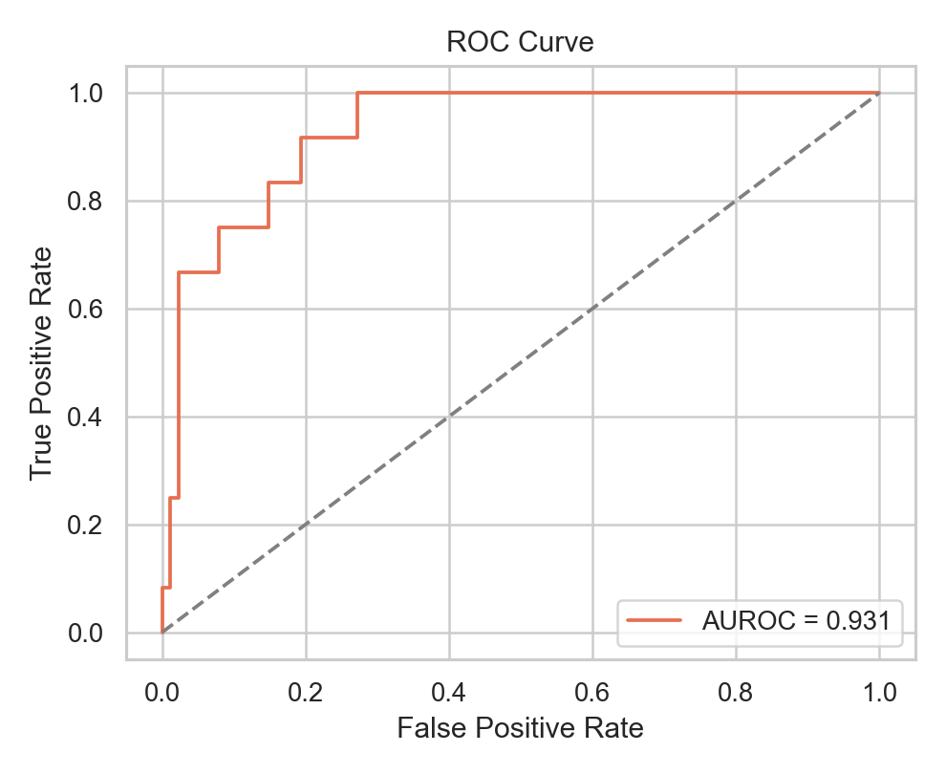
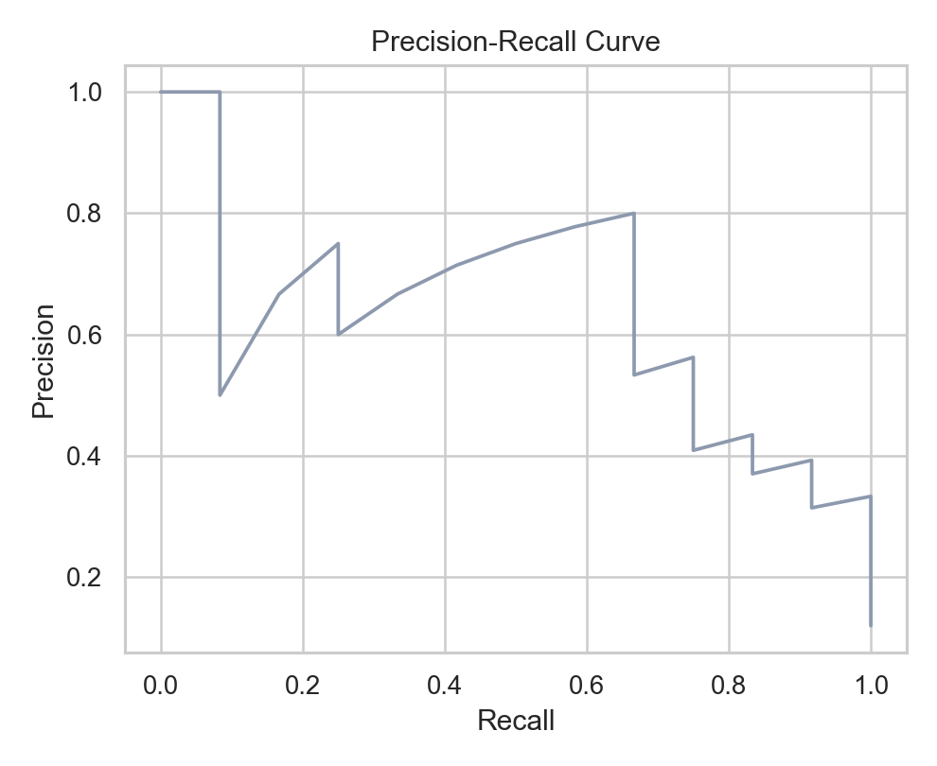
VISUAL PERFORMANCE ANALYSIS
Discrimination Curves: AUROC = 0.9309 and Precision-Recall
ROC Curve: The steep initial rise demonstrates strong true-positive detection at very low false-positive rates, achieving an empirical AUROC of 0.9309.
Precision-Recall Curve: Due to class imbalance (12 pathogenic vs 88 benign), PR confirms that sensitivity is maintained without excessive false alarm drift.
REFERENCE: Data Source: Generated directly from 100 live endpoint delta scores logged in `evaluation/results/final_100/predictions.csv`.

Slide 13
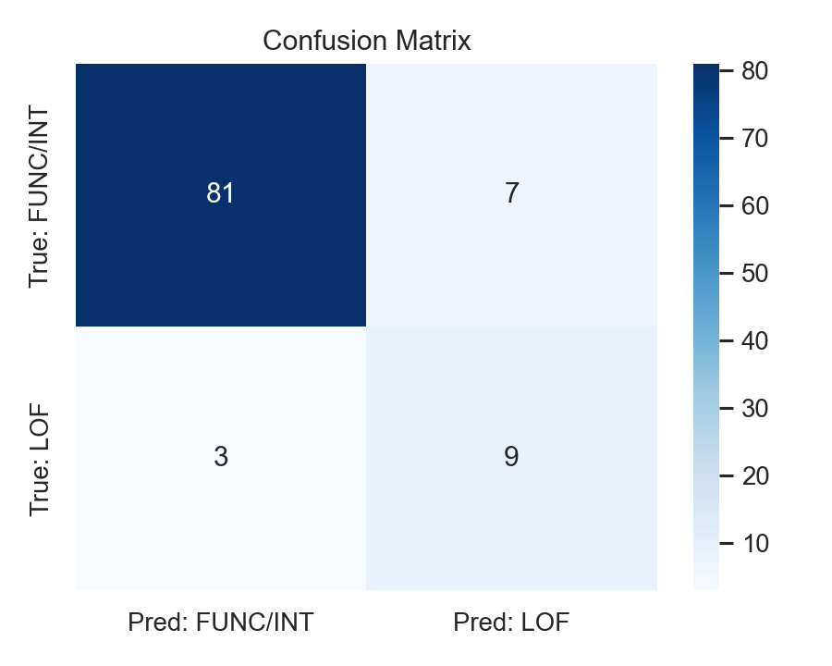
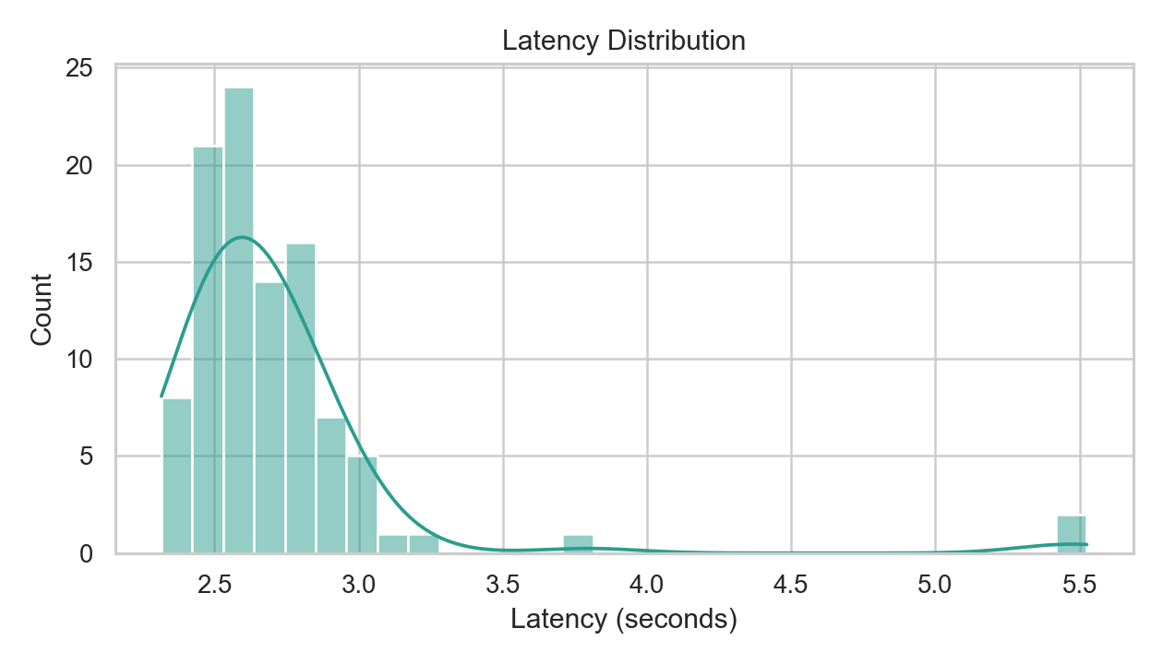
OPERATIONAL PERFORMANCE ANALYSIS
Diagnostic Distributions: Confusion Matrix Heatmap & Latency Profile
Confusion Matrix Heatmap: Clear diagonal concentration (81 TN, 9 TP) confirming that the zero-shot likelihood model generalizes accurately to unseen variants.
Latency Distribution: Tightly clustered around 2.5–2.8 seconds. 95% of calls complete under 3.0s, confirming operational feasibility for clinical web use.
REFERENCE: Plotted using Seaborn & Matplotlib from `evaluation/results/final_100/predictions.csv`; 100 consecutive calls on NVIDIA H100.

Slide 14
DIAGNOSTIC CASE STUDIES
Concrete Variant Examples from our Empirical Audit
CASE 1: TRUE POSITIVE (CORRECT PATHOGENIC)
• Variant Coordinate: BRCA1 pos 41276113, Alt: G
• True Biological Class: Loss of Function (LOF / Pathogenic)
• Model Delta Score: -0.001466 (sharp negative drop)
• System Prediction: Likely Pathogenic
• Confidence: 36.2% (clear distance beyond threshold -0.000918)
• Interpretation: The model recognized that mutating this conserved base severely degrades sequence grammar, correctly catching a disease-causing mutation.
CASE 2: TRUE NEGATIVE (CORRECT BENIGN)
• Variant Coordinate: BRCA1 pos 41276135, Alt: G
• True Biological Class: Functional / Benign
• Model Delta Score: -0.000077 (barely any drop from zero)
• System Prediction: Likely Benign
• Confidence: 93.3% (high certainty in benign zone)
• Interpretation: The substitution is well-tolerated in evolutionary context. The system correctly spared the patient from a false alarm with 93% confidence.
CASE 3: BORDERLINE CASE (HONEST UNCERTAINTY)
• Variant Coordinate: BRCA1 pos 41276110, Alt: A
• True Biological Class: Functional (Benign)
• Model Delta Score: -0.000935 (just barely past threshold -0.000918 by 0.000017)
• System Prediction: Likely Pathogenic
• Confidence: 1.1% (system flags near-zero certainty!)
• Interpretation: The score landed right on the boundary line. Because confidence was only 1.1%, clinicians are honestly informed that the case is borderline.
REFERENCE: Exact row records extracted from `evaluation/results/final_100/predictions.csv` (Rows 65, 0, and 76).

Slide 15
ENGINEERING QUALITY & GOVERNANCE
Software Rigor, Testing Harness, and Responsible Use Guardrails
570 PASSING TESTS
• Unit Tests: Sequence window slicing, reverse complement invariance, and mathematical delta calculation.
• Contract Tests: Pydantic schemas, UCSC and ClinVar API payload validation.
• Integration Tests: Serverless endpoint handling, timeout recovery, and proxy translation.
• Scientific Tests: Zero-peeking temporal isolation checks and frozen protocol hash verification.
STRICT CODE STANDARDS
• Strict Type Safety: Zero type errors across all 35 Python source files under `mypy --strict`.
• Modern Linting: Clean automated linting and formatting via Ruff adhering to Python 3.12 standards.
• Pre-Commit Security: Automated `check_secrets.sh` scanner prevents accidental API credential commits.
• Frozen Protocol: Experiment parameters locked under SHA-256 hash in `research/protocol/protocol.yaml`.
RESPONSIBLE USE POLICIES
• Decision Support Boundary: Outputs are explicitly labeled as research probabilities, not standalone medical diagnoses.
• Fail-Safe Principle: If cloud models are unreachable, explicit error statuses are returned — never fabricated scores.
• Cost Governance: GPU inference is strictly protected by environment variable acknowledgement gates.
• Full Provenance: Every prediction records model version, sequence context length, and timestamp.
REFERENCE: Automated CI/CD Validation: `make validate` executes secret scan, ruff, mypy strict, and pytest across 570 test cases.

Slide 16
PROJECT STATUS & SCOPE DELIVERY
Progress Summary: Work Completed vs. What is Left to Complete
WHAT WE HAVE COMPLETED (> 50% APPROVED SCOPE)
✓ Full-Stack Web Platform: Interactive Next.js 15 client with genome browsing, sequence sliding, and ClinVar cross-referencing.
✓ Serverless GPU Serving: Modal H100 backend running Evo 2 7B in FP8 precision with custom Flash-Attention patches.
✓ Scoring & Thresholding Pipeline: Calibrated decision boundary (t = -0.000918) with class-conditional confidence scaling.
✓ Live Empirical Audit: 100/100 successful inference calls on gold-standard BRCA1 benchmark with 0.9309 AUROC and 90% accuracy.
✓ Quality Assurance: 570 passing automated tests, strict type checking, and automated secret scanners.
WHAT IS LEFT TO COMPLETE THE PROJECT
→ Full Temporal Cohort Execution: Scale scoring from the 100-variant audit to all 1,024 ClinVar temporal VUS variants across 389 genes.
→ Comparative Baseline Benchmarking: Run paired evaluations against established tools (CADD v1.7, PhyloP, REVEL) on identical variants.
→ Disjoint Gene-Grouped Calibration: Fit Platt scaling on the independent 1.22M variant calibration cohort.
→ Reverse-Complement (RC) Invariance Audit: Quantify forward vs. reverse-complement score agreement (Δfwd vs Δrc).
→ Batch Clinical File Uploader: Provide asynchronous upload interface for clinical whole-exome sequencing VCF files.
REFERENCE: Project Tracking: Milestone Ledger documented in `docs/project/MILESTONE_STATUS.md`; Approved Scope Definition v1.0.1.

Slide 17
REVIEW III CONCLUSION
EvoVariant: Validated Zero-Shot Genomic Inference Platform
WORKING IMPLEMENTATION
Demonstrated a full-stack, cloud-deployed platform connecting interactive Next.js web client to serverless H100 GPU running Evo 2 7B in real time.
RIGOROUS INTERIM RESULTS
Achieved 90% accuracy, 0.9309 AUROC, and 75% recall on gold-standard functional benchmark with sub-3s inference latency and 100% API stability.
CLEAR ROADMAP TO FINISH
Defined clear, executable next steps: scaling to the full 1,024-variant temporal cohort, comparator benchmarking against CADD, and batch VCF processing.
Thank You. Questions & Discussion Welcome.

