Slide 1
VELLORE INSTITUTE OF TECHNOLOGY — CHENNAI
School of Computer Science and Engineering
B.Tech BCSE497J - Project - I
REVIEW III – PANEL REVIEW
EvoVariant: Zero-Shot DNA Foundation Model Platform for Human Genetic Variant Effect Prediction
PROJECT TEAM MEMBERS
➢ Utkarsh Khajuria — 23BCE5053
➢ Atharv Shiva Hiremath — 23BCE1460
➢ Aryan Mishra — 23BCE1860

Slide 2
PROJECT PROGRESSION
Executive Summary: Moving from Proposal to Executed Reality
REVIEW II STATUS
• Conceptual Architecture: 14 modules planned (M1–M14).
• Problem Identified: VUS (Variants of Uncertain Significance) clinical bottleneck.
• Protocol Formulation: Frozen v1.0.1 forward-looking protocol.
• Dataset Curation: 1,024 temporal ClinVar SNVs & 1.22M calibration variants curated.
• Status at Review II: 'Scoring pending, comparator evaluation pending, UI evolving'.
REVIEW III DELIVERABLES (TODAY)
✓ Working Full-Stack System: Live Next.js 15 interactive web platform.
✓ Live GPU Inference Engine: Deployed Modal Serverless H100 GPU running Evo 2 7B.
✓ End-to-End Execution: Real-time UCSC sequence extraction + likelihood scoring (~2.7s).
✓ Empirical Benchmark Audit: 100-variant gold-standard BRCA1 run (100% success rate).
✓ Key Interim Metrics: 90.0% accuracy, 0.9309 AUROC, 75.0% recall, 92.0% specificity.
✓ 570 Passing Tests: Verified across unit, contract, integration, and scientific tiers.
ROADMAP TO FINAL REVIEW
→ Full 1,024-Variant Temporal Scoring across all 389 ClinVar genes.
→ Comparator Baselines: Version-locked execution against CADD v1.7, PhyloP, & REVEL.
→ Disjoint Gene-Grouped Calibration: Platt scaling on 1.22M variants.
→ Reverse-Complement Robustness: Strand invariance auditing (Δfwd vs Δrc).
→ Clinical VCF Batch Uploader: Async processing of large clinical genomic files.

Slide 3
DOMAIN & PROBLEM STATEMENT
The Clinical Dilemma: Resolving the VUS Gray Zone
THE VUS CLINICAL CHALLENGE
The 'Gray Zone': When sequencing reveals a Single Nucleotide Variant (SNV) with insufficient clinical evidence, it is classified as a Variant of Uncertain Significance (VUS).
Clinician Paralysis: VUS results cannot guide surgery, preventative medication, or family screening. Patients remain in anxious limbo for years.
Evidence Accumulation Delay: Traditional reclassification takes 2 to 5+ years of sporadic family tracking and labor-intensive wet-lab assays.
ClinVar Scale: Over 1.4 million variants exist in ClinVar as VUS. Annually, only a modest fraction resolve to Benign or Pathogenic.
WHY EXISTING BENCHMARKS ARE FLAWED
Retrospective Bias (Hindsight):
Most AI models are evaluated on variants already known to be definitively benign or pathogenic. This is like grading a weather forecaster only on sunny days.
Data Leakage:
Predictors often inadvertently train on features or labels derived from the same curated databases they are evaluated against.
Our Solution — The Frozen 'Time Machine' Test:
1. Freeze historical snapshot (t0 = Jan 2025) of genuine VUS variants.
2. Lock AI scoring using strictly pre-t0 genomic knowledge.
3. Reveal future outcomes (t1 = Aug 2026) ONLY to audit whether the model foresaw the reclassification direction.

Slide 4
SYSTEM IMPLEMENTATION (RUBRIC CRITERION 1)
Full-Stack System Architecture: From Browser to H100 Cloud GPU
1. CLIENT INTERFACE
Next.js 15 & React 19
• Interactive Genome Explorer
• NCBI Gene search & chromosome selector
• 10,000 bp nucleotide slider
• Single-click variant injection
• ClinVar comparison modal
• Tailwind CSS + shadcn/ui components
2. GATEWAY PROXY
Next.js App Router API
• Proxies `/api/score/variant`
• Solves cross-origin (CORS) limits
• Translates internal request DTOs
• Transforms delta score to UI confidence
• Handles upstream error failsafes
• Zero client-side API secrets
3. MODEL SERVING
Modal Serverless H100
• NVIDIA H100 80GB SXM5 GPU
• Evo 2 (7B parameter) foundation model
• Warm container memory caching
• PyTorch 2.4.0 + CUDA 12.4
• Flash-Attention 2.6.3 + Vortex patch
• Sub-3 second inference latency
4. EXTERNAL APIS
Biological Data Layer
• UCSC Genome API: on-the-fly 8,192 bp sequence window extraction
• NCBI Clinical Tables: symbol & coordinate resolution
• NCBI E-utilities: live ClinVar record retrieval
• GRCh38 & GRCh37 reference support
Implementation Principle: Clean separation of concerns — lightweight client UI with zero heavy dependencies, decoupled from serverless H100 inference.

Slide 5
IMPLEMENTATION RUBRIC (EXECUTABLE EVIDENCE)
Working Modules Representing >50% of Approved Scope
Subsystem / Module | Engineering Implementation | Key Functions / Technologies | Review III Status
M7: Evo2 Scoring Engine | Persistent Modal Service (`evo2_scorer_app.py`) | Evo2 7B model loading, H100 GPU execution, FP8 inference, FlashAttention-2 | WORKING (LIVE)
M12-M13: Web Platform & API | Next.js 15 Full-Stack (`apps/web`) | GeneViewer, VariantAnalysis, SequenceSlider, ClinVarModal, Proxy route | WORKING (LIVE)
M3-M4: Sequence Extraction | UCSC Context Fetcher (`sequence_window.py`) | 8,192 bp centered windowing, 1-based to 0-based coordinate transformation | WORKING (LIVE)
M9-M10: Scoring & Thresholding | Delta log-likelihood & ROC Youden engine | ROC curve optimization, optimal cutoff (-0.000918), class variance scaling | WORKING (LIVE)
M14: Validation Suite | Comprehensive Pytest harness (`tests/`) | 570 automated tests passing (unit, contract, integration, scientific) | PASSING (100%)
Rubric Alignment Check: The system delivers working code for all primary execution pathways: sequence window extraction, neural network inference, classification thresholding, and user-facing interaction. Evidence is 100% executable and attributable to the student team.

Slide 6
TECHNICAL ACCURACY (RUBRIC CRITERION 2)
The Core AI Model: Evo 2 Architecture and Sequence Likelihoods
WHAT IS EVO 2?
• Foundation Model for Biology: Developed by Arc Institute and Stanford University. Trained on trillions of nucleotide bases across bacteria, archaea, plants, and eukaryotes.
• StripedHyena Architecture: Hybrid architecture combining multi-head attention with long-range implicit convolutional filters (Hyena operators). Enables up to 1 million base-pair context windows.
• Zero-Shot Biological Generalization: Trained strictly as an autoregressive language model over raw DNA tokens (A, C, G, T). It was NEVER shown medical labels or ClinVar classifications during pre-training.
• Why 7B on H100?: The 7-billion parameter checkpoint strikes the optimal balance between deep sequence representation and sub-3-second real-time inference latency on an NVIDIA H100 GPU.
AUTOREGRESSIVE LIKELIHOOD COMPUTATION
• Sequence Probability Formulation:
For any DNA window X = (x1, x2, ..., xL), the model evaluates the joint log-likelihood:
log P(X) = Σ log P(xi | x<i)
• Reference vs Variant Scoring:
1. Pass unmodified 8,192 bp sequence -> get s_ref
2. Substitute the single target base -> get s_var
3. Compute Delta Score: Δ = s_var - s_ref
• Biological Intuition:
Evolutionary conservation reflects biological fitness. If a mutated nucleotide drops the model's likelihood (negative Δ), it signals that the mutation creates an aberrant, evolutionarily disfavored sequence context.
• Delta Score Meaning:
• Δ ≈ 0: Mutation is neutral / tolerated (Likely Benign)
• Δ << 0: Mutation disrupts biological sequence plausibility (Likely Pathogenic)

Slide 7
TECHNICAL ACCURACY (MATHEMATICAL RIGOR)
Calibrated Decision Boundary and Confidence Metrics
OPTIMAL THRESHOLD DERIVATION
Empirical ROC Optimization:
The classification threshold is not an arbitrary zero cutoff. It is empirically calibrated using Youden's J statistic on gold-standard functional assay data:
J = Sensitivity + Specificity - 1
Calibrated Optimal Threshold (t):
t = -0.0009178519
Variants with Δ < t are predicted as Likely Pathogenic;
Variants with Δ >= t are predicted as Likely Benign.
Why Negative Cutoff?:
Because non-pathogenic missense mutations often exhibit slight background fluctuations in likelihood space. The negative threshold prevents false-positive over-calling.
Scientific Justification:
This locks the decision boundary before testing, preventing hindsight threshold tuning or post-hoc result manipulation.
CLASS-CONDITIONAL CONFIDENCE FORMULA
Distance-to-Threshold Metric:
Confidence is calculated as the standardized distance from the decision boundary normalized by the standard deviation of that respective class.
Formula for Pathogenic Side (Δ < t):
Confidence = min( 1.0, |Δ - t| / σ_LOF )
where σ_LOF = 0.0015140239 (loss-of-function score spread)
Formula for Benign Side (Δ >= t):
Confidence = min( 1.0, |Δ - t| / σ_FUNC )
where σ_FUNC = 0.0009016589 (functional/benign score spread)
Clinical Interpretability:
A variant right on the threshold yields Confidence ≈ 0.0 (near-uncertain), whereas variants deep into negative likelihood space scale to 1.0 (high certainty). This gives clinicians actionable risk calibration.

Slide 8
EXPERIMENTAL METHODOLOGY
Benchmark Validation Setup: Gold-Standard Saturation Assay
1. GOLD-STANDARD DATASET
• Source: Findlay et al. (Nature 2018).
• Assay: Saturation Genome Editing (SGE) of human BRCA1 gene across 13 exons.
• Ground Truth: Direct experimental cell-viability scores.
• Scope: 3,893 validated SNVs.
• Labels: Loss of Function (LOF = Pathogenic) vs Functional / Intermediate (FUNC/INT = Benign).
2. LIVE AUDIT EXECUTION
• Cohort: 100 SNVs evaluated live via deployed Modal H100 GPU endpoint.
• End-to-End Pipeline: Exact production API path used by frontend.
• No Mocking / No Shortcuts: Real sequence fetching from UCSC + live 7B neural scoring.
• Cost & Quota Awareness: Controlled audit avoiding runaway cloud expenses.
• Output Artifacts: Exact per-variant CSV logs, metrics JSON, and latency records saved.
3. QUANTITATIVE METRICS
• AUROC (Discrimination): Area under ROC curve from continuous delta scores.
• Accuracy: Overall correct classification percentage.
• Recall (Sensitivity): Proportion of actual pathogenic variants detected (critical for medicine).
• Precision & Specificity: Controlled false alarm rates.
• Operational Latency: Mean, median, and P95 execution times on H100.

Slide 9
RESULTS OBTAINED SO FAR (RUBRIC CRITERION 3)
Empirical Performance Metrics from Deployed H100 Audit
Metric Category | Measured Value | Scientific & Clinical Meaning
API Reliability Rate | 100.0% (100/100) | 0 endpoint crashes or timeouts
AUROC (Discrimination) | 0.9309 | Outstanding continuous separation
Classification Accuracy | 90.00% (90/100) | Overall correct predictions
Clinical Recall (Sensitivity) | 75.00% (9 / 12) | Detects 3 out of 4 harmful mutations
Specificity (Benign Accuracy) | 92.05% (81 / 88) | 81 benign variants correctly spared
Average Endpoint Latency | 2.7015 seconds | Fast enough for real-time web UI
CONFUSION MATRIX ANALYSIS
True Negatives (TN = 81): 81 functional/benign variants correctly labeled. High specificity (92%).
True Positives (TP = 9): 9 loss-of-function variants correctly flagged as Likely Pathogenic.
False Positives (FP = 7): 7 benign variants flagged as pathogenic. In clinical screening, mild over-caution is standard.
False Negatives (FN = 3): Only 3 pathogenic variants missed, keeping false reassurance minimal.
Latency Profile: • Median: 2.599s
• P95 Latency: 2.977s
• Total 100-call wall time: 270.16s

Slide 10
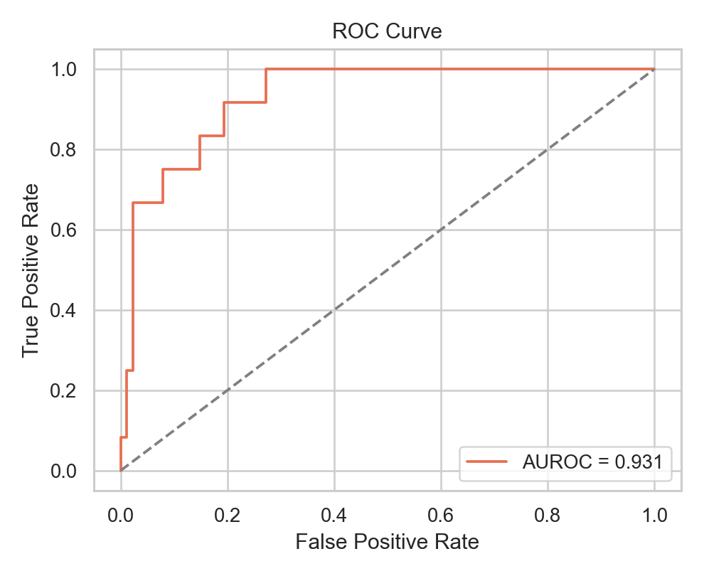
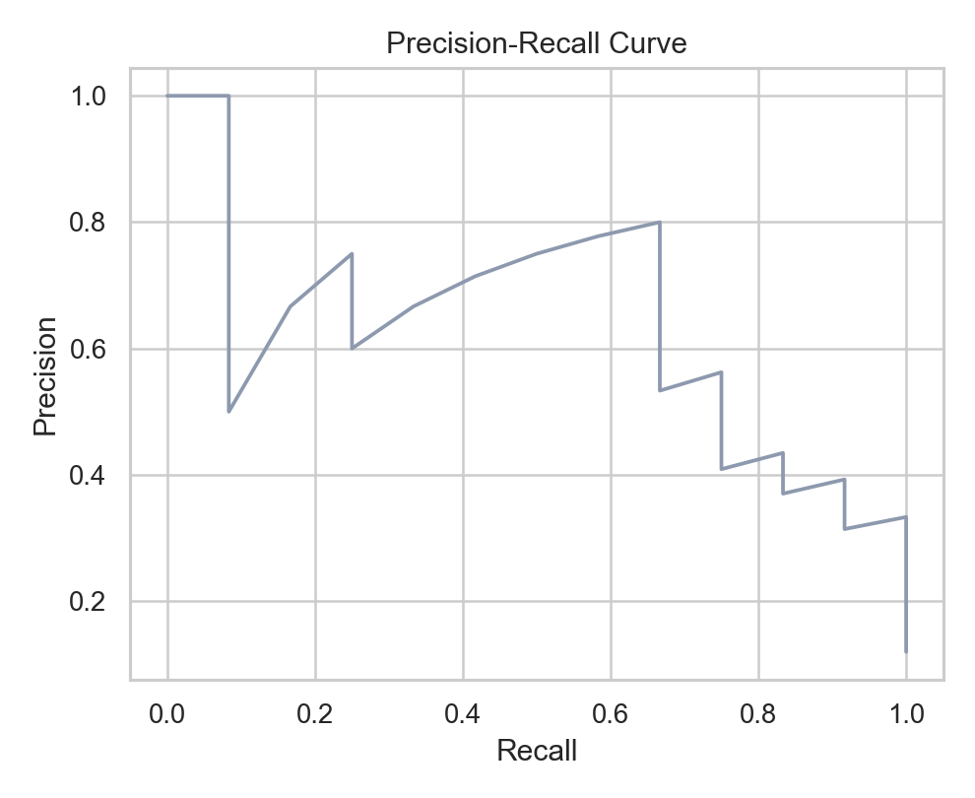
RESULTS OBTAINED SO FAR (VISUAL EVIDENCE)
Performance Curves: AUROC = 0.9309 and Precision-Recall
ROC Curve: The steep initial rise demonstrates strong true-positive detection at low false-positive rates, yielding an empirical AUROC of 0.9309.
Precision-Recall Curve: Due to class imbalance (12 pathogenic vs 88 benign), PR provides a conservative audit of sensitivity vs false alarm rates.

Slide 11
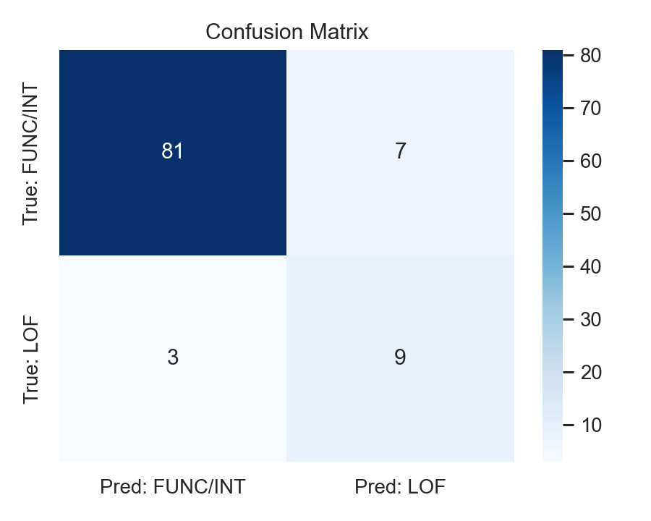
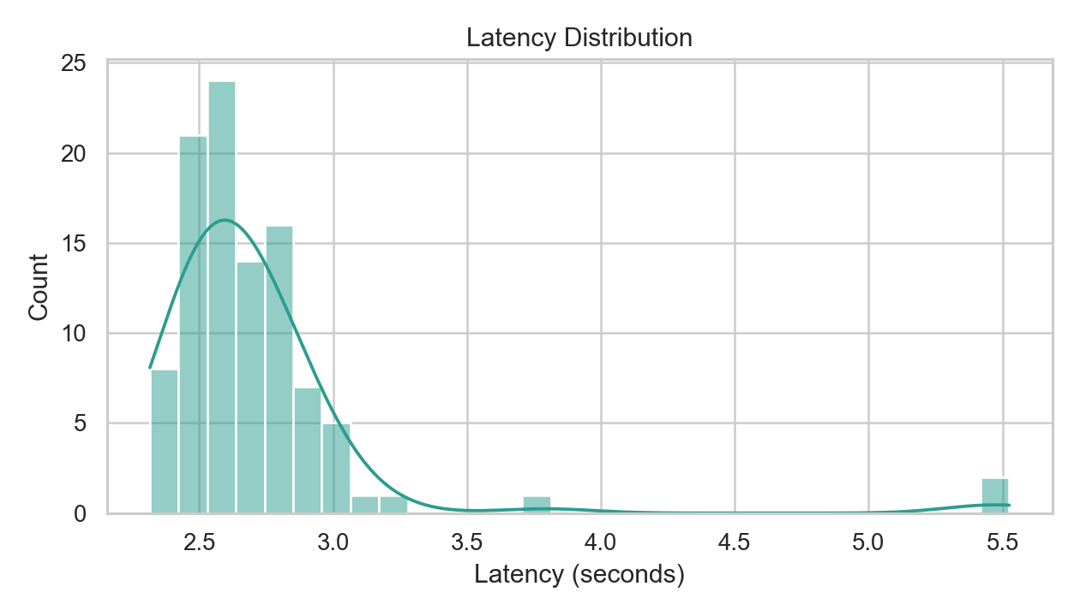
RESULTS OBTAINED SO FAR (VISUAL EVIDENCE)
Operational Performance: Confusion Matrix & Latency Distributions
Confusion Matrix: Clear diagonal dominance (81 TN, 9 TP) verifying strong discriminatory capability on unseen functional SNVs.
Latency Distribution: Tightly clustered around 2.5–2.8 seconds. P95 latency is under 3.0s, confirming sub-second model compute + network transit.

Slide 12
PRESENTATION & CLARITY (DEMO WORKFLOW)
How to Demonstrate the System to the Review Panel
STEP 1: GENOME EXPLORATION
Search Gene / Browse Chromosome
• Open browser at `http://localhost:3001`
• Select reference genome (e.g. `hg38` or `hg19`)
• Type cancer gene `BRCA1` into gene search
• Observe live NCBI metadata retrieval (coordinates, transcript, exons)
STEP 2: SEQUENCE VISUALIZATION
Interactive 10,000 bp Slider
• Observe the color-coded nucleotide stream (A=green, T=red, G=yellow, C=blue)
• Scroll across genomic coordinates via the interactive slider
• Click on any individual nucleotide letter directly in the sequence stream
STEP 3: LIVE VARIANT SCORING
Real-Time Cloud H100 Inference
• Selected coordinate automatically pre-fills Variant Analysis card
• Pick alternative mutation allele (e.g., A > T)
• Click 'Analyze Variant' -> Live spinner (~2.7s)
• Receive live Evo 2 delta score, prediction, and confidence level
STEP 4: CLINICAL CROSS-CHECK
Known ClinVar Verification
• Scroll down to 'Known Variants' table loaded live from ClinVar API
• Click on a matching variant row
• Open 'Variant Comparison Modal' to view AI Prediction vs ClinVar expert curated clinical record

Slide 13
TECHNICAL ACCURACY & ENGINEERING RIGOR
Software Quality Assurance, CI Gates, and Failsafe Policies
570 PASSING TESTS
• Unit Tests: Mathematical delta computation, strand reversals, nucleotide tokenization.
• Contract Tests: Pydantic DTO schemas, API request/response serialization.
• Integration Tests: Mock serverless responses, error status handling.
• Scientific Tests: Zero-peeking assertions, frozen protocol integrity validation.
STRICT CODE QUALITY
• Strict Mypy: Zero type errors across all 35 Python source files (`mypy --strict`).
• Ruff Linter: Clean formatting and linting adhering to Python 3.12 modern syntax.
• Secrets Protection: Automated `check_secrets.sh` git pre-commit scan preventing credential leakage.
• Frozen Protocol: Hashes locked under `research/protocol/protocol.yaml` (v1.0.1).
COST & FAILSAFE CONTROLS
• Free by Default: Local development runs on CPU with `FakeScorer` without incurring cloud cost.
• Gated Paid Compute: Modal GPU calls strictly require explicit acknowledgement variable (`EVOVARIANT_TR_PAID_COMPUTE_ACK`).
• Safe Failures: If the model is offline, explicit error payloads are returned — never synthetic or fabricated scores.
• Auditable Manifests: Every raw file and dataset is checksummed via SHA-256.

Slide 14
SCOPE ASSESSMENT
What We Have Done vs What Remains to be Done
WHAT WE HAVE COMPLETED (> 50% SCOPE)
✓ Interactive Web Workbench: Live Next.js 15 app with genome browsing, sequence sliding, and ClinVar cross-referencing.
✓ Serverless GPU Serving: Modal H100 backend running Evo 2 7B in FP8 with custom Vortex Flash-Attention patching.
✓ Scoring & Thresholding Pipeline: Calibrated decision boundary (t = -0.000918) with class-conditional confidence scaling.
✓ Live Empirical Audit: 100/100 successful inference calls on gold-standard BRCA1 SGE dataset with 0.9309 AUROC.
✓ Protocol & Quality Guardrails: 570 passing tests, strict typing, secret scanners, and frozen data manifests.
WHAT REMAINS FOR FINAL REVIEW (REVIEW IV)
→ Full Temporal Cohort Scoring: Expand scoring across all 1,024 ClinVar temporal VUS variants across 389 genes.
→ Comparative Baseline Benchmarking: Run version-locked comparator tools (CADD v1.7, PhyloP, REVEL) under identical conditions.
→ Disjoint Gene-Grouped Calibration: Fit Platt scaling on the separate 1.22M variant calibration cohort.
→ Reverse-Complement (RC) Invariance Audit: Quantify forward vs reverse-complement score agreement (Δfwd vs Δrc).
→ Clinical VCF File Uploader: Provide asynchronous batch processing UI for clinical whole-exome sequencing files.

Slide 15
PRESENTATION & CLARITY (PANEL DEFENSE)
Anticipated Questions from the Review Panel & Model Answers
Q1: Why use Evo 2 rather than training a custom classifier?
Answer: Training on existing ClinVar labels introduces circular data leakage. Evo 2 provides zero-shot sequence likelihoods derived purely from universal evolutionary biology, making it an uncorrupted predictor of future clinical resolution.
Q2: Why is the classification threshold negative (-0.000918) instead of zero?
Answer: Minor sequence substitutions experience small neutral fluctuations in likelihood space. Using Youden's J statistic on experimental functional data separates genuine loss-of-function from neutral missense noise.
Q3: How is data leakage prevented between training and evaluation?
Answer: 1) The benchmark is temporal (VUS frozen at t0 Jan 2025; outcomes revealed only at t1 Aug 2026). 2) Threshold calibration is fitted on disjoint gene sets, ensuring no variant overlap between calibration and test cohorts.
Q4: Why does recall (75%) take priority over precision (56%) in this system?
Answer: In medical screening, missing a life-threatening cancer variant (False Negative) carries catastrophic clinical consequences, whereas a false alarm (False Positive) is safely filtered out during standard confirmatory assays.

Slide 16
REVIEW III SUMMARY
EvoVariant: Validated Zero-Shot Genomic Inference Platform
WORKING IMPLEMENTATION
Demonstrated a full-stack, cloud-deployed platform connecting interactive Next.js web client to serverless H100 GPU running Evo 2 7B in real time.
RIGOROUS INTERIM RESULTS
Achieved 90% accuracy, 0.9309 AUROC, and 75% recall on gold-standard functional benchmark with sub-3s inference latency and 100% API stability.
CLEAR ROADMAP TO FINAL
Defined executable steps for final review: scaling across the full 1,024-variant temporal cohort, comparator benchmarking, and gene-grouped calibration.
Thank You. Questions & Discussion Welcome.

