Slide 1


TELEVISION CHANNEL
a management app
PRESENTED BY:
Utkarsh Agarwal

Slide 2


01 | Introduction
03 | Project Objective
04 | Proposed system Diagram
05 | Proposed system introduction
08 | List of Modules
09 | Details of Modules
10 | WebAPP Screenshots
Agenda

Slide 3
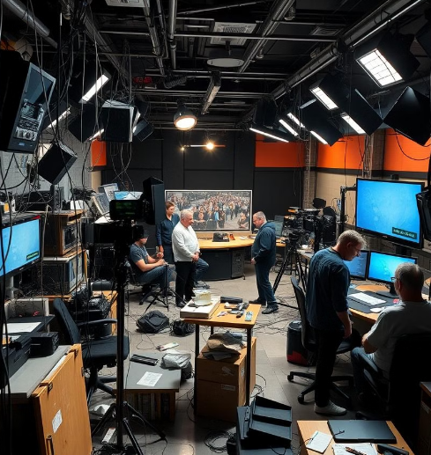
Introduction
The Television Channel Management System is a comprehensive solution designed to streamline the management of television production workflows. It addresses challenges such as scheduling conflicts, advertisement allocation, role-based content access, and compliance tracking. By integrating robust authentication with JWT, a responsive frontend using Angular 17 and Material UI, and a secure backend powered by .NET and SQL Server, this system provides a seamless platform for managing shows, advertisements, media libraries, and viewer feedback. Its analytics capabilities further empower decision-makers to optimize content and enhance viewer satisfaction...

Slide 4
Project Objectives
objective # 3
objective # 1
Ensure Compliance and Quality Control: Integrate tools for tracking regulatory adherence and conducting quality checks on content before airing.
Implement Role-Based Access Control (RBAC): Ensure secure and streamlined workflows by assigning specific roles and permissions to users such as Channel Manager, Content Producer, Editor, and Advertiser.
objective # 2
Develop a Centralized Database: Create a unified system to manage shows, schedules, advertisements, and media files efficiently, reducing redundancy and enhancing data consistency.
objective # 4
Facilitate Multi-Platform Accessibility: Design a responsive and adaptable user interface for seamless access across desktops, tablets, and mobile devices.

Slide 5
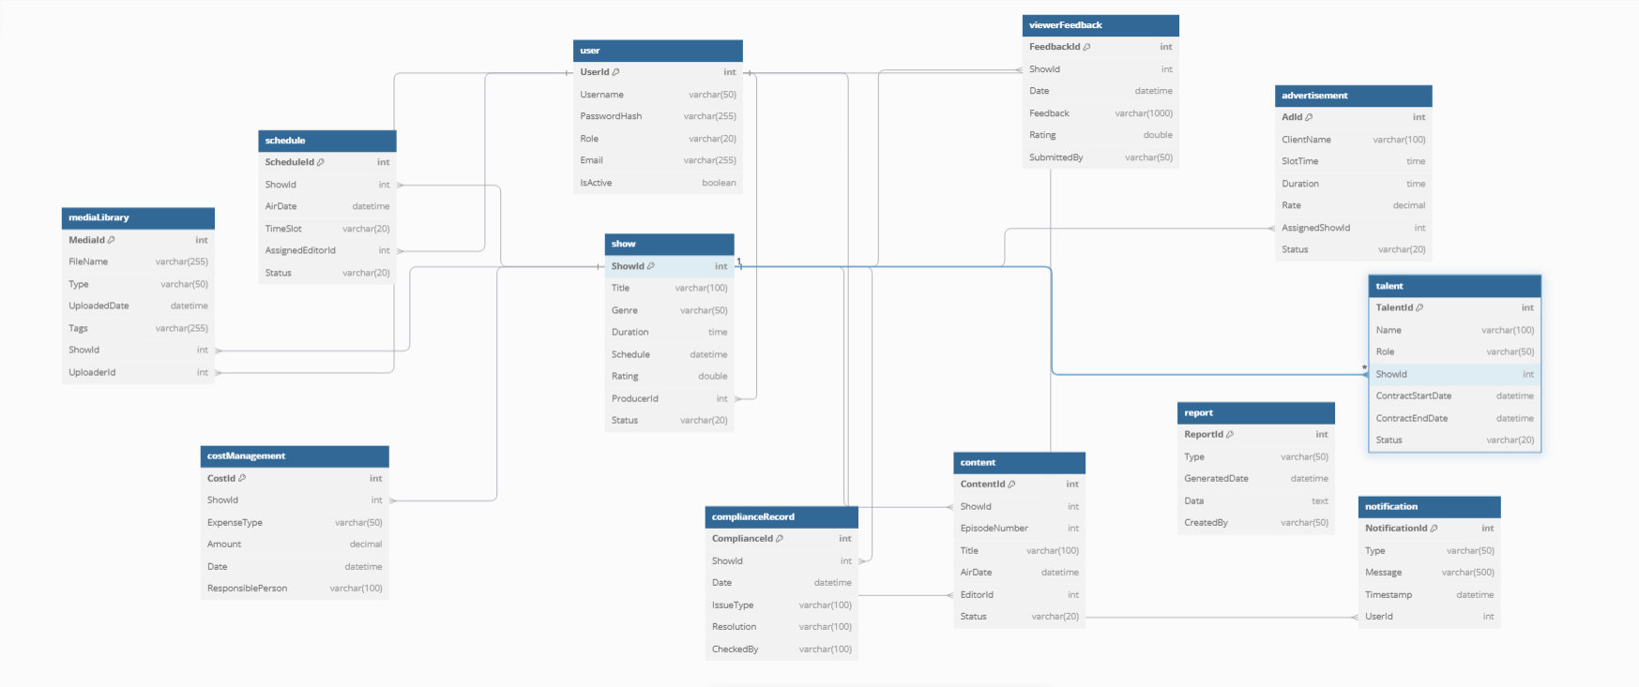
Proposed EF Diagram

Slide 6
Modules
Content Producer Module
Admin Module
Handles media uploads, categorization, and management.
Organizes promos, trailers, and episodes in the media library.
Manages user accounts and roles.
Provides access control to ensure secure workflows.
Channel Manager Module
Director Module
Manages shows, advertisements, and schedules.
Tracks viewer feedback and ratings for performance analysis.
Oversees talent management, including actor and staff information.
Tracks contracts, availability, and payments.

Slide 7
Modules
Advertiser Module
Authentication and User Management
Adds and schedules advertisements.
Manages client information and advertisement slots.
UserController: Manages user creation, updating roles, and deactivating/activating users.
LoginController: Handles user authentication and login functionality.
JWTService: Provides JWT token generation and validation for secure API access.
Reporter Module
Views reports and analyzes viewer feedback trends.
Generates insights for audience engagement strategies.
Advertisement Management
AdvertisementController: Handles adding, updating, scheduling, and managing advertisement slots.

Slide 8
Modules
Feedback and Reporting
Media and Content Management
FeedbackController: Captures and manages viewer feedback, ratings, and complaints.
ReportsController: Generates and retrieves analytics reports on shows, advertisements, and viewership trends.
MediaController: Manages media file uploads, categorization, and retrieval for shows and promos.
ContentController: Handles organization and management of show episodes and other related content.
Show and Schedule Management
ShowController: Manages show details, including genre, duration, ratings, and status.
ScheduleController: Handles broadcast scheduling, including show lineups and advertisement slots.
Talent Management
TalentsController: Oversees the management of actors, hosts, and staff information, including contracts and availability.

Slide 9
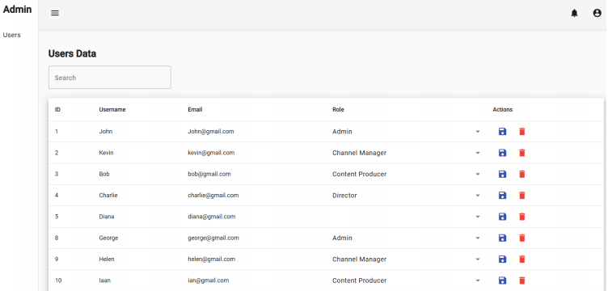
App Screenshots
Admin

Slide 10
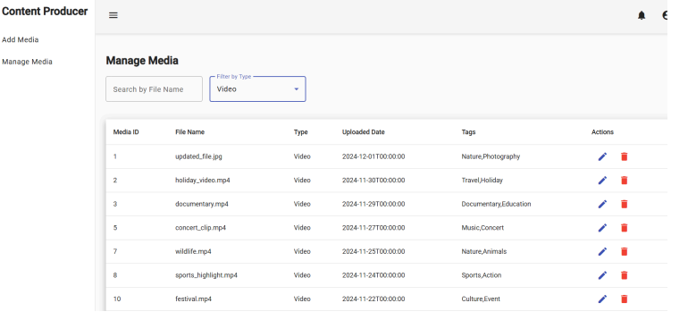
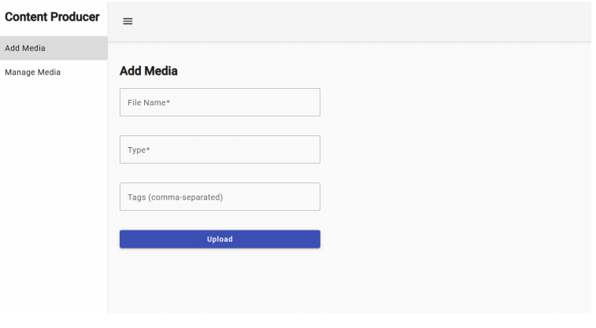
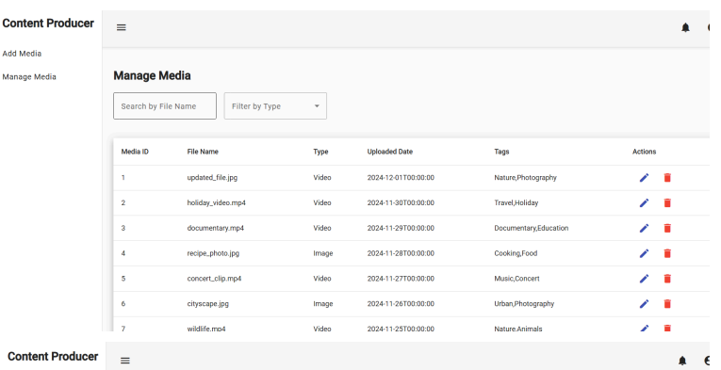
App Screenshots
Content Producer

Slide 11
App Screenshots
Content Producer

Slide 12
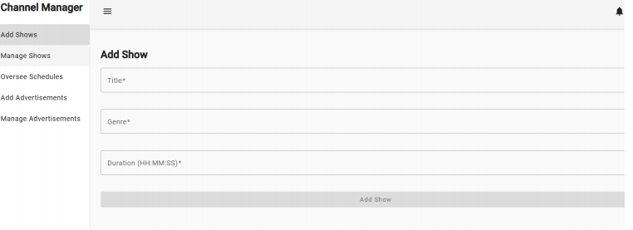
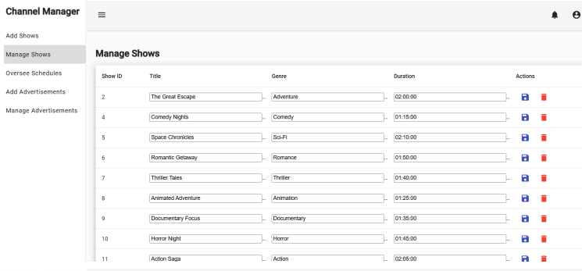
App Screenshots
Channel Manager

Slide 13
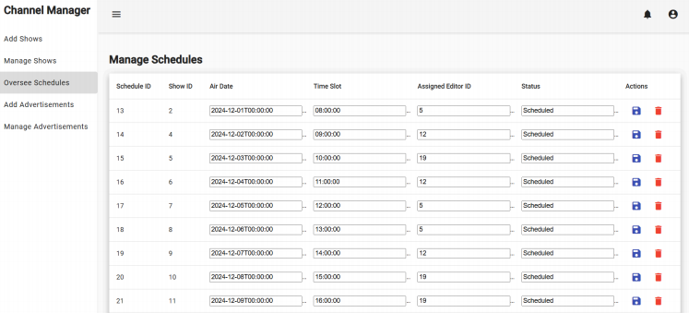
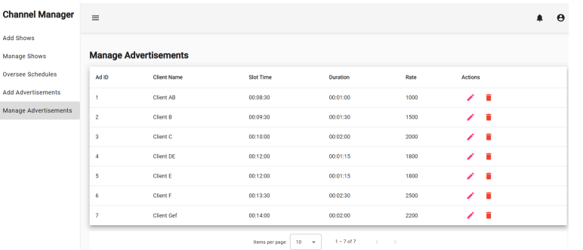
App Screenshots
Channel Manager

Slide 14
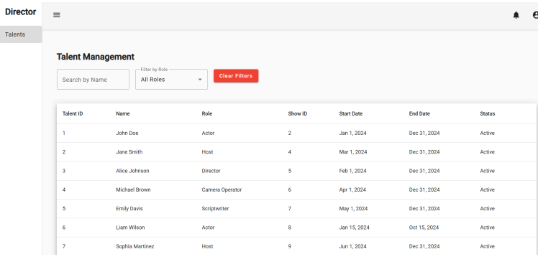
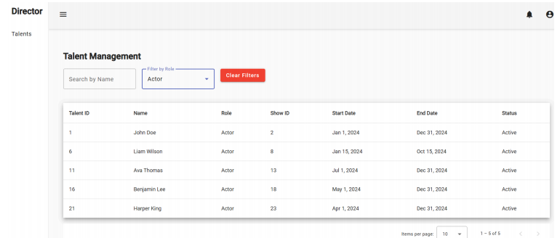
App Screenshots
Director

Slide 15
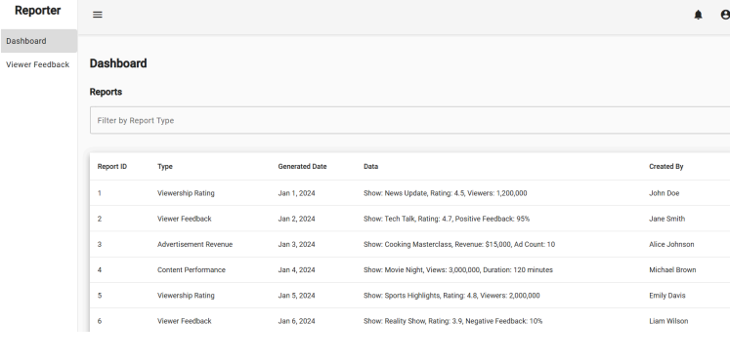
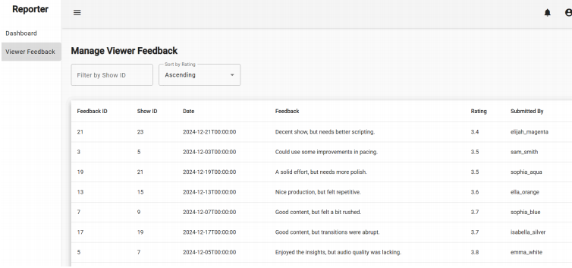
App Screenshots
Reporter

Slide 16
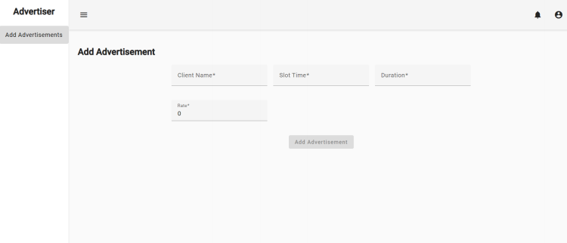
App Screenshots
Advertiser

Slide 17
Thank you

