Slide 1
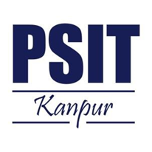
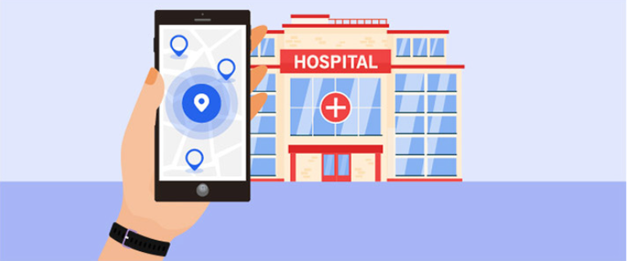
REMEDIUM- A HEALTHCARE APPLICATION
HOSPITAL FINDER AND REMEDIES ADVISOR

Slide 2
TEAM MEMBERS
Utkarsh Rai CS-AIML III B 2101641530159
Utkarsh Mishra CS-AIML III B 2101641530158
Vaibhavi Mishra CS-AIML III B 2101641530164
Maham Barika CS-AIML III A 2101641530085
Vaibhavi Dubey CS-AIML III B 2101641530163

Slide 3
PROJECT OBJECTIVES
Hospital Locator Functionality
Comprehensive Disease Information
Home Remedies Database
First-Aid Precautions
User Education and Empowerment
Real-Time Updates
Accessibility and User-Friendliness
Feedback and Improvement

Slide 4
FEASIBILITY STUDY
Technical Feasibility
Operational Feasibility
Leveraging location-based services and an extensive database of hospitals, the app can efficiently connect users to healthcare facilities. Additionally, curating and presenting home remedies can be achieved through user-generated content and expert input.
Compliance with healthcare regulations and data privacy laws is mandatory. Ensuring the accuracy of home remedy information and avoiding misleading claims is also vital. Overall, REMEDIUM presents a feasible and potentially profitable solution to bridge the gap between traditional and modern healthcare, offering users convenient access to both hospital care and time-tested home remedies while adhering to legal and ethical standards. Further market research and a pilot launch will be essential steps in realizing its full potential.

Slide 5
FEASIBILITY STUDY
Economic Feasibility
Schedule Feasibility
Our website is economically feasible for our users as our users do not need to pay any money to use our website. It is completely free-of-cost platform. Economic feasibility checks whether the cost required for complete system development is feasible at the available resources in hand. Revenue streams may include subscription models, sponsored content, or partnerships with healthcare providers. A cost-effective development strategy and scalable infrastructure can lead to profitability.
A feasibility study for REMEDIUM, a web app designed to assist patients and their caregivers in locating nearby hospitals and providing traditional home remedies ('Nani-Dadi ke Nuskhe') for various illnesses, reveals promising potential.

Slide 6
FEASIBILITY STUDY
Legal Feasibility
Ensuring our website is legal and compliant with all relevant laws and regulations is a top priority. We will follow data protection, privacy, and healthcare regulations as needed, and take measures to protect user data and privacy. Our terms and conditions will outline our commitment to legal compliance, and we will continuously monitor and adapt to changes in regulations to ensure ongoing legality and data privacy for our users.

Slide 7
GANTT CHART

Slide 8
Data Flow Diagram (DFD)

Slide 9
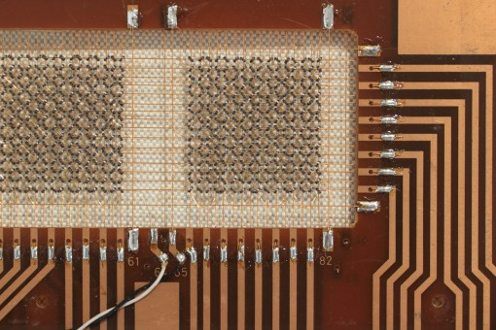
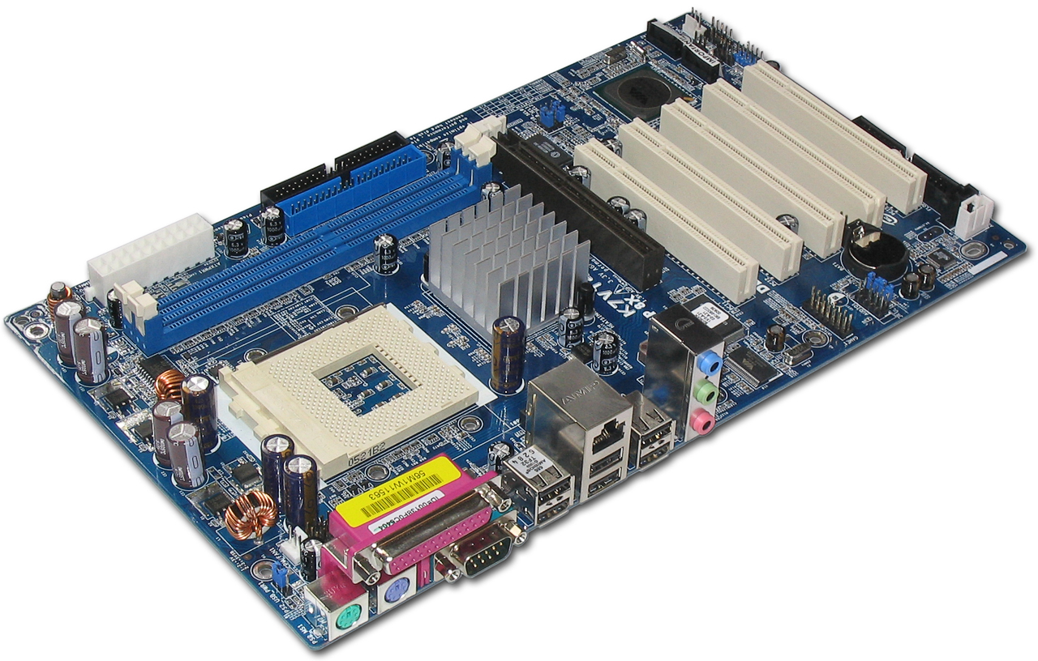
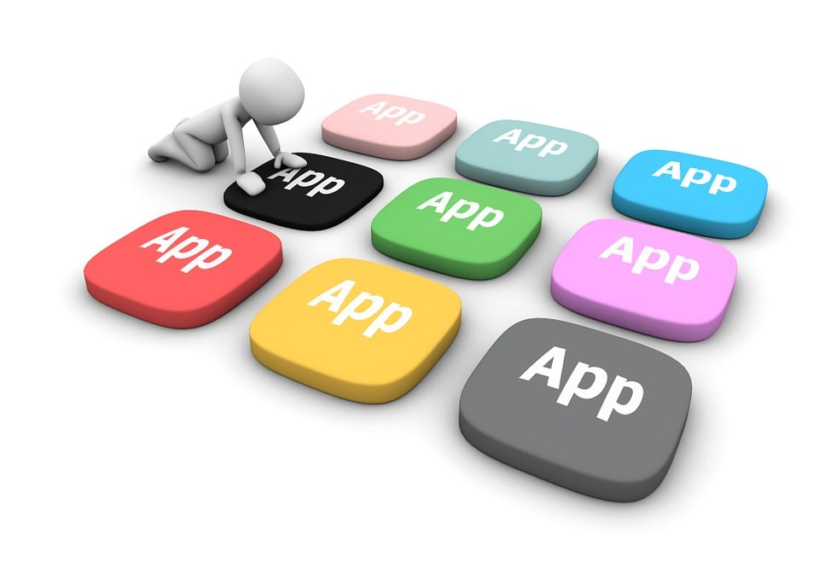
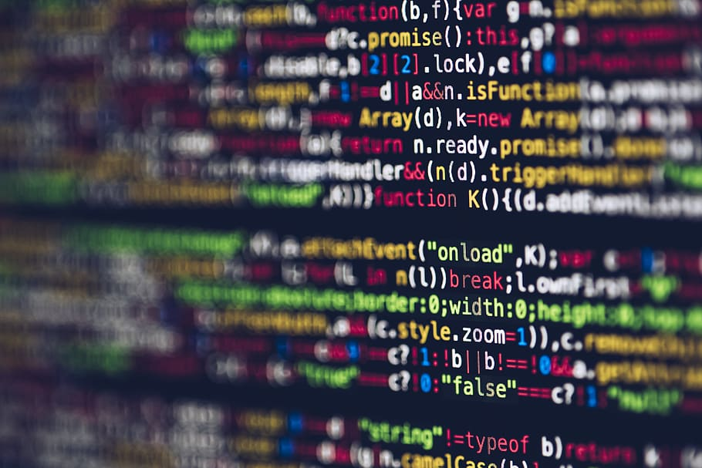
Tools/Technology Used
Minimum Hardware Requirements :
Hardware required for the development of the project.
• CPU: Intel i5
• RAM: 4GB
• GPU: Intel Integrated Graphics
• HDD: 500 GB
• 64 bit processor
Minimum Software Requirements :
Software required for the development of the project.
• OS : Windows 11
Tech Stack:
• Git
• GitHub
• Django
• Firebase
• Realtime Database
• Firebase Storage
• HTML, CSS, JavaScript
• Beautiful-Soup
• Selenium

Slide 10
FUTURE SCOPE/IMPROVEMENTS/ADD ONS
Health Insurance Advisor
Doctor Availability
Treatment Cost
Time to reach nearest hospital
Remedies Suggestion

Slide 11


