Slide 1
Friendbook: A Semantic-based Friend Recommendation System for Social Networks
By
Uthkarsh Agarwal(17TR1A0585)
B.Jyothi(18TR5A0502)
M.Vaishnavi(17TR1A0549)
K.Akhil(16TR1A0548)

Slide 2
ABSTRACT
In this project we present Friendbook, a novel semantic-based friend recommendation system for social networks, which recommends friends to users based on their life styles instead of social graphs.
By taking advantage of sensor-rich smartphones, Friendbook discovers life styles of users from user-centric sensor data, measures the similarity of life styles between users, and recommends friends to users if their life styles have high similarity.
Inspired by text mining, we model a user’s daily life as life documents, from which his/her life styles are extracted by using the Latent Dirichlet Allocation algorithm.

Slide 3
Contd…
We further propose a similarity metric to measure the similarity of life styles between users, and calculate users’ impact in terms of life styles with a friend-matching graph.
Finally, Friendbook integrates a feedback mechanism to further improve the recommendation accuracy.
We have implemented Friendbook on the Android-based smartphones, and evaluated its performance on both small-scale experiments and large-scale simulations.
The results show that the recommendations accurately reflect the preferences of users in choosing friends.

Slide 4
EXISTING SYSTEM
Most of the friend suggestions mechanism rely on pre-existing user relationships to pick friend candidates.
For example, Facebook relies on a social link analysis among those who already share
common friends and recommends symmetrical users as potential friends.

Slide 5
Contd…
The rules to group people together include:
Habits or life style
Attitudes
Tastes
Moral standards
Economic level
People they already know
Apparently, rule #3 and rule #6 are the mainstream factors considered by existing recommendation systems.

Slide 6
DISADVANTAGES OF EXISTING SYSTEM
Existing social networking services recommend friends to users based on their social graphs, which may not be the most appropriate to reflect a user’s preferences on friend selection in real life.

Slide 7
PROPOSED SYSTEM
A novel semantic-based friend recommendation system for social networks, which recommends friends to users based on their life styles instead of social graphs.
We model a user’s daily life as life documents, from which his/her life styles are extracted by using the Latent Dirichlet Allocation algorithm.
Similarity metric to measure the similarity of life styles between users, and calculate users.
We integrate a linear feedback mechanism that exploits the user’s feedback to improve recommendation accuracy.

Slide 8
ADVANTAGES OF PROPOSED SYSTEM
Recommended potential friends to users if they share similar life styles.
The feedback mechanism allows us to measure the satisfaction of users, by providing a user interface that allows the user to rate the friend list

Slide 9
HARDWARE REQUIREMENTS
System : Intel(R) Core(TM) i3-7020i3CPU@2.30GHz
Hard Disk : 1TB
Monitor : 15 VGA Colour.
Mouse : Logitech.
Ram : 4GB
System type: 64-bit OS

Slide 10
SOFTWARE REQUIREMENTS
Operating system : Windows 7/8/10
Coding Language : JAVA/J2EE
IDE : Netbeans 12.2
Database : MYSQL 8.0.23

Slide 11
MODULES:
Life Style Modeling
Activity Recognition
Friend-matching Graph Construction
User Impact Ranking

Slide 12
Life Style Modeling
Life styles and activities are reflections of daily lives at two different levels where daily lives can be treated as a mixture of life styles and life styles as a mixture of activities. This is analogous to the treatment of documents as ensemble of topics and topics as ensemble of words.

Slide 13
Activity Recognition
We need to first classify or recognize the activities of users. Life styles are usually reflected as a mixture of motion activities with different occurrence probability. Generally speaking, there are two mainstream approaches: supervised learning and unsupervised learning.

Slide 14
Friend-matching Graph Construction
To characterize relations among users, in this section, we propose the friend-matching graph to represent the similarity between their life styles and how they influence other people in the graph. In particular, we use the link weight between two users to represent the similarity of their life styles. Based on the friend-matching graph, we can obtain a user’s affinity reflecting how likely this user will be chosen as another user’s friend in the network.

Slide 15
User Impact Ranking
The impact ranking means a user’s capability to establish friendships in the network. In other words, the higher the ranking, the easier the user can be made friends with, because he/she shares broader life styles with others. Once the ranking of a user is obtained, it provides guidelines to those who receive the recommendation list on how to choose friends.

Slide 16
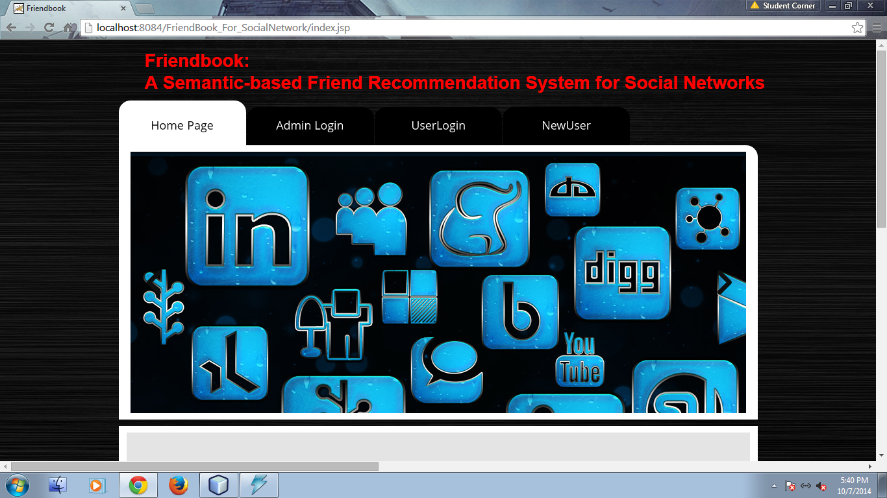

Slide 17
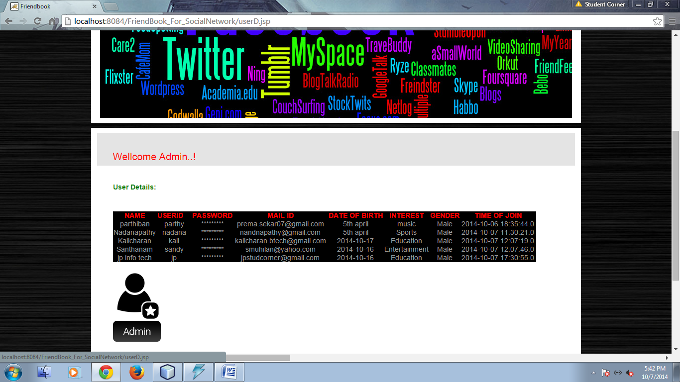

Slide 18
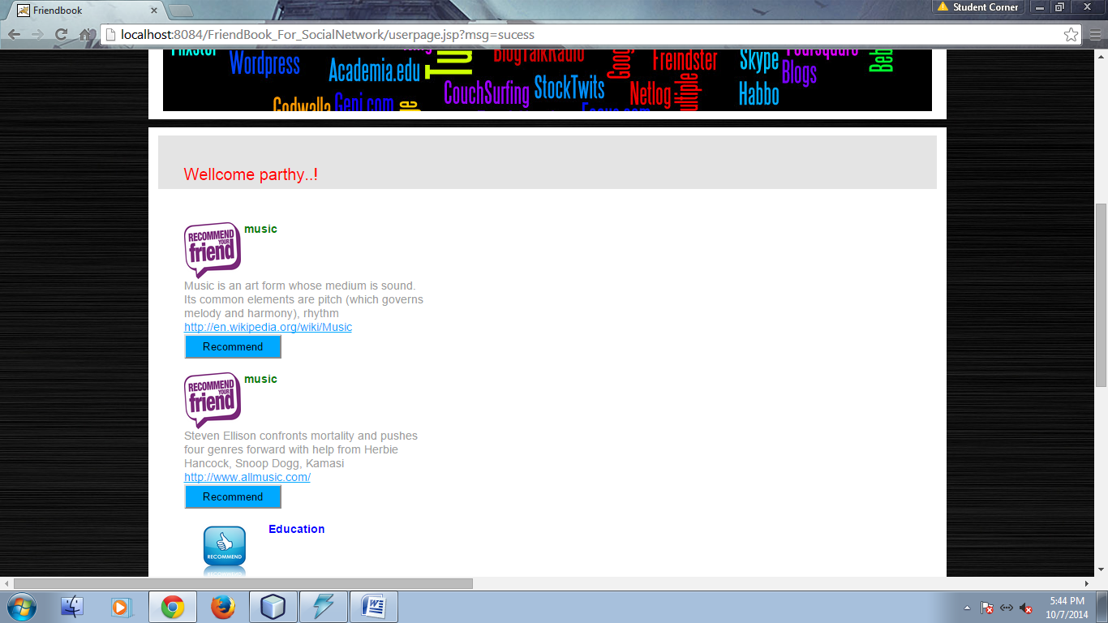

Slide 19
REFERENCES
Zhibo Wang, Student Member, IEEE, Jilong Liao, Qing Cao, Member, IEEE, Hairong Qi, Senior Member, IEEE, and Zhi Wang, Member, IEEE, “Friendbook: A Semantic-Based Friend Recommendation System for Social Networks”, IEEE TRANSACTIONS ON MOBILE COMPUTING, VOL. 14, NO. 3, MARCH 2015.

